Slide 2
Why and how to upgrade from an older version to LS Central SaaS
Jakob P. Nickelsen
Johann Sveinsson
Ricardo Moinhos

Slide 3

The reasons – let’s turn it around a bit
All the insecurity of upgrading
  I do not believe in SaaS; I want to control
  I do not want to change my ‘way of working’
  Our business depends on us, not ‘them’
  Vendor lock-in
  The internet connectivity
  Data security
  Privacy concerns
  Performance

Slide 4

The reasons – Not to
There are a million reasons not to upgrade
  Customization and integration complexity
  Data migration Challenges
  Change management resistance
  Compliance and regulatory challenges
  Compatibility issues
  Downtime, service disruptions and changes
  Cost concerns

Slide 5

The reasons – Because there are a million to go to the latest
Look around conneXion at all the goodies
  Easily utilize the newest functionality/technology available from LS Retail and Microsoft
  Two major releases per year from LS Retail and Microsoft
  CAP and AIM programs
  Consulting stand-by
  Telemetry and feedback
  Quality assurance
  Best practices and guidelines

Slide 6
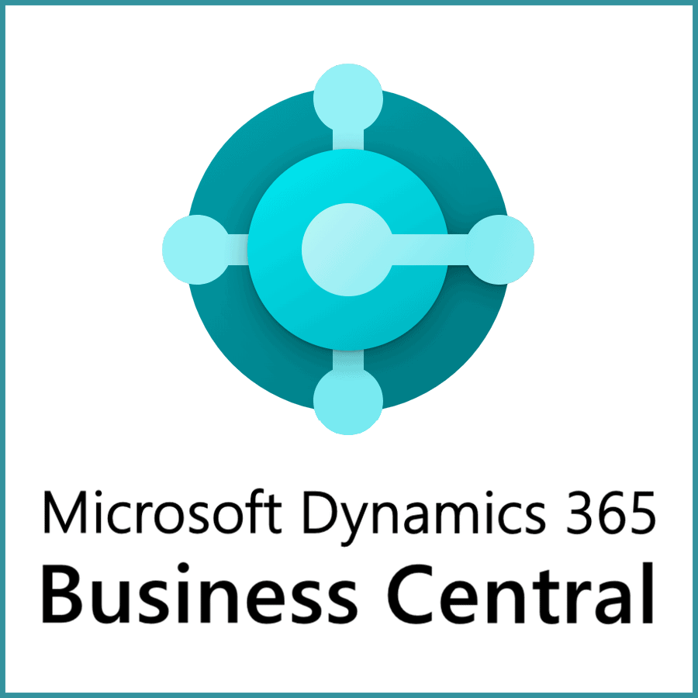
The reasons – Because there are a million to go to the latest
Business Central improvements
  Performance optimization
  Improved efficiency and productivity
  Increased flexibility and scalability enhancements
  Platform stability
  User interface improvements
  Security enhancements
  AI and machine learning
  Page scripting
  Retention policies
  Best ERP in 2024

Slide 7

The reasons – Because there are a million to go to the latest
LS Central improvements
  Optimized POS testing
  Replacing Preaction with Timestamp
  Continuously events creation
  POS UI improvements
  Autotests
  Statement calculation and posting
  Replenishment for Aggregated Inventory
  RFID tags support
  Interactive dual display
  Self-service and hotels

Slide 8
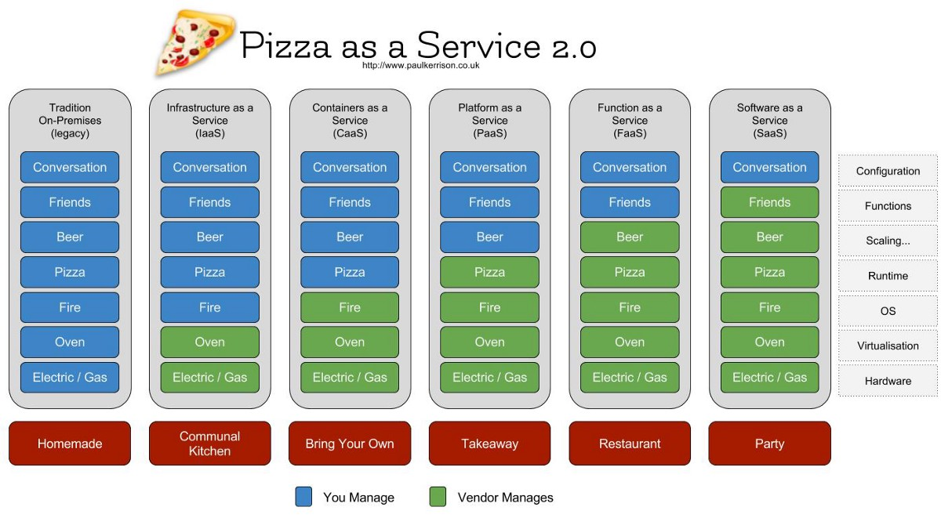
The reasons – Now let’s look at it in a slightly different way

Slide 9

The reasons – So, which one are you?
The control freak?
or...
The party freak?
Answer:
  Me, I am on the way to the Party

Slide 10
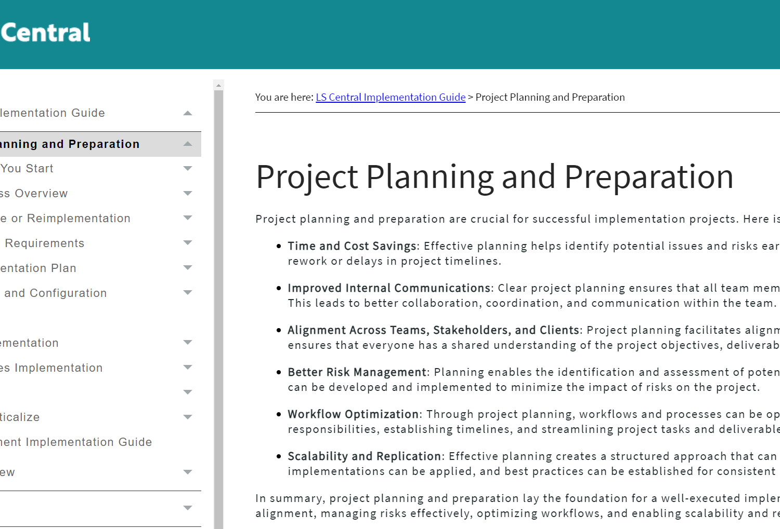
The reasons – Remember, come prepared, also for the take-away or the restaurant
It’s a collaborative effort to analyze which process should go into SaaS
It’s not just about the steps but also about how to execute them and who is responsible
LS Central on-prem typically comes distributed to secure a seamless end-customer experience, so what goes into SaaS?
Plan, plan and plan;
  Migration strategy
  Data validation and testing
  Deployment and monitoring
  Training and support
  Optimization and continuous improvement

Slide 11

Why upgrade to SaaS?
Subscription
Staying current
Hosted by Microsoft
Accessibility
SaaS?

Slide 12
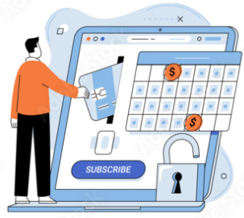
Subscription
Low up-front investment
Operational expenditure model (OPEX)
Scalability. Adjustable monthly
Significant money savings

Slide 13
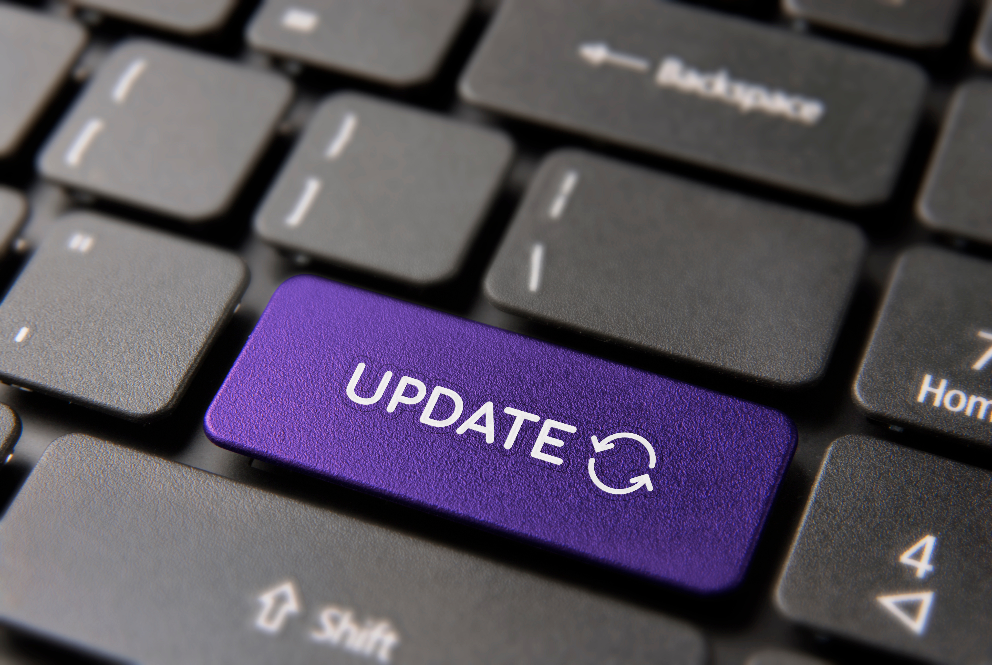
Staying current
Always updated
  Short update cycles
  Benefits of the newest technology and features
You stay current with minimal effort
No upgrade projects

Slide 14
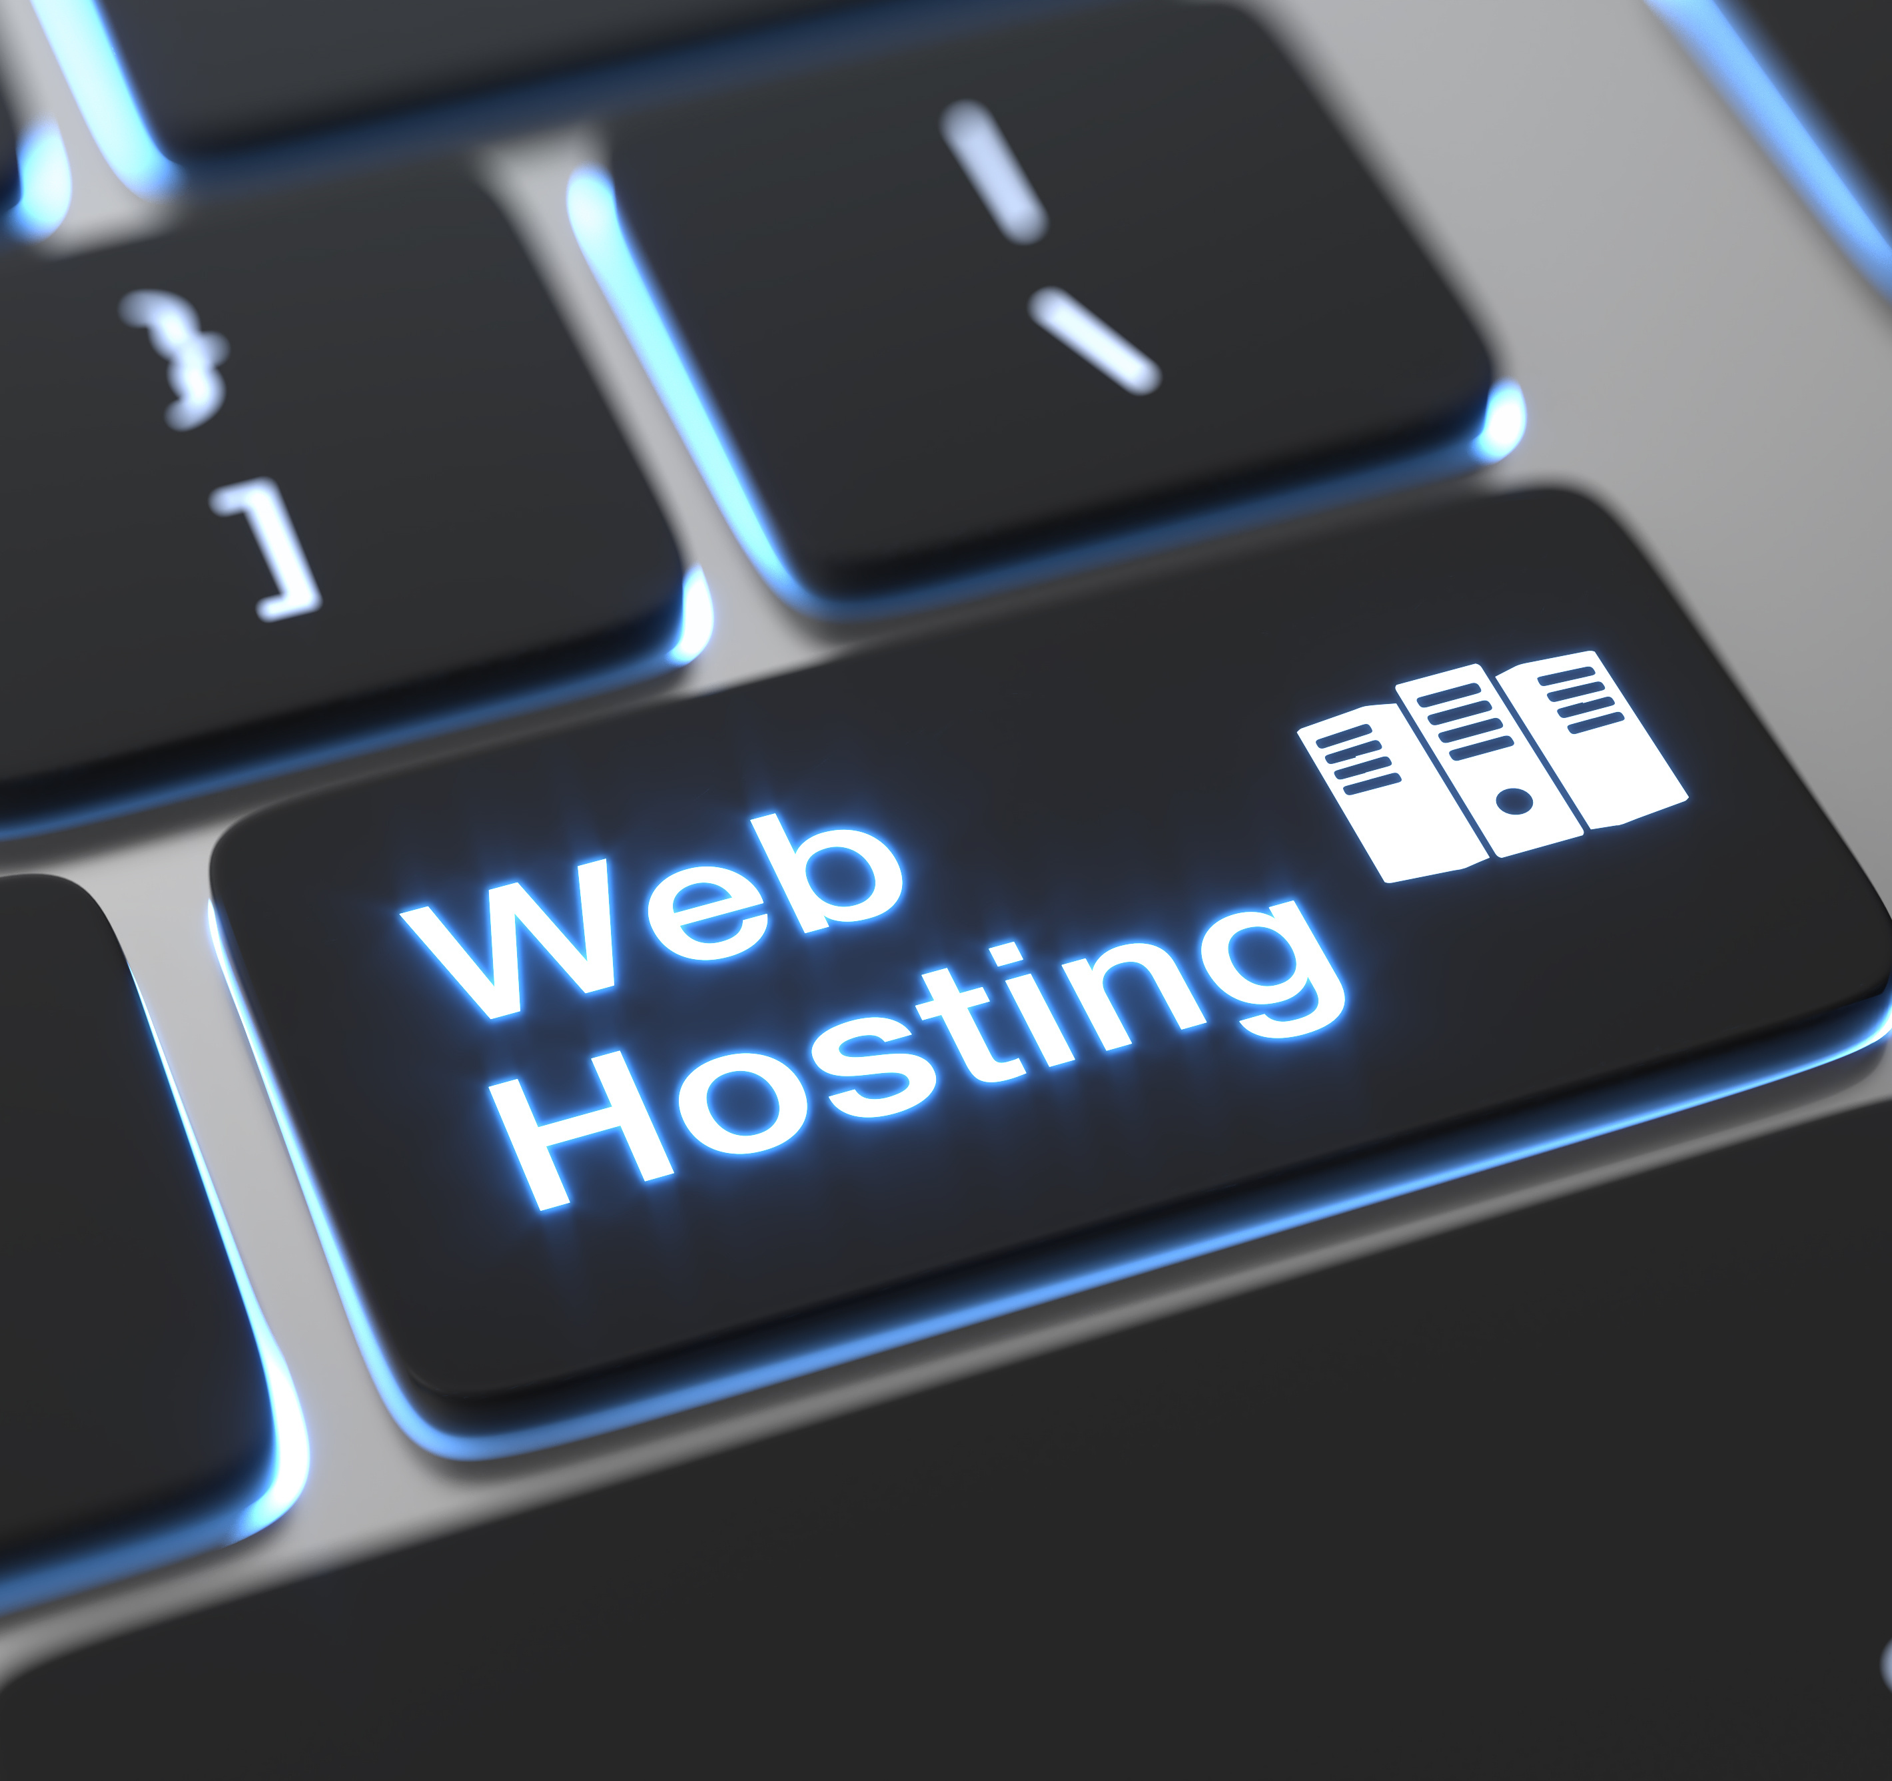
Hosted by Microsoft
Forget about infrastructure maintenance/cost
Reliable scalable environment for performance
Tools to monitor and analyze – like telemetry
Best in class-security
Works great with cloud tools
  Power Apps, Power BI, Power Flow
  Hosted Office environment

Slide 15


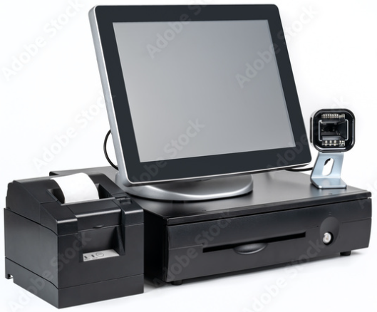
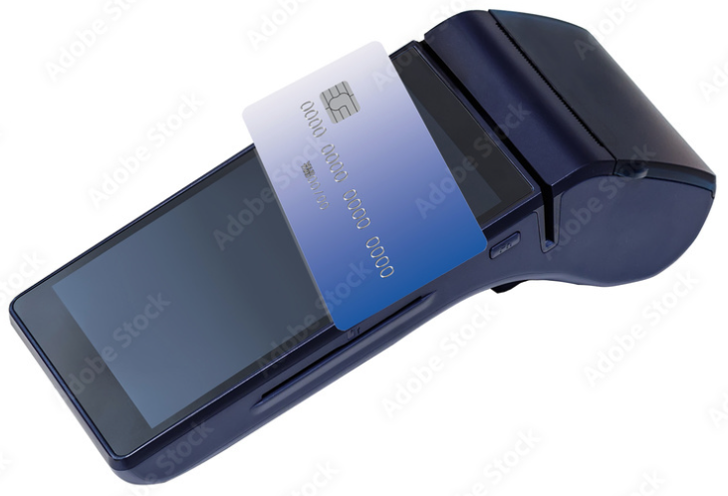

Accessibility
Accessible from anywhere at any time using an internet connection
From various devices: computer, tablets, and smartphones

Slide 16
SaaS and Hybrid
ERP in SaaS
Online POS
Offline POS
Mixed environment

Slide 17
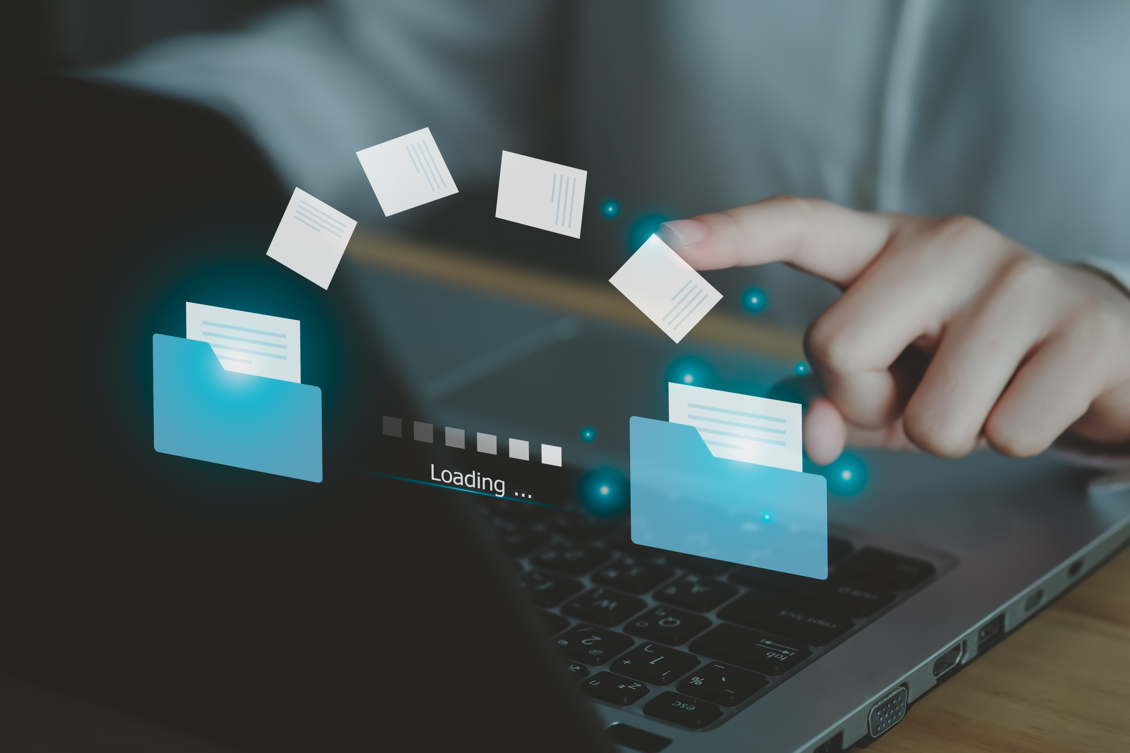
How to migrate to LS Central SaaS
Our goal
Migration paths
Migration process
Challenges and what we have done to help

Slide 18

Our goal
Where you think you are
LS Central latest
SaaS
Help you
To get to the place
where you think
you are!
Where you are
Older
LS NAV / LS Central
versions

Slide 19
Migration paths
Extension based versions
LS Central 15 or later
LS Central 15 or later
LS Central latest
LS Central SaaS
Doing the technical migration process on-premises
Using Cloud Migration Tool
Non-Extension based versions
LS NAV 6.0 up to LS Central 14
LS NAV 6 up to LS NAV 13
LS Central 14.2
LS Central latest
LS Central SaaS
Doing the technical migration process on-premises
Using Cloud Migration Tool

Slide 20
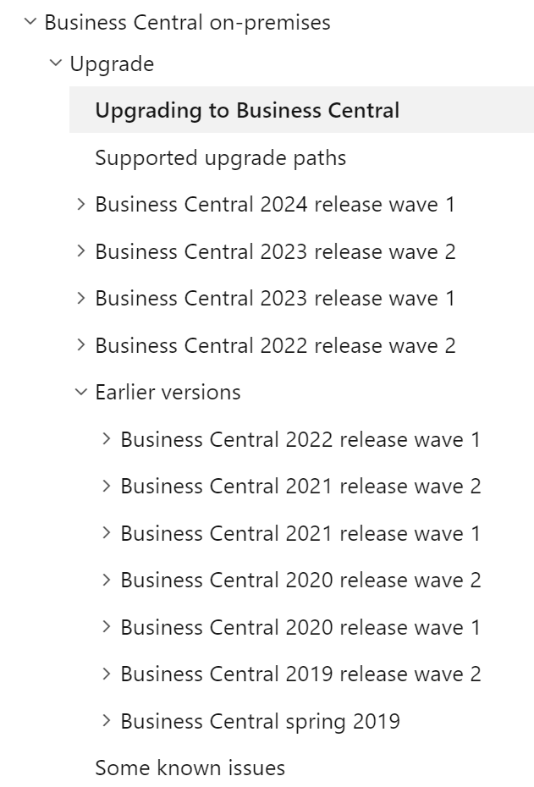
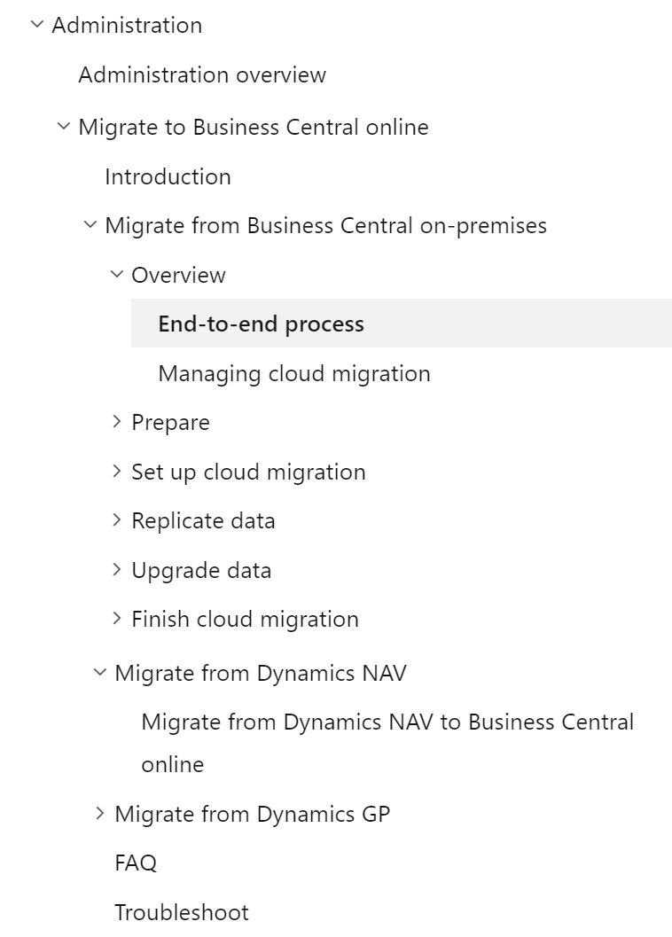
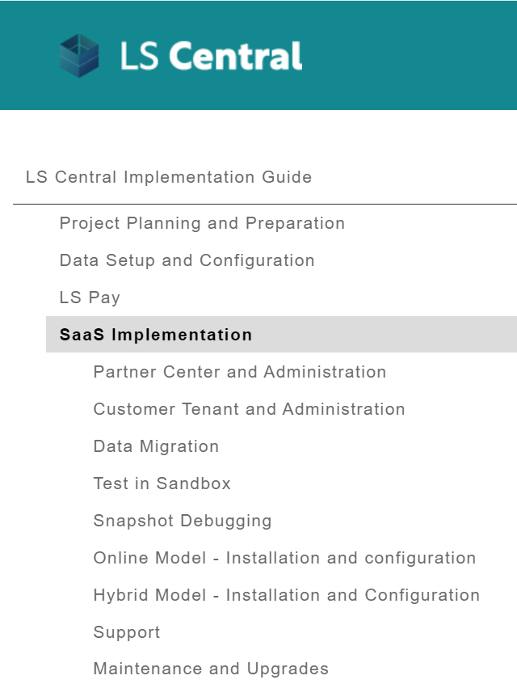
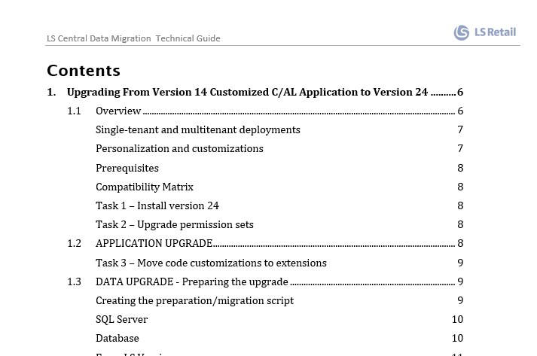
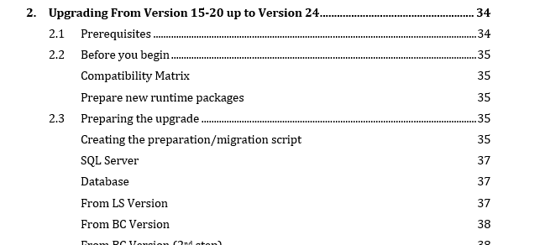
Migration process
Two main tasks
Data Migration - Migrating customer’s data
Code Migration – Migrating customizations
Recommendations
Use and abuse from documentation
  Microsoft Learn
    Business Central on-premise → Upgrade → Upgrading to Business Central
    Administration → Migrate to Business Central online
  LS Retail Online Help and Implementation Guide
  LS Central Migration Process
    Step-by-step documentation following Microsoft guidelines
    LS Migration Tools PowerShell module to ease the migration process
    Ask for it through our Partner Support desk

Slide 21

LS Central 15 and up
Migrating data
Straightforward process
What we have done
LS Central Migration Process documentation
Includes LSMigrationTools
Make the process more comprehensive and easier to follow

Slide 22


LS Central 15 and up
Migrating customizations
Objects/procedures marked as internal in v22
Missing events
Missing parameters in existing events
Added LS Central repository to Github, available to partners
Partners can submit events and scope changes requests through a pull request
      New events added
      New procedures made public
      On every new hotfix released
Today we have more than 3000 events in LS Central v24

Slide 23

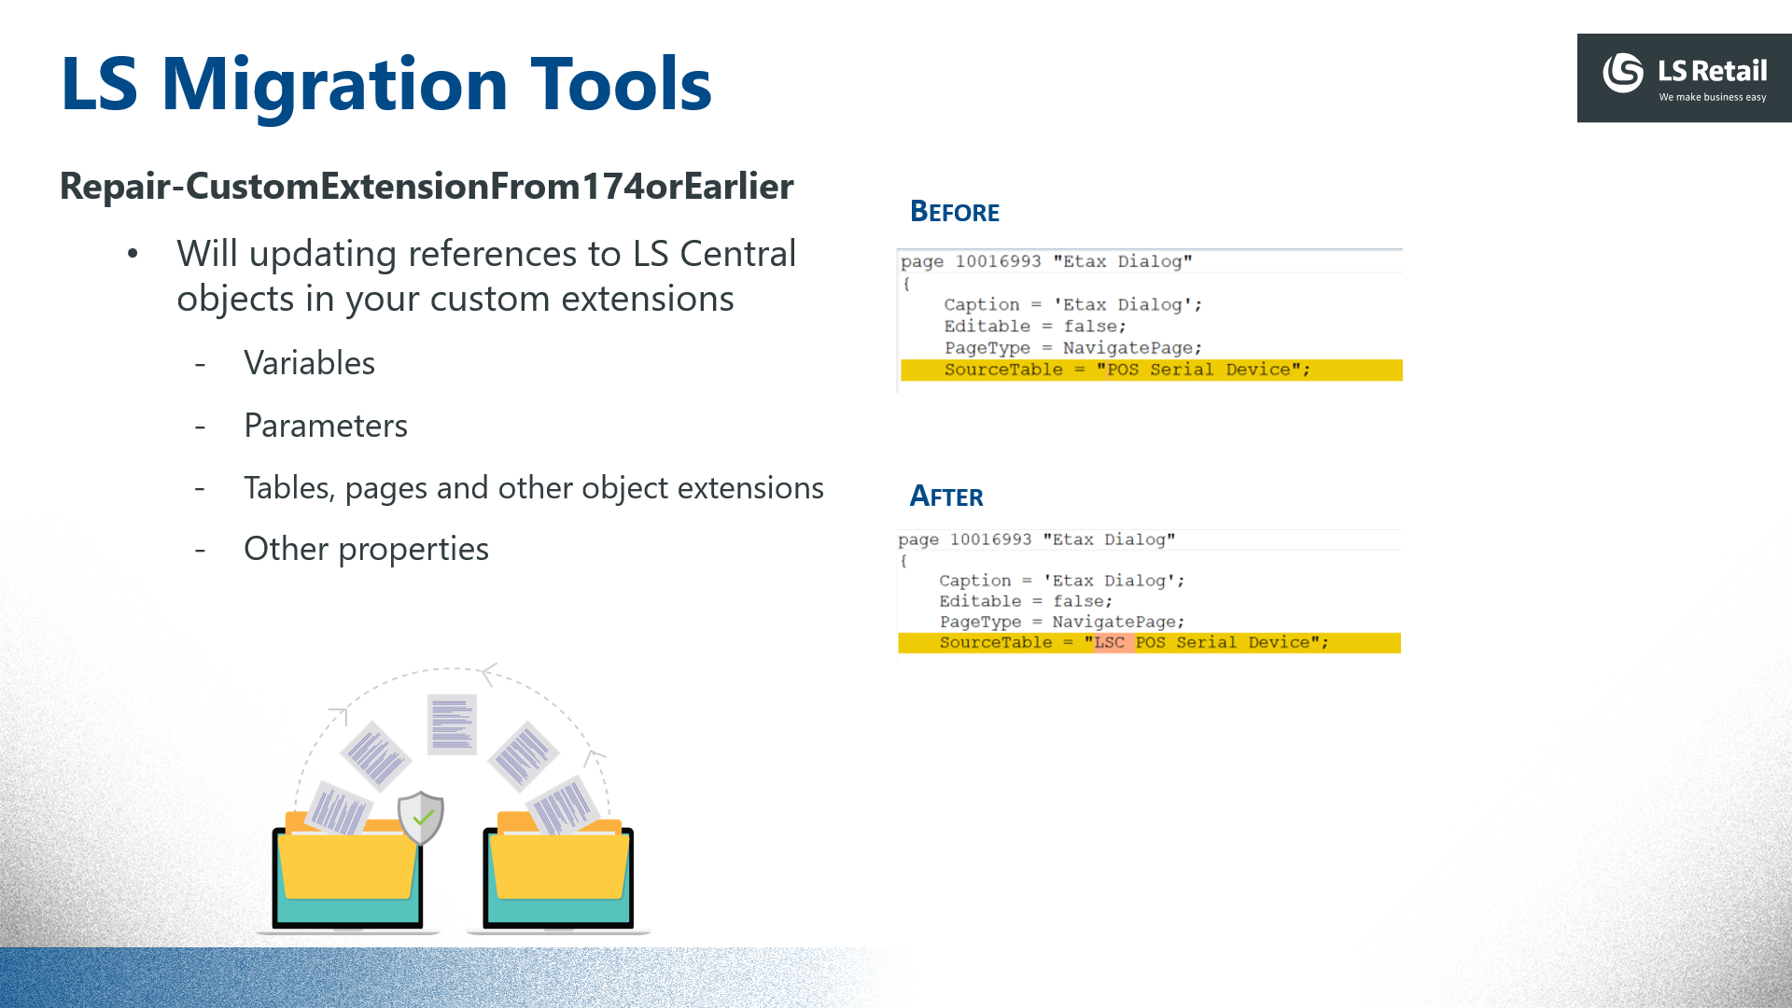
LS Central 15 and up
Migrating customizations
Objects renaming in LS Central 17.5 – Added LSC prefix
Partners have to:
Find and replace all references to LS Central objects in their custom extension projects prior to v17.5

Slide 24

LS NAV 6 up to LS Central 14, to latest
Recommendations
Don’t migrate legacy data
Start clean
  Open balances, master data, historical data
  Small database (avoid concern with storage capacity)
  Avoid (existing) performance issues
Do a gap list analysis
  Stick to the standard
  Migrate only critical customizations
  Leave non-critical customizations for last

Slide 25

LS NAV 6 up to LS Central 14, to latest
If you and your customer still wants to move all the data (and customizations)
What we will do (but not only)
LS Central Migration Process
Extending our documentation to include migration steps/tips for older versions
Adding tips on how to tackle specific challenges when migrating some modules to newer versions
Other tips based on challenges partners are facing
Recommendation
Rely on the AIM Assessment report to understand the customized objects
AIM Development Center can ease your life with their experience/tooling

Slide 26



Book a session with the
CAP team

Slide 27
Questions?

