Slide 1
LS Central performance
under the hood
Bjarki Hall
Vlad Jacota
Hilmar Vilhjalmsson

Slide 2
Agenda

Slide 3
Agenda
Performance in LS Central
Introduction
Tests, diagnostics, debugging
POS Client improvements
Back office
Replenishment
Parallel statement posting
Replacing PreAction to Timestamp
Consulting – user stories

Slide 4
Performance in LS Central

Slide 5
Why performance matters
Performance directly impacts user experience, productivity, and overall project success
Collaboration between Development and Consulting is crucial to address performance challenges effectively
Together we ensure smooth operations and satisfied clients

Slide 6
Ambiguity
Performance can be ambiguous
What is slow?
How?
In what context?
For everyone?
Every time?
Compared to what?
How do we measure it?
How can we improve it?
How can we make sure it stays that way?

Slide 7
Outside factors
Web Browser version
Windows version
BC version
Web Client performance
AL Runtime performance
Database performance
AL coding performance
Hardware specs
Slow printer/scanner?
Old drivers?
Old computer (Bad CPU? Low memory?)
Slow network/router?
How far away is the server?
Cold starts?

Slide 8
Trade-offs
Performance is a balance:
Bad performance means too much is happening
Improvement is usually at the cost of removing something else
Removing involves risk
Over time, other things get favored over performance:
Maintenance cost
Quick-fixes
Code readability
If decisions like these are made, they should be intentional
Know the performance cost
Benefits should be more rewarding than their cost

Slide 9
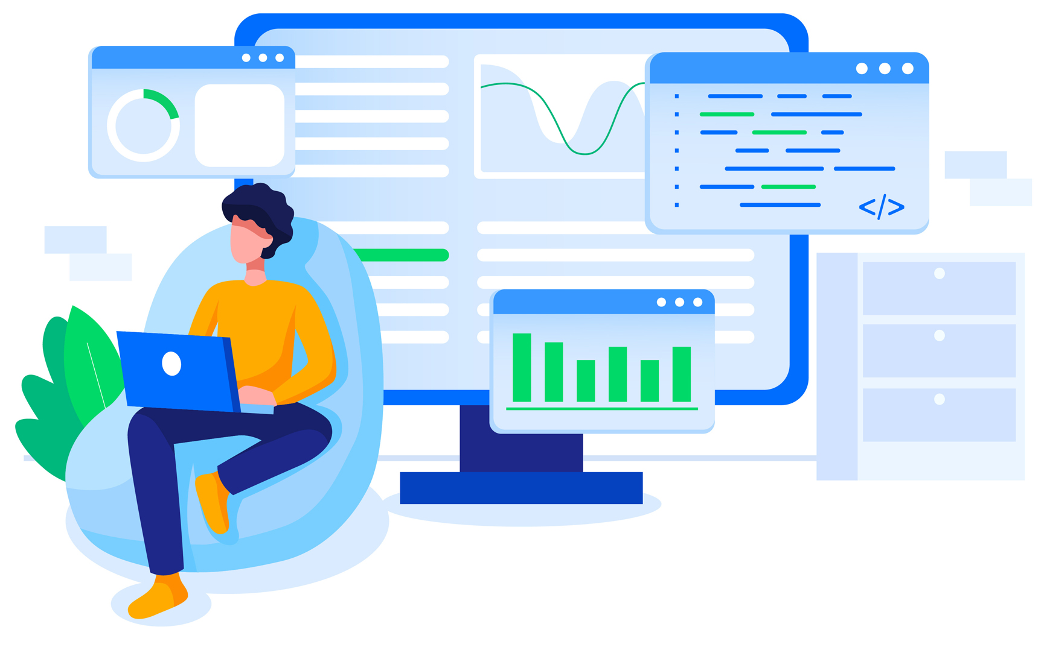
What are we doing about it?
Everything we can!
Workflows:
Following AL guidelines
More focus on training/workshops
Seeking advice from MVPs and Microsoft
Github contributions
Tooling:
Grouping code and placing under code-ownership
Using Code Analyzers, Build Validations, Autotests
Advice from Github Copilot
Telemetry, logging, feedback from partners

Slide 10
Tooling
for monitoring and debugging

Slide 11
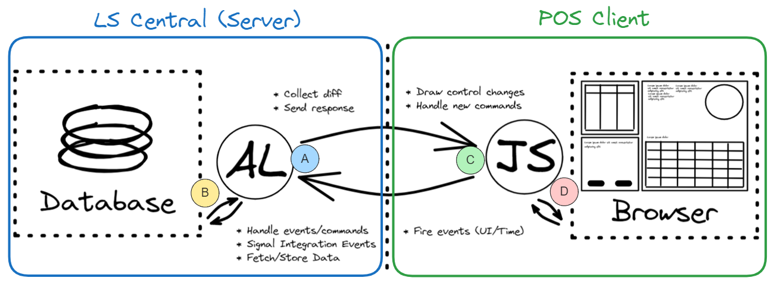
Pipelines
We run compilation, code-analysis, and auto-tests (unit/integration) for:
LS Central (A, B), POS Client (C) and the automation tool itself
We run full (end-to-end) tests against:
LS Central (on-prem w. Demo Data) and Standalone POS Client (D)

Slide 12
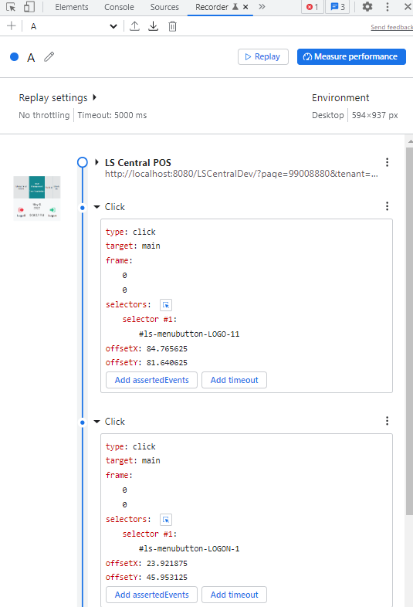
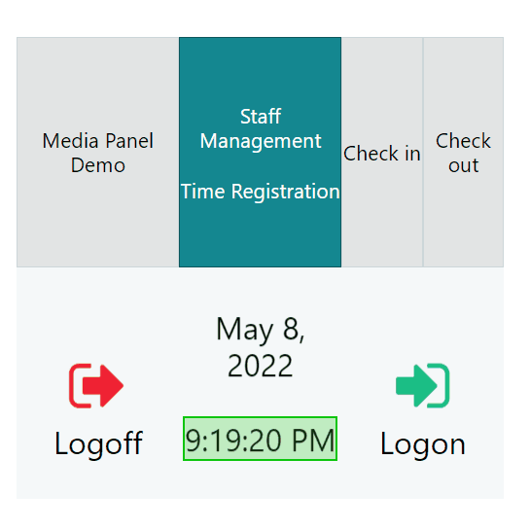
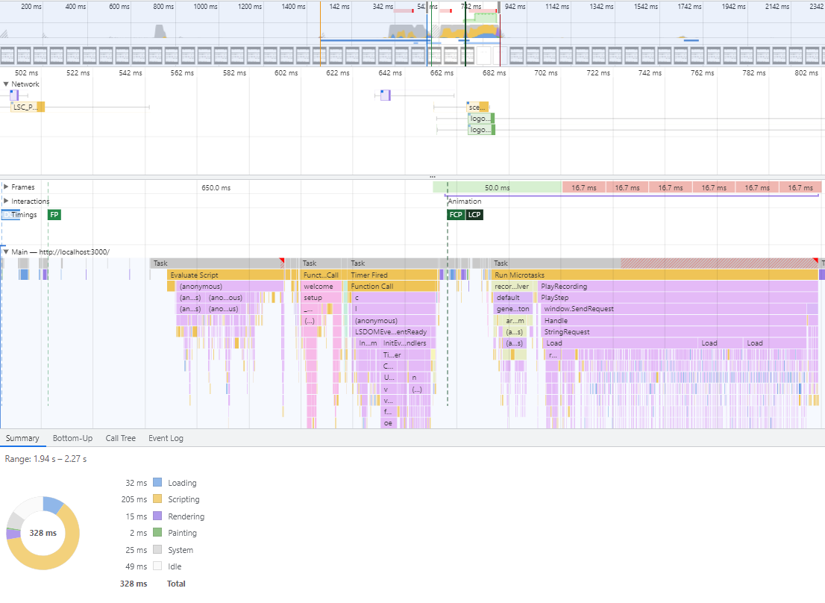
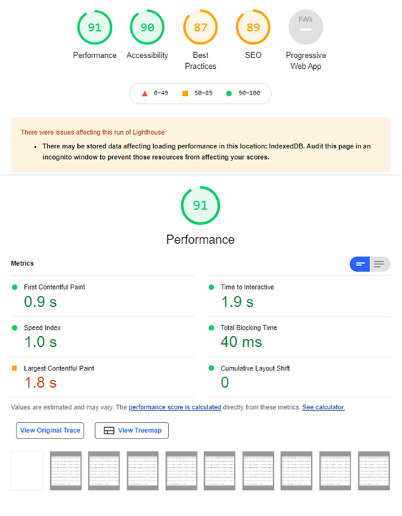
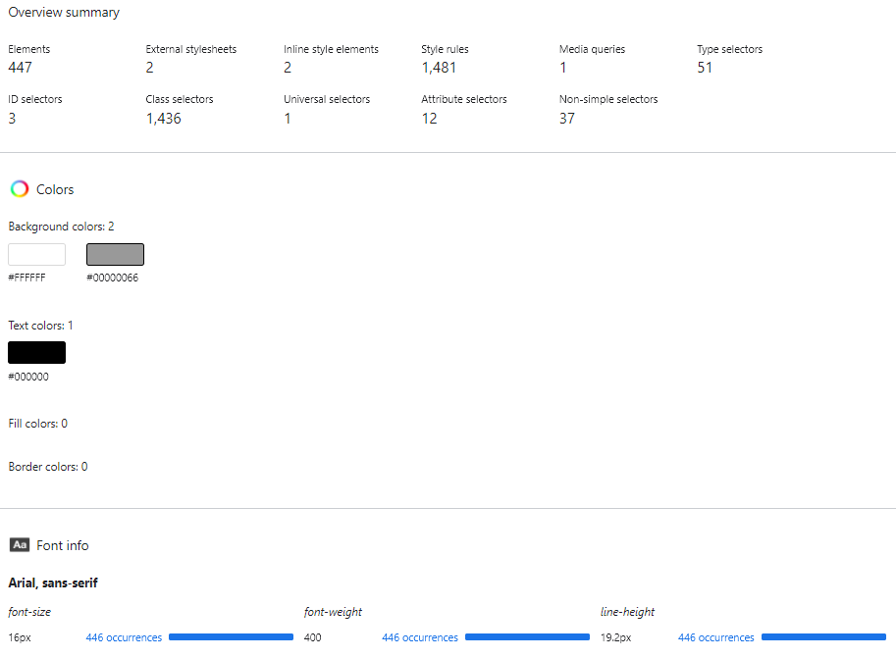
Browser tools

Slide 13
Diagnostics: Data recording
Collect data sent to/from Server
Replay the recording to debug/fix
Contains metadata and timings
Steps to download:
Add &ls-record to URL
Execute steps
Press Alt+R

Slide 14
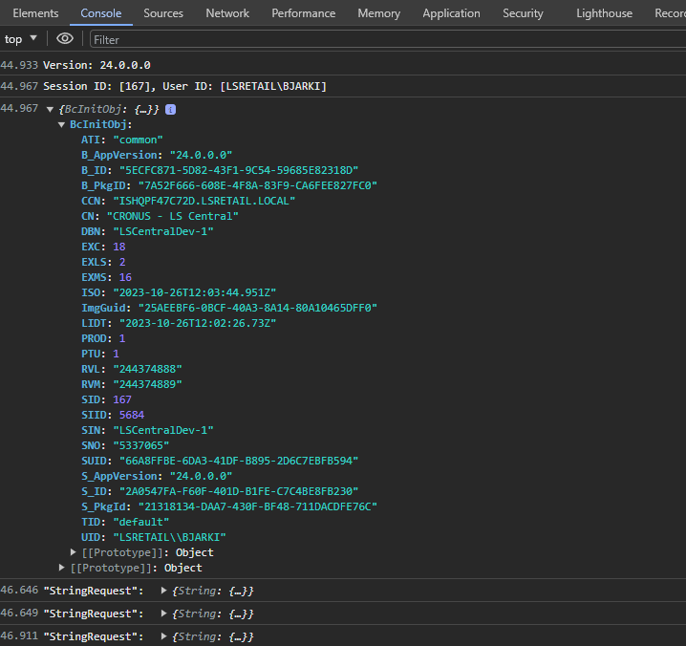
Diagnostics: Client log
Sometimes the web browser has:
Metadata/warnings/errors
These are not logged in AL
Optionally enable more extensive client logging:
Server communication
Add &ls-logstr=1 to URL
And more (Dual Display, Web Templates, …)
Steps to download:
F12
Console
Right-click
Save as (.log file)

Slide 15
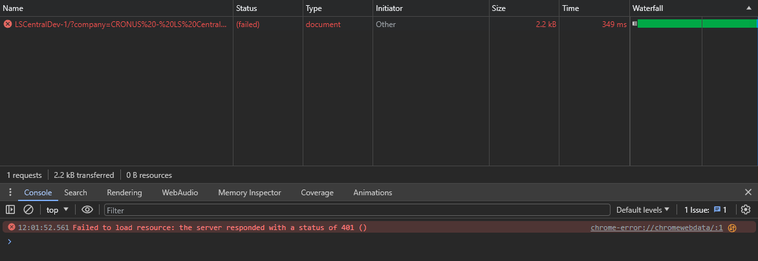
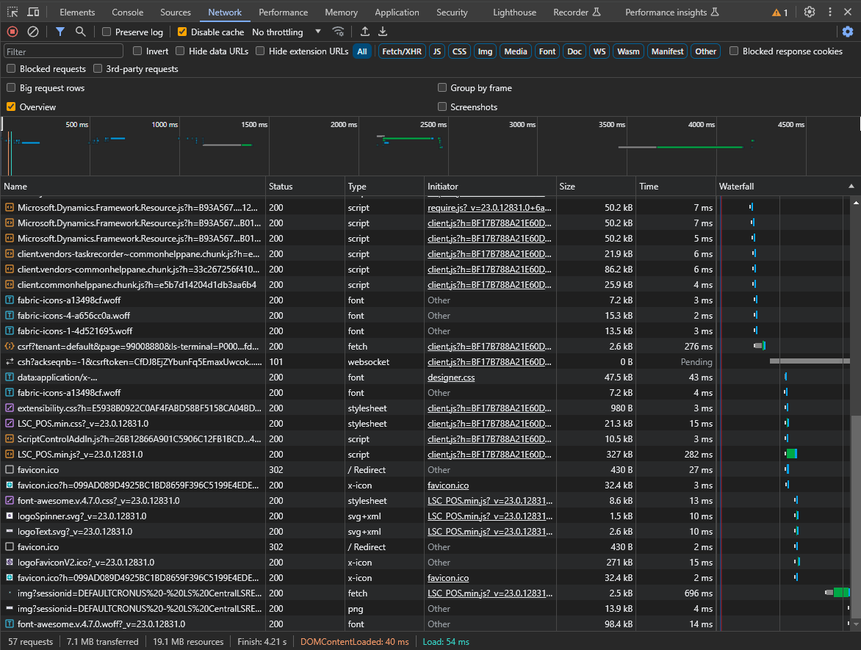
Diagnostics: Network error
Performance regressions/errors?
Big files
Slow network connection
Waterfall requests
File not found (404)
Steps to download:
F12
Network
Record
Export Har (.har)

Slide 16
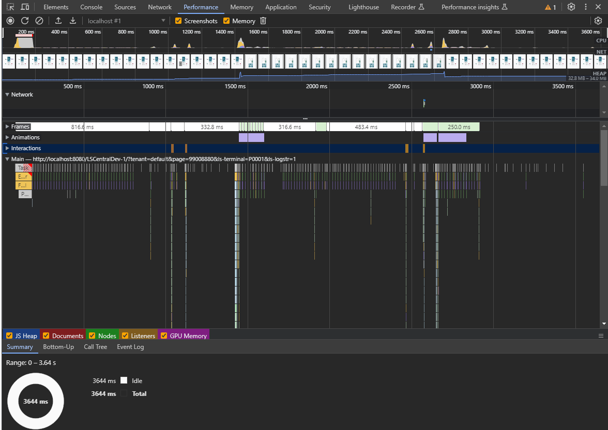
Diagnostics: Client performance
Client vs. Server?
Flamechart
Rendering
Screenshots/Video
Memory/CPU load
Steps to download:
F12
Performance
Record
Save profile (.json)

Slide 17
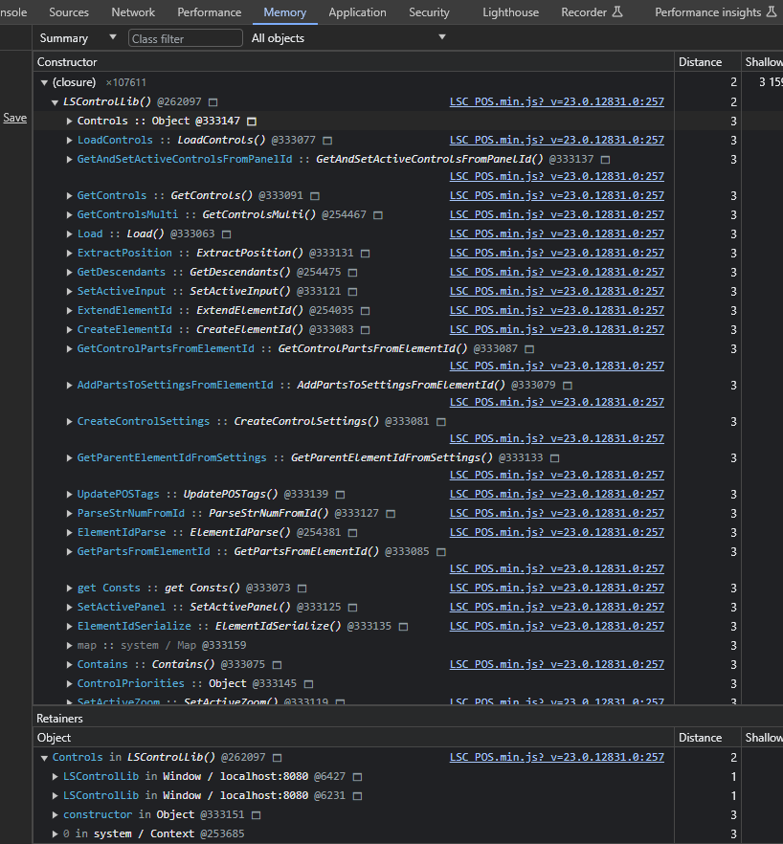
Diagnostics: Client memory
Analyze memory leaks
Compare 2 recordings
Where is memory reserved?
Steps to download:
F12
Memory
Take Heap snapshot
Save (.heapsnapshot)

Slide 18
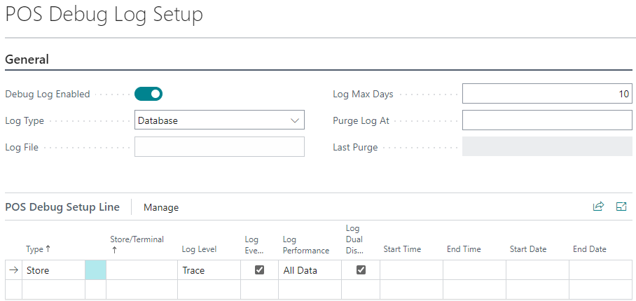
Diagnostics: Server log
Verbosity (warning/error/tracing)
Performance information
SQL statements, durations, timestamps
Scoped/Timed/Purged
Store/Terminal, Start/End Time
Logging impacts performance
Steps to download:
Open “POS Debug Log Setup” page and make sure logging is enabled
Execute steps in POS
Open “POS Debug Log” page and hit Download (.txt)
Quicker approach:
Add &ls-debuglog to URL, or use POS Command=DEBUGLOG

Slide 19
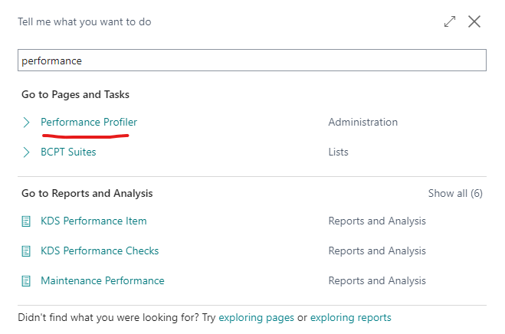
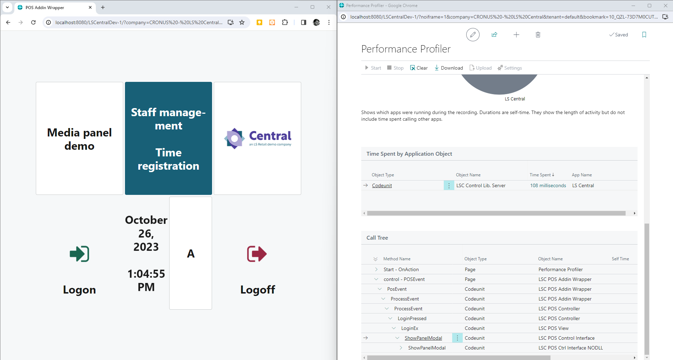
Diagnostics: Server performance
Find long-running AL methods
Using In-Client Profiling (Sampling)
Old Steps (while in POS):
Press Alt+Q+Q
Search for and open “Performance Profiler”
Pop the window out
Place the windows side by side
Click Start, execute steps, Stop, and Download
Quicker approach:
Add &ls-alprofiler to URL
or use POS command ALPROFILER
Execute steps
Trigger command again to Stop and Download (.alcpuprofile file)

Slide 20
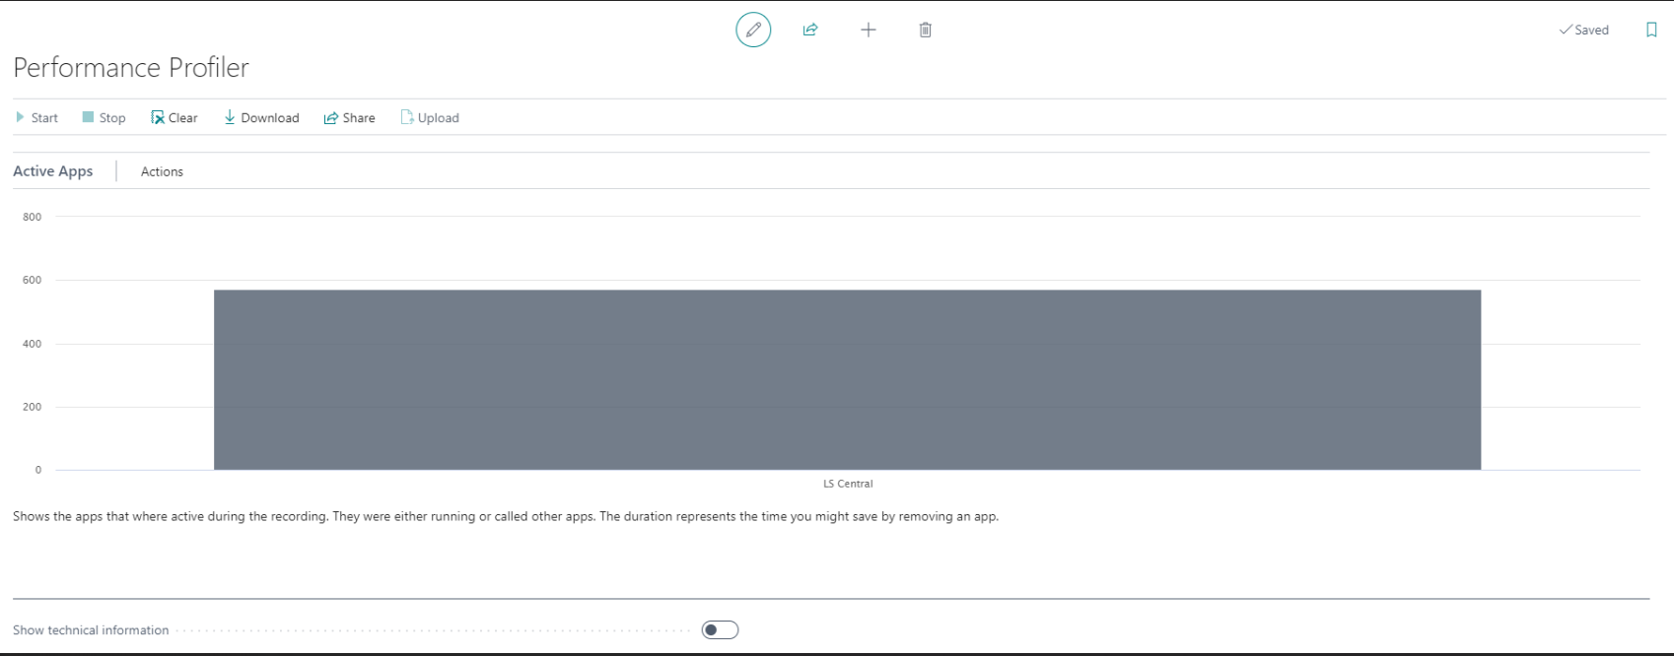
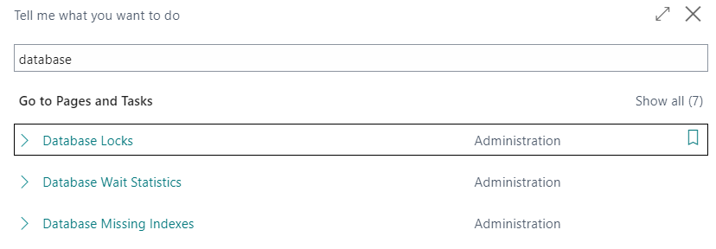
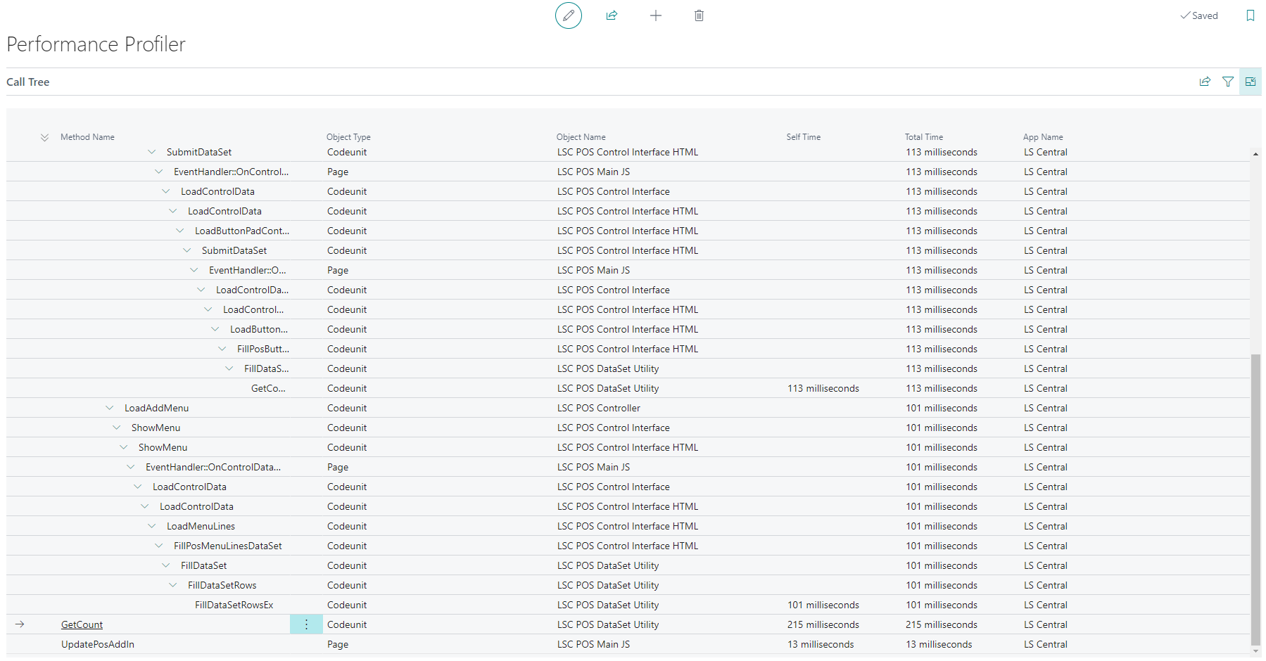
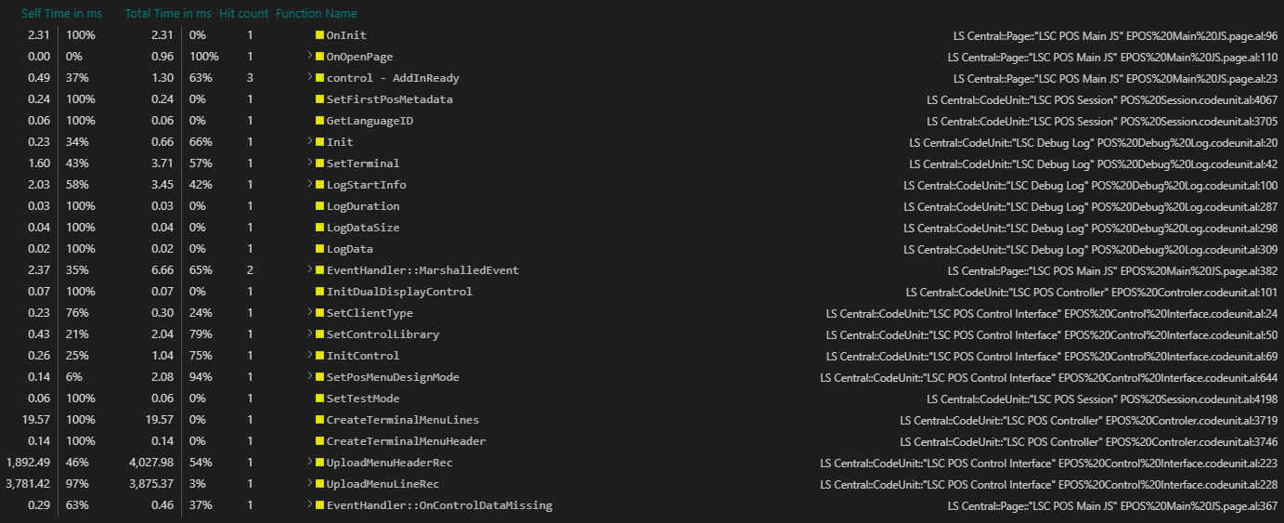
Instrumentation Profiling (vscode)

Slide 21
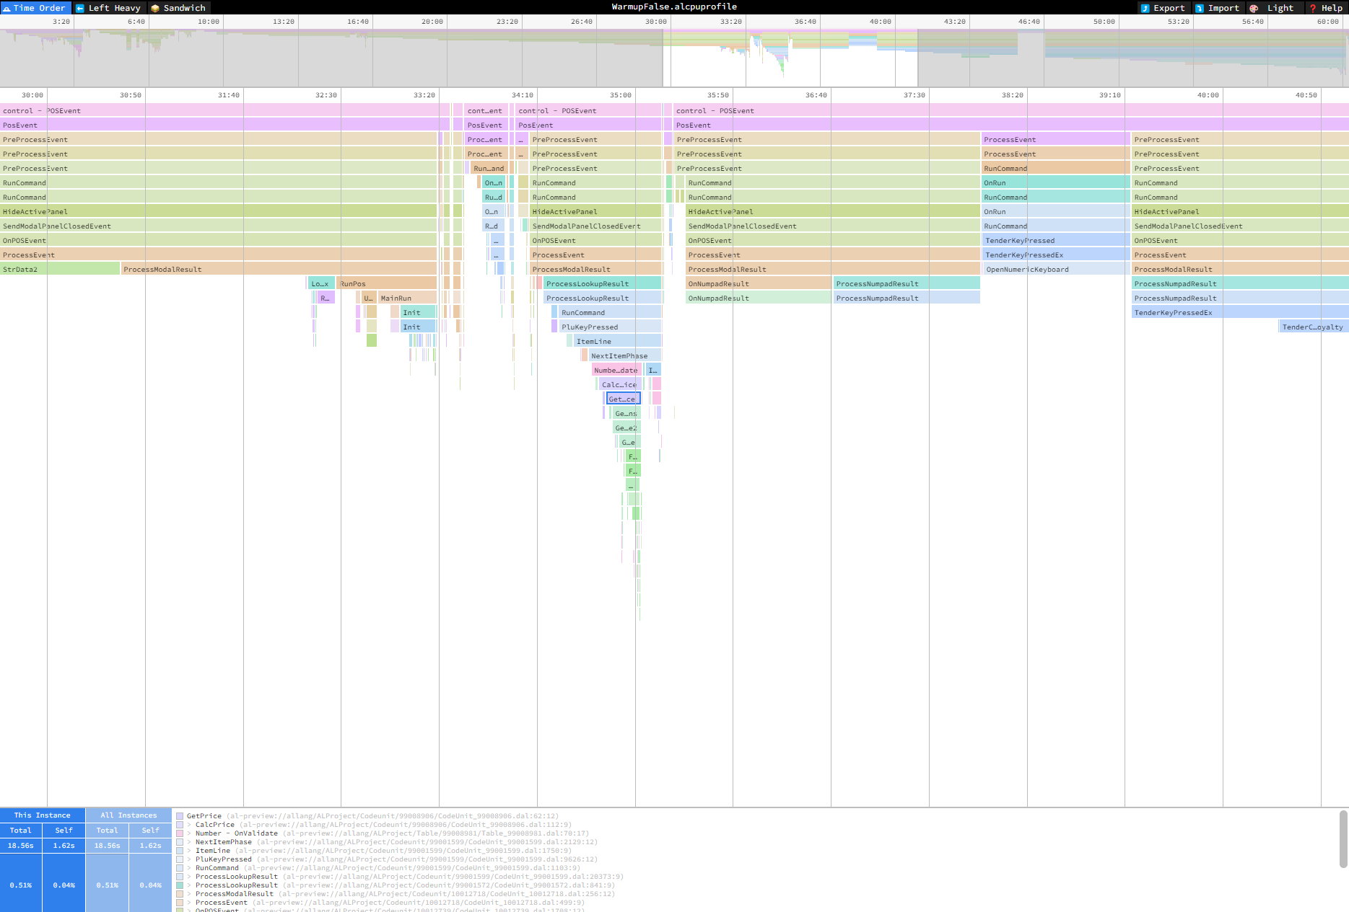
Tip: speedscope.app

Slide 22
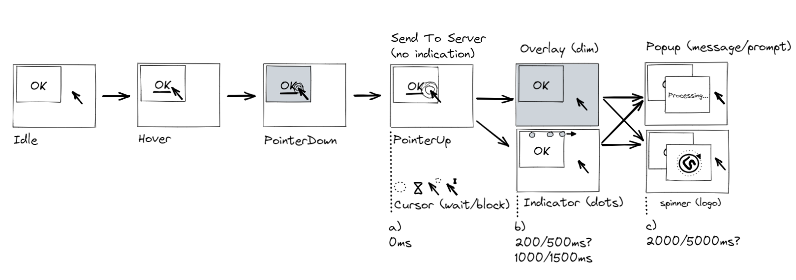
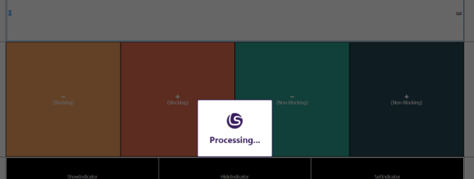
POS perceived performance
Sometimes things just “take time”
Not possible to do things in the background (or small steps)
Maybe users should not do much while process is still running?
Gradual visual indication/guidance:
“Loading indicator”
Three dots fly over the top of the screen
Happens, X seconds after BC started a task and hasn’t finished
User can still interact, but commands are queued
Can be enabled/disabled globally
“Blocked UI”
Buttons/Commands can be marked as “Blocked”
No user interaction (click/keyboard/etc.) allowed until execution has finished
Can be enabled/disabled globally

Slide 23
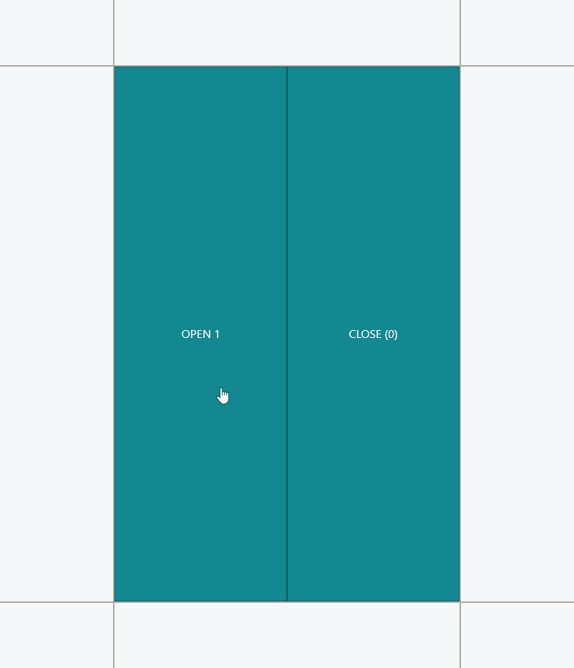
POS client startup
POS client is tested in isolation from BC
And vice versa
Minimal baseline and startup
Compress client-code, lazy-load data, diff-check, debounce…
Stress-test what might happen
How does the POS client handle 500 buttons on a menu? Or a million data grid lines?
Playback recordings where things were slow and measure
Browsers can profile performance, network requests, memory footprint…

Slide 25
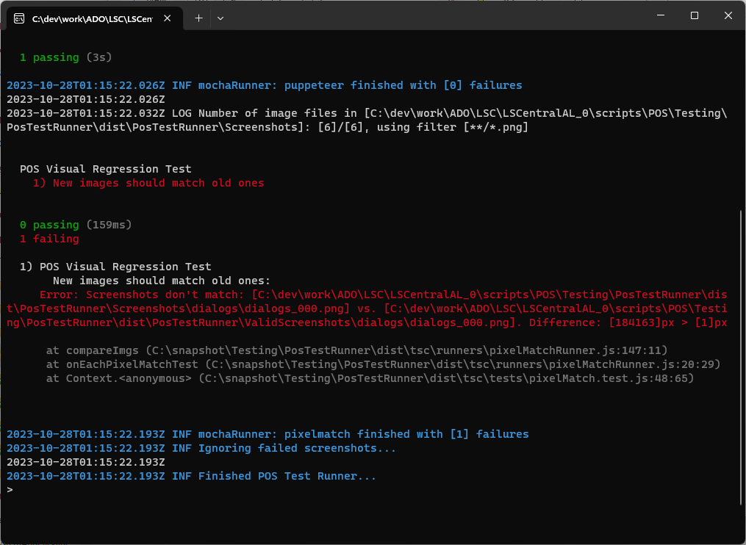
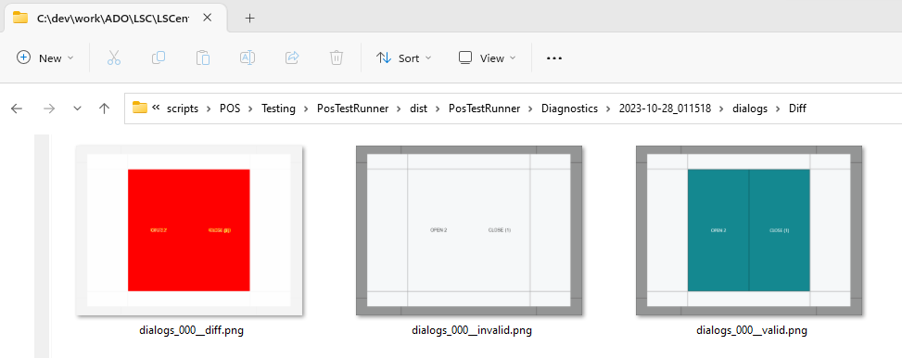
Screenshot comparison
Visual Regression Testing
Keep “valid” screenshots
Catch if text/style changes
Diff folder will contain 3 images:
Valid
Invalid
Diff
Steps to resolve:
Review the changes
Replace old screenshots with new

Slide 26
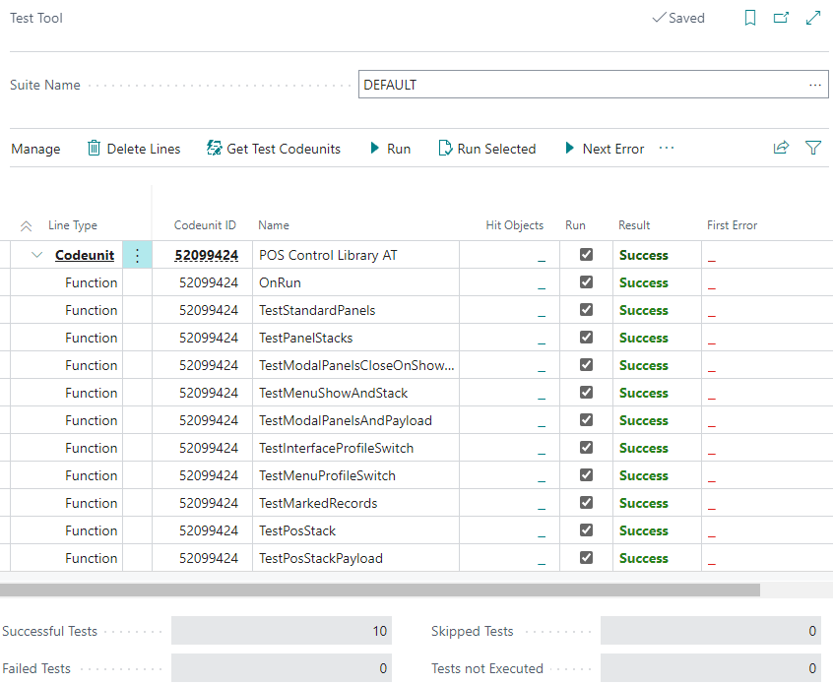
Autotests
Unit/Integration/E2E tests report durations
Track durations to see when a test started reliably taking 5x longer to execute
The whole chain can be automated
MS introduced “Page Scripting” for BO in BC 24.0
LS Central has similar internal tool for the POS
AL can be tested in isolation from POS Client
Benchmarks compare single-user execution
BC Performance Toolkit simulates multi-user scenarios

Slide 27
LS Central performance toolkit
Run multiple POS sessions
Easy configuration
Number of POS terminals
Transactions per minute
Items per transactions
Run in pipeline

Slide 28
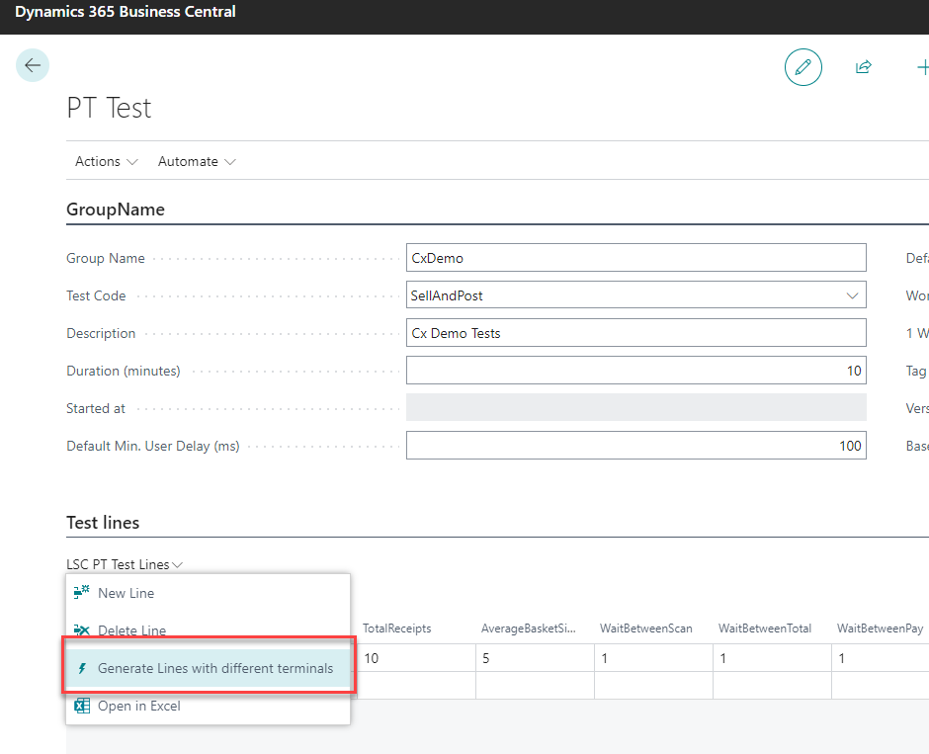
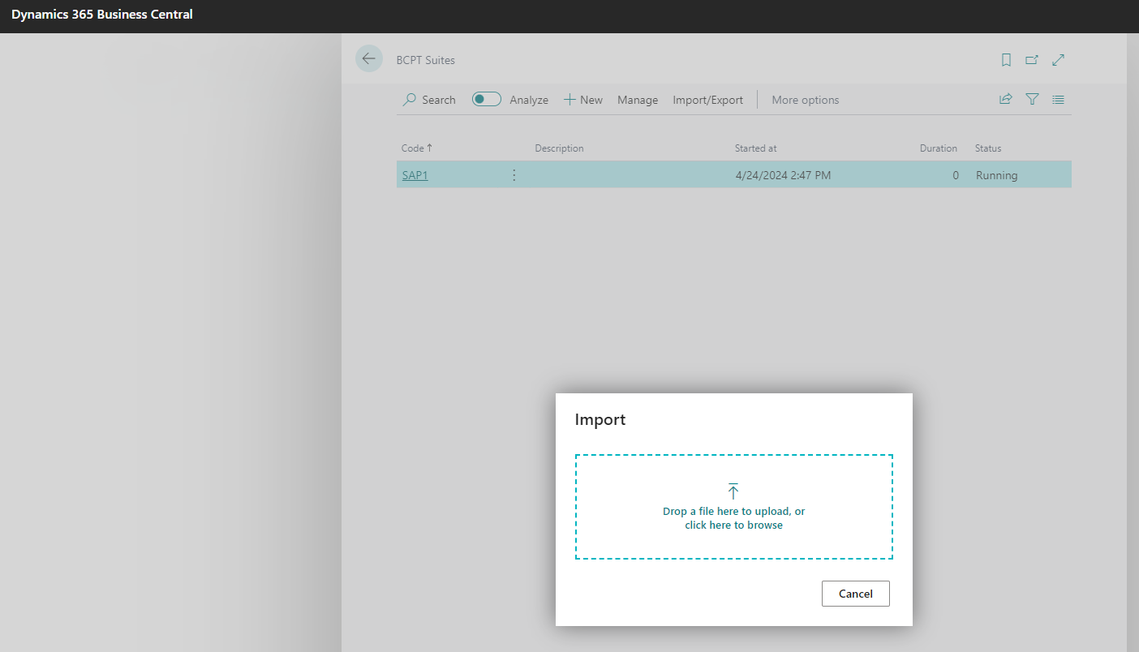
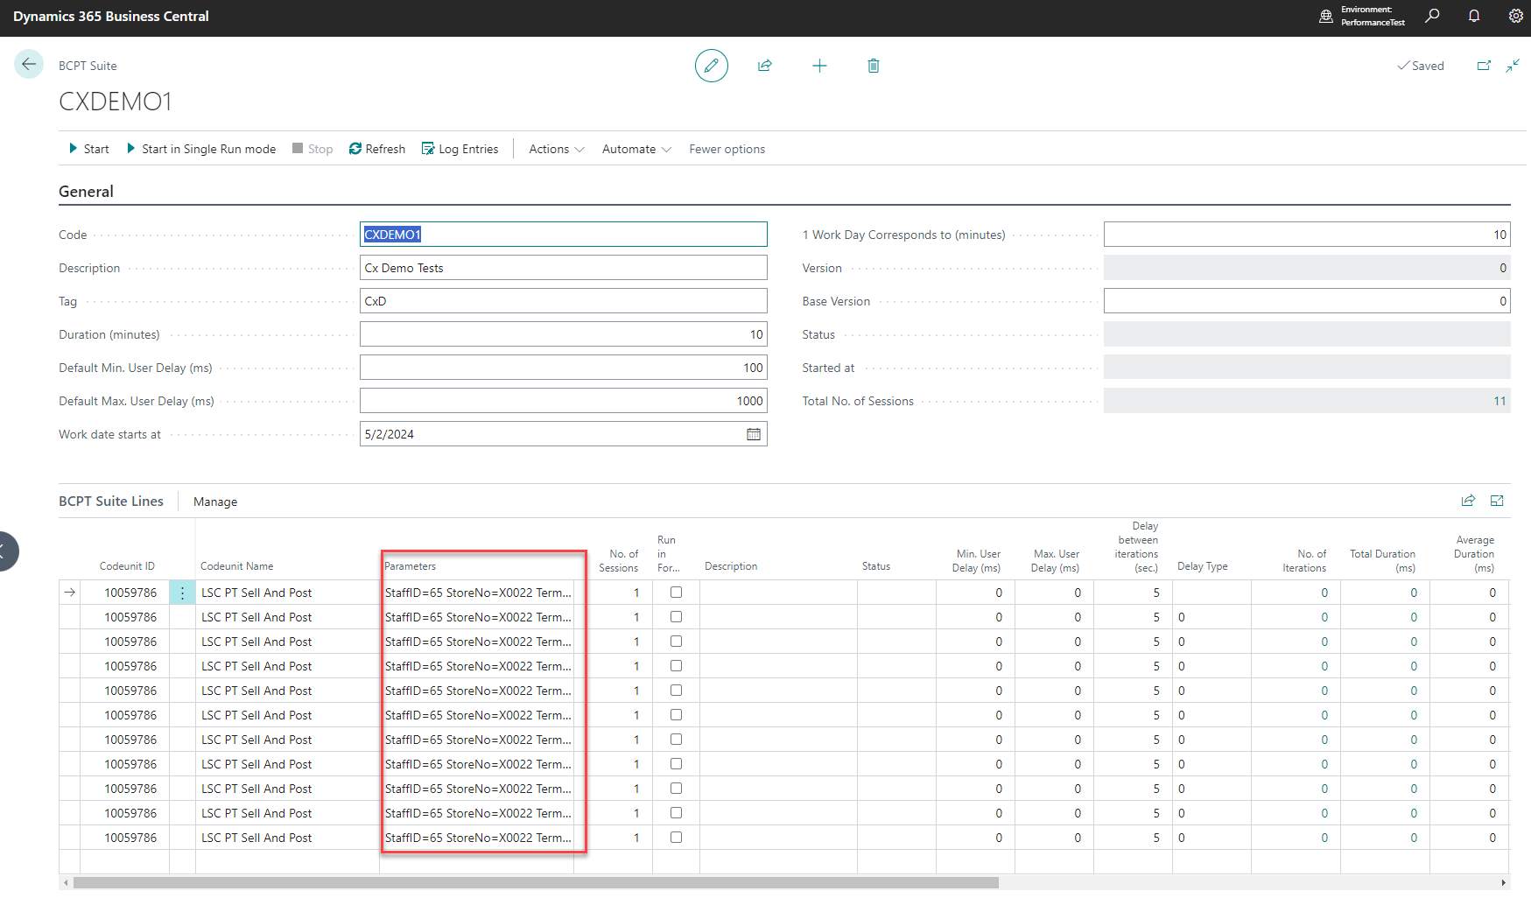
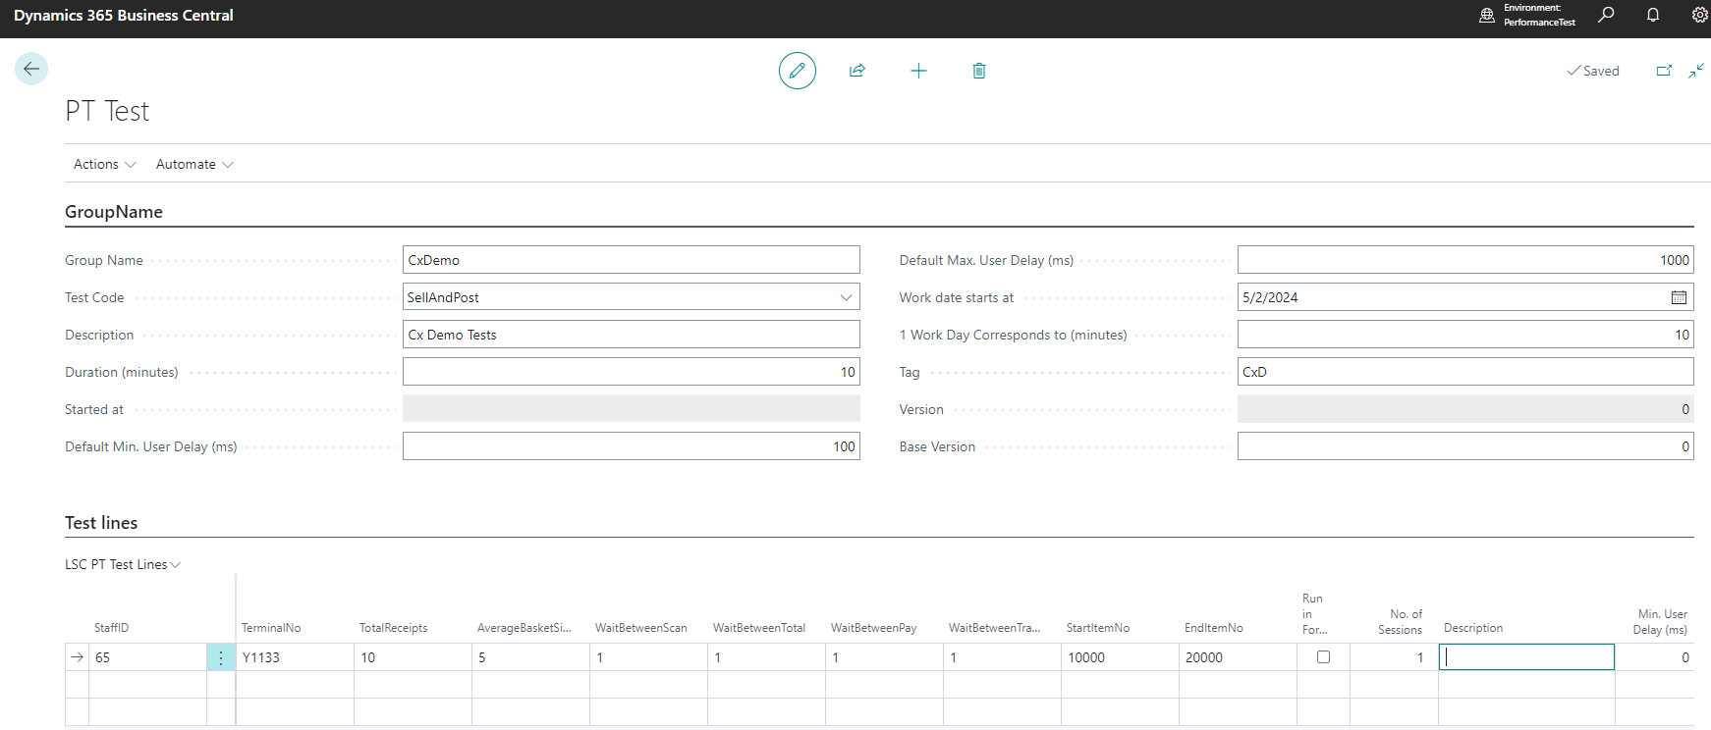
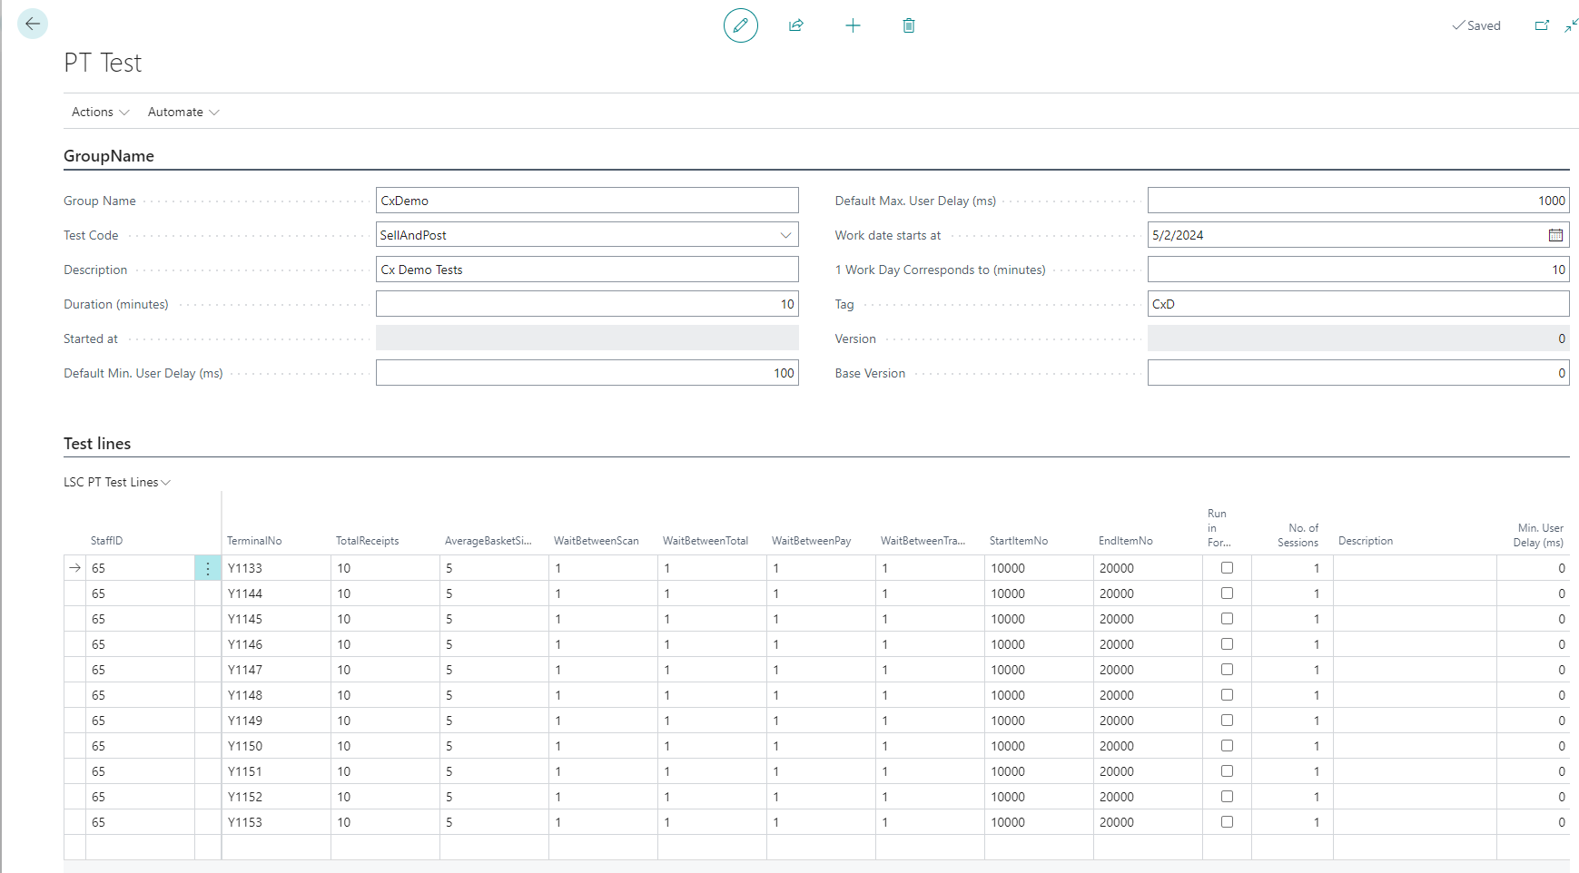
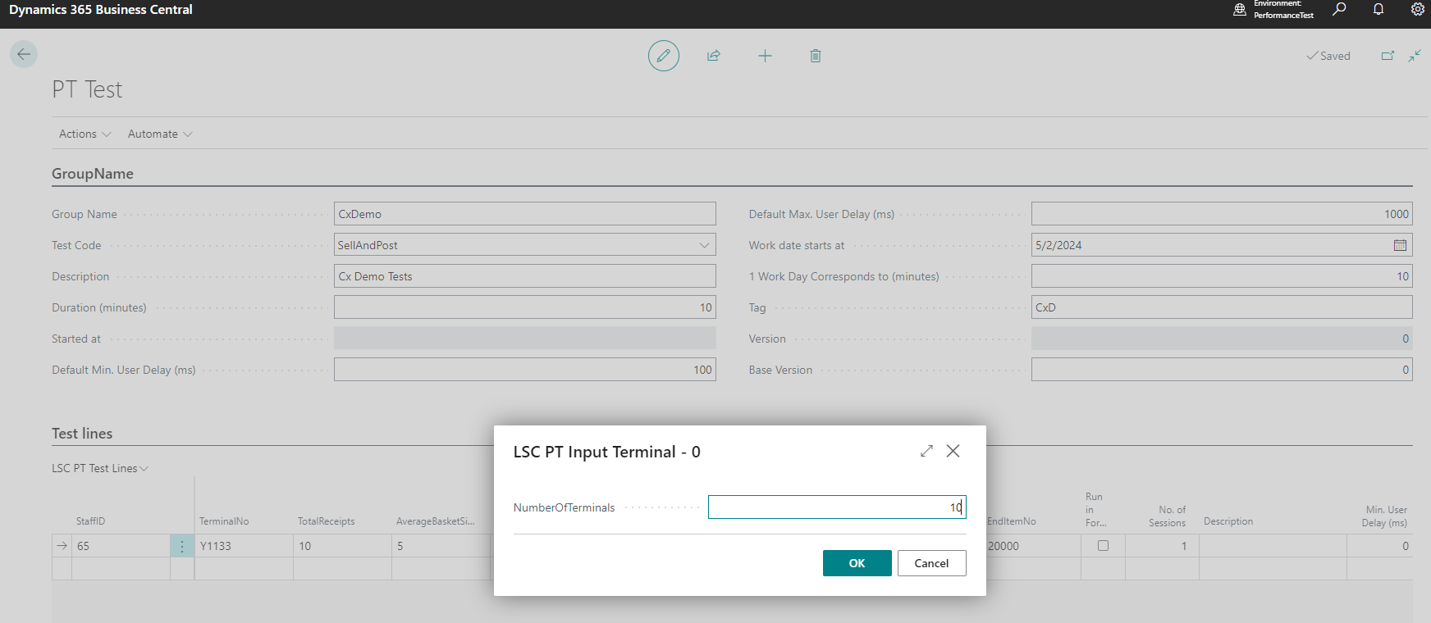
LS Central performance toolkit
Run multiple POS sessions
Easy configuration
Number of POS terminals
Transactions per minute
Items per transactions
Run in pipeline
Create your own tests

Slide 29
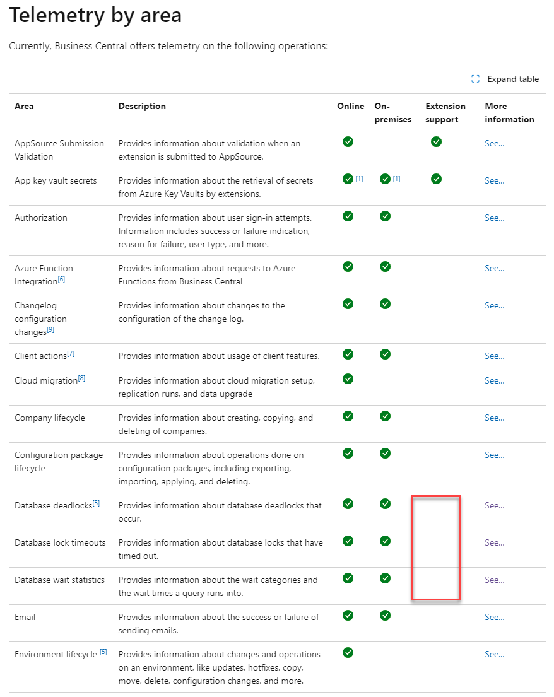
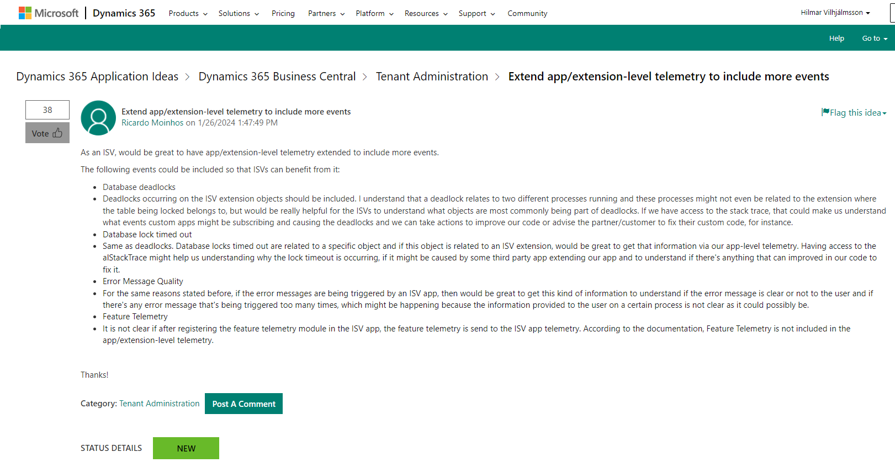
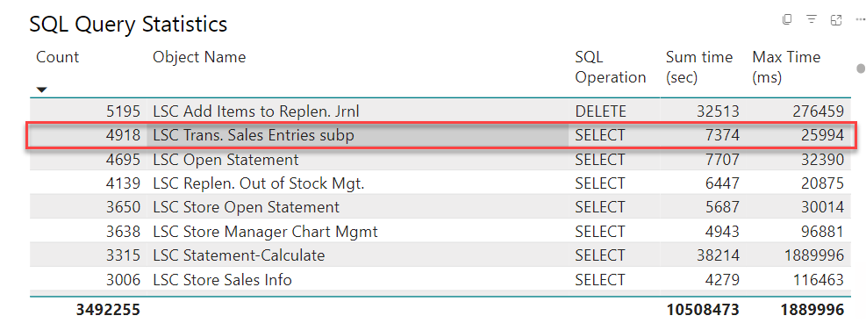
Telemetry
Analyze customer specific issues
Limitations in ISV Telemetry
Please give the BC idea your vote
Detect performance issues proactively

Slide 30
Back office
Performance improvements

Slide 31
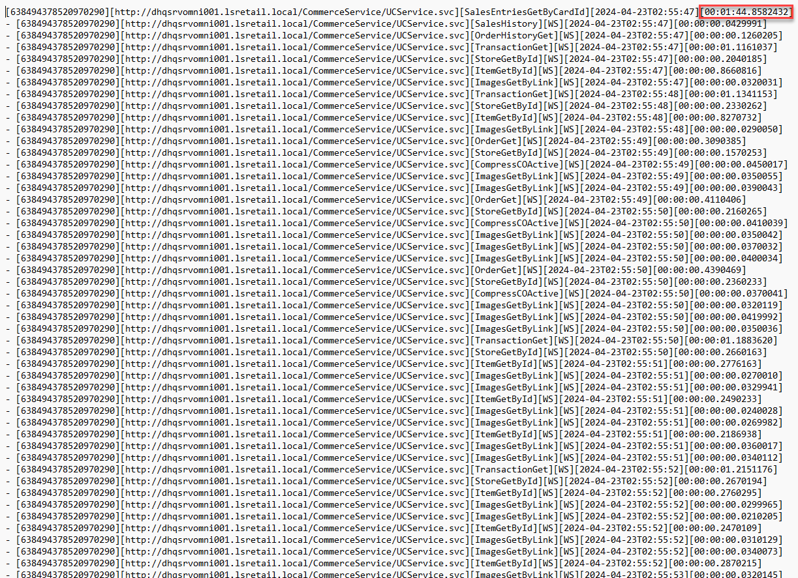
Commerce Server
Commerce request mgt
Optimized web services for ecommerce

Slide 32
Statement calculation and posting improvements
Statement calculation
70% faster due to code improvements
New process: Incremental Statement Calc.
Statement posting
55% faster due to code improvement
Improved process: Parallel Batch Posting
72% time reduction with parallel posting

Slide 33
Replenishment Calculation
Performance Test Results:
Replenishment Calculation | Baseline Calc. Time | 10 Parallel Calc. Time | Improvement
RIQ | 4 hours 3 mins | 38 mins | 84.50 %
OOS | 6 hours 25 mins | 1 hour 18 mins | 79.08 %
Replenishment Quantity Items calculation
Out-of-stock calculation
Replenishment Journal Calculation
No. of Parallel Sessions | Original Calc. Time (mins) | New Calc. Time (mins) | Improvement %
1 | 56 | 50 | 11%
2 | 56 | 26 | 54%
5 | 56 | 12 | 79%
10 | 56 | 10 | 82%

Slide 34
Replenishment challenge
SaaS customer
Before
7 (seven!!) hours

Slide 35
Replenishment challenge
SaaS customer
After
2 (TWO) hours

Slide 36
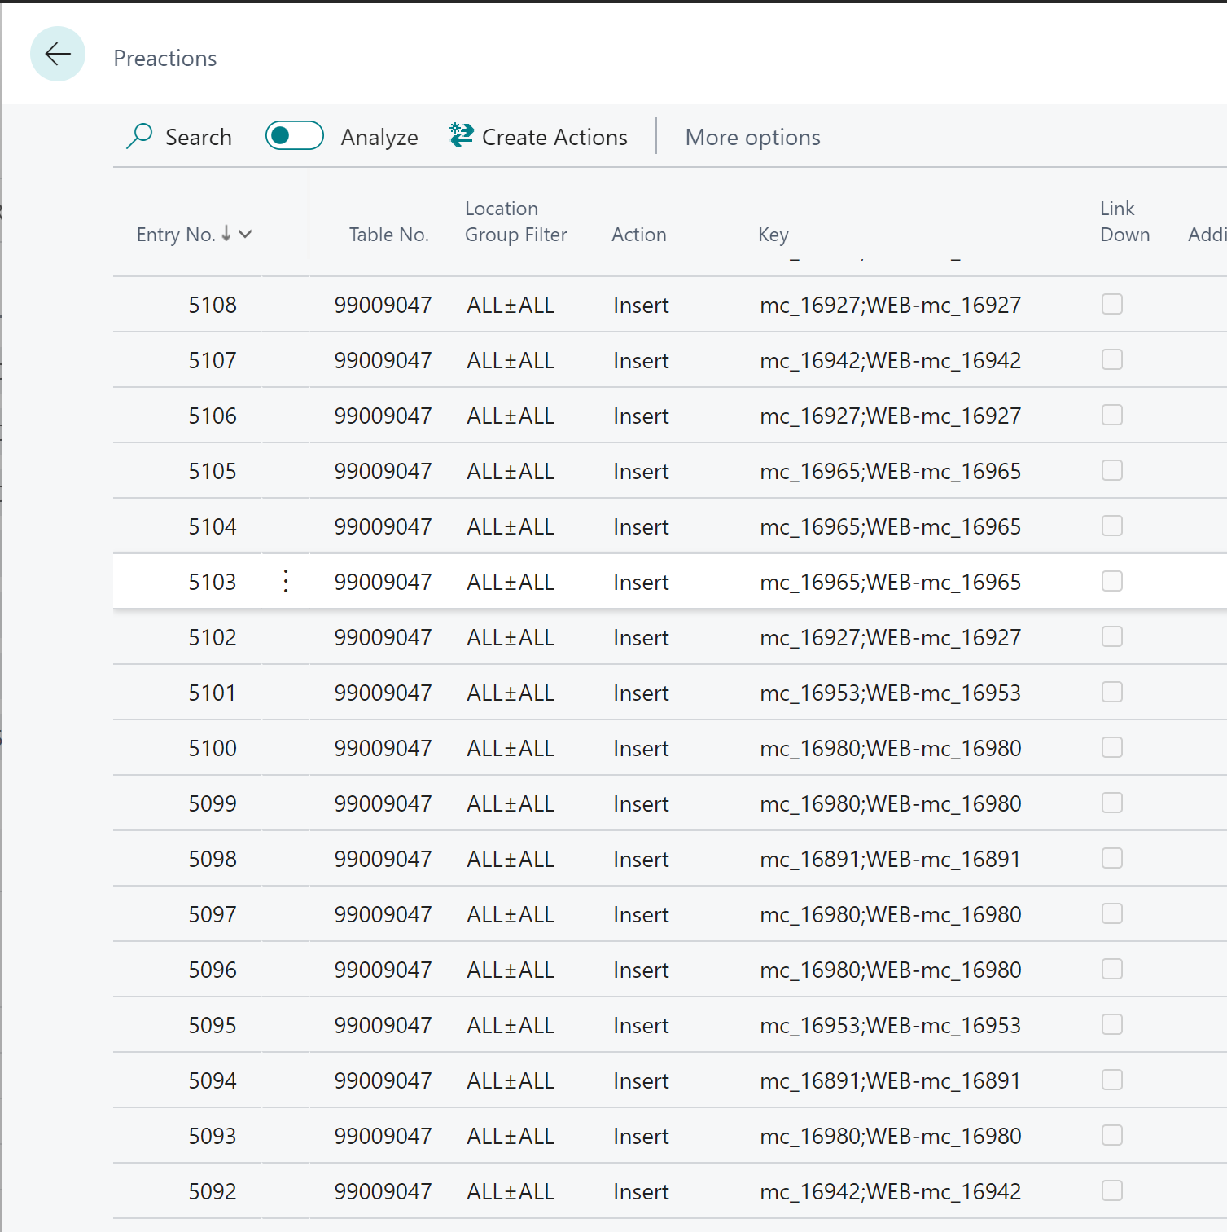
Replacing PreAction with Timestamp
Business Central feature
Auto-save as you work
PreAction created for every field modified in a page instead of one PreAction when closing the page
Base delta on Timestamp instead of PreAction
PreActions are created on demand in temp table

Slide 37
Collaborative performance optimization
Maximizing project success

Slide 38
Collaboration in performance optimization
Development department: Implements performance-enhancing features
Consulting department: Provides performance analysis and recommendations
Close collaboration: Continuous feedback loop ensures alignment and effectiveness

Slide 39
Success Story #1: Pharmacy industry
Challenging project in the Pharmacy industry
Customer: 90,000 items assortment, 350 stores rollout
Only 3.5hrs available per night for replenishment calculation
LS Retail Consulting's innovative solution: Optimized Replenishment Journal calculation process
Technical details: Optimistic approach for record marking and batch deletion
Result: 30% reduction in Replenishment Journal calculation time
Impact: Improvement part of LS Central standard as of LSC 24.0

Slide 40
Success Story #2: Ferry company
Customer: Ferry Company with a high number of daily reservations
Challenge: Performance issues during upgrade to centralized comments for activities and restaurants
LS Retail Consulting's solution: Utilized Database Missing Indexes and Query Store to identify missing index
Collaboration with Development: Index included in hotfix
Result: Improved performance and seamless upgrade

Slide 41
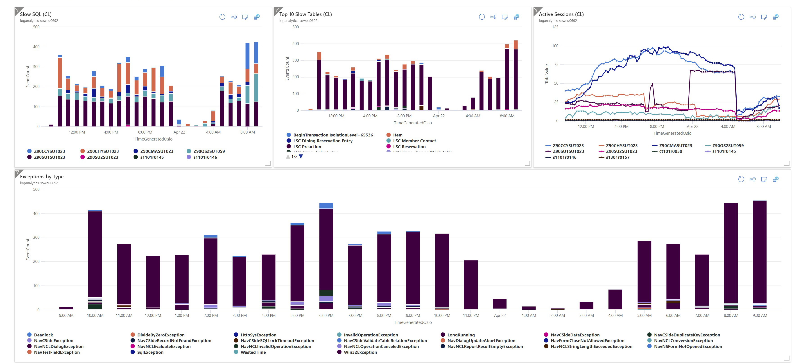
Tools for monitoring

Slide 42
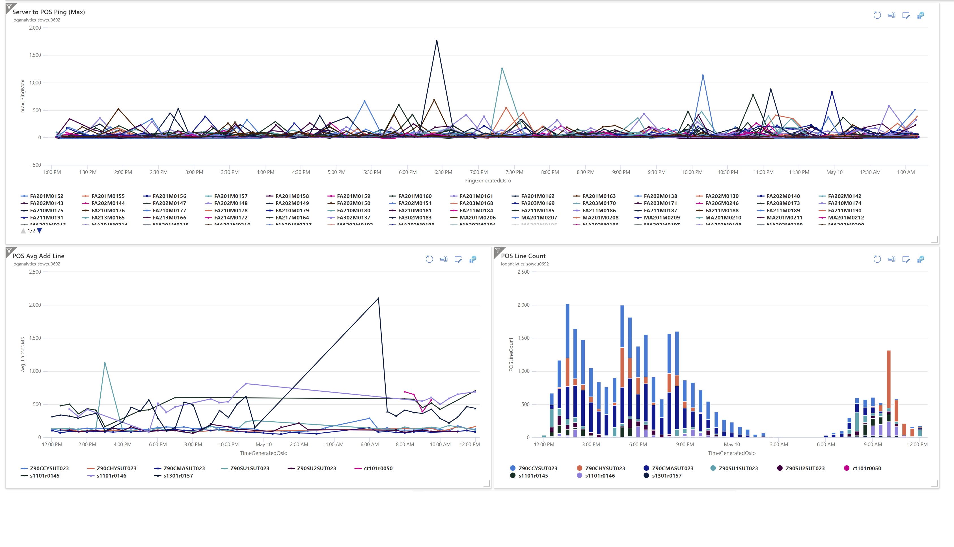

Slide 43
Summary
Eliminate ambiguity/external factors
Set a clear goal for improvement
Use the appropriate tool
It’s a continuous effort
It’s a collaboration

Slide 44
Thank you
Who has the first question?

Slide 45
!IMPORTANT!
The “an Aptos company” version is the main version to use. Only use the logo without it if the logo is very small.
Primary
Secondary
Primary
Secondary

Slide 52
Desktop/POS

Slide 53
POS/Tablet

Slide 54
Tablet/surfacePro

Slide 55
Tablet/iPad

Slide 56
Mobile

