Slide 1
Make payments easier with LS Pay in
LS Central and Business Central
Jennifer Oddo – Director of Consulting, Americas

Slide 2
Offering EFT integrations to the leading PSPs, in all our main market regions
Allowing our customers
to have a choice

Slide 3
65+
50+
Payment integrations
Supported countries
330
35
Customers
Countries

Slide 4
Some of our customers

Slide 5
What’s new in LS Pay?
Adyen - Tap2Pay
SoftPay – Support for tips
Gift Cards – POS support
New online documentation

Slide 6
New PSPs
Multipay
DNA Payments
Straumur
Teya
RazorPay
Geidea
AltaPay
Fawry
BNP Paribas

Slide 7
Payment Service Providers (PSPs) Americas

Slide 8
Payment Service Providers
Supported
Roadmap
Adyen
Planet
Elavon
Credibanco
Redeban
JPMorgan Chase
FreedomPay
Shift4
Stripe
Global Payments
Transbank
TD Merchant Services
Moneris
Verifone
TBD (MX)
WorldPay

Slide 9
How to request new Payment Service Providers?

Slide 10
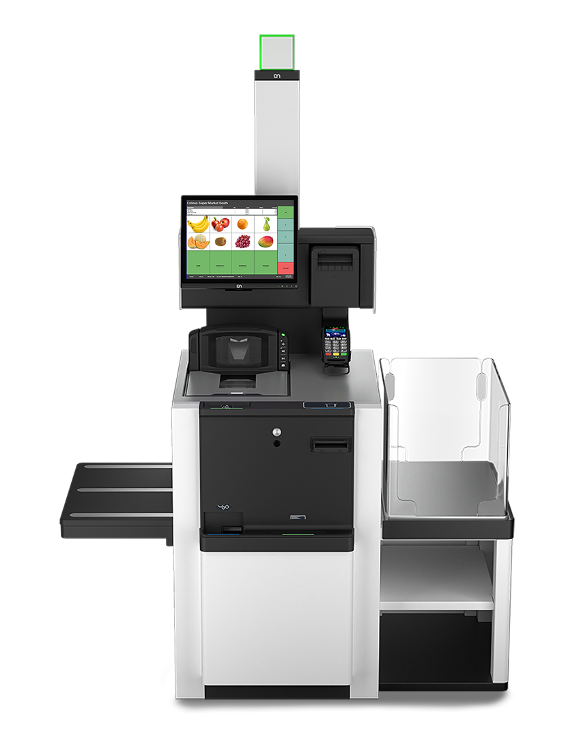
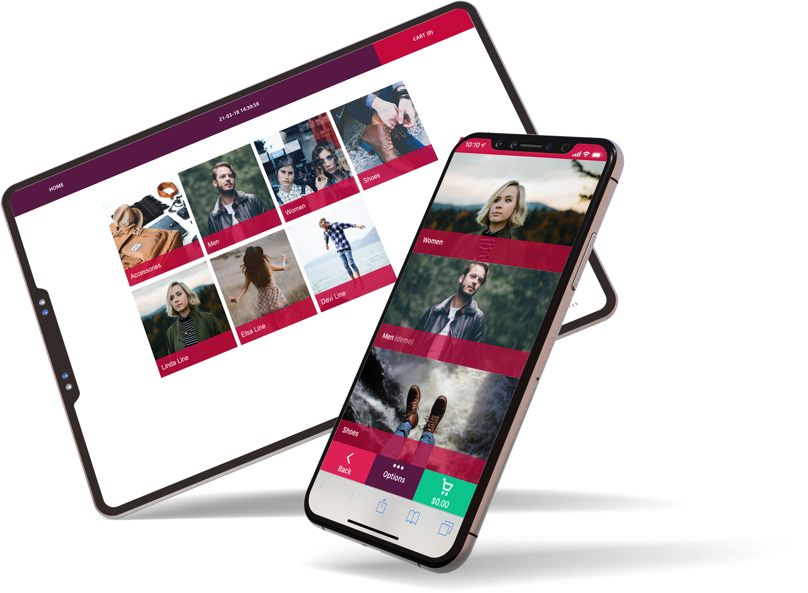
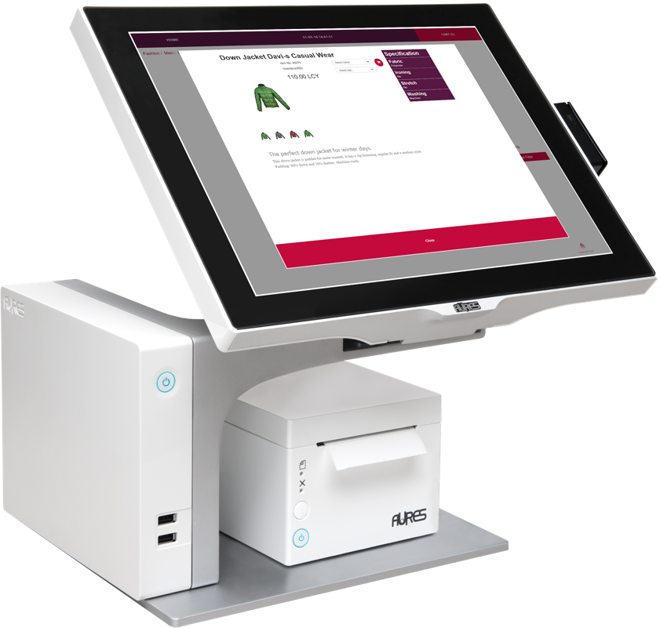
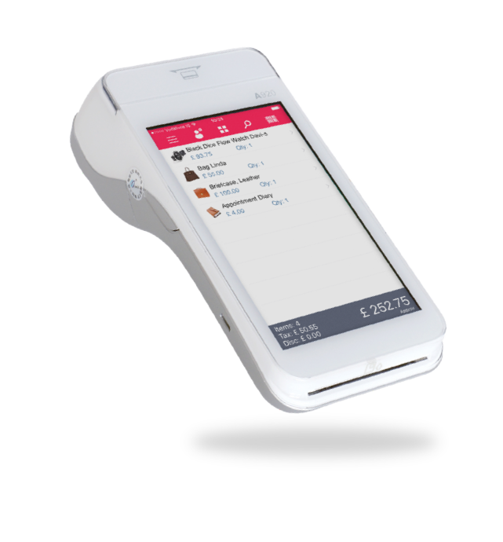
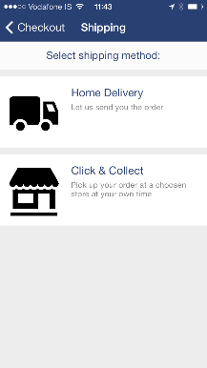
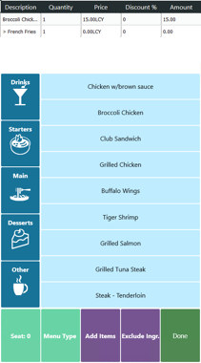
Supporting all POS platforms

Slide 11
LS Pay for Business Central
Payment support for standard Sales Documents in BC
Published as the LS Pay app on the Microsoft AppSource

Slide 12
Our target group…
LS Central merchants requiring back office payment support
Standard Business Central merchants
Not having a point-of-sale system
Requiring payment support
Card present & card not present

Slide 13
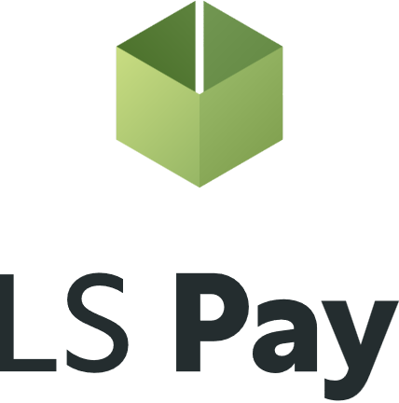
LS Pay – Core engine
Adyen
Elavon
Planet
Freedom Pay

Slide 14
Introducing the LS Pay Service
Adyen
LS Pay Service
Elavon
Planet
Freedom Pay

Slide 15
Introducing the EFT Extension
Payment refactoring in the LS Central POS
Contains all payment logic and dialogs for EFT payments
Exposes a payments API that the POS, BO and HO can interface
Connects to the LS Pay Service
A generic Business Central extension
Business Central
LS Central & LS Express
LS Central
POS
BO
HO
Call Centers
EFT Extension
LS Pay Service

Slide 16
Business Central
Business Central
LS Pay App
EFT Extension
Partner App
EFT Extension
LS Express
LS Central
LS Pay Service
POS
BO
HO
Call Center
POS
BO
EFT
Extension
EFT Extension

Slide 17
Two deployment options
#1
#2
Business Central
Business Central
LS Pay App
EFT
Extension
Partner App
EFT Extension

Slide 18
Available on the Microsoft AppSource

Slide 19
Supported features
EFT Extension for partner apps
LS Pay App
Card present payments & returns
Sales orders
Sales return orders
Sales invoices
Sales credit memos
Card not present payments
Manual card number entry
Multiple tender types
Cards, cash, cheques & customer accounts
Payment profiles
Cloud based logging

Slide 20
LS Pay for BC Demo

Slide 21
Licensing
Same licensing model as with LS Pay for LS Central
The number of LS Pay licenses equals the number of connected pin pads (PEDs)
Pricelist available on the LS Retail portal

Slide 22
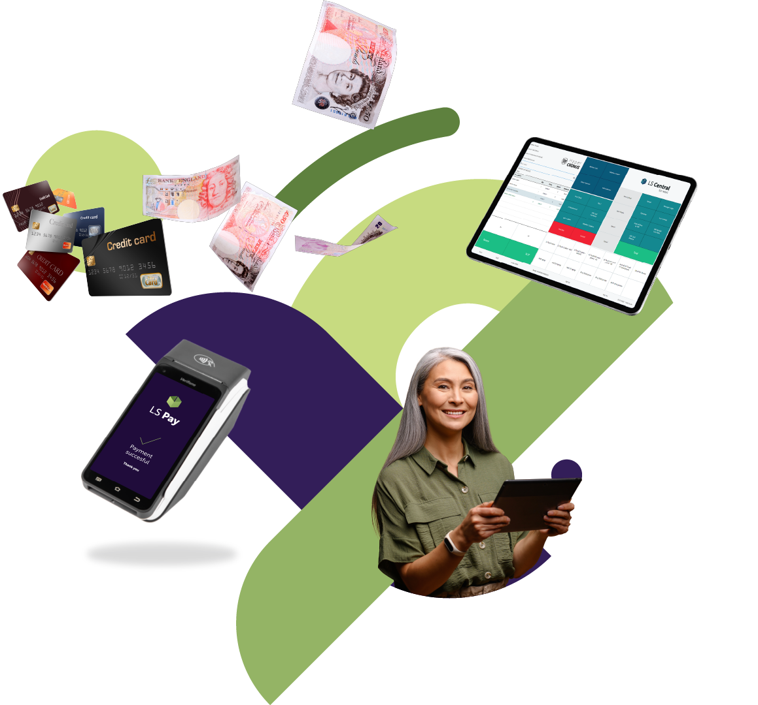
Security
LS Pay is out of scope for PCI DSS related vulnerabilities
LS Pay is out of scope for PCI DSS certification

Slide 23
Roadmap – LS Pay for BC
Card not present transactions
Online payment links
Virtual terminals (PEDs)
UI streamlining
Document copying to returns, etc.
Partner requests
Leaving room for partner requests and needed features
Additional PSP support (demand driven)
Service orders
eCommerce orders
Customer accounts
Invoice grouping
Card on file
Pre-authorizations and full captures
Extending time periods of pre-auths
Adjusting pre-auth amounts
Cancelling pre-auths

Slide 24
Roadmap - LS Pay
EFT Extension for LS Central POS
Adyen – Tap2Pay
Installments – BR & MX
LS Academy course for LS Pay
Gift card support on the LS Central POS

