Slide 2
LS Central for forecourt
Run fuel sales, F&B, and c-stores with LS Central for forecourt
Bjarni Asmundsson – Regional Director APAC
Johann Sveinsson – Senior Developer
Olafur Jonsson – Principal Product Owner

Slide 3

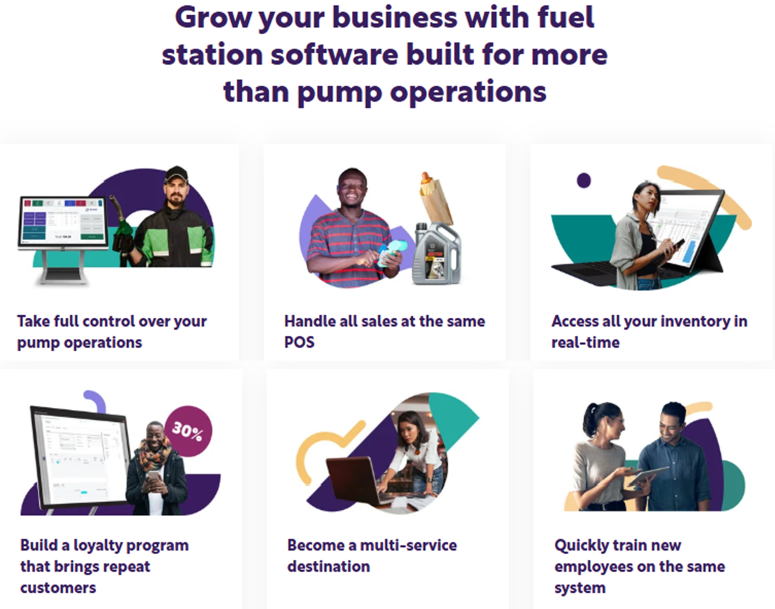
Agenda
Evolution of gas stations
POS and Pumps
Fuel and loyalty
Wet Stock Management
Fuel replenishment
OFT – How we develop forecourt
Questions
The forecourt solution of the future

Slide 4
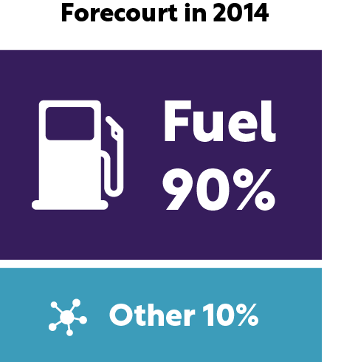
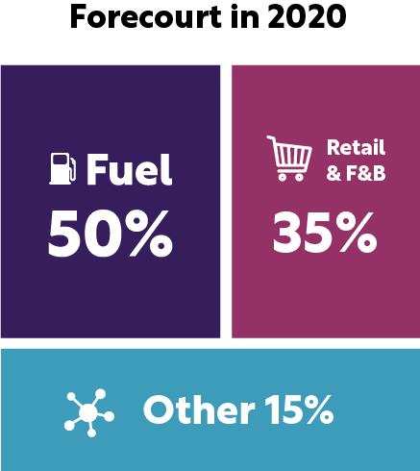
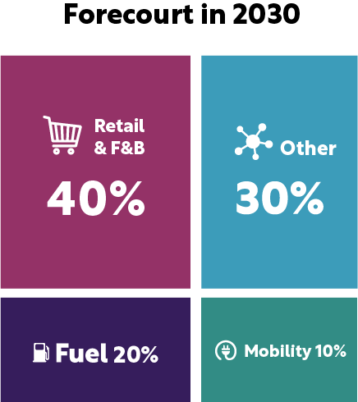
The evolution of gas stations
*KPMG, May 2020, Fuel Forecourt Retail Market

Slide 5


Customer experience
The fuel retailers that thrive will be those that deliver compelling experiences and environments for their customers

Slide 6

Gas stations future needs
Ability to connect to pumps and sell fuel
Handle retail, fast food, and other services, like:
  High end restaurants
  Luxury cafes
  Pharmacies
  Parcel pick-up points and different services
With multiple payment options
Can a single platform handle that?

Slide 7
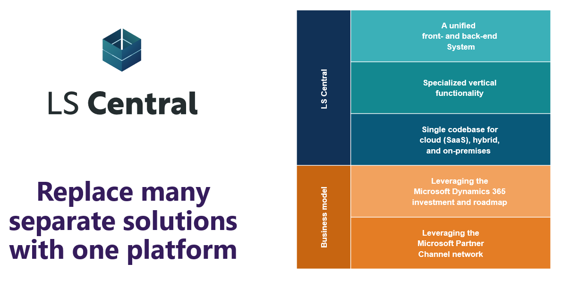
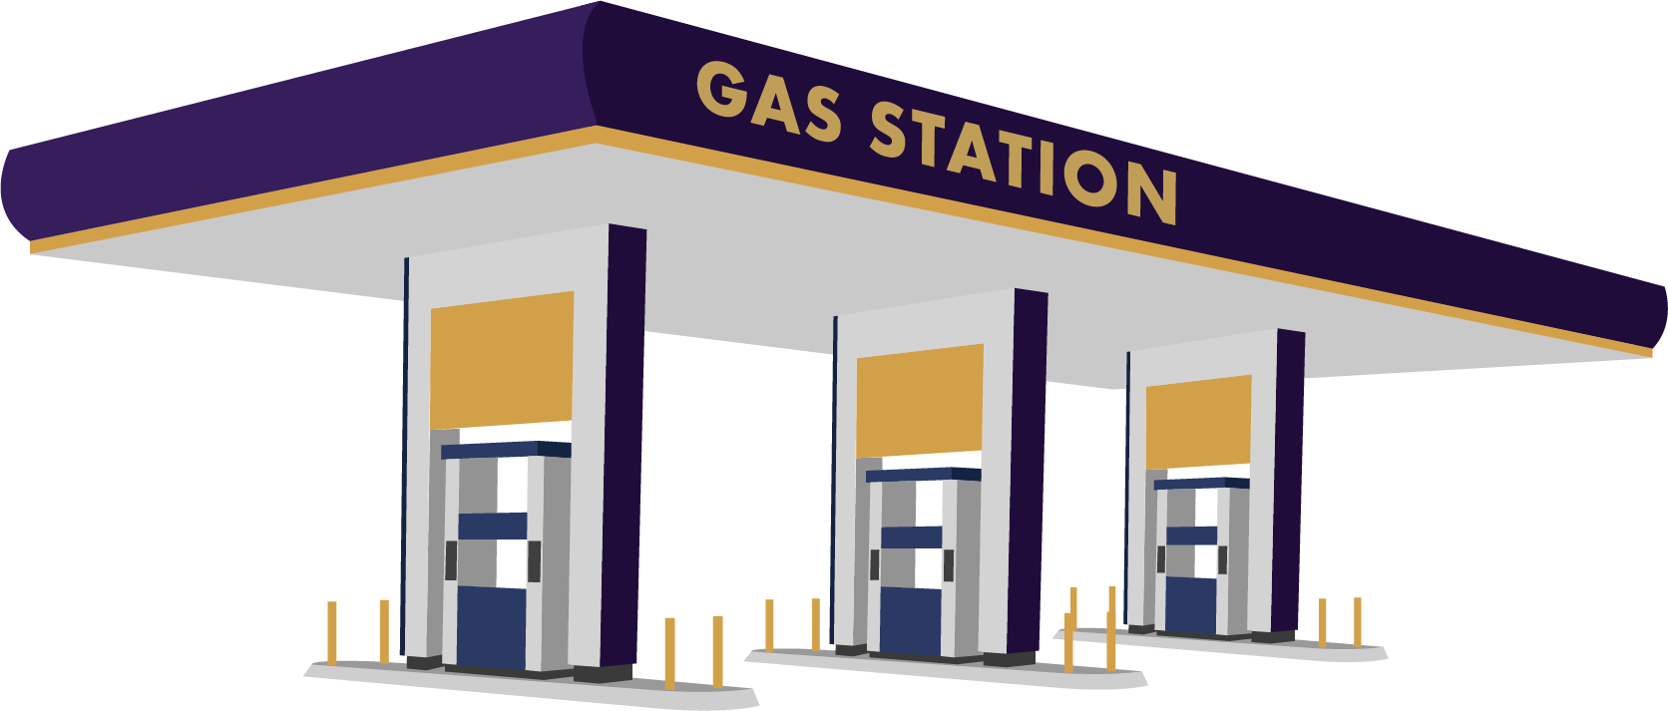

LS Central for forecourt
?

Slide 8

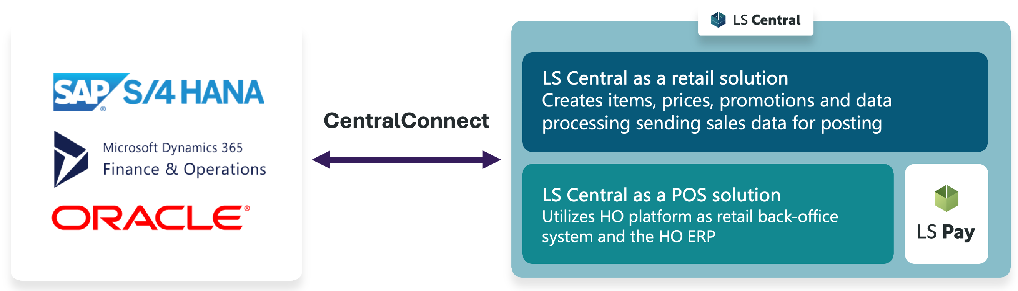


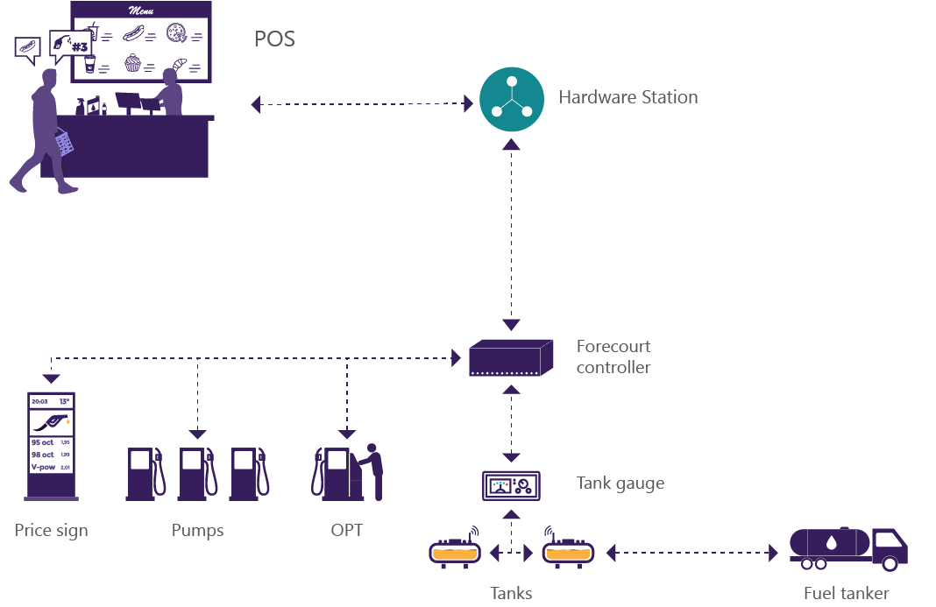

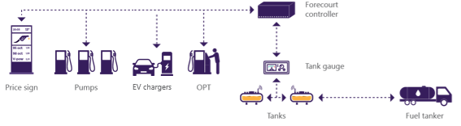
LS Central for forecourt
End-to-end solution for fuel retailers
CentralConnect
Pump control in POS with ability to sell fuel and communicate with pumps
POS
Hardware
station
Forecourt tank journal framework to handle forecourt data using Business Central orders for transfer and purchase of fuel between depot and stations
Forecourt
controller
Tank gauge
Price sign
Pumps
EV chargers
OPT
Tanks
Fuel tanker

Slide 9
LS Central for forecourt
POS in a browser connecting to pumps
LS Central POS connects to pumps through Forecourt controller
Forecourt controller connection is a part of the Hardware Station for LS Central:
  Allows for the communication from POS to different forecourt controllers.
  Plugin specially made for each forecourt controller type.
  Plugins for other controllers need to be created by a partner or in a consulting project with the LS Retail Consulting team.
POS
Hardware
station
Forecourt
controller
Tank gauge
Price sign
Pumps
EV chargers
OPT
Tanks
Fuel tanker

Slide 10
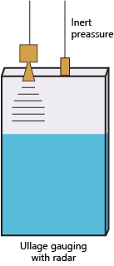
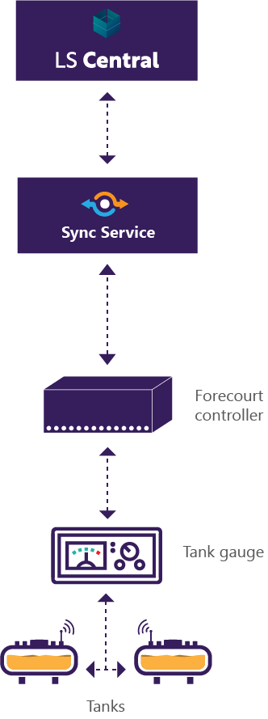
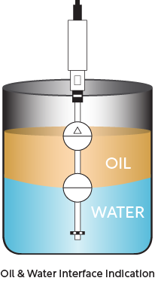
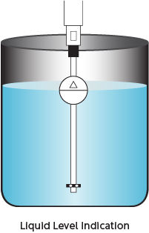
LS Central for forecourt
ATG connection – how much fuel is in a tank ?
The solutions can connect to ATG system through the Forecourt controller (*).
Each Forecourt controller type has a list of what ATG protocols they support.
(DOMS support 23 protocols, many manufacturers use same protocols)
(*) data availability depends on info from the forecourt
ATG information can be read from the tanks,
at a specific scheduled interval, and stored in
LS Central.
  Date of dip / Time of dip / Tank number / Grade name / Dip reading / User
Tank dipping information can then be sent to 3rd party systems or be used in the LS Central system.

Slide 11
LS Central for forecourt
Fuel banner in the LS Central POS
Opens a banner on top of the LS Central POS
The banner displays status of fuel pumps and handles communication from the POS
Allows POS user to do various Pump Controller operations
  Authorizing pumps
  Stop and start pumps
  Possible drive-off detection
  Handle fuel sales from inside the store

Slide 12
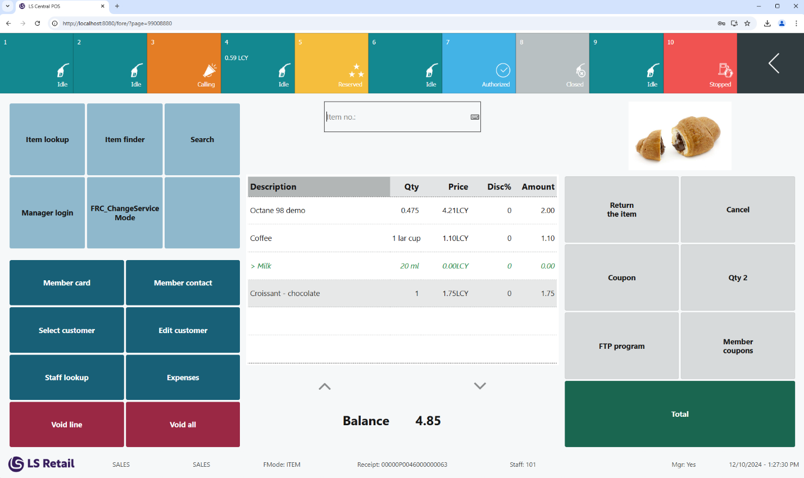
Fuel sale with retail items

Slide 13
Loyalty programs in fuel retail
Various types of loyalty programs
  Points-based rewards
  Discount programs
  Subscription plans
  Partnered credit cards
  Fleet & business programs – Special incentives for corporate and commercial fuel purchases
LS Central powerful loyalty management
Examples from customer projects

Slide 14







#1 - Price Calculation in LS Central
Payment on the pump
Member Key is scanned on the pump
Forecourt controller calls with web request into LS Central
LS Central finds the best amount discount from fuel unit price for the member
New price per liter is displayed on the pump
Payment in the store
Quantity and price from the pump is coming into the POS
Member Key is scanned and validated in
LS Central
LS Central delivers best unit price for the member to the POS
Web Request: Get discount from Unit Price
Get discount from Unit Price
Forecourt controller
Hardware Station
Scan Member Key

Slide 15
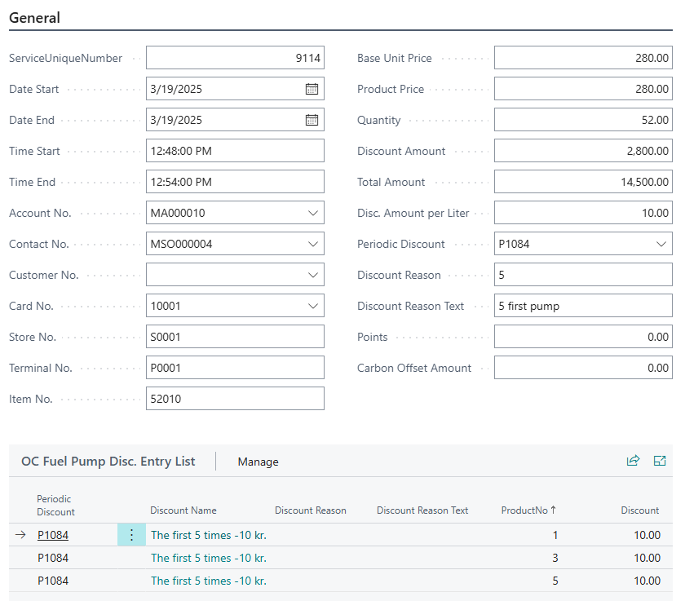
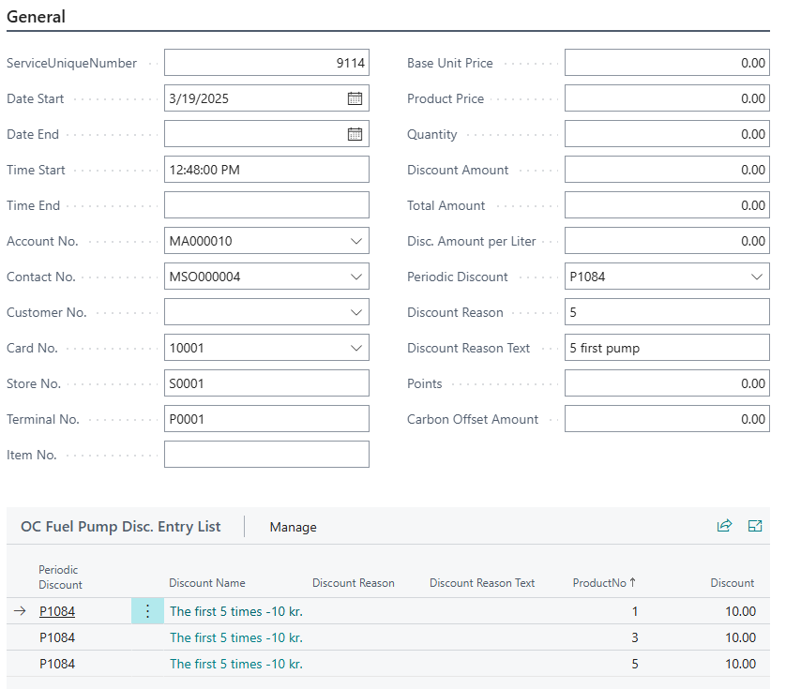


#2 - Price Calculation in LS Central
Forecourt controller
Pump
Hardware Station
Get Member Discount
Find best fuel discount
for the Member
Amount Discount from Unit Price
Create record in Fuel Pump Entry
Display new fuel unit price
Post Fuel Transaction
Update Fuel Pump Entry
Modify Fuel Pump Entry

Slide 16
#3 - Quantity and Fuel Restrictions
Forecourt controller
Customer restriction can be for example:
  Fuel type
  Max quantity/Amount to purchase
In LS Central the restriction is stored for the member
Web Request is coming into LS Central with the member number
Fuel Pump Entry is monitoring the purchase and the restriction for the member
Pump
Hardware Station
Get Member Discount
Find member restriction
Amount Discount from Unit Price
Create record in Fuel Pump Entry for the member
Open/close pump. Max Amount to purchase
Post Fuel Transaction
Update Fuel Pump Entry
Modify Fuel Pump Entry with fuel quantity

Slide 17




#4 – Harbor pump integration
Pump at the harbor for the fishing boats
Customers have an account and must be recognized at the pump with a key
All transactions from the pump contains a customer key
In LS Central invoicing for the customers is scheduled.
Forecourt controller
Pump at the harbor
Get pump entries from the pump
Integration task
Create record in Fuel Pump Entry for the Customer
Calculate balance for the customer and send invoice

Slide 18
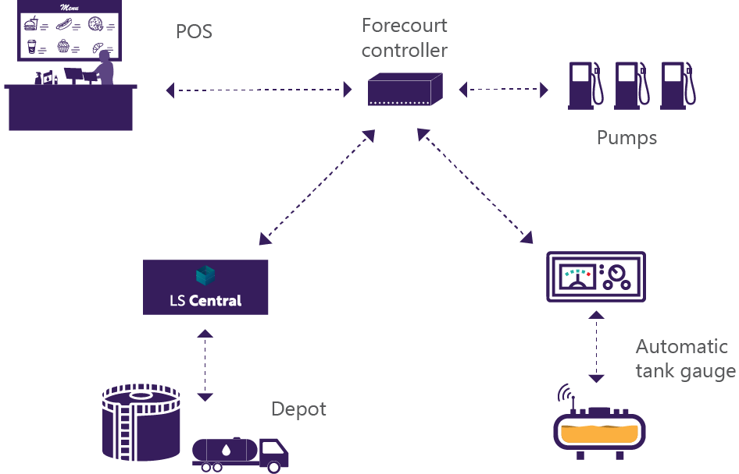
LS Central for forecourt
Wet stock management *
All wet stock data is available in BO
  Fuel sales
  Fuel deliveries *
  Tank gauge readings *
  Purchases / Transfers *
  Can be used in processes like wet stock reconciliation or delivered to external system that handles wet stock
  * data availability depends on info from the forecourt
Standard liter
  System calculates standard liter amount (15C) *
  In transactions stores both actual/standard liter if available
Fuel deliveries and replenishment
  Implementation depends on processes at customer
* Note: Wet stock management is a framework that can be enhanced for customers at request

Slide 19
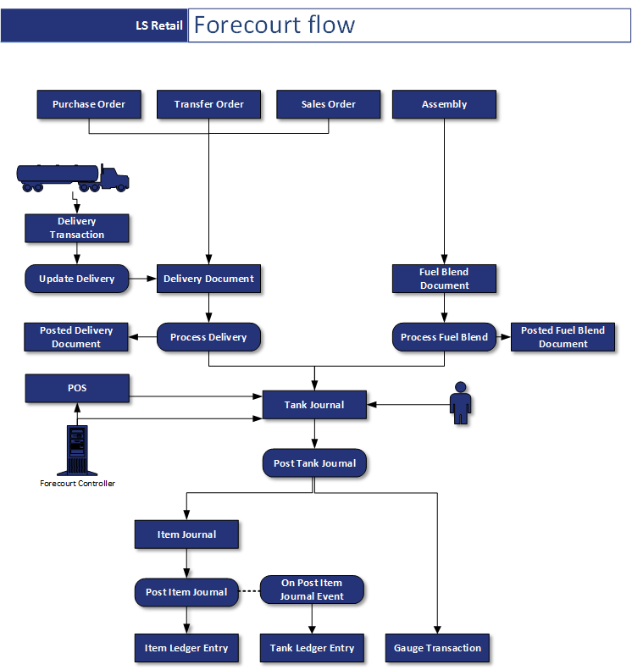
LS Central for forecourt
Forecourt tank journal framework
Framework to handle Forecourt data
  Fuel sales
  Fuel deliveries
  Fuel blend
  Tank gauge readings/entries
  Wet stock manual adjustments
Uses different types of BC orders to handle the Forecourt flow
  Transfer orders - Transfer orders are used when transferring stock between storage tanks.
  Purchase orders - Purchase orders are used when receiving fuel to a location i.e. depot and store.
  Sales orders - Sales orders are used when the truck is delivering fuel to customers.
  No document - It is also possible to have no document attached to a delivery, in which case the stock is updated using Item Journal.
Handling of Forecourt flow at customer needs to be defined in exploratory sessions

Slide 20
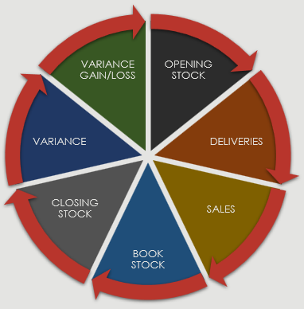
LS Central for forecourt
Wet stock reconciliation
Wet stock data available in BO
  Fuel sales
  Fuel deliveries *
  Tank gauge readings *
  Purchases / Transfers *
  Can be used in processes like wet stock reconciliation or delivered to external system that handles wet stock
  * data availability depends on info from the forecourt
Base for Wet stock reconciliation
  Book stock = Opening stock + Deliveries - Sales
  Variance = Closing (measured) stock – Book stock
Wet stock variance is booked accordingly
“Trend” in Wet stock variance can be detected and acted on
Wet stock reconciliation can be performed in LS Central or customer's head office platform

Slide 21
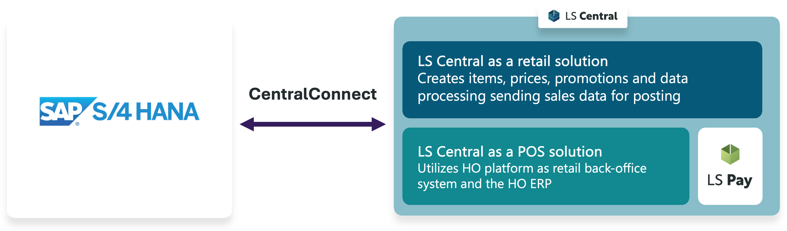
LS Central for forecourt
Fuel replenishment

Slide 22
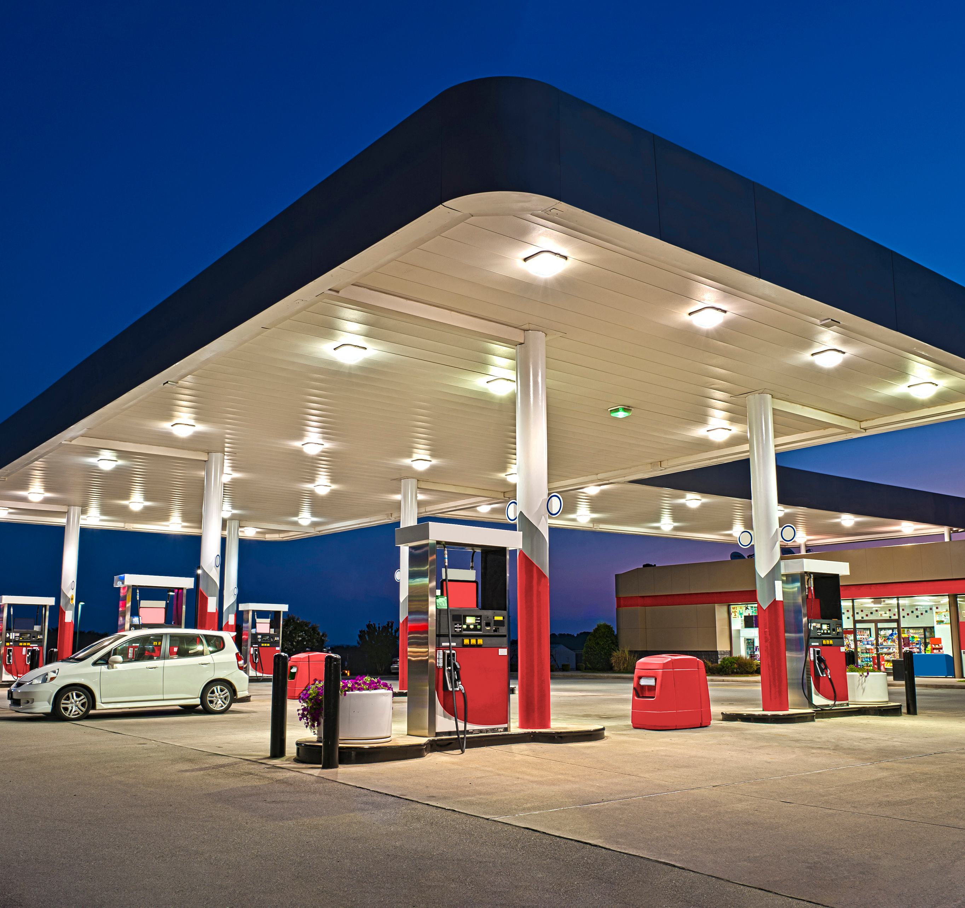

OFT
One Forecourt Team

Slide 23
Virtual organization
To enhance internal teamwork and meet market demands
  Make sure resources are used efficiently and effectively
  Keep a close eye on current customers
  To align our products with market needs
OFT Members:
  Bjarni Asmundsson: Regional Director
  Olafur Jonsson: Principal Product Owner
  Johann Sveinsson: Senior Consultant
  Deena Frye : Principal Consultant
  Asta Margret Karlsson: PMO Director
  Giada Pezzini: VP Marketing
Working directly with selected and strategic customers
The team's aim is to streamline our processes, enhance our service offerings, and improve our products. Our goal is to ensure we deliver top-notch solutions to our customers. Working with this team gives customers opportunity to give direct feedback into product development.

