Slide 1
Run successful events with Bookings for LS Central
Anna Dis Thorvaldsdottir
Consulting Manager
Alejandro Vazquez
Principal Consultant

Slide 3
Managing an event
Quote
Reservation
Operating event
Payment

Slide 4
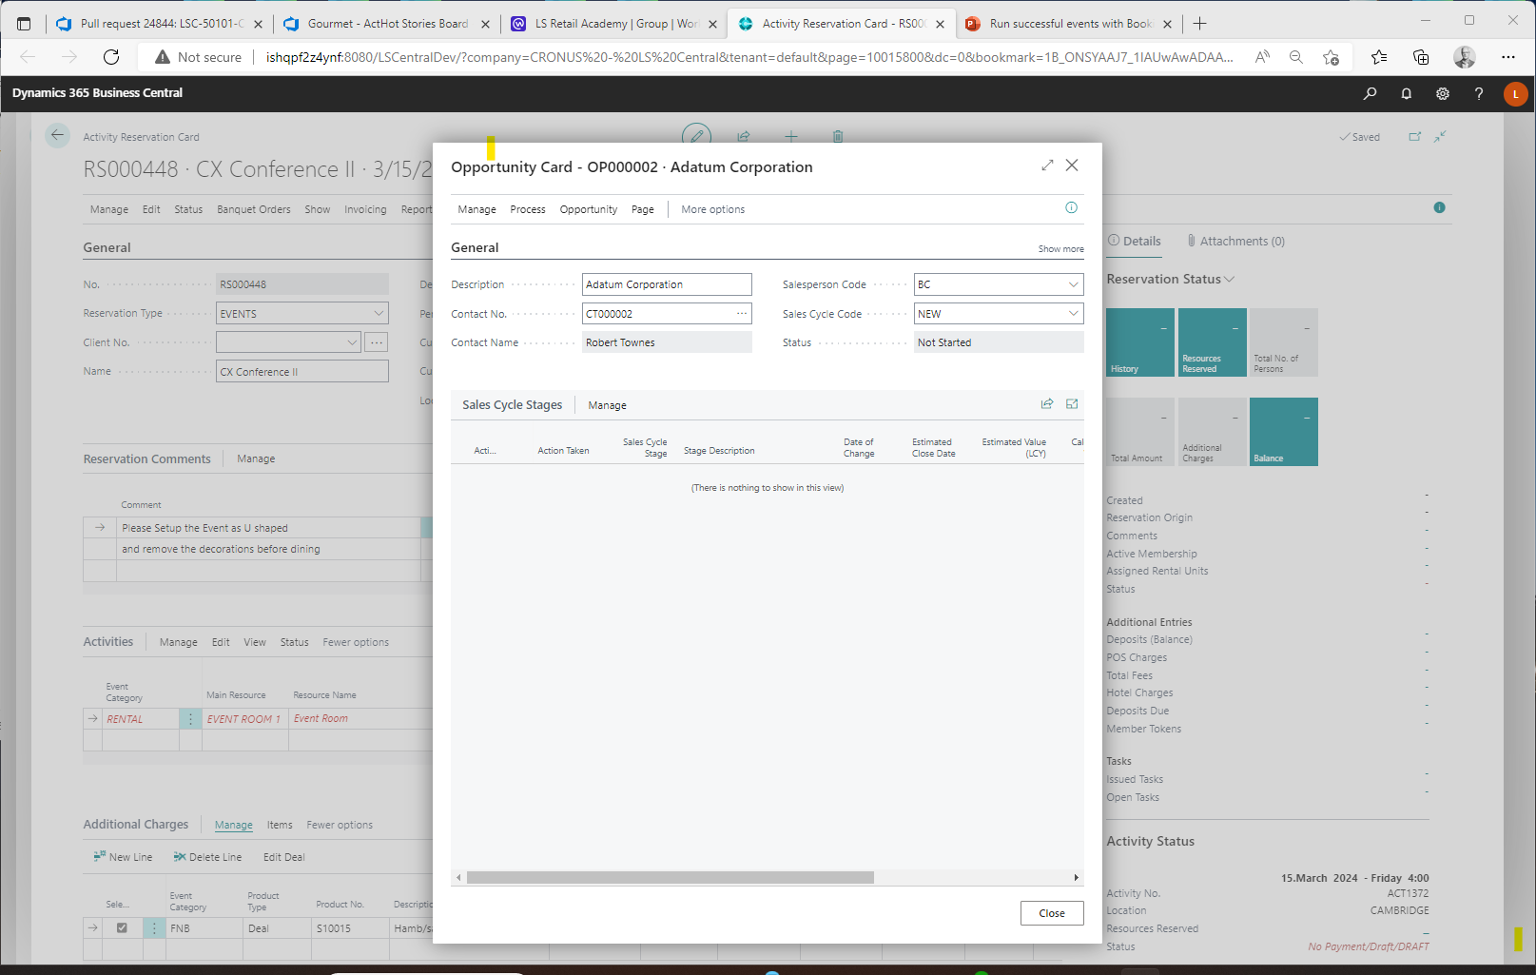
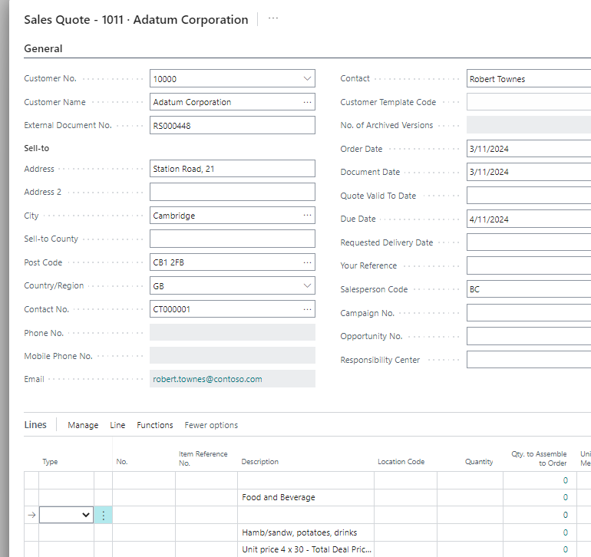
Banquet Events – The presale process
Standard BC functionality:
CRM (Opportunity)
Create Opportunity
Linked to a reservation
Manage sales cycle
To Do's/Emails
Communication Mgmt
Quote
Create BC quote

Slide 5
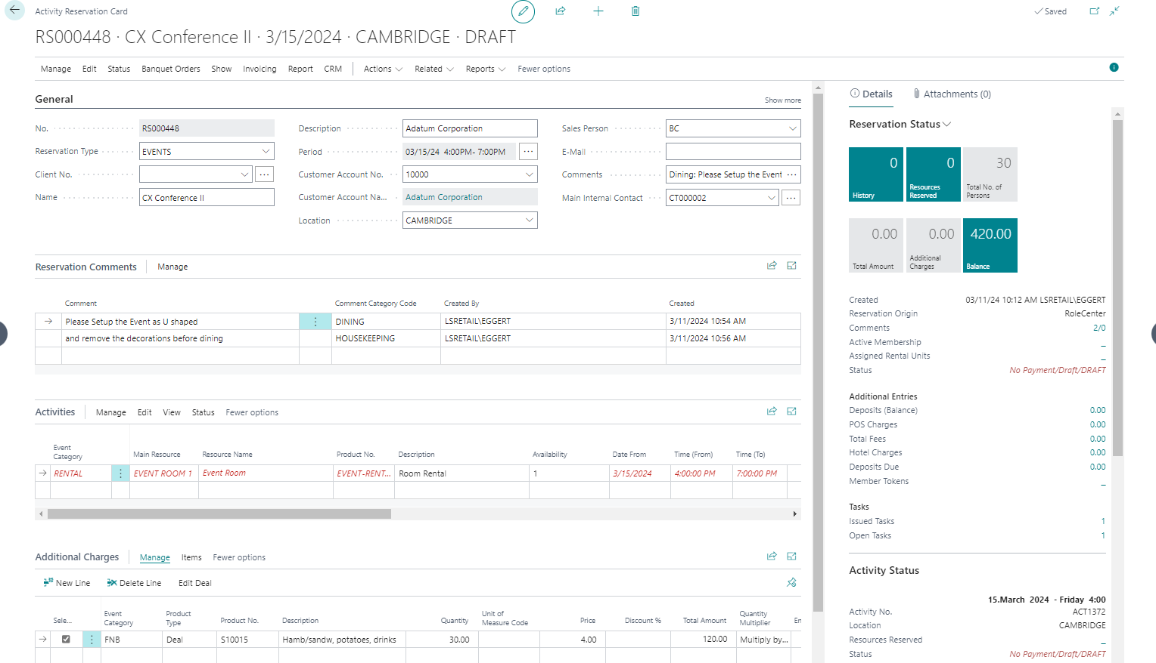
Banquet Events – The Reservation
Reserve and charge for
Event Rooms
Equipment
Human Resources
Items
Food & Beverage
Menus & deals
Track comments and requests
Assign responsibilities
Issue and monitor tasks

Slide 6
Banquet Event: Versioning and change tracking
Track all changes during the lifetime of the event reservation and notify the responsible parties if needed.
Group the reservation entries into Banquet Categories, i.e. AV, F&B, RENTAL, and define the layout of the BEO (banquet event order).
Version Control of the reservation and changelog of all reservation changes, including rooms, prices, quantities and comments.

Slide 7
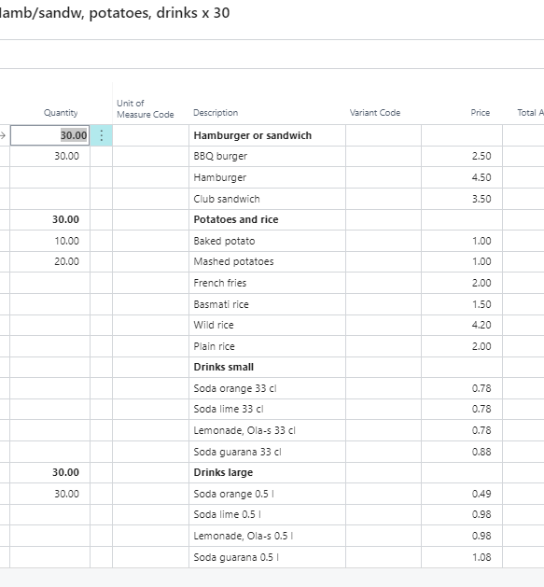
Menu & deal handling
Use F&B deals to setup menus and offers
Preselect menu options for catering
Client selects menu options for a la carte
Using allowances
Cost calculations
Compress menu content details at POS

Slide 8
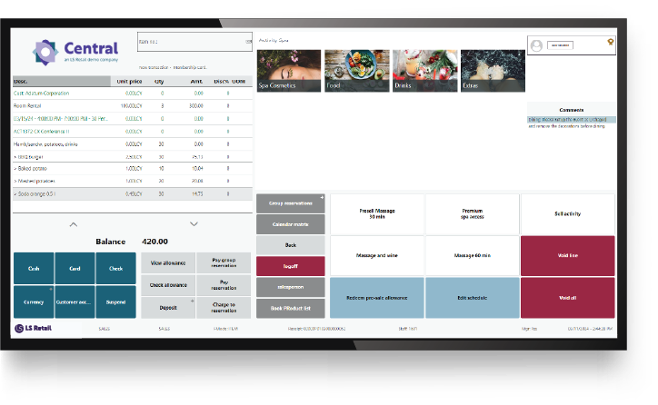
Finalizing and Payments
Finalizing of event reservations using
Point of Sale
BC Sales Invoice
Token (Pre-authorization) handling
Deposit management
Deposit policies
Cancellation & refunds
Cancellation policies

Slide 9
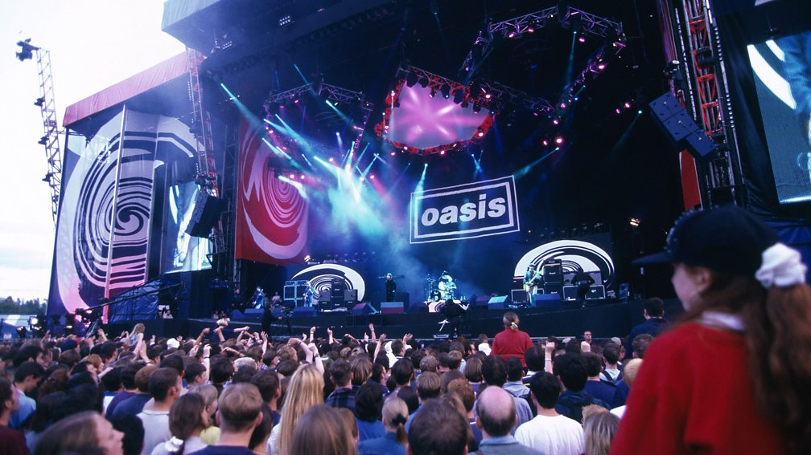

Slide 10
Event Management: Stadiums & shows
Reserve resources and charge for
Suites
Equipment rental
Items
Food & beverages
Menus & deals
Keep track of multiple event related reservations under one "umbrella"
Pre-allocate resources
Can then only be reserved by event related reservations
Issue and monitor tasks
Set charge restrictions based on event

Slide 11
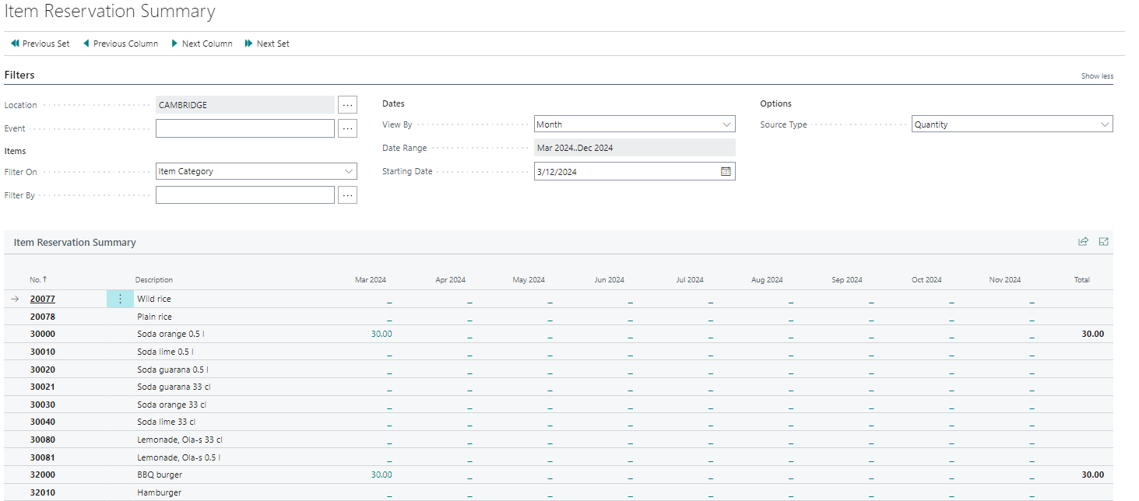
Analysis and summaries
Summary of item/deal reservations
Cost Amount
Quantity
Sales Amounts
Periods – years, months, weeks, or dates
Per Event
Per Item Category
Per Product Group
Per Special Group
Per Deal / Menu
Cost Reports
Per Reservation
Per Event
All general reports in BC/LS Central
Sales
Inventory

Slide 12
Banquet Events and Event Management demo

Slide 13
Event Management v25
Cost management
Quotes
Invoiced
Task defaults for event types
Banquet event category
Cost Management

Slide 14
What are events?
Banquet Event Orders (BEO management)
Conferences/Weddings
Meetings/Celebrations
Event management (Stadiums/Venues)
Concerts
Sporting events
Theater and shows

Slide 15
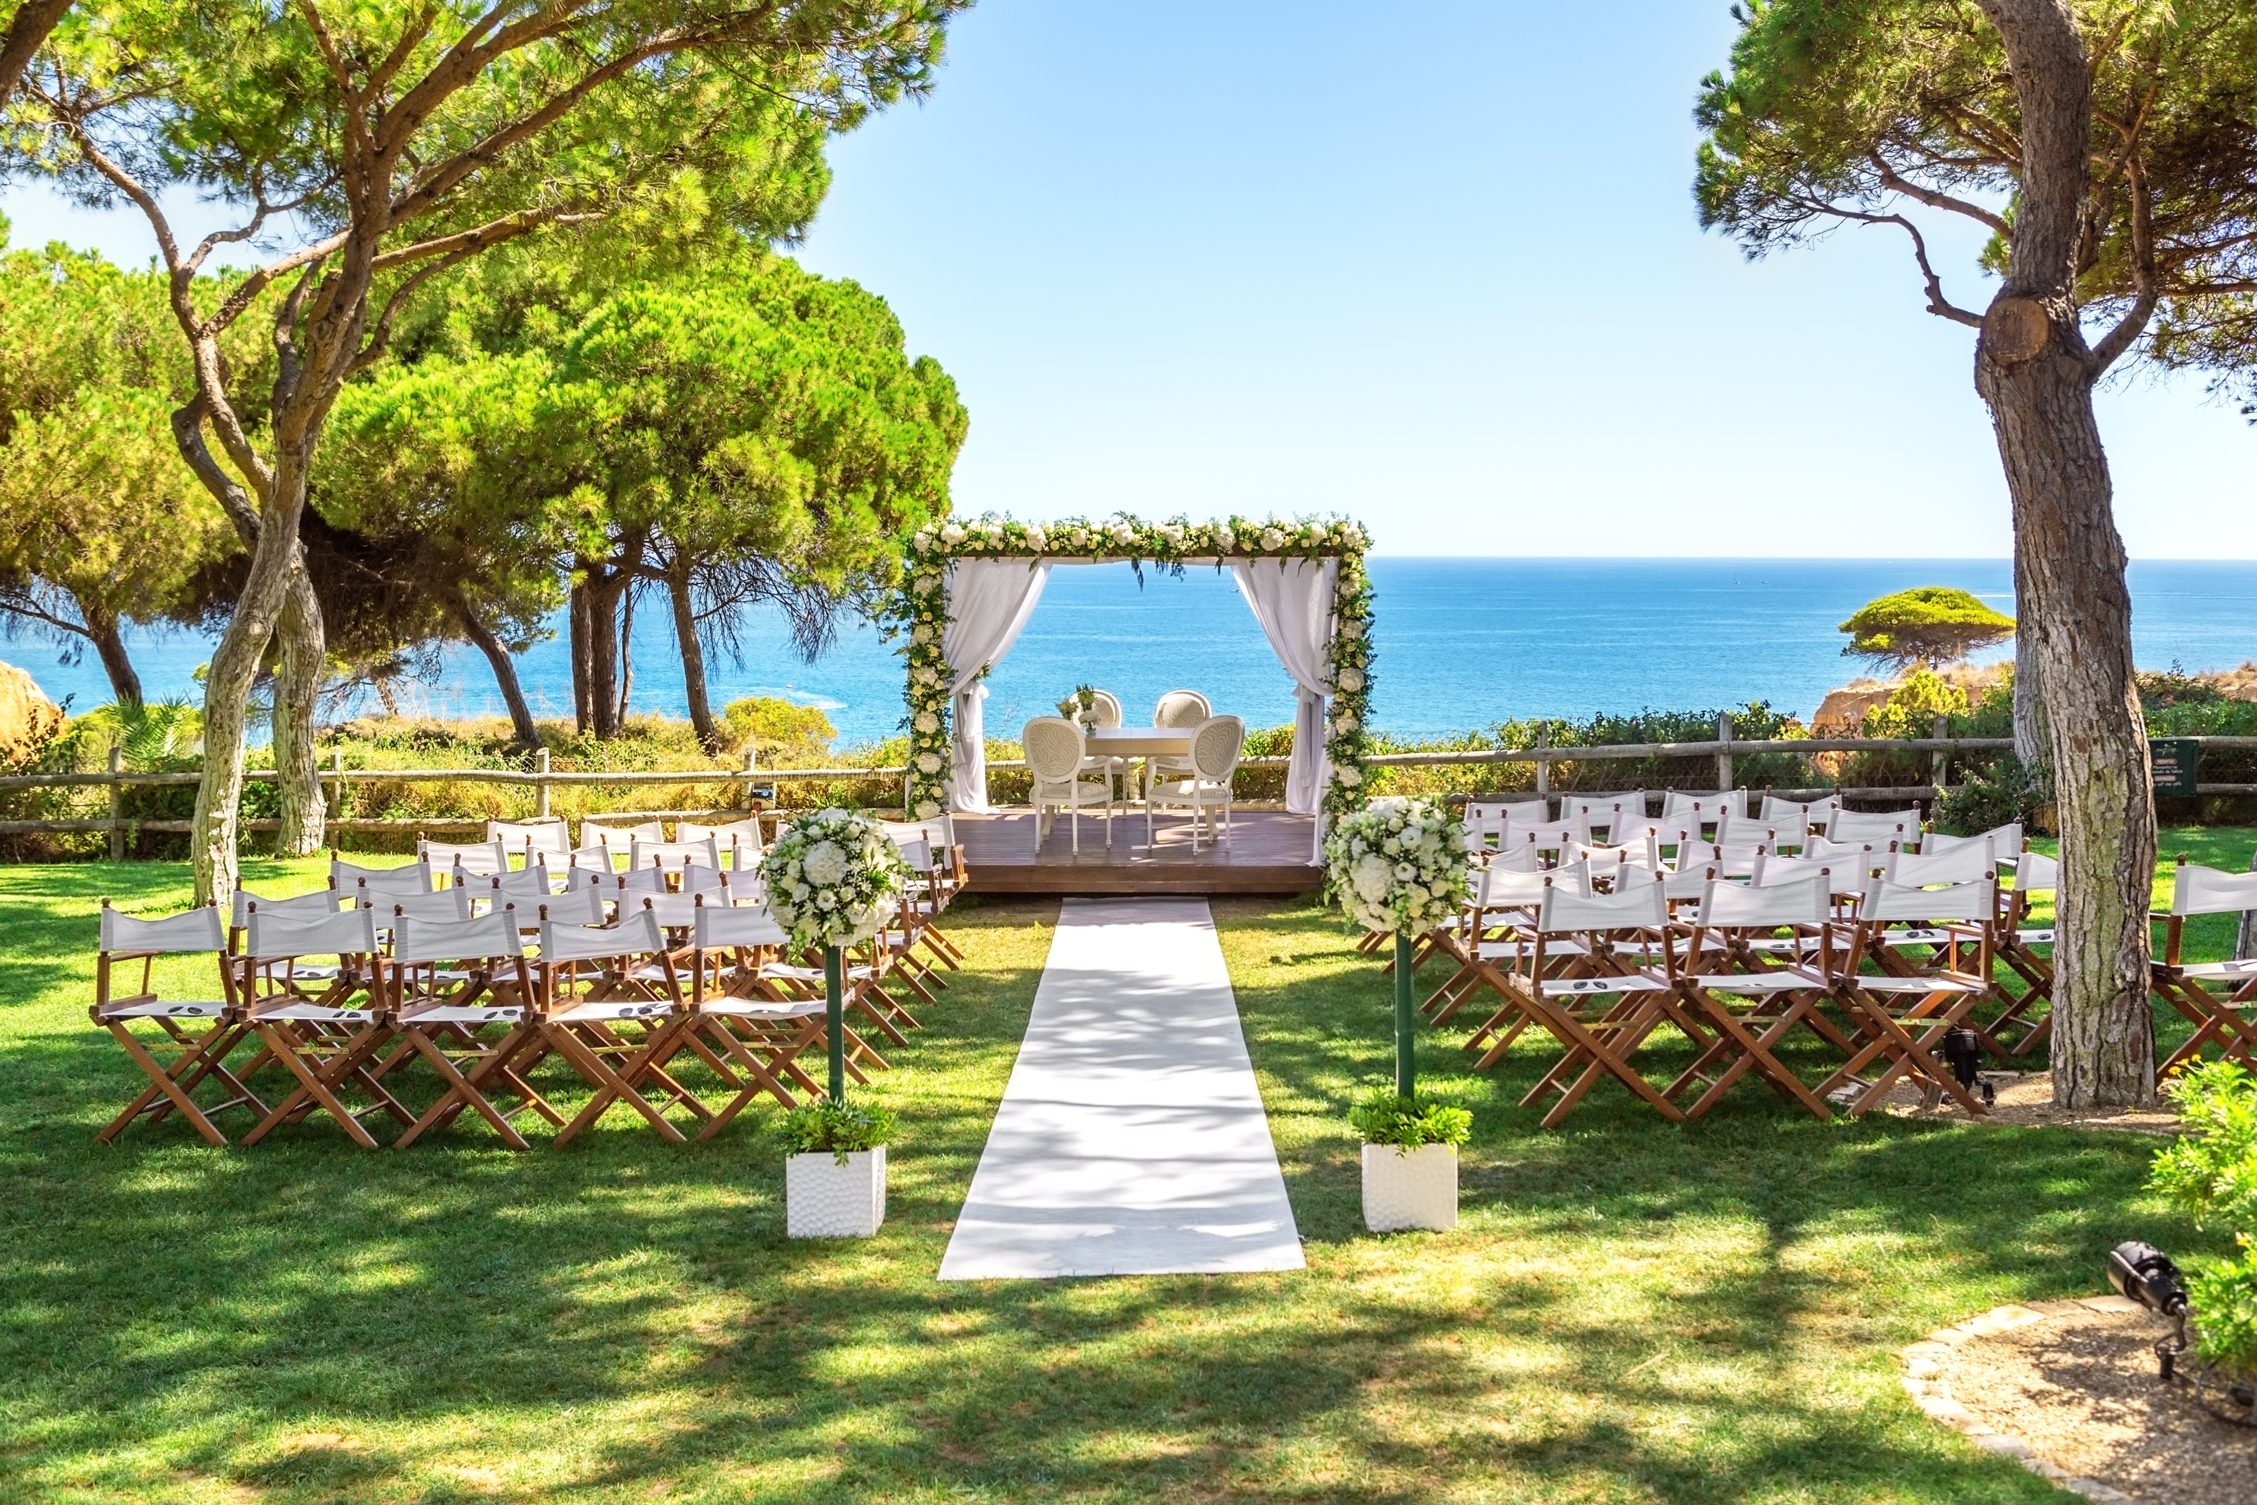
Questions?

