Slide 1
LS Central for pharmacies
Building the future of pharmacy
Einar Pall Gudlaugsson einargu@lsretail.com

Slide 2
LS Central for pharmacies ǀ 1.150 stores in Scandinavia
550+ stores in Sweden with Kronans
Kronans and AG now merging as the third biggest pharmacy chain in Sweden
A large eCom footprint, with shipping directly from the warehouse to the customer's home
600+ stores in Norway
NMD (Vitus & Ditt brands) now fully rolled out
AHN (Boots) now fully rolled out
Both with a mix of own and franchise pharmacies

Slide 3
Global availability with SaaS
Now present in 7 countries
Bulgaria
Georgia
Iceland
Norway
Sweden
Trinidad and Tobago
UK
(alphabetical order)

Slide 4
“The main benefit for us is that all information is now the same across stores, and we can control and manage it centrally.
Once the rollout is complete, we will fully integrate the entire omnichannel ecosystem, including our e-commerce platform.
This will also enable us to implement initiatives like Click & Collect and self-checkout across the chain and manage everything from within LS Central”
Svein Faksvaag Retail Director
150 pharmacies across Norway
6 months from kick-off to a live pilot store
14* months from kick-off to completing roll-out (*paused roll-out for 1 month during December)
Various integrations
Including SAP, Relex and Voyado
Additional 28 franchise pharmacies
https://www.lsretail.com/customers/boots

Slide 5
A part of the LS Central ecosystem
LS Central for pharmacies is a fully integrated part of the LS Central ecosystem
One base for the world
Country localizations for ePrescriptions and integrations to each countries National Health Administration or Insurance Companies
Easy to extend and customize for any eventuality
Customer Integrations
Country
Localization
LS Central for pharmacies
LS Central
MS Dynamics 365 Business Central

Slide 6
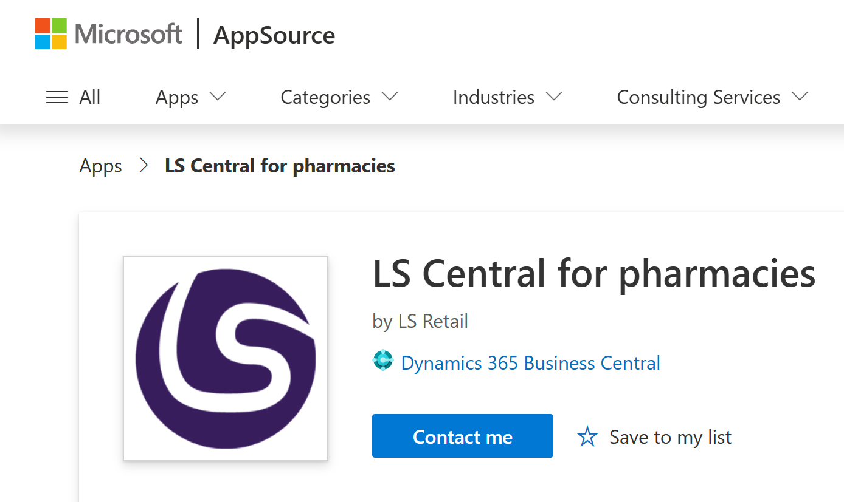
LS Central for pharmacies Light (W1)
Full featured pharmacy dispensing solution ready for use or extensions!
Customer Integrations
Already available in SaaS!
Country
Localisation
LS Central for pharmacies
LS Central
MS Dynamics 365 Business Central
Try it in our LS Retail Virtual Machines!

Slide 7
LS Central for pharmacies modular design
Head Office
Back Office
Front Office
Microsoft
Business Central Functionality
LS Retail Developed or Enhanced Functionality
Core ERP
Supply Chain / Logistics Mgmt
Commercial
Front-End Operations
Finance
Inventory Mgmt
Pricing/Promotions
Channel-Specific
Omnichannel
Supplier Mgmt
Personalisation
In-Pharmacy
POS
Loyalty Program
Accounting
Demand Forecasting
Sales Analytics
Store Performance
Cross channel returns
Human Resources
Retail
Retail
Staff Management
Merchandising
Range Planning
Prescription handling
Unified view of stock
Warehouse Mgmt
Product Recommendations
Prescription handling
e-commerce
Pharmacy
Pharmacy
Online Store Mgmt
Single customer database
Specific medication stock handling
Customer identification
Online User Interface
Medication master data
Medication search category
Prescription dispensing
A modular unified platform that holds all data providing “single view of the world”

Slide 8
Our Big, Hairy, Audacious Goal for 2025!
CATCH UP WITH THE LS CENTRAL DEVELOPMENT
How are we going to do that?
Creating the right team structure and processes to support growth
Focus on quality by refactoring our products
Customer-centric approach with a continuous product improvement plan driven by our User Forums

Slide 9
The right team structure and processes
LS Retail’s Pharmacy Development Team changes
Regional laws and regulation compliance
Support for current regions and future growth
“Coming together is the beginning. Keeping together is progress.
Working together is success.”
- Henry Ford
Product Director
Product Lead
Product Lead
Quality Lead

Slide 10
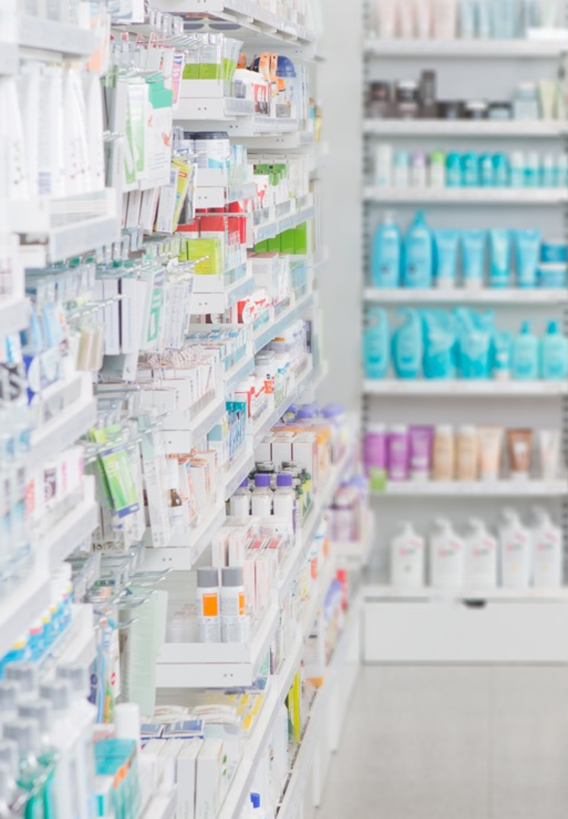
Focus on Quality
Extensive code refactoring
6.000+ Autotests in W1
Released for BC26
Localizations refactored and uprated
Norway – Q3 2025
Iceland – Q4 2025
Sweden – Q4 2025
Ready for our global partners to create their own integrations
GitHub contributions from partners in Q3 2025

Slide 11
Continuous Product Improvement Plan
Customer-centric approach with a continuous product improvement plan
Driven by our User Forums
Emphasis on improvements towards:
Pharma Expedition Flow
In-Store Operations
Adoptability
Mapping out possible benefits of introducing AI into workflows

Slide 12
Dispensing Robots
Integration soon available as an LS Retail Standard Product
Utilizing the WWKS2 communication standard
Two license modules:
Simple – Dispensing only
Full – Dispensing and Inventory

Slide 13
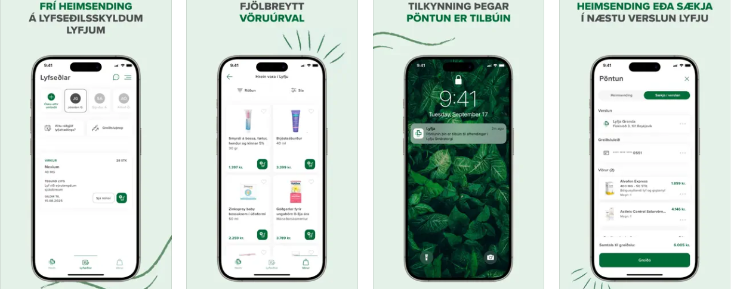
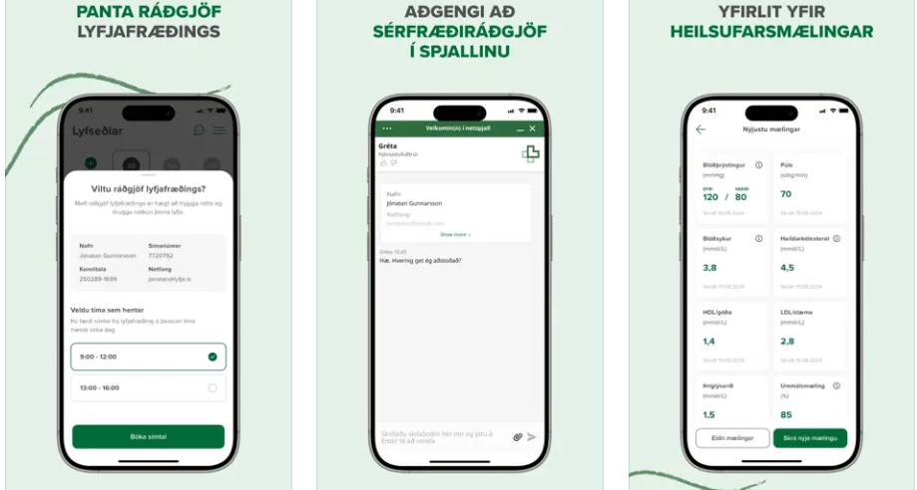
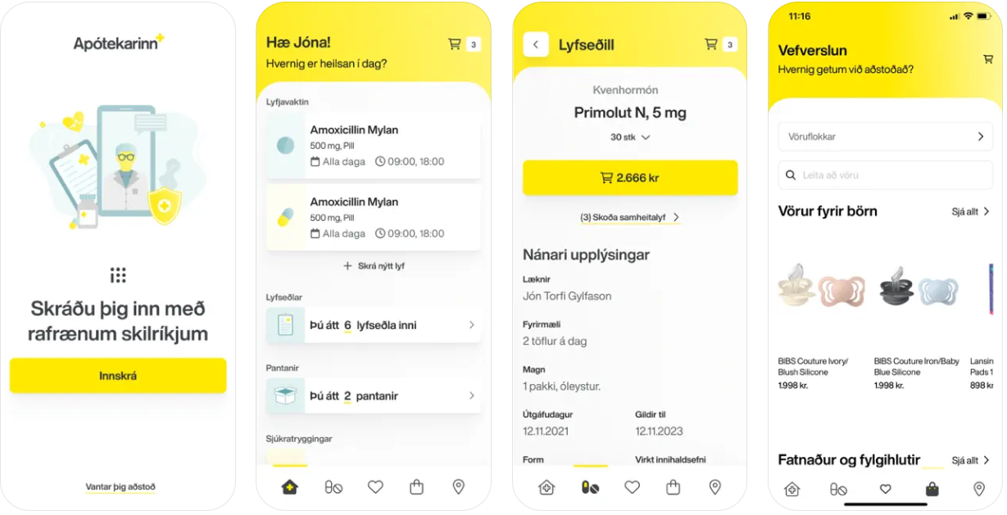
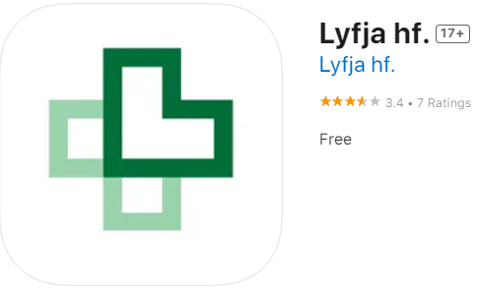
Customer Facing Apps by LS Retail Partners

Slide 14
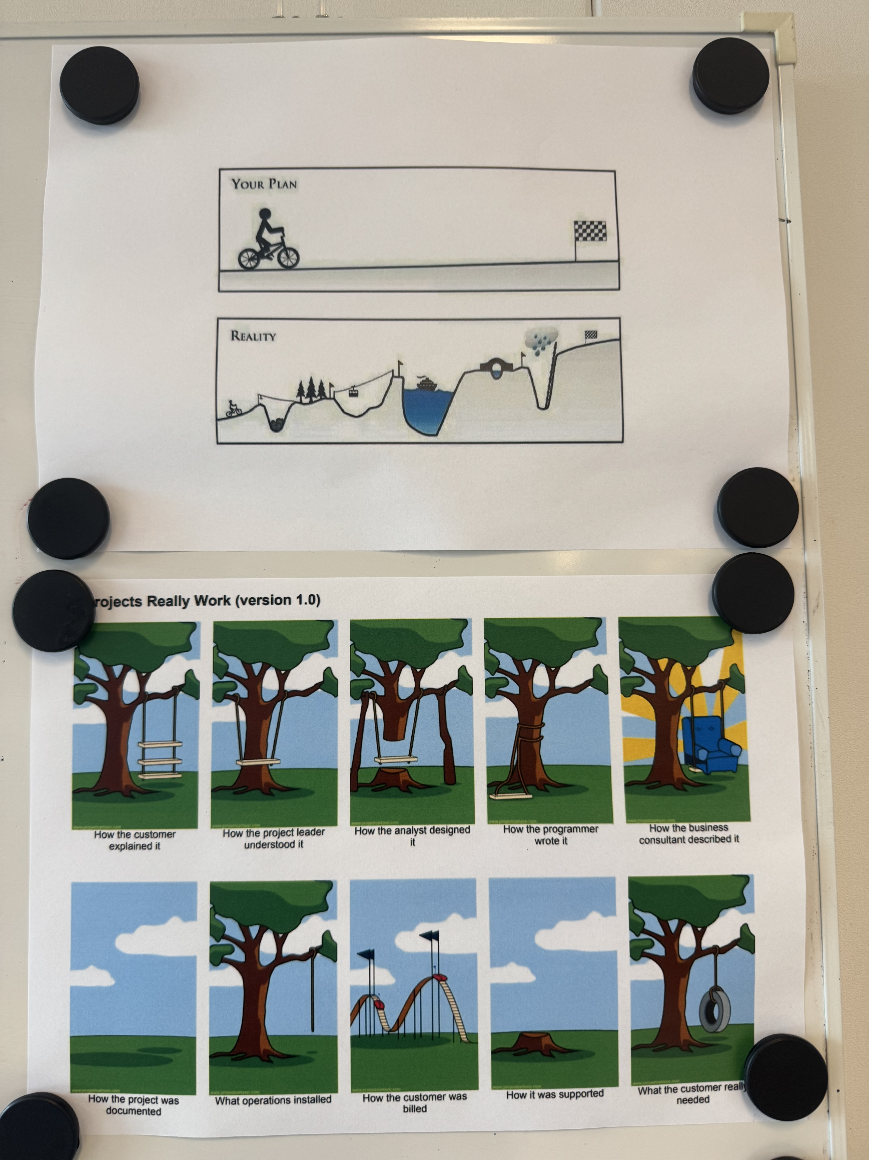
Selling LS Central for pharmacies
No two companies are the same. Everyone is “Special” and “Complex”
The “pharma flow” is the biggest hurdle
So “difficult” to create an integration for the government refund part
The little things sometimes make a big difference
Staff Management
Member Management / Loyalty Club
Time to market is the key
After that it's just pure Retail, Wholesale, and eCom sales

Slide 15
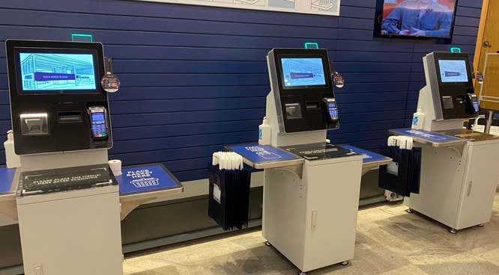
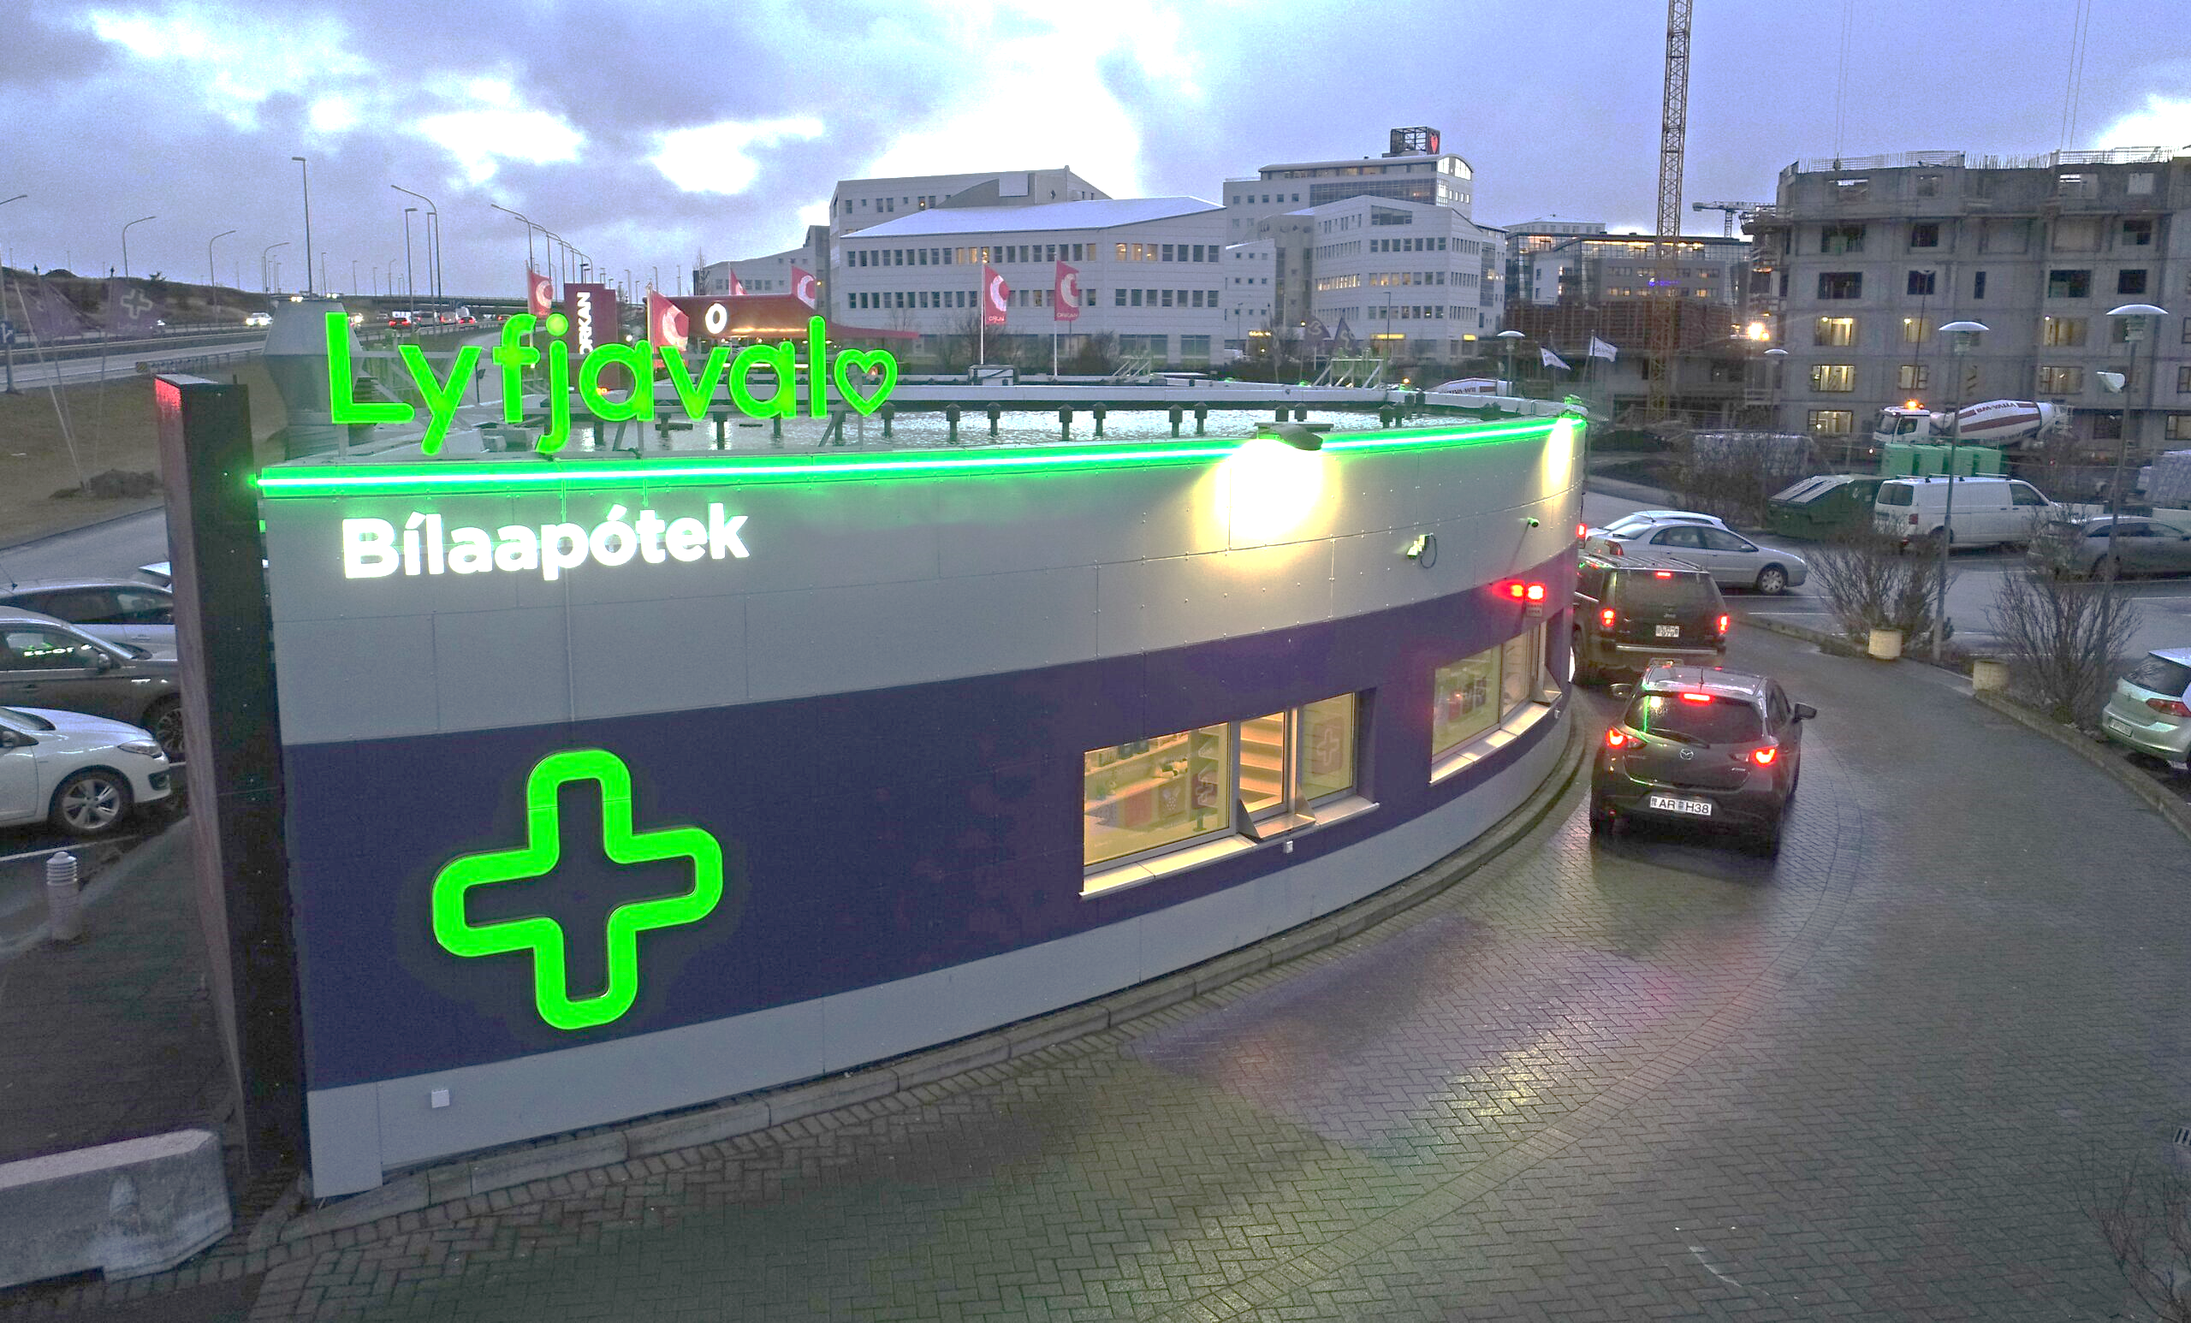
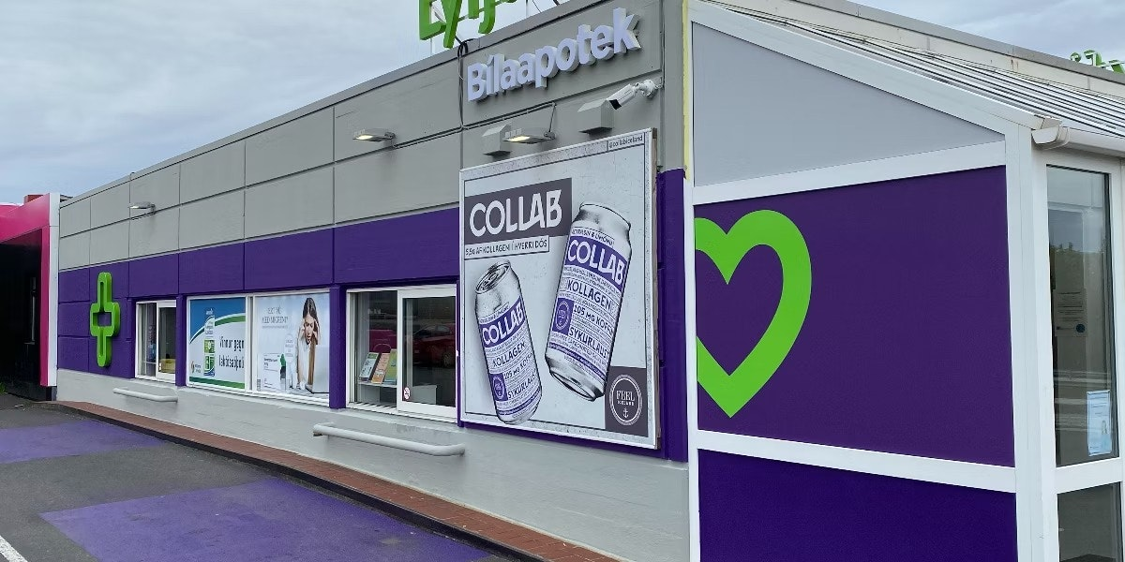
Trends between countries
Emphasis on retail processes like basket size and self-service checkout lanes
B2C where the pharmacists is located in a central warehouse processing prescriptions and send the products directly to the customers' homes with general post service
Call Center to assist relatives outside the country to order and purchase products for people inside the country
Drive-thru pharmacies open 24/7/365

Slide 16
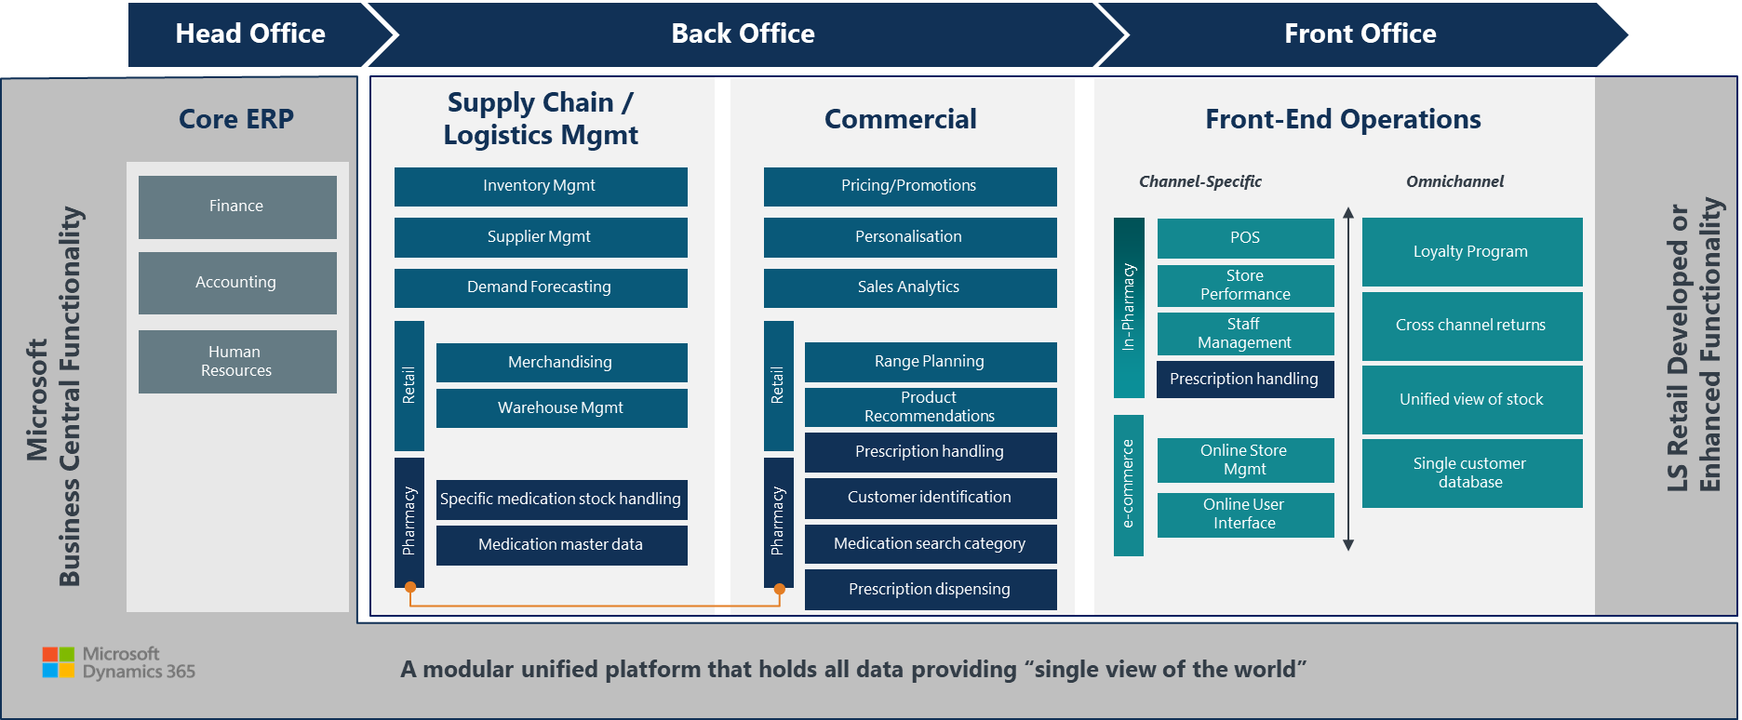
Matching the team setup to the customer
Platform and Architecture
Environments (DEV; TST; PreProd; Prod), Release Management
Servers, Network, Cyber Security, Data Distribution, API’s
Back Office Operations
Finance, Reporting, Product Procurement, Customer Loyalty
Product Pricing, POS setup, Promotions setup, Warehouse Activity, Shipping
Front Office (In-store) Operations
Product Receiving, Returns, Inventory, Stock Count, Shelf Replenishment
Pharma Expedition, Non-Rx Sales,
Integrations
3rd party ERP integrations
Custom Development
Training a part of all teams!

Slide 17
10 avoidable pitfalls, if you plan for them
Change management prior to kick-off - Get the right people on the bus
Setup a special internal support team than then integrates with IT Support post project
Build in-house competence to maximize the opportunities the system gives you
IT Infrastructure setup is always more complex than you think
No change requests (new stuff) allowed for the first 3 months of the project
Don’t forget about the reports for Finance
Bonuses and salaries are often related to KPI’s reports on the bottom line
You are not done when you have the first store live
Your Super-Users will quit and leave before the roll-out is done
Re-training after the go-live to get efficiency up in the stores
Have a post-roll-out change management schema

Slide 18
Plan for the transition from Project to BAU
Project phase
Roll-out phase
BAU
Transition to BAU
Roll-out is a critical phase of the project with high demands for immediate fixes and enhancements needed, but no major development.
Need for high availability of support increasing as the roll-out goes on.
New way of working will be needed to finish the transition into Business As Usual (BAU) support phase.

