Slide 2



Breaking down barriers
Aggregated inventory and
distributed architecture
Kathryn White
Martin Kleindl
Bjarni Asmundsson

Slide 3


Business Central SaaS

Slide 4



Slide 5


Slide 6

Challenges for large(r) retailers
Data volume in entry tables
Item Ledger Entries
Value Entries
Storage cost of data in BC SaaS

Slide 7

Challenges for large(r) retailers
Long running processes
Statement Calculation & Posting
Replenishment calculation
Cost Adjustment & Posting
Data volume in entry tables
Item Ledger Entries
Value Entries
Storage cost of data in BC SaaS

Slide 8



Statement posting - Current approach
G/L Entries
Item Ledger Entries
Example:
A retailer operates 300 stores and
sells 2000 different items per day.
This creates:
  600.000 Item Ledger Entries per day
  18 Mio. Item Ledger Entries per month
Store 1
- Cash
- CC
Store 2
- Cash
- CC
Store 300
- Cash
- CC
Store 1
- Item A, 10 pcs
- Item B, 20 pcs
Store 2
- Item A, 20 pcs
- Item B, 20 pcs
Store 300
- Item A, 15 pcs
- Item C, 10 pcs
Sales
Statement
Calc.
Statement Post
Store 1
Sales
Statement
Calc.
Statement Post
Store 2
…………………………………………………………………………………………….......…
Sales
Statement
Calc.
Statement Post
Store 300
Many stores
→ data volume
→ long running
processes

Slide 9




Slide 11
Aggregated Inventory
  The “Loki” idea:
  Instead of posting every stock movement
  into individual store locations
  let’s post into aggregated locations
  (and keep the details in a separate table)

Slide 12
Statement posting - New approach
Aggregated posting for store locations
Current approach
Item Ledger Entries for individual stores
One entry per item, per location, per day
New approach
  Item Ledger Entries
  for aggregated store location(s)
  Details are stored in a new table
  LSC Aggr. Inventory Entry (10059488)
Item Ledger Entries
current
Aggr. Inventory
Entries
new
Store 1
---------------
---------------
Store 2
---------------
---------------
Store 3
---------------
---------------
Store 4
--------------- ---------------
Store 300
--------------- ---------------
Store 1
---------------
---------------
Store 2
---------------
---------------
Store 3
---------------
---------------
Store 4
---------------
---------------
Store 300
---------------
---------------
Store “RETAIL-1”
---------------
---------------
one day’s entries
Store “RETAIL-2”
---------------
---------------

Slide 13

Statement posting - New approach
G/L Entries
Item Journal
Store 1
- Cash
- CC
Store 2
- Cash
- CC
Store 300
- Cash
- CC
Store 1
- Item A, 10 pcs
- Item B, 20 pcs
Store 2
- Item A, 20 pcs
- Item B, 20 pcs
Store 300
- Item A, 15 pcs
- Item C, 10 pcs
Sales
Statement
Calc.
Statement Post
Store 1
Sales
Statement
Calc.
Statement Post
Store 2
Sales
Statement
Calc.
Statement Post
Store 300
1. Aggregate Stores
Store “RETAIL”
- Item A, 45 pcs
- Item B, 40 pcs
- Item C, 10 pcs
2. Post

Slide 14
Statement posting - New approach
Item Ledger Entries
Aggr. Inventory Entries
G/L Entries
Store 1
- Cash
- CC
Store 2
- Cash
- CC
Store 300
- Cash
- CC
Store 1
- Item A, 10 pcs
- Item B, 20 pcs
Store 2
- Item A, 20 pcs
- Item B, 20 pcs
Store 300
- Item A, 15 pcs
- Item C, 10 pcs
Sales
Statement
Calc.
Statement Post
Store 1
Store “RETAIL”
- Item A, 45 pcs
- Item B, 40 pcs
- Item C, 10 pcs
Sales
Statement
Calc.
Statement Post
Store 2
…………………………………………………………………………………………….......…
Sales
Statement
Calc.
Statement Post
Store 300
Store “RETAIL”
- Revenue
- Inventory
- Cost

Slide 15
Let’s take a look….

Slide 16
Other documents, processes, and integrations
Purchase
Purchase Orders
Purchase Quotes
Sales Orders
Sales Quotes
Transfer Orders
Drop Shipments
Integrations
Sales
Blanket Orders
Purchase Return Orders
Blanket Orders
Sales Return Orders
Other
Special Orders
Analytics for
LS Central
Store Worksheet
(Count, Pick, Recv)
POS Lookups (Availability check)
eCom Integration (Availability check)
Web Services
Mobile Inventory
Item Revaluation
Item Reclassification

Slide 17
Other documents, processes, and integrations
Purchase
Purchase Orders
Purchase Quotes
Sales Orders
Sales Quotes
Transfer Orders
Drop Shipments
Integrations
Sales
Blanket Orders
Purchase Return Orders
Blanket Orders
Sales Return Orders
Other
Special Orders
Analytics for
LS Central
Store Worksheet
(Count, Pick, Recv)
POS Lookups (Availability check)
eCom Integration (Availability check)
Web Services
Mobile Inventory
Replenish-
ment
Assembly Orders
Production Orders
Future Versions
Item Revaluation
Item Reclassification

Slide 19

Known limitations
Aggregated inventory is not the best fit if:
  Very diverse assortments across stores
  Many sales for on-account customers (invoices)
  Many items with lot / serial no. tracking
  Integrations to 3rd party solutions with
  dependency on Item Ledger Entries
  Detailed costing on store/location level
  (We can have multiple aggregation locations for
  store groups to mitigate this.)
Groceries
Convenience stores
Hospitality
Fashion
“mass retail”
Electronics
Furniture

Slide 20
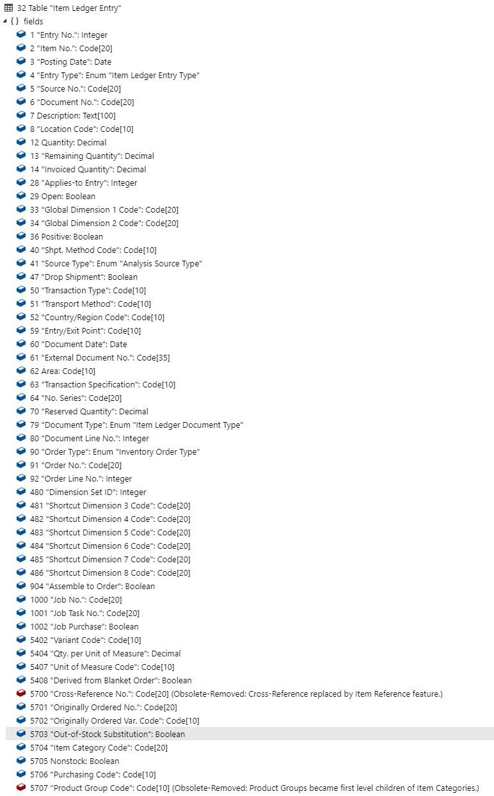
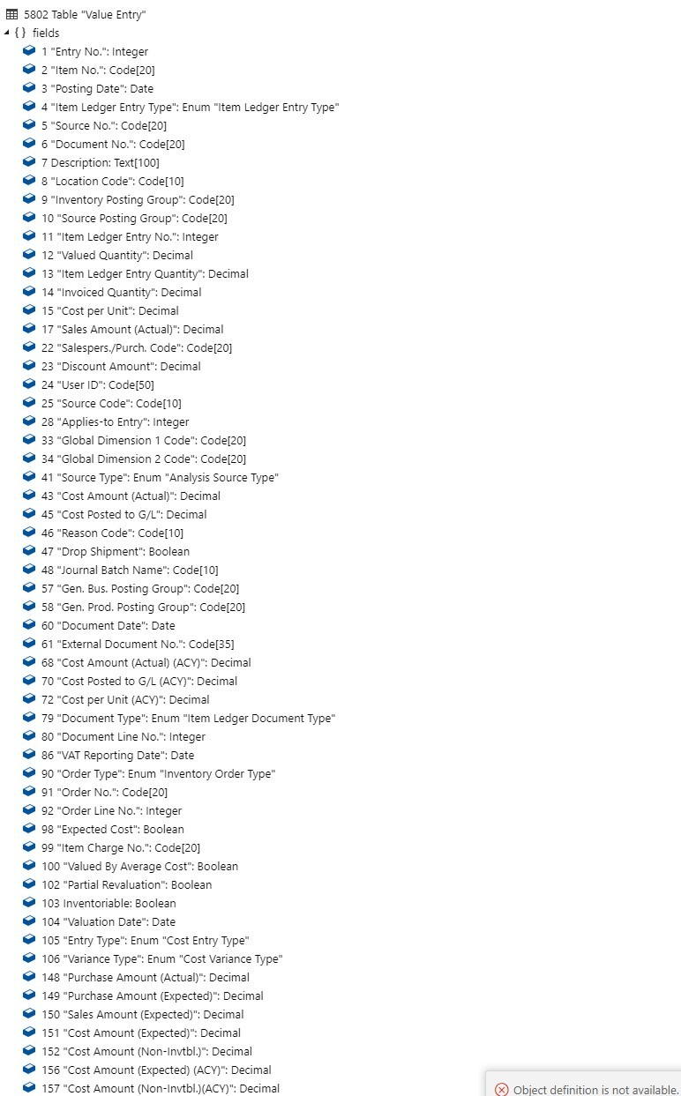
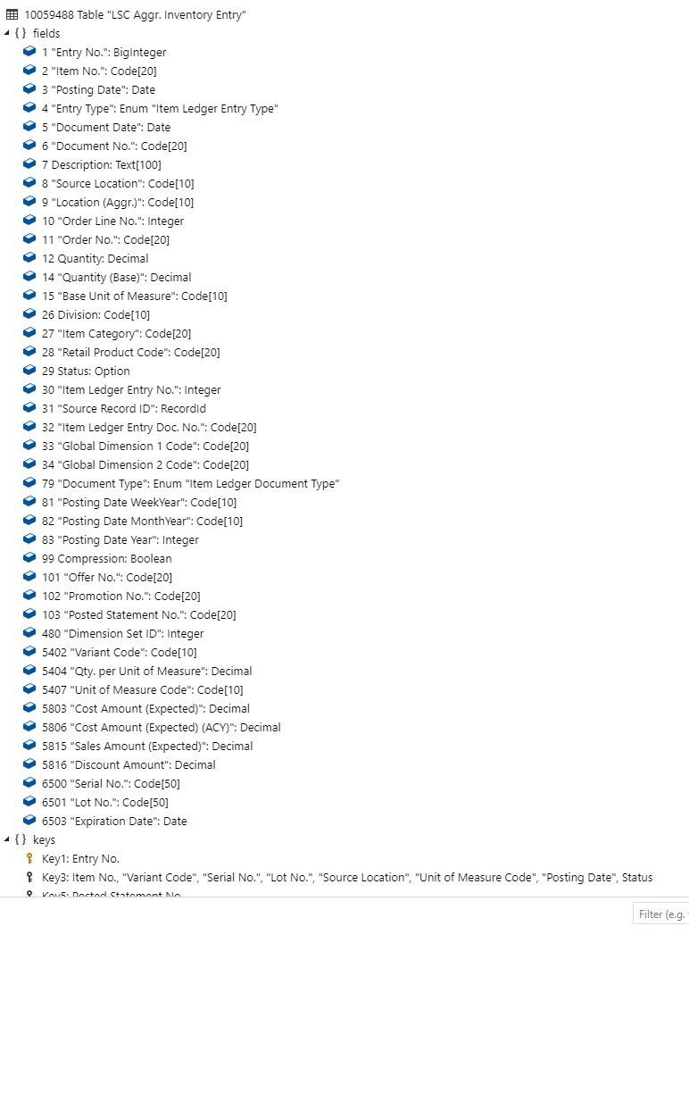
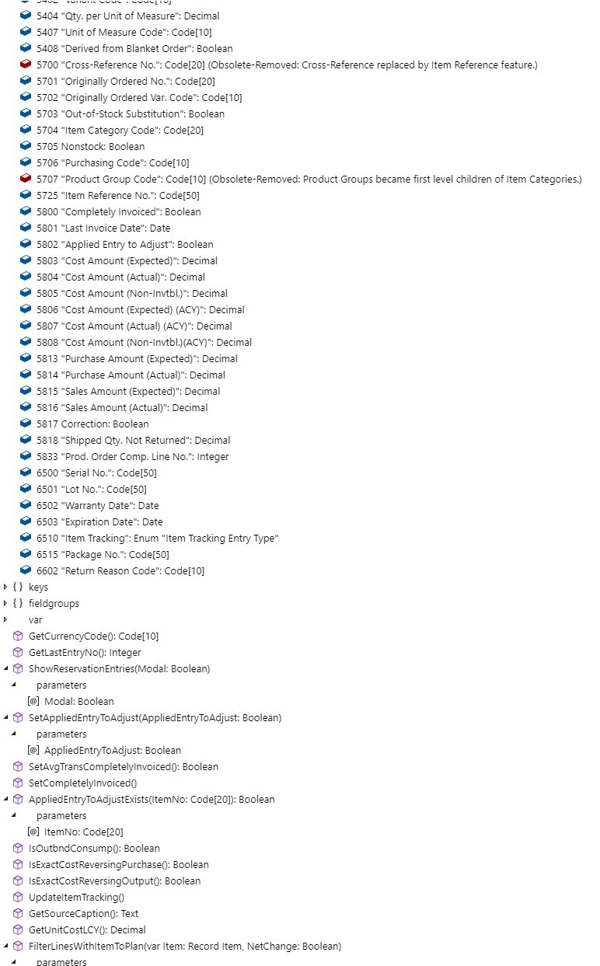
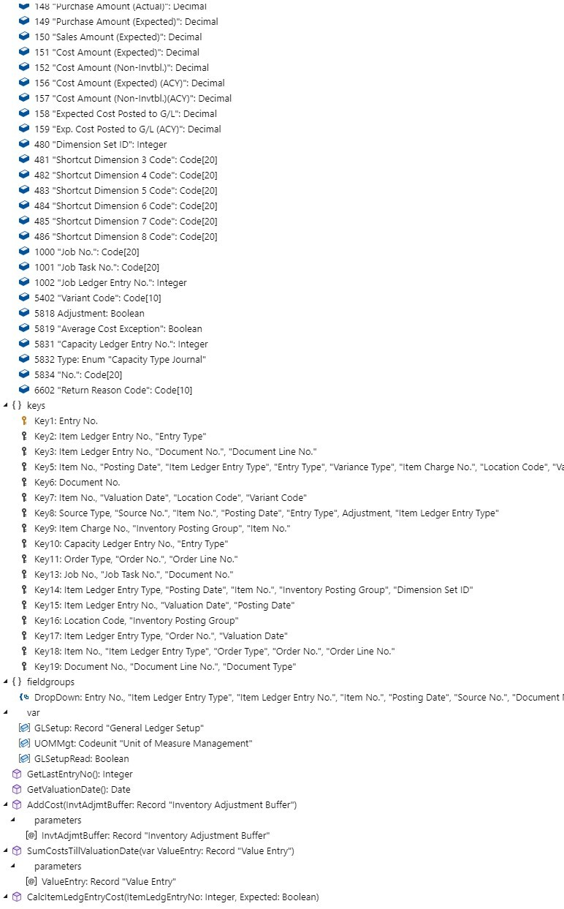
Your benefits
Reduced database size growth
Optimized data structure
Compression and archiving of data
Item Ledger Entry Value Entry Aggr. Inventory Entry
Fields: 85, Keys: 11 Fields: 76, Keys: 17 Fields: 42, Keys: 10

Slide 21
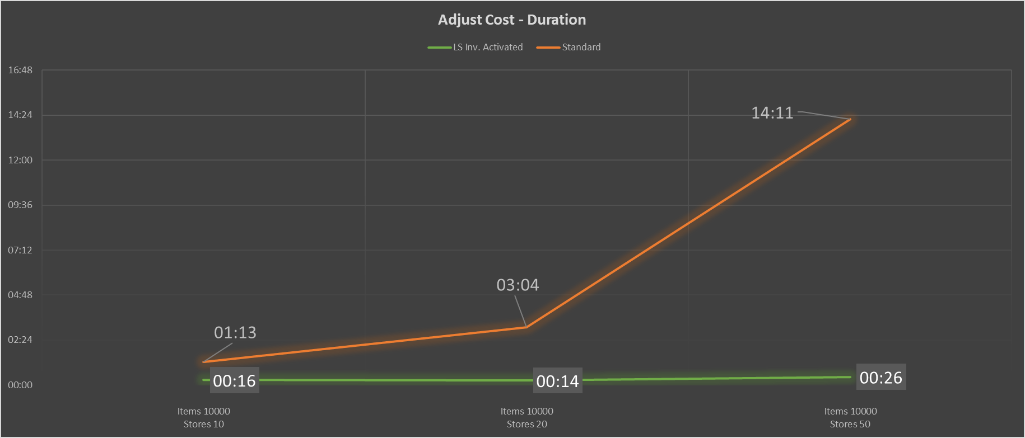
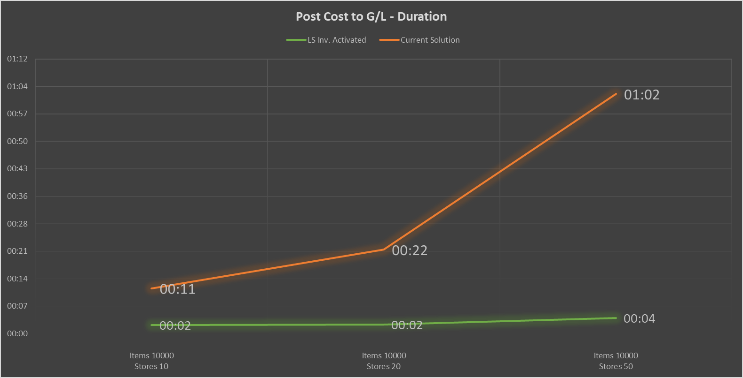
Your benefits
Faster processes
(Example: 10.000 items, 200 stores)
  ILE & VE (record count): -99%
  Adjust Cost (duration): -97% (14hours to 26min)
  Post Cost (duration) : -94% ( 1hour to 4min)
Adjust Cost
Post Cost to G/L

Slide 22
Aggregated Inventory
An Extension on top of LS Central
Status
  Released with LS Central version 24 (April ‘24)
  Provided on request to partners
  Will be placed on Partner Portal in the future
  First requests for POCs
Package includes
  Aggr. Inventory Extension
  Wizard (in BC) to upgrade from “classic” approach
  SQL Scripts to calculate improvements before implementation
This is not just Plug & Play → This requires a project.

Slide 24



Slide 26
Distributed Architecture
  The “Thor” idea:
  Instead of running a monolithic
  company / database
  shatter it into smaller pieces
  to distribute data & workload

Slide 28
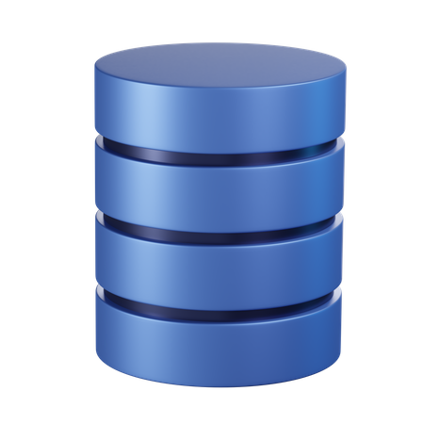
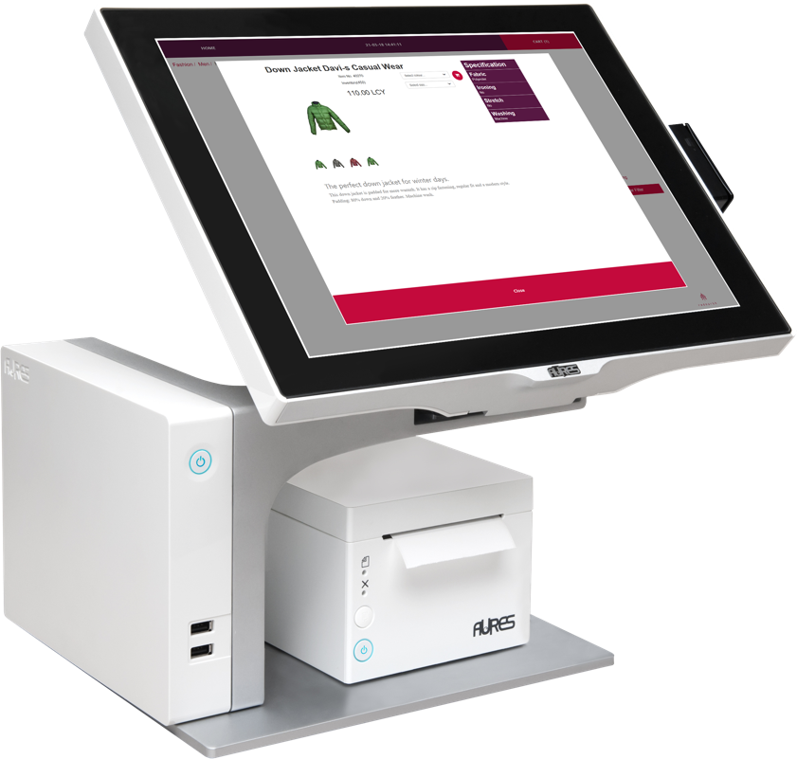
Monolithic Approach
BC Company
100
POS
100
POS
100
POS
100
POS

Slide 29
Distributed Approach
BC Company
Each BC company has its own SQL tables
100
POS
100
POS
BC Company
Each BC company has its own SQL tables
100
POS
BC Company
Each BC company has its own SQL tables
100
POS
BC Company
Each BC company has its own SQL tables

Slide 30
There are some more things we need to take care of…
Finance
Master data management
POS data entries validation (gift cards and vouchers)
Member management and loyalty points validation
Inventory lookup
Replenishment management

Slide 31

Distributed Approach
GL only
AP / AR / Bank etc.
Finance
100
POS
100
POS
100
POS
100
POS

Slide 32
Distributed Approach
Master Data : Store, Location,
POS Terminal etc.
100
POS
Finance
Master Data : Items, Prices,
Discounts, Vendors, etc.
Centralized Replenishment
Retail Master
100
POS
POS Data Entries validation
Loyalty Points Earn & Burn etc.
100
POS
100
POS

Slide 33
Distributed Approach
Finance
100
POS
Retail Master
100
POS
100
POS
POS Transactions
Purchase Orders
Transfer Orders
Sales Orders
etc.
Item Ledger Entries
Value Entries
Retail 1
Retail 2
Retail 10
Retail 11
100
POS
Retail X
Retail Y

Slide 34




Distributed Approach v.2
Finance
Retail Master
100
POS
100
POS
Retail 1
Retail 2
100
POS
Retail 10
Retail 11
100
POS
Retail X
Retail Y

Slide 35
Your benefits
Supported by all standard functionality
Low additional cost
Grows with you
Upgrades made easier
Note! Currently this is project configuration and needs careful planning

Slide 36


Slide 37
Your Questions please!
(or feedback ☺)

Slide 40
Thank you
Martin Kleindl
Product Director

