Slide 2
LS Retail MaxAttention
and overview of other support possibilities
Johann Thorlaksson
Matthias Matthiasson

Slide 3
LS Retail MaxAttention
Overview of Supporting Functions
and overview of other support possibilities
LS Retail Consulting Services
LS Retail MaxAttention

Slide 4

Overview of Services
Supporting Functions
Partner Technical Support
Cloud Accelerator Program (CAP)
License Management
Partner Development
Professional Services
LS Retail Academy
LS Retail Consulting
LS Retail MaxAttention

Slide 5
Supporting Functions

Slide 6

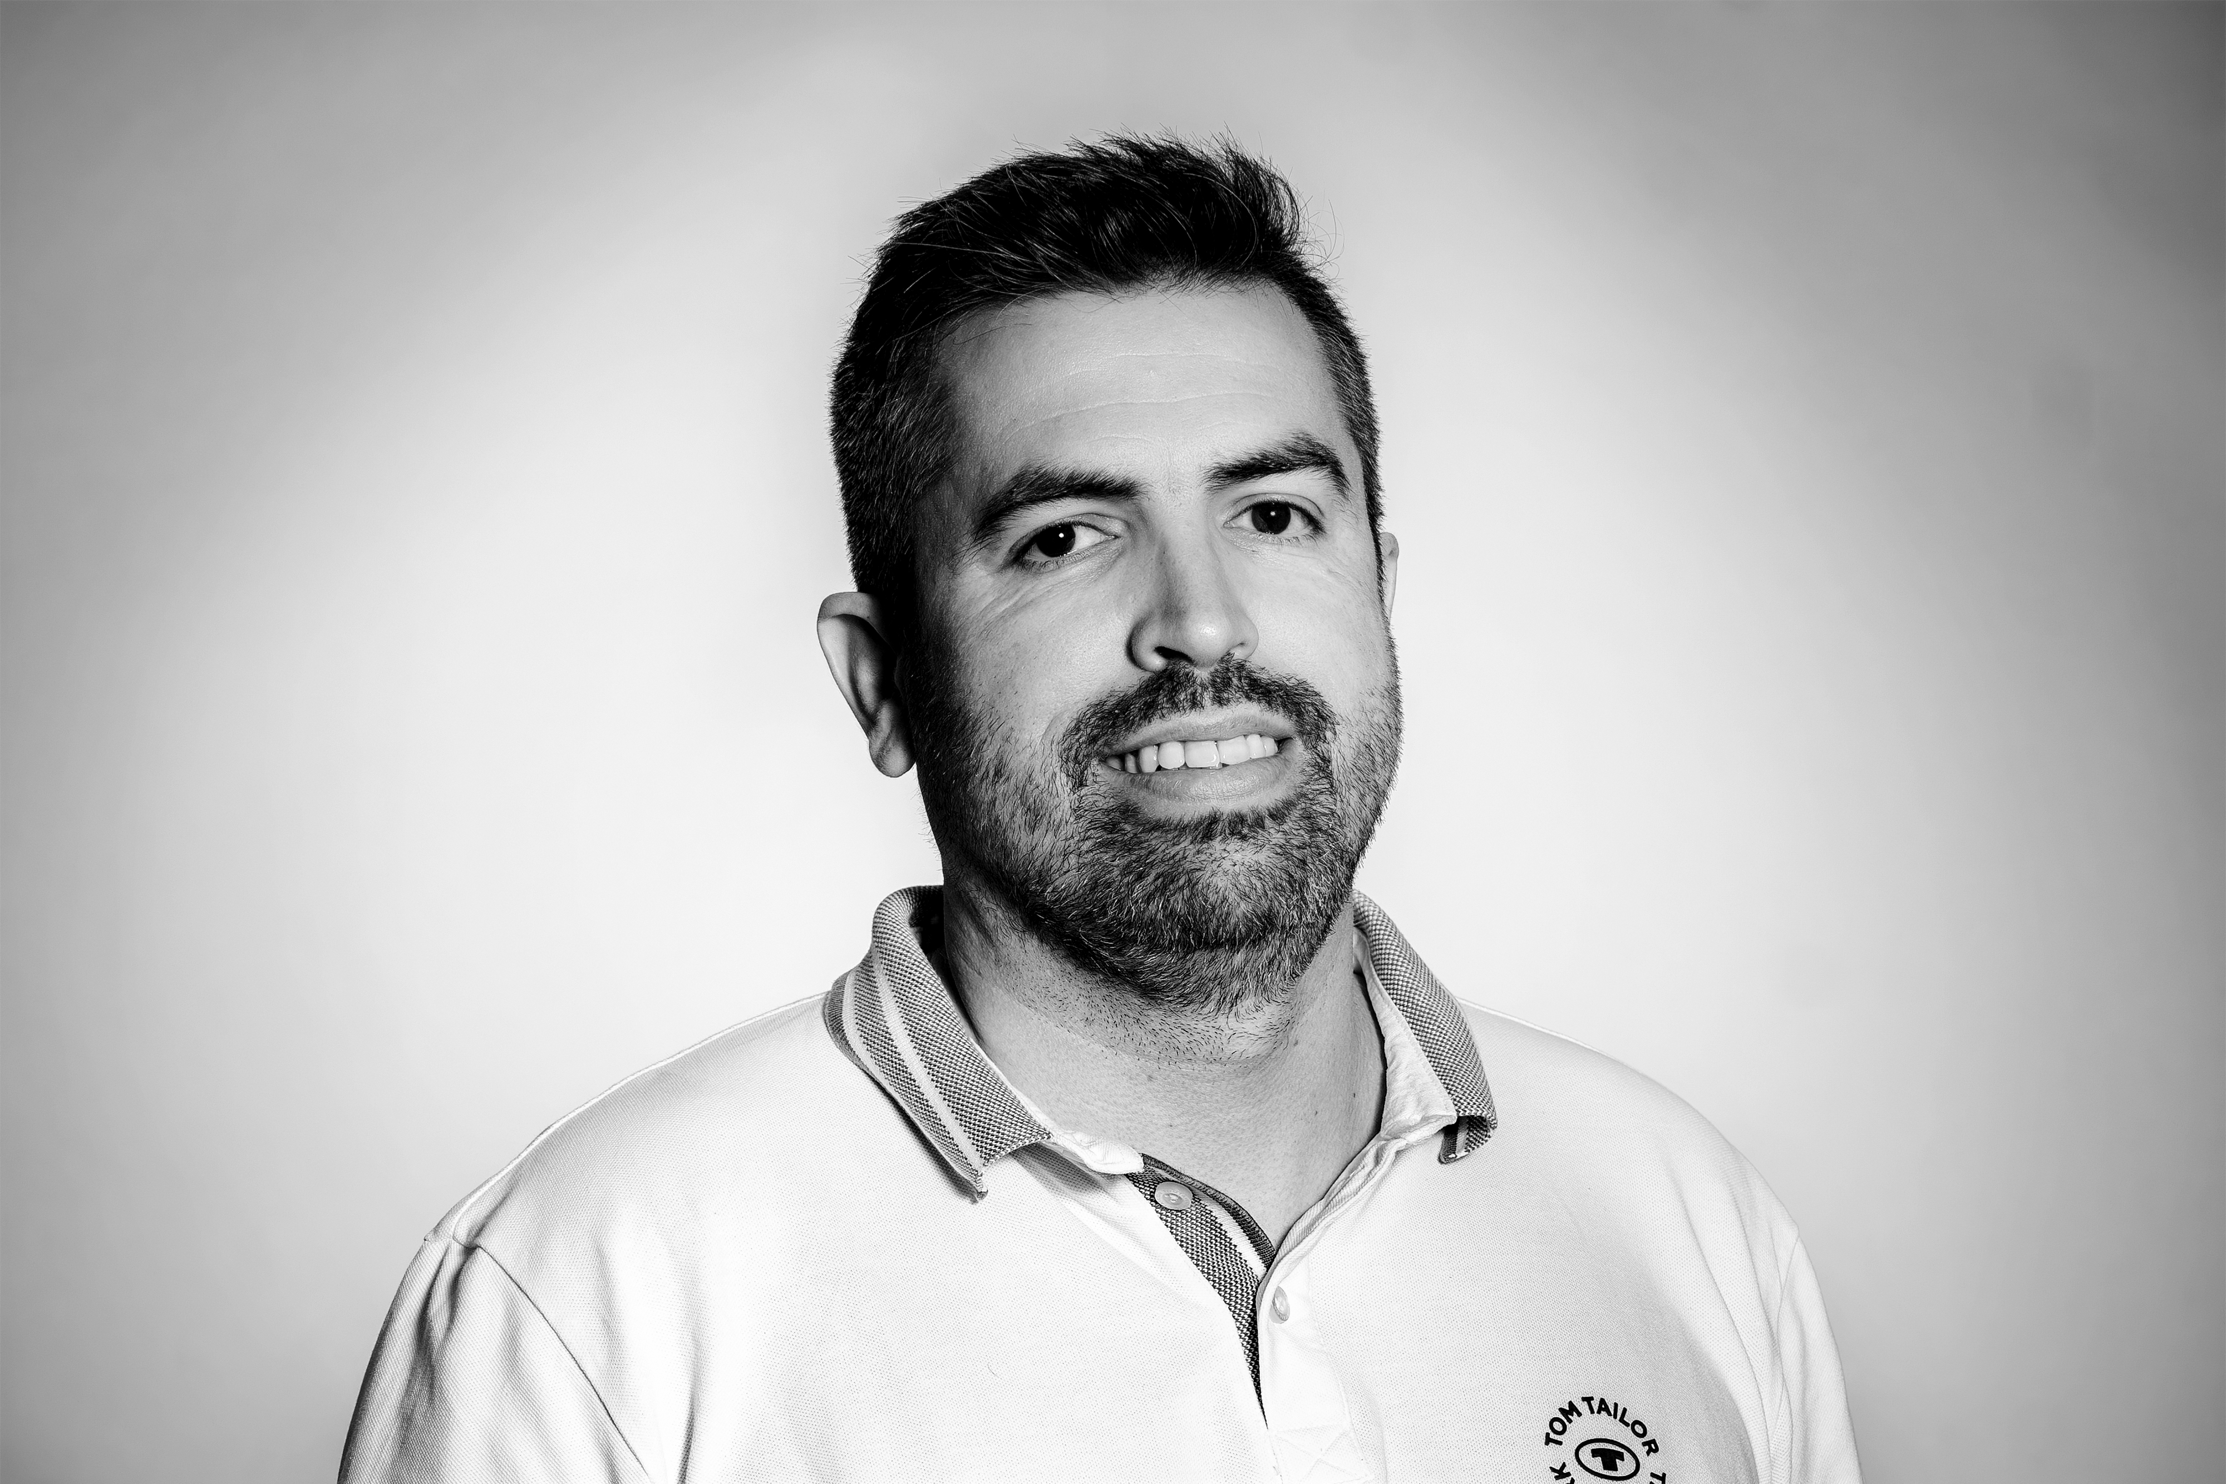
Partner Technical Support
Technical support for partners assisting
End-users with an active enhancement plan or subscription
On supported versions
Trained personnel
Office Hours
  24-7 Blockers in SaaS
APAC – Europe – Americas
  Ticket prioritization twice a day
Support through tickets
Issues need to be reproducible
Partner declare expectations
  Status Hotfix
Cesar Cruz
Support Specialist
Paulo Nobrega
Support Specialist

Slide 7

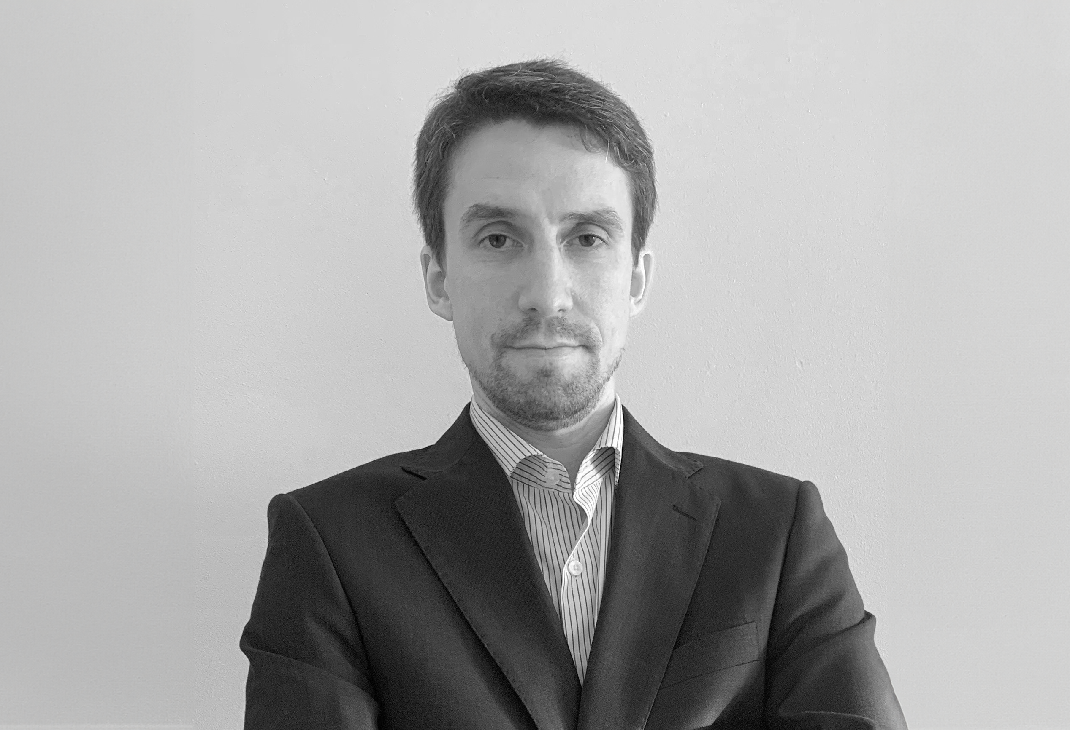
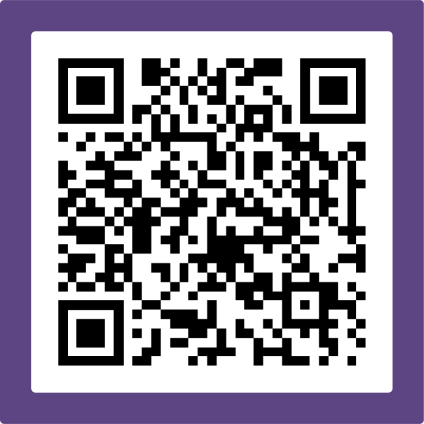
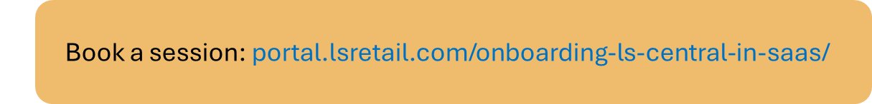
Cloud Accelerator Program (CAP)
The CAP team assists partners in their transition to SaaS by focusing on
  Addressing the challenges
  Opportunities
  Best practices
SaaS specialists, supported by
  Development team
  Consulting team
  Licensing team
Advices on
  Migration topics
  Architecture
  Technical SaaS challenges
Aðalbjörg Karlsdóttir
Onboarding Lead
Ricardo Moinhos
Onboarding Specialist
Book a free session with the CAP team

Slide 8
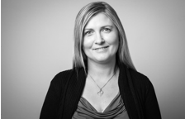
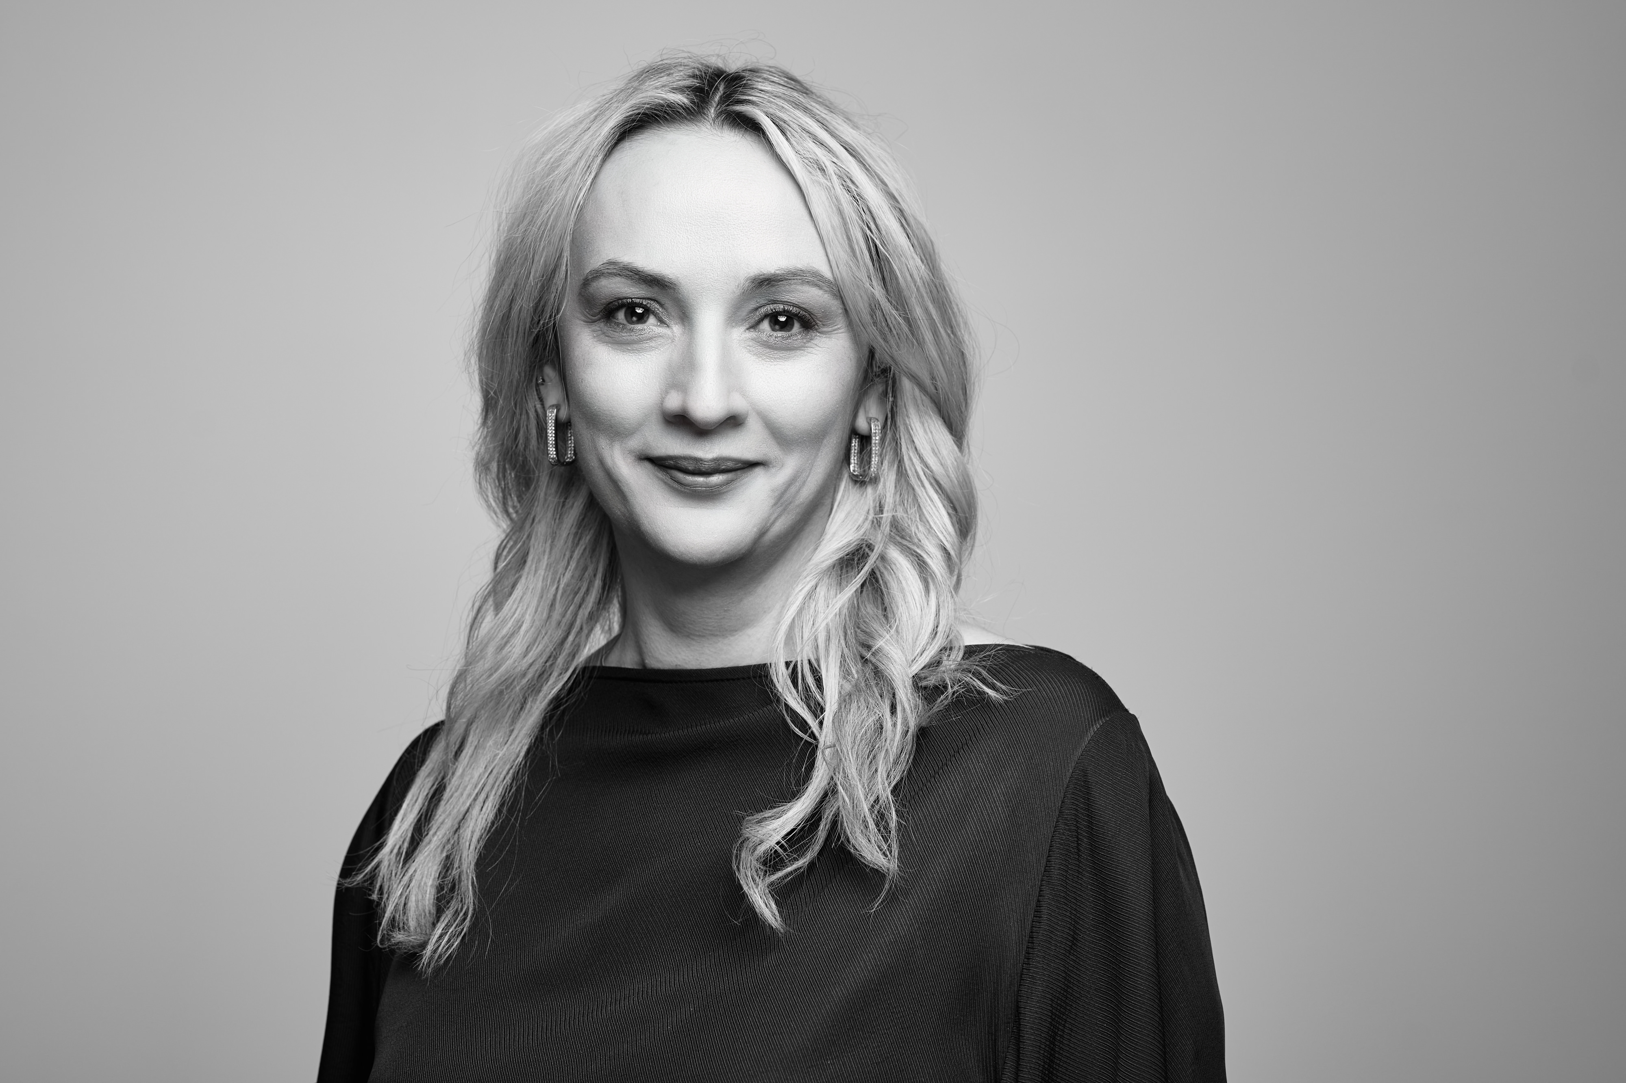
License Management
The Licensing Department takes care of
Orders / Offers / Special deals
Promotions
Enhancement and subscription renewal
Price list
Partner Dev/Customer trial licenses
Licensing topics
All requests should be submitted
Support Tickets
Email
Operational Guidelines for key licensing-related information (LS Retail Portal)
Margrét Matthiasdóttir
Director of Licensing
Irina Christina Olaru
Licensing Specialist

Slide 9
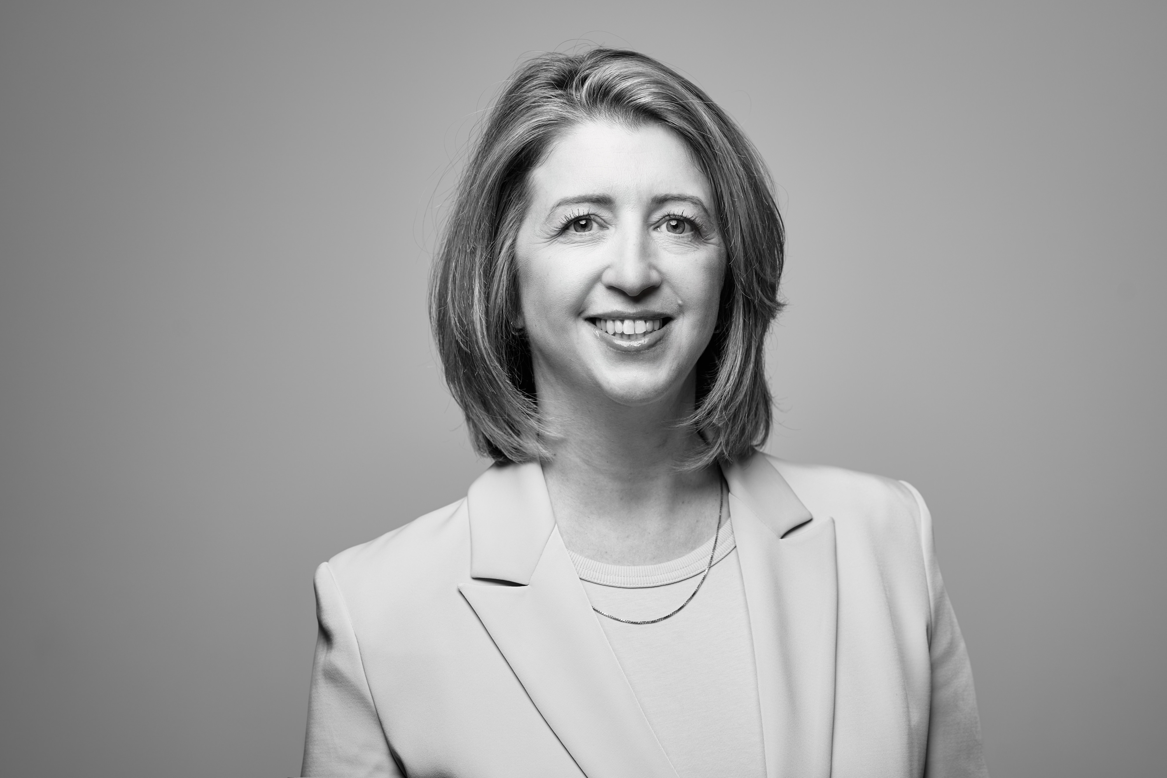
Partner Development
The Partner Development team is responsible for:
Partner Channel Expansion
New Partner Onboarding
Partner Agreements
Partner Enablement & Support
Partner Program, loyalty and incentives
Partner Directory
Partner Portal & Business Hub
Microsoft Indirect Reseller relationship
Muriel Léglise
Director Partner Development

Slide 10
Professional Services

Slide 11
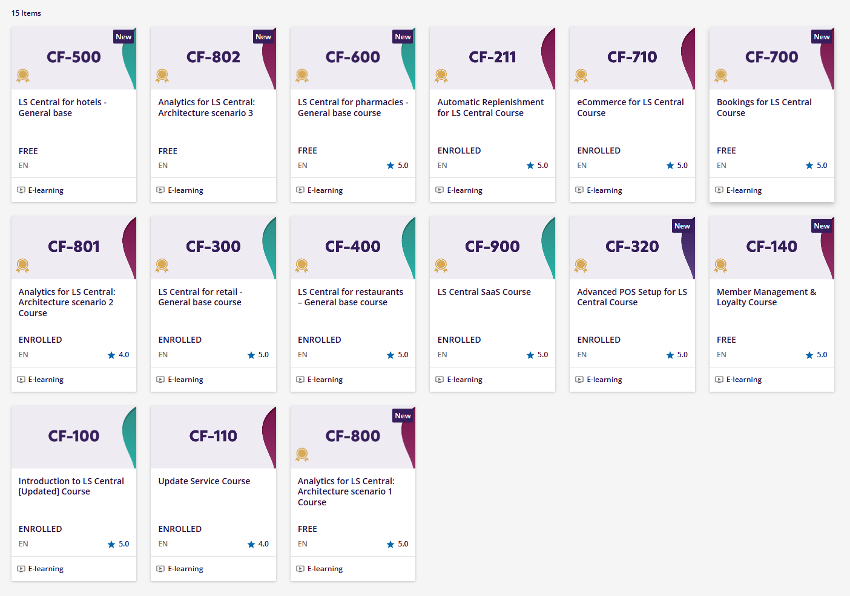
LS Retail Academy
Learning is at your fingertips with our eLearning courses!
Our on-demand training offers a comprehensive learning experience, featuring instructional text, videos, interactive knowledge checks, and graphics.
These courses have been developed and recorded by experienced LS Retail consultants who specialize in the course topics.
For more information visit our portal: https://lsretail.com/academy

Slide 12

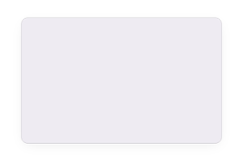
Global PMO
Global MaxAttention
Consulting Europe
Consulting Americas
Consulting MEA&I
Consulting APAC
A global team

Slide 13




LS Retail consulting services
We collaborate with partners to make them and their customers
more successful.
Global team of 100 people
Diverse team
Extensive experience
Subject matter experts
Support partners in sales and in the full project lifecycle
Increase the quality of the implementations
Bring extra capacity and specialized industry expertise
Reduce project risk and cut down implementation time
Bring customer insights into product development
Technical Consultants
Functional Consultants
Solution Architects
Project Managers

Slide 14
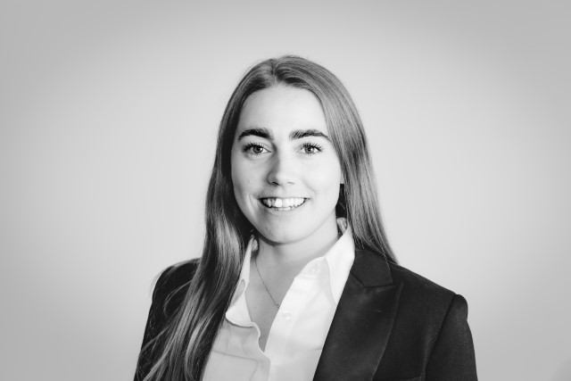
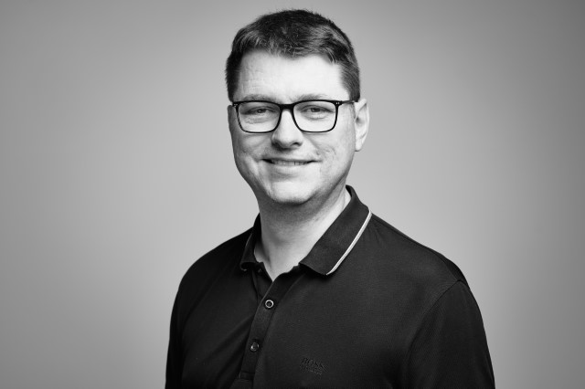

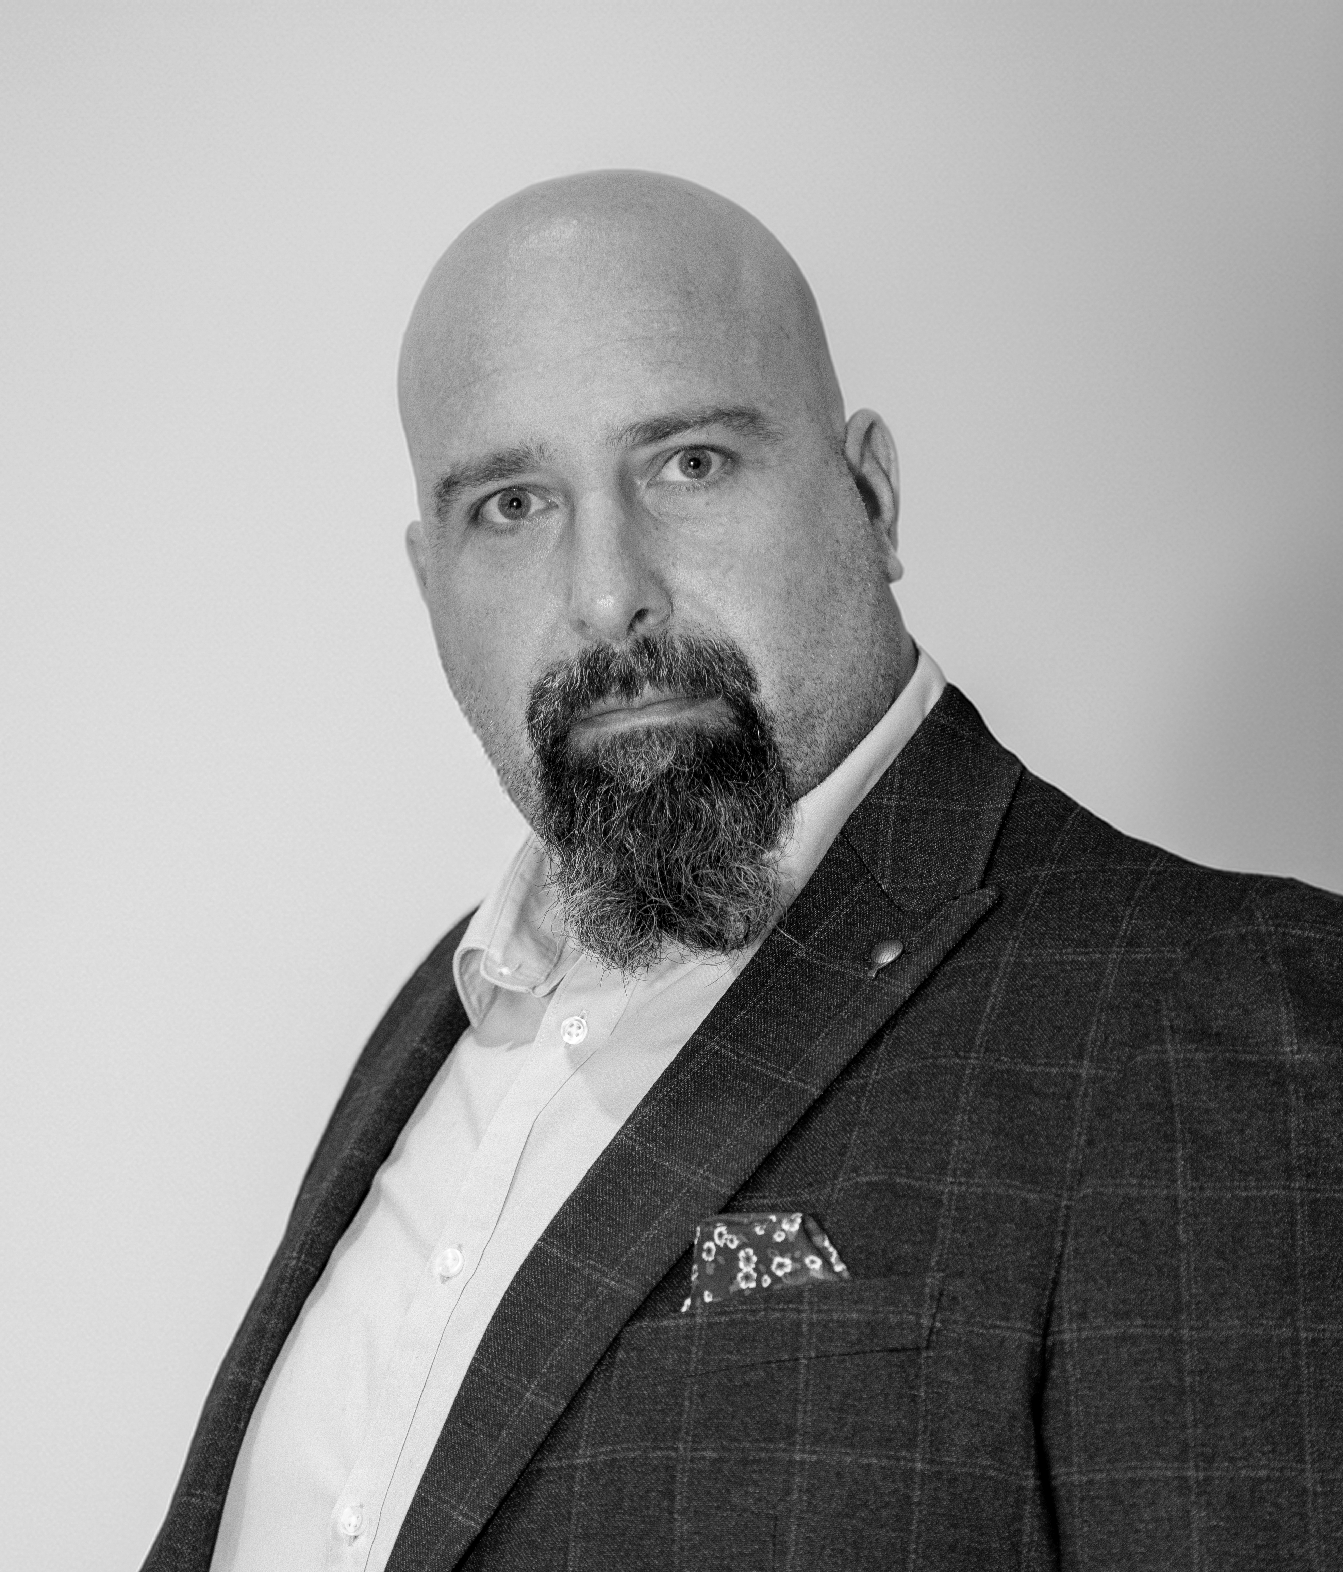
Consulting Europe Management at conneXion
Urður Anna Björnsdóttir
Consulting Director
Einar Páll Guðlaugsson
Pharmacy Director
Anna Dís Þorvaldsdóttir
Consulting Manager
Sergio Castelluccio
Consulting Manager

Slide 15


Until a few years ago, LS Retail Consulting primarily focused on implementation projects and training, working closely with partners and a few strategic customers.
LS Retail did generally not offer 2nd and 3rd level customer support services, leaving customer support fully to the partner network.
Our standard Technical Partner Support, delivered by our development team, only offers support during business hours and with no SLA’s.

Slide 16
Why LS Retail MaxAttention?
The request for tailor-made support services from LS Retail has increased.
  Many partners don’t have support teams, limiting their possibilities to take on or provide necessary services to customers
  Many partners request advanced support, both for their own teams and for their customers, within and outside of business hours
  Bigger customers - demand vendor involvement
  Global customers – not serviced by a single partner
  Customers where partners lack industry knowledge
More and more customers and prospects are very demanding, with global operations, and with ambitious visions.
  If they are able to select LS Central as a solution, we need to assist our partners in meeting their expectations

Slide 17
What is LS Retail MaxAttention?
LS Retail MaxAttention is a support initiative to ensure that LS Retail partners (and customers) receive the best assistance possible, whenever they need and wherever they are located, for LS Central and customer-specific functionality
LS Retail MaxAttention is a dedicated Support Service desk offering
  Standard to advanced partner, or customer specific, support
  Support not only for standard products
  Business hours to 24/7 support
  2nd and 3rd level support with SLA’s
  Additional services – e.g. customization maintenance, deployments, etc.
  Dedicated or shared support manager
  Skilled regional professionals
LS Retail MaxAttention is not part of the technical partner support delivered by our development team

Slide 18
Customer support and service needs
Back Office Support
Customer responsible
Level-1 Support
Partner responsible
Level-2 Support
LS Retail MaxAttention
Level-3 Support
LS Retail MaxAttention
Additional Support Services
Partner or LS Retail MaxAttention
Enhancement Fee / EULA
LS Retail Development
Consulting Services
Partner or LS Retail

Slide 19
Enhancement fee / EULA
Enhancement Fee / EULA
Corrective Maintenance
  Core LS Retail Products
  Microsoft Dynamics 365 Business Central
Roadmaps and new functionality
Major release of new versions
Covered by licenses
Standard modules and verticals, delivered twice a year
  Core LS Retail Products
  New features
  Improvements
  Corrective maintenance
  Microsoft Dynamics 365 Business Central
Support delivered by our Partner Technical Support
Business hours support, available only to partners
New standard releases available to partners and customers

Slide 20
Handled by customers
Back Office Support
User Management
  Access rights and Roles in BC
  IDP setup
Item Management
  Creation, Pricing, Promotions and Distribution
  POS Setup and POS layout
Customer GDPR requests handling
Infrastructure Maintenance
  Updates, Backups and Disaster Recovery
  Virus and Intrusion Prevention
  Security Monitoring
Middleware maintenance
  Updates, Backups and Disaster Recovery
  DB-Admin Operations
Internal BC and LS Central knowledge Competence
  Super User training
  Support Team training
Level-1 Support
System Enquiries from users
  “I’m getting an error”
  “System is slow”
  “How do I do that?”
User Management
  “I can't log in”
  “I don’t have access”
Basic Operation Maintenance
  POS stopping
  Posting stopping
  Restarting Server Services
User Training
  Maintain Knowledge Base
  Training Center
Basic support:
Internal competences to manage customer environments, access rights, train employees, etc.
1st level support often outsourced to companies with no or very limited LS Retail competence
  “Please restart your computer”

Slide 21
LS Retail MaxAttention - 2nd and 3rd level
Level-2 Support
Incidence handling and Resolution
Error Handling and Resolution
  Fixing data errors that are stopping processes
  “Multiple users reporting this issue”
Basic Operation Maintenance
  Posting stopping
  Restarting Server Services
Operational availability and performance monitoring
  In-Store network and infrastructure
  Central Server CPU, Memory and Disk Space monitoring
  Integrations monitoring
Internal BC monitoring
  Data Replication monitoring
  Posting queue monitoring
  Long running queries
Access Security Monitoring
  Audit Log monitoring
Level-3 Support
Advanced LS Central support
Incidence handling and Resolution
Error Handling and corrective actions
  Create workarounds
  Create temporary fixes
  Resolving Data Integrity
Advanced support:
2nd and 3rd level support
Customer specific support
The team has knowledge about the customer implementation, environments, and needs
24/7 support – if requested
Quick reaction time with SLA’s

Slide 22
Additional services
Additional Support Services
Customizations Maintenance
  Corrective maintenance
  Minor improvements
Release management
  Pre-deployment Testing
  Deployment Assistance
Training
Consulting Services
Customer specific projects, implementations, integrations, deployments
Advanced training
Additional Support Services agreed on in a separate SOW
  Delivered by the partner or the LS Retail MaxAttention team (if requested)
Consulting services agreed on in multiple SOW’s
  Delivered by the partner

Slide 23
Customer Support and Service needs
Back Office Support
Customer responsible
Level-1 Support
Partner responsible
Level-2 Support
LS Retail MaxAttention
Level-3 Support
LS Retail MaxAttention
Additional Support Services
Partner or LS Retail MaxAttention
Enhancement Fee / EULA
LS Retail Development
Consulting Services
Partner or LS Retail

Slide 24
Overview Support and Service needs
Back Office Support
User Management
  Access rights and Roles in BC
  IDP setup
Item Management
  Creation, Pricing, Promotions and Distribution
  POS Setup and POS layout
Customer GDPR requests handling
Infrastructure Maintenance
  Updates, Backups and Disaster Recovery
  Virus and Intrusion Prevention
  Security Monitoring
Middleware maintenance
  Updates, Backups and Disaster Recovery
  DB-Admin Operations
Internal BC and LS Central knowledge Competence
  Super User training
  Support Team training
Level-1 Support
System Enquiries from users
  “I’m getting an error”
  “System is slow”
  “How do I do that?”
User Management
  “I can't log in”
  “I don’t have access”
Basic Operation Maintenance
  POS stopping
  Posting stopping
  Restarting Server Services
User Training
  Maintain Knowledge Base
  Training Center
Level-2 Support
Incidence handling and Resolution
Error Handling and Resolution
  Fixing data errors that are stopping processes
  “Multiple users reporting this issue”
Basic Operation Maintenance
  Posting stopping
  Restarting Server Services
Operational availability and performance monitoring
  In-Store network and infrastructure
  Central Server CPU, Memory and Disk Space monitoring
  Integrations monitoring
Internal BC monitoring
  Data Replication monitoring
  Posting queue monitoring
  Long running queries
Access Security Monitoring
  Audit Log monitoring
Level-3 Support
Advanced LS Central Support
Incidence handling and Resolution
Error Handling and corrective actions
  Create workarounds
  Create temporary fixes
  Resolving Data Integrity
Additional Support Services
Customizations Maintenance
  Corrective maintenance
  Minor improvements
Release management
  Pre-deployment Testing
  Deployment Assistance
Training
Enhancement Fee / EULA
Corrective Maintenance
  Core LS Retail Products
  Microsoft Dynamics 365 Business Central
Roadmaps and new functionality
Major Release of new versions
Consulting Services
Customer specific projects, implementations, integrations, deployments
Advanced training

Slide 25

LS Retail MaxAttention support plans
For 2nd and 3rd level support, LS Retail offers different MaxAttention support plans
  Basic (T&M)
  Standard
  Premium
Schedules vary in level of service, response times (SLA), benefits, and price
Support outside of business hours is defined as extended service and is available for Standard and Premium support

Slide 26
LS Retail MaxAttention support plans framework
Basic
Online only
No Severity and SLA
Hourly rate
Shared Service Manager
Standard
Online only
Severity 1 to 4
SLA’s with down to two-hour response time for Severity 1 cases
Defined resolution time
Hourly rate or bulk of hours
Shared Service Manager
Possibility of extended support
Premium
Online and on-site
Severity 1 to 4
SLA’s with down to 30-minute response time for Severity 1 cases
Defined resolution time
Bulk of hours or fixed fee per month
Quarterly Case & Product Reviews
Dedicated Service Manager
Possibility of extended support
*All agreements are partner / customer specific and can be adjusted

Slide 27

How can we work together?
The idea behind LS Retail MaxAttention is the same as with our consulting services
The purpose is to support our partners to grow and deliver their projects, serving as a backup or to complement their services
Engagements can be short- or long-term, all based on the partner's (and the customer's) needs
If a partner brings in a customer to LS Retail MaxAttention, it is fully on its terms and conditions – as soon as the assistance is no longer needed, LS Retail will assist in moving the customer back to the partner
Contracts can be made either through the partner or directly with the customers

Slide 28
Ambitions
Our ambition is to offer best in business 2nd and 3rd level support for LS Retail partners and customers
To enable customers and prospects to select LS Central as a solution, meeting their high demands
To enable our partners to grow and take on bigger and more demanding customers
LS Retail MaxAttention can play a significant role in the future success of LS Retail partners and customers

Slide 29
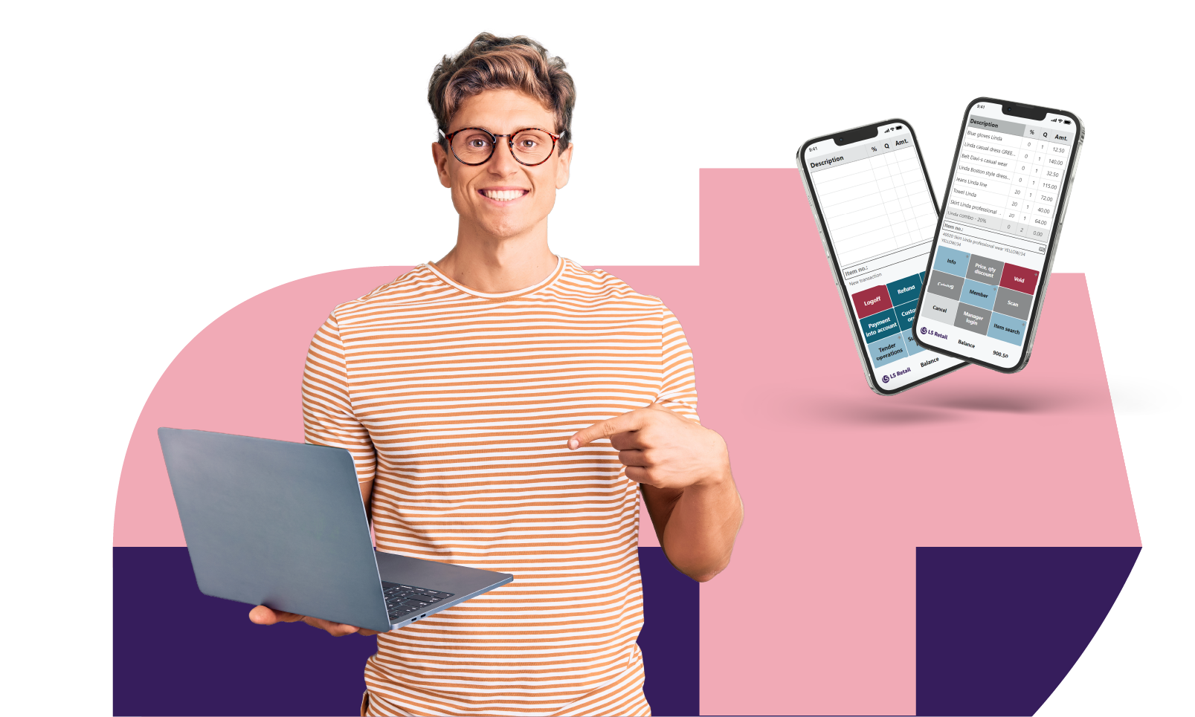
Additional Information
Contact
  Request more information about LS Retail MaxAttention:
    LS Retail MaxAttention: discover personalized technical support
  Email: MaXAttention@lsretail.com

Slide 30







LS Retail MaxAttention
a dedicated customer service desk offering:
Ad-hoc to advanced 24/7 support
2nd and 3rd level support with SLA´s
Additional service to LS Retail partners and customers
Dedicated support manager and skilled regional professionals

