Slide 2
Analytics for LS Central Create your epic BI journey
Omair Zuberi Martin Kleindl Jonheidur Isleifsdottir

Slide 6
Agenda
Reporting in BC and Analytics
Analytics under the hood
What’s new
Architecture options
The BC23 challenge
How to get started
How to implement with success

Slide 7
Kennie Pontoppidan Principal Program Mgr. Microsoft

Slide 8
Data analysis in Business Central

Slide 9
LS Central –Analysis views

Slide 10
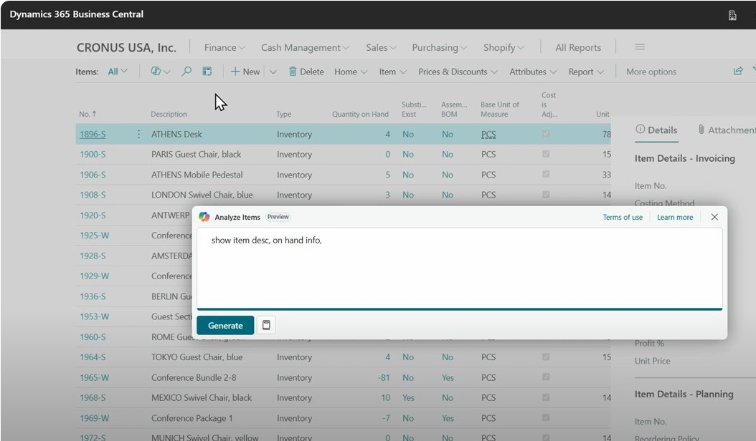
Kennie Pontoppidan Principal Program Mgr., MS

Slide 11
Analytics for LS Central

Slide 12
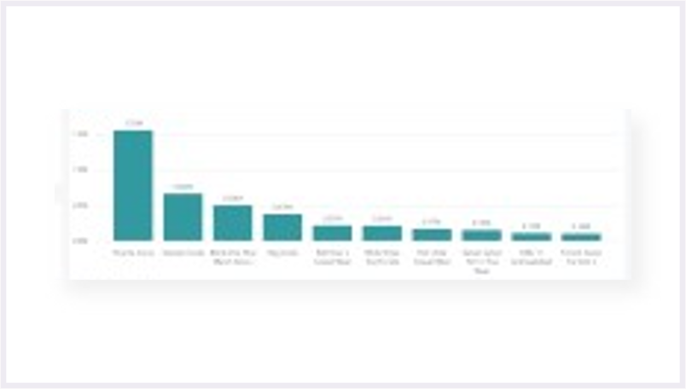
Analytics for LS Central
Business Central
Power BI Service
Power BI Reports
API
Microsoft Power BI Connector
Tables (on-prem)
API
Data
Tables (SaaS)
API
Query business logic
API

Slide 13
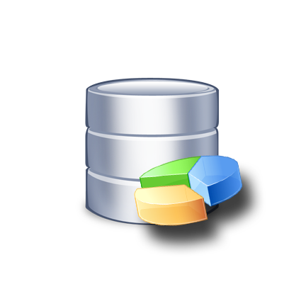
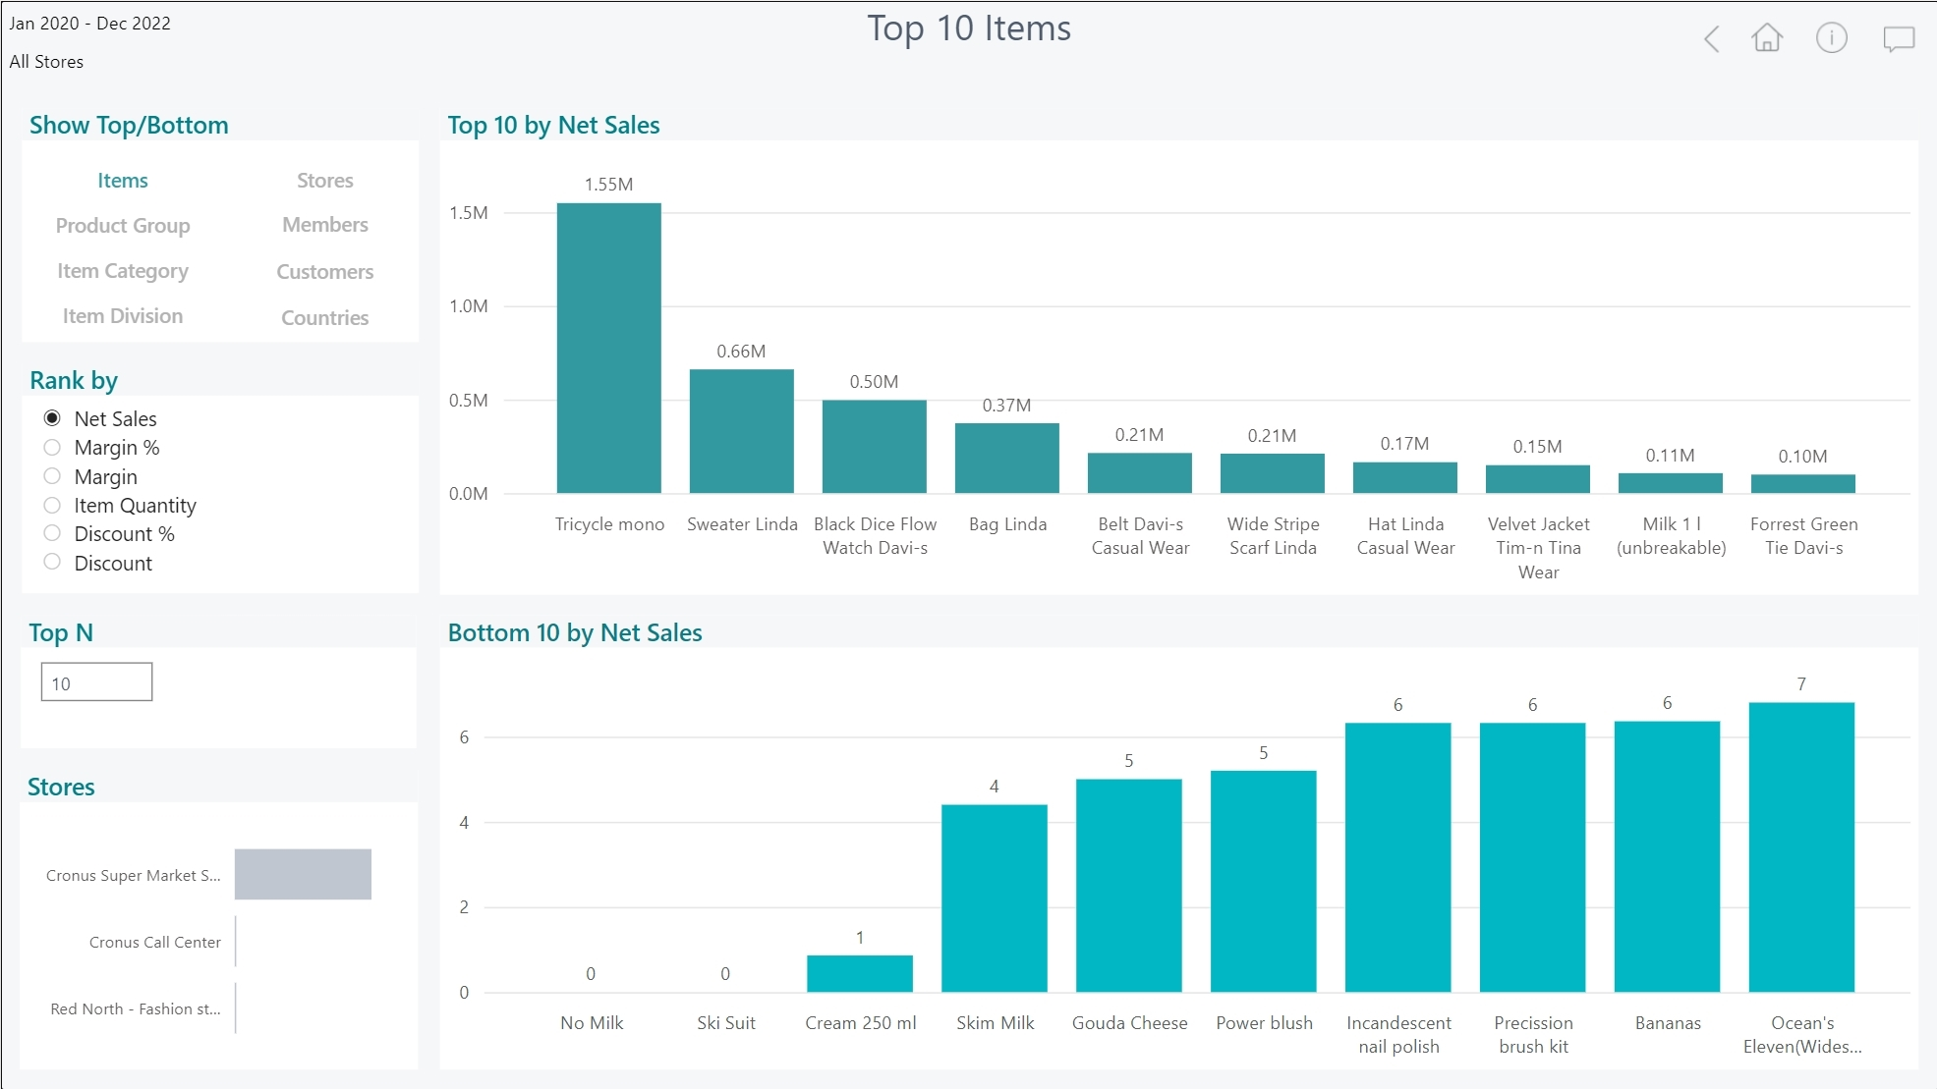
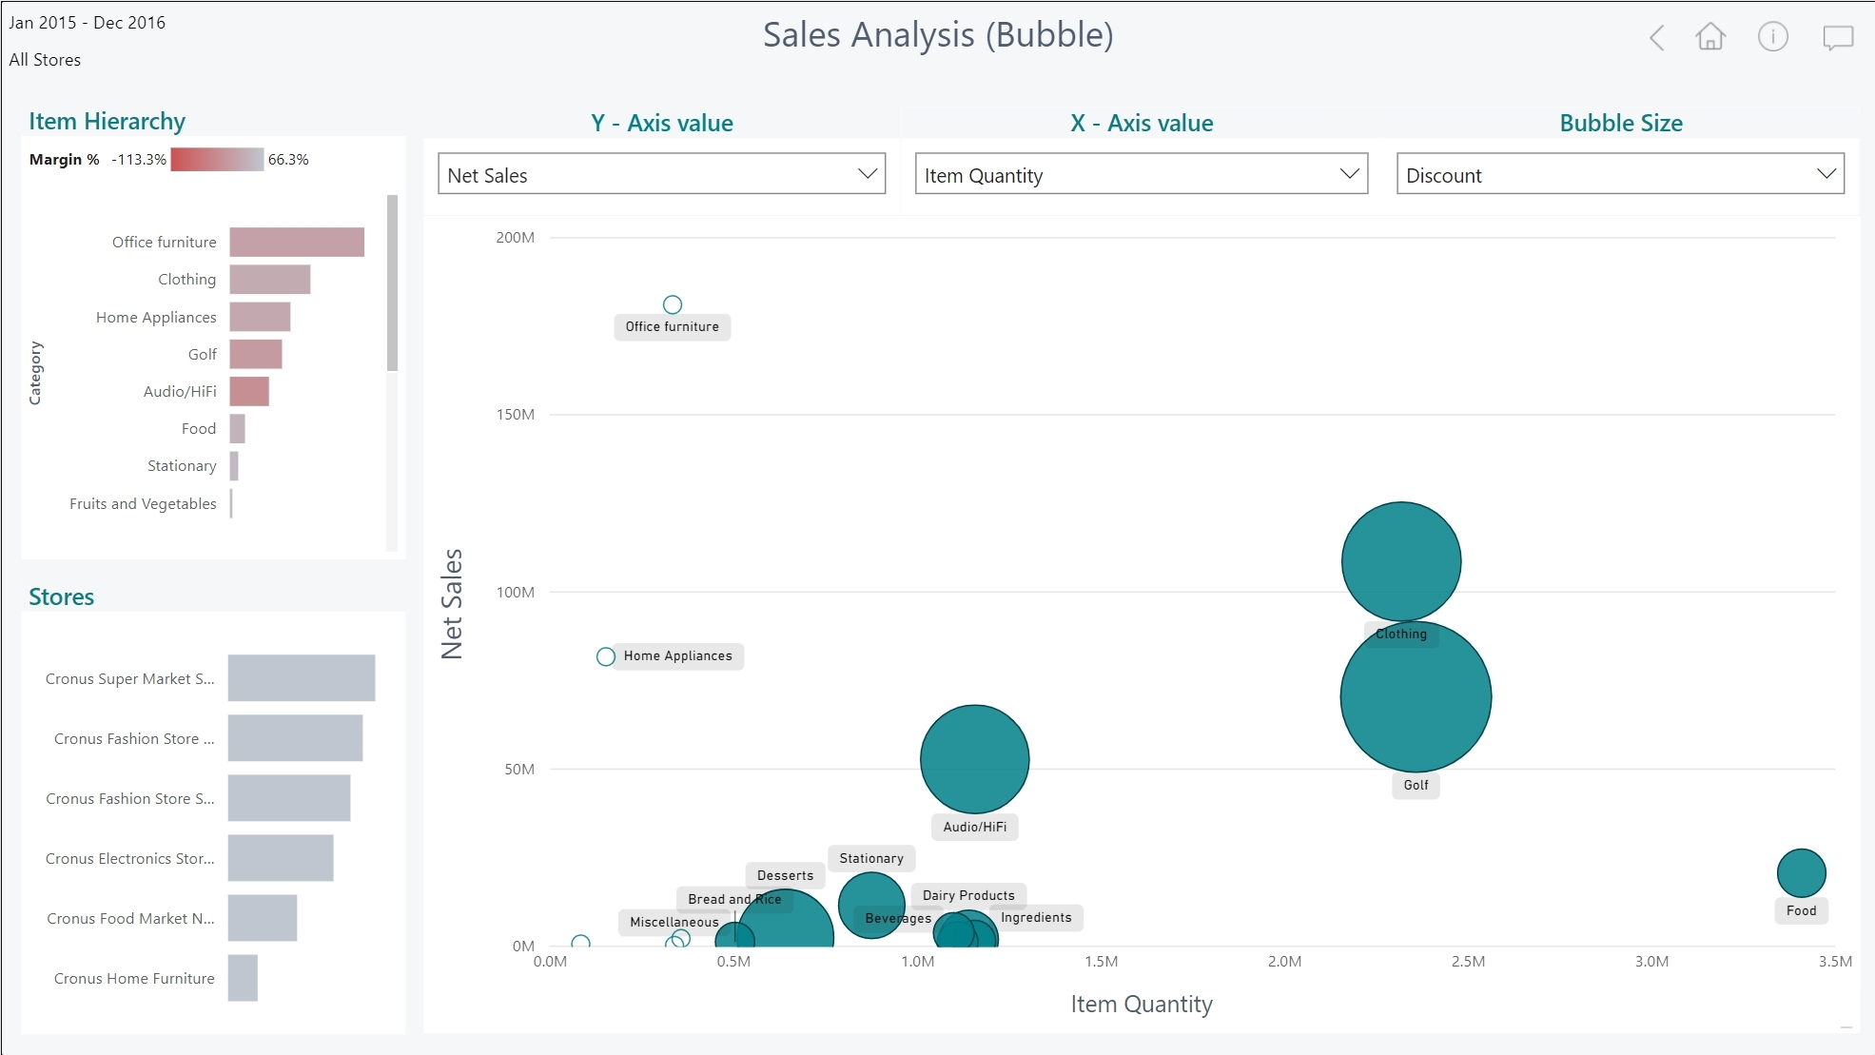
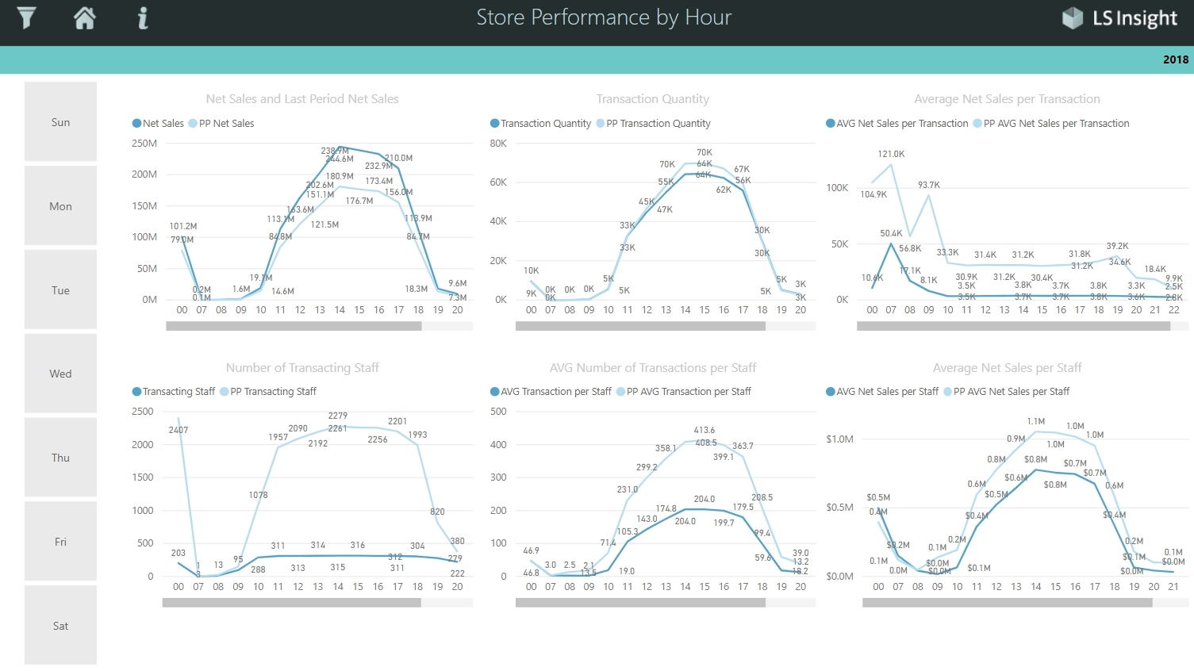
Analytics for LS Central
150+
Business Central
Azure SQL Server Datawarehouse
Power BI Service
Power BI Reports
Power BI Report templates
Azure Data Factory
Data
warehouse
Tables (on-prem)
Data
warehouse
Data
Staging
Tables (SaaS)
Staging
Query business logic
Prestaging
Prestaging
Data Director Webservices
Azure Data Factory

Slide 14
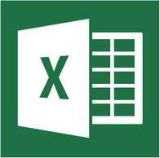
Analytics for LS Central
Analytics - Data Warehouse
Standard Microsoft technology
Azure SQL Server or SQL Server
Azure Data Factory (ETL processes and pipelines)
Easy to extend (new fields, tables, and other data sources)
LS Retail…
Provides ready-to-use data model, pipelines and logic
You…
Setup SQL Server (Azure /on-prem)
Download and setup the deployment package from LS Retail
Connect to BC, load data → GO!
…
Analytics – Data WH
Business Central (LS Central)

Slide 15
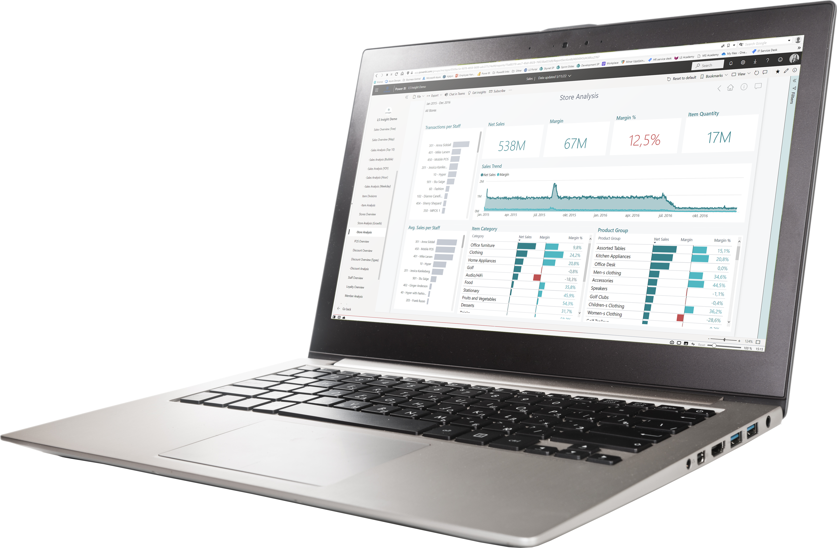
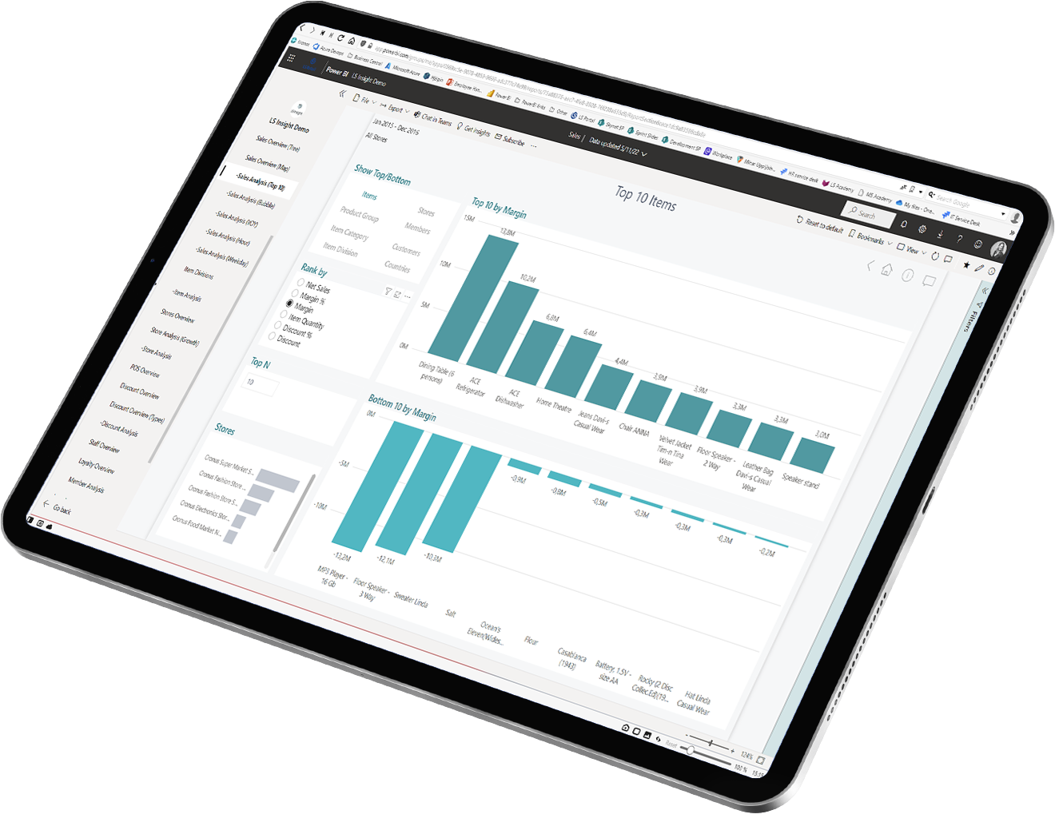
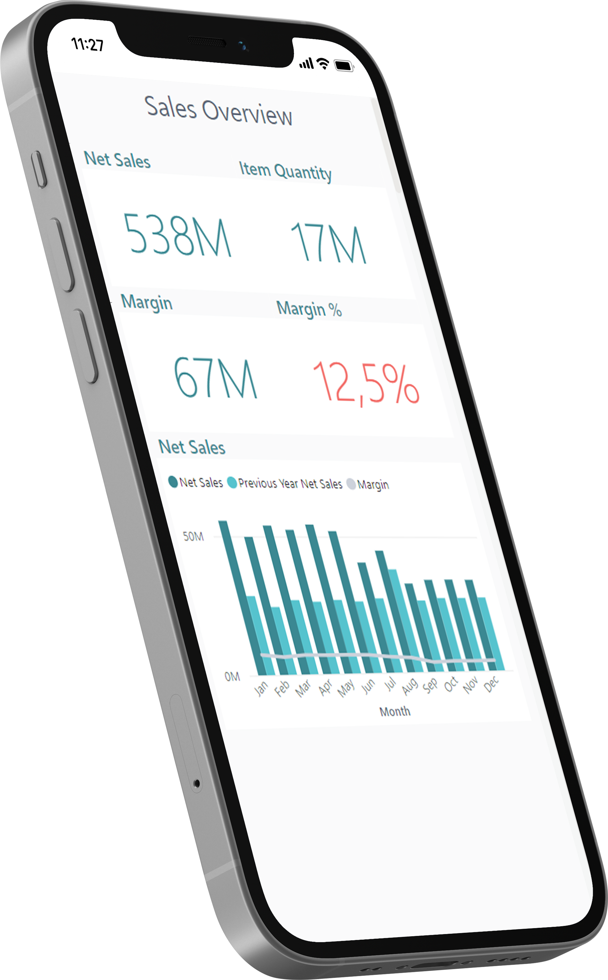
Analytics for LS Central
Analytics - Reports
Power BI based Report and Dashboard templates
Built on data from Analytics Data Warehouse
150+ report page templates
Easy to adapt, extend or build your own
Strong integration with MS Teams, Excel, and Powerpoint
LS Retail…
Provides ready-to-use report templates
You…
Subscribe to Power BI (@ Microsoft)
Setup the report packages from the deployment package
Connect to DW, load data → GO!

Slide 16
Analytics for LS Central
Report packs
Sales (added Budget and Section/Shelve reports)

Slide 17
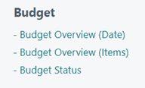
Should be sales

Slide 18
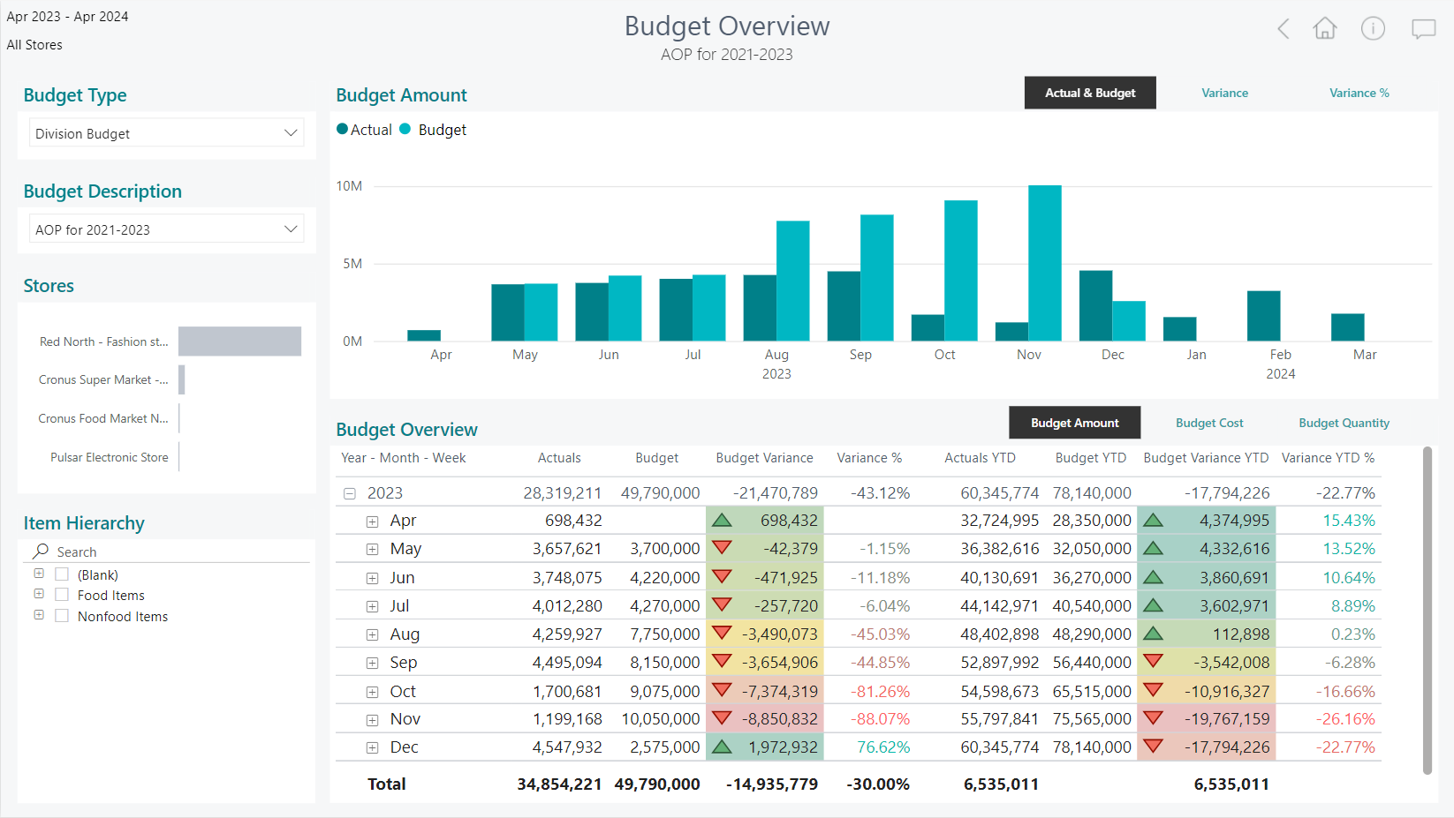
Enhancements in sales
reports

Slide 19
Should be sales

Slide 21
Analytics for LS Central
Report packs
Sales (added Budget and Section/Shelve reports)
Inventory
Supply Chain
Actionable Insights
Hotels
Hospitality (!!! New !!!)

Slide 22
Analytics for LS Central
Report packs
Sales (added Budget and Section/Shelve reports)
Inventory
Supply Chain
Actionable Insights
Hotels
Hospitality (!!! New !!!)
Aggregated Inventory (work in progress)

Slide 23
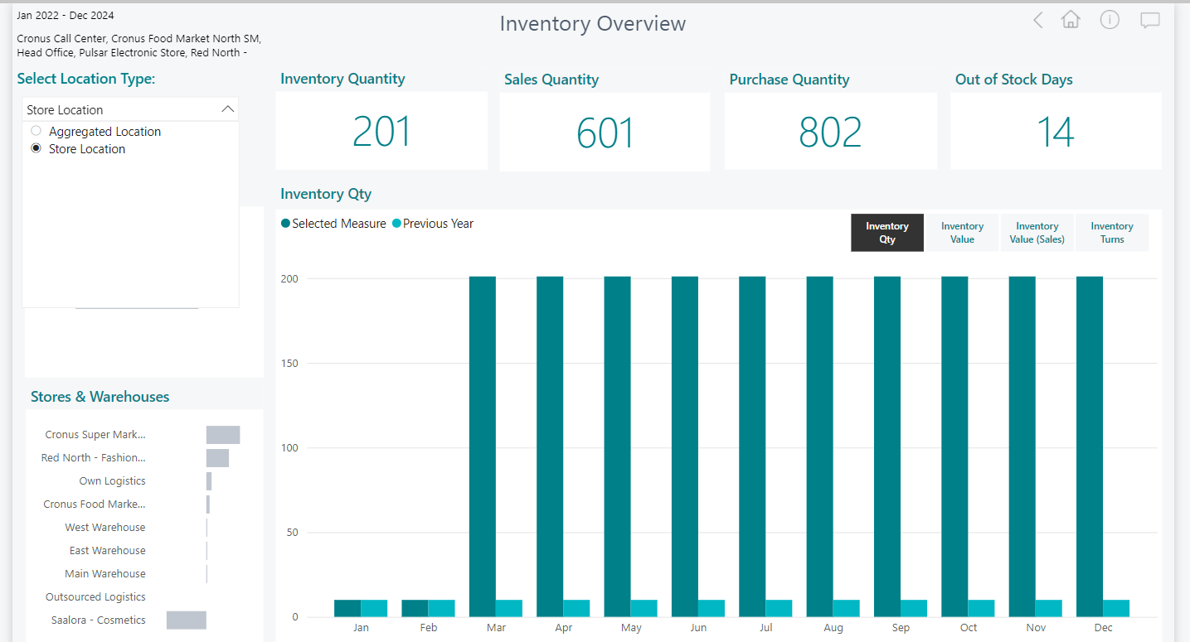
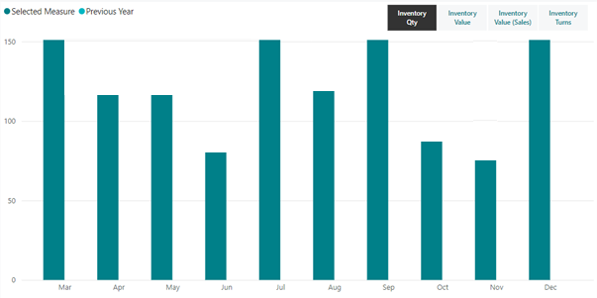
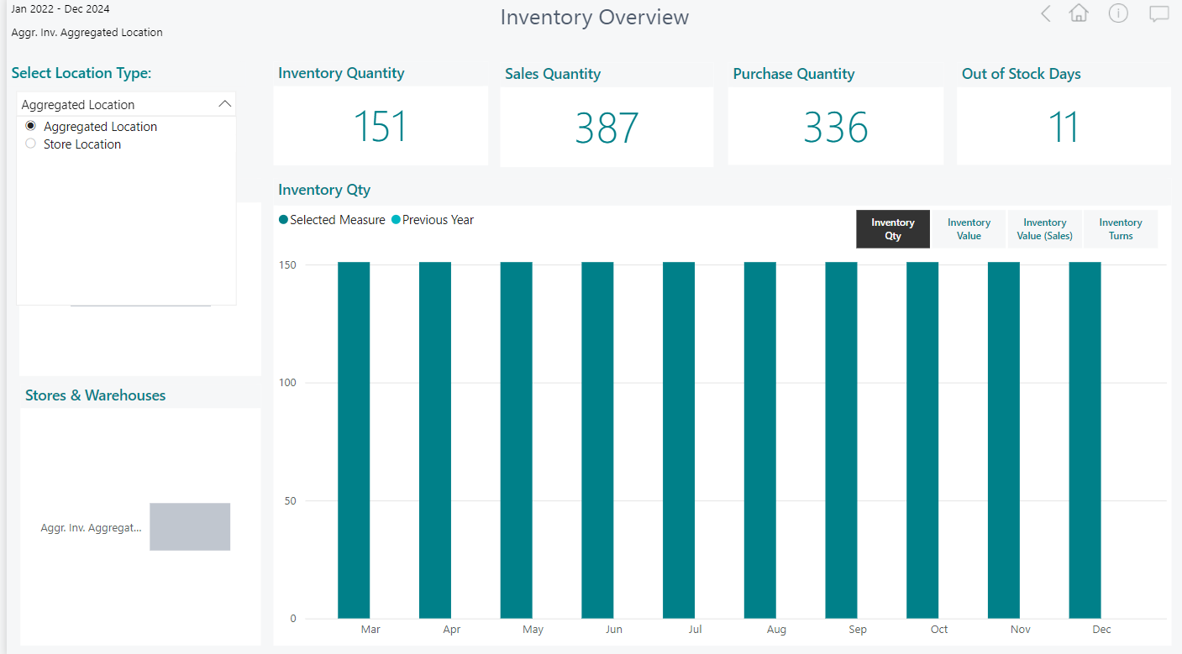
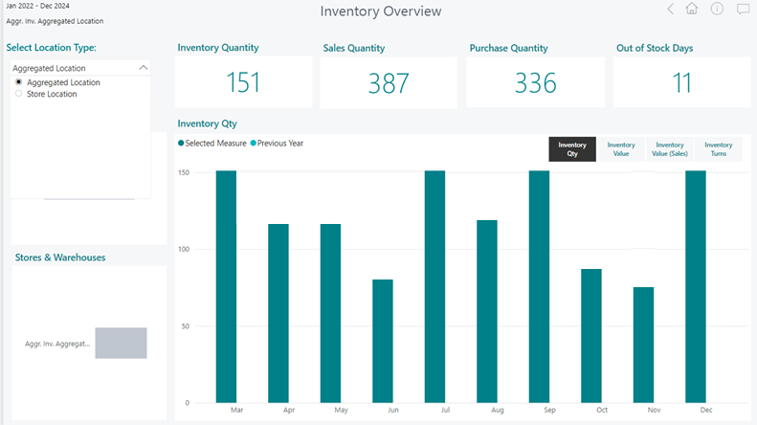
Aggregated Inventory

Slide 24
Analytics for LS Central
Report packs
Sales (added Budget and Section/Shelve reports)
Inventory
Supply Chain
Actionable Insights
Hotels
Hospitality (!!! New !!!)
Aggregated Inventory (work in progress)
Continuous improvements and additions based on customer feedback
Industry specific report packs currently in development

Slide 25
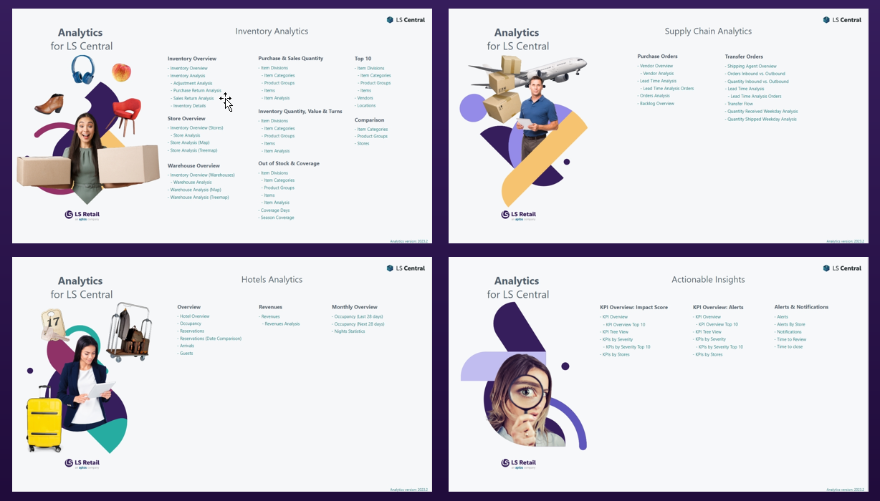
Customizations
Business Central
Analytics for LS Central DW
Power BI Service
SaaS or
On-premise

Slide 26
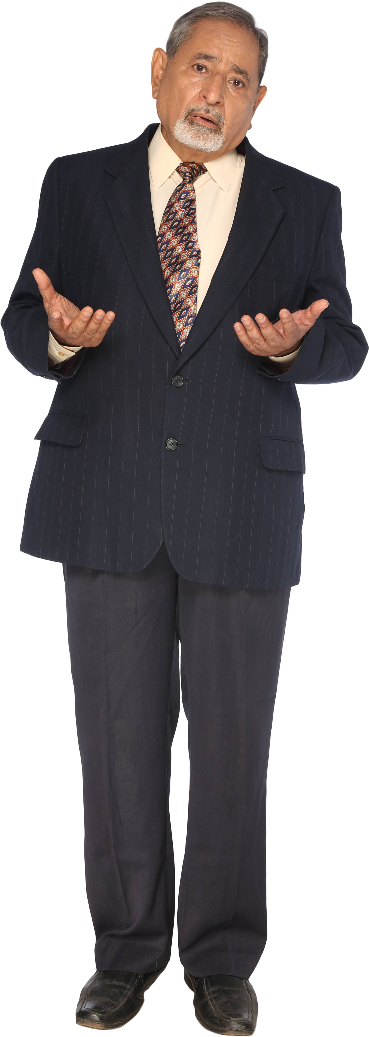
Can we add data from an external system that we have?
Can we add this field from LS Central?
What about the data from the extension you created?
We really need this information to be able to make the big decisions.

Slide 27
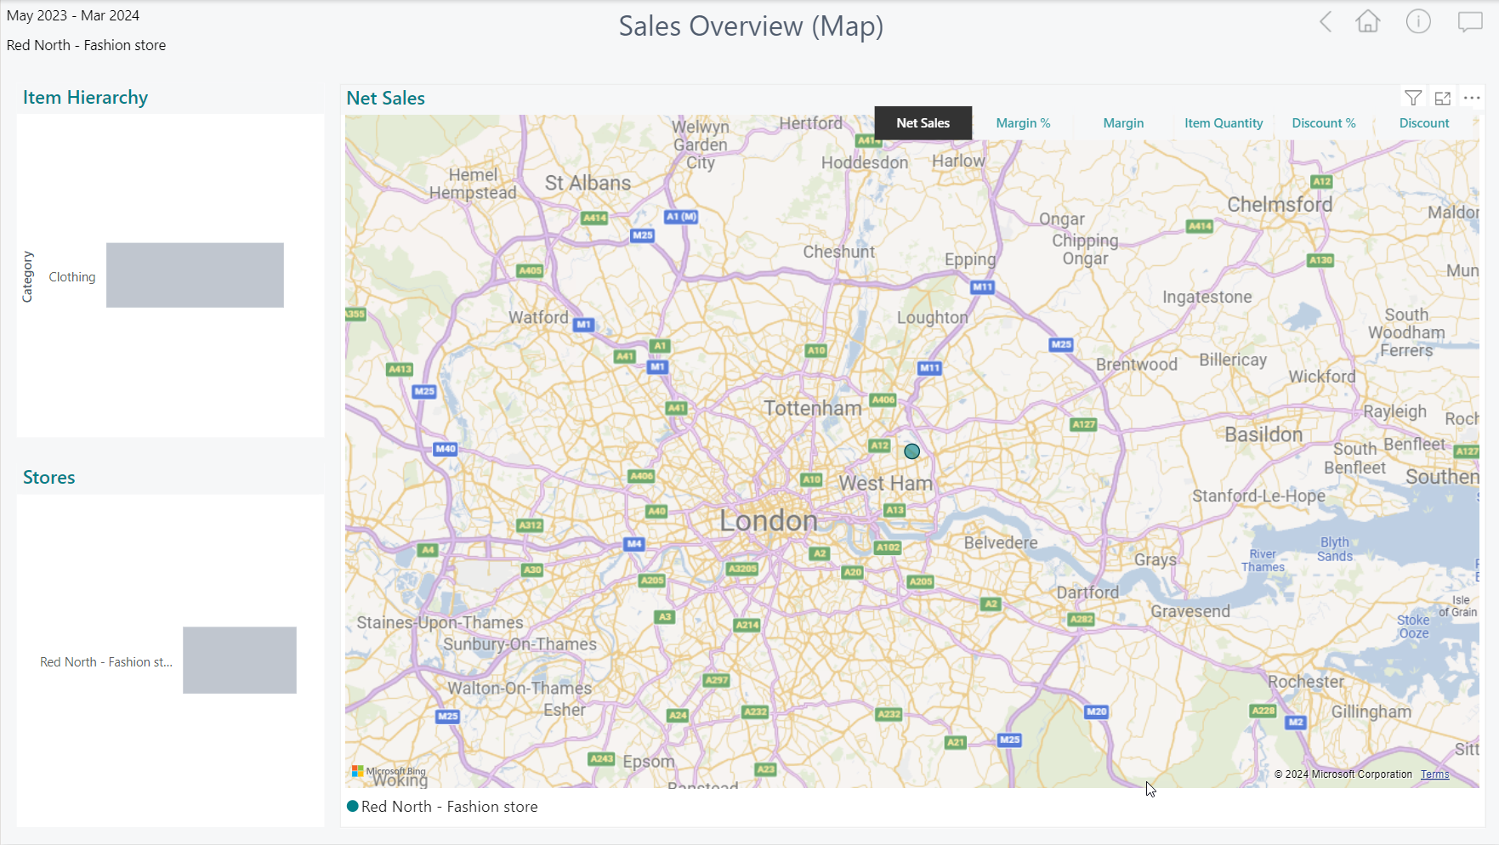
Customizations
Third party data
Business Central
Analytics DW for LS Central
Power BI Service
SaaS or
On-premise

Slide 30
Customizations
Third party data
Business Central
Analytics DW for LS Central
Power BI Service
SaaS or
Documentation for customization scenarios is available in Extension guidelines in Online Help
On-premise

Slide 31
Analytics for LS Central Architecture options

Slide 32
Architecture options
Business Central
Analytics DW for LS Central
Power BI Service
Business Central
SaaS
DW on Azure SQL
DW on on-prem SQL
Azure Data Factory
Data Director Webservices
On-premises
Power BI Connector

Slide 33
Architecture options – on prem
Business Central on-prem
Azure SQL Server (Analytics DWH)
Power BI Service
Azure Data Factory Integration Gateway (Interface to read from SQL server)
Power BI service pulls data from the data warehouse (based on a schedule)
Azure Data Factory (Pipelines to load and transform data)

Slide 34
Architecture options – SaaS
Business Central SaaS
Azure SQL Server (Analytics DWH)
Power BI Service
HCS Server / VM
LS Central Scheduler, Data Director
Power BI service pulls data from the data warehouse (based on a schedule)
Scheduled data replication
- from Business Central
- to Analytics database
Azure Data Factory (Pipelines to transform data)

Slide 35
Needed licenses/subscriptions
Analytics - BC on premises
Request Analytics license
Subscribe (Microsoft)
Power BI License
Azure SQL Server
Azure Data Factory
Analytics - BC SaaS
Request Analytics License
Subscribe (Microsoft)
Power BI License
Azure SQL Server
Azure Data Factory
Purchase 1 Offline Store license for the VM/Server to replicate data (not needed if you are using hybrid approach)

Slide 36
Business Central v23 SQL schema change for extension companion tables

Slide 37
Upgrade to BC 23 – LSC on-prem
New SQL schema for extension companion tables
LS Central on-premises 22.3 and earlier
LS Central on-premises 23.0 and later
Actions:
Upgrade Analytics to 2023.4 or later
Run the Factory Reset pipeline Pro-Tip: Boost your environment for 1 day ☺
Steps:
Upgrade Analytics to 2023.4 or later
Run the Factory Reset pipeline Pro-Tip: Boost your environment for 1 day ☺
Analytics for LS Central
2023.3 or earlier
Analytics for LS Central
2023.3 or earlier
Analytics for LS Central
2023.4 or later

Slide 38
Upgrade to BC 23 – LSC SaaS
LS Central SaaS 22.3 and earlier
LS Central SaaS 23.0 and later
No immediate action needed. We recommend upgrading to get the latest version.
Analytics for LS Central
2023.3 or earlier
Data Director Webservices
Analytics for LS Central
2023.3 or earlier
Analytics for LS Central
2023.4 or 2024.1

Slide 39
Agenda
Reporting in BC and Analytics
Analytics under the hood
What’s new
Architecture options
The BC23 challenge
How to get started
How to implement with success

Slide 41
Project plan
“Analytics for LS Central is so easy to install… why aren’t all my customers using it.”
Project plan in a nutshell
Key decisions
Prerequisites
Installation/Configuration
Go live

Slide 42
Project phases
½ Hour
Key Decisions
Pre requisites
Installation
GO LIVE
Configura-tion
Key Decisions:
LS Central on-prem
→ Analytics in Azure
→ Analytics database on-prem
LS Central SaaS → Analytics in Azure
Communication Server (for LS Central SaaS only)
Physical Server
VM in Azure

Slide 43
Project phases
4 hours
Pre requisites
Installation
GO LIVE
Key Decisions
Configura-tion
Prerequisites (LS Retail):
Register for the license
Download the product package
Procure/Spin Up – Communication Server
Prerequisites (Microsoft):
Power BI Pro account (10 USD per person/month)
Azure subscription (~100 USD per month)
Data Factory
Azure SQL Database

Slide 44
Project phases
8 Hours
Installation
GO LIVE
Key Decisions
Pre requisites
Configura-tion
Installation: (only LS Central SaaS)
Setup Communication Server (Physical or VM)
SQL Server
LS Central
Data Director

Slide 45
Project phases
8 Hours
Installation
GO LIVE
Key Decisions
Pre requisites
Configura-tion
Configuration:
Get Azure login credentials
Configure database connection
Run scripts in Data Factory
Assign users for Power BI

Slide 46
Project phases
0 Hours
GO LIVE
Key Decisions
Pre requisites
Installation
Configura-tion
GO LIVE:
Relax, have coffee
Enjoy the praise
Look at the reports with your data
Start building your own or modify existing

Slide 47
Analytics - after Go Live
GO LIVE
Key Decisions
Pre-requisites
Installa-tion
After GO LIVE
Configuration
Is the project really over after going live? Things to consider
Updates
Customization
Monitoring
Maintenance
Analytics, like any other software, needs updates, monitoring, and maintenance. Managed by partners or customers.

Slide 48
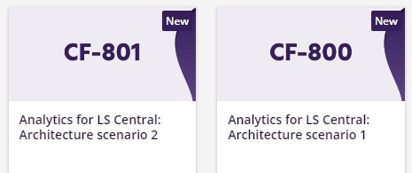
The future
Report packs
General improvements
Bookings reporting pack
Aggregated Inventory
LS Retail Academy courses
We listen to you!
CF-803
Soon

Slide 49
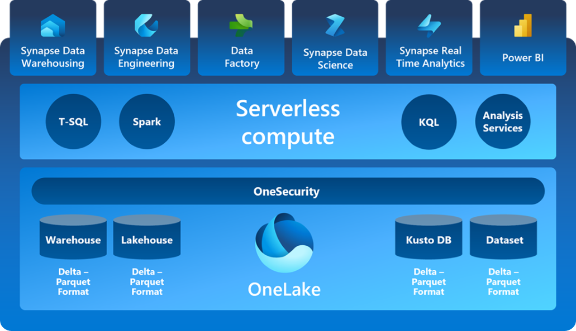
The future
Data load with Microsoft Fabric
Microsoft Fabric
Database mirroring
Business Central

Slide 50
Your Questions please! (or feedback ☺)

Slide 52
Thank you

