Slide 1
conneXion 2025 social media post
image template
There are 4 options for each version of cX25
Light and dark option with your name and picture.
Light and dark options with conference branding only
If there are any complications, please reach out to horduro@lsretail.com

Slide 2

Posting to social media
Once you have created the image, export it as a .jpg or .png file and post it to your social media platform.
In your post make sure to include important and practical information about the show and don’t forget to tag LS Retail and the conference.
The most used hashtags are #LSRetail #LSCentral #RetailSoftware #SoftwareSolutions #ModularSoftware - try to use max 5-6 hashtags.
If the post is industry related more specific hashtags like #HospitalitySoftware #RestaurantSoftware #RetailPOS or #RestaurantPOS might be more appropriate, so be selective and prioritize accordingly.

Slide 3
Add your picture
Make sure to use the correct cX version for your slide
Add your name and title

Slide 4
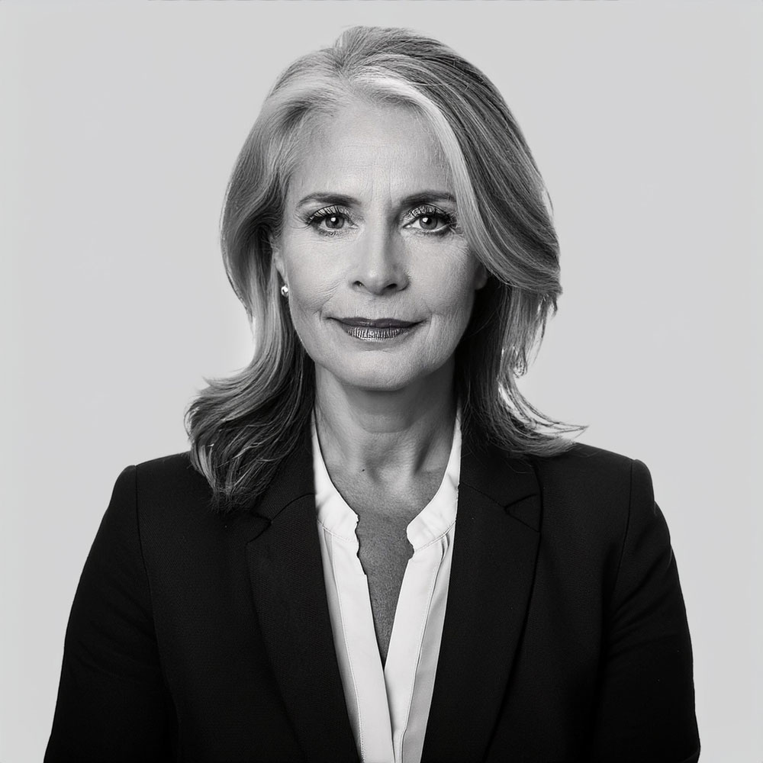
Demo Moore
AI employee for mockup

Slide 5
Demo Moore
AI employee for mockup

Slide 8
Demo Moore
AI employee for mockup

Slide 9
Demo Moore
AI employee for mockup

Slide 12
Demo Moore
AI employee for mockup

Slide 13
Demo Moore
AI employee for mockup

