Slide 1
What is LS Central for pharmacies?
Henrik Oskar Thordarson
Stefan Georgsson

Slide 2
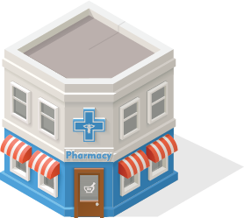
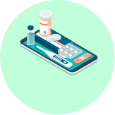
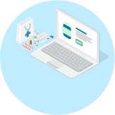
Our vision for innovation in pharmacy
Unified Pharmacy
All-in-one pharmacy suite
ERP
Finance
Warehousing
Advanced Shipping Notification
Dispensing
E-prescriptions
Rx master data
Dose dispensing
Integration
Localization for prescription & insurance gateways
Retail
Health and beauty
Loyalty
360-degree view of the customer
Clienteling
Personalized service on the pharmacy floor
Appointments and reservations
eCommerce
Retail and prescriptions
Prescription
Retail items
Click & collect
Traditional
Social media
Customer
App
Done
We know dispensing
Web

Slide 3
Modular design of LS Central
Each component in the system is like a Lego brick with seamless data integration
For customers, this means that it is now possible to update the system without a major upgrade project
Works both as a standalone pharmacy solution and a complete ERP, retail, and pharmacy solution
Unifies all channels & runs them from the same back-end solution
Member management/loyalty program is an integrated part of the solution
Customer Integrations
Country
Integration
Pharmacy module
LS Central
MS Dynamics 365 Business Central

Slide 4
LS Central for pharmacies
Contains general processes commonly used by all localizations
Prescription handling with or without connection to centralized ePrescription entity
BC24/SaaS available
Fully integrated to the LS Retail product portfolio
Can be used as a standalone solution
Ready for localizations or integrations
Now available all over the world by LS Retail and the LS Retail Partner Network
Customer Integrations
Country
Integration
Pharmacy module
LS Central
MS Dynamics 365 Business Central

Slide 5
Localizations and integrations
Localizations developed by LS Retail and supported by LS Retail to include any changes needed as local regulations evolve
Available for
Iceland
Norway
Sweden
UK – England, Scotland and Wales
Next countries?
Customer Integrations
Country
Integration
Pharmacy module
LS Central
MS Dynamics 365 Business Central

Slide 6
Key functionality areas
All standard prescription processes
Prescription handling
paper, electronic, emergency, animal, etc.
Generic substitution
Pharmaceutical control
Pick control
FMD Control
Order requests when item is not in stock and subscriptions
Pharmacy specific user permissions
Customer identification
Pharmacy customer database or link to national registry
Handling of Power of Attorney and care units
Master data import and management
Master data for prescription handling
Pharmaceutical Items
Item Groups including ATC and Substance Groups
Health Personnel

Slide 7
DEMO

Slide 8
Why LS Central for pharmacies?
Built on Microsoft Business Central and LS Central
Browser based, low footprint
Available as SaaS in Microsoft Azure
Easy integration with Power BI and other Microsoft apps
Continuous updates from Microsoft and LS Retail
Security
Built on server and client from Microsoft
MS SQL database
User traceability
Possibility to use RFID and MFA
Pharmacy access restricted by roles
Barcode control for safety
Efficient flow for prescription handling
Has been sold to nearly 3,000 pharmacies
A-Z single solution
ERP, POS, retail, and prescriptions

Slide 9
Questions?

