Slide 2
How to implement Replenishment in 45 minutes
Christina Cheng Martin Kleindl

Slide 6
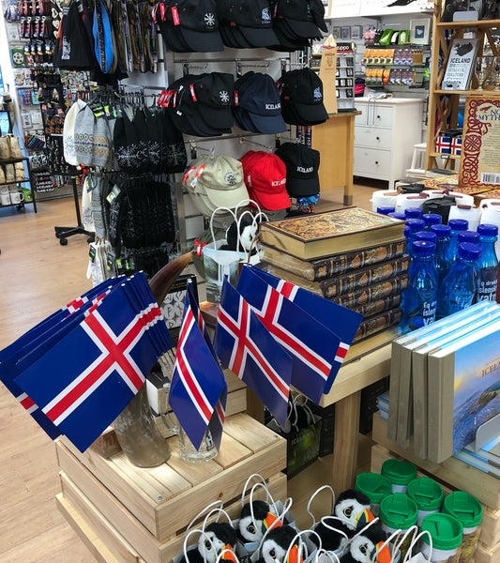

Slide 7
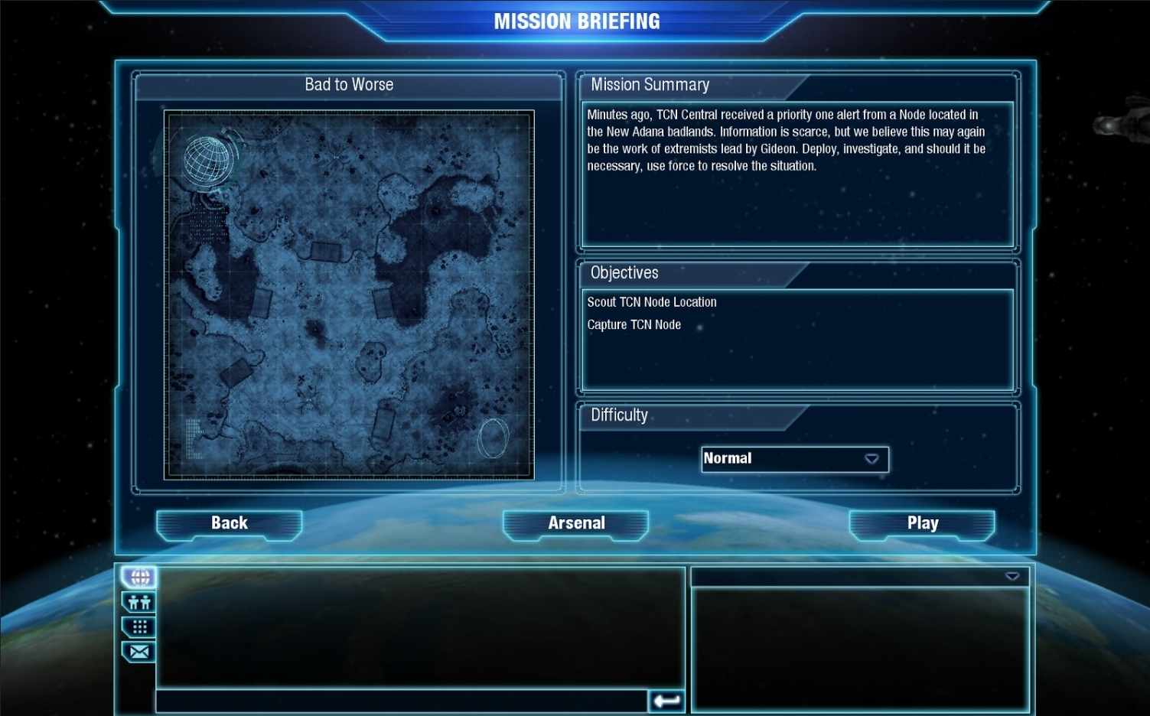
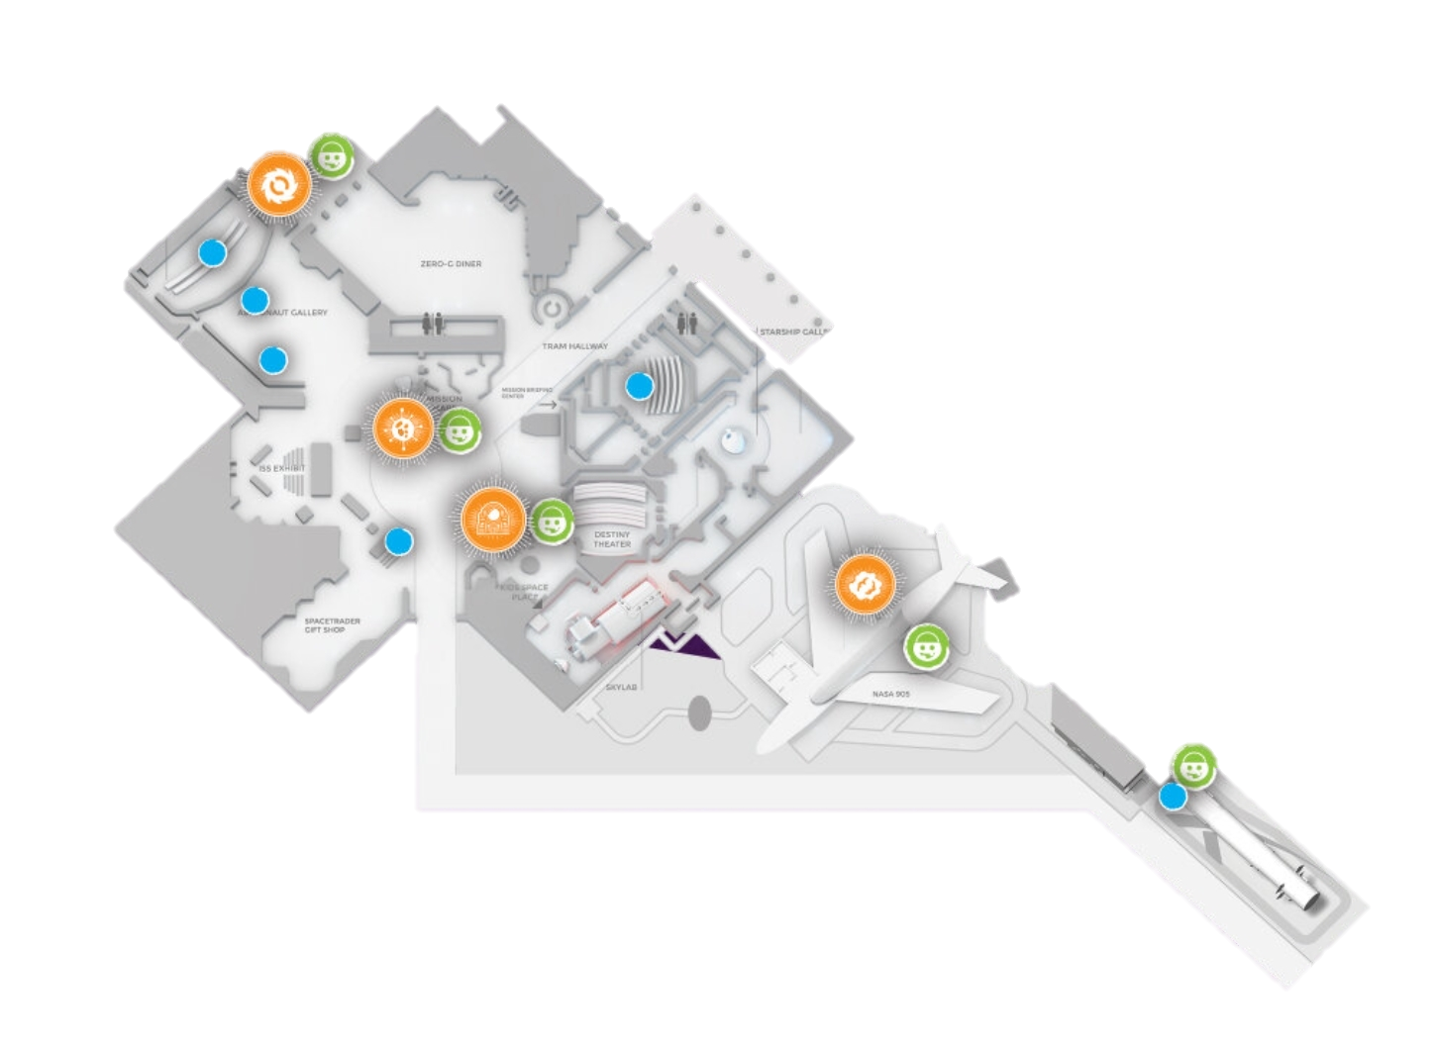
MISSION: BREAK the ICE!
Small Warehouse
Activate Replenishment for Christina’s Iceland Gift store
→ for 2 Stores
Store
Cafe
Automatic PO & TO creation for Stores - based on Stock - based on Sales History
Store
Low/Medium. Time = 45 minutes
Hint 1: Use Replenishment Implementation Guide
Hint 2: Focus on a couple of items before you setup all items

Slide 8
Replenishment Setup
Basic Setup
Warehouse, Store Locations
Items, Basic calc. rule
Replen. Journals
Advanced calc. rules (sales history)
Sales History Adjustment
Automation (Scheduler)
G.O.A.L.
Document Creation

Slide 9
Replenishment Setup
Basic Setup
Warehouse, Store Locations
Items, Basic calc. rule
Replen. Journals
Advanced calc. rules (sales history)
Sales History Adjustment
Document Creation
Automation (Scheduler)
G.O.A.L.

Slide 10
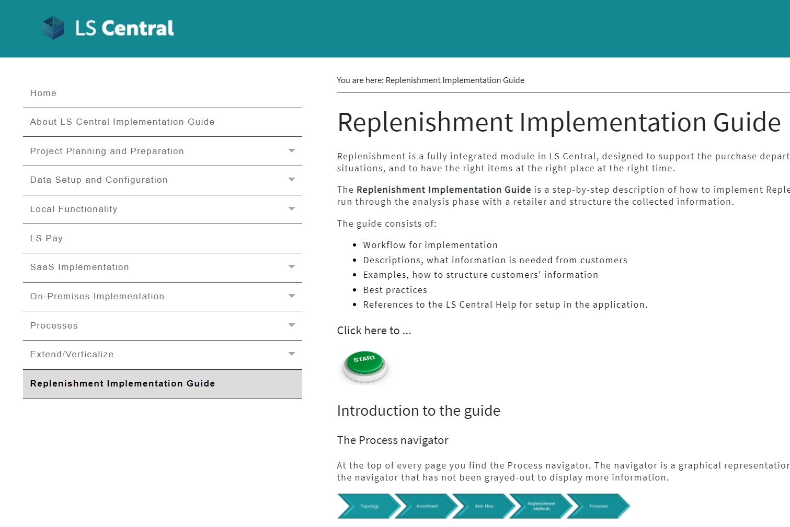
Basic setup, warehouse, store locations
How to start?
→ Replenishment Implement. Guide
Provides:
Workflow for implementation
Description what information is needed
Explains different use cases/scenarios
Best practices
References to LS Central Help

Slide 11
Let’s set up … Warehouses and Stores for Replenishment

Slide 12
Replenishment Setup
Basic Setup
Warehouse, Store Locations
Items, Basic calc. rule
Replen. Journals
Advanced calc. rules (sales history)
Sales History Adjustment
Document Creation
Automation (Scheduler)
G.O.A.L.

Slide 13
Item setup
Needed steps to activate items:
Select in which stores the items should be replenished
Select the replenishment calculation method
Specify parameters for the chosen method
Stores
Store 1
Store 2

Slide 14
Replenishment calculation
Demand calculation methods
Supported methods:
Reorder point/Max. inventory
Like for like
Manual estimate
Average usage
Adaptive models
Seasonality (Forward Profiles)
Replenishment Calendars (moving events like Easter)
Retail forecast
Integration to 3rd party forecasting engines

Slide 15
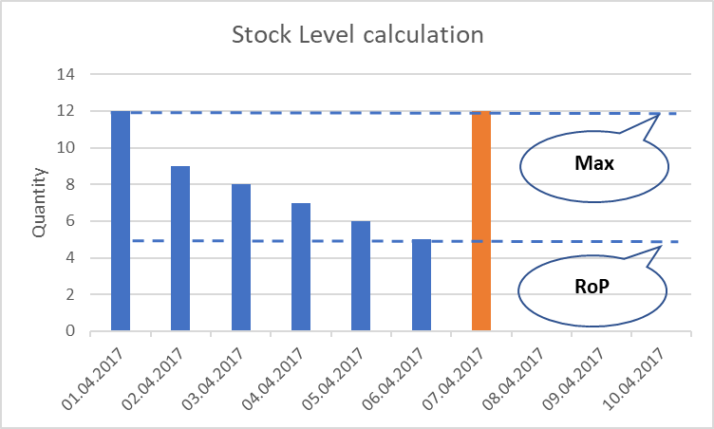
Item setup
Needed steps to activate items:
Select in which stores the items should be replenished
Select the replenishment calculation method
Specify parameters for the chosen method
Stores
Store 1
Store 2
Stock Level ordering based on existing store stock
Fields
Vendor
Reorder Point
Max. Inventory

Slide 16
Let’s set up … Items for Replenishment

Slide 17
Replenishment Setup
Basic Setup
G.O.A.L.
Warehouse, Store Locations
Items, Basic calc. rule
Replen. Journals
Advanced calc. rules (sales history)
Sales History Adjustment
Document Creation
Automation (Scheduler)

Slide 18
Replenishment journals
The place where we calculate the proposals for:
Purchase Orders
Transfer Orders
Elements
Template Defines what should be calculated in the Journal and how (rules)
Batch Defines when (in which interval) the Journal should be calculated

Slide 19
Template types
Warehouse 1
Store 1
Store 2
Store 3
Warehouse 2
Store 4
Store 5
Vendor A
Vendor C
Vendor B
Types
Purchase Order
Vendors to stores
Purchase Order
Vendors to warehouses
Transfer Order
Warehouses to stores
Purchase Order
Vendors to warehouses with Cross Docking (warehouses to stores)
Redistribution
Stores to stores
To store
To warehouse
To warehouse with Xdocking
(A)
(B)
(D)
(C)
(E)

Slide 20
Template Types
Warehouse 1
Store 1
Store 2
Store 3
Warehouse 2
Store 4
Store 5
Vendor A
Vendor C
Vendor B
Types
Purchase Order
Vendors to stores
Purchase Order
Vendors to warehouses
Transfer Order
Warehouses to stores
Purchase Order
Vendors to warehouses with Cross Docking (Warehouses to Stores)
Redistribution
Stores to stores
To Store
To Warehouse
To Warehouse with Xdocking
(A)
(B)
(D)
(C)
(E)

Slide 21
Let’s set up Replenishment Templates (and do our first calculation)

Slide 22
Replenishment Setup
Basic Setup
G.O.A.L.
Warehouse, Store Locations
Items, Basic calc. rule
Replen. Journals
Advanced calc. rules (sales history)
Sales History Adjustment
Document Creation
Automation (Scheduler)

Slide 23
Replenishment Setup
Basic Setup
Warehouse, Store Locations
Items, Basic calc. rule
Replen. Journals
Advanced calc. rules (sales history)
Sales History Adjustment
Document Creation
Automation (Scheduler)
G.O.A.L.

Slide 24
Replenishment calculation
Demand calculation methods
Supported methods:
Reorder point/Max. inventory
Like for like
Manual estimate
Average Usage
Adaptive models
Seasonality (Forward Profiles)
Replenishment Calendars (moving events like Easter)
Retail forecast
Integration to 3rd party forecasting tools

Slide 25
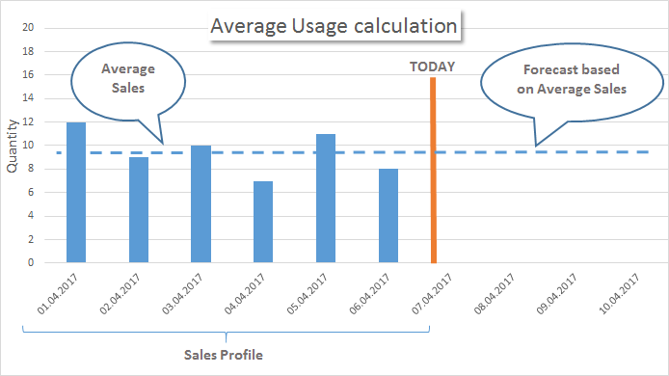
Calculation methods
Historical sales: Average usage Transfer Orders and/or Purchase Orders are proposed based on sales history.
Needed fields:
Sales profile defines time horizon how far we look back
Coverage period
Warehouse: based on purchase interval
Stores: based on store replenishment interval

Slide 26
Let’s change our Item’s setup to use Average Usage (and do another calculation)

Slide 27
Replenishment Setup
Basic Setup
Warehouse, Store Locations
Items, Basic calc. rule
Replen. Journals
Advanced calc. rules (sales history)
Sales History Adjustment
Document Creation
Automation (Scheduler)
G.O.A.L.

Slide 28
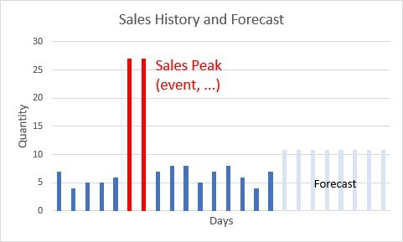
Sales history adjustments
Simulation or adjustment of sales history
Methods:
Simulate sales history for new items or stores (from other item’s sales history with factors)
Correction of sales history - Automatic outlier detection - Planned demand event/promotions tracking - Manual corrections

Slide 29
Let’s simulate sales history for our new item (and do another calculation)

Slide 30
Replenishment Setup
Basic Setup
Warehouse, Store Locations
Items, Basic calc. rule
Replen. Journals
Advanced calc. rules (sales history)
Sales History Adjustment
Document Creation
Automation (Scheduler)
G.O.A.L.

Slide 31
Let’s create Purchase Orders (from the Template)

Slide 32
Replenishment Setup
Basic Setup
Warehouse, Store Locations
Items, Basic calc. rule
Replen. Journals
Advanced calc. rules (sales history)
Sales History Adjustment
Document Creation
Automation (Scheduler)
G.O.A.L.

Slide 33
How to automate this process?

Slide 34
Replenishment Setup
Basic Setup
Warehouse, Store Locations
Items, Basic calc. rule
Replen. Journals
Advanced calc. rules (sales history)
Sales History Adjustment
Document Creation
Automation (Scheduler)
G.O.A.L.

Slide 35
MISSION: BREAK the ICE!
Small Warehouse
Activate Replenishment for Christina’s Iceland Gift Store
→ for 2 Stores
Store
Cafe
Automatic PO & TO creation for Stores - based on Stock - based on Sales History
Store
Low/Medium. Time = 60 minutes
Hint 1: Use the Replenishment Implement. Guide
Hint 2: Focus on a couple of items before you setup all items

Slide 36
Replenishment
Planning & Data Maintenance
Manual Replenish- ment
Automatic Replenish- ment
Execution
Monitoring
Sales & Purchase Budgets
Allocation Plans
Buyer‘s Push, Stock Recall
Allocation Rules
Variant Weight Dim. Pattern
Demand Forecasts
Store Stock Redistribution
Purchase & Transfer Orders
Stock Requisition
Buyer‘s Workbench
Inventory and Demand
Store Capacity
Stock Coverage
Vendor Performance
Open to Buy
Assortment Mgmt.
Lifecycle Mgmt.
Replenishment Journal Calculation
Threshold Mgmt.
Lifecycle Planning WS
Cross Docking
Manual Purch. & Transfer Orders
Replen. Item Quantity Calculation
Out-of-Stock Calculation
Item Import

Slide 37
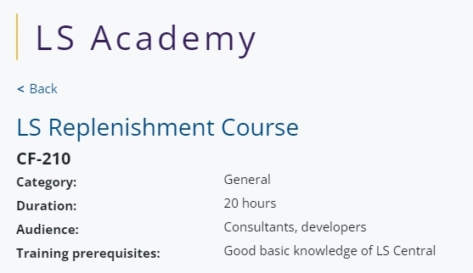
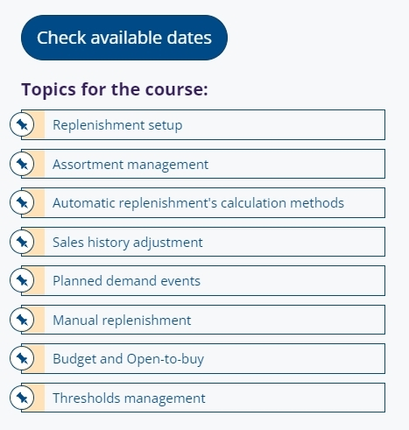
How to get started?
LS Retail Academy
Training
LS Retail Academy – training course https://www.lsretail.com/ls-academy/
Individual training through LS Retail Consulting
Webinars and LS Central Help
Sales support
Presales, solution design, concept reviews by LS Retail Consulting
Implementation support
by LS Retail Consulting

Slide 38
Feature Improvements
Effective Inventory calculation New rule to specify horizon of back periods Consideration of Purchase Return Orders New rule to handle Negative Eff. Inventory (nullify or keep)
Transfer Unit of Measure New field on Item Card; allows conversion of UoM for Transfer Orders
Replen. Journal Cross Docking improvements Enhanced calculation for better results with Transfer Multiples New field: Inb. WH xDock Handling Time (Date Formula)
Reorder Point and Max. Inventory for WHs New setup fields to specify different RoP/MaxInv for stores and warehouses
Further performance improvements & process enhancements

Slide 39
Feature Improvements
Exclude Item Groups from Out-of-Stock calc. Option for users to exclude items from Out-of-Stock calculation to reduce calculation time
Further improvements
Stock Recall
Replen. Control Data list
Sales History Adjustment
Advanced Date handling for Purchase Orders
Performance improvements

Slide 40
Replenishment - performance
Improvements for the core Replenishment processes
Out of Stock Calculation
Replen. Item Quantity Calculation
Replen. Journal Calculation
Detect current OOS situations 4,0h → 38 min -84,5 %
Calculate current stock situation
Calculate historical sales performance 6,5h → 78 min -79,0 %
Calculate demand
Calculate proposals for Purchase or Transfer 1,0h → 10 min -82,0 %
Document Creation
Purchase Orders
Transfer Orders
Assembly Orders -15,0 %

Slide 41
Replenishment - performance
Improvements for the core Replenishment processes
Out of Stock Calculation
Replen. Item Quantity Calculation
Replen. Journal Calculation
Detect current OOS situations 4,0h → 38 min -84,5 %
Calculate current stock situation
Calculate historical sales performance 6,5h → 78 min -79,0 %
Calculate demand
Calculate proposals for Purchase or Transfer 1,0h → 10 min -82,0 %
Document Creation
Purchase Orders
Transfer Orders
Assembly Orders -15,0 %
LS Central version 24

Slide 42
The future
Multi-Warehouse Replenishment
Improved processes for scenarios with multiple warehouses
Secondary and tertiary warehouses for items
Warehouse to warehouse transfers
Replenishment for Bill of materials (BOM)
Handling of BOM in BOM
Assembly Order creation
Further performance improvements & process enhancements

Slide 43
Your Questions please! (or feedback ☺)

Slide 46
Thank you

