Slide 2
LS Retail Office Hours Overview of Replication in SaaS without Data Director
Matthias Matthiasson
Ricardo Moinhos
Aðalbjörg Karlsdóttir
Director Partner Experience
Senior Onboarding Specialist
Onboarding Lead

Slide 3
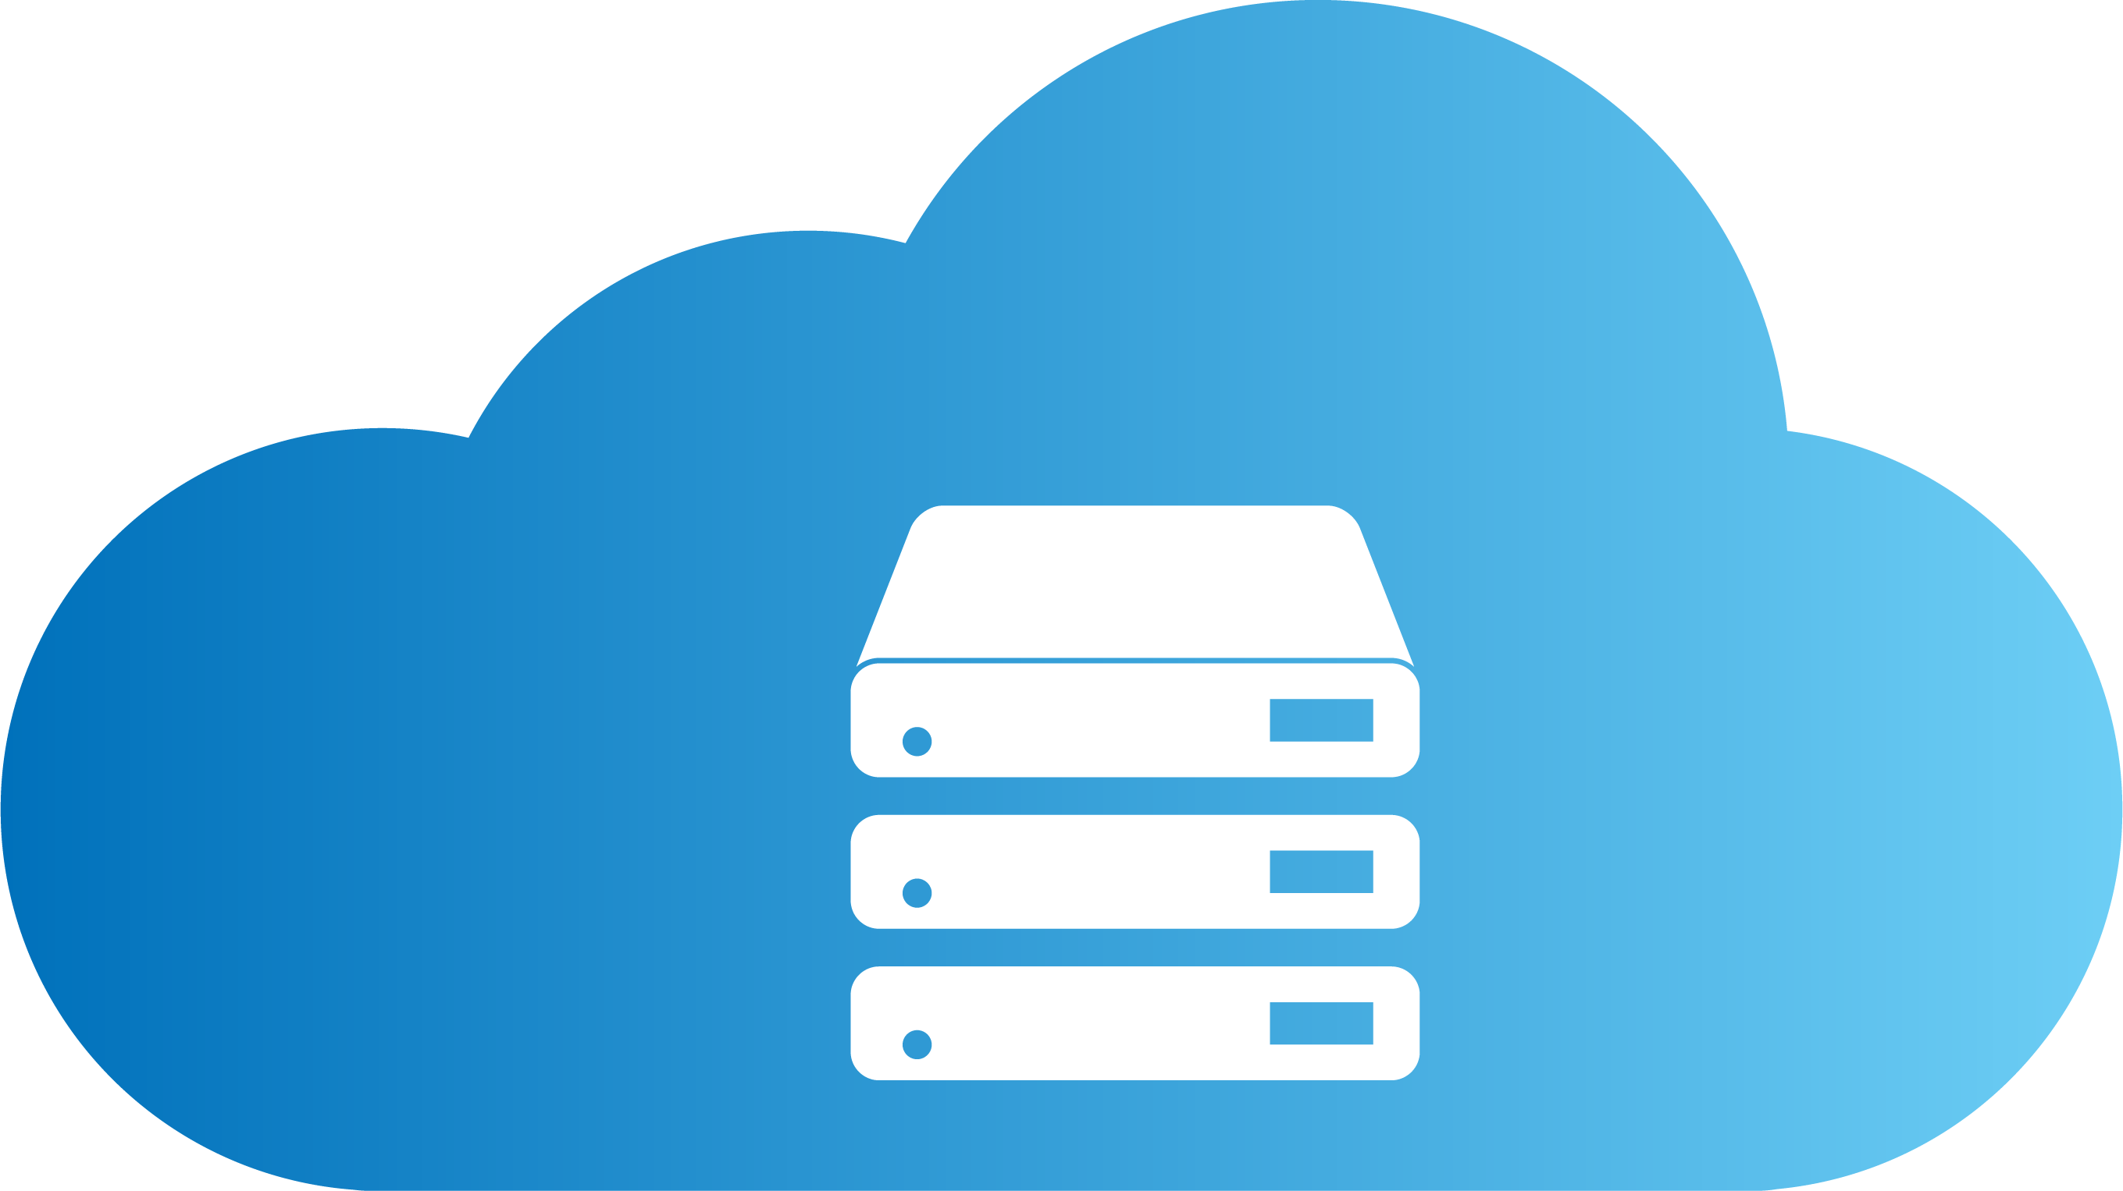
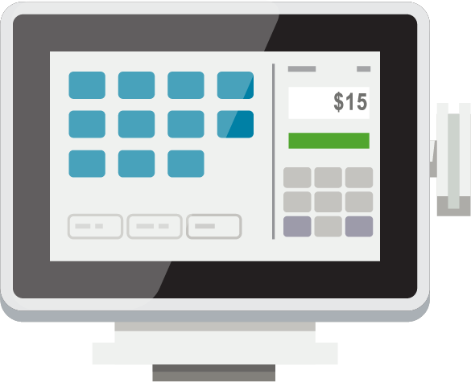
The Big SaaS Picture
LS Central SaaS
BC SaaS
Azure Storage
Service Bus
Update Service
Hosted on-premise
Azure Service (plans)
Commerce Service
Hosted on-premise
Connect directly to BC Server
Mobile Inventory (supported)
Other (plans)
AZURE
Commerce Service
Update
Service
Update
Service
Planned
BC/LS
SaaS
Azure Storage
Service
Bus
STORE
Online POS
Offline POS

Slide 4
Fundamentals of Replication

Slide 5
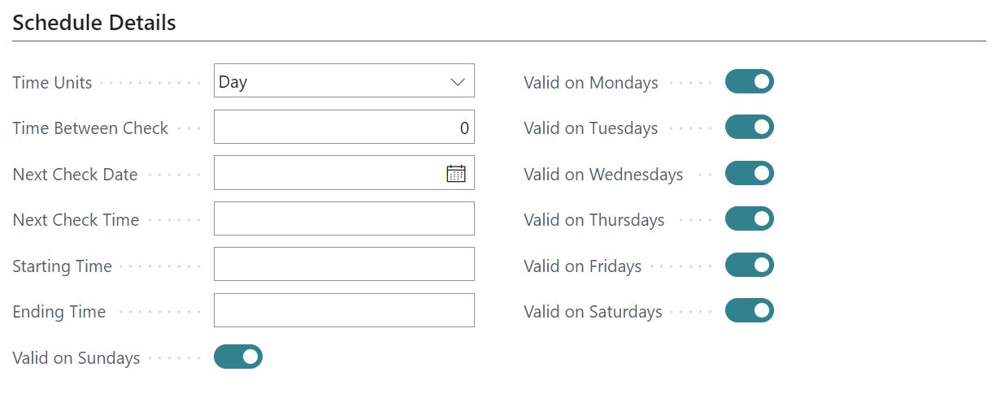
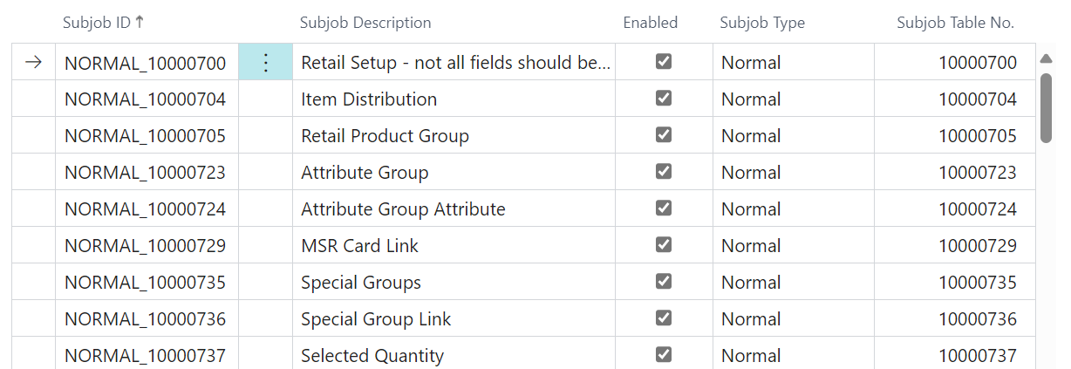
Scheduler Job
When
When the Scheduler Job is run
Defines Destination
Location / Distribution Location
Locations / Distribution Groups
What is replicated
Scheduler subjobs

Slide 6
Scheduler Subjob
Replication Methods
Normal
All data
By Replication Counter
By Action
Pre-Actions
Actions
Preload-Actions

Slide 7
Replicating Master Data
with Web Replication

Slide 8
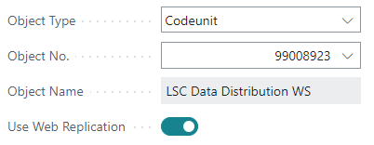
Web Replication
Activate Web Replication on the Scheduler job card
Only push from the current location
Only to the same table and field at the destination
Scheduler Job

Slide 9
Web Replication
The normal job now supports deletes
Deletes all data in the destination table
Data inserted/updated without Data Validation
Solution implemented within BC/AL

Slide 10
Web Replication
Scheduler Job
Step 1
Create Replication Requests
Source
Destination
Scheduler
Job – Data
Distribution
WS
Request
Table

Slide 11
Web Replication
Scheduler Job
Step 2
Data Replicated by Web Replication Module
Source
Destination
Scheduler
Job – Data
Distribution
WS
Web
Replication Method
Request
Table
Web Replic.
Packet Data
Update
destination
table
Scheduler
Job – Repl.
Function
Web
Replication
Queue
Defined in Distribution Location

Slide 12
Point to Point (P2P)
Prerequisite
Distribution Location record the Web Replication Method is set to Web Services (Odata 4)
Replicate between two BC Environment
Destination table modified automatically
Distribution Location
----- -----
-----
-----
------ ------
------
------
------
P2P
------ ------
------
------
------

Slide 13
Azure Storage (AzS)
Prerequisite
Distribution Location record the Web Replication Method is set to Azure Storage
Used for replication to Offline POS
Two step process
POS: Trigger replication
POS background session
Scheduler job
Azure Storage costs less than $10 per month
1 million Items, 8 full and 120 deltas replication
Distribution Location
------ ------
------
------
------
------ ------
------
------
------
AzS
----- -----
-----
-----

Slide 14
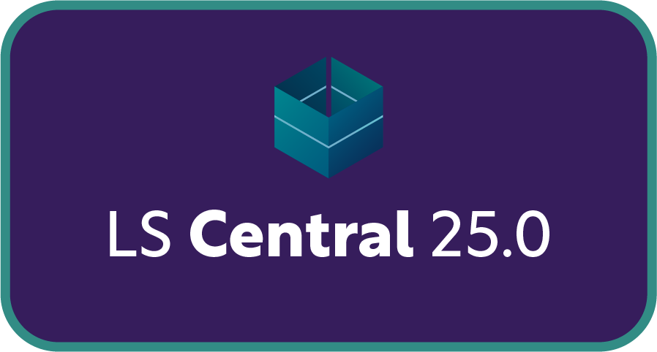
Company to Company (C2C)
Prerequisite
Distribution Location record the Web Replication Method is set to Company to Company
Replicate between two BC Companies in same Environment/SQL
Destination table modified automatically
Distribution Location
----- -----
-----
-----
----- -----
-----
-----
26

Slide 15
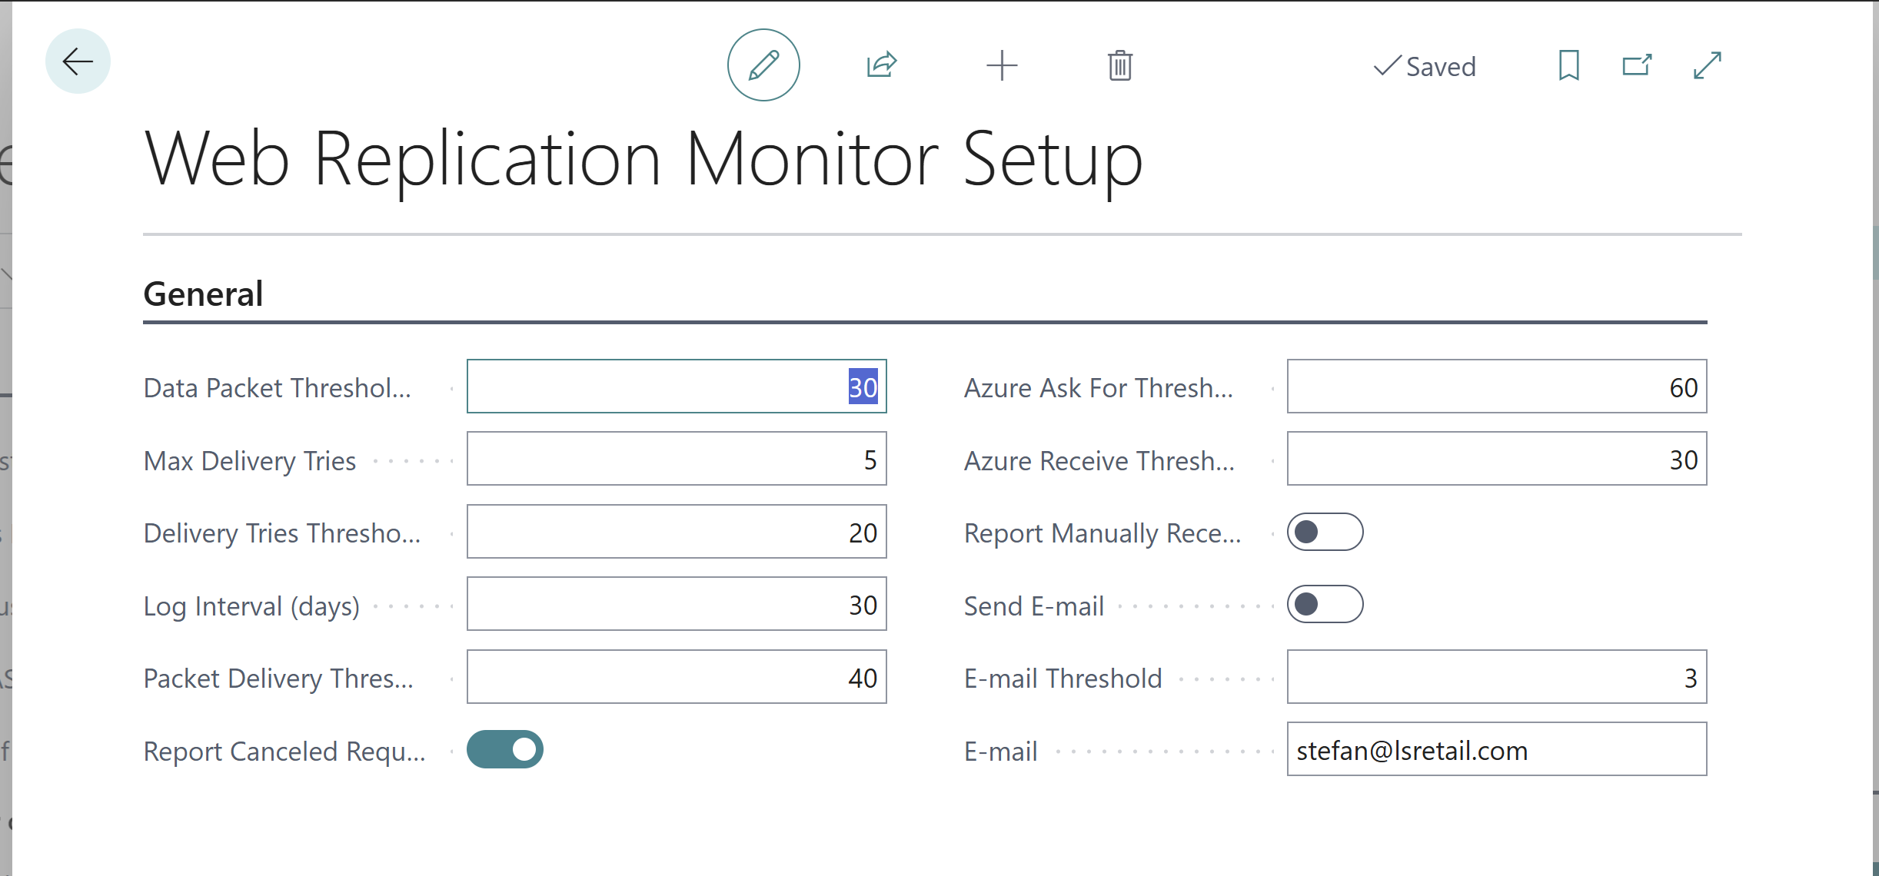
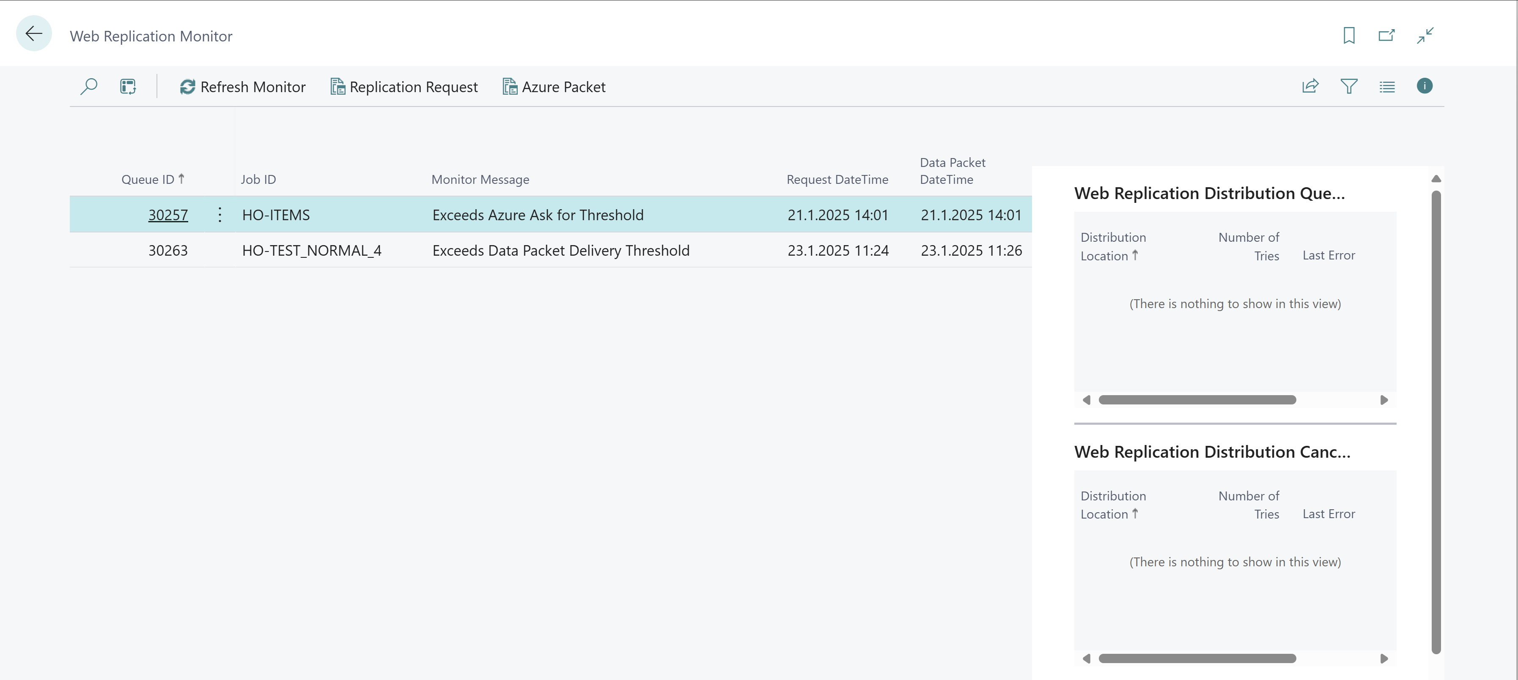
Web Replication Monitor
Monitor web replication tasks and send notifications if needed
Setup
Define threshold for monitor
Monitor Dashboard
Gives a good overview for issues that need resolving
Can send emails

Slide 16
Timestamps

Slide 17
Timestamp
LS Central 26 will support using timestamps instead of Pre-actions
Uses SQL timestamp of record insert or modification
All record deletes logged in a deleted record table
Use of timestamps can be activated for a specific distribution location
Most likely head office
Other distribution locations can continue to use pre-actions
Why timestamps
Less table locking resulting from pre-action table
Pre-action table can grow very large
Risk
Any extension/integrations relying on pre-action technology will not work
26

Slide 18
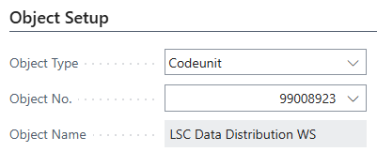
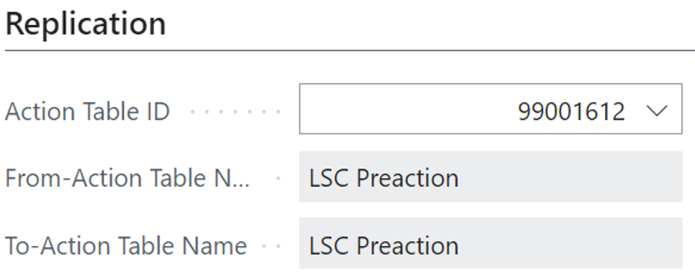
Timestamp - Replicate
If timestamp is activated in source distribution location
Then timestamp and delete table will be used to select record instead of pre-action table
Replicating
Scheduler Job
Object setup is codeunit 9900893
Scheduler Subjob
Method is by action
Replicating by pre-action table
Scheduler Job
Scheduler Subjob

Slide 19
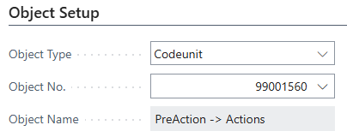
Timestamp – Pre-actions to Actions
If timestamp is activated in source distribution location
Pre-actions to Actions
Scheduler Job
Object setup is codeunit 99001560
No Subjobs needed
Takes all Pre-actions defined in Table Distribution Setup
Scheduler Job

Slide 20
Send POS Transactions to
Head Office

Slide 21
Send POS Transactions (Send Transaction)
Web Request Send Transaction
Can be run
Directly
Background Session
xmlport defines tables and fields.
How to extend
New xmlport, implementing all fields and table (SendTransactionXML) - host
New codeunit to publish the new xmlport (SendTransaction) - host
Extension (codeunit)to standard SendTransactionUtils Use events to implement changes (SendTransactionUtils) - POS
POS functional Profile

Slide 22
Send POS Transactions (Web Replication)
Web Replication in Background Session
No xmlport
Includes all fields for selected tables.
How to extend
New codeunit to define additional tables in the replication local procedure OnAfterLoadTransactionTables
POS functional Profile

Slide 23
Send POS Transactions
through Service Bus
to Head Office

Slide 24
Send POS Transactions through Azure Service Bus
26
Planned
Planned for LS Central 26 (April 2025)
POS send transaction to the head office
POS creates a package on Azure Storage with transaction details
POS creates a message in Azure Service Bus
Pointing to Azure Storage package
Head office import
HO reads Azure Service Bus message on transactions to import
HO imports transaction detail in the Azure Storage package
Service
Bus
Azure
Storage

Slide 25
Send POS Transactions through Azure Service Bus
26
Planned
High availability for POS to send transactions
Service Bus and Azure Storage is designed for high volume and availability
HO controls the speed of transaction import
Gives more control over how the HO system performance is impacted
Service
Bus
Azure
Storage

Slide 26
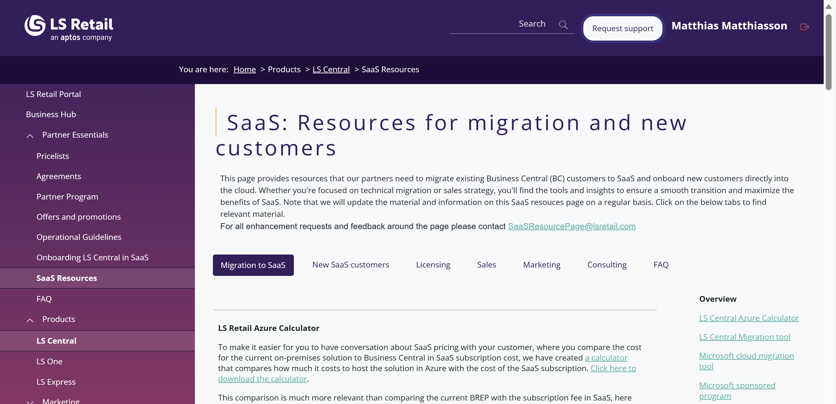
SaaS: Resources for migration and new customers
https://portal.lsretail.com/products/ls-central/saas-resources/
Topics
Migration
New customers
Licensing
Sale
Marketing
Consulting
FAQ
Technical
License
Please share your feedback SaaSResourcePage@lsretail.com
SaaSResourcePage@lsretail.com

Slide 28
How to Proof Performance in SaaS
LS Retail Office Hours
March 2025

Slide 29
Book a session with the
CAP team

Slide 30
Time for QUESTIONS

Slide 31
Thank you matti@lsretail.com

