Slide 1
eCommerce for LS Central
What’s new?
Marco Antonio Peña Corona – LATAM Sales Manager
Hasse Nielsen - Principal Technical Consultant

Slide 2







3rd party
eCommerce
providers
eCommerce API
Commerce Services for
LS Central
Local Inventory

Slide 3
Supported projects
Adobe
Shopify
3rd party
57
17
21

Slide 4

What’s new?
Retail
Stand-alone
integration options

Slide 5
What’s new?
Retail
Stand-alone
integration options
Time based discounts

Slide 6
What’s new?
Retail
Stand-alone
integration options
Time based discounts
Push notifications (PWA)

Slide 7
What’s new?
Retail
Stand-alone
integration options
Time based discounts
Push notifications (PWA)
Code coverage

Slide 8

What’s new?
Retail
Restaurants
Stand-alone
integration options
Improved QR code
group ordering
Time based discounts
Push notifications (PWA)
Code coverage

Slide 9
What’s new?
Retail
Restaurants
Stand-alone
integration options
Improved QR code
group ordering
Time based discounts
Queue counter support
Push notifications (PWA)
Code coverage

Slide 10
What’s new?
Retail
Restaurants
Stand-alone
integration options
Improved QR code
group ordering
Time based discounts
Queue counter support
Push notifications (PWA)
Code coverage
Code coverage

Slide 11

What’s new?
Retail
Smart order routing

Slide 12
What’s new?
Retail
Smart order routing
Data translations

Slide 13
What’s new?
Retail
Smart order routing
Data translations
GraphQL Transitions (Ph 1)

Slide 14
What’s new?
Retail
Smart order routing
Data translations
GraphQL Transitions (Ph 1)
Collection support

Slide 15
What’s new?
Retail
Smart order routing
Data translations
GraphQL Transitions (Ph 1)
Collection support
Partial shipments

Slide 16
What’s new?
Retail
Smart order routing
Data translations
GraphQL Transitions (Ph 1)
Collection support
Partial shipments
Store send

Slide 17
What’s new?
Retail
Smart order routing
Data translations
GraphQL Transitions (Ph 1)
Collection support
Partial shipments
Store send
Two-way member sync

Slide 18
What’s new?
Retail
Smart order routing
Data translations
GraphQL Transitions (Ph 1)
Collection support
Partial shipments
Store send
Two-way member sync
Web hook configuration

Slide 19
Google
Local
Inventory
Ads

Slide 20
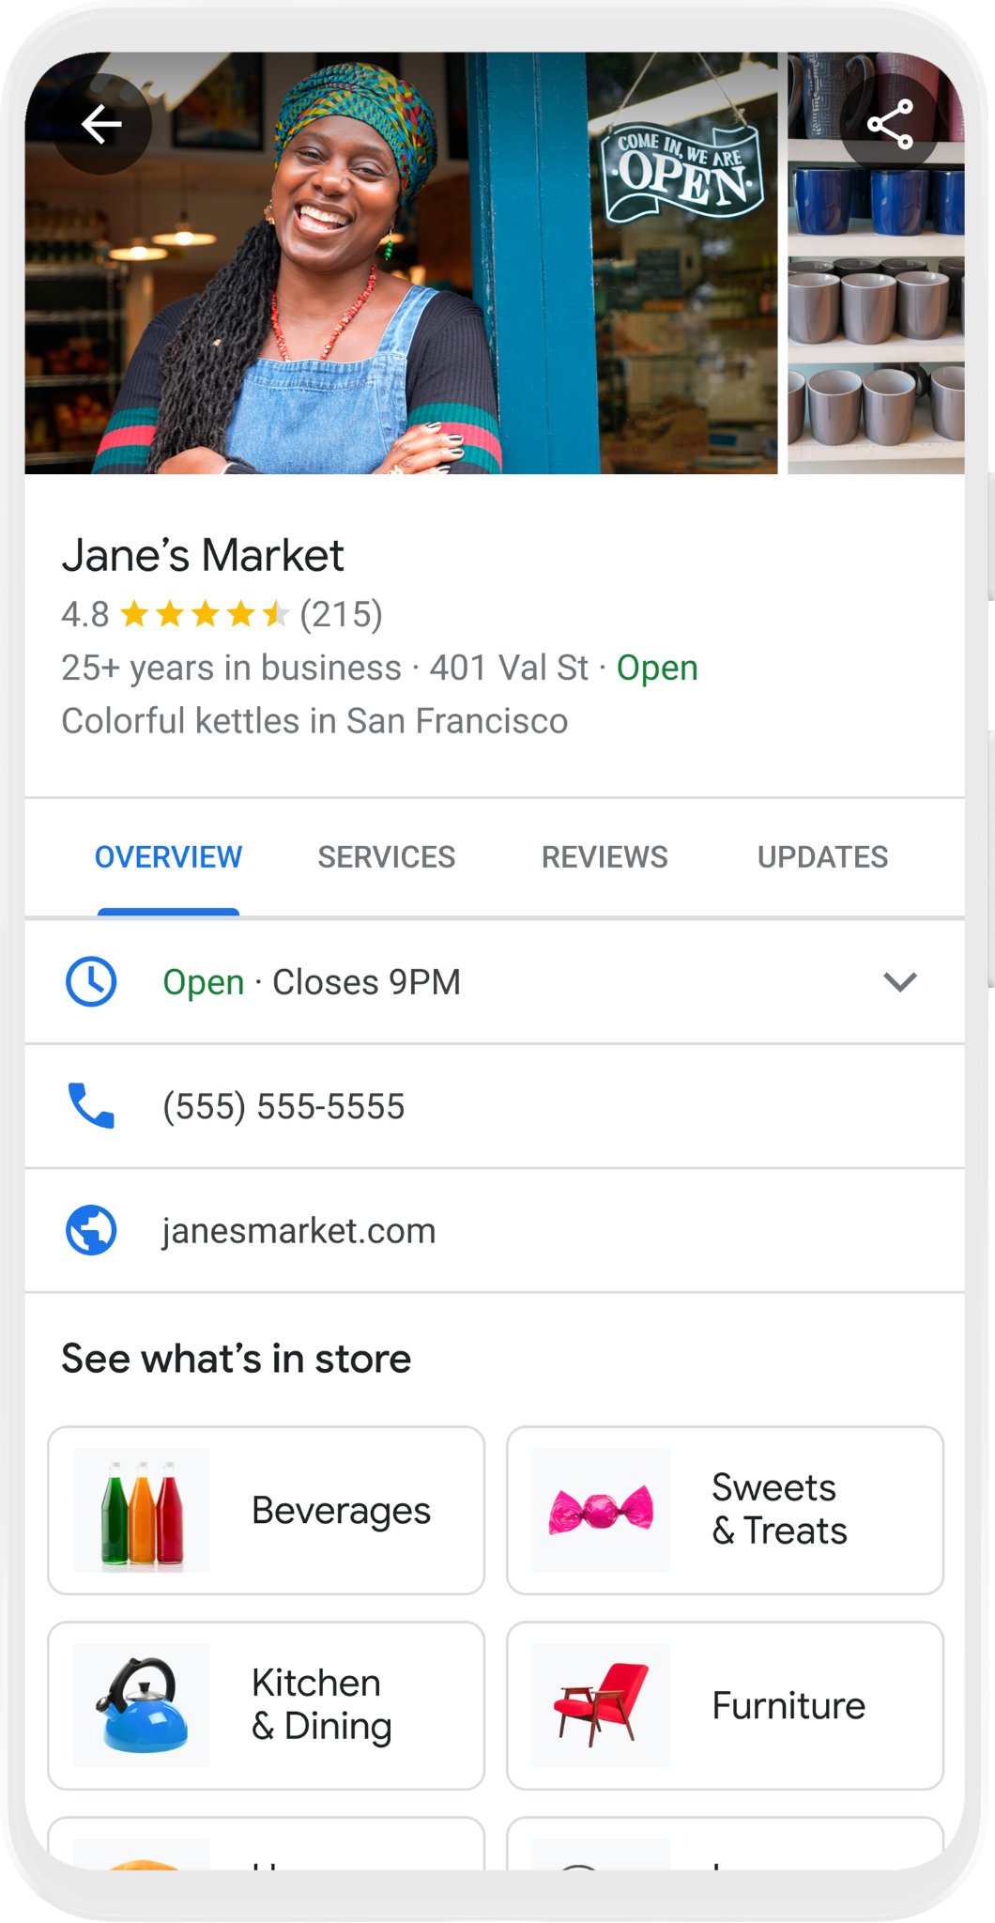
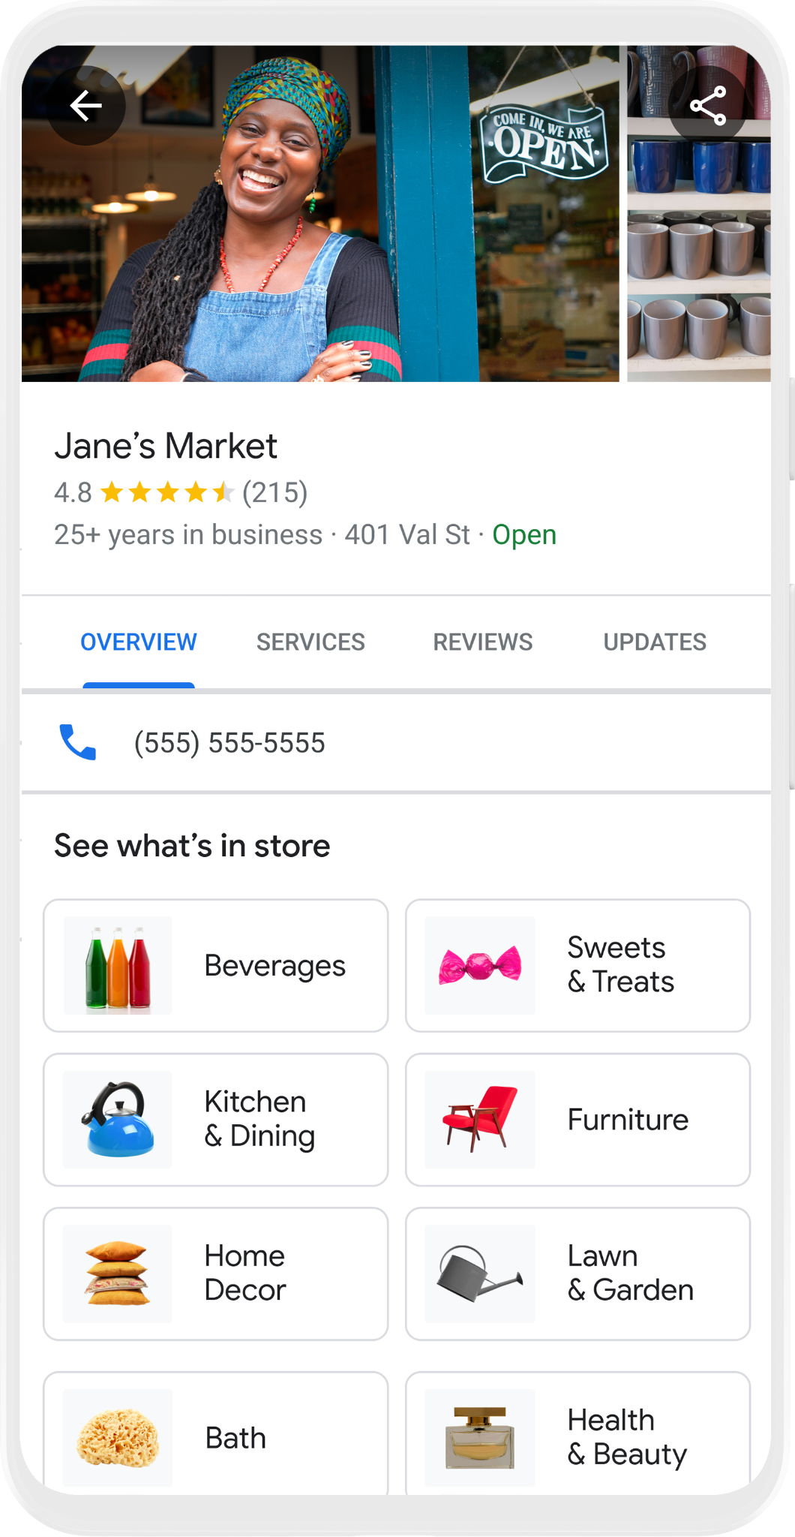


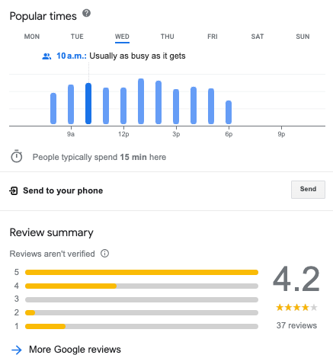
4.8
See What’s In Store

Slide 21
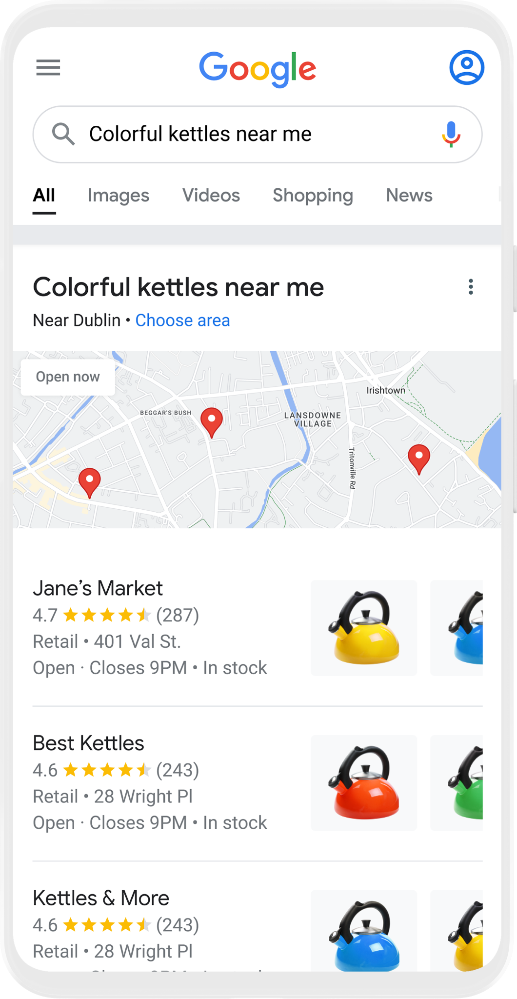
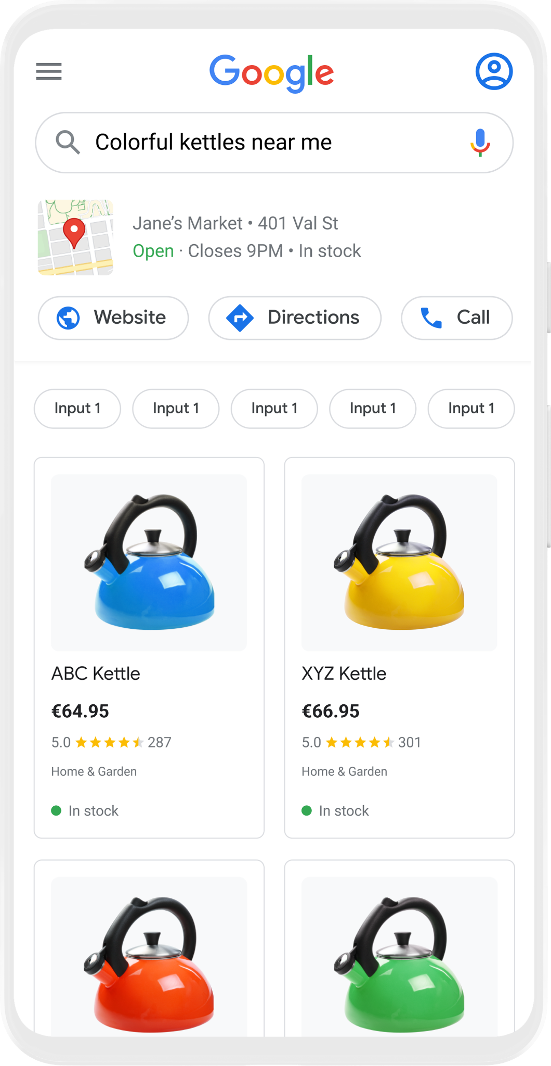

Free Local Product Listings
Showcase your store’s products for free on Google Search
Google Search
Shopping Tab
Google Business Profile
Red
Yellow
Large
Electric
Blue

Slide 22


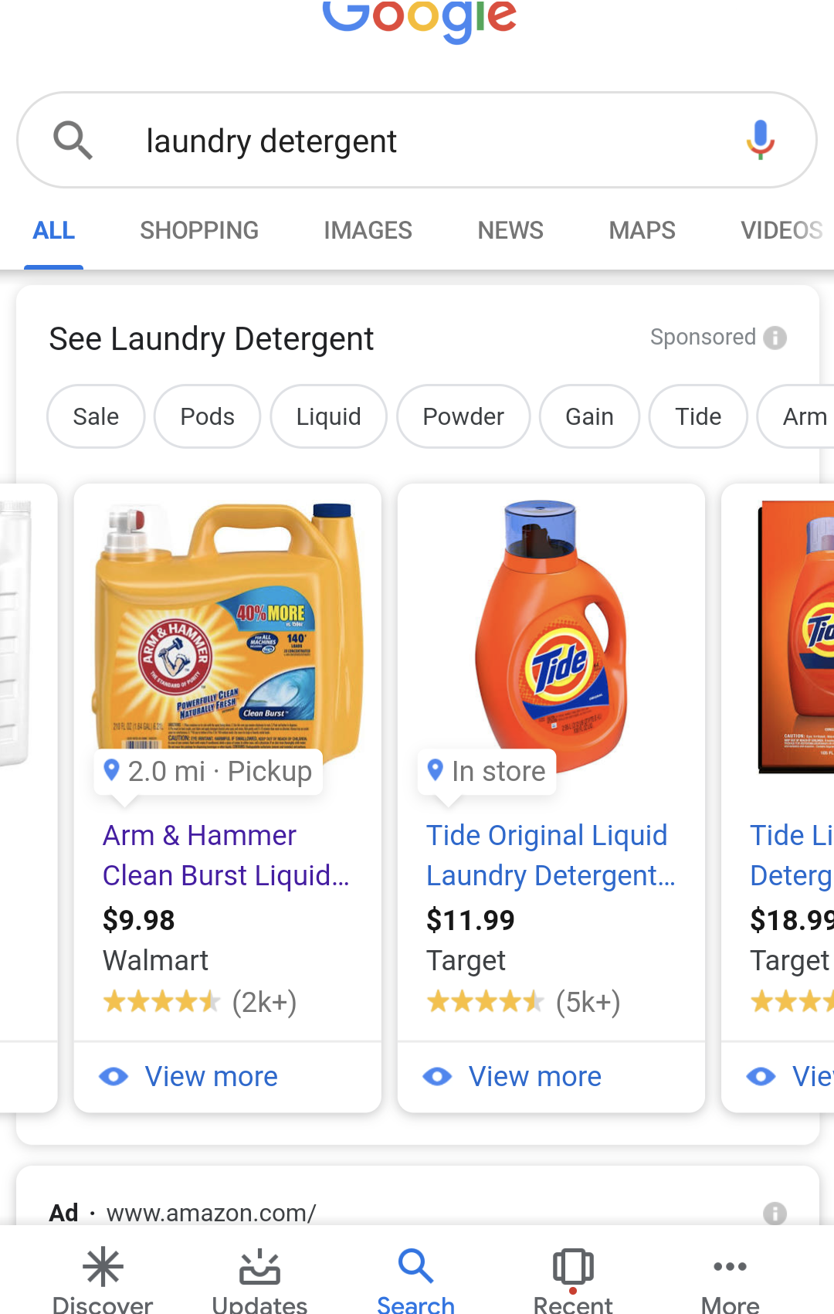
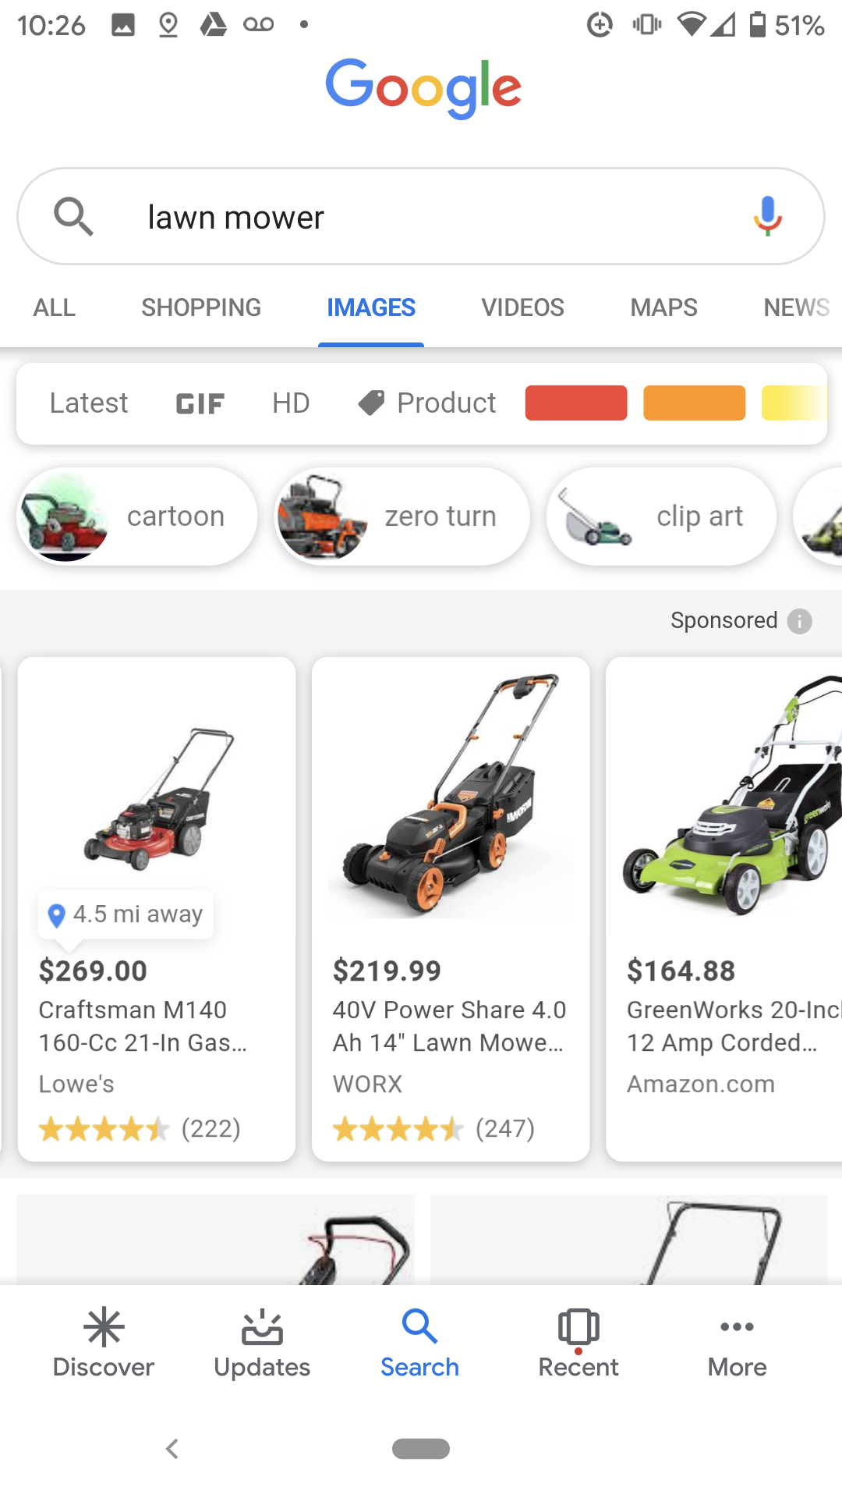
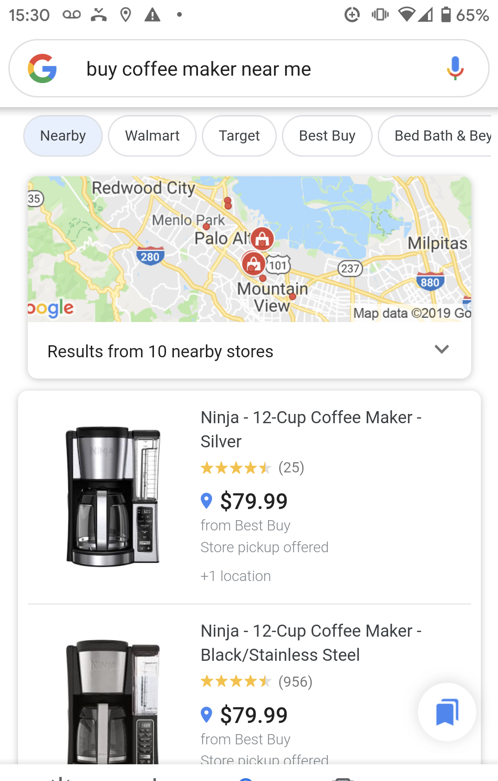
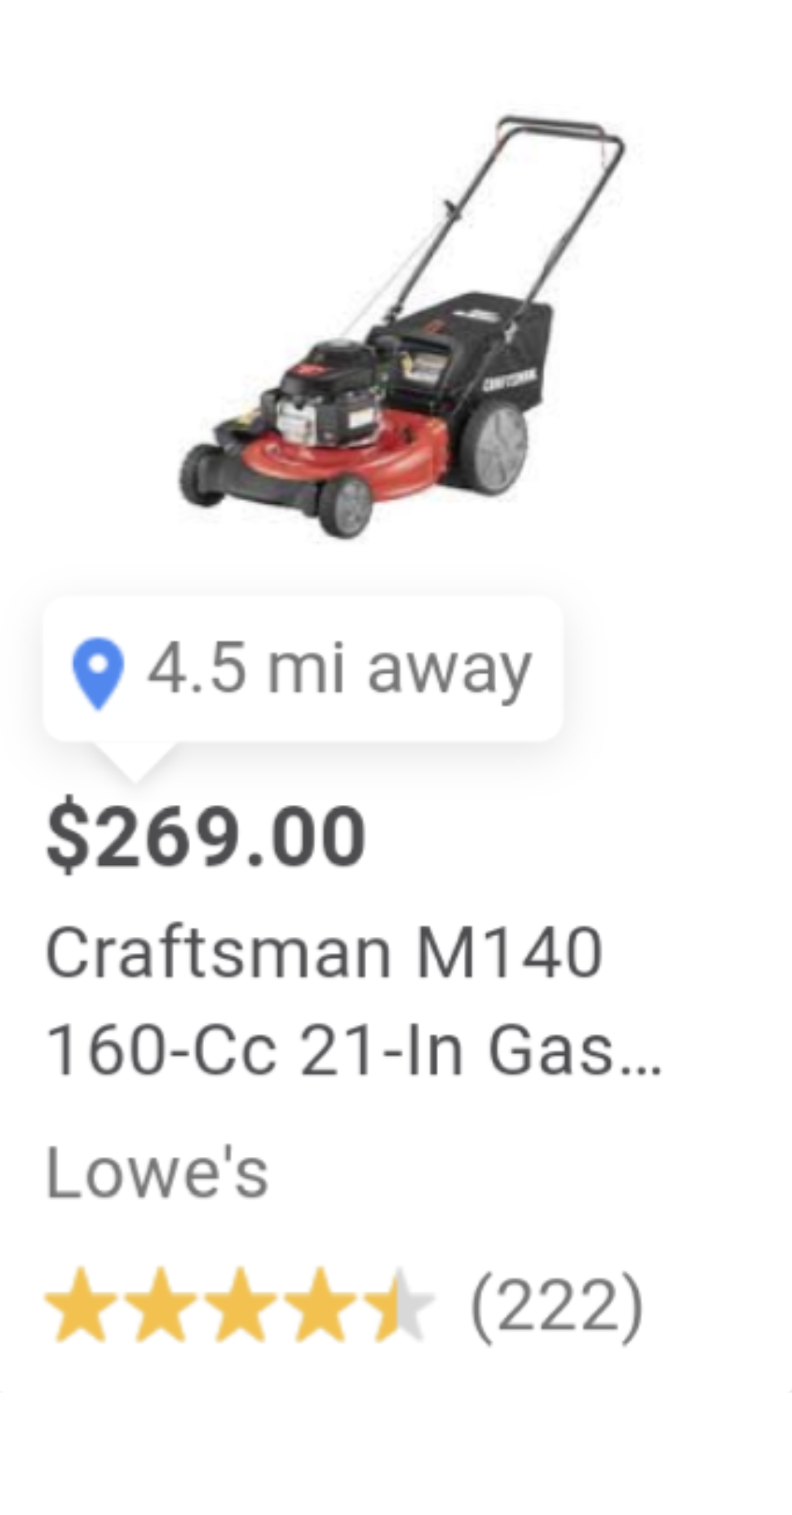
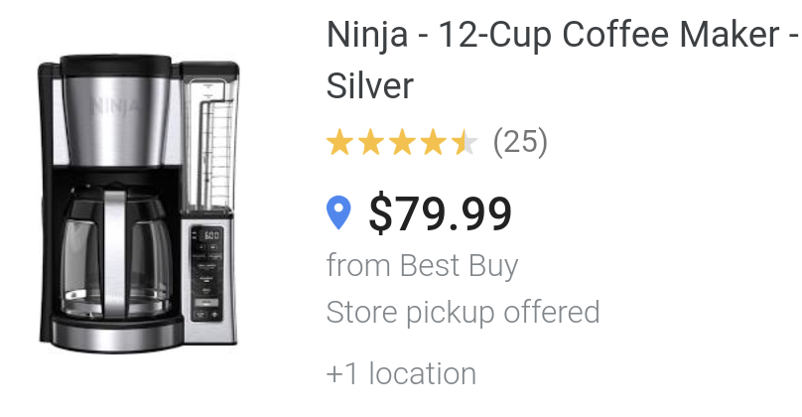
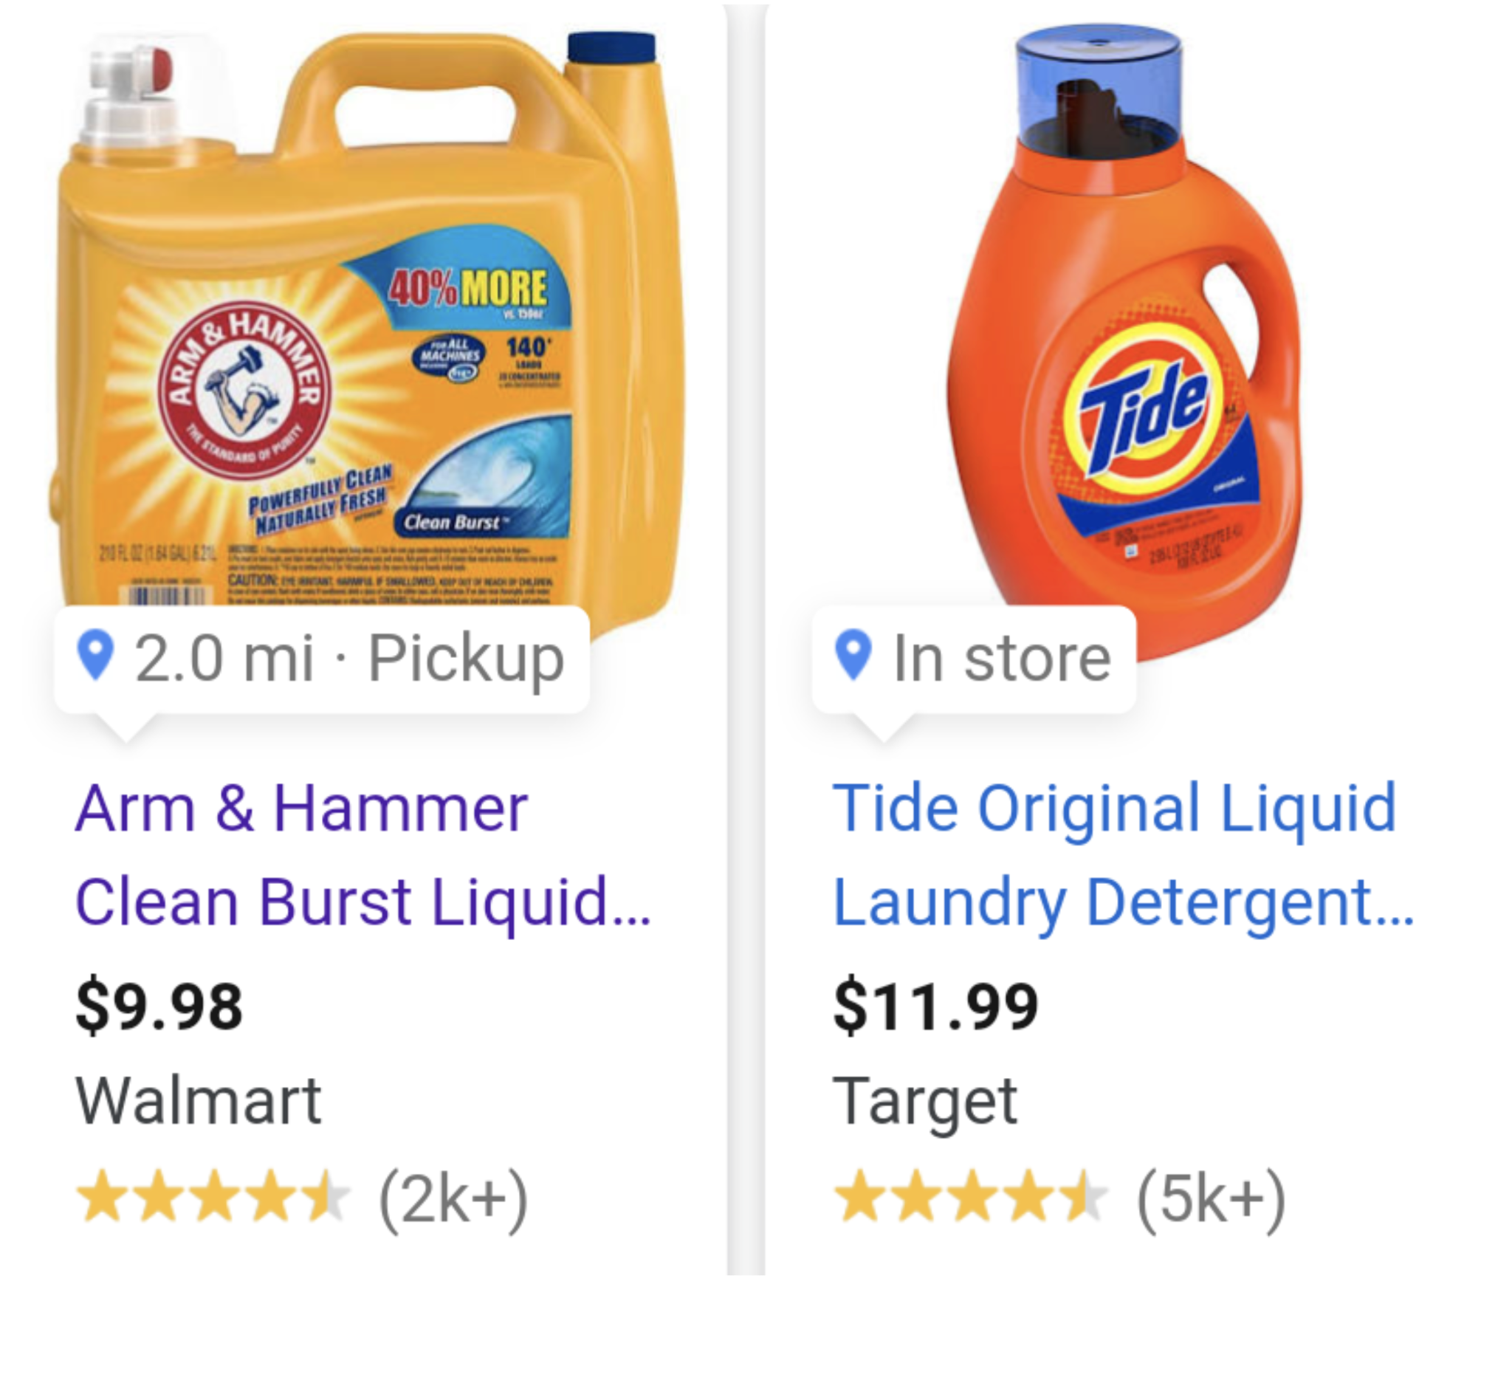


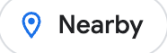


Local Inventory Ads
Drive more in store sales with highly targeted Ads campaigns
Top of Page Results
Image Search
Shopping Tab
2.0 mi · Pickup
Nearby
4.5mi away

Slide 23
LS Retail Academy
CF-710 eCommerce for
LS Central

Slide 24
LS Retail Academy
CF-710 eCommerce for
LS Central
CF-720 eCommerce for
LS Central - Shopify

Slide 25
LS Retail Academy
CF-710 eCommerce for
LS Central
CF-720 eCommerce for
LS Central - Shopify
To be released:
CF-730 eCommerce for Hospitality

Slide 26
3rd party online market-places
An extendable framework for custom marketplace integrations
Following our Shopify architecture
Default integrations provided by LS Retail
Starting with Shopee

Slide 27
3rd party
eCommerce
providers
3rd party
marketplaces
eCommerce API
Commerce Services for
LS Central
Local Inventory

Slide 28

Roadmap v27
3rd party online marketplaces – Shopee
Google local inventory – Phase II
Online returns
Magento
  Click and collect improvements
Shopify
  GraphQL transition – Phase II
  Partner feature requests
Moving the eCommerce API to LS Central

Slide 29
3rd party
eCommerce
providers
Commerce Services
for LS Central
Local Inventory
Scan
Pay
Go
3rd
Party
Apps
3rd party
marketplaces

