Slide 2
Tips and tricks on how to deliver successful implementations
From LS Retail Consulting team
Krist Tee
Project Manager

Slide 3

Agenda
LS Retail Consulting team
Offering and services
Best practices for successful delivery
Delivery tips and tricks
Technical tips and tricks
Your success is our success

Slide 4


A global consulting team
Asta M. Karlsson
Project Management
Johann Thorlaksson
MaxAttention
Urdur Anna Bjornsdottir
Europe
Jennifer Oddo
Americas
Bjarni Asmundsson
APAC

Slide 5


We work with partners and customers to make their deliveries more successful.
Global team of 100 people
Diverse team
Extensive experience
Subject matter experts
Technical Consultants
Functional Consultants
Solution Architects
Project Managers

Slide 6


We work with partners and customers to make their deliveries more successful.
Support partners in sales and in the full project lifecycle
Increase the quality of the implementations
Bring extra capacity and specialized industry expertise
Reduce project risk and cut down implementation time
Bring customer insights into product development

Slide 7
Project approach
LS Retail Consulting services can be used for different phases of the project lifecycle:
  Pre-sales
  Analysis and workshops
  Architecture and customization guidance
  Implementation and deployment
  Key-user training
  Testing and support
Bring in the right resources at the right time.

Slide 8
Delivery tips
Implementation challenges
Best practices for successful delivery

Slide 9

What challenges do we face?

Slide 10

What challenges do we face?
Unclear strategy
Undefined goals, missing value focus

Slide 11





Unclear strategy
Customer Story
Implementation project kicked off and worked on for a few months. At some point, it was clear that the overall delivery approach did not align with the goal of the program.
The main reason for failure: the program strategy was unclear.
Key decision (not in control of the program) did not align with the overall project goal.
Project execution with timeline and budget not aligned with strategy.
Define a clear strategy on the reasons for the program initiative.
Key to understanding the value drivers.
Create a business case to evaluate the key deliveries and the benefits they bring.
Define what the program needs to focus on to achieve the set-out goals.
It will help guide the program on decisions, scope etc.

Slide 12

What challenges do we face?
Management
dynamics
Sales to execution
Unclear strategy
Undefined goals, missing value focus

Slide 13

Management dynamics
Customer story
Project kicked off with management involved as well as key users that had been given certain responsibilities on different areas.
The leadership team followed the program through the whole process and communicated the strategy and vision regularly at project meetings.
Decisions on feature and functionality priorities were taken fast.
Management reduced the risk of end-user resistance to system change by involving them early on.
This resulted in a successful implementation and go-live without any onsite work.
Communicate to the customer the importance of management support throughout the program delivery
Make sure they understand the benefits:
  Strategic alignment
  Securing budget & resources
  Faster decision making
  User adoption and buy-in
  Encourages ownership
  Risk mitigation
  Continuous improvement and feedback loop

Slide 14
What challenges do we face?
No change management
Missing acceptance of new solution
Management disappearance
Sales to execution
Unclear strategy
Undefined goals, missing value focus

Slide 15
Customer story
In every stakeholders meeting the Program Manager started by reminding the internal and external team members of:
Why there was a need for new solution.
What the program benefits were, and its defined goals.
How the stakeholders would need to adjust to new ways of working in new solution.
That it would not be easy to go from custom made to standard solution.
  Internal marketing of the project and solution
  Explaining the strategy and long-term benefits
  Managing expectations to internal stakeholders

Slide 16
What challenges do we face?
Lack of ownership
Allocation and workload underestimated
No change management
Acceptance of new solution
Management disappearance
Sales to execution
Unclear strategy
Undefined goals, missing value focus

Slide 17

Lack of ownership
Engage users early
Define clear responsibilities
  Establish ownership of specific tasks
  Define product owner's and supporting roles
Responsibilities from both the vendor's and customer's side should be clear to everyone involved.
Communicate to the customer the need for key user capacity and allocation to the project.

Slide 18
What challenges do we face?
Lack of ownership
Allocation and workload underestimated
Siloed organisations
Unclear requirements and internal politics
No change management
Acceptance of new solution
Management disappearance
Sales to execution
Unclear strategy
Undefined goals, missing value focus

Slide 19

Organizations silos
  Need to break down internal organizations structure.
  Customer needs to understand that a program of this size needs to be owned by Business teams, not only IT teams.
  Leadership team needs to mitigate internal politics from the project to ensure delivery.
Customer story
An implementation team unable to progress and reach milestones because of internal politics and unclear prioritization of tasks.
Improvements were made with following actions:
Customers leadership team internally defined the priorities.
Key stakeholders from different departments/areas were allocated to the project.
Executive meetings on project progress included both leadership and project/delivery management members from both business and IT.

Slide 20
What challenges do we face?
Unrealistic
expectations
Unachievable budgets & timelines
Lack of ownership
Allocation and workload underestimated
Siloed organisations
Unclear requirements and internal politics
No change management
Acceptance of new solution
Management disappearance
Sales to execution
Unclear strategy
Undefined goals, missing value focus

Slide 21

Unrealistic expectations
Customer story
Project was kicked off with a defined scope and timeline on specific areas, some were left out as they were set to be all standard.
When those areas were to be configured, users complained that they did not fulfill expectations. Management then expected vendor to:
  Solve the issue fast and without any extra cost.
  Stick as much to standard as possible with minor tweaks, even if requirements were way out of standard functionality.
  Expected consultants to know everything!
Set clear project scope & timeline
  Decide on an MVP
Make sure the customer understands the impact of customizations
Educate customers on constraints
  Technical, budget, time etc.
Use phased rollouts & agile methodology
  Lego brick ideology
  Allows feedback and adjustments
Regular project meetings with all stakeholders involved

Slide 22
What challenges do we face?
Scope Creep
Change management process
Unrealistic
expectations
Unachievable budgets & timelines
Lack of ownership
Allocation and workload underestimated
Siloed organisations
Unclear requirements and internal politics
No change management
Acceptance of new solution
Management disappearance
Sales to execution
Unclear strategy
Undefined goals, missing value focus

Slide 23

Scope Creep
  Clear scope & get customer sign off
  Implement clear change request process
  Use agile and iterative development
  Manage stakeholder expectations
  Strong project governance
  Prioritization
    You get something but not everything
  Communication
    All stakeholders should be aligned on scope, progress, and constraints

Slide 24
What challenges do we face?
Ineffective communication
Internally and externally
Scope Creep
Change management process
Unrealistic
expectations
Unachievable budgets & timelines
Lack of ownership
Allocation and workload underestimated
Siloed organisations
Unclear requirements and internal politics
No change management
Acceptance of new solution
Management disappearance
Sales to execution
Unclear strategy
Undefined goals, missing value focus

Slide 25
What challenges do we face?
Ineffective communication
Internally and externally
Scope Creep
Change management process
Unrealistic
expectations
Unachievable budgets & timelines
Lack of ownership
Allocation and workload underestimated
Siloed organisations
Unclear requirements and internal politics
No change management
Acceptance of new solution
Management disappearance
Sales to execution
Unclear strategy
Undefined goals, missing value focus

Slide 26
Technical tips
Adapt not adjust
  Limit customization and utilize standard offerings in solutions
Stay current on Saas
  SaaS Onboarding Buddy program
  How to apply for an Onboarding Buddy?
    Contact your LS Retail regional team
Update Service
  Tool to simplify the process of installing LS Retail's products and keeping them up-to-date.

Slide 27
Technical tips
Telemetry
  Business Central Administration Center provides telemetry to enable troubleshooting and support for the tenant
  Easy, intuitive access to performance metrics
LS Retail Academy platform
  Comprehensive learning experience with on-demand courses on LS Retail products
  Available for partners and customers
Utilize consulting services
  LS Retail Consulting can give you the right support at the right time

Slide 28
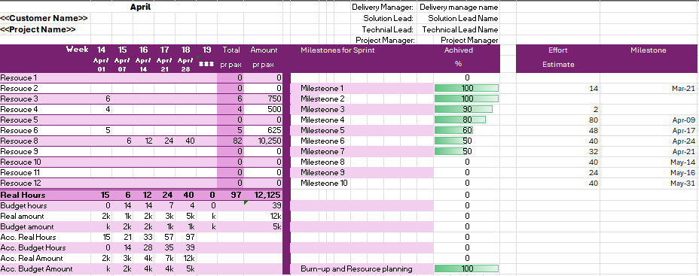
Project Tracking Template

Slide 29
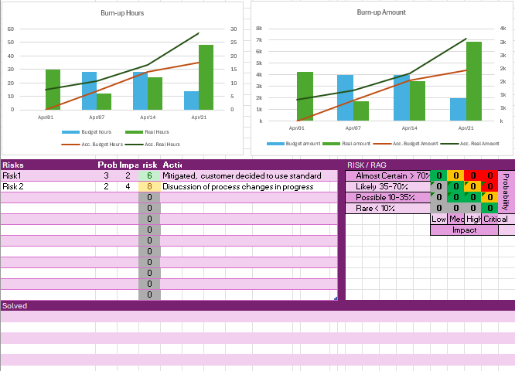
Project Tracking Template

Slide 30

Our aim is to increase the success of our partners and customers!
Extensive offering of services available to our partners.
Extend your capabilities and ensure you have the knowledge, skills, and resources needed to succeed.
How can we help you succeed?

