Slide 2
Beyond migration opportunities: CAP and Microsoft AIM program
Ricardo Moinhos Adalbjorg Karlsdottir Matthias Matthiasson

Slide 3
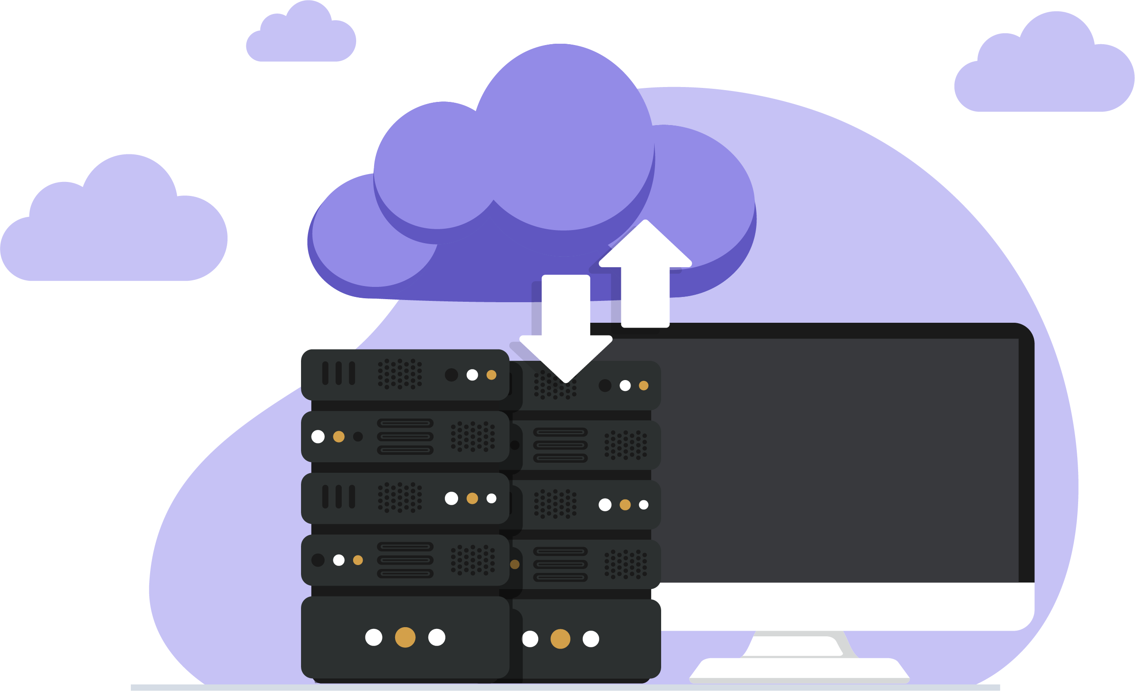
Agenda
Going to SaaS - how can we help you?
Sessions with the CAP team
Gyde365
Going to SaaS – technical challenges
Discussions
AIM partner - Simplanova

Slide 4
Going to SaaS - how can we help you?
Pre-sales
Before go-live
After go-live

Slide 5
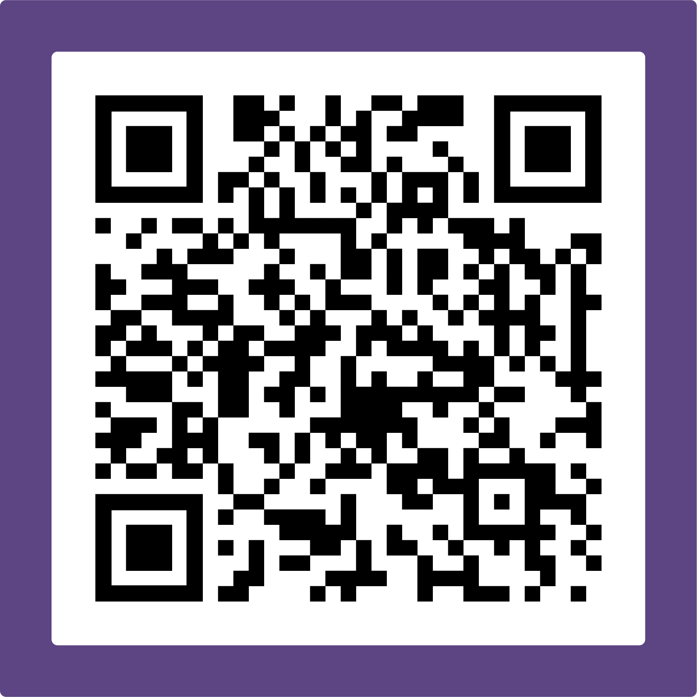
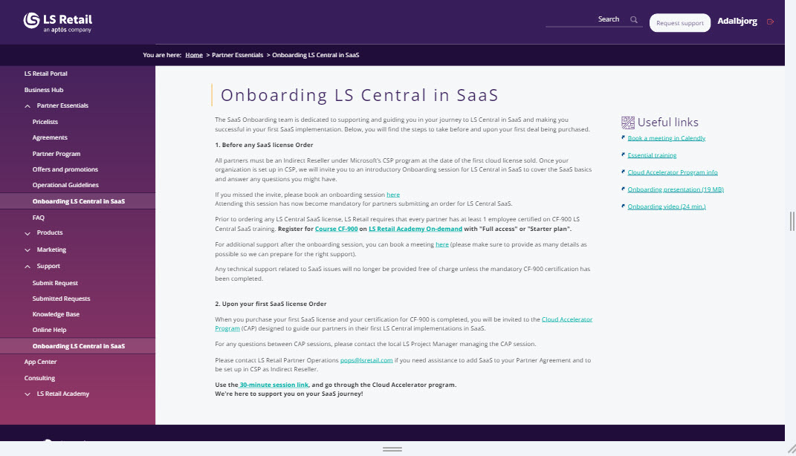
How?
Sessions with the CAP team
https://calendly.com/lsconboarding/30minsession

Slide 6
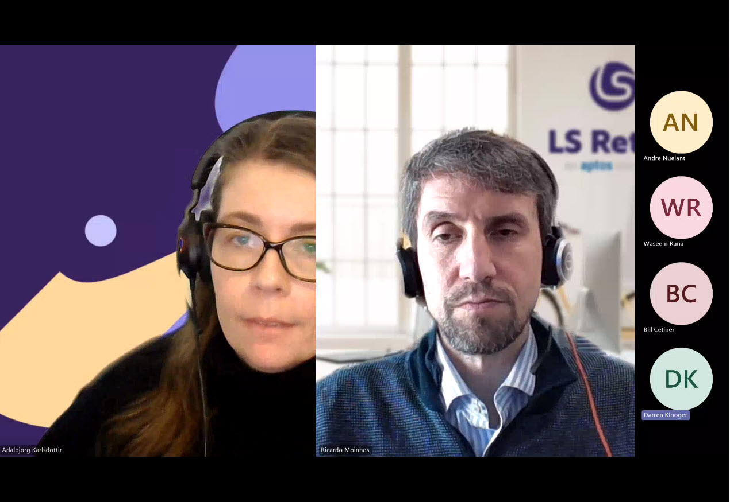
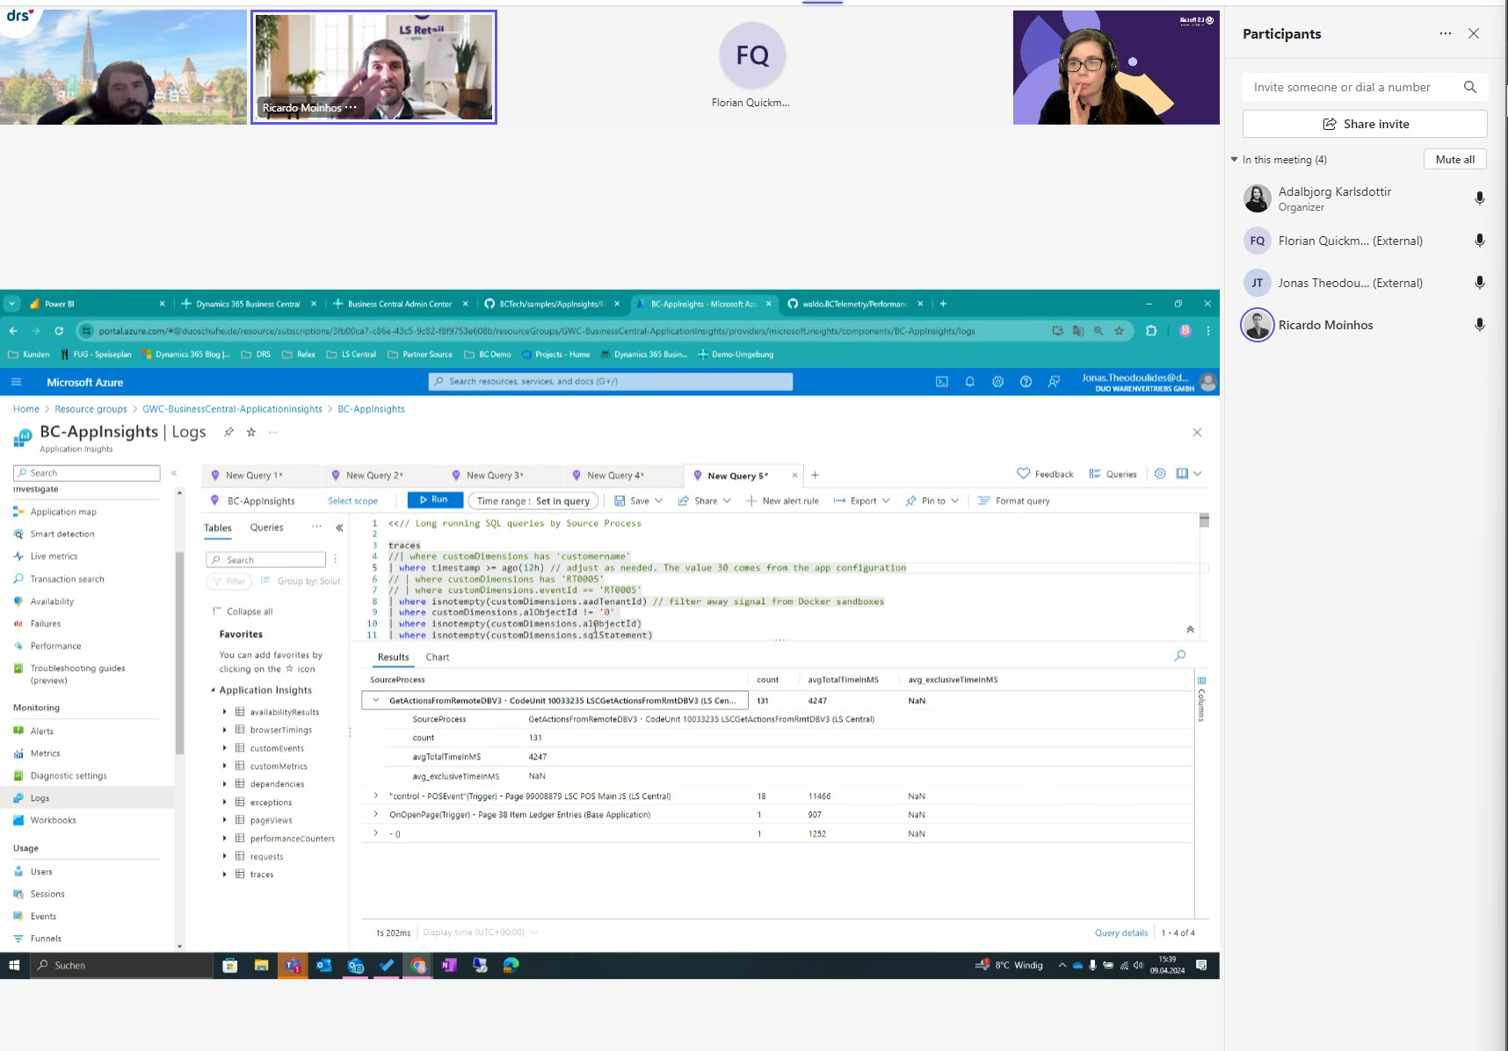
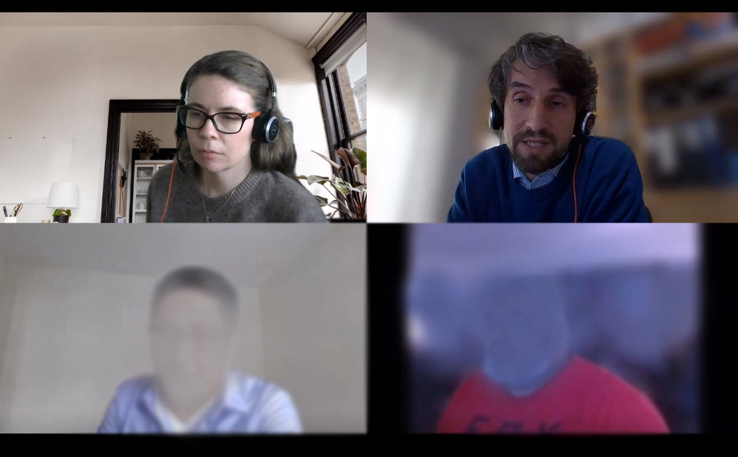
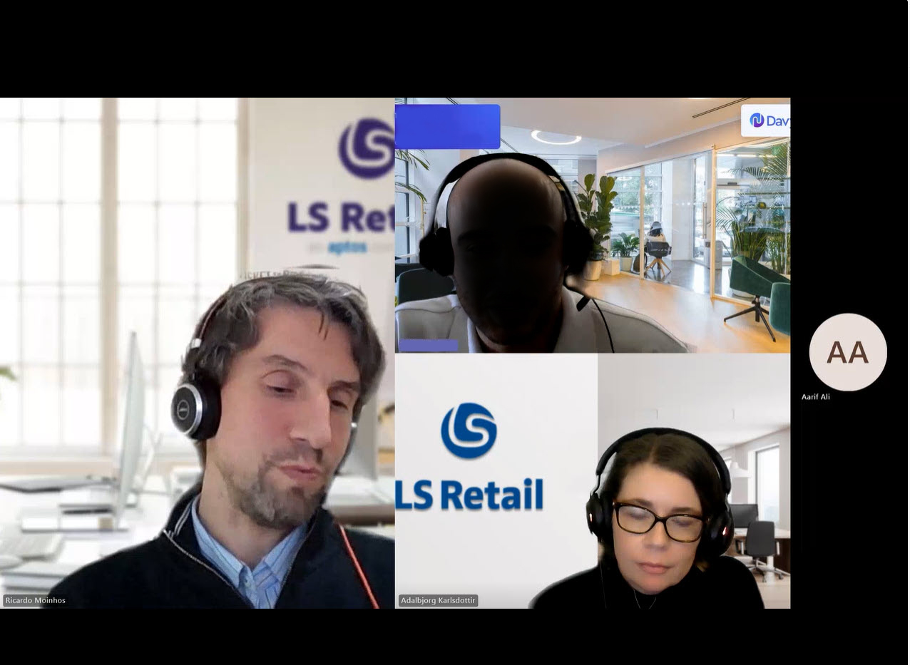
Sessions with the CAP team

Slide 7
Pre-sales
Moving customers' on-prem environment
to SaaS
SaaS architecture
LS Central architecture
Integrations
Fit/gap using Gyde365
SaaS doubts?

Slide 8
Before go-live
Upgrade to latest
Migration of data
Oauth
Offline POS
Replication
LS Central Implementation Guide

Slide 9
Before go-live
Upgrade to latest
Migration of data
Oauth
Offline POS
Replication
LS Central Implementation Guide

Slide 10
After go-live
Performance
Examples from the field
Advanced telemetry is key
MSFT escalation

Slide 11
After go-live
Performance
Examples from the field
Advanced telemetry is key
MSFT escalation

Slide 12
Going to SaaS – Technical challenges
Storage capacity
Migration Paths
Extension based versions - LS Central 15 or later
Non-Extension based versions - LS NAV 6.0 up to LS Central 14
Data migration
challenges
Customization migration challenges

Slide 13
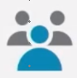
Storage capacity
What is a small or a big database?
Why is this a challenge?
Dynamics 365 Business Central
Examples
# POSes Device license | Full Users Essential | Total capacity (GB)
1 | 1 | 83
20 | 10 | 120
50 | 20 | 210
200 | 200 | 680
400 | 200 | 800
Base entitlement
80 GB
Per user allocation
2 Gb/User (Essentials)
3 Gb/User (Premium)
1 Gb/Device
Total capacity shared amongst the Production and up to 3 Sandbox environments
Data Compression in SaaS
Expect around 40-50% compression ratio on average

Slide 14
Storage capacity
Environment / Company Size
 | Customer #1 | Customer #2 | Customer #3
Total Capacity (80 Gb + Licensed Users/Devices) | 1500 Gb (1,5 Tb) | 500 Gb | 140 Gb
Production Environment size | 200 Gb | 230 Gb | 30 Gb
Tables Size
 | Customer #1 |  | Customer #2 |  | Customer #3
LSC Preaction | 50 Gb | 25% | 22 Gb | 9% | - | -
G/L Entry | 40 Gb | 20% | 34 Gb | 14% | 1.6 Gb | 5%
Change Log Entry / LSC WS Request Log | 5 Gb | 3% | 10 Gb | 4% | 0.2 Gb | 1%
Tenant Media | 12 Gb | 6% | 4.5 Gb | 2% | 1.1 Gb | 3%
Item Ledger Entry / Value Entry | 26 Gb | 13% | 40 Gb | 17% | 5 Gb | 15%

Slide 15
Storage capacity
Environment / Company Size
 | Customer #1 | Customer #2 | Customer #3
Total Capacity (80 Gb + Licensed Users/Devices) | 1500 Gb (1,5 Tb) | 500 Gb | 140 Gb
Production Environment size | 200 Gb | 230 Gb | 30 Gb
Tables Size
 | Customer #1 |  | Customer #2 |  | Customer #3
LSC Preaction | 50 Gb | 25% | 22 Gb | 9% | - | -
G/L Entry | 40 Gb | 20% | 34 Gb | 14% | 1.6 Gb | 5%
Change Log Entry / LSC WS Request Log | 5 Gb | 3% | 10 Gb | 4% | 0.2 Gb | 1%
Tenant Media | 12 Gb | 6% | 4.5 Gb | 2% | 1.1 Gb | 3%
Item Ledger Entry / Value Entry | 26 Gb | 13% | 40 Gb | 17% | 5 Gb | 15%

Slide 16
Storage capacity
Environment / Company Size
 | Customer #1 | Customer #2 | Customer #3
Total Capacity (80 Gb + Licensed Users/Devices) | 1500 Gb (1,5 Tb) | 500 Gb | 140 Gb
Production Environment size | 200 Gb | 230 Gb | 30 Gb
Tables Size
 | Customer #1 |  | Customer #2 |  | Customer #3
LSC Preaction | 50 Gb | 25% | 22 Gb | 9% | - | -
G/L Entry | 40 Gb | 20% | 34 Gb | 14% | 1.6 Gb | 5%
Change Log Entry / LSC WS Request Log | 5 Gb | 3% | 10 Gb | 4% | 0.2 Gb | 1%
Tenant Media | 12 Gb | 6% | 4.5 Gb | 2% | 1.1 Gb | 3%
Item Ledger Entry / Value Entry | 26 Gb | 13% | 40 Gb | 17% | 5 Gb | 15%

Slide 17
Storage capacity
Environment / Company Size
 | Customer #1 | Customer #2 | Customer #3
Total Capacity (80 Gb + Licensed Users/Devices) | 1500 Gb (1,5 Tb) | 500 Gb | 140 Gb
Production Environment size | 200 Gb | 230 Gb | 30 Gb
Tables Size
 | Customer #1 |  | Customer #2 |  | Customer #3
LSC Preaction | 50 Gb | 25% | 22 Gb | 9% | - | -
G/L Entry | 40 Gb | 20% | 34 Gb | 14% | 1.6 Gb | 5%
Change Log Entry / LSC WS Request Log | 5 Gb | 3% | 10 Gb | 4% | 0.2 Gb | 1%
Tenant Media | 12 Gb | 6% | 4.5 Gb | 2% | 1.1 Gb | 3%
Item Ledger Entry / Value Entry | 26 Gb | 13% | 40 Gb | 17% | 5 Gb | 15%
Top 25 tables
Takes > 80% disk space

Slide 18
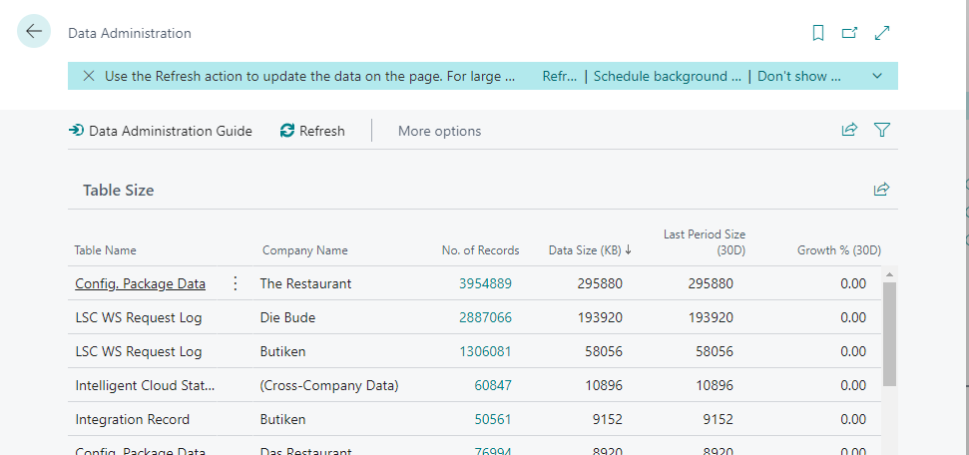
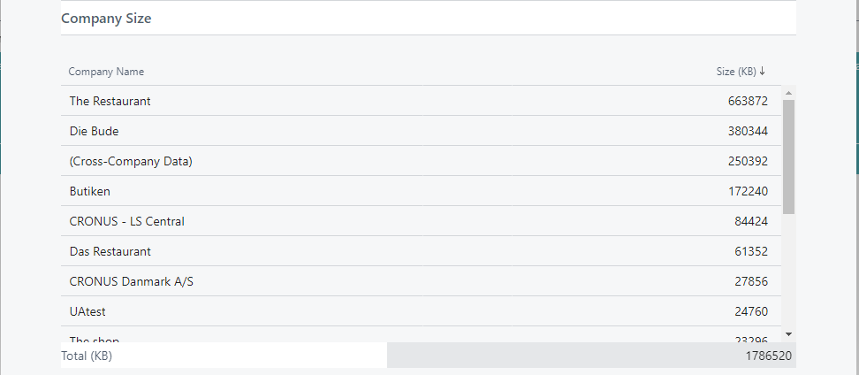
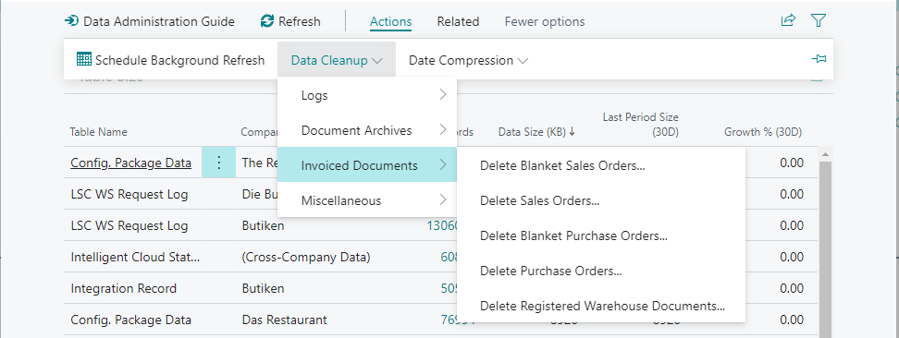
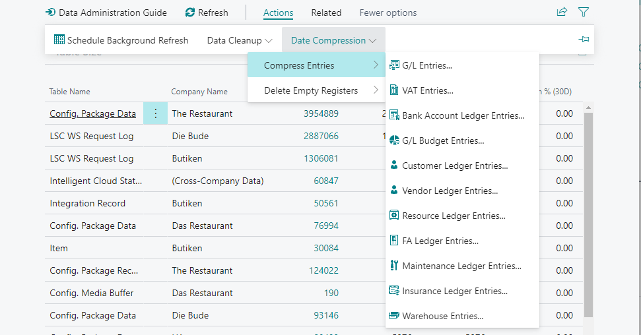
Storage capacity
Slimming down the database
Recommendations/Best practices
Clean up your data (Business Central)
Data Administration page allows you to:
List the following, per table:
Nr of records
Data Size
Data Size 30 days before
Growth % in the last 30 days
List the total size per Company
Use the Data Cleanup reports
Use the Date Compression reports
Run the Retention Policies
Available from version 18.2

Slide 19
Storage capacity
Slimming down the database
Recommendations/Best practices
Clean up your data (LS Central)
Codeunit LSC Delete Logs allows you to clean up:
Preactions
Actions
Scheduler Log
POS Log
Forecasting Log

Slide 20
Discussion

Slide 21
Challenges with data and customizations migration
The migration paths
Extension based versions
LS Central 15 or later
Non-Extension based versions
LS NAV 6.0* up to LS Central 14**
* Dynamics NAV 2009
** Business Central Spring 2019 (v14)

Slide 22
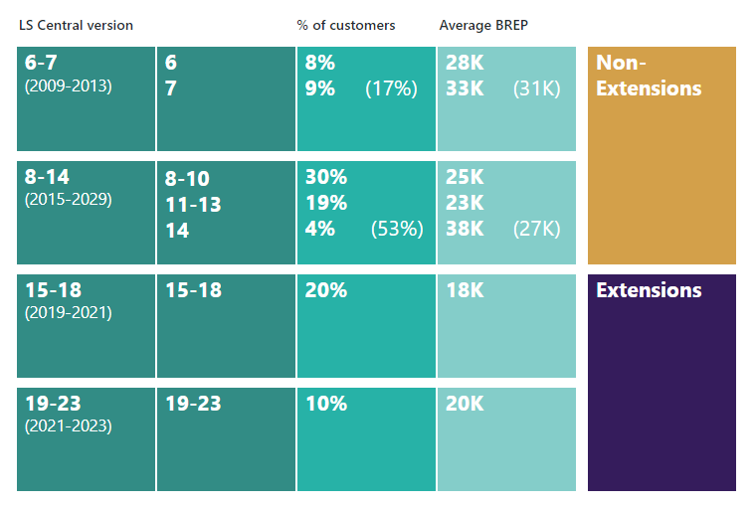
Migration analysis matrix
High
Reimplement
Customization Level
Migrate
Migrate
or
Reimplement
Number of licenses per partner
(on BREP)
1 – 9 licenses 82% of partners
10 – 19 licenses 12% of partners
Low
6
14
15
23
Lower complexity
Non-Extension Version
Extension Version
Version
Higher complexity

Slide 23
Migration analysis matrix
High
Reimplement
Customization Level
Migrate
Migrate
or
Reimplement
Number of licenses per partner
(on BREP)
1 – 9 licenses 82% of partners
10 – 19 licenses 12% of partners
Low
6
14
15
23
Lower complexity
Non-Extension Version
Extension Version
Version
Higher complexity

Slide 24
Migration analysis matrix
High
Reimplement
Customization Level
Migrate
Migrate
or
Reimplement
Number of licenses per partner
(on BREP)
1 – 9 licenses 82% of partners
10 – 19 licenses 12% of partners
Low
6
14
15
23
Lower complexity
Non-Extension Version
Extension Version
Version
Higher complexity

Slide 25
LS Central 15 and up
Migrating data
Straightforward process
A few steps required
PowerShell knowledge
What we have done
LS Central Migration Process
Step-by-step documentation on how to go through the migration process (we are following Microsoft guidelines) and how to troubleshoot known issues
LSMigrationTools - PowerShell module to ease the migration process
Seamless data upgrade process if there are no breaking changes in table schema

Slide 26
LS Central 15 and up
Migrating customizations
Objects/procedures marked as internal in v22
Partners have to:
Review code and use existing events instead, if possible
Ask for an object/procedure to be made public
Lacking parameters in existing Events
Partners have to:
Review code and use a different event, if possible
Ask for new events or new parameters to be added
Means more work if solution is heavily customized
Ask for new events or methods to be made public through LS Retail Partner Support
Request access to LS Central repository in Github and submit your events request through a pull request

Slide 27
Extension based versions - LS Central 15 and up
New events
LS Central App
Version | # Events | %
19.5 | 1464
20.5 | 1808 | +24%
21.4 | 2066 | +14%
New events added
New procedures made public
On every new release
24.0 | 3017 | +46%

Slide 28
LS Central 15 and up
Migrating customizations
Objects renaming in LS Central 17.5 – Added LSC prefix
Partners have to:
Find and replace all references to LS Central objects in their custom extension projects prior to v17.5

Slide 29
Discussion

Slide 30
LS NAV 6* up to LS Central 14**, to latest
Migrating data
Legacy Data
Makes sense to migrate all the data?
Big database
Performance Issues
Re-implement vs Upgrade
If going for an upgrade, data cleanup routines are quite relevant
* Dynamics NAV 2009
** Business Central Spring 2019 (v14)

Slide 31
LS NAV 6 up to LS Central 14, to latest
Migrating data
Upgrade process to LS Central latest
Too many steps
Error-prone
PowerShell knowledge
LS Central Migration Process
What we have done
Documentation includes migration process from LS Central 14 and up to latest
What we’re focus on
Extending the documentation to include migration process from LS NAV 6 and up, including tips, known issues and automating some tasks
To include LS NAV 6 and 8 in our data migration processes (upgrade codeunits)

Slide 32
LS NAV 6 up to LS Central 14, to latest
Migrating customizations
Identify what is standard
It is hard for the customer to understand what is standard and what is not
C/AL to AL conversion
Moving from non-ext. to extension framework
Stick to the standard to avoid converting code
Recommendation
Do a gap list analysis
Stick to the standard
Migrate only critical customizations
Leave non-critical customizations for last

Slide 33
LS NAV 6 up to LS Central 14, to latest
Migrating customizations
Integrations with 3rd party platforms
Moving to Web Services and OAuth2
Customizations in dataports, reports, and other objects
Recommendations
Rely on the AIM Assessment report to understand the customized objects
AIM Modernization Centers can ease your life with their experience/tooling

Slide 34
Simplanova – Microsoft Modernization and ISV Dev Center
CUSTOMER TESTIMONIAL
Serving Partner for 10 years now!
Partners served:
“Simplanova and we have had a partnership for quite a long time. As we were satisfied with the effective work in previous upgrade projects, we have chosen Simplanova once again to continue the collaboration.”
Bart Lammers
Consultant at Blisss

Slide 35
Facts About Simplanova Services
111 500
Hours saved for Dynamics NAV / 365 Business Central Upgrade projects
500+
Successful Dynamics NAV / 365 Business Central upgrade projects
234+
Microsoft Partners Have Trusted Simplanova's Services And Products
38
Simplanova Has Helped Microsoft Partners in 38 Countries

Slide 36
AIM Modernization Center
AIM with Simplanova: your guide in new Microsoft migration incentives
Pre-sales:
BC Needs Assessment
Workshop: claim $1,500 per customer
AIM Assessment
Assessment: claim $3,500 per customer
Post-Sales:
AIM Deployment Offer
Migration: claim up to $50k per customer
For:
Dynamics 365 Business Central on-premises
Dynamics NAV

Slide 37
Workshop: AIM BC Needs Assessment
Evaluation: AIM Assessment
Who can apply?
ENGAGEMENT TERM October 1, 2023 – June 30, 2024.
CUSTOMER QUALIFICATION
You can apply via any path to BC SaaS: Reimplementation, clean-start, or regular upgrades.
Cannot apply if already using Bridge-to-Cloud. But you can apply to Bridge-to-Cloud after AIM!
The end-user does not have to commit to the upgrade.
PARTNER ELIGIBILITY
Partner Agreement
Microsoft Cloud Partner Program Agreement
Program Enrollment
Microsoft Commerce Incentives
PARTNER QUALIFICATION
Legacy competency for Cloud Business Applications (Silver or Gold) and purchased benefits package; OR
Solution Partner Designation for Business Applications
ENGAGEMENT SUMMARY Workshops for customers to demonstrate how well Business Central SaaS works, how well it integrates with One Microsoft Cloud, and how it solves on-prem issues.
PROOF OF EXECUTION List of Attendees; Challenge(s)/Opportunity(ies); Top Initiatives Identified
MEASURE AND REWARD Activity Payment – Fixed Market A = $1500 Market B = $1200 Market C = $800
COMBINE PROGRAMS AIM BC Needs Assessment $1,500 + AIM Assessment Report $3,500 = $5,000
ENGAGEMENT SUMMARY An eligible report for the customer containing technical and functional evaluations, recommended upgrade approach, price, and scope.
PROOF OF EXECUTION AIM Assessment Report by Simplanova
MEASURE AND REWARD Activity Payment – Fixed Market A = $3500 Market B = $2500 Market C = $1500
SIMPLANOVA ACTIVITIES Report and its eligibility, Microsoft communication, and submitting it all for you.

Slide 38
FUNCTIONAL EVALUATION
TECHNICAL EVALUATION
Business objectives overview
High-level business process and functional review to understand the current on-premises business processes and map those to the capabilities of Dynamics 365 in the cloud
High-level assessment of the new capabilities and enhancements in Dynamics 365 cloud relevant to the customer’s business objectives.
ISV and customization overview with recommendations
Provide alternatives where relevant
Evaluate the new features in BC to eliminate the need for ISV
Licensing
The number and types of Dynamics 365 licenses needed to transition to the cloud
Evaluation: AIM Assessment report
In this phase, the partner assesses and documents (at minimum) the following:
Integrations: Integrations that will need to be updated to be compatible with the cloud
Database: Amount of schema and data that will need to be relocated to the cloud
Custom code: The amount of code that will need to be assessed for cloud readiness
Processes: Custom workflows, business process flows, dialogs, and custom actions that will need to be evaluated for cloud compatibility
Reporting: The amount of custom reports that will need to be refactored and/or rescoped for cloud computability
Automation refactoring (extra)
What can and cannot be upgraded (extra)
CONCLUSION OF THE REPORT
Recommended Upgrade Approach: Assess and recommend the type of migration suited for the customer’s needs (e.g., lift and shift, hybrid, reimplementation, etc.).
Next steps in the migration journey
Total scope, timeline and fixed price proposal
Detailed technical migration analysis
Migration workshop with Simplanova offer (free for high-probability opportunities)

Slide 39
Migration services: AIM Deployment Offer
ENGAGEMENT TERM November 15, 2023 – June 30, 2024
CUSTOMER QUALIFICATION
Comittment to go-live within 12 months of signing!
Dynamics on-premises customers (Dynamics NAV, GP, SL) with an active Enhancement Plan;
Must be to BC SaaS;
Used after the BC license is transacted!
1-year commitment to Business Central SaaS license plan in NCE from March 1st (NEW!)
Bridge to Cloud, CSP2BC or other license discount cannot apply – must purchase full price;
PARTNER ELIGIBILITY
Partner Agreement
Microsoft Cloud Partner Program Agreement
Program Enrollment
Microsoft Commerce Incentives
PARTNER QUALIFICATION
Legacy competency for Cloud Business Applications (Silver or Gold) and purchased benefits package; OR
Solution Partner Designation for Business Applications
ENGAGEMENT SUMMARY Incentive amount based on Business Central annual non-discounted license revenue. The AIM Business Central Deployment Offer helps accelerate customer migration and modernization projects to cloud.
PROOF OF EXECUTION - Signed migration agreement between Partner and end-customer, which includes data migration, customization refactoring, ISV connections, etc. - Migration plan. - Screenshots showing licenses acquired.
BENEFITING PARTY Reseller will be receiving the incentive, not the end-user.
MEASURE AND REWARD Activity Payment – Fixed
Engagement Size | Annual BC License Value | Payout range
Extra-small | $5,000 - $10,000 | $2,000 - $5,000
Small | $10,001 - $20,000 | $6,000 - $15,000
Medium | $20,001 - $35,000 | $10,000 - $25,000
Large | $35,001 - $55,000 | $13,000 - $35,000
Extra-large | $55,001 - $75,000 | $20,000 - $50,000

Slide 40
Migration services: AIM Deployment Offer
ENGAGEMENT EXAMPLE
NO of BC Users | License Type | Annual BC License Value | “Market A” Payout
5 | Essentials | 5 x $70/user/mo x 12 months = $4,200 | $0
10 | Essentials | $8,400 | $5,000
20 | Essentials | $16,800 | $15,000
50 | Essentials | $42,000 | $35,000
67 | Essentials | $56,280 | $50,000
200 | Essentials | $168,000 | $50,000

Slide 41
COOP: Dynamics 365 New Commerce and Dynamics 365 Customer Add New Commerce – Indirect Reseller
ENGAGEMENT TERM October 1, 2023 – September 30, 2024.
PARTNER ELIGIBILITY
Partner Agreement
Microsoft Cloud Partner Program Agreement
Program Enrollment
Microsoft Commerce Incentives
PARTNER QUALIFICATION
One of the following:
One of the six Solution Partner Designations (i.e. Solution Partner Designation for Business Applications);
Legacy Competences (Cloud Business Applications, Cloud Platform, Cloud Productivity, Data Analytics, Data Platform, Enterprise Mobility Management, Enterprise Resource Planning, Small and Midmarket Cloud Solutions, Windows and Devices)
EARNING TYPE
60% direct payout 40% COOP budget
ENGAGEMENT SUMMARY Rewards CSP partners who drive Business Apps adoption. Ongoing sales and new customer adds
CORE INCENTIVES Dynamics 365 New Commerce Program Core – Business Applications billed revenue, 4.75% Strategic Accelerator – Tier 2 (BC and Sales Enterprise), 10% Dynamics 365 Customer Add New Commerce Program Customer Add – Business Applications billed revenue, 20%
REVENUE REQUIREMENTS $25k 12-month revenue threshold for CSP Indirect Resellers
MEASURE AND REWARD New customers – for 12 months after first purchase. Existing – calculated monthly based on billing cadence.

Slide 42
Move: FY24 Bridge to the Cloud 2 offer
PROMOTION DURATION: Feb 1, 2023 – Dec 31, 2024
BTTC2
This promotion offers a fixed 3-year term that is non-renewable / non-cancellable, is purchasable on NCE, may include Dual Use Rights (as described in the Policy), and is available only to customers that have not previously purchased a cloud version on the product.
Qualifying Licenses
Dynamics AX
Dynamics CRM
Dynamics GP
Dynamics NAV
Dynamics SL
Dynamics 365 Business Central, on-premises
Dynamics XAL/Business Edition/CS
Dynamics 365 for Operations
Dynamics RMS/POS
Eligible Dynamics 365
online services
Most Dynamics 365 cloud products (detailed breakdown in the appendix)
Promotion
discount
40% discount of Dynamics 365 online subscription licenses
Subscription
term
3-year subscription, non-renewable
Availability
New Commerce Experience (NCE)

Slide 43
 | Clean-Start Upgrade | Full Upgrade
Destination | Cloud or on-premise | Cloud or on-premise
Customization upgrade | Not included | Full upgrade
Add-on upgrade | Yes | Yes
Test data migration | Yes | Yes
Production data migration | Yes (optional) | Yes (optional)
Automated tools used | Yes, data migration scripts | Yes, DM scripts and Simplanova AL Tools
Functional testing | Yes | Yes
Free warranty | Up to 1 month | Up to 3 months
Fixed price | Yes | Yes
Time to production | Typically 1-2 months | Typically 2-6 months
Quote process | Instant price calculator | 1 week full scope analysis
Suggested Upgrade Paths

Slide 44
Why Work Together on Migration?
95%
Of Time Saved On Automated Upgrades To RDLC/AL Reports.
2.0
Expertise From 2.0 To Dynamics 365 Business Central Latest Version.
Weekly Progress Reports & Full Functional Testing.
100%
Free Evaluation Of The Project.
3
Free Warranty Up To 3 Months (Response In 5 Business Hours).
Fixed Project Price Or Time & Material Work.

Slide 45
How To Start With an Upgrade Quote?
We offer as simple process as possible. Our team will contact you and discuss your specific case, needs and schedule.
Send us the .FOB file
Get FREE assessment in 5 days
That’s it!

Slide 46
Innovate: Why Use Clean-Start Upgrade Service?
The fastest and cost-effective way to upgrade to the latest Dynamics 365 Business Central version (on-premise or SaaS)
Instant Proposal
Fixed Price Guarantee
Start in 4 weeks
Free Warranty
Process Automation

Slide 47
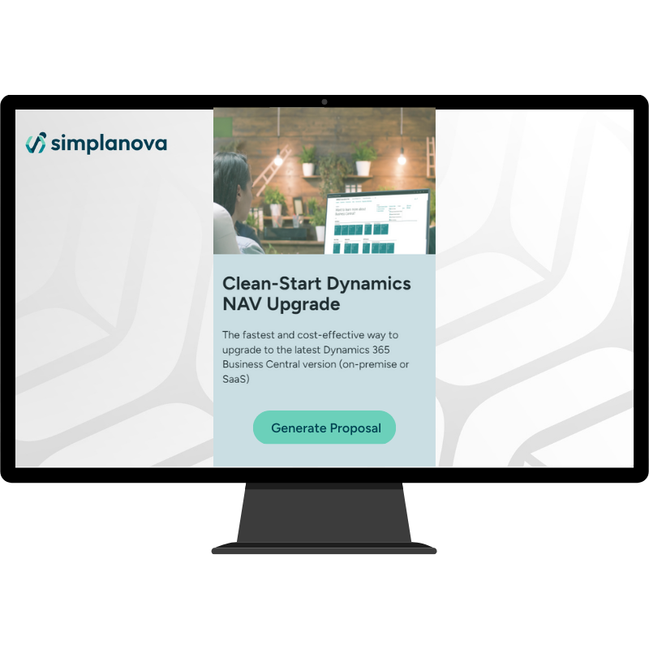
Innovate: Clean-Start Upgrade Calculator
Fill in the form with your customer Dynamics NAV/365 BC solution data and you will receive the fixed price Proposal by email instantly.

Slide 48
Innovate: Automated Upgrade to
Extensions Tools
SALT
Report Converter
Dataport Converter
Move Dynamics NAV / 365 Business Central Code To Extensions Automatically
(breaking changes, tempblob, file mngt, events).
Convert Classic Dynamics NAV report To RDLC/AL Format.
Convert Automatically Dynamics NAV Dataports To Xmlports.

Slide 49
Innovate: Simplanova AL Tools (SALT)
Upgrades to BC taking too long?
Automate migration with SALT!
SALT Automatically Handles:
TempBlob Usage
Triggers
Events
Breaking Changes
Options to Enums
File Management
30%
of estimated time can be saved on a heavily modified conversion from C/AL to AL
1000s hours
saved on Simplanova’s C/AL to AL upgrade projects
200 Q&A
of estimated time can be saved on a heavily modified conversion from C/AL to AL

Slide 50
Development Support
Extended Team: remote development contracts for 3 – 12 months;
Full-time, part-time, flexible engagements.
Project based development;
Experience based pricing model.
BC (C/AL & AL). Also available for .NET, AX / FSCM, CRM, Azure architects.
Areas of expertise: Finance, Trading, Inventory, Fixed Assets, Warehousing, Manufacturing, Logistics;
Product Development (Add-on);
Integration
Speed Optimization
Extensions Development
BUSINESS CENTRAL DEVELOPMENT
ADD-ON TO APPSOURCE

Slide 51
Discussion

