Slide 2
CentralConnect
LS Central integration to 3rd party head-office platforms
Johann Thorlaksson
Sævar Jonasson

Slide 3
About LS Central Built on a solid base
LS Central extends head-office platforms
Leveraging the Microsoft Dynamics 365 investment and ecosystem
More than 40,000 businesses use Business Central as their ERP
LS Central is recognized by Gartner® as a representative vendor in the Digital-Business-Ready POS applications

Slide 4
A global POS solution
The LS Central Point of Sale solution has a unique market advantage
We have a global presence that is unmatched by competitors
This global footprint makes LS Retail the ideal provider for retailers who want to work with the same solution in all the regions and countries where they operate
Some competitors have good coverage in multiple regions with 1-3 verticals
Some competitors have good coverage in multiple verticals with 1-3 regions
But LS Retail is unique with coverage in multiple verticals in multiple countries

Slide 5
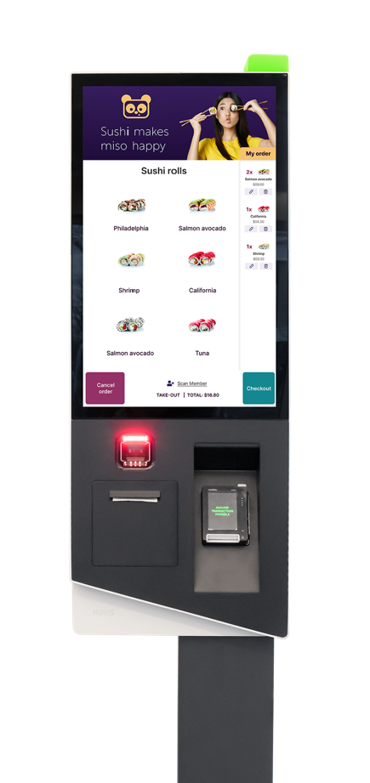
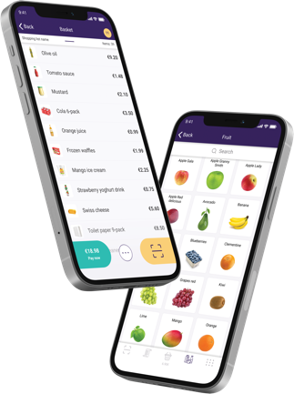
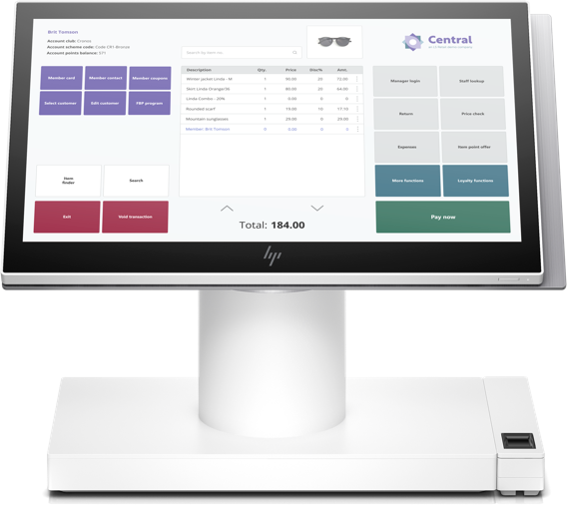
LS Retail named one of the 10 largest point of sale software suppliers
in the world*
*according to RBR’s annual “Global POS software” report

Slide 6
Have you...
Ever had an opportunity with a large chain or enterprise business interested in using LS Central for their operations?
Possibly a prospects using third-party ERP but interested in LS Central?

Slide 7
The challenge
Customers have made considerable investments in a 3rd party head-office platform which they want to retain
Many of these solutions are built to handle a very high number of users in multiple countries
They still have a need for a modern retail system like LS Central
They want the head-office platform to run processes like finance, warehousing & distribution
But LS Central to take care of retail & hospitality
There has been no standardized way or an integration framework that can connect LS Central to these head-office platforms in an easy way
Building an integration between ERP systems takes time & effort

Slide 8
Have you...
Ever wished that there was on out-of-the-box integration that would seamlessly connect LS Central’s industry-leading functionality with the customer’s current head office or ERP platform?

Slide 9
What would it mean if...
You could easily integrate LS Central with an existing (non-BC) ERP or head office platform?
You could tell prospects that they can effortlessly manage their entire front-end operations with smooth communication to the back-end system?
The prospect would have the flexibility to use LS Central as a complete retail or hospitality solution or as a Point of Sale, but still keeping data and item management within the head office platform?

Slide 10
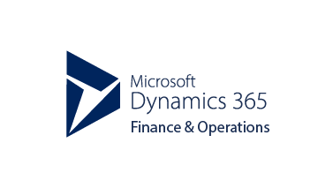
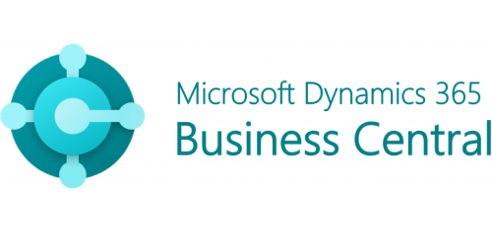
Can you imagine?

Slide 11
Can you imagine?

Slide 12
CentralConnect An LS Central integration to head-office platforms
With LS Central, you can manage retail stores, restaurants, pharmacies, hotels and gas stations from front to back with one centralized solution that integrates Point of Sale (POS) to financials, inventory, eCommerce, and more.
CentralConnect is a packaged framework which manages the integration of LS Central to 3rd party head-office platforms such as Dynamics 365 F&SCM, SAP S/4HANA, & Oracle

Slide 13
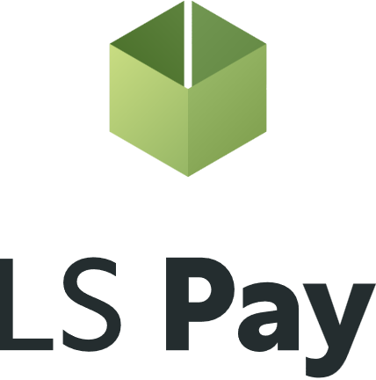
LS Central retail integrations with CentralConnect
Head-Office Platform
Business Central Retail & Hospitality Platform
LS Central as a retail back-office solution
Receives master data from 3rd party platform
Manages configurations, promotions, permissions, inventory, etc.
LS Central as a POS solution
Used as a front-end for retail and hospitality
ERP platforms that understand XML
Available in 157 countries and 23 verticals

Slide 14
HO Platform
Retail functionality
LS Central - a feature-rich POS & retail solution
HO
Point of sale (POS)
Self-service checkouts
eCommerce integration to Shopify
Online orders, click & collect, omni-channel returns
Store transfers
Stock mgmt. on mobile
ScanPayGo
LS Pay
Warehouse mgmt.
Supplier mgmt.
Inventory mgmt. Multi-location/chain mgmt.
Analytics and reports
Commercial
Loyalty program
Prices, offers and promotions
Sales analytics
End-of-day reports
Replenishment
Staff management
Sales commission
F&B functionality
Self-ordering kiosks
Ingredient and menu mgmt.
Ingredient costing

Slide 15
EFT integrations to leading Payment Service Providers in all our main market regions
Supporting 65 payment integrations in 50+ countries
Support for all platforms and form factors
POS hardware, self-checkout, self-ordering kiosks, tablets, phones and SoftPay/Tap to Pay
Alternative payments via respective PSPs
Back-office payments through LS Pay for Business Central
Can be integrated to 3rd party solutions (kiosks)

Slide 16
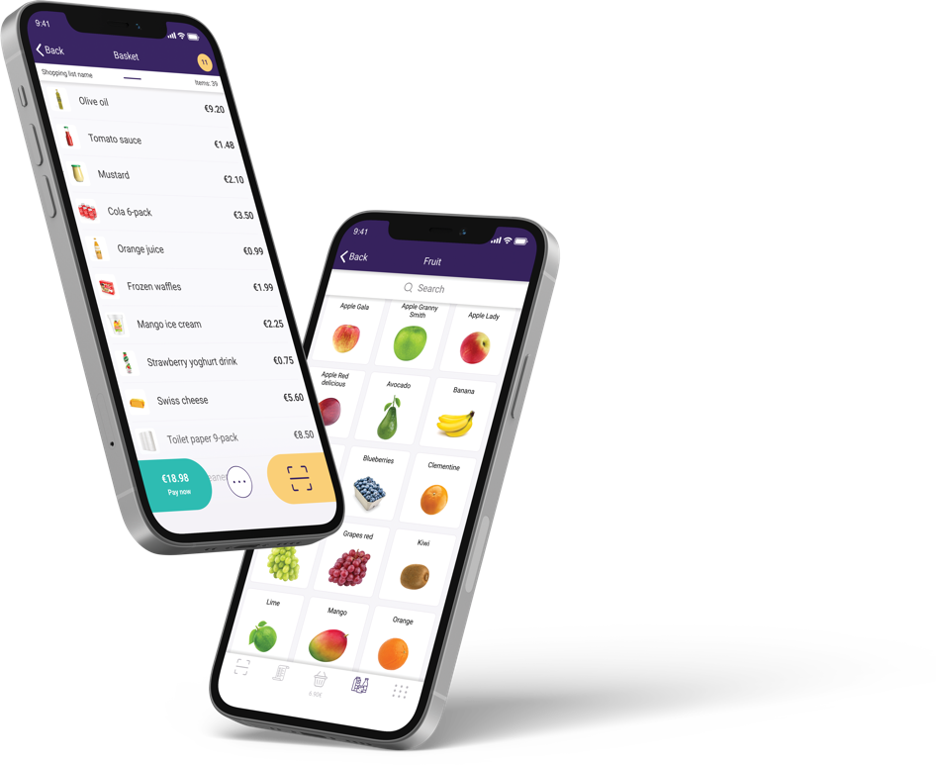
ScanPayGo for LS Central A new generation of loyalty app
Branded by the retailer
An easy-to-use loyalty app
Designed for the modern shopper
Functions
Scanning on the go
Integrated payments
Information about items
Easy to create shopping lists and share with friends and family
View offers, promotions, and coupons
Create your basket, pay in app or at a self-service POS

Slide 17
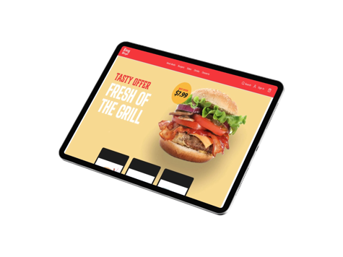
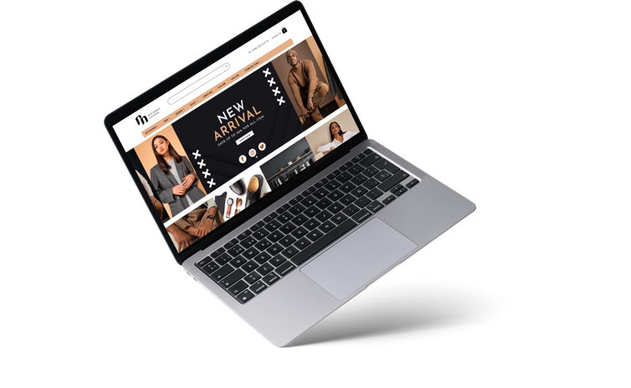
eCommerce for LS Central
A unified approach via Adobe Commerce or 3rd party platforms – retail & hospitality
Items, prices, discounts, basket calculation, loyalty, click & collect, transaction repository, returns, etc.
A simple approach via Shopify
Various front-end options
Traditional UI, PWA, or headless
Google Local Inventory

Slide 18
CentralConnect ǀ Functionality
Uses Azure storage
Azure blob storage for data packages
Web services for data transfers
Export data to Azure storage for 3rd party applications
XML file-based transfers (other formats available if needed)
Azure environment security
Integrations logs for traceability
Built using the Microsoft Dynamics 365 Business Central extensibility framework and can be extended by partners

Slide 19
Data flow from head-office
Azure storage used for temporary data storage.
Azure function triggers data export from F&O
Data packages inserted into Azure storage
Message created in message queue
Data imported into LS Central
Data validated and inserted into LS Central tables
Even if the data flow in this example is based on Dynamics F&SCM this can be applied to any ERP platform that can access Azure and work with XML documents
Data processed
Validation before insert
Data inserted
Storage
Data management framework
Azure function
Message queue
Message imported

Slide 20
Example of End of day – Retail sales flow
Sales data flow from LS Central and into Azure storage
End of day in LS Central triggers an Azure function
Creates F&O data package
Stored in Azure storage
Trigger import into data management via web-service
Data flow into F&O, data management validates and inserts sales orders
Data Management framework
Azure Function
End of day procedure
Daily retail operation
Sales order
Storage

Slide 21
Export to external storage LS Central
Azure storage used for temporary data storage.
Export is triggered in Central Connect.
Data packages inserted into Azure storage
Formats supported in first version XML/JSON/CSV
Data ready to be used in 3rd party applications
Data processed
Validation before insert
Data inserted
Storage

Slide 22
Requirements
Data needs to be written and read from Azure Storage
Current format is XML
We may support other types such as Json and CSV as well
For F&O we can trigger the import and export of data using web-services
For systems that don’t support web-services, this can also be accomplished using scheduled jobs

Slide 23
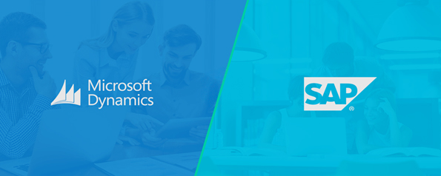
Inventory management
In general, we assume that inventory is managed in LS Central.
Inventory changes sent to for example SAP or F&O either during the day or at EOD.
LS Central will manage:
Receiving
Transfers
Stock count
Positive/Negative adjustm.
Items, Barcodes, Prices, Vendors, etc
Stock movements
EOD statements

Slide 24
Demo

Slide 25
Scenario 1
Review the configuration for CentralConnect
Azure Functions, Azure Storage, Azure Application, Azure Service Bus
Create a mapping for Vendors from F&O to Central
Change a Vendor in F&O
Run the data export/import process
Review the changes in LSCentral

Slide 26
Scenario 2
Open Point of sale
Sell a transaction on POS
Run the Statement Post process (end-of-day)
Run the data import/export process to import the sales data into F&O
Create a sales order and review in F&O

Slide 27
Summary
CentralConnect is an integration platform that enables retail and hospitality businesses to use LS Central as their retail or point of sale solution and seamlessly connect it to a 3rd party enterprise ERP or head office platform.

Slide 28
Are you interested?
CentralConnect is now available through our partner portal and pricelists – sold as a consulting add-on.
Please reach out to respective PM Office for more details:
Europe: pmeurope@lsretail.com
APAC: pmapac@lsretail.com
MEA&I: pmmea@lsretail.com
Americas: pmamericas@lsretail.com
More information can also be found at our homepage:
www.lsretail.com
CentralConnect An LS Central integration to head-office platforms

