Slide 1
Make payments easier with LS Pay in
LS Central and Business Central
Andreas Stenlund – Product Owner

Slide 2


Offering EFT integrations to the leading PSPs in all our main market regions
Allowing our customers
to have a choice

Slide 3

70
50+
Payment integrations
Supported countries
330
35
Customers
Countries

Slide 4
















Some of our customers

Slide 5
What’s new in
LS Pay?
Adyen - Tap2Pay
SoftPay – Support for tips
Gift Cards – POS support
New online documentation

Slide 6
New
PSPs
Multipay
DNA Payments
Straumur
Teya
RazorPay
Geidea
AltaPay
Fawry
BNP Paribas

Slide 7



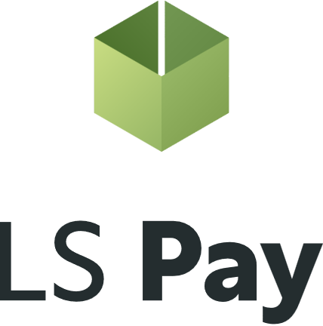

LS Pay – Core engine
Adyen
Elavon
Planet
Freedom Pay

Slide 8




LS Pay – Core engine
Adyen
Elavon
Planet
Acquiring/Processing:
Freedom Pay

Slide 9
Payment Service Providers (PSPs)
Americas
Notes:
Please note that only one of these regional chapters will be visible per CX event!

Slide 10

















Logo update pending

Slide 11

Roadmap candidates - Americas
Logo update pending

Slide 12

Payment Service Providers (PSPs)
EMEA

Slide 13
Logo update pending

Slide 14
Roadmap candidates - EMEA
Logo update pending

Slide 15

Payment Service Providers (PSPs)
APAC

Slide 16
Logo update pending

Slide 17
Roadmap candidates - APAC
Logo update pending

Slide 18
How to request new Payment Service Providers?

Slide 19
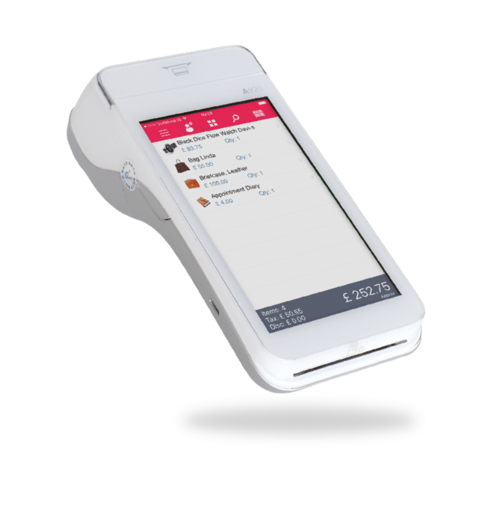

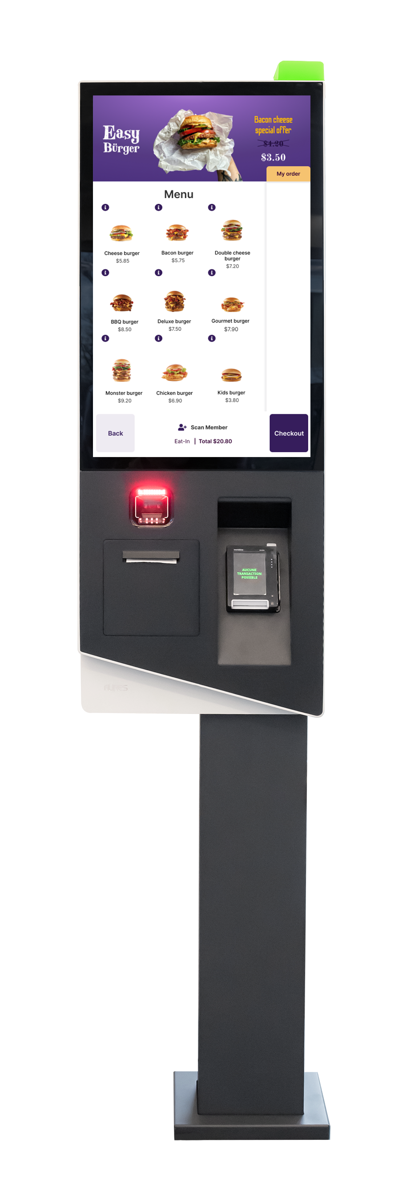
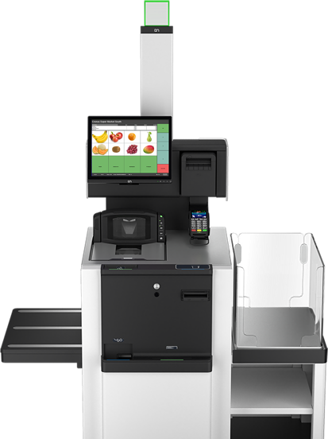
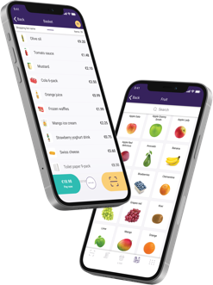
Supporting all POS platforms

Slide 20
LS Pay for Business Central
Payment support for standard Sales Documents in BC
Published as the LS Pay app on the Microsoft AppSource

Slide 21
Our target group…
LS Central merchants requiring back-office payment support
Standard Business Central merchants
  Not having a point-of-sale system
  Requiring payment support
    Card present & card not present

Slide 22
LS Pay – Core engine
Adyen
Elavon
Planet
Freedom Pay

Slide 23
Introducing the LS Pay Service
Adyen
LS Pay Service
Elavon
Planet
Freedom Pay

Slide 24


Introducing the EFT Extension
Payment refactoring in the LS Central POS
Contains all payment logic and dialogs for EFT payments
Exposes a payments API that the POS, BO, and HO can interface
Connects to the LS Pay Service
A generic Business Central extension
  Business Central
  LS Central & LS Express
LS Central
POS
BO
HO
Call Centers
EFT Extension
LS Pay Service

Slide 25
Business Central
Business Central
LS Pay App
EFT Extension
Partner App
EFT Extension
LS Express
LS Central
LS Pay Service
POS
BO
HO
Call Center
POS
BO
EFT
Extension
EFT Extension

Slide 26
Two deployment options
#1
#2
Business Central
Business Central
LS Pay App
EFT
Extension
Partner App
EFT Extension

Slide 27

Phase I – Released Jan 25
EFT Extension for partner apps
LS Pay App
  Card present payments & returns
    Sales orders
    Sales return orders
    Sales invoices
    Sales credit memos
  Multiple tender types
    Cards, cash, cheques & customer accounts
  Payment profiles
  Cloud based logging

Slide 28



Phase II – CX 25
Card not present payments
  Manual card number entry
Support for additional Payment Service Providers

Slide 29
LS Pay for BC
Demo

Slide 30
Available on the Microsoft AppSource
LS Pay App
EFT Extension
Appsource image pending appoval

Slide 31
Licensing
Same licensing model as with LS Pay for LS Central
The number of LS Pay licenses equals the number of connected pin pads (PEDs)
Pricelist available on the LS Retail portal

Slide 32

Roadmap – LS Pay for BC
Card not present transactions
  Online payment links
  Virtual terminals (PEDs)
UI streamlining
  Document copying to returns, etc.
Partner requests
  Leaving room for partner requests and needed features
Additional PSP support (demand driven)
Service orders
eCommerce orders
Customer accounts
  Invoice grouping
  Card on file
Pre-authorizations and full captures
  Extending time periods of pre-auths
  Adjusting pre-auth amounts
  Cancelling pre-auths

Slide 33
Roadmap - LS Pay
EFT Extension for LS Central POS
Adyen – Tap2Pay
Installments – BR & MX
LS Retail Academy course for LS Pay
Gift card support on the LS Central POS

