Slide 1
SaaS replication and connectivity
Adalbjorg Karlsdottir – Onboarding lead
Johann Sveinsson – Senior developer

Slide 2

Agenda
Scheduler overview
Web Replication
Timestamps
Send Transaction
Offline POS
SaaS Migration

Slide 3
Replication fundamentals

Slide 4
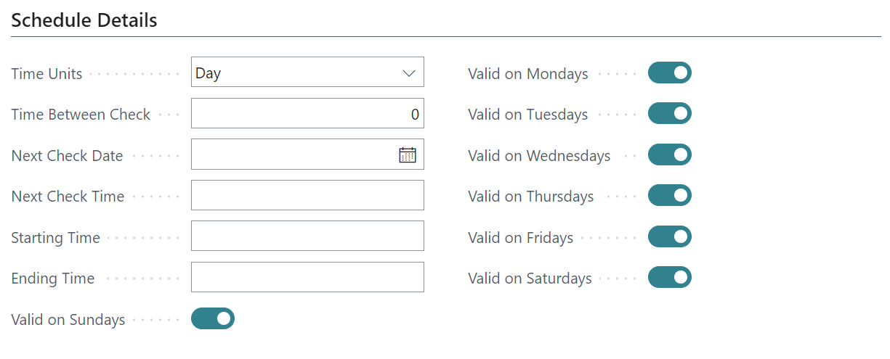
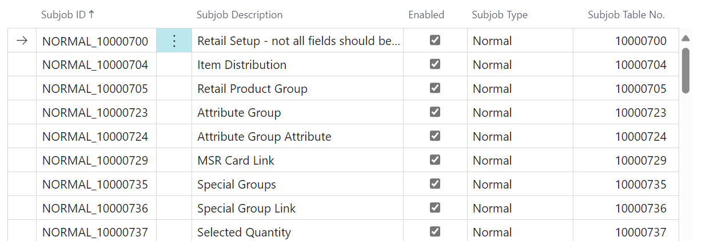
Scheduler Job
  When
    When the Scheduler Job is run
  Defines destination
    Location / Distribution Location
    Locations / Distribution Groups
  What is replicated
    Scheduler subjobs

Slide 5
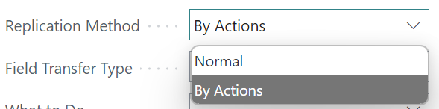



Scheduler Subjob
Replication Methods
  Normal
    All data
    By Replication Counter
  By Action
    Pre-Actions
    Actions
    Preload-Actions

Slide 6
Replicating Master Data with Web Replication

Slide 7
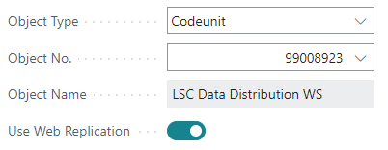
Web Replication
Scheduler Job
Activate Web Replication on the Scheduler job card
Only push from the current location
Only to the same table and field at the destination

Slide 8
Web Replication
The normal job now supports deletes
    Deletes all data in the destination table
Data inserted/updated without Data Validation
Solution implemented within BC/AL

Slide 9
Web Replication
Scheduler Job
Step 1
Create Replication Requests
Source
Scheduler
Job – Data
Distribution
WS
Request
Table

Slide 10
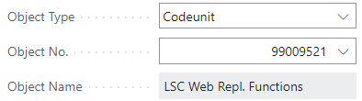
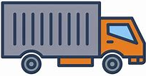
Web Replication
Scheduler Job
Step 2
Data Replicated by
Web Replication Module
Source
Destination
Scheduler
Job – Data
Distribution
WS
Web
Replication
Method
Request
Table
Web Replic.
Packet Data
Update
destination
table
Scheduler
Job – Repl.
Function
Web
Replication
Queue
Defined in
Distribution Location

Slide 11
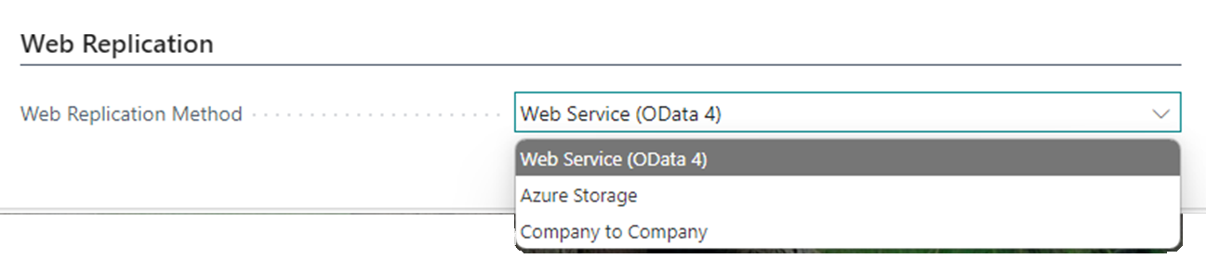

Point to Point (P2P)
Prerequisite
  Distribution Location record the Web Replication Method is set to Web Services (Odata 4)
Replicate between two BC Environment
Destination table modified automatically
Distribution Location
-----
-----
-----
-----
------
------
------
------
------
P2P
------
------
------
------
------

Slide 12
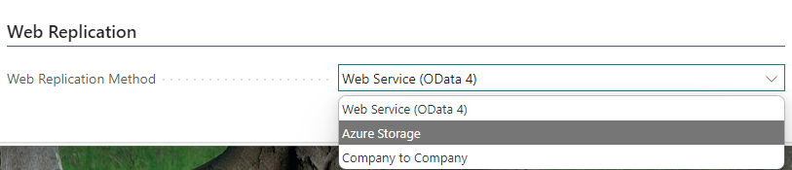

Azure Storage (AzS)
Prerequisite
  Distribution Location record the Web Replication Method is set to
  Azure Storage
  Used for replication to Offline POS
  Three step process
Distribution Location
------
------
------
------
------
AzS
-----
-----
-----
-----

Slide 13
Azure Storage (AzS)
Prerequisite
  Distribution Location record the Web Replication Method is set to
  Azure Storage
  Used for replication to Offline POS
  Three step process
  POS: Trigger replication
  POS background session
  Scheduler job
  Azure Storage subscription
  Managed by the customer
Distribution Location
------
------
------
------
------
------
------
------
------
------
AzS
-----
-----
-----
-----

Slide 14
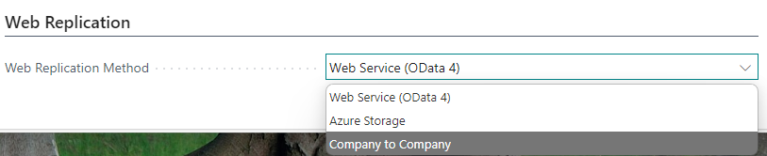
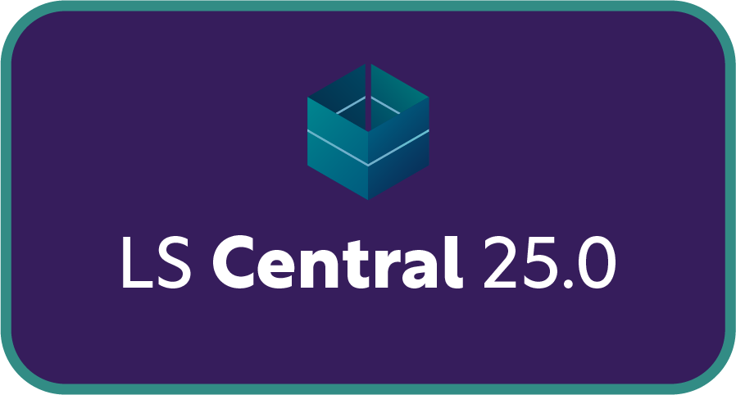
Company to Company (C2C)
Prerequisite
  Distribution Location record the Web Replication Method is set to Company to Company
Replicate between two BC Companies
in same Environment/SQL
Destination table modified automatically
Distribution Location
-----
-----
-----
-----
-----
-----
-----
-----
26

Slide 15
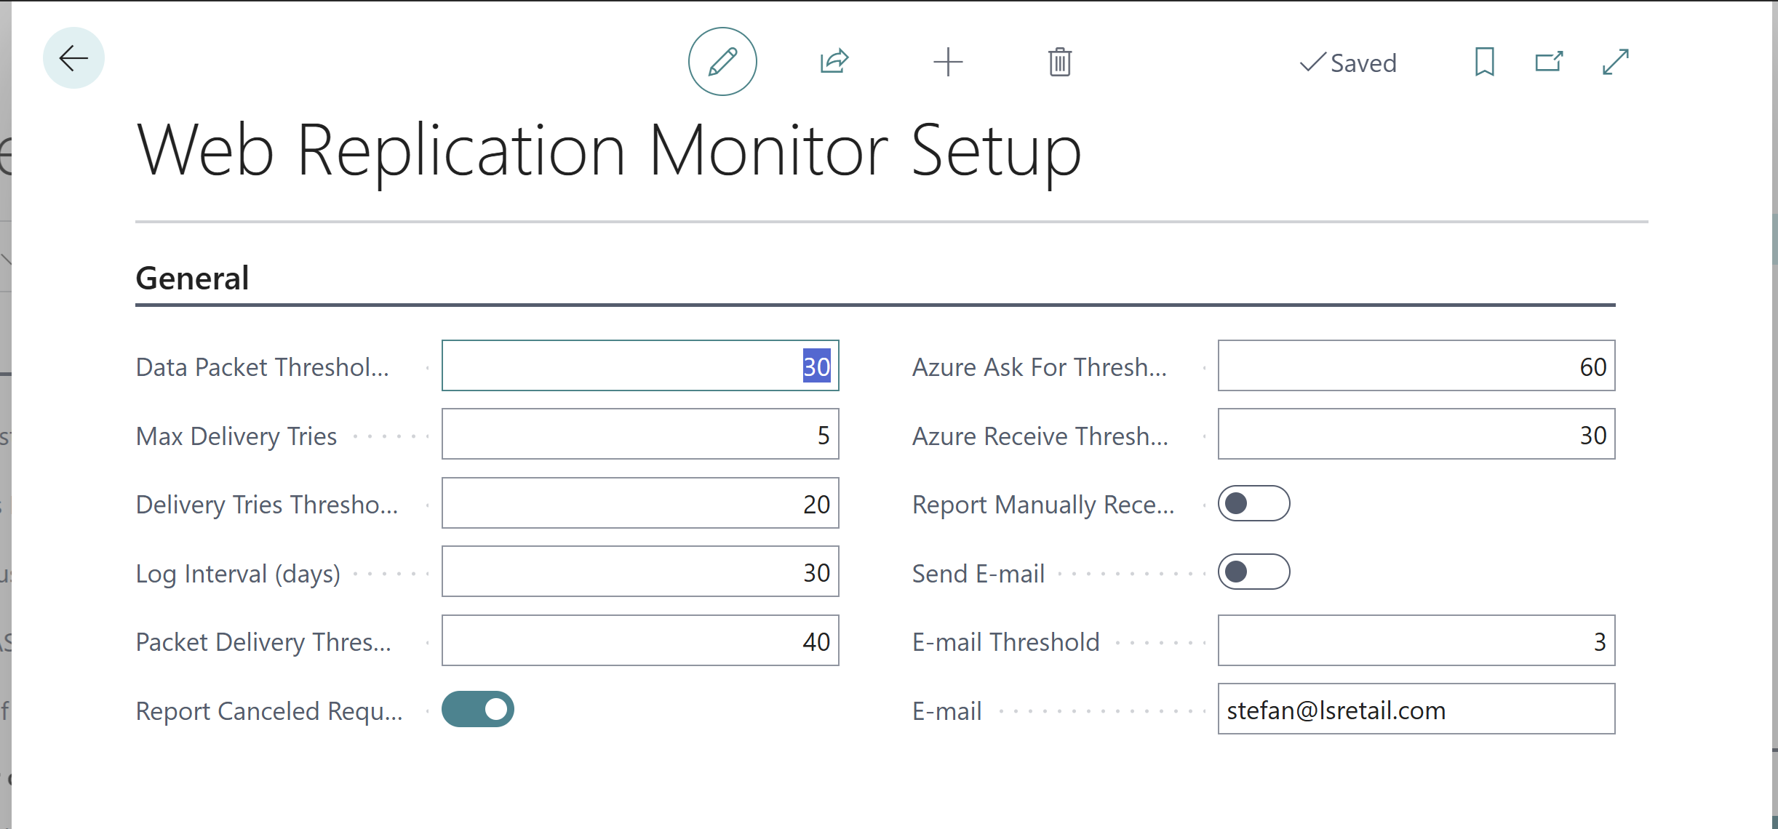
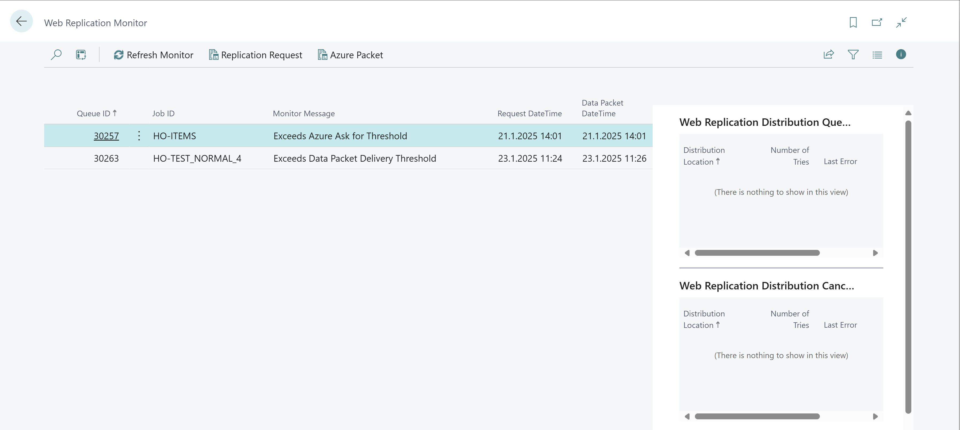
Web Replication Monitor
Monitor web replication tasks and send notifications if needed
Setup
  Define threshold for monitor
Monitor Dashboard
  Monitor each step of the package flow
  Alerts are created via e-mail

Slide 16
Timestamps

Slide 17
Timestamp
LS Central 26 supports using timestamps instead of
Pre-actions
  Uses SQL timestamp of record insert or modification
  All record deletes logged in a deleted record table
Why timestamps
  Less table locking resulting from pre-action table
  Pre-action table can grow very large
Risk
  Any extension/integrations relying on pre-action technology will not work
26

Slide 18
Send POS Transactions to
Head Office

Slide 19



Send POS Transactions (Send Transaction)
Web Request Send Transaction
  Can be run:
    Directly
    Background Session
  xmlport defines tables and fields.
How to extend
  New xmlport, implementing all fields and table (SendTransactionXML) - host
  New codeunit to publish the new xmlport (SendTransaction) - host
  Extension (codeunit)to
  standard SendTransactionUtils
  Use events to implement changes (SendTransactionUtils) - POS
POS functional Profile

Slide 20

Send POS Transactions (Web Replication)
Web Replication in Background Session
  No xmlport
  Includes all fields for selected tables.
How to extend
  New codeunit to define additional tables in the replication local procedure OnAfterLoadTransactionTables
POS functional Profile

Slide 21
Send POS Transactions through Service Bus to Head Office

Slide 22
Send POS Transactions through
Azure Service Bus
26.1
Planned
Planned for LS Central 26.1
POS send transaction to the head office
  POS creates a package on Azure Storage with transaction details
  POS creates a message in Azure Service Bus
    Pointing to Azure Storage package
Service
Bus
Azure
Storage

Slide 23
Send POS Transactions through
Azure Service Bus
26.1
Planned
Planned for LS Central 26.1
POS send transaction to the head office
  POS creates a package on Azure Storage with transaction details
  POS creates a message in Azure Service Bus
    Pointing to Azure Storage package
Head office import
  HO reads Azure Service Bus message on transactions to import
  HO imports transaction detail in the Azure Storage package
Service
Bus
Azure
Storage

Slide 24
Send POS Transactions through
Azure Service Bus
26
Planned
High availability for POS to send transactions
  Service Bus and Azure Storage is designed for high volume and availability
HO controls the speed of transaction import
  Gives more control over how the HO system performance is impacted
Service
Bus
Azure
Storage

Slide 25
Send Transaction - summary
SendTransaction w. Web Replication in background session – default option
Azure Service bus for large implementations

Slide 26
Send Transaction - summary
SendTransaction w. Web Replication in background session – default option
Azure Service bus for large implementations
Scheduler and DD – not recommended
  Azure Service Bus – in LS 26.1
  Self healing process for transactions – future releases

Slide 27
Offline POS – best practices

Slide 28
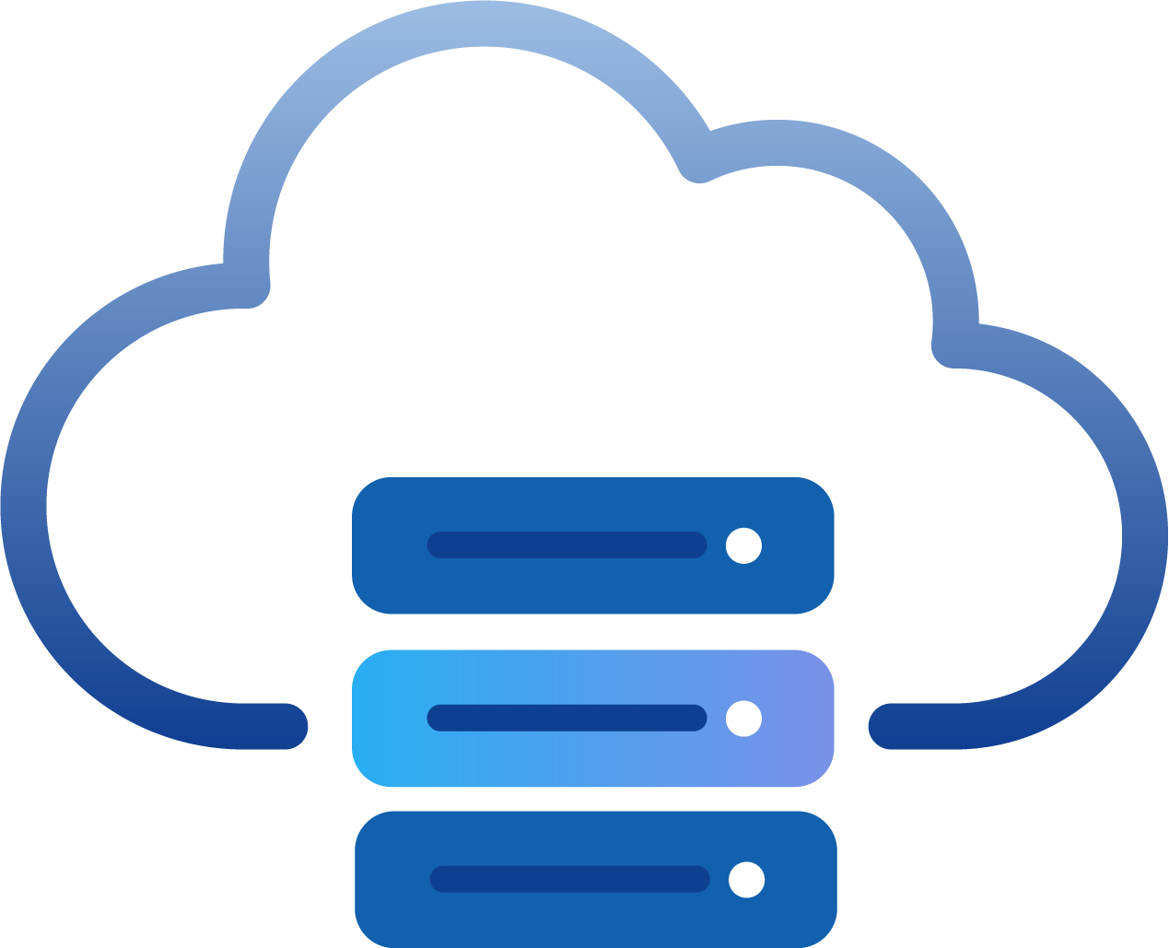




Offline POS overview – Hybrid server
HEAD OFFICE IN
BC SaaS
DD Webservice mode​
Data Director in WS mode
Middle layer – Hybrid server
  Hosted on premises
Scheduler runs on the HCS
HYBRID COMPONENT SERVER
POS MASTER
DATA DIRECTOR
UPDATE SERVICE
STORE 1
STORE 2
Offline POS
Offline POS
Offline POS
Offline POS

Slide 29




Offline POS overview – offline POS using Azure Storage
HEAD OFFICE IN
BC SaaS
Azure
Storage
Web Replication w. Azure Storage
No middle layer
Scheduler runs in SaaS
STORE 1
STORE 2
Offline POS
Offline POS
Offline POS
Offline POS

Slide 30
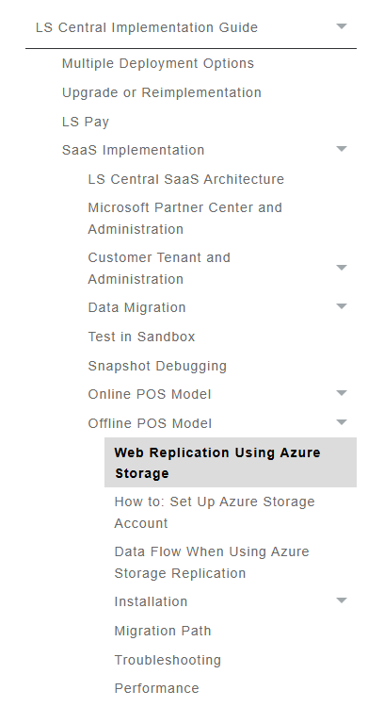
Offline POS – best practices
Use Web Replication with Azure storage
  The recommended way to setup and run the offline POS
The Hybrid Server is not going away
New Offline POS project for the Update Service
LS Central – Implementation Guide
  Step by Step instructions
help.lsretail.com

Slide 31
The new Offline POS – benefits
Simpler to setup and maintain
Better performance
A fully cloud hosted solution
Simpler to keep the POS current
Less cost running the Offline POS
  No subnet costs – 6$ per subnet SKU
  500 POS = 3000$
  Azure Storage cost – example
  500 POS =10$
Automatic subscription of POS Web services included

Slide 32
The new Offline POS – benefits
Simpler to setup and maintain
Better performance
A fully cloud hosted solution
Simpler to keep the POS current
Less cost running the Offline POS
  No subnet costs – 6$ per subnet SKU
  500 POS = 3000$
  Azure Storage cost – example
  500 POS =10$
Automatic subscription of POS Web services included

Slide 33
Offline POS – Backward Compatibility
Offline POS 3 major version supported
HotFix 3 major version backward - last minor release
v23 | V23.1 | v24 | v24.1 | v25 | v25.3 | v26 | v26.1 | v27
Last minor
= HotFixed
Last minor
= HotFixed
Last minor
= HotFixed

Slide 34
How to replicate to and from an old LS Central database?

Slide 35

Replicating to SaaS from an older version
Migrating to SaaS in steps
  HO first then Stores/Pos
  POS first then HO
Hurdles and how to overcome them
  Table renaming in 17.5
  S2S (OAuth 2.0) Authentication

Slide 36
Replicating to SaaS from an older version
Migrating to SaaS in steps
  HO first then Stores/Pos
  POS first then HO
Hurdles and how to overcome them
  Table renaming in 17.5
  S2S (OAuth 2.0) Authentication
Best practices
  Middle server on-premise running LS Central latest version
  Push not pull

Slide 37

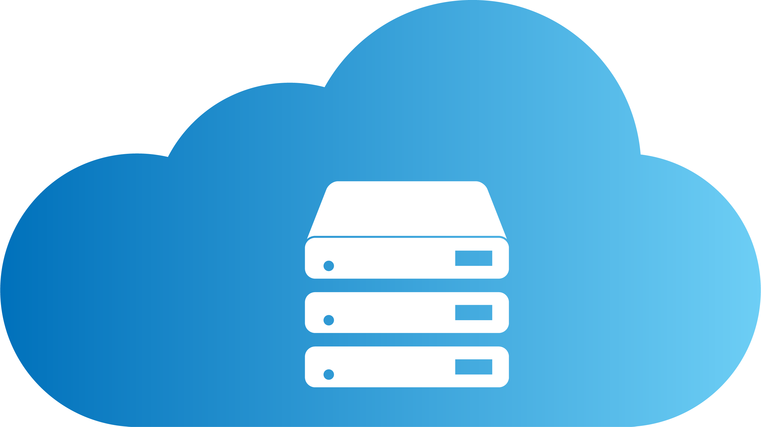
Replicating to SaaS from an older version
BC/LS
SaaS
Azure
Storage
  Use the Scheduler to replicate
  < LS17.5 map LS tables and fields
  < LS18.1 only push not pull
  Web Replication
  OAuth2
  Web Replication using Azure Storage
  The Scheduler is used to define tables and receivers
The Scheduler
Runs LSC Web Repl. AzS Utility codeunit
  Web Repl. using Azure Storage
  Call to HO to check for package
Web Repl. using Azure Storage
Package pulled down from Azure Storage
LS NAV/LS Central
DATA DIRECTOR
LS Central v. 26
  Use the Scheduler to replicate
  < LS17.5 map LS tables and fields

Slide 38
Replicating to SaaS from an older version
3
BC/LS
SaaS
Azure
Storage
  Use the Scheduler to replicate
  < LS17.5 map LS tables and fields
  < LS18.1 only push not pull
  Web Replication
  OAuth2
2
4
5
  Web Replication using Azure Storage
  The Scheduler is used to define tables and receivers
The Scheduler
Runs LSC Web Repl. AzS Utility codeunit
1
  Web Repl. using Azure Storage
  Call to HO to check for package
Web Repl. using Azure Storage
Package pulled down from Azure Storage
LS NAV/LS Central
DATA DIRECTOR
LS Central v. 26
6
  Use the Scheduler to replicate
  < LS17.5 map LS tables and fields

Slide 39



  Book a session: portal.lsretail.com/onboarding-ls-central-in-saas/
Aðalbjörg Karlsdóttir
Onboarding Lead
Book a session with the
CAP team
Ricardo Moinhos
Onboarding Specialist

