Slide 2
Around 14-35% of all IT projects fail to succeed
Source; Pulse of the Profession report 2021 by Project Management Institute

Slide 3
Anna Dis Thorvaldsdottir
Consulting Manager
Sergio Castelluccio
Consulting Manager
How LS Retail Consulting Services can help you

Slide 4
LS Retail Consulting services
Global team of 90 people
Diverse team
Very extensive experience
Subject matter experts
Technical Consultants
Funtional Constultants
Solution Architects
Project Managers

Slide 5
Why contact LS Retail Consulting?
Expertise needed
Taking on new module or extensive functionality
Complex project/customer
Architectural guidance needed
Closer cooperation needed with LS Retail teams
Advice and consulting support
Need additional resources

Slide 6
Our projects today and what is “new”

Slide 7
The good old days
This is no longer the case:
Project spanned over 6-18 months
Requirements, analyses, development, proof of concept, rollout
Stable project environment
Same BC version
After rollout, the client using same version for years
It works – don’t fix it
Smaller ongoing enhancements
If this is still the case
there is something not right …

Slide 8
The good new days – What is our new project life cycle?
SaaS
Projects are now more frequently updated
Updates or upgrades during project’s phases
Project environment strategy
Production frequently updated
And how about
Reviewing upcoming standard functionality and plan into projects
Consuming new functionality

Slide 9
Project “toolkit”
GitHub
DevOps
Auto-Testing
ATDD
Acceptance Test Driven Development
Test your Dynamics 365 implementation
Introduction to test automation in Business Central
Release management
Continuous integration with Azure DevOps for Microsoft Dynamics 365 Business Central - Training | Microsoft Learn

Slide 10
Project “toolkit” – Release Management
Development - local
QA
UAT
Pre-Production
Production
Unrelated? Test/Sandbox
Hotfixes via Master branch
Development branch into UAT
Feature brand into QA
Auto-testing

Slide 11
What can LS Retail Consulting services do for you?

Slide 12
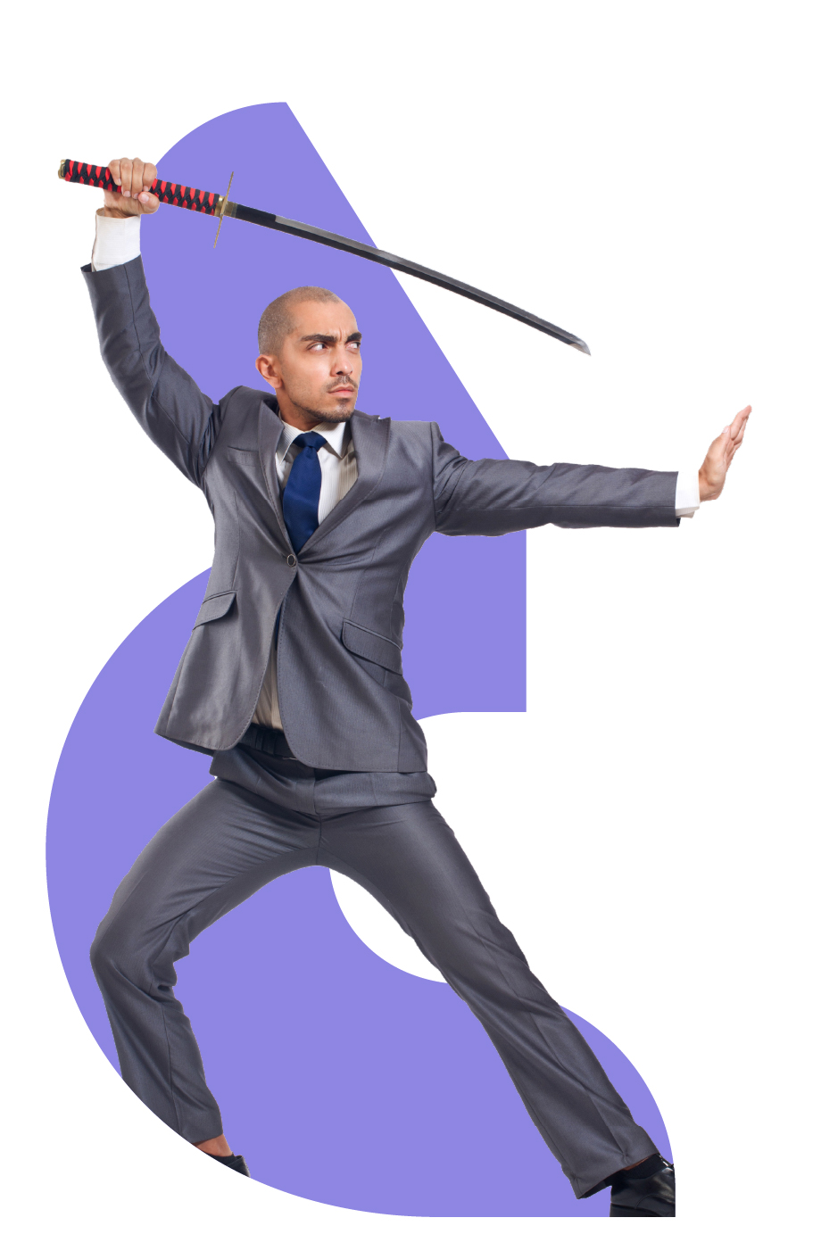
What do we offer?
Training
Partner certifications are offered by LS Retail Academy but in-depth or customized training on specific LS Central modules and functionality.
Deliver needed training for partner
Design courses specific to your needs
Create teaching materials based on actual issues

Slide 13
Training examples
AL programming
Replenishment
Bookings for LS Central
LS Central for hotels
Membership management
Kitchen displays and printing
Analytics for LS Central
Telemetry

Slide 14
What do we offer?
Presales assistance and analysis
Our consultants have extensive knowledge and experience on LS Central modules, functionality, and implementations. Therefore, they can:
Give customized presentations and demos for certain functionality
Pinpoint the needs along the chain with Fit/gap analysis
Identify solutions to those needs
Create an implementation strategy
Document processes and areas for both standard solutions and customized systems

Slide 15
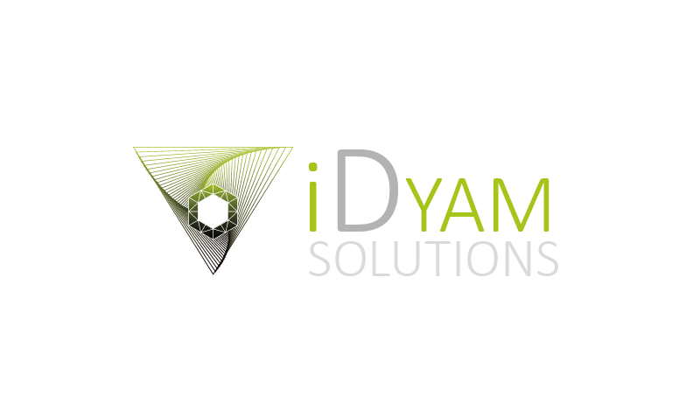
National Trust for Scotland - iDyam
Presales presentations
Fit and gap analysis
Project scoping
Architecture guidance

Slide 16
What do we offer?
Configuration
Our consultants are the experts of LS Central and its modules and know how to:
Setup the solution to give the best functionality
Tailor functions to each customer’s needs
Configure and test a system for optimal performance
Create, run, and document evaluations for functions

Slide 17
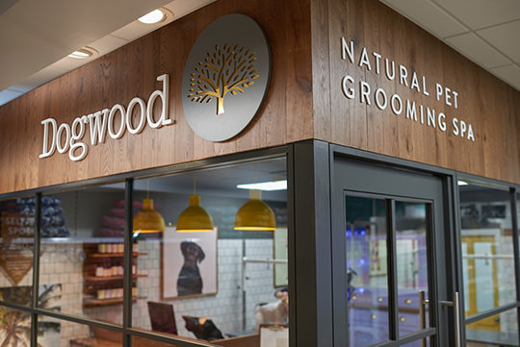
Pet Family
Pets Corner
160+ retail stores
Dogwood
Around 50 Dogwood stores
Pet Treatments
Bath & Brush
Groom
Trim
Nail Clipping
Etc..
About 10.000 monthly appointments

Slide 18
What do we offer?
Implementation & deployment
Our consultants ensure resilient software implementations from the start through:
Architectural guidance
Release management advising
Work on data migration
Installing the software and its hardware
On-site guidance and support when the project goes live

Slide 19
VITA with Bedege
Beauty and cosmetics chain
Major SaaS project
Experience on SaaS needed
Use of Update Service for LS Central
Customizations

Slide 20
What do we offer?
Customizations
Each customer is different and some of their needs don’t fit within the standard solution.
Our consultants assist with solving these challenges by:
Designing new functionality within the solution
Customizing current and new LS Retail products
Testing and delivering new developments
Advising on implementing new solutions
Developing customized integrations

Slide 21
Channex
Hotel channel manager API platform
Supports selling and managing rooms online via 3rd party channels
Integration done in cooperation with Blue Lagoon
Coming out in v.25

Slide 22
What do we offer?
Project management
Our team can give you a hand as management leads or as support during each phase of the project.
Initiation: from developing a business case, to feasibility studies, to phase reviews.
Planning: creating plans to manage resources, finances, communication, risks, quality control, and more.
Execution: ensuring the project goes according to plan in terms of times, costs, quality, and internal acceptance.
Closure: delivering the project to the end.

Slide 23
Peninsula Hot Springs with MicroChannel
Presales and analysis
Certain modules expertise
Customization
Architecture consulting
Project management

Slide 24
Summary
Project toolkit
Architectural guidance
LS Pay integrations
Performance review
Customized training and consulting
Presales assistance and fit gap analysis
Functional and technical consulting
Customization design and development
Project planning, scoping, and management

Slide 25
Our aim is to increase the success of our partners and customers!
Extensive offering of services available to our partners.
Extend your capabilities and ensure you have the knowledge, skills, and resources needed to succeed.
How can we help you succeed?
Reach out to us directly or pmeurope@lsretail.com

