Slide 2
How LS Central can support your grocery chain
Marco Antonio Peña Corona Olafur Jonsson

Slide 7
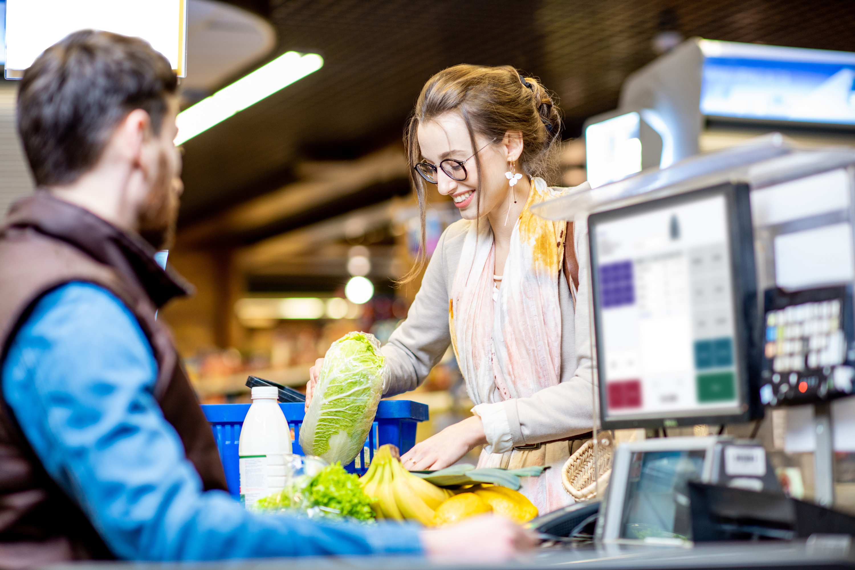
NEED A GROCERY ORIENTED PICTURE SHOWING LS CENTRAL TECHNOLOGY

Slide 8
High transaction volume

Slide 9
Batch Posting
Tried and tested functionality
Posting big chunks of data in batches
Statement
Purchase
Receiving

Slide 10
Parallel Statement Posting
Compliments Batch Posting
Available for statements

Slide 11
Aggregated Inventory

Slide 12
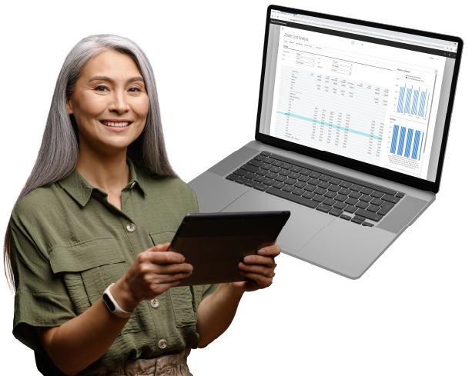
Aggregated Inventory
Huge item list + transaction volume + locations
Consolidation of transactions

Slide 13
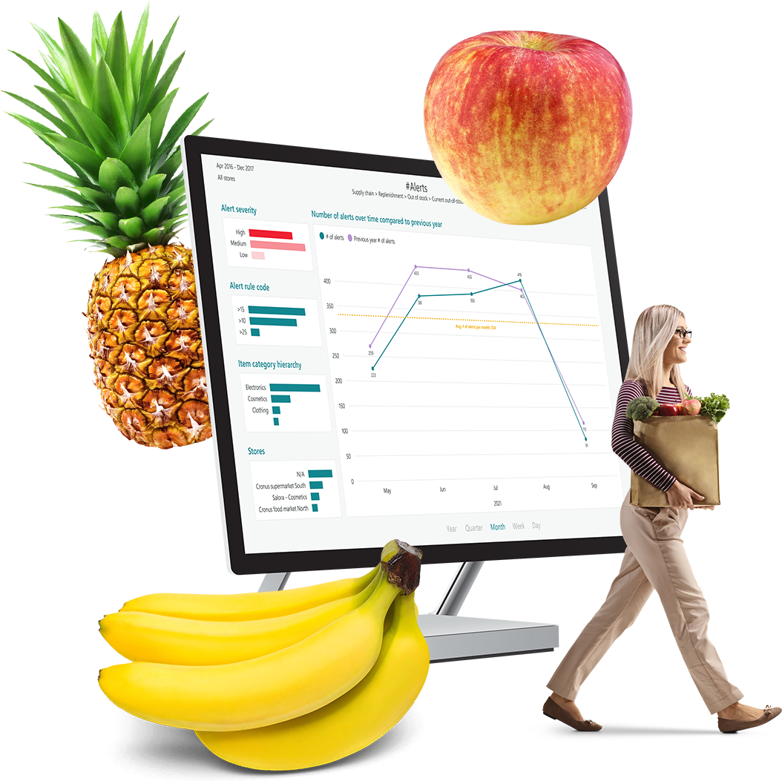
Parallel Replenishment
Out of stock calculation
Replenishment Item Qty
Replenishment Journal Calculation

Slide 14
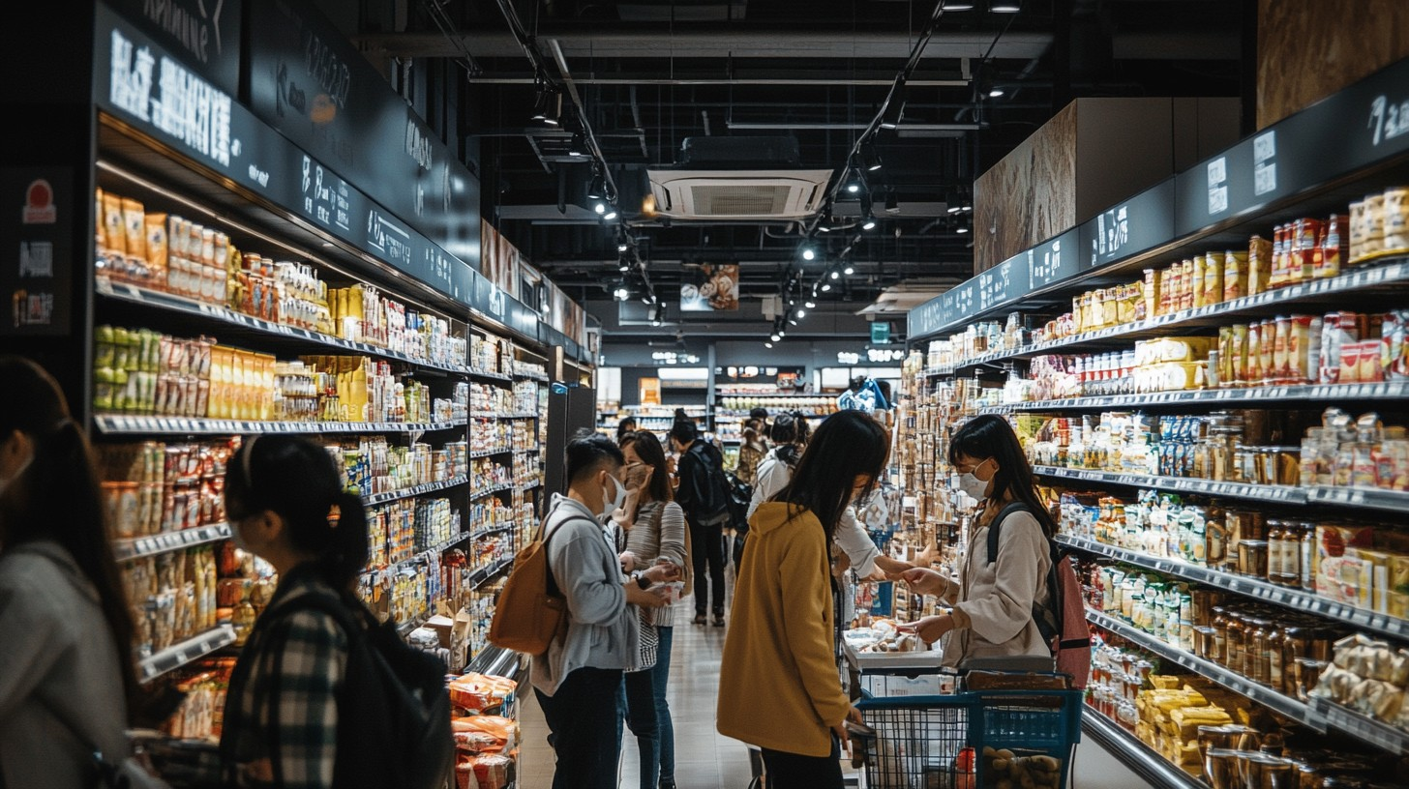

Slide 15
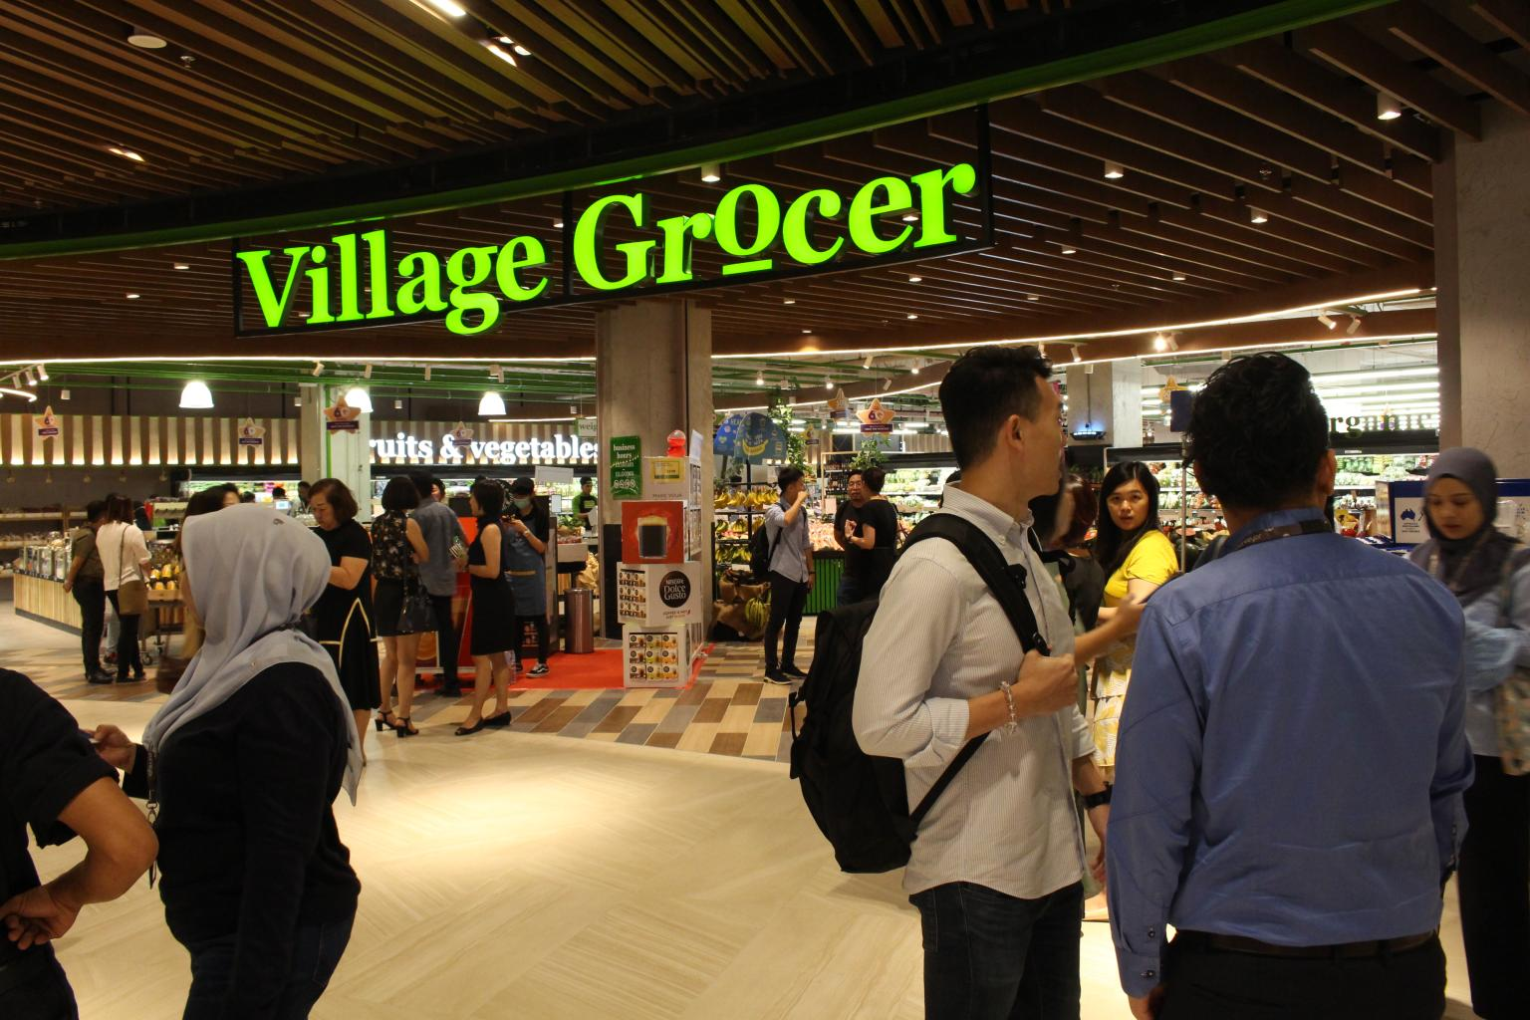

Slide 16
Electronic Shelf Labels (ESL)
Label printing used for ESL
Needed some modifications by partners
Not fully out-of-box support
Standard integration with one ESL provider Pricer

Slide 18
Fast POS
Web replication for offline POS
LS Update service as a Azure Service

Slide 19
Fast POS
"
"
“With the implementation of the new system, we have witnessed a 30% increase in transactions per hour at the POS terminals due to faster checkout processes and improved system responsiveness.”
“Customers may spend hours browsing products in the store, but they are not willing to wait for a long time in the checkout queue. With LS Central we have faster checkout speeds.”
"
"
“The sale procedure is now seamless and easy, thanks to an ergonomic design of user interaction at the Point of Sale. The POS only presents relevant information for each specific sales step. Customers are satisfied with the improved efficiency. “
"The average time of a single POS transaction has reduced by around 50%."

Slide 20
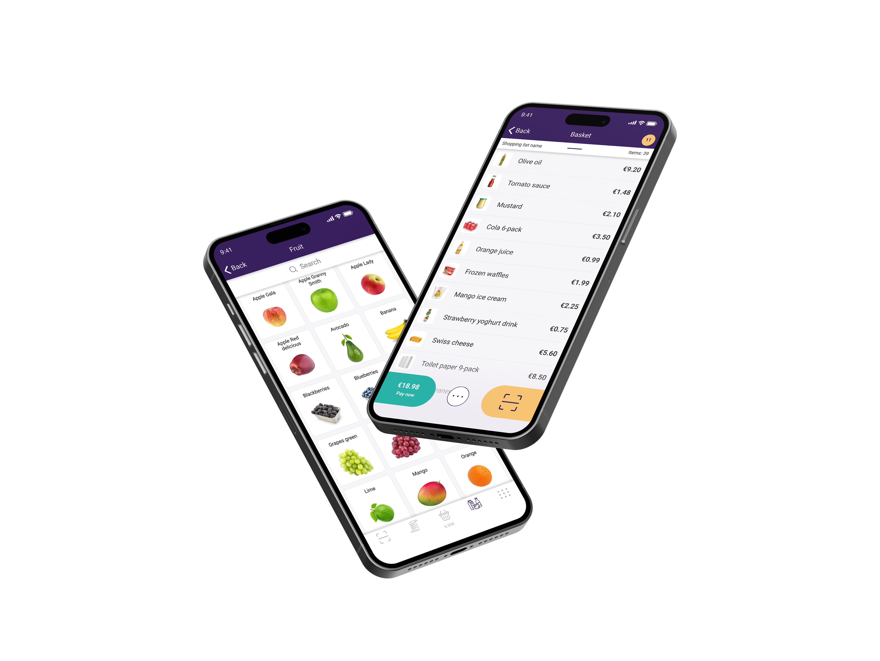
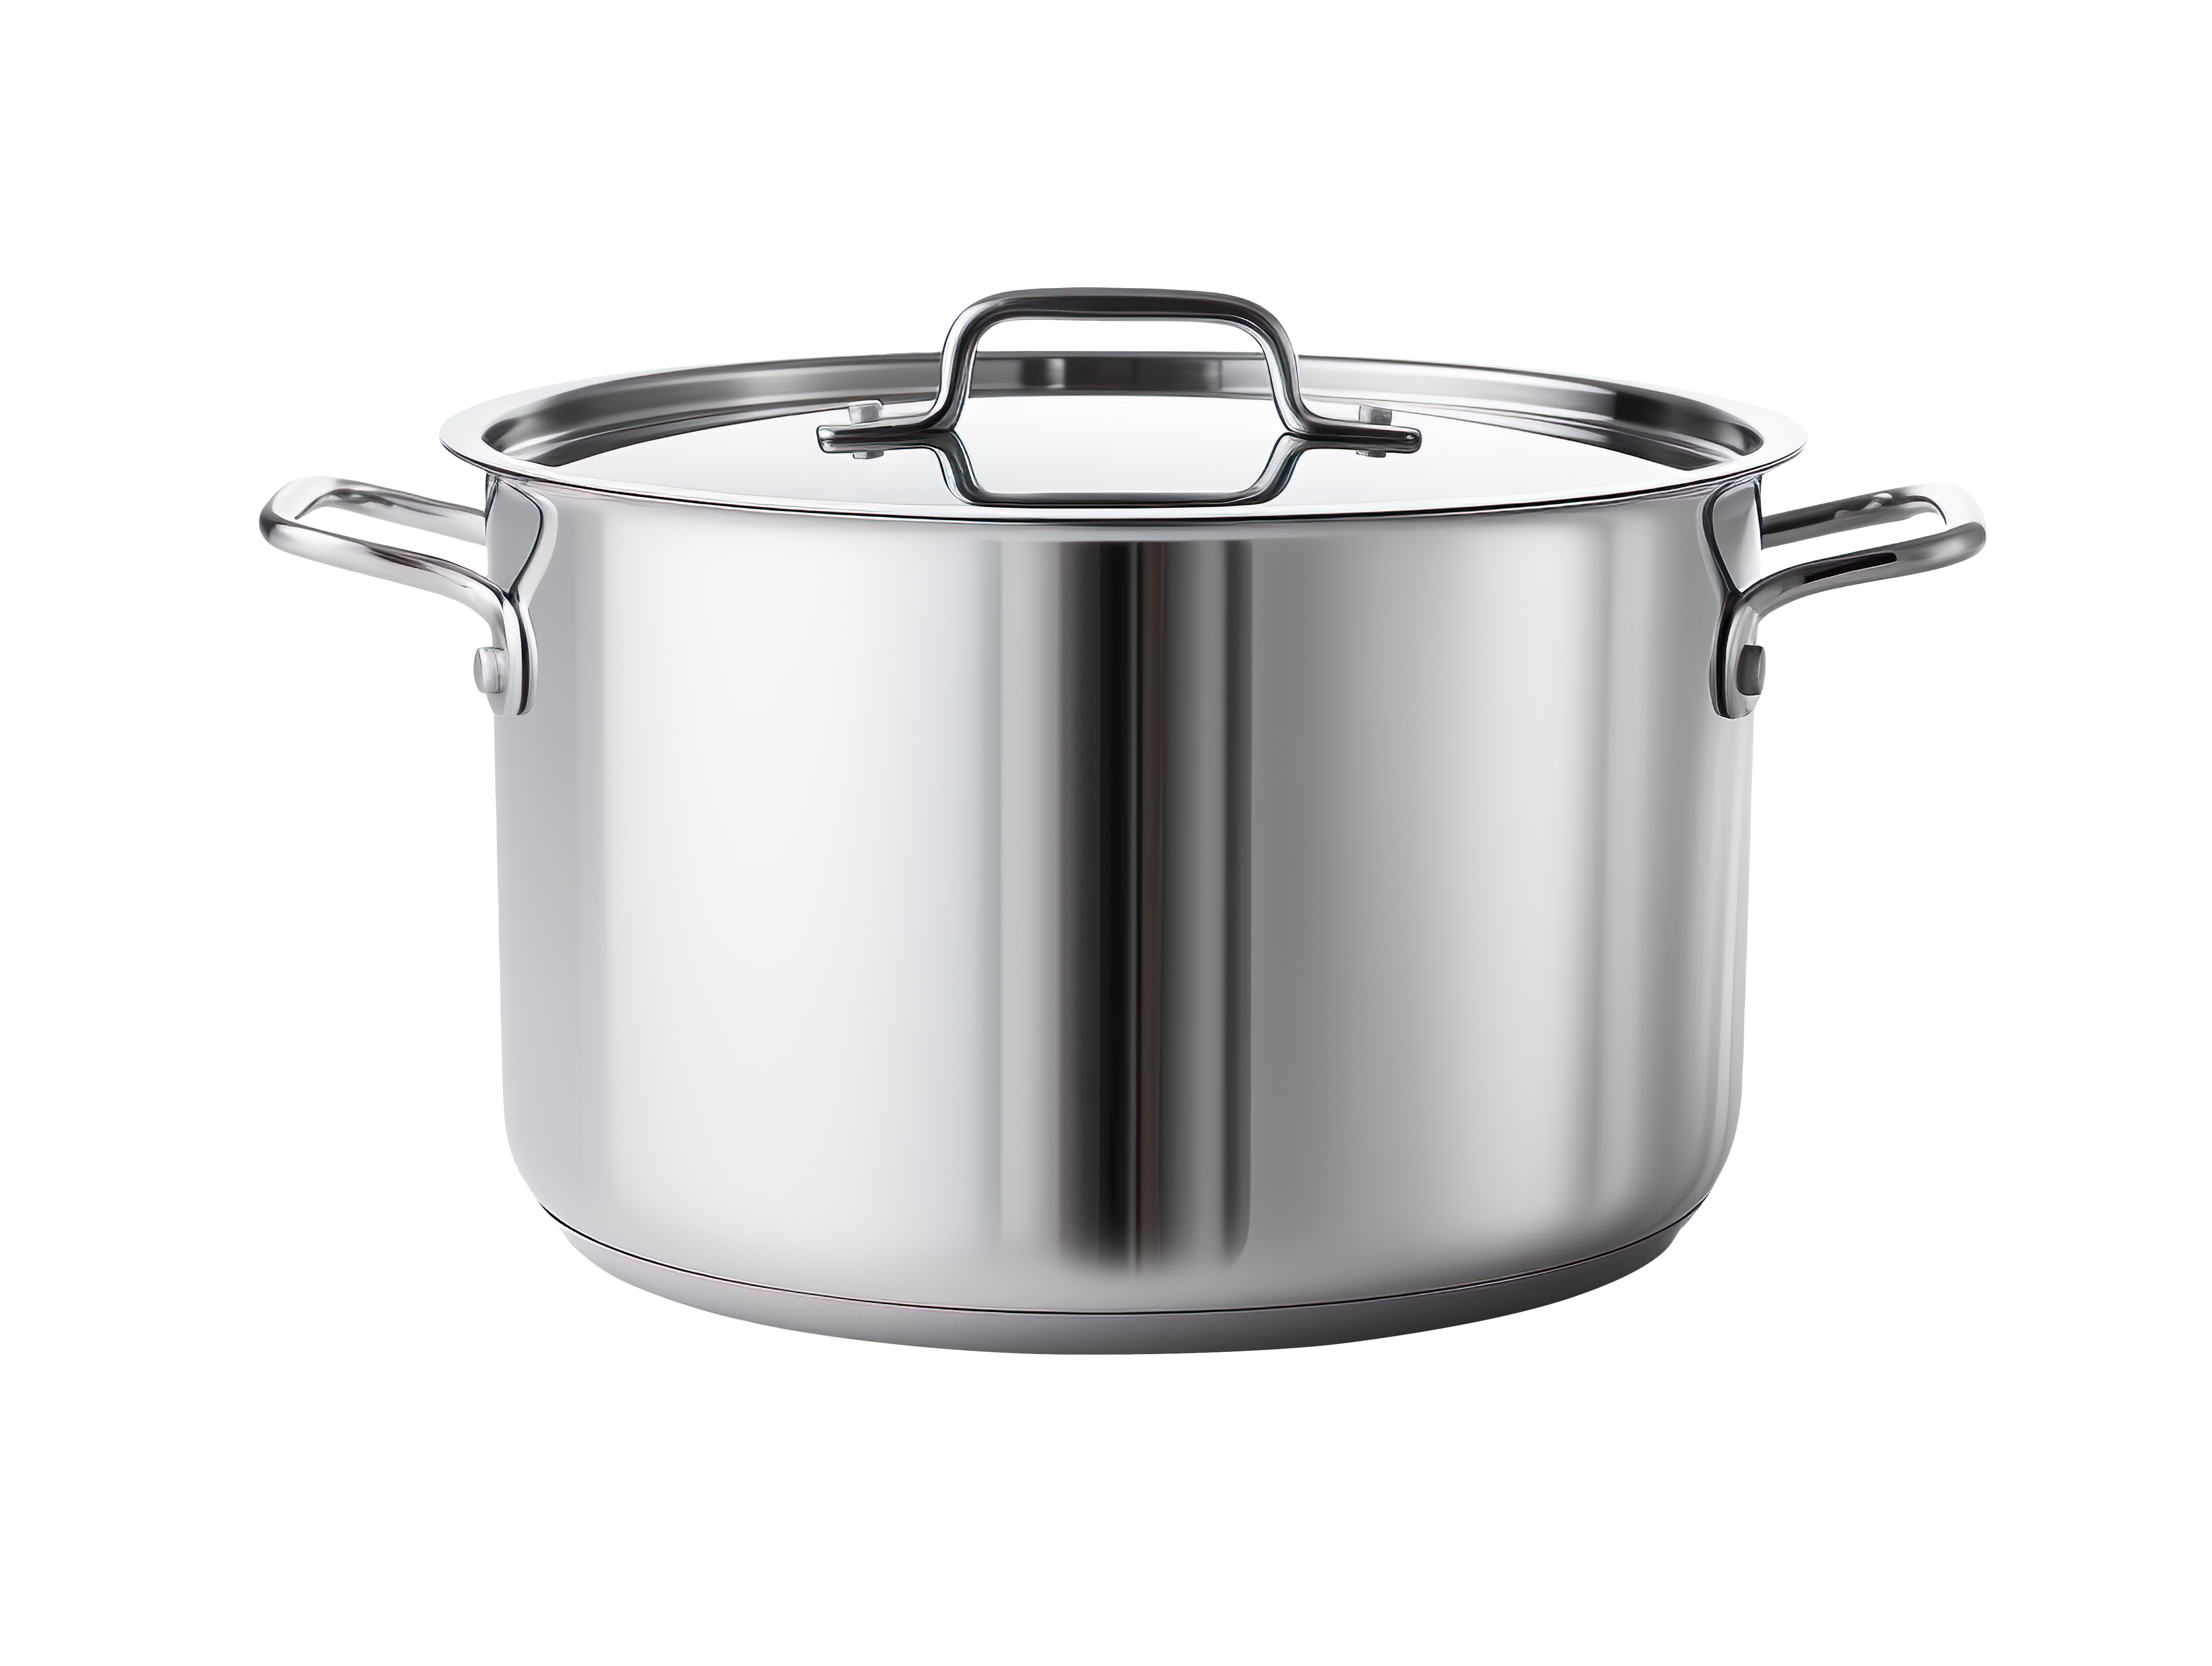
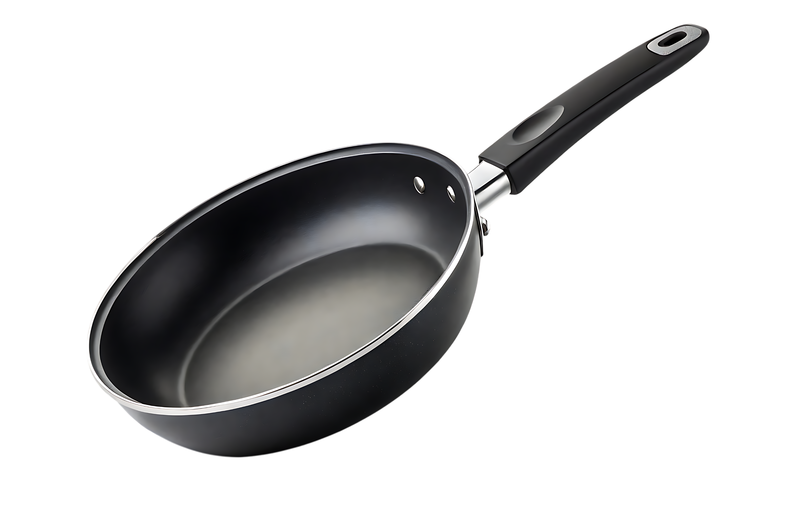
ScanPayGo
Loyalty app branded by retailer
Designed for modern shoppers
Used on their Mobile phone
Can finalize full sales on app
But – also as loyalty app only

Slide 21
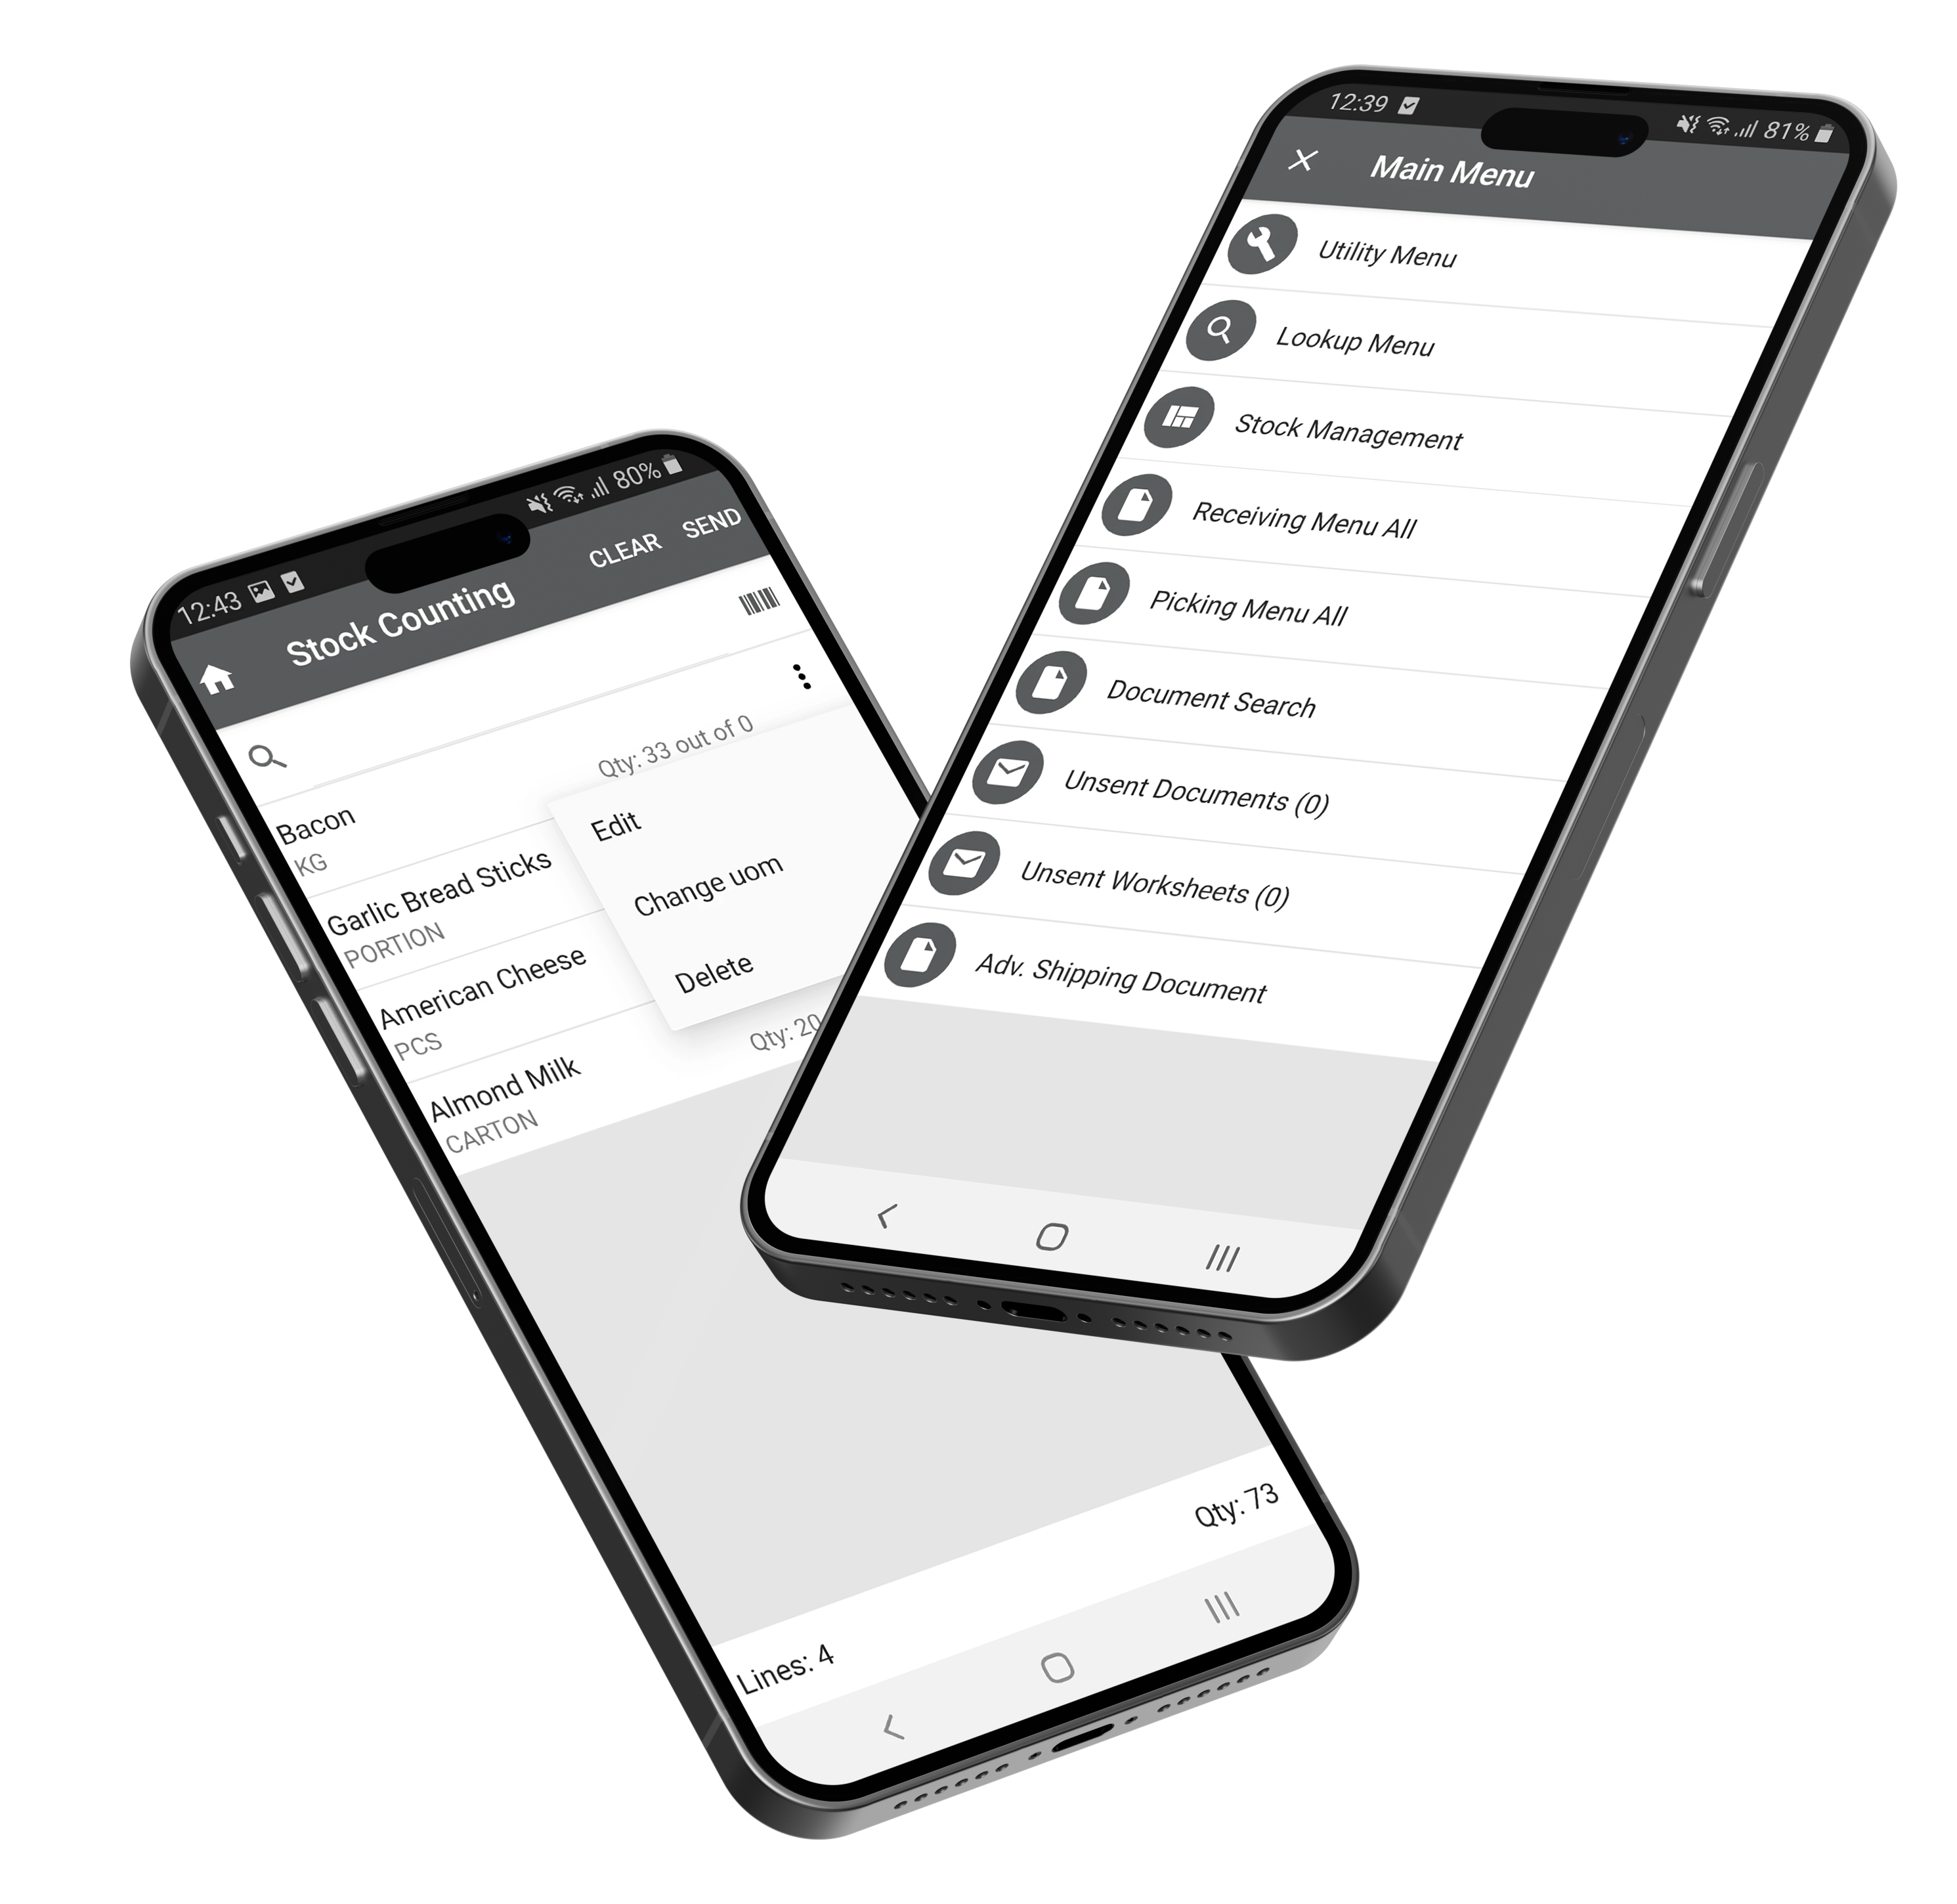
Mobile Inventory
Inventory app to manage In-Store inventory
Handles all major retail processes
picking, receiving, counting,..
Integral part of grocery store operations
High movement of goods
“Out-of-stock” is expensive
Increases efficiency of staff

Slide 22
Mobile Inventory
Items not on file
Counting
Receiving
Change UOM for documents
Partial Picking & Receiving documents
RFID

Slide 23
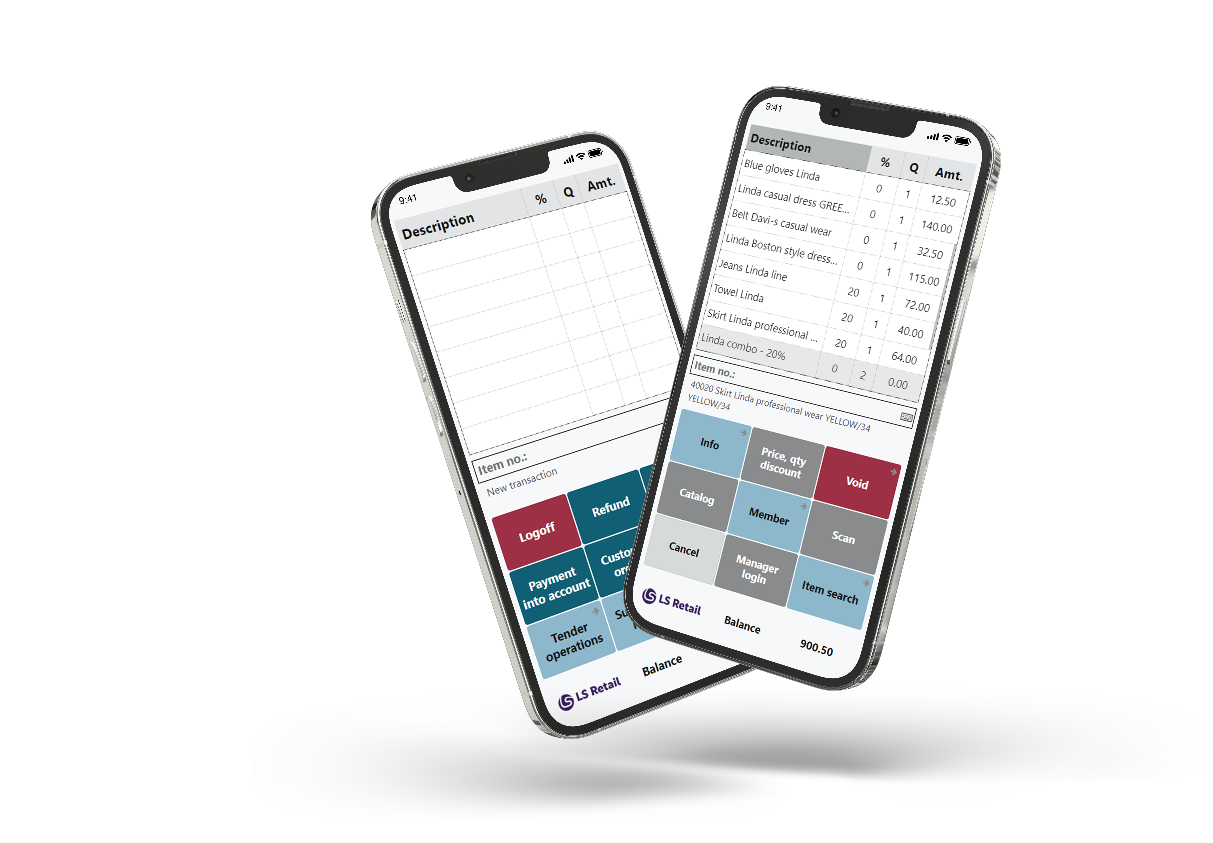
AppShell
Supported Platform
Android
iOS
Windows
Both native apps & browser version
Android Enterprise Management support

Slide 24
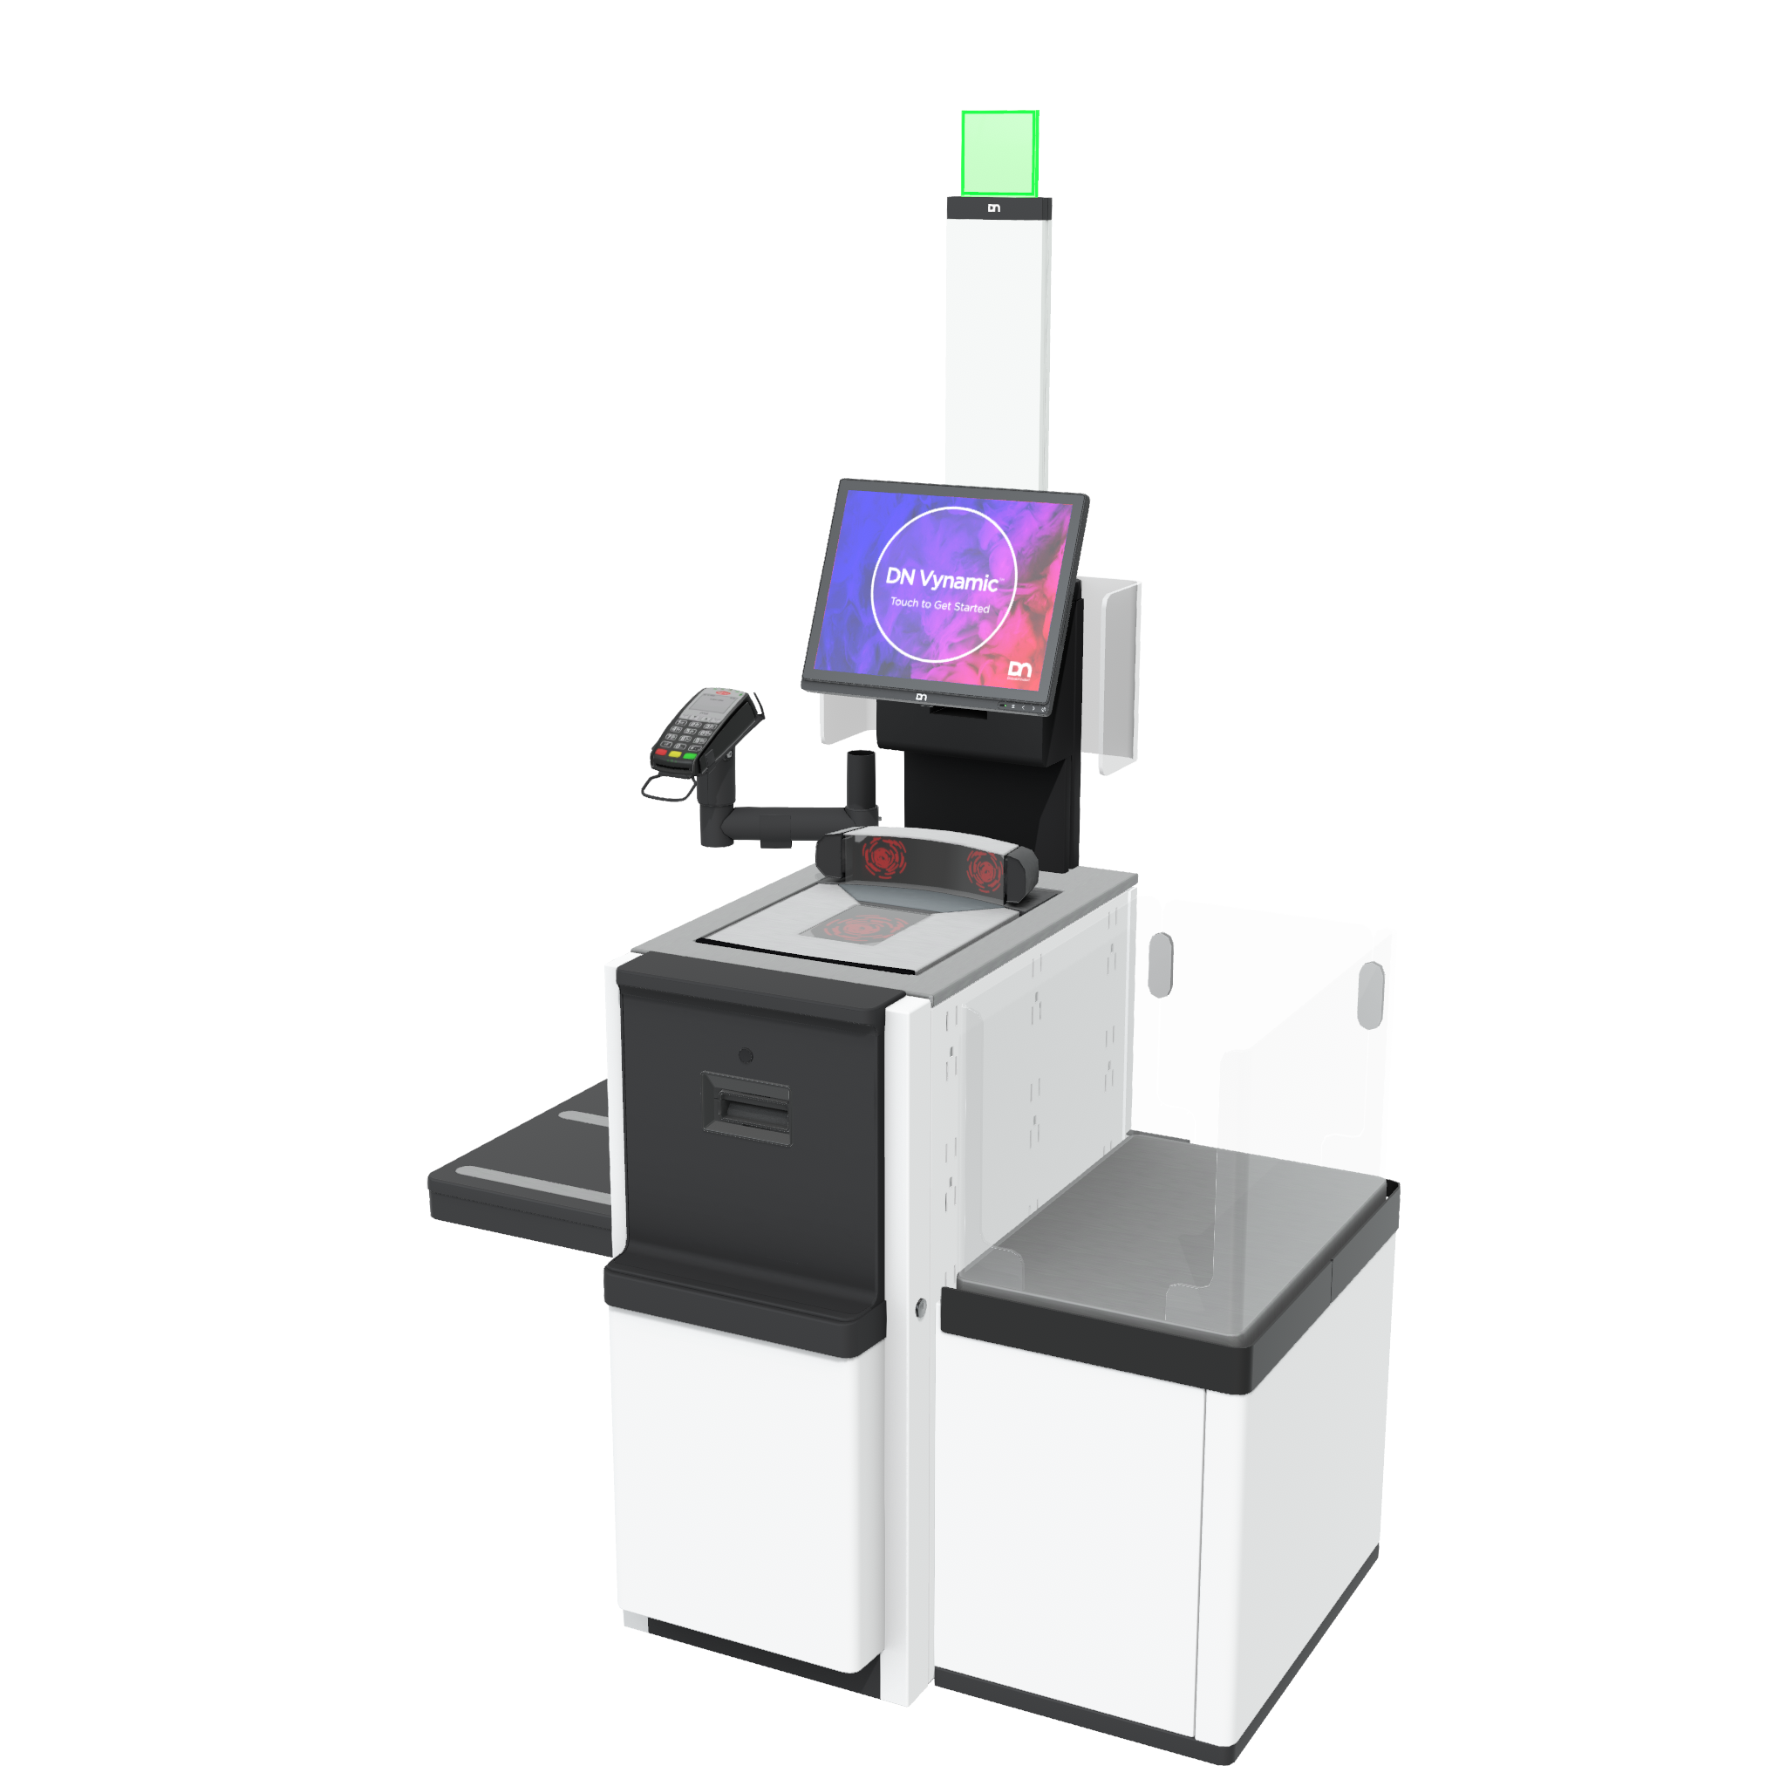
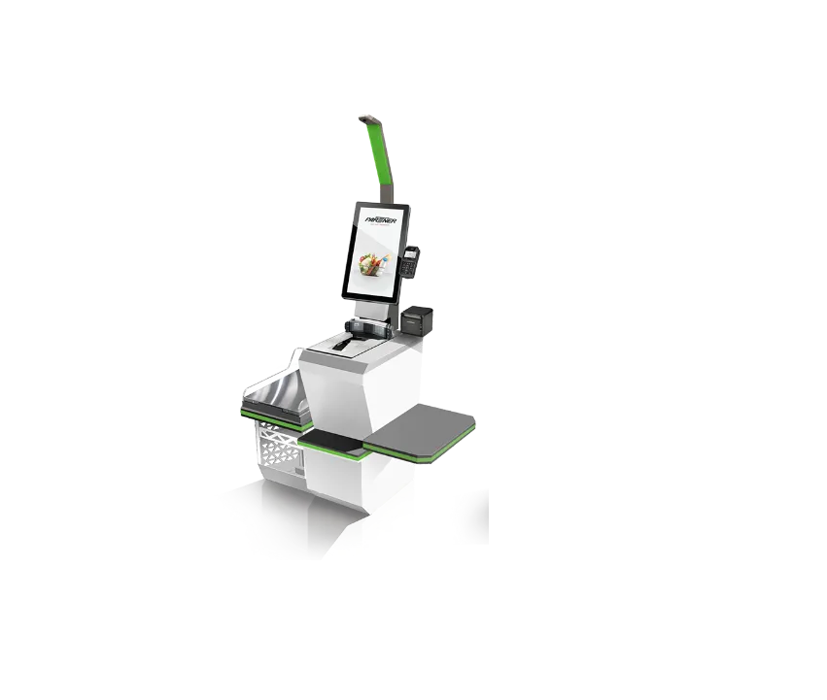
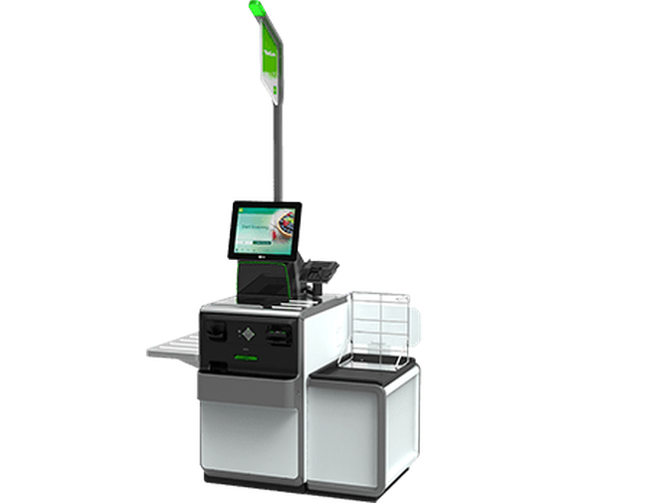
Self checkout / Self service
Web service Support for 3rd party vendors
Diebold Nixdorf / PartnerTech / NCR
Custom made POS layouts within LS Central POS
v27 – Standard LS Central SCO process

Slide 25
Unisuper – La Torre
Founded in 1950 by Ernesto Ruiz Sáenz de Tejada (Cremería París)
First self-service supermarket in Guatemala
Named after Torre del Reformador
Headquartered in Guatemala City
Over 119 La Torre supermarkets, 108 Express stores, and 7 Econosuper locations
Wide range of products: groceries, fresh produce, meats, bakery, and dairy
Pioneers in innovations: deli counters, digital checkout
Merged with Econosuper in 2001, forming Unisuper
Strong community support programs and focus on service quality

Slide 26
Meet Gerber Bautista – IT Innovation Manager, Unisuper
Degree in Systems Engineering and an MBA
Certified in Oracle, AWS, Azure, and Project Management
18+ years of IT experience in retail, agriculture, banking, telecommunications, marketing, and insurance
6 years at Unisuper as IT Innovation Manager
Leads software development and implementation projects
Key contributor to Unisuper’s digital transformation:
Merchandise management systems
Supply chain systems
LS Retail POS and peripheral systems
Led LS Retail POS rollout: implementation, integrations, peripheral development, 30% store deployment, and first-line support
Currently leads technology projects for eCommerce and perishable goods distribution centers

