Slide 1
CentralConnect
LS Central integration to 3rd party head-office applications
PrimeAttention
and overview of other support possibilities
Bjarni Asmundsson

Slide 2




About
LS Central Built on a solid base
LS Central extends head-office platforms
Leveraging the Microsoft Dynamics 365 investment and ecosystem
More than 40,000 businesses use Business Central as their ERP
LS Central is recognized by Gartner® as a representative vendor in the Digital-Business-Ready POS applications

Slide 3

A global POS solution
The LS Central Point of Sale solution has a unique market advantage
We have a global presence that is unmatched by competitors
This global footprint makes LS Retail the ideal provider for retailers who want to work with the same solution in all the regions and countries where they operate
  Some competitors have good coverage in multiple regions with 1-3 verticals
  Some competitors have good coverage in multiple verticals with 1-3 regions
  But LS Retail is unique with coverage in multiple verticals in multiple countries

Slide 4
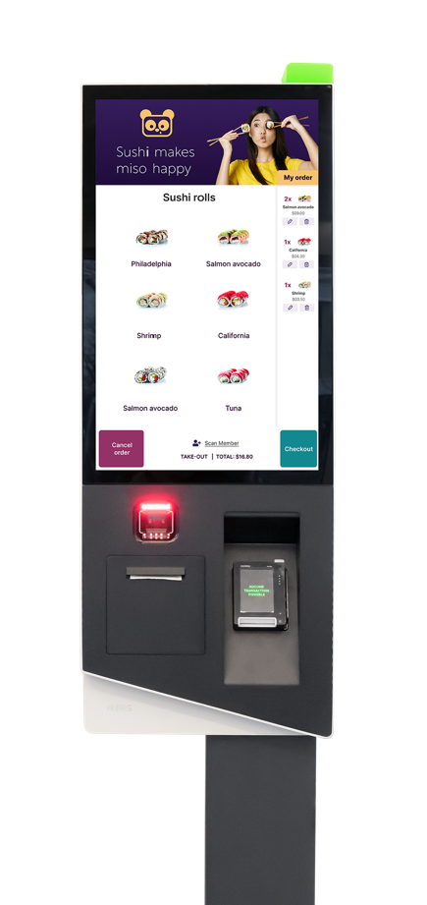
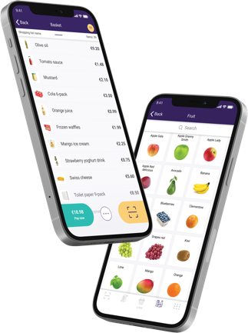
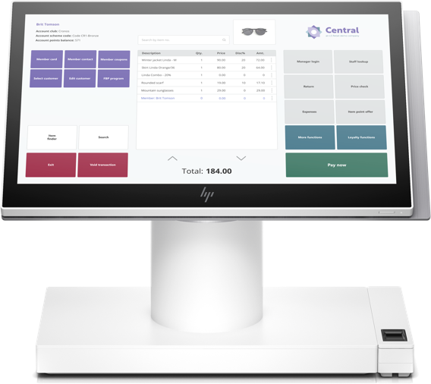
LS Retail named one of the 10 largest point of sale software suppliers
in the world*
*according to RBR’s annual “Global POS software” report

Slide 5

Have you...
Ever had an opportunity with a large chain or enterprise business interested in using LS Central for their operations?
Possibly a prospects using third-party ERP but interested in LS Central?

Slide 6
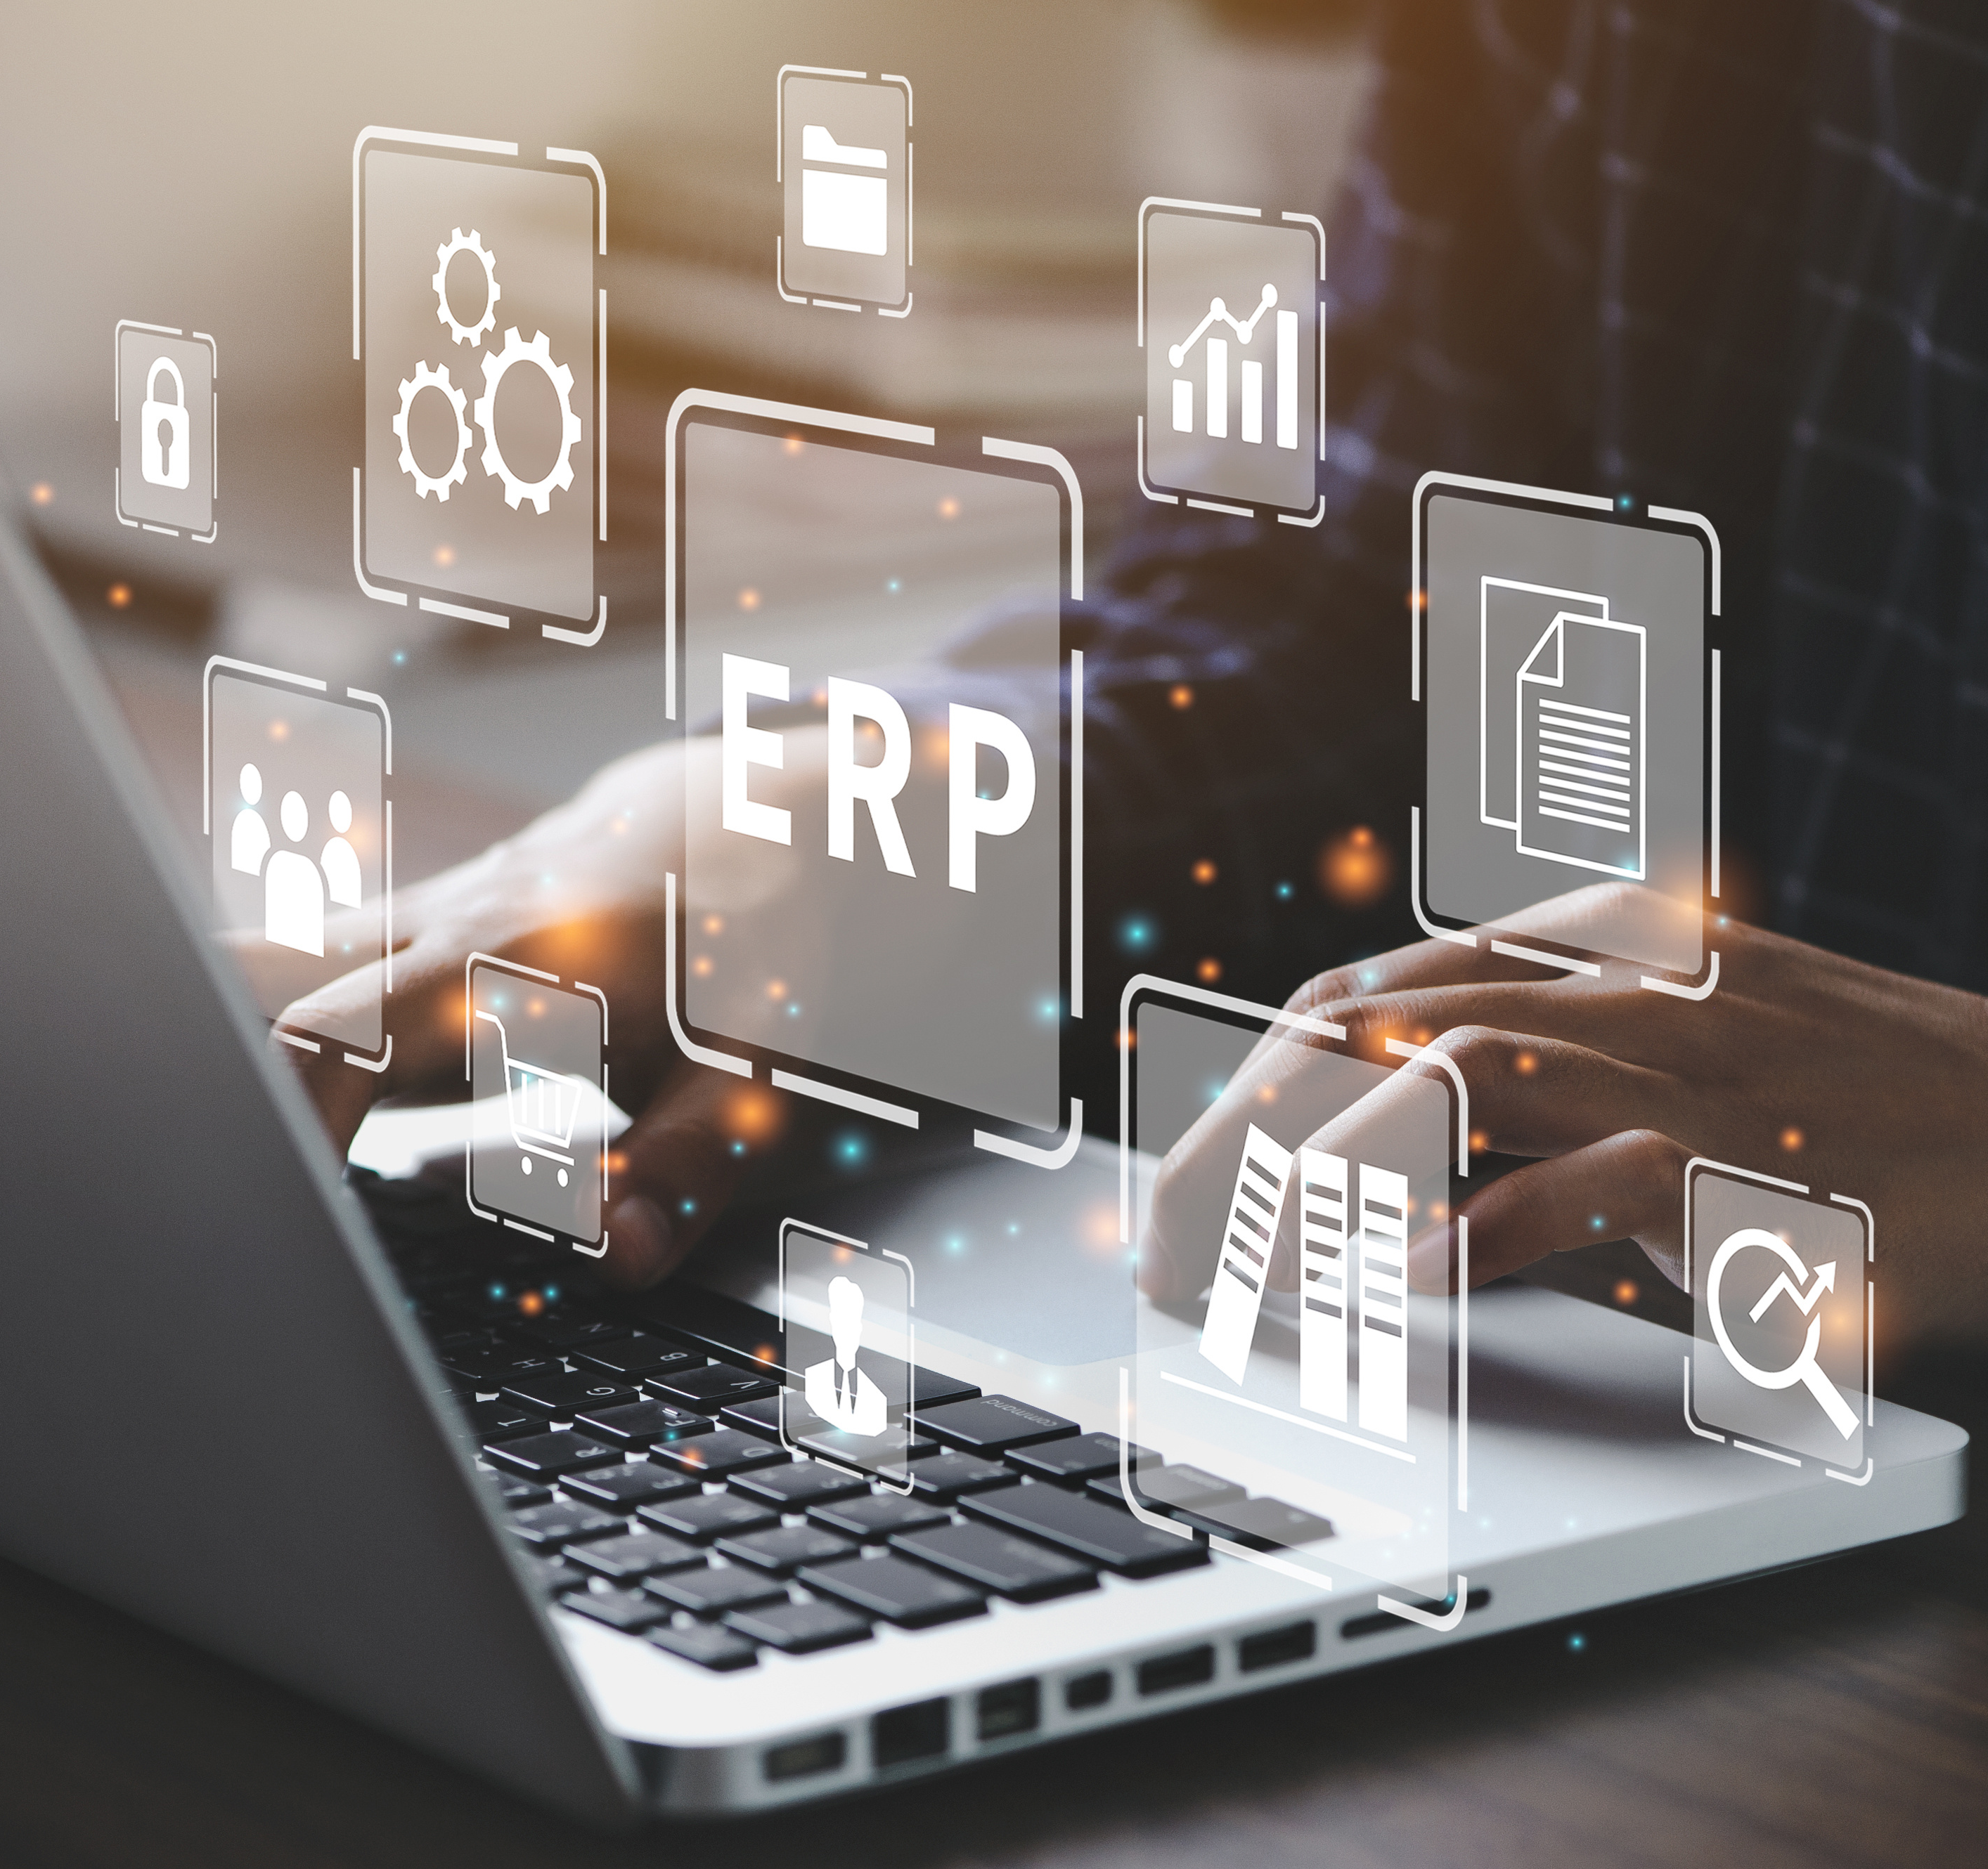
The challenge
Customers have made considerable investments in a 3rd party head-office platform which they want to retain
Many of these solutions are built to handle a very high number of users in multiple countries
They still have a need for a modern retail system like LS Central
They want the head-office platform to run processes like finance, warehousing & distribution
But LS Central to take care of retail & hospitality
There has been no standardized way or an integration framework that can connect LS Central to these head-office platforms in an easy way
Building an integration between ERP systems takes time & effort

Slide 7
Have you...
Ever wished that there was on out-of-the-box integration that would seamlessly connect LS Central’s industry-leading functionality with the customer’s current head office or ERP platform?

Slide 8
What would it mean if...
You could easily integrate LS Central with an existing (non-BC) ERP or head office platform?
You could tell prospects that they can effortlessly manage their entire front-end operations with smooth communication to the back-end system?
The prospect would have the flexibility to use LS Central as a complete retail or hospitality solution or as a Point of Sale, but still keeping data and item management within the head office platform?

Slide 9
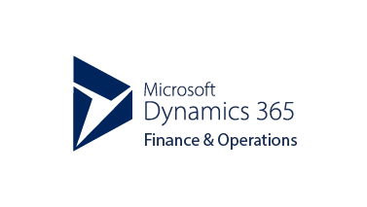
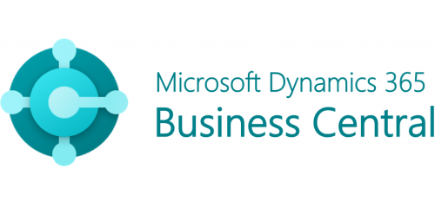

Can you imagine?

Slide 10
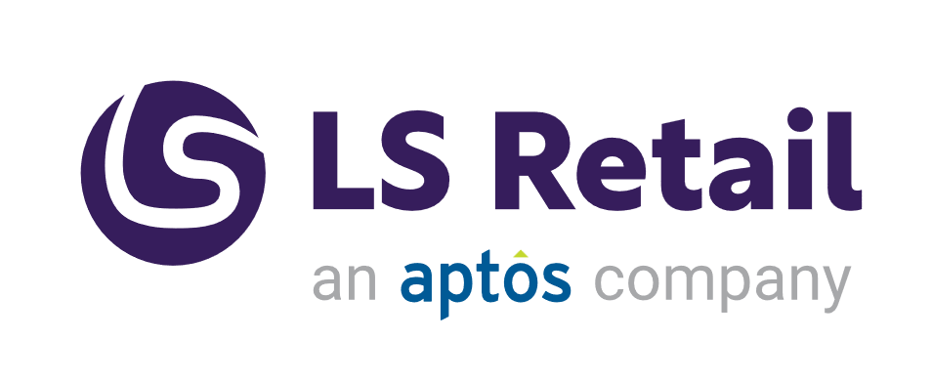
CentralConnect an LS Central integration to head-office platforms
With LS Central, you can manage retail stores, restaurants, pharmacies, hotels and gas stations from front to back with one centralized solution that integrates Point of Sale (POS) to financials, inventory, eCommerce, and more.
CentralConnect is a packaged framework which manages the integration of LS Central to 3rd party head-office platforms such as Dynamics 365 F&SCM, SAP S/4HANA, & Oracle

Slide 11


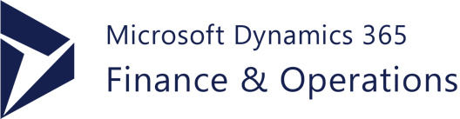
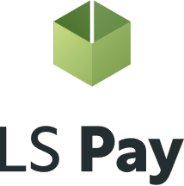

LS Central retail integrations with CentralConnect
Head-Office Platform
Business Central Retail & Hospitality Platform
LS Central as a retail back-office solution
Receives master data from 3rd party platform
Manages configurations, promotions, permissions, inventory, etc.
LS Central as a POS solution
Used as a front-end for retail and hospitality
ERP platforms that understand XML
Available in 157 countries and 23 verticals

Slide 12

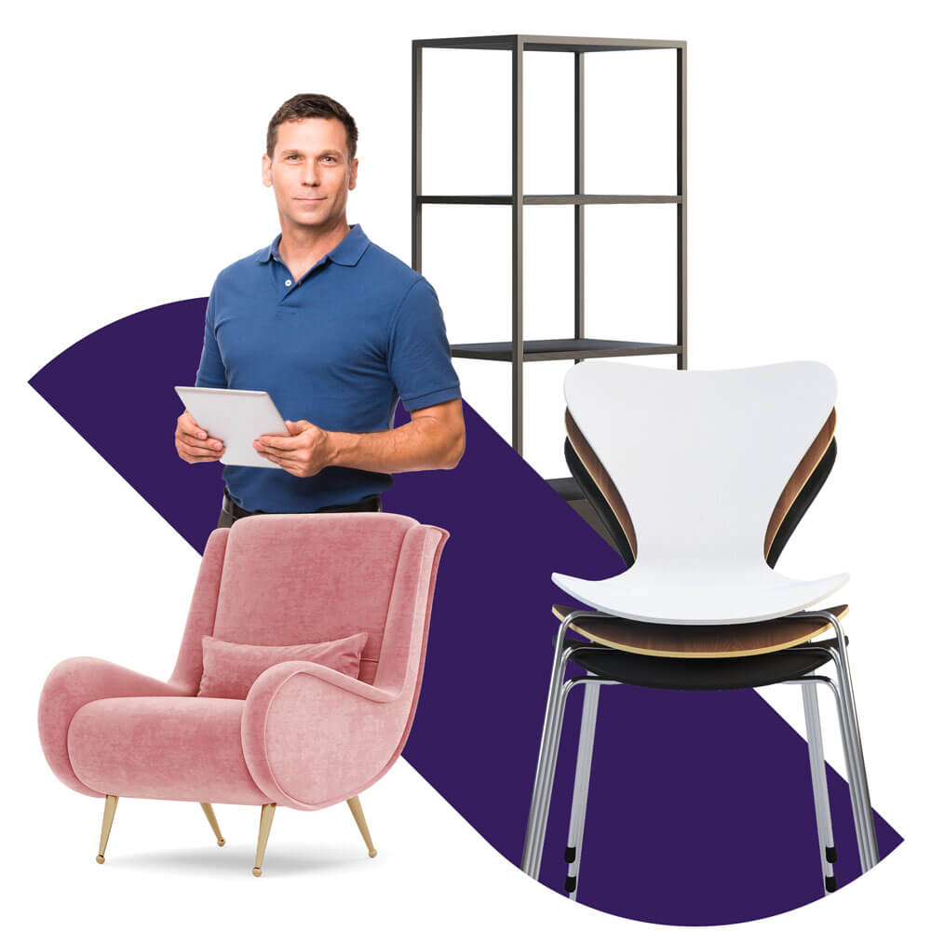
HO Platform
Retail functionality
LS Central - a feature-rich POS & retail solution
HO
Point of sale (POS)
Self-service checkouts
eCommerce integration to Shopify
Online orders, click & collect, omni-channel returns
Store transfers
Stock mgmt. on mobile
ScanPayGo
LS Pay
Warehouse mgmt.
Supplier mgmt.
Inventory mgmt.
Multi-location/chain mgmt.
Analytics and reports
Commercial
Loyalty program
Prices, offers and promotions
Sales analytics
End-of-day reports
Replenishment
Staff management
Sales commission
F&B functionality
Self-ordering kiosks
Ingredient and menu mgmt.
Ingredient costing

Slide 13

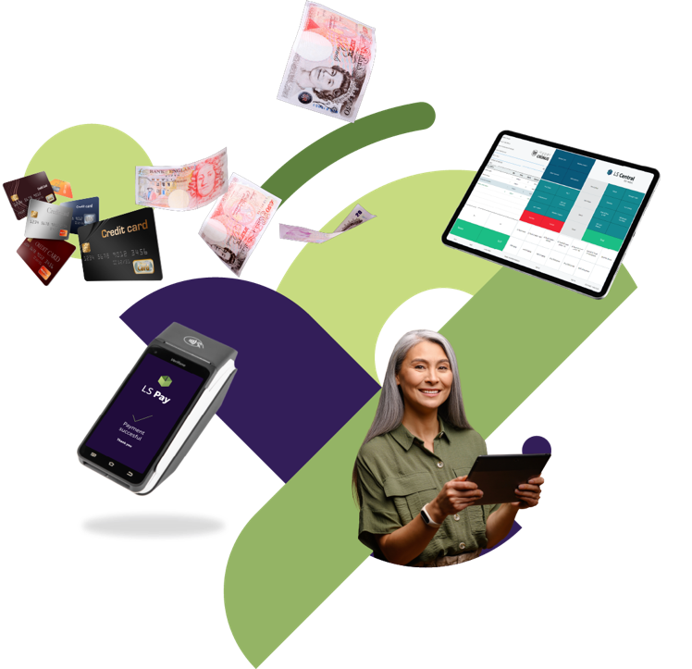
EFT integrations to leading Payment Service Providers in all our main market regions
Supporting 65 payment integrations in 50+ countries
Support for all platforms and form factors
  POS hardware, self-checkout, self-ordering kiosks, tablets, phones and SoftPay/Tap to Pay
Alternative payments via respective PSPs
Back-office payments through LS Pay for Business Central
Can be integrated to 3rd party solutions (kiosks)

Slide 14
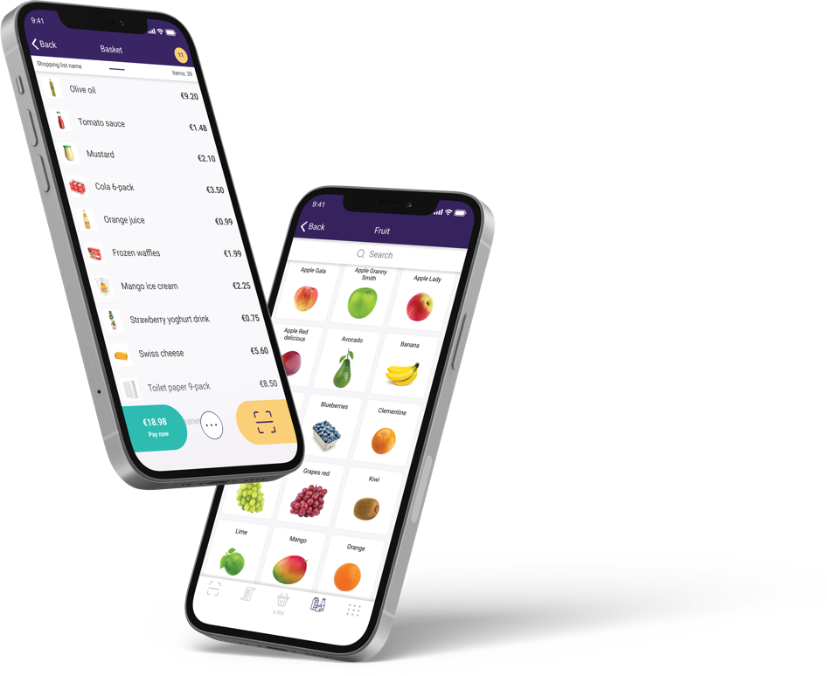

ScanPayGo for LS Central
A new generation of loyalty app
Branded by the retailer
An easy-to-use loyalty app
Designed for the modern shopper
Functions
Scanning on the go
Integrated payments
Information about items
Easy to create shopping lists and share with friends and family
View offers, promotions, and coupons
Create your basket, pay in app or at a self-service POS

Slide 15

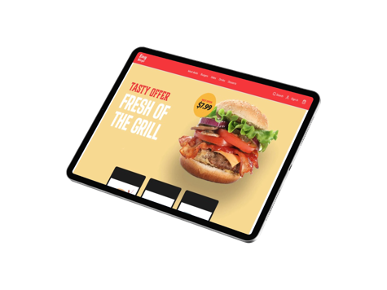
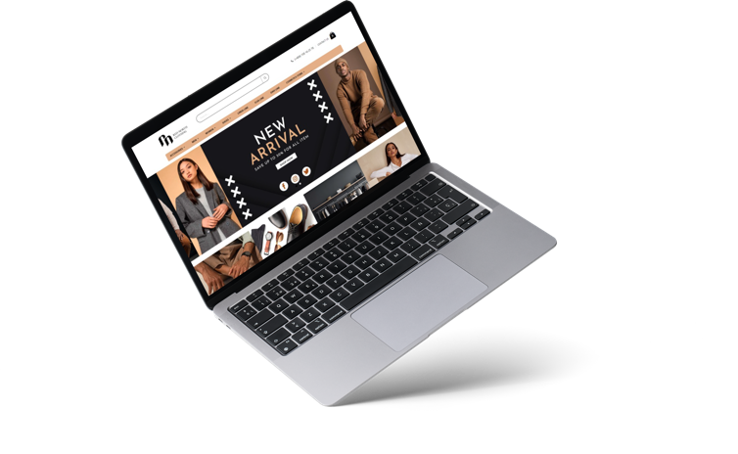



eCommerce for LS Central
A unified approach via Adobe Commerce or 3rd party platforms – retail & hospitality
Items, prices, discounts, basket calculation, loyalty, click & collect, transaction repository, returns, etc.
A simple approach via Shopify
Various front-end options
Traditional UI, PWA, or headless
Google Local Inventory

Slide 16

CentralConnect ǀ Functionality
Uses Azure Storage
  Azure blob storage for data packages
Web services for data transfers
Export data to storage for 3rd party applications
XML file-based transfers
  Can make other formats available if needed
Azure environment security
Integrations logs for traceability
Built using the Microsoft Dynamics 365 Business Central extensibility framework and can be extended by partners

Slide 17
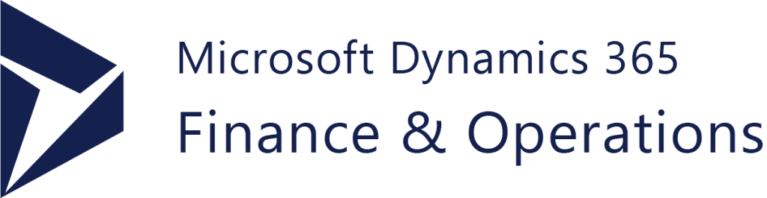

Data flow from head-office
Azure storage used for temporary data storage.
Azure function triggers data export from F&O
Data packages inserted into Azure storage
Message created in message queue
Data imported into LS Central
Data validated and inserted into LS Central tables
Even if the data flow in this example is based on Dynamics F&SCM this can be applied to any ERP platform that can access Azure and work with XML documents
Data processed
Validation before insert
Data inserted
Storage
Data management framework
Azure function
Message queue
Message imported

Slide 18
Example of End of day – Retail sales flow
Sales data flow from LS Central and into Azure storage
End of day in LS Central triggers an Azure function
  Creates F&O data package
  Stored in Azure storage
  Trigger import into data management via web-service
  Data flow into F&O, data management validates and inserts sales orders
Data Management framework
Azure Function
End of day procedure
Daily retail operation
Sales order
Storage

Slide 19
Export to external storage LS Central
Azure storage used for temporary data storage.
Export is triggered in Central Connect.
Data packages inserted into Azure storage
  Formats supported in first version XML/JSON/CSV
Data ready to be used in 3rd party applications
Data processed
Validation before insert
Data inserted
Storage

Slide 20
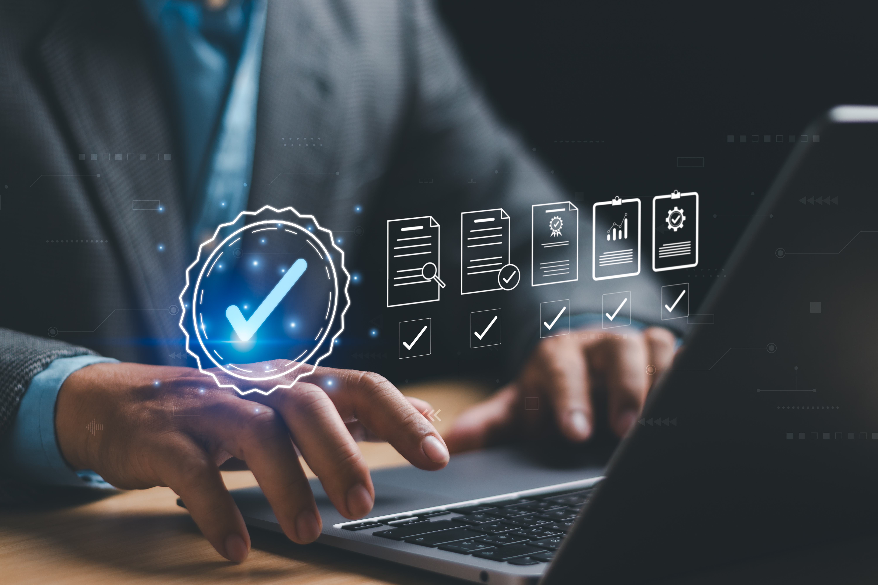
Requirements
Data needs to be written and read from Azure Storage
Current format is XML
  We may support other types such as Json and CSV as well
For F&O we can trigger the import and export of data using web-services
  For systems that don’t support web-services, this can also be accomplished using scheduled jobs

Slide 21
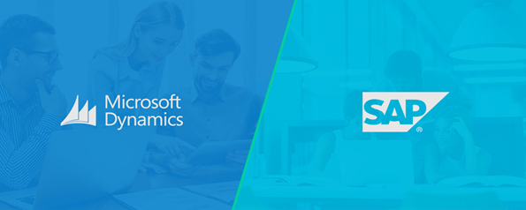
Inventory management
In general, we assume that inventory is managed in
LS Central.
Inventory changes sent to either SAP or F&O either during the day or at EOD.
LS Central will manage:
  Receiving
  Transfers
  Stock count
  Positive/Negative adjustm.
Items, Barcodes, Prices, Vendors, etc
Stock movements
EOD statements

Slide 22






LS Retail’s CentralConnect
an LS Central integration to head-office platforms
Use LS Central for Retail Operation
For (large) clients with F&O or SAP or…
Seamless integration via Azure Storage
Use LS Central as POS solution,
or its advanced Retail Management functionality

Slide 23
LS Retail PrimeAttention
Overview of Supporting Functions
and overview of other support possibilities
LS Retail Consulting Services
LS Retail PrimeAttention

Slide 24

Overview of Services
Supporting Functions
Partner Technical Support
Cloud Accelerator Program (CAP)
License Management
Partner Development
Professional Services
LS Retail Academy
LS Retail Consulting
LS Retail PrimeAttention

Slide 25
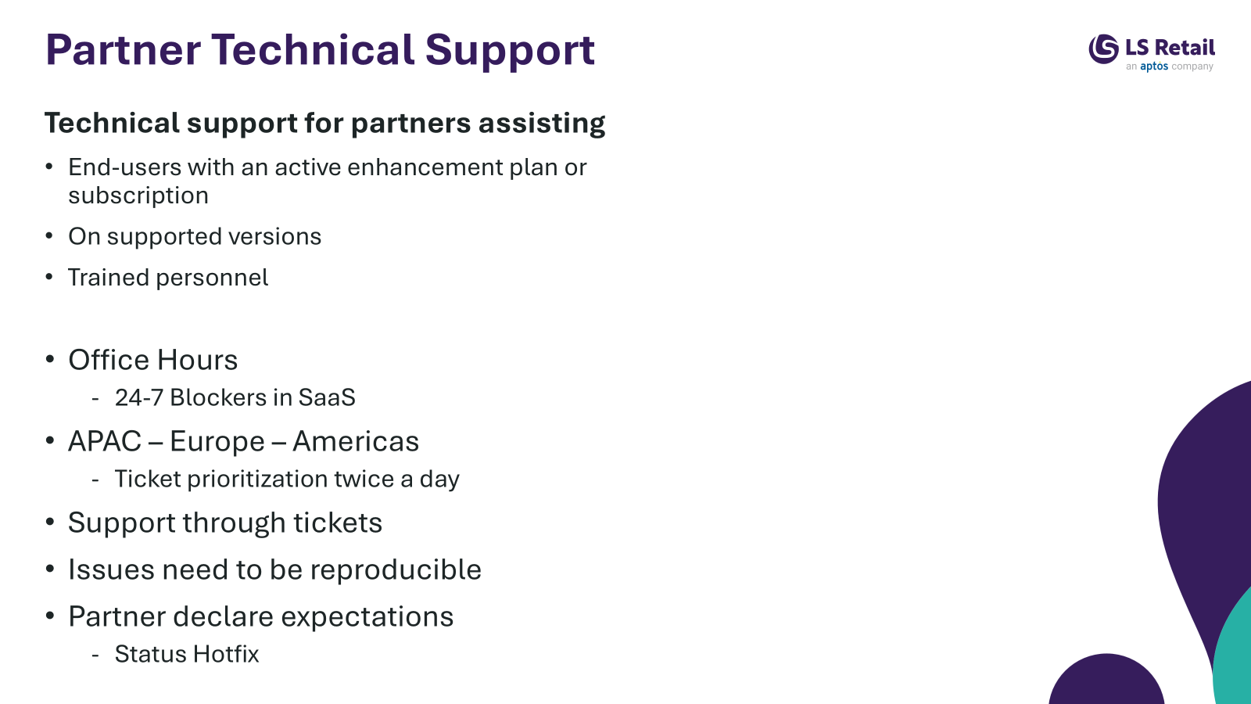
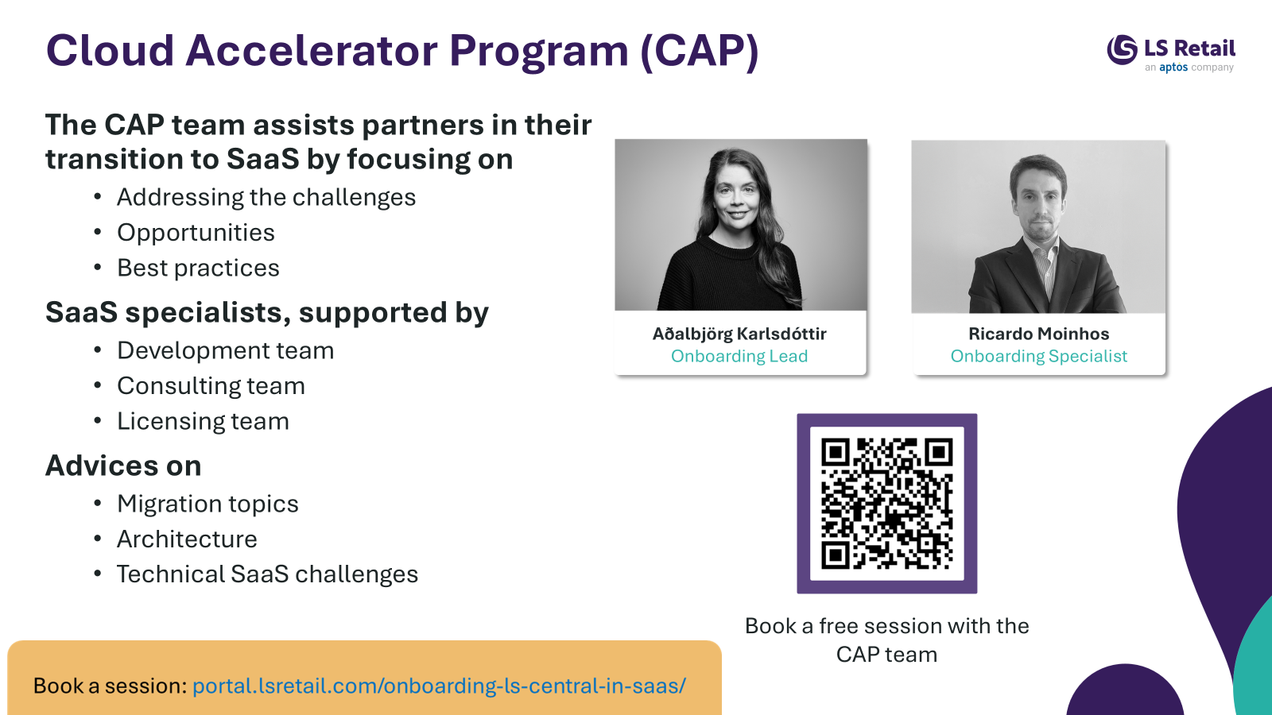
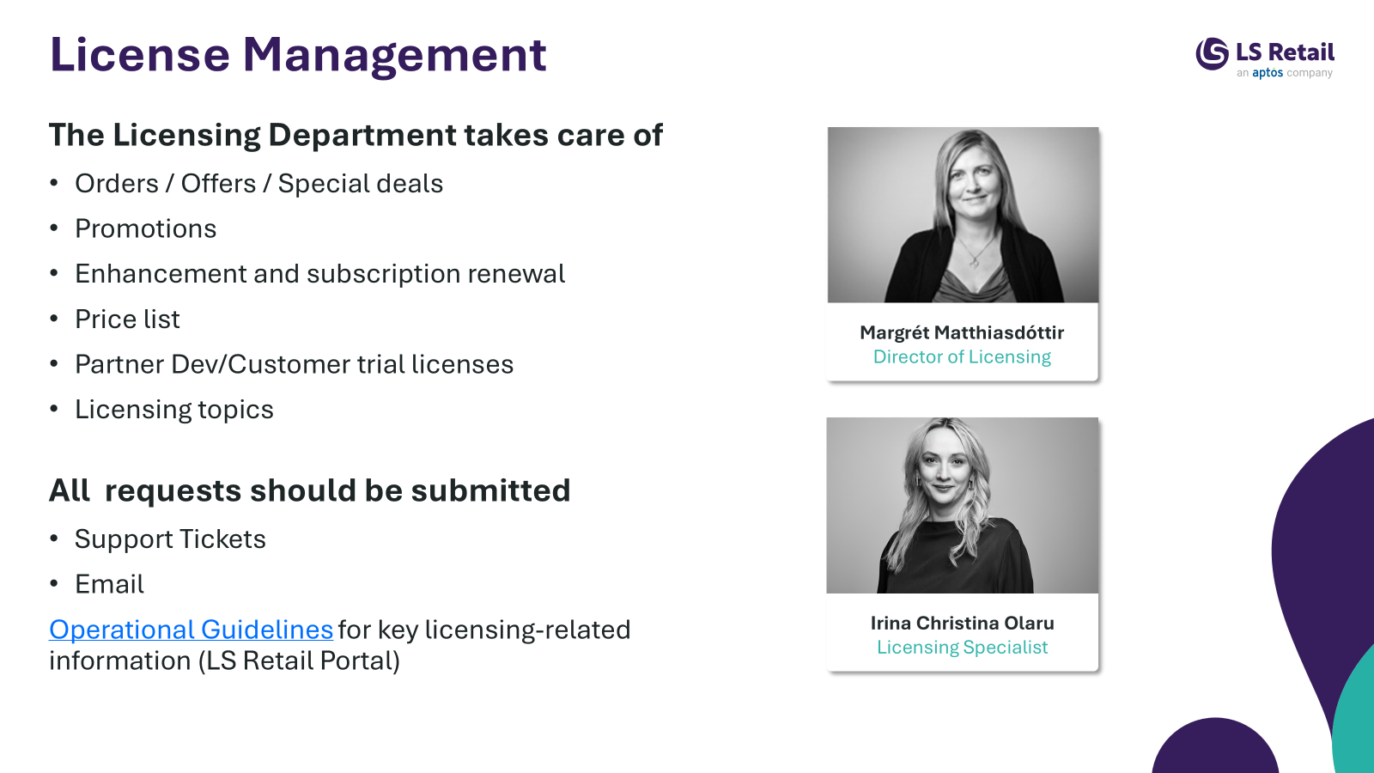
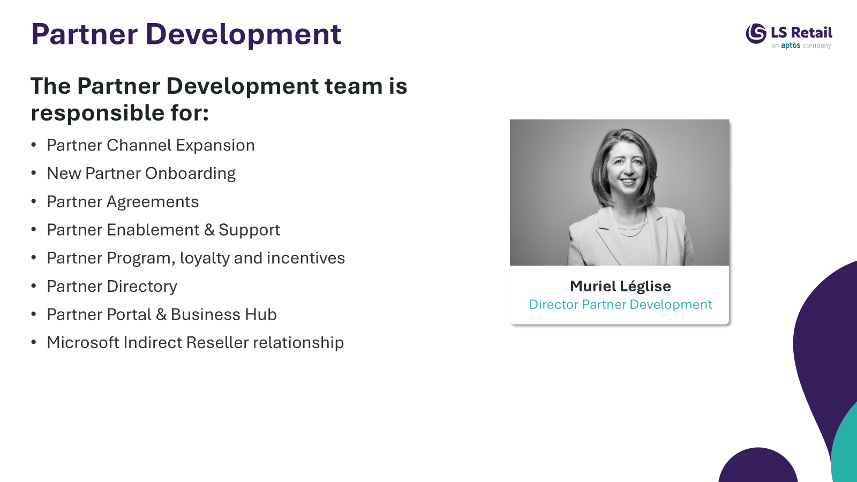
LS Retail’s – Partner Technical Support

Slide 26
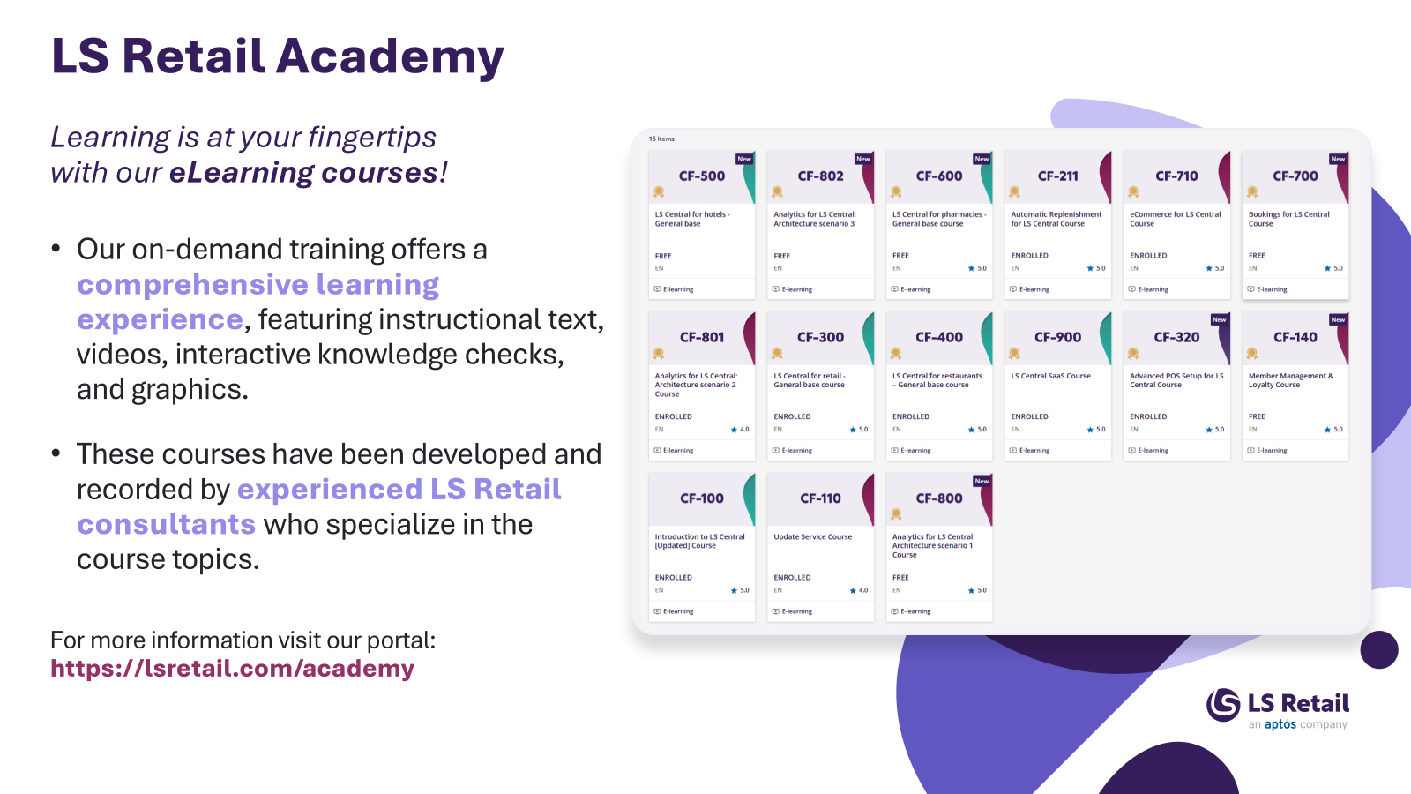
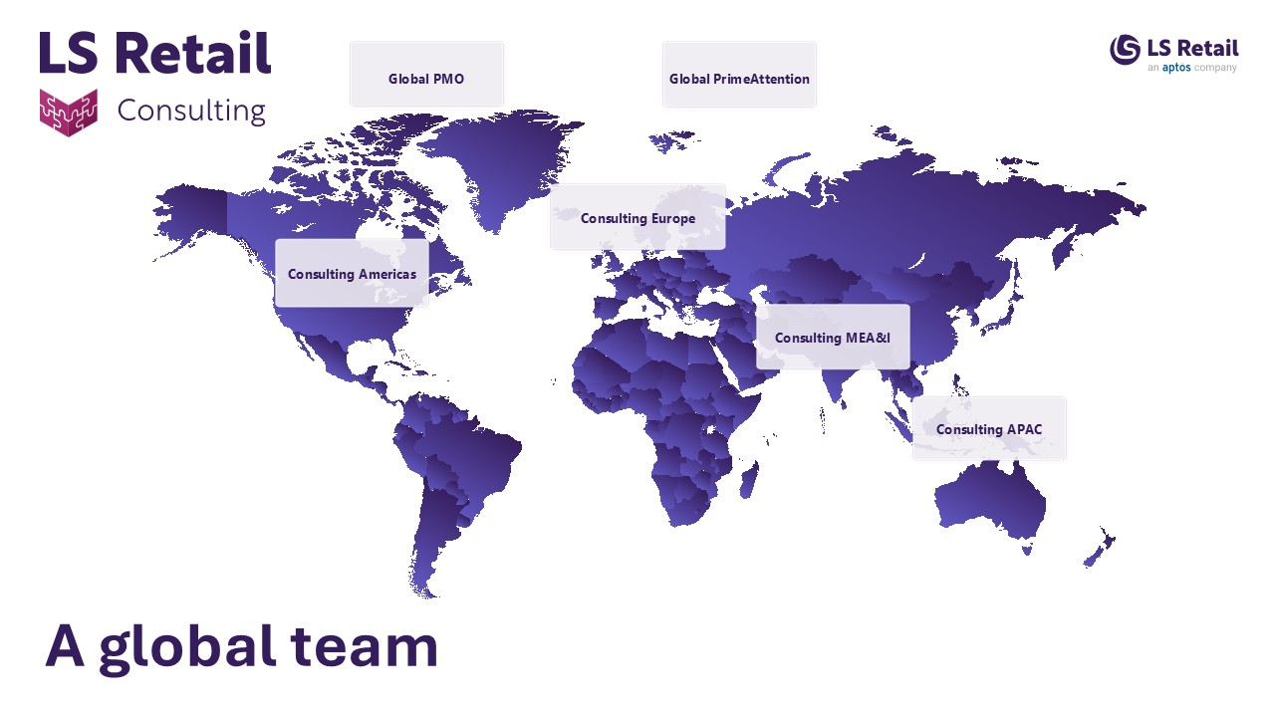
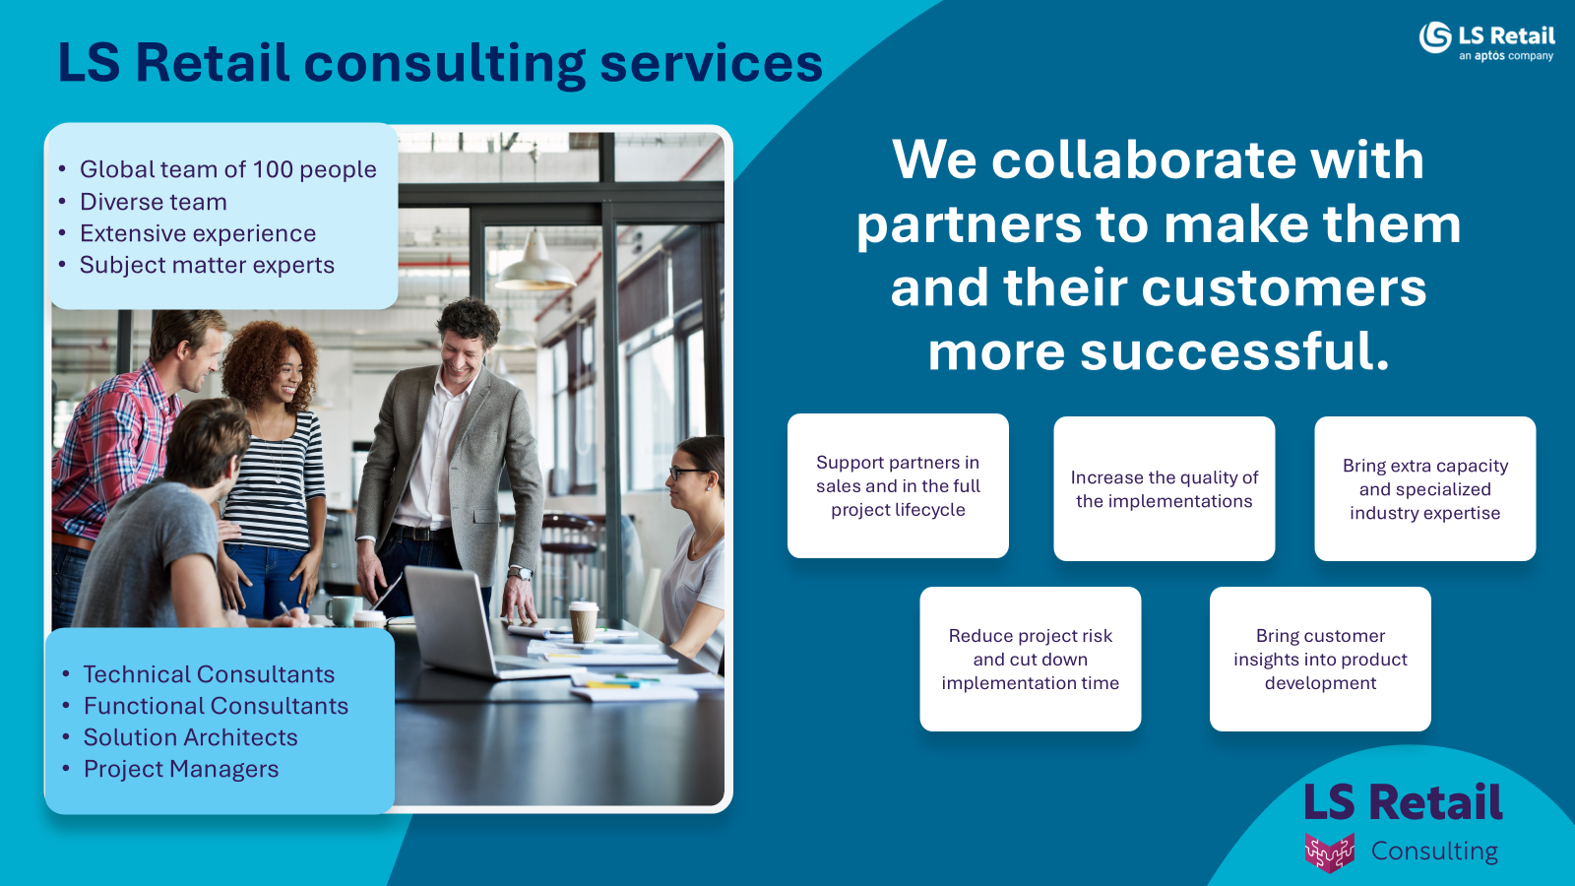
LS Retail’s – Professional Services

Slide 27

Why LS Retail PrimeAttention?
The request for tailor-made support services from LS Retail has increased.
  Many partners don’t have support teams, limiting their possibilities to take on or provide necessary services to customers
  Many partners request advanced support, both for their own teams and for their customers, within and outside of business hours
  Bigger customers - demand vendor involvement
  Global customers – not serviced by a single partner
  Customers where partners lack industry knowledge
More and more customers and prospects are very demanding, with global operations, and with ambitious visions.
  If they are able to select LS Central as a solution, we need to assist our partners in meeting their expectations

Slide 28
What is LS Retail PrimeAttention?
LS Retail PrimeAttention is a support initiative to ensure that LS Retail partners (and customers) receive the best assistance possible, whenever they need and wherever they are located, for LS Central and customer-specific functionality
LS Retail PrimeAttention is a dedicated Support Service desk offering
  Standard to advanced partner, or customer specific, support
  Support not only for standard products
  Business hours to 24/7 support
  2nd and 3rd level support with SLA’s
  Additional services – e.g. customization maintenance, deployments, etc.
  Dedicated or shared support manager
  Skilled regional professionals
LS Retail PrimeAttention is not part of the technical partner support delivered by our development team

Slide 29
Overview Support and Service needs
PrimeAttention
Back Office Support
User Management
  Access rights and Roles in BC
  IDP setup
Item Management
  Creation, Pricing, Promotions and Distribution
  POS Setup and POS layout
Customer GDPR requests handling
Infrastructure Maintenance
  Updates, Backups and Disaster Recovery
  Virus and Intrusion Prevention
  Security Monitoring
Middleware maintenance
  Updates, Backups and Disaster Recovery
  DB-Admin Operations
Internal BC and LS Central knowledge Competence
  Super User training
  Support Team training
Level-1 Support
System Enquiries from users
  “I’m getting an error”
  “System is slow”
  “How do I do that?”
User Management
  “I can't log in”
  “I don’t have access”
Basic Operation Maintenance
  POS stopping
  Posting stopping
  Restarting Server Services
User Training
  Maintain Knowledge Base
  Training Center
Level-2 Support
Incidence handling and Resolution
Error Handling and Resolution
  Fixing data errors that are stopping processes
  “Multiple users reporting this issue”
Basic Operation Maintenance
  Posting stopping
  Restarting Server Services
Operational availability and performance monitoring
  In-Store network and infrastructure
  Central Server CPU, Memory and Disk Space monitoring
  Integrations monitoring
Internal BC monitoring
  Data Replication monitoring
  Posting queue monitoring
  Long running queries
Access Security Monitoring
  Audit Log monitoring
Level-3 Support
Advanced LS Central Support
Incidence handling and Resolution
Error Handling and corrective actions
  Create workarounds
  Create temporary fixes
  Resolving Data Integrity
Additional Support Services
Customizations Maintenance
  Corrective maintenance
  Minor improvements
Release management
  Pre-deployment Testing
  Deployment Assistance
Training
Enhancement Fee / EULA
Corrective Maintenance
  Core LS Retail Products
  Microsoft Dynamics 365 Business Central
Roadmaps and new functionality
Major Release of new versions
Consulting Services
Customer specific projects, implementations, integrations, deployments
Advanced training

Slide 30

LS Retail PrimeAttention support plans
For 2nd and 3rd level support, LS Retail offers different PrimeAttention support plans
  Basic (T&M)
  Standard
  Premium
Schedules vary in level of service, response times (SLA), benefits, and price
Support outside of business hours is defined as extended service and is available for Standard and Premium support

Slide 31

LS Retail PrimeAttention
a dedicated customer service desk offering:
Ad-hoc to advanced 24/7 support
2nd and 3rd level support with SLA´s
Additional service to LS Retail partners and customers
Dedicated support manager and skilled regional professionals

Slide 32
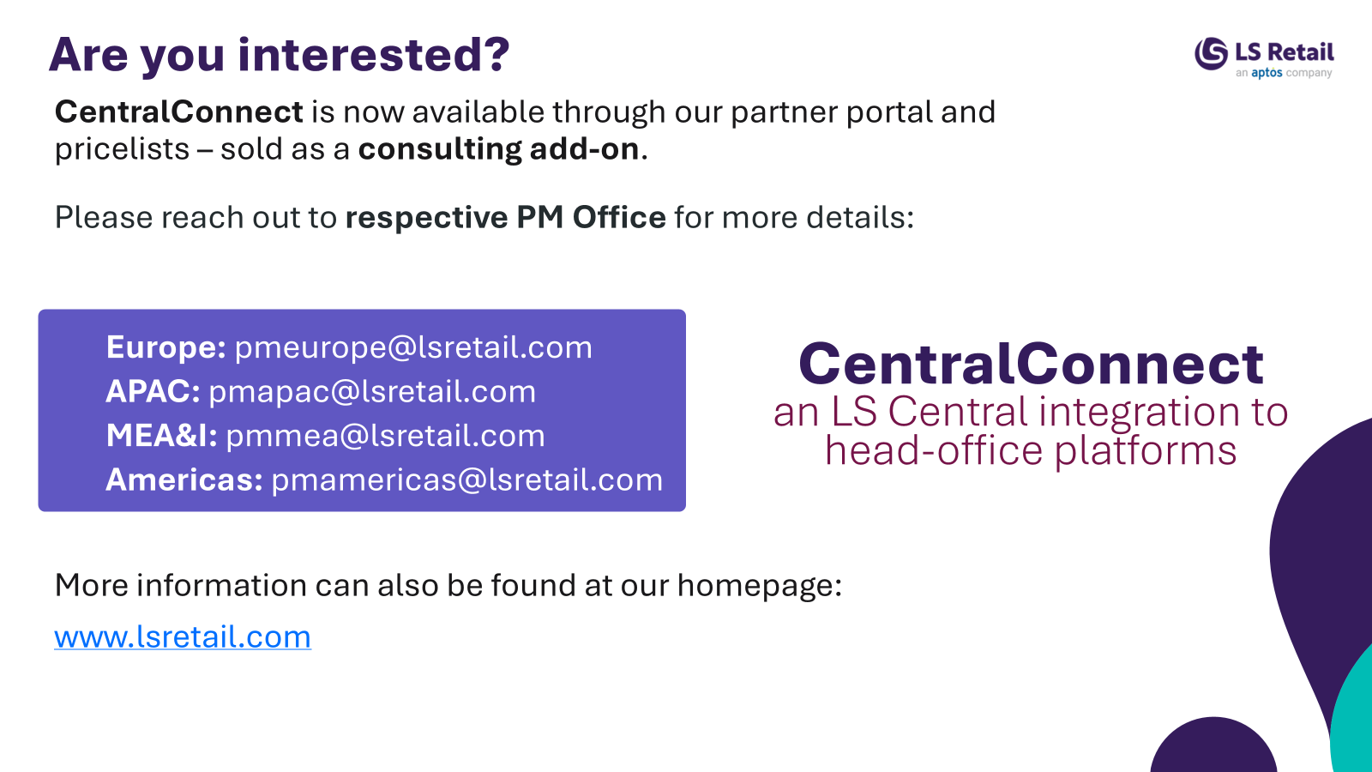
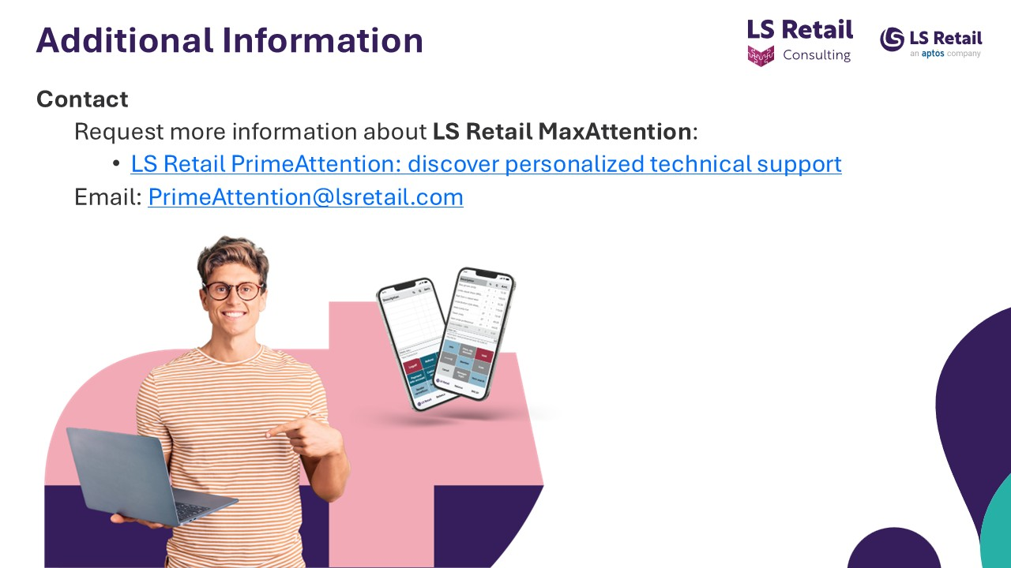
CentralConnect
&
PrimeAttention
Q&A

