Slide 2



LS Central in SaaS - Onboarding
Adalbjorg Karlsdottir
Drifa Orvarsdottir
Ricardo Moinhos
Onboarding Lead
Onboarding Buddy
Migration Specialist
adalbjorg@lsretail.com
drifaor@lsretail.com
Ricardomo@lsretail.com

Slide 3







About the evergreen train
It’s Automatically renewed and repeatedly made valid.
It requires internal change to bee successful, not only within LS Retail but within our partners organizations too.
  Continuous improvements
  Continuous delivery
  Rapid implementation
  Automation

Slide 4

Go

Slide 5
But don‘t just jump on board!
Go

Slide 6


Educate yourself
Implementing LS Central SaaS is a process that should be approached with strategy
Educate yourself on the differences between LS Central SaaS and on-premise and determine the principal activities of your future LS Central SaaS operations
This is LS Central SaaS
LS Central Implementation Guide
Onboarding Buddy and CAP
Educate yourself
LS Academy
CF-900 is now available On-demand

Slide 7

Understand the support process
Understand the support process and your responsibility in supporting your customers.
Outage communication strategy
Partner Center
Delegated Administrator
Admin Center
Learn more about Support
Business Central reselling partner, means that you will get requests for support from your customers that you must triage, investigate, and either resolve or escalate to Microsoft or LS Retail, depending on the issue's nature.
As a Business Central reselling partner, you are an administrator of your customers' Business Central tenants, and you are the first line of support

Slide 8
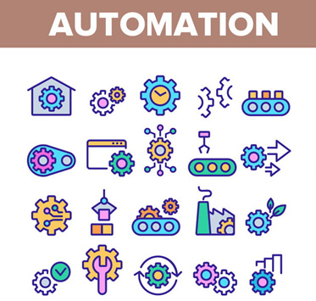
Automation is your BEST friend
In a SaaS business, direct labor is your enemy. Automation is your friend.
When you neglect to automate core business processes and then cover it up with people, you ensure long-term unprofitability and engender a culture that undermines long term success.
Solve problems through automation, and then add people to push sales and service performance over the top, not to provide the basic function.
Make test environment as close to real environment as possible.
Don’t forget to test Hardware Station, printing, etc…

Slide 9


Cherry pick your first customers
Cherry pick your customers, focusing only on those that have the highest need and are the easiest to reach.
Don’t chase the big, bad elephants that need special features, requires a long sales cycle and has restrictive legal requirements.

Slide 10
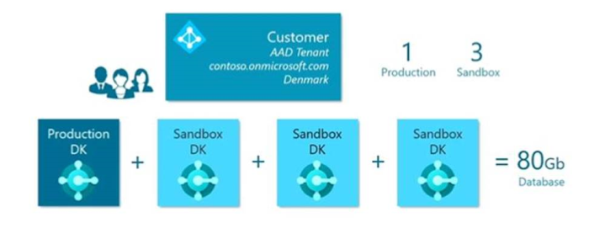
Production Environment
Every Production Environment comes with 3 sandboxes which all add up to the 80 GB of free space.
50% compression
Images are not included
Learn more
+ 3/2/1 GB per user

Slide 11
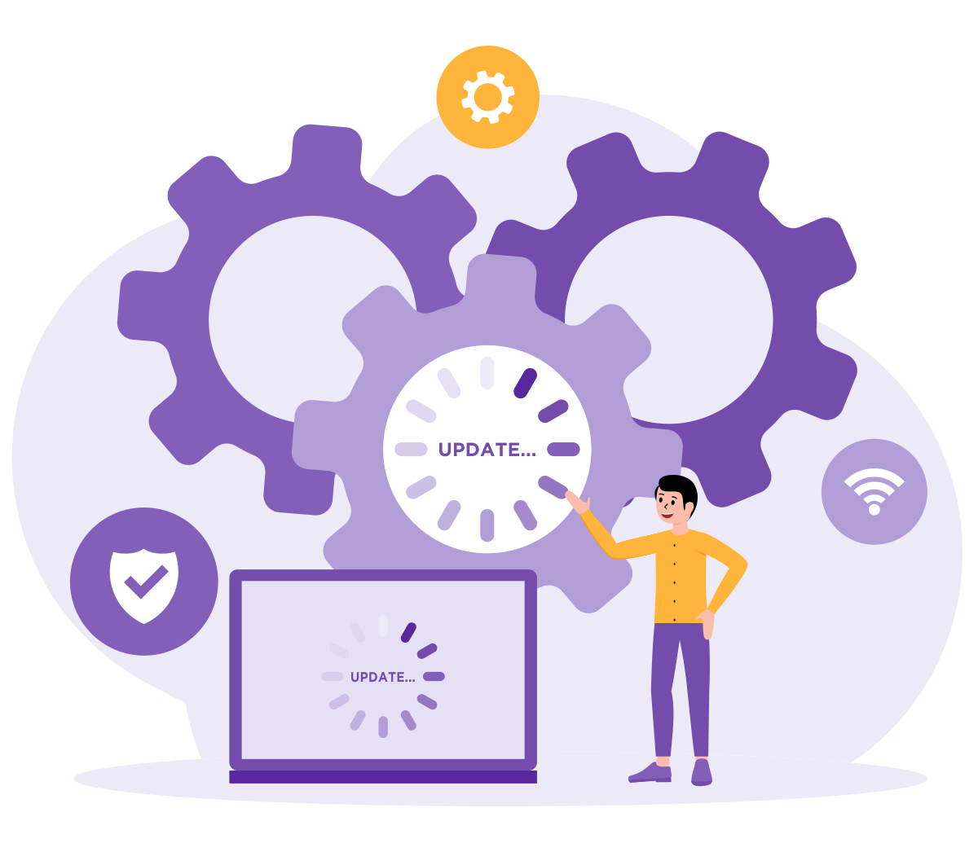
What is your support concept?
What is the customer ready to pay for?
  Per hour
  Monthly service fee
Hybrid - you need more time for support etc.
Online – Hardware Station updates

Slide 12


Template database
Template database contains standard components
Creating a customer database from a template:
Reduces the time for data setup
Ensures that databases are created consistently
Start with on-premise database and create a new company
Basic Setup needed for running HO, Store and POS
  Run Retail Setup -> Insert default data
  Use Import/Export Worksheet to get POS setup data
How to setup Template Database
GL/Account
Posting Groups
General Ledger Setup
Unit of Measure
Source Code
Reason Code
Payment Method
No Series
Retail Setup
Store
POS
Tender Type
Staff Permission
POS Setup
Keep the template database up to date on the newest LS Central SaaS version
Keep it clean!

Slide 13

Get ready

Slide 14

A stress-free go-live
Do a test implementation before starting the customer implementation*
Develop a plan for onboarding
*Partners can get access to a development environment in LS Central SaaS – please contact our licensing team to request a development environment in SaaS

Slide 15

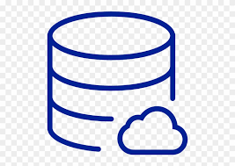

Onboarding with a new Customer
On-Premise
Copy of Template Database
- Master data
- Opening balance
- Quantities
Customer
Tenant
LS Central SaaS
Customer
Database
Migrate
How to Migrate
Adjust setup
Adjust setup
Customer test
Database/company
Test
Test

Slide 16

Onboarding with On-Premise Customer
When it is time to decide whether to undertake upgrade or re-implementation, our advice is to re-implement if LS Central's version is older than v15 and has extensive customizations.
In the case of upgrades and migration, we strongly advise you to review the data before migration.
  Which elements might be left behind?
  The value of old data?
Learn more
We advice you to:
Upgrade to latest version before you migrate to LS Central SaaS

Slide 17
Onboarding with customer already on BC SaaS
  Create a support ticket with MS – please include our license team in the communication
  Link to step-by-step instructions/mandatory information that must be collected before running migration between two tenants

Slide 18

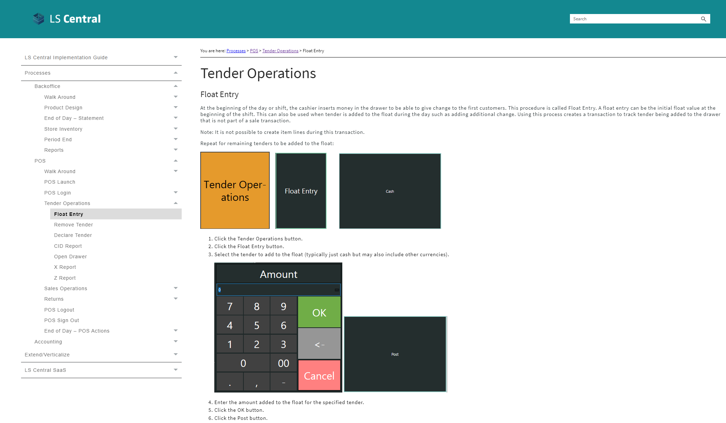
Educate your customer
Training material

Slide 19

Online or Hybrid?
In LS Central SaaS, you can choose between two deployment options:
  Online POS
  Hybrid POS.
You can also combine the two.
To select the right deployment option for each customer, consider:
  The pros and cons of each option alongside specific customer factors (volume of transactions, stability and quality of internet connection, etc.)

Slide 20
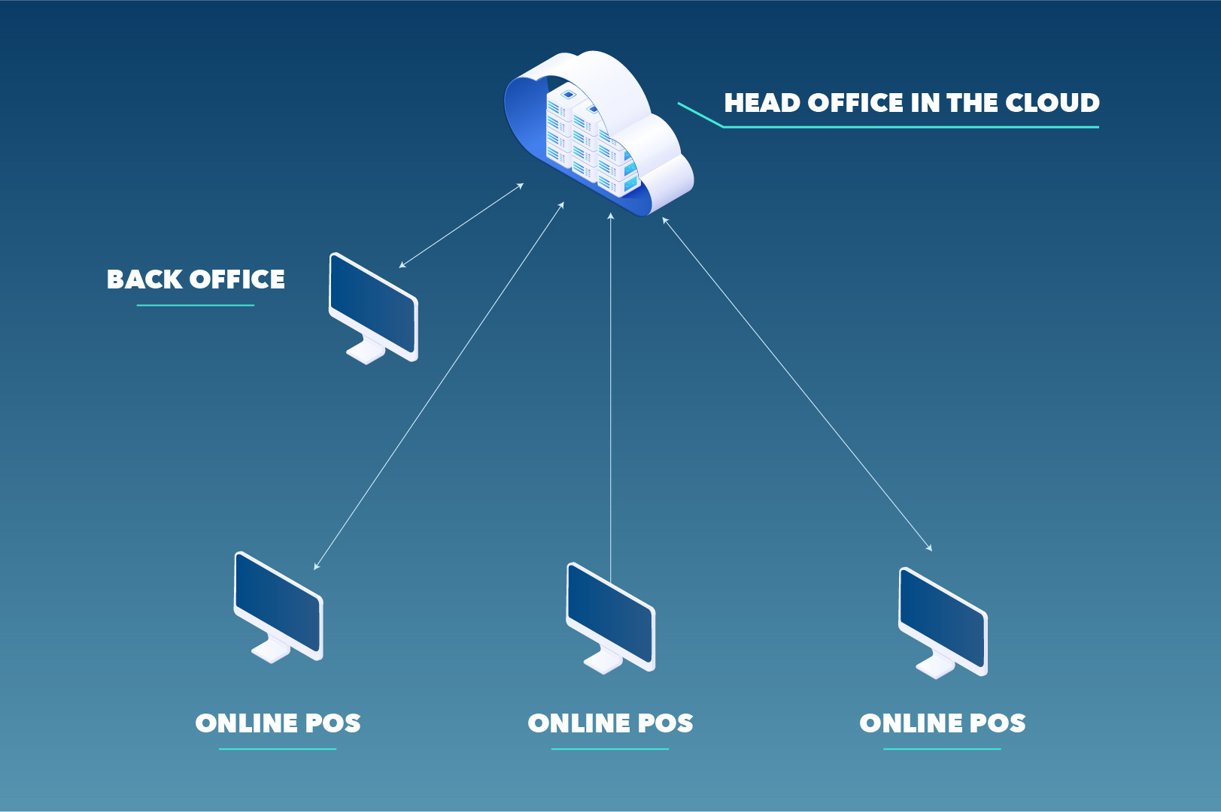
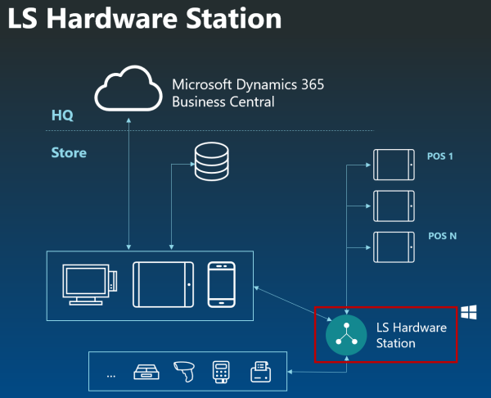
Online POS
POSs and back-office users run a modern web client and connect to the LS Central SaaS and are reliant on the internet works and they have access to the LS Central SaaS always
Software installation: Hardware station
Install Hardware Station using Update Service

Slide 21
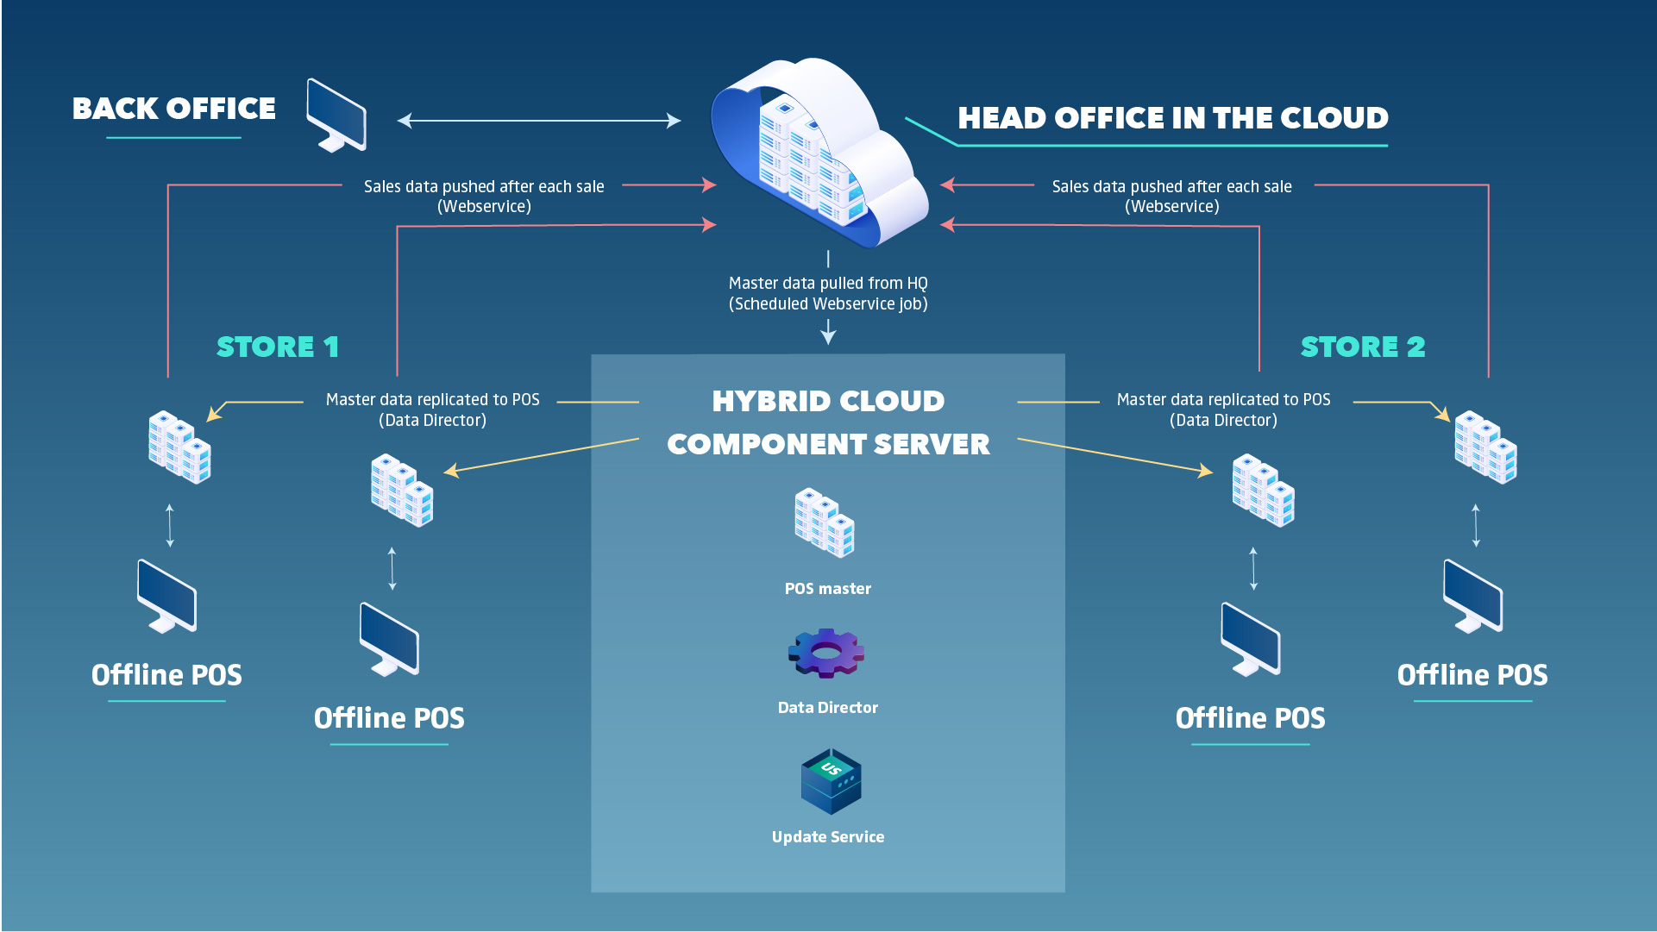
Hybrid POS
A hybrid setup gives customers the ability to take advantage of the benefits of cloud hosting and the resilience of an offline POS.
LS Retail uses the Hybrid Cloud Component Server to achieve offline device architecture.
There are two deployment options for setting up the Hybrid model:
  Offline POS Database
  Offline POS Server Database

Slide 22

Hybrid Cloud Component Server 101

Slide 23

Before you start
It is important that you:
Have finished the LS Central General Base Course training
Know how Data Distribution and Replication is set up and works in LS Central
Basic PowerShell knowledge (Learn more)
Are familiar with Update Service (Learn more)

Slide 24
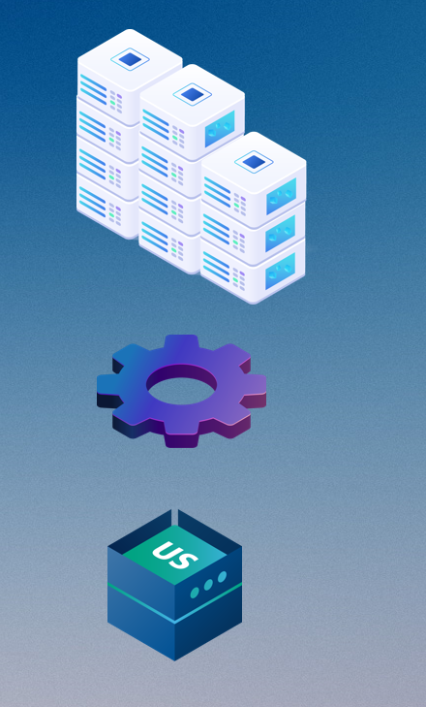
Components
HCCS is hosted on-premises, either on a Virtual Machine in cloud (f. ex. Azure) or in the customer's Head Office environment.
POS master – template database and runs the scheduler
Data Director – replicates master data
Update Service – installs components and keeps the on-premise setup up to date
POS Master
Data Director
Update Service

Slide 25
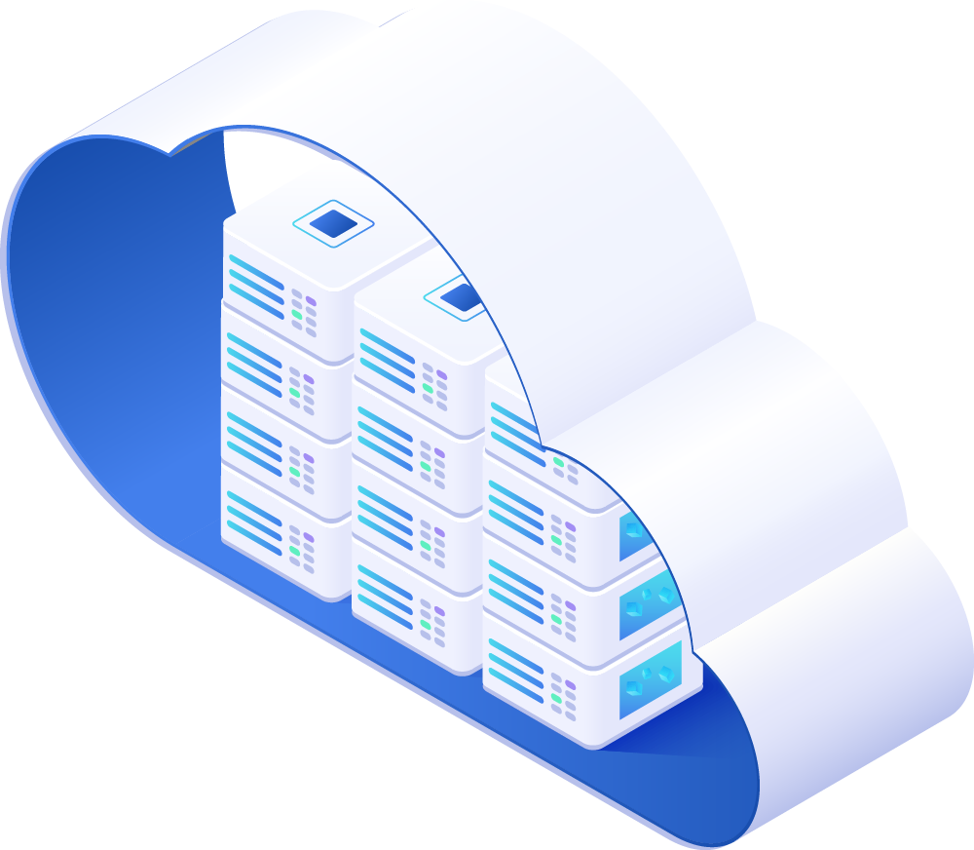
Head Office in LS Central SaaS
GL/Account
It’s important to finish all setup in the Head Office Tenant before you start implementing.
Posting Groups
General Ledger Setup
Unit of Measure
Source Code
Reason Code
Payment Method
No Series
Retail Setup
Store
POS
Tender Type
Staff Permission
POS Setup

Slide 26
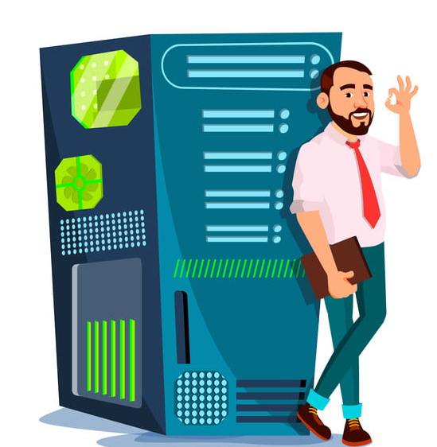
Step 1 - Prepare the server for the HCCS
The Hybrid Cloud Components Server is not a part of the SaaS service. The customer or partner needs to host it and manage it. The server can be in Azure or on an in-house server.

Slide 27
Step – 2 to 8
Step 2 - Download and import configuration packages
Step 3 -Run the HCCS install on HCCS server
Step 4 - Data director settings
Step 5 - Configure and install POS master with Update Service project
Step 6 - POS master
Step 7 - Prepare and install the first POS device
Step 8 - POS sales data to head office database

Slide 28
Azure – script
Hybrid Component Server setup with script
Steps 1-6

Slide 29
How often does LS Retail release new updates?​
Hotfixes are released when needed
New Events are released weekly
LS Central Releases
Jan.
Feb.
Mar.
Apr.
May
June
July
Aug.
Sept.
Oct.
Nov.
Des.
1*
2*
3*
4*
6*
7*
8*
9*
10*
12*
5**
11**
*LS Central release, including Microsoft Business Center monthly updates
**LS Central release including Microsoft Business Center major updates, usually in May and November each year

Slide 30
How do I know when a new update is available?​
A new version of LS Central on-premises W1 version is available for download on the LS Retail Portal
The new LS Central version is available in SaaS**
LS Central Release
Upgrade window
LS Retail sends out an announcement/email to all LS Central partners including release notes*
Notifications sent to all email addresses that are listed in the Notification recipients list of the Business Central Administration Center
* If you are not receiving the email and want to be on the list, you can send an email to info@lsretail.com and request to be added to the recipient list.
**​ The localized update is available for upgrade in LS Central SaaS, typically 7 to 14 days later

Slide 31
What do I need to do when a new update is released?​
Last selectable Scheduled Update date
Update is available
Outside upgrade window
Within upgrade window
Test window
Upgrade starts*
Day 1
Day 14
Day 21
* If Scheduled Update date has not been set earlier within the upgrade window
The day when the version of LS Central SaaS becomes available
The day when the update is automatically scheduled
The last day you can choose to extend your upgrade date to.

Slide 32
What do I need to do when a new update is released?​
A new version of LS Central on-premises W1 version is available for download on the LS Retail Portal
The new LS Central version is available in SaaS
Outside upgrade window
LS Central Release
Upgrade window
Day 1
Day 21
Get familiar with the new release
Test your addons on the new release
Set Scheduled Update date and define update time window in the Business Central Admin Center
Notify customers

Slide 33
What if the update fails?​
1W
2W
3W
Update fails
New update date scheduled +7 days
Update fails
Update fails
Update fails
Managing updates customer tenant
Managing POS updates Online Model
Managing POS updates Hybrid Model

Slide 34
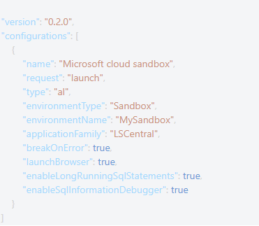
Symbols download - extension publishing to SaaS
This is how Launch.json should look like

Slide 35
Hardware Station online in SaaS - Https
Can use http if localhost
Https recommended for increased security
SSL certificate
Self-signed for testing only
Track expiry of certificate
One certificate per customer setup using DNS management see link:
How to use Https in LS Hardware Station

Slide 36

Application insight for telemetry
How telemetry can help you solve problems in a live SaaS environment
It is important to connect the tenant to Application Insights
You can monitor health, updates and also monitor if extensions are affecting performance etc.
Learn more
These videos on GitHub are helpful to guide you to connect your tenant to Application insights
Here is the power BI performance report referred to in one of the videos.

Slide 37


It’s still LS Central- but on a new platform
...with new rules, everyone needs to get used to.
You can still use all your LS Central knowledge and expertise when moving to SaaS.
Implementing in the cloud is like going to the gym and having a personal trainer, where the trainer makes sure you do the exercises and you do it right, while implementing on premise is like you go to the gym without the trainer and it‘s up to you when and how much effort you put into your exercises. – Matthías Matthíasson Product Director

Slide 38

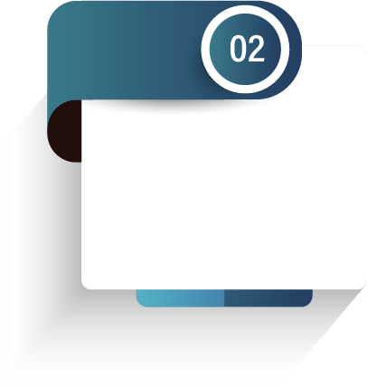
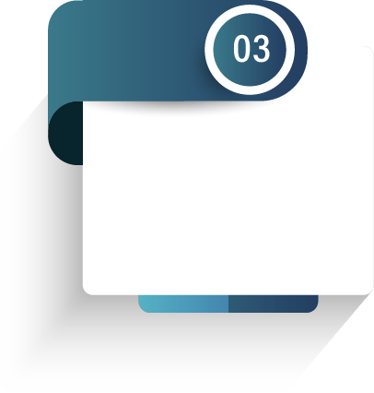
Partners journey to SaaS
Phase 1 – CSP Partner
CSP
Overview
Training

Slide 39

CAP
Cloud Acceleration Program

Slide 40
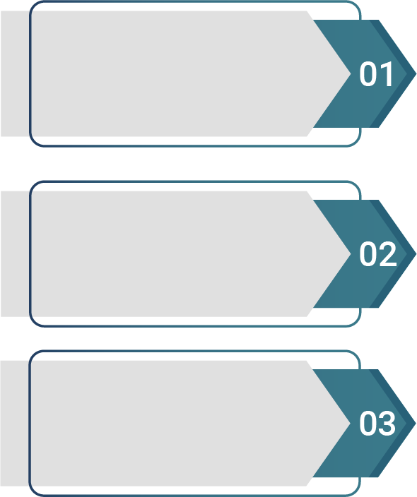

Partners journey to SaaS
Phase 2 – Cloud Acceleration Program (CAP)
  Onboarding with
  Buddy Support
SaaS License
SaaS Project
Evaluation Meeting
  Guided Onboarding
  Onboarding with
  Consulting Team

Slide 41
Book a session with the Onboarding team
  https://calendly.com/lsconboarding/30minsession

Slide 42

Questions?

Slide 43
Thank you

