Slide 2

Enhance LS Central through
POWER PLATFORM
Jasvinder Singh
Consultant

Slide 3

Agenda
Introduction
Power Apps
Power Automate
Power BI
Power Virtual Agents
Power Pages
Live Demo
News

Slide 4





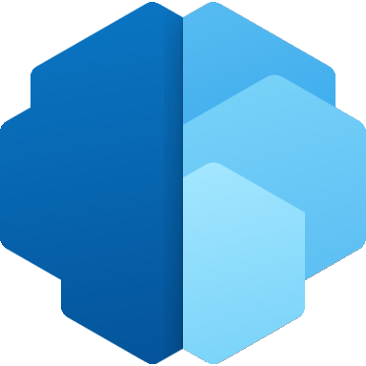



Introduction to
Microsoft Power Platform | Low Code Platform
The world’s most complete set of integrated, low-code development tools
Power Apps
Power Automate
Power Virtual Agents
Power Pages
Power BI
for web and mobile application development
for process or workflow automation
for chatbots and conversational agents
for
building secure, data-centric business websites
for data exploration, analytics and reporting
Data connectors
AI Builder
Microsoft Dataverse
Power Fx
Managed Environments

Slide 5
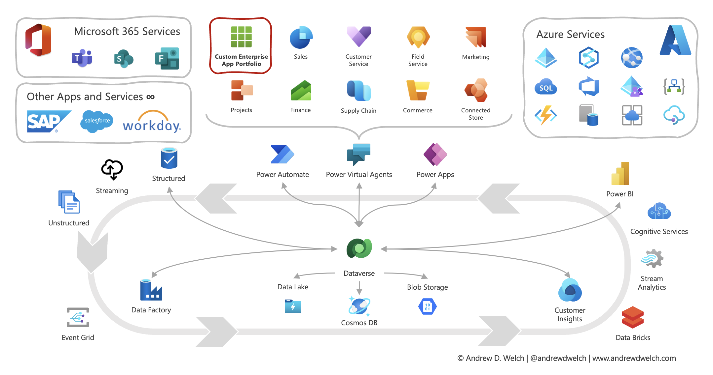
Power platform
Power platform

Slide 6

Power Apps
Power Apps provides a low-code approach to rapidly build apps for any device while seamlessly working with various data sources through a rich extensibility model for professional developers.
Drag-and-drop interface.
Power Apps can be used to create apps for various platforms including iOS, Android and web.

Slide 7
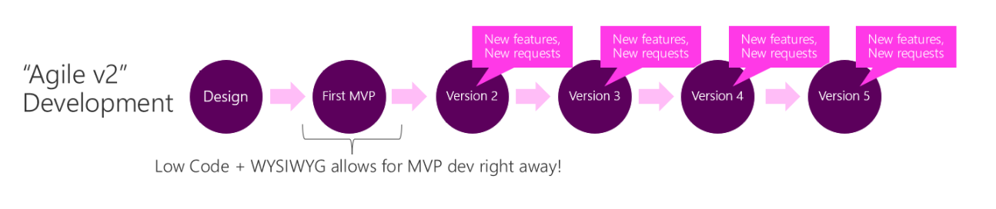
Differences between Power App and traditional ...
With Power Apps, you can quickly create a usable version of your app because it provides a WYSIWYG (what you see is what you get) development experience. Users experience the actual working app very early in the development process, and if new requirements arise, new features can be added to the next version. Source

Slide 8

Power Automate
Power Automate, previously known as Microsoft Flow, is a no-code automation platform that allows you to leverage previously off-limits legacy systems. Quickly automate solutions through simple workflow automation or through robust process automation using RPA.

Slide 9

Power BI
Power BI is a data visualization tool that allows users to connect to various data sources and create interactive reports and dashboards.
An analytics solution that lets you visualize your data and share insights across your organization or embed them in your app or website.
Azure analytics services and Power BI together allow you to quickly unlock insights for your entire organization.

Slide 10
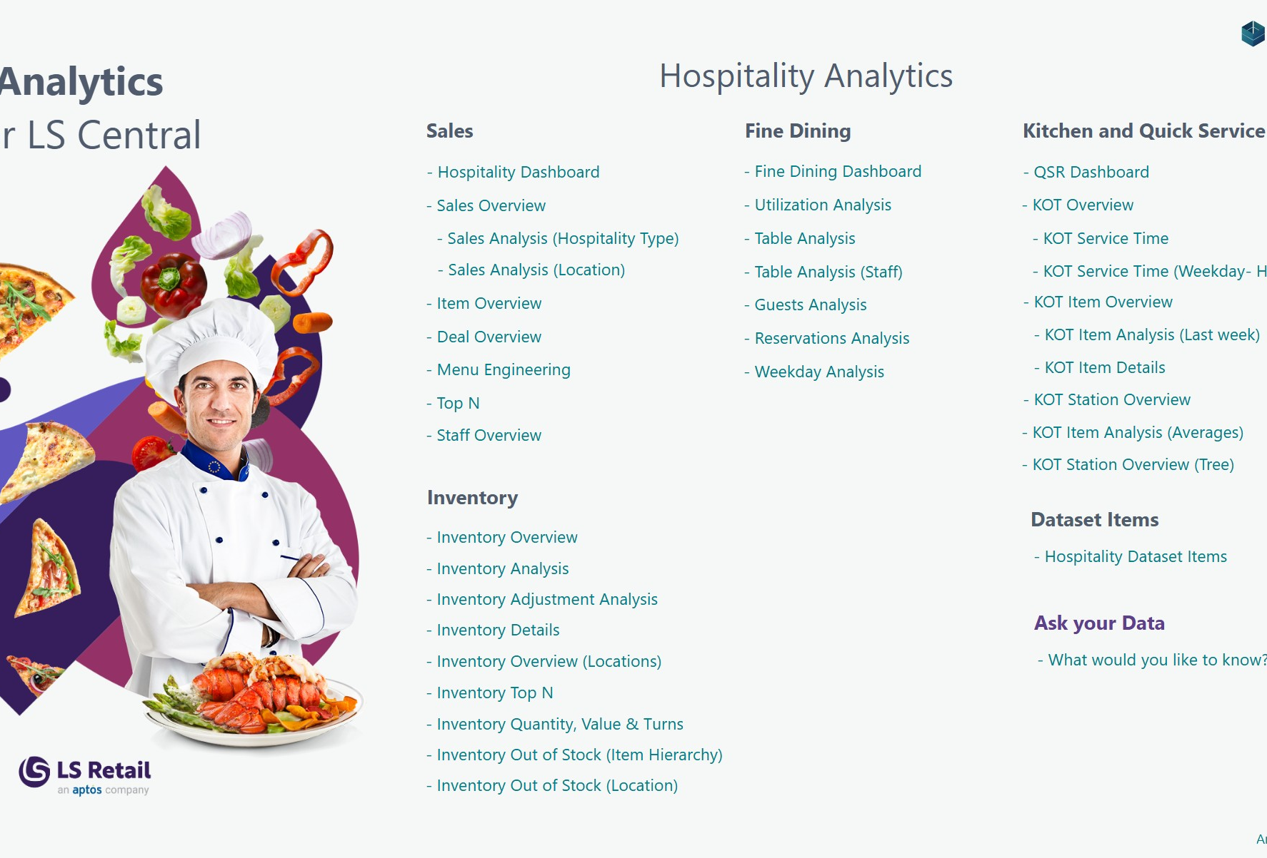
Analytics uses Power BI
Sales Analytics
Inventory Analytics
Bookings Analytics
Hospitality Analytics
Hotel Analytics
Supply Chain Analytics
Analytics

Slide 11
Power Pages
Power Pages is a secure, enterprise-grade, low-code software as a service (SaaS) platform for creating, hosting, and administering modern external-facing business websites.

Slide 12
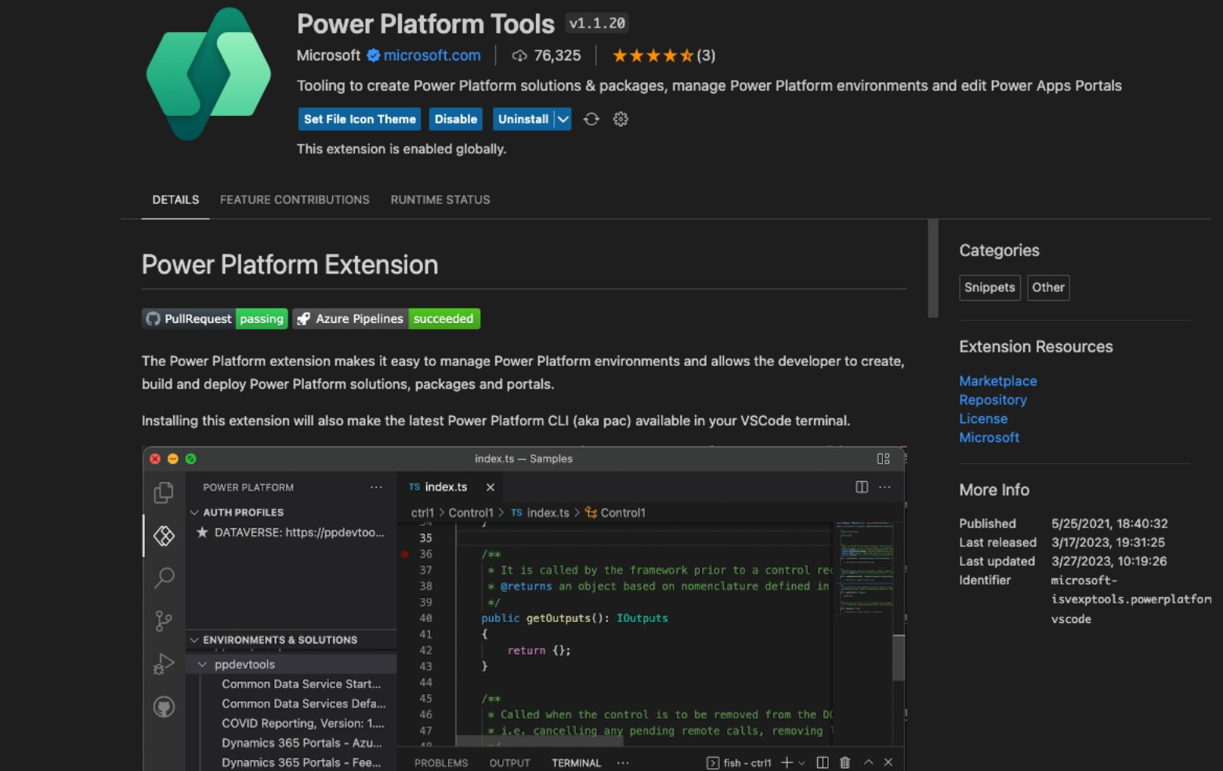
Power Pages
Develop with pro tools
Fine-tune your layout using HTML, CSS, and Javascript, and make changes directly to page code using the built-in integration with vscode.dev in Design Studio.
VS code extension

Slide 13

Power Virtual Agents
Power Virtual Agents enables you to create intelligent no-code chatbots and easily integrate with existing services by calling customer workflows using Power Automate and extending bots with custom capabilities using Bot Framework Skills.

Slide 14


Slide 15

What You’ll Need
Power App Platform
The Power Apps Platform is a suite of apps, services, and connectors that provides a rapid development environment to build custom business apps. It enables users to create feature-rich apps without writing code, connecting to various data sources like SharePoint and SQL Server. Access here
Housekeeping App
The example in this demo is based on Housekeeping App – An app that was requested from a customer to execute the LS Central for hotels housekeeping functionality outside the POS directly on a mobile app.

Slide 16
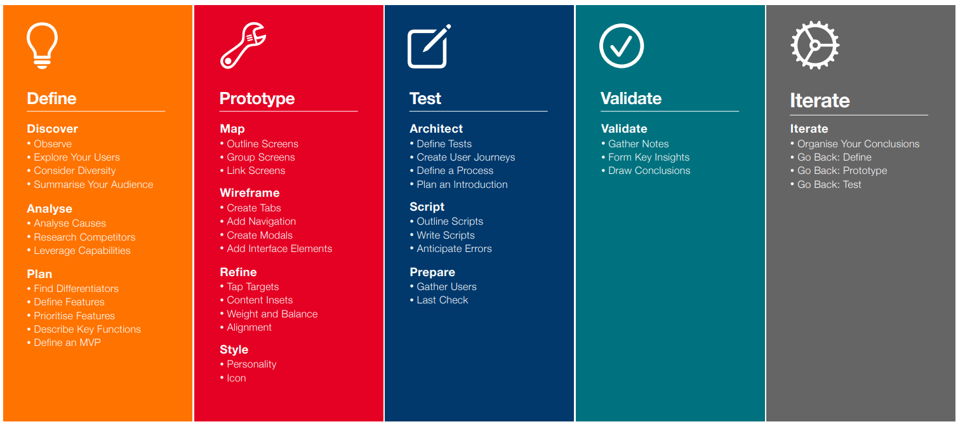
App Design Cycle

Slide 17
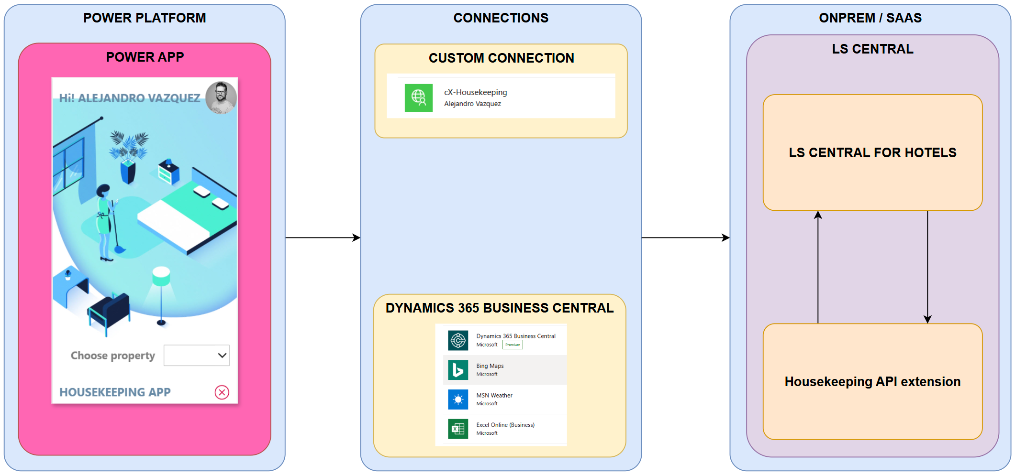
Architecture

Slide 18
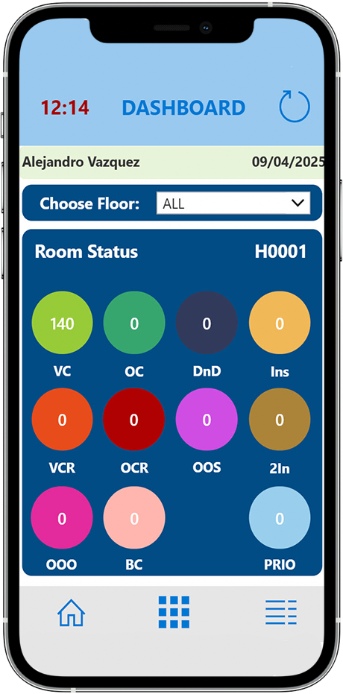
Demo
LS Retail Consulting created a Power App to handle Housekeeping tasks from the hotel.
Users are room attendants.
After choosing a property, you will get an overview of the HK Status of the hotel.
In the example, we can see that there are rooms with status VCR (vacant cleaning request).

Slide 19

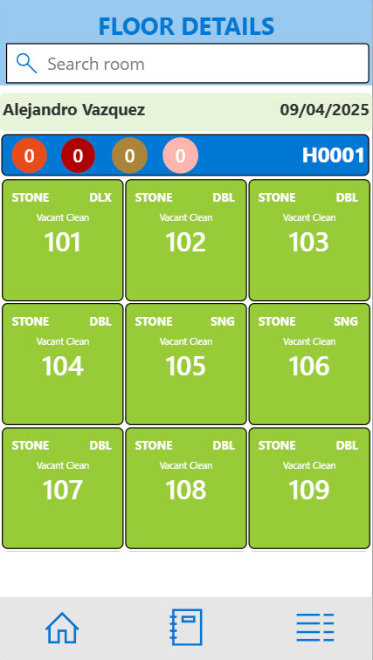
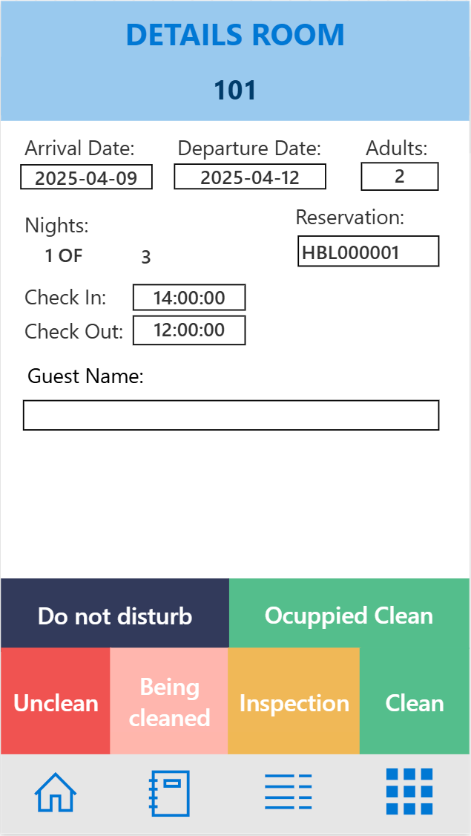
Demo cont.
By clicking the icon, you will access the rooms with that status. In this view, you get more info about the room.
Room type
How many persons in the room
Check-out time
How many nights they will/have stayed
Priority room or not
Extra bed or crib in the room
By clicking a room, the room attendant can change the HK status when done with the room. This will then update the status in the system.

Slide 20
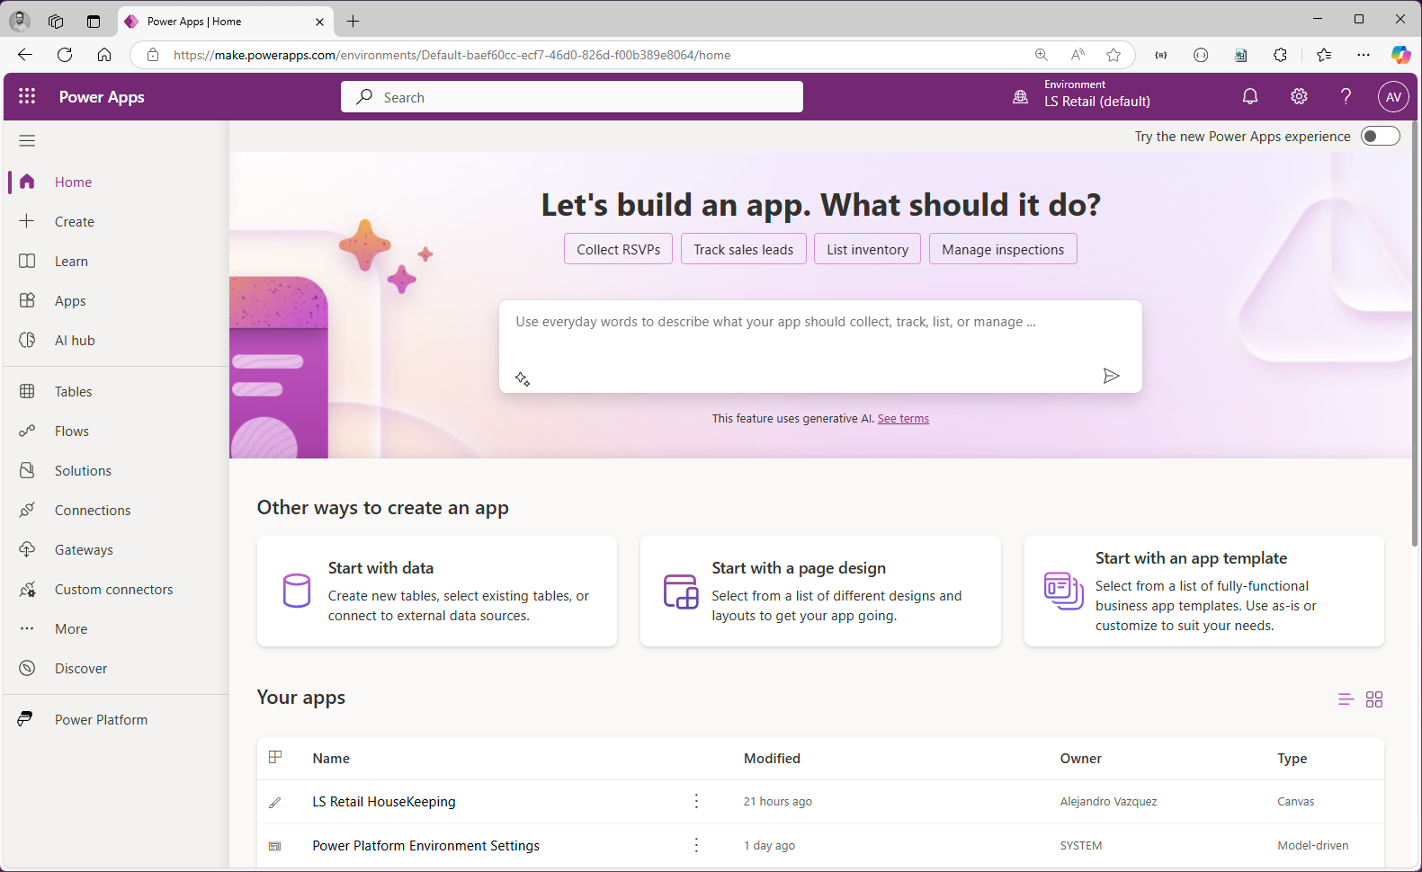



make.powerapps.com

Slide 21
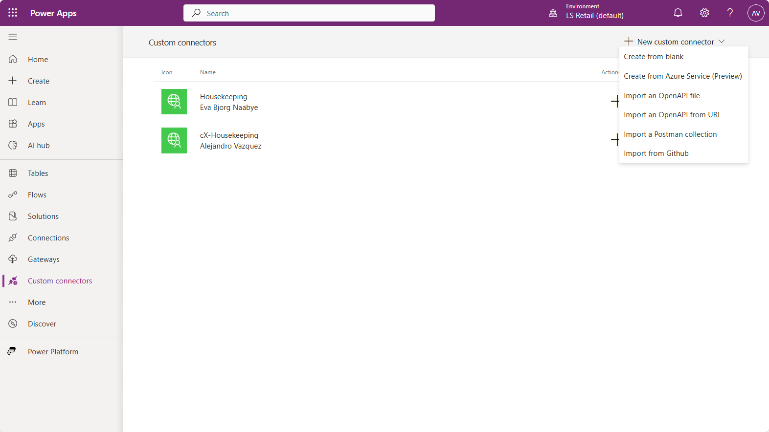
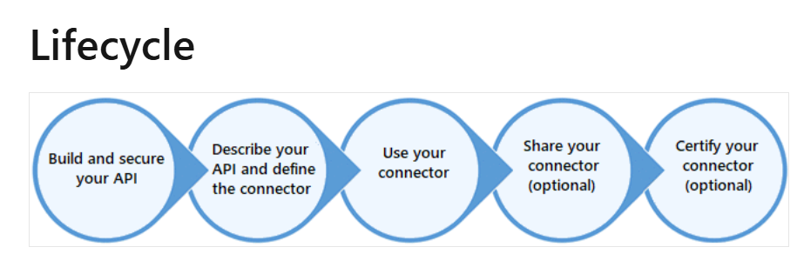



Custom Connector
Push me to know more…

Slide 22
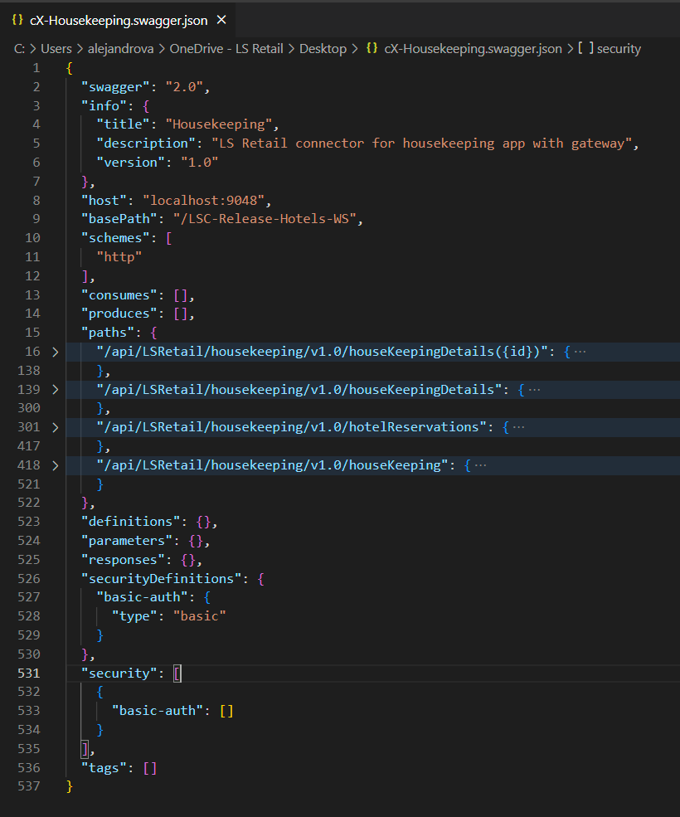
Custom Connector

Slide 23
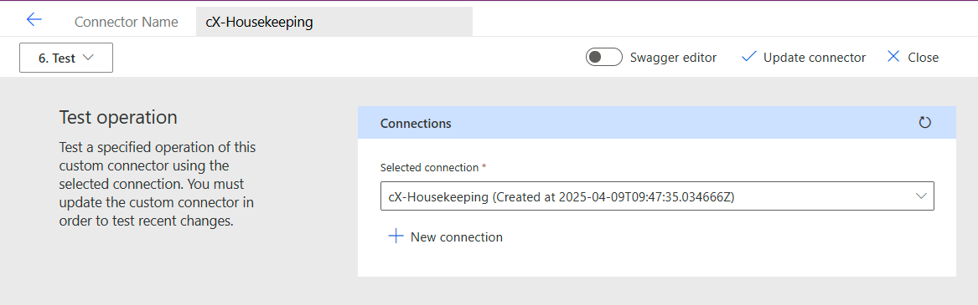
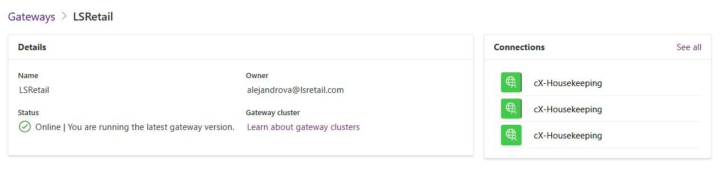
Custom Connector - Gateway

Slide 24
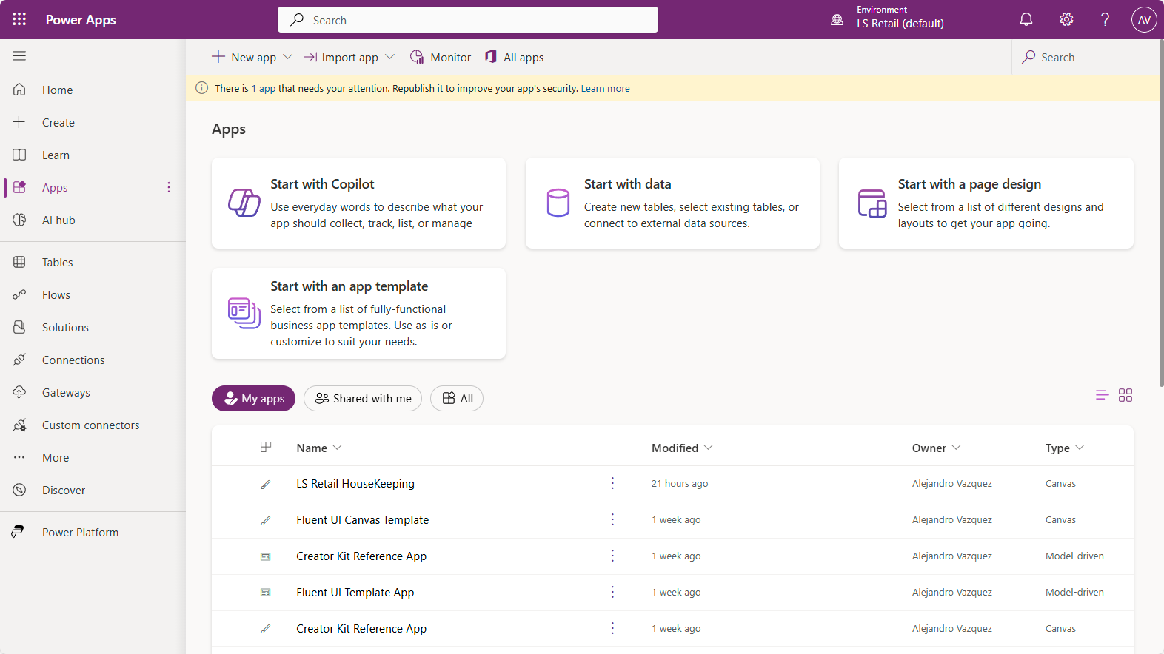

Apps - Canvas

Slide 25
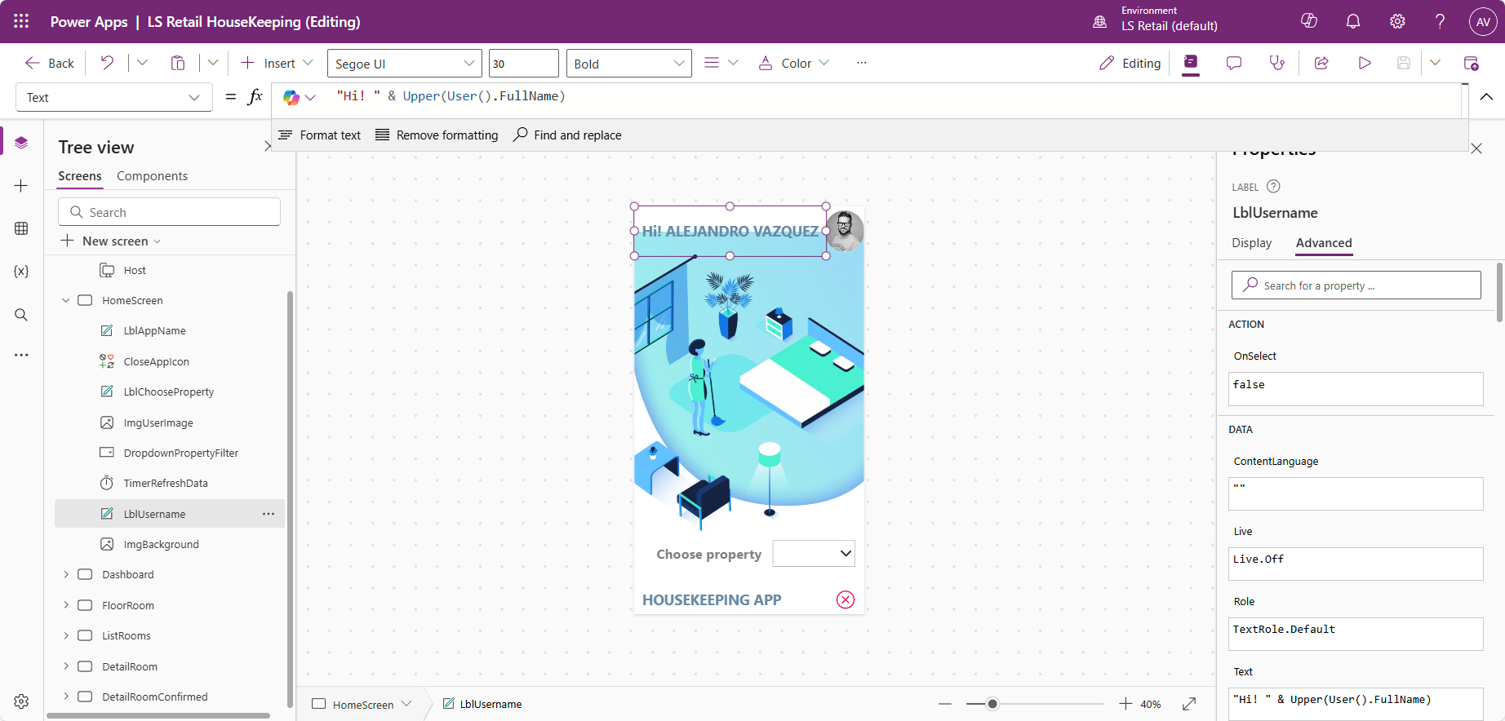
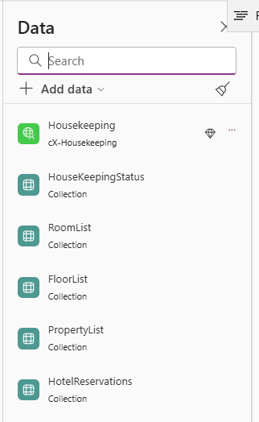





Apps - Canvas

Slide 26
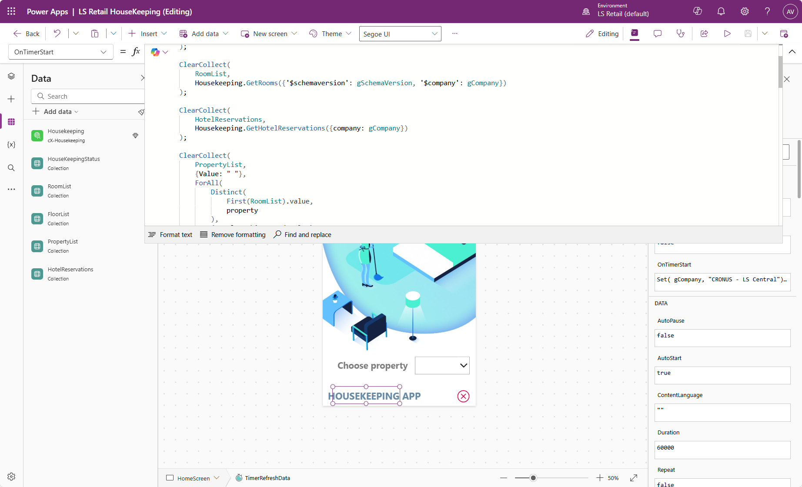
Apps - Coding

Slide 27
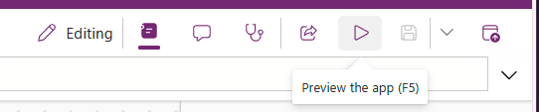
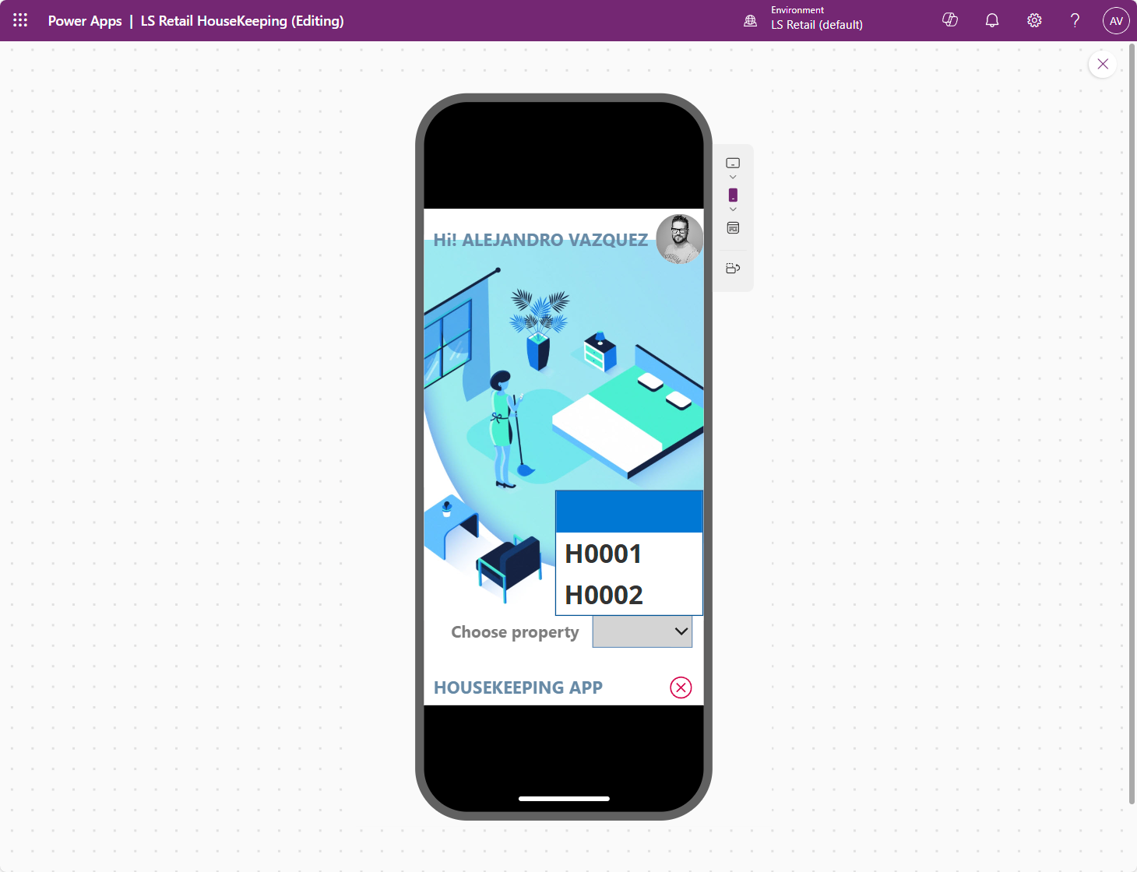
Preview the app

Slide 28
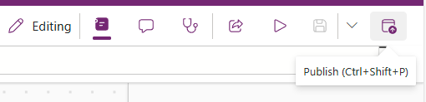
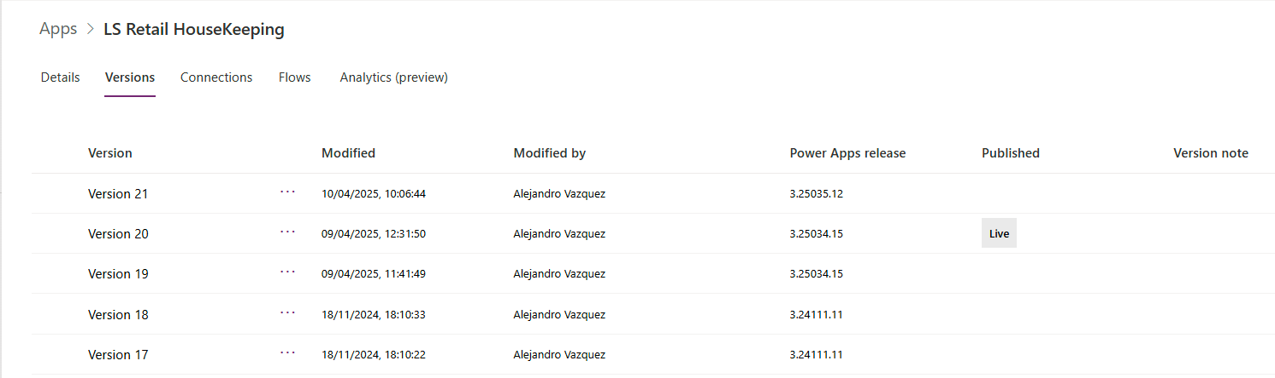
Publish & Versioning

Slide 29
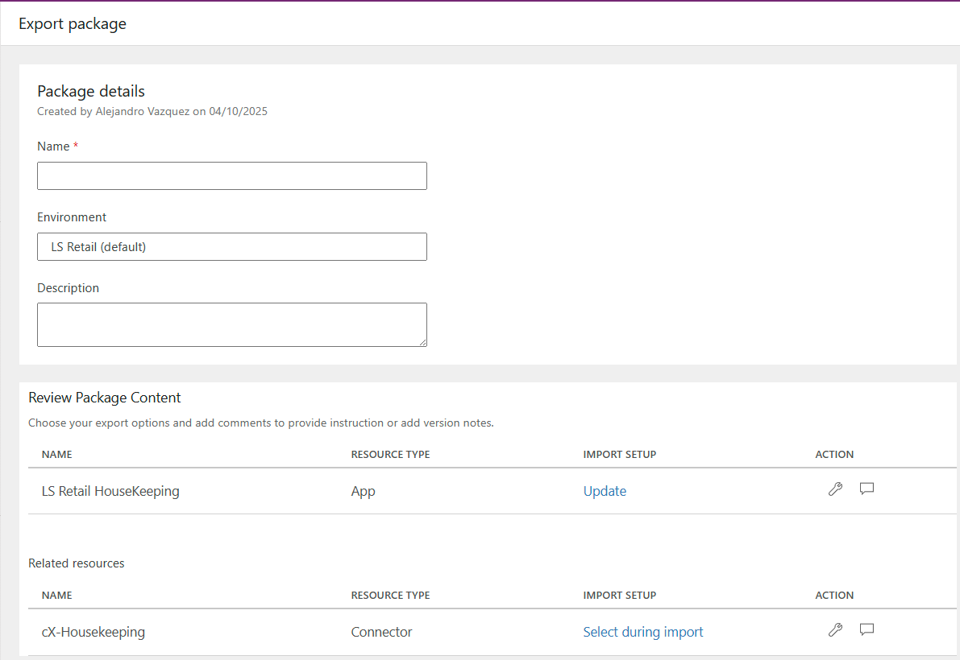
Exporting the app

Slide 30

EXTRA POWER

Slide 31
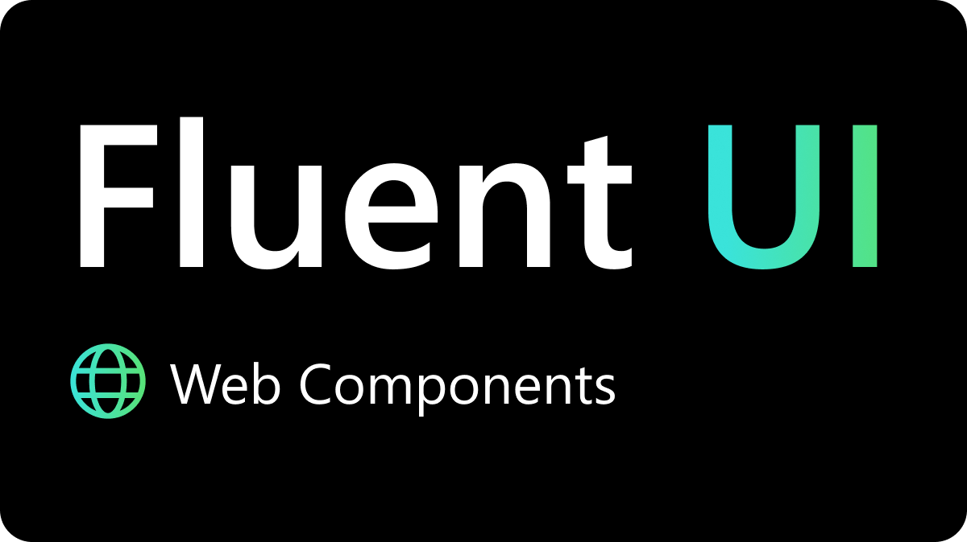
CREATOR KIT

Slide 32

What’s new?
Copilot Studio is a graphical, low-code tool for both creating an agent—including building automation with Power Automate—and extending a Microsoft 365 Copilot with your own enterprise data and scenarios.

Slide 33
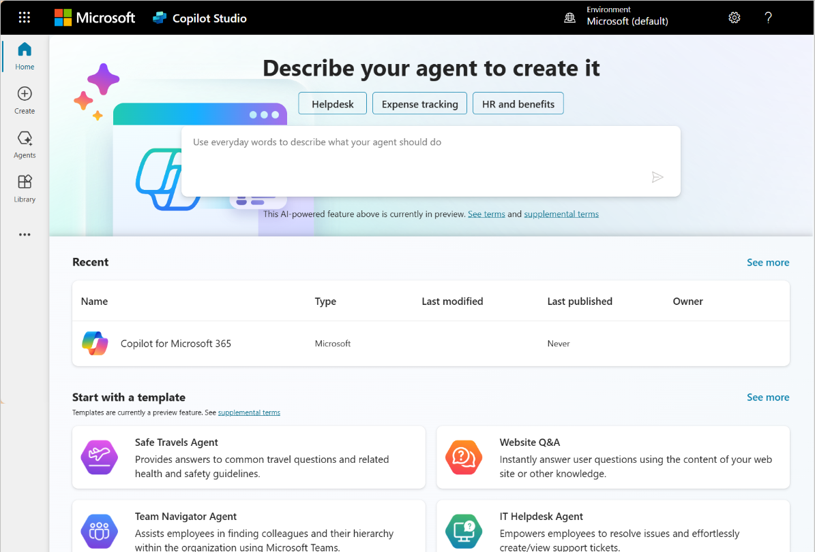
Copilot Studio
Build your own Agent
Samples
Build your first Agent!

