Slide 1
Cloud queue and storage services
Hilmar Vilhjalmsson
Bjarni Asmundsson

Slide 2
Why queue and storage services
Agenda
LS Central queue and storage services

Slide 3

Why queue and storage services
To overcome
Complexity
Operational limit
Lack of performance
Security concerns
Connectivity
Cloud services offer
Scalability & georedundancy
Security
Performance
Lower cost

Slide 4

Queue services
Asynchronous
Scalable
Durable
Increased reliability
Write once, read many, ordering
Security
Cost

Slide 5

Storage service
Scalable
Accessibility
Redundancy
Security
Cost

Slide 6

Telemetry
Metric
Numeric, periodic, high level
Log
Detailed, verbose, context, various levels
Trace
Detailed, lifecycle, end-to-end, diagnostics

Slide 7
What services are out there
Queue services
Azure Service Bus, Event Grid, Event Hub
AWS MQ, SQS, SNS
GCP Pub / Sub
Others: Apache Kafka, Mulesoft, Confluent
Storage services
Azure storage
AWS S3
GCP cloud storage
Others: IBM, Oracle, DigitalOcean, Alibaba

Slide 8
Master Data to Azure storage
Head Office
Writes data to storage

Slide 9
Master Data to Azure storage
Head Office
Writes data to storage
POS
Is there data to import?
Import data from storage
Notify Head Office

Slide 10
LS Central storage and queue integration module
Proven technology
Makes integrations easier

Slide 11
LS Central storage and queue integration module
Proven technology
Makes integrations easier
Extendable

Slide 12
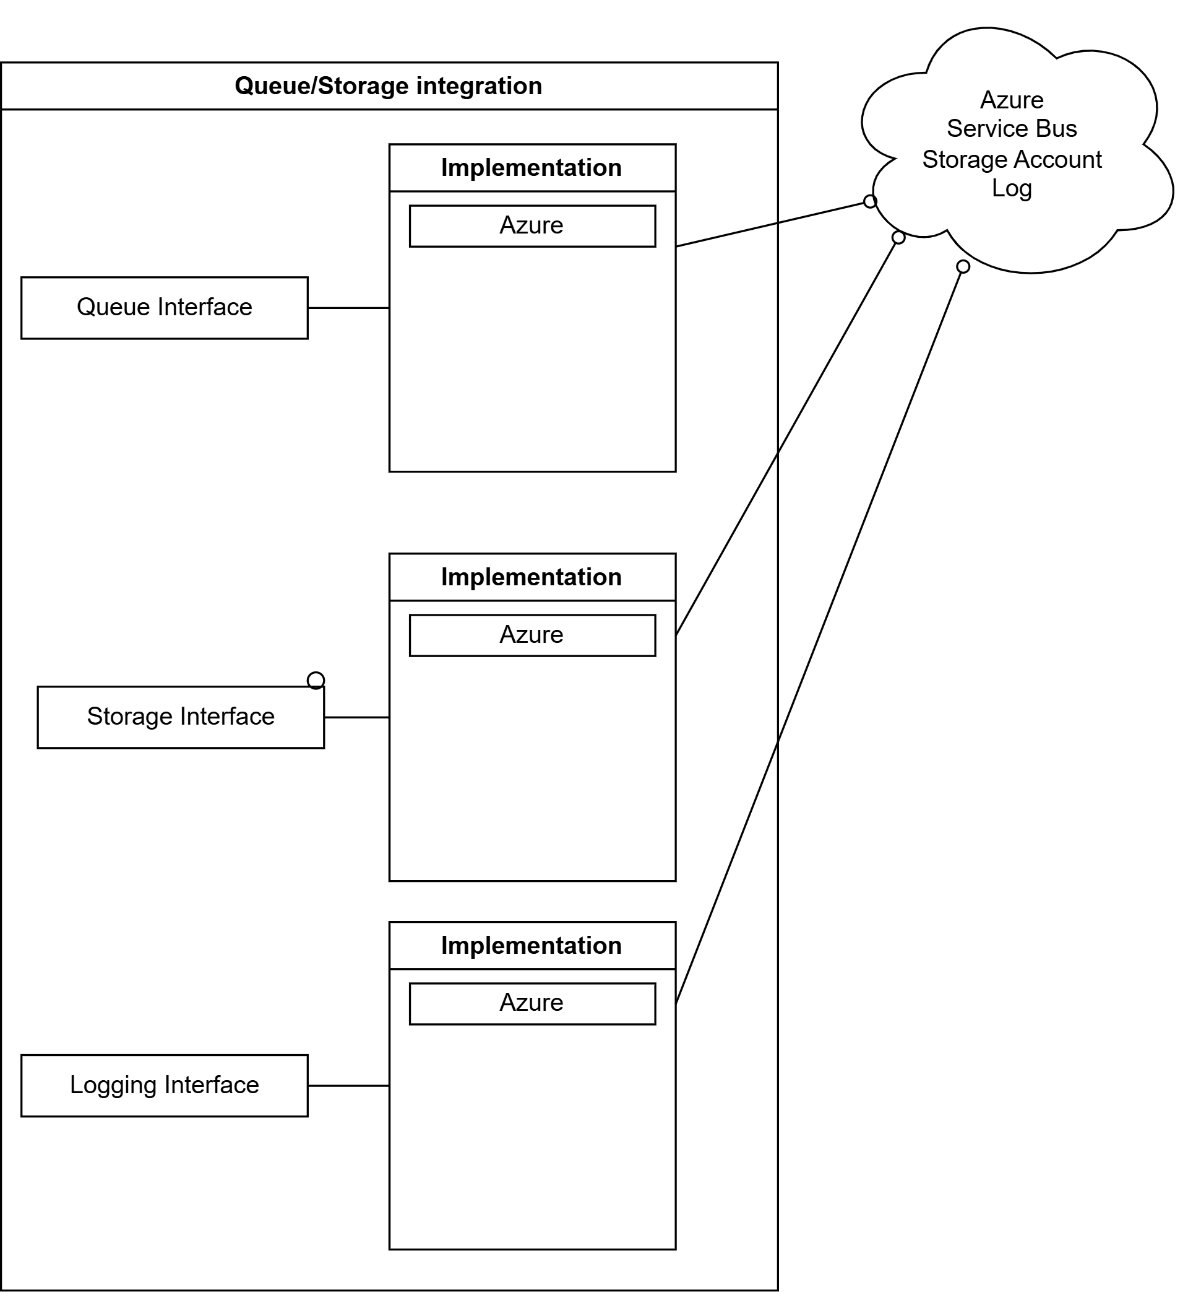
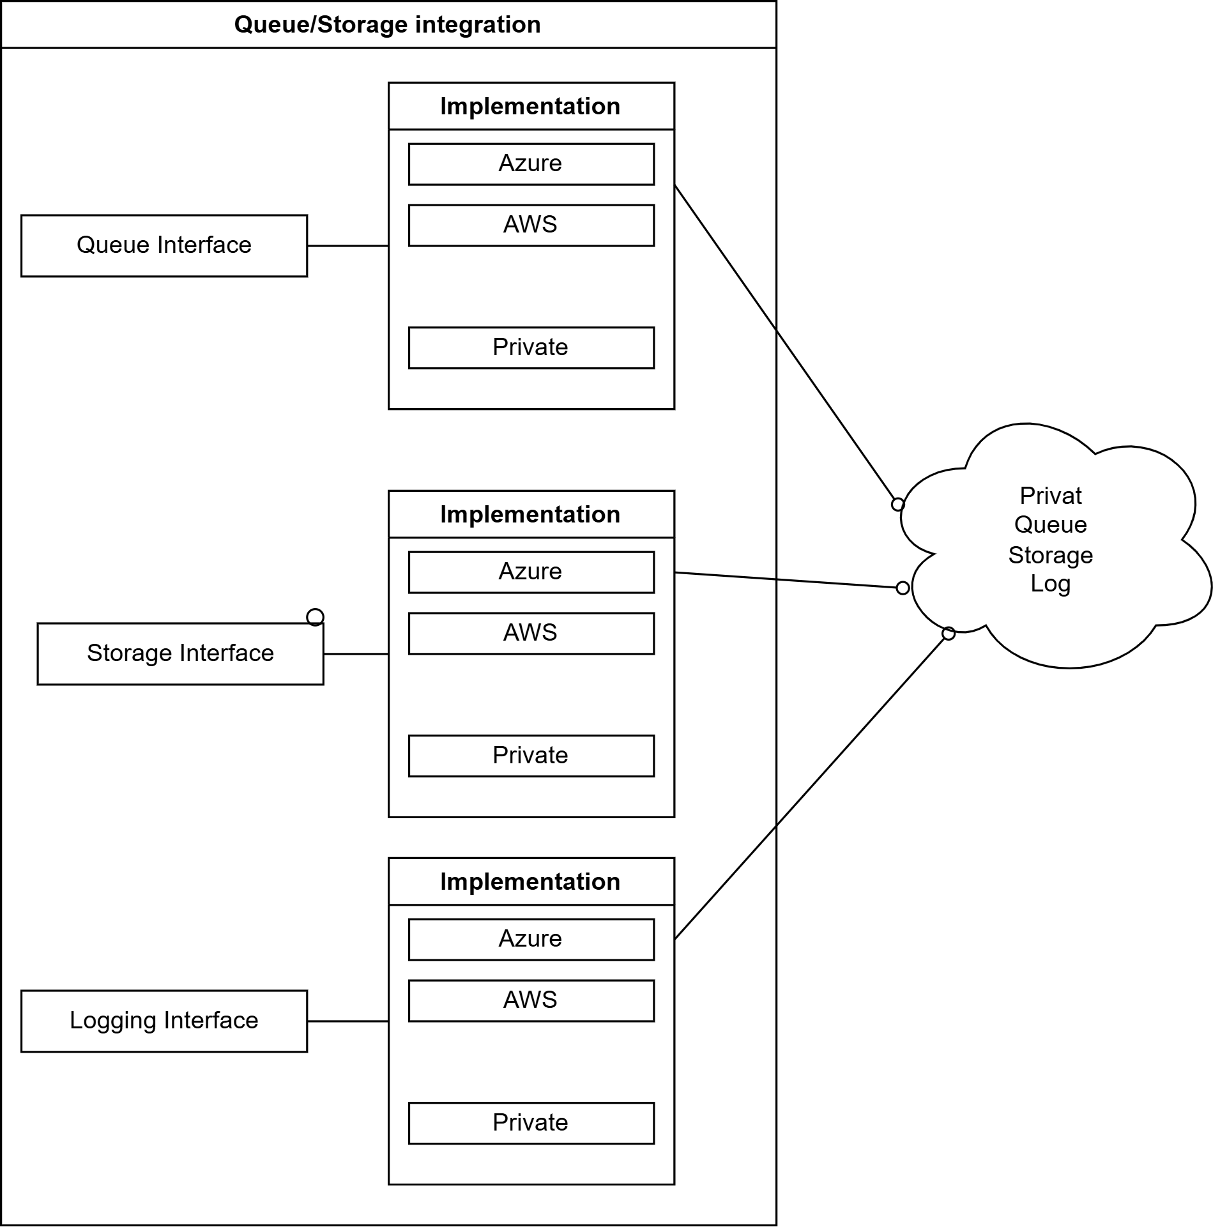
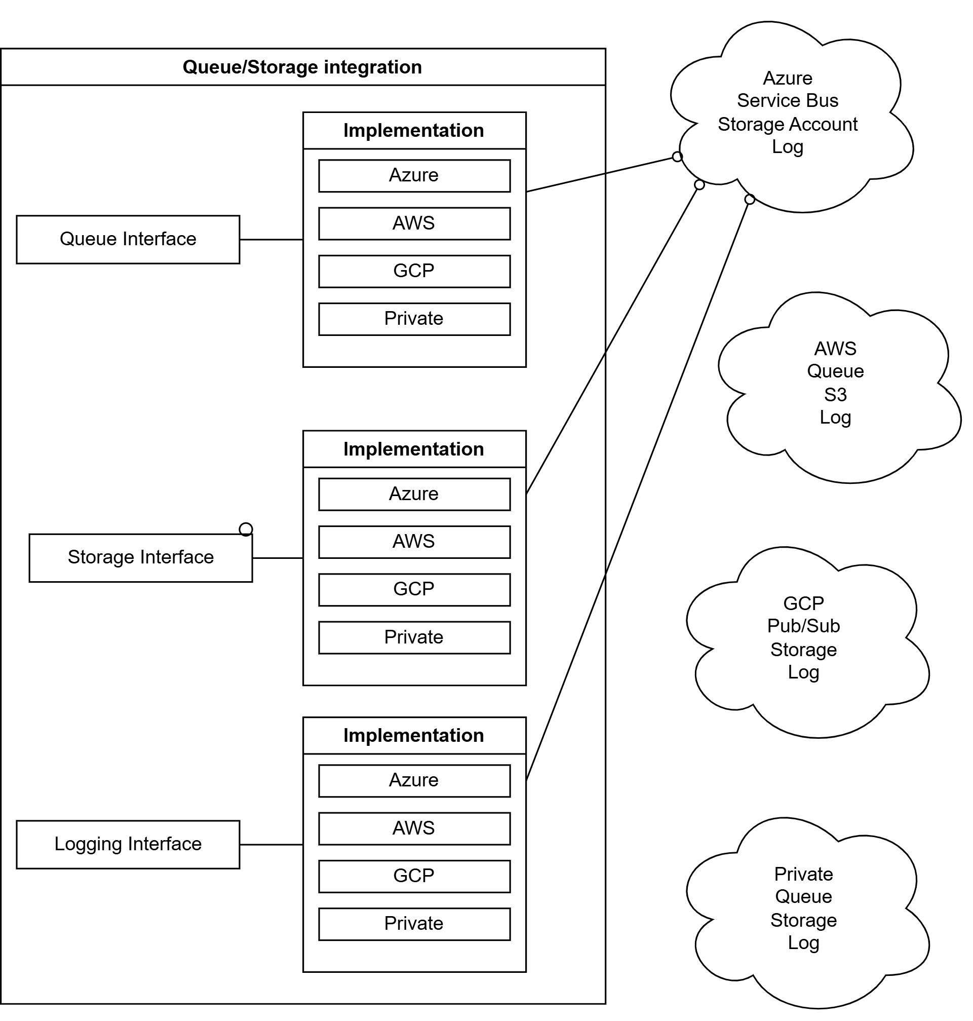
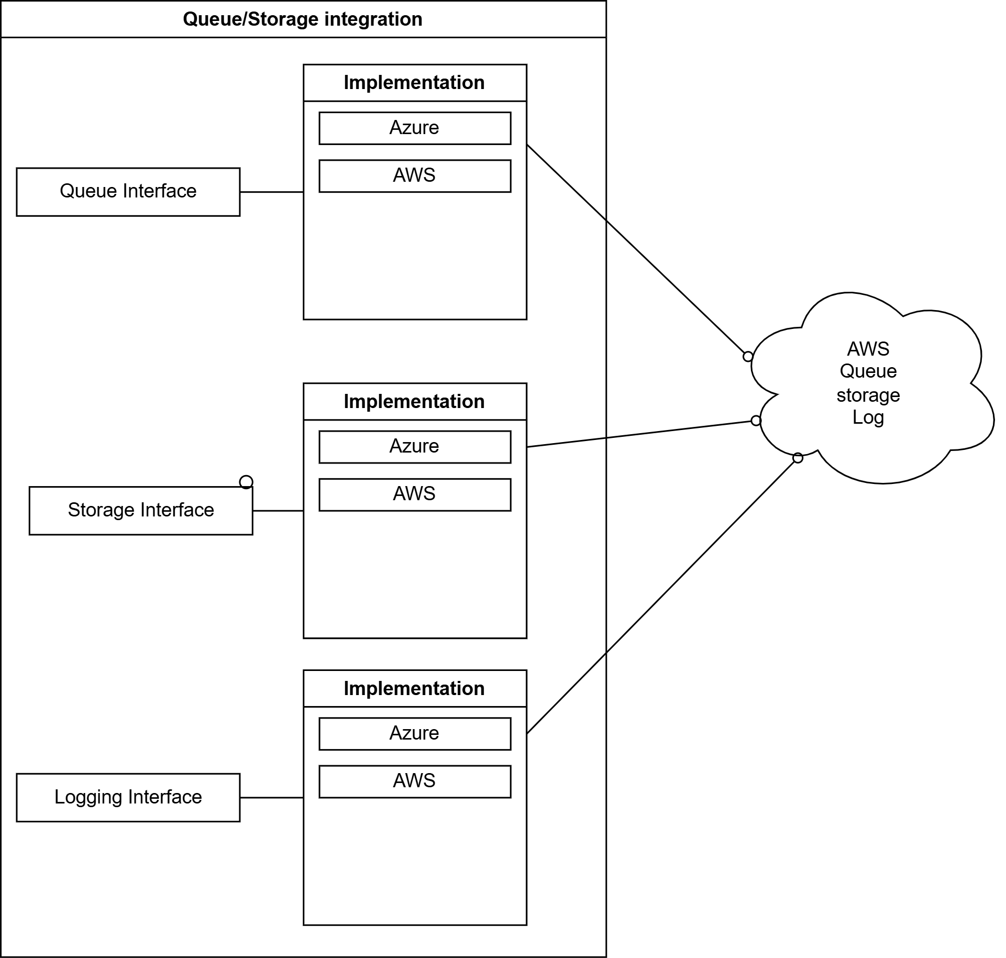
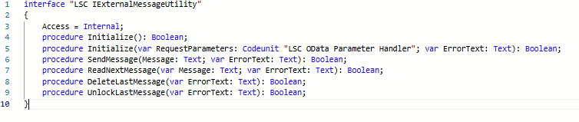

Slide 13
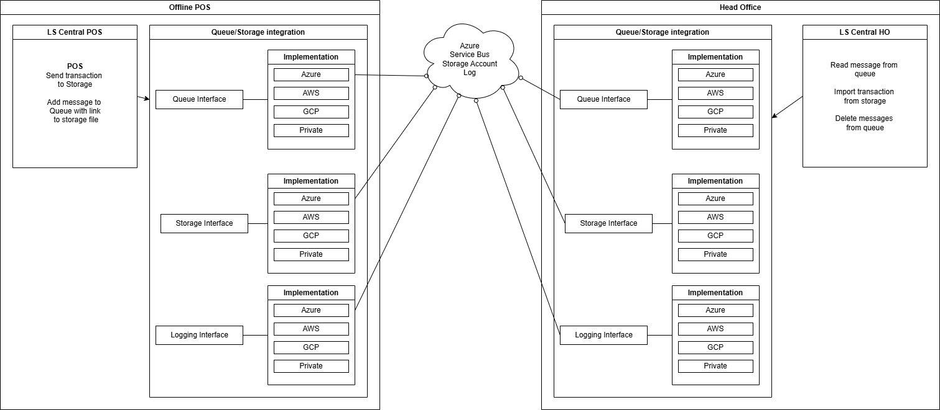

Slide 14
Sending transactions
POS
Write transaction to storage
Add message to queue
Head Office
Read messages from queue
Import transaction from storage
Process message

Slide 15
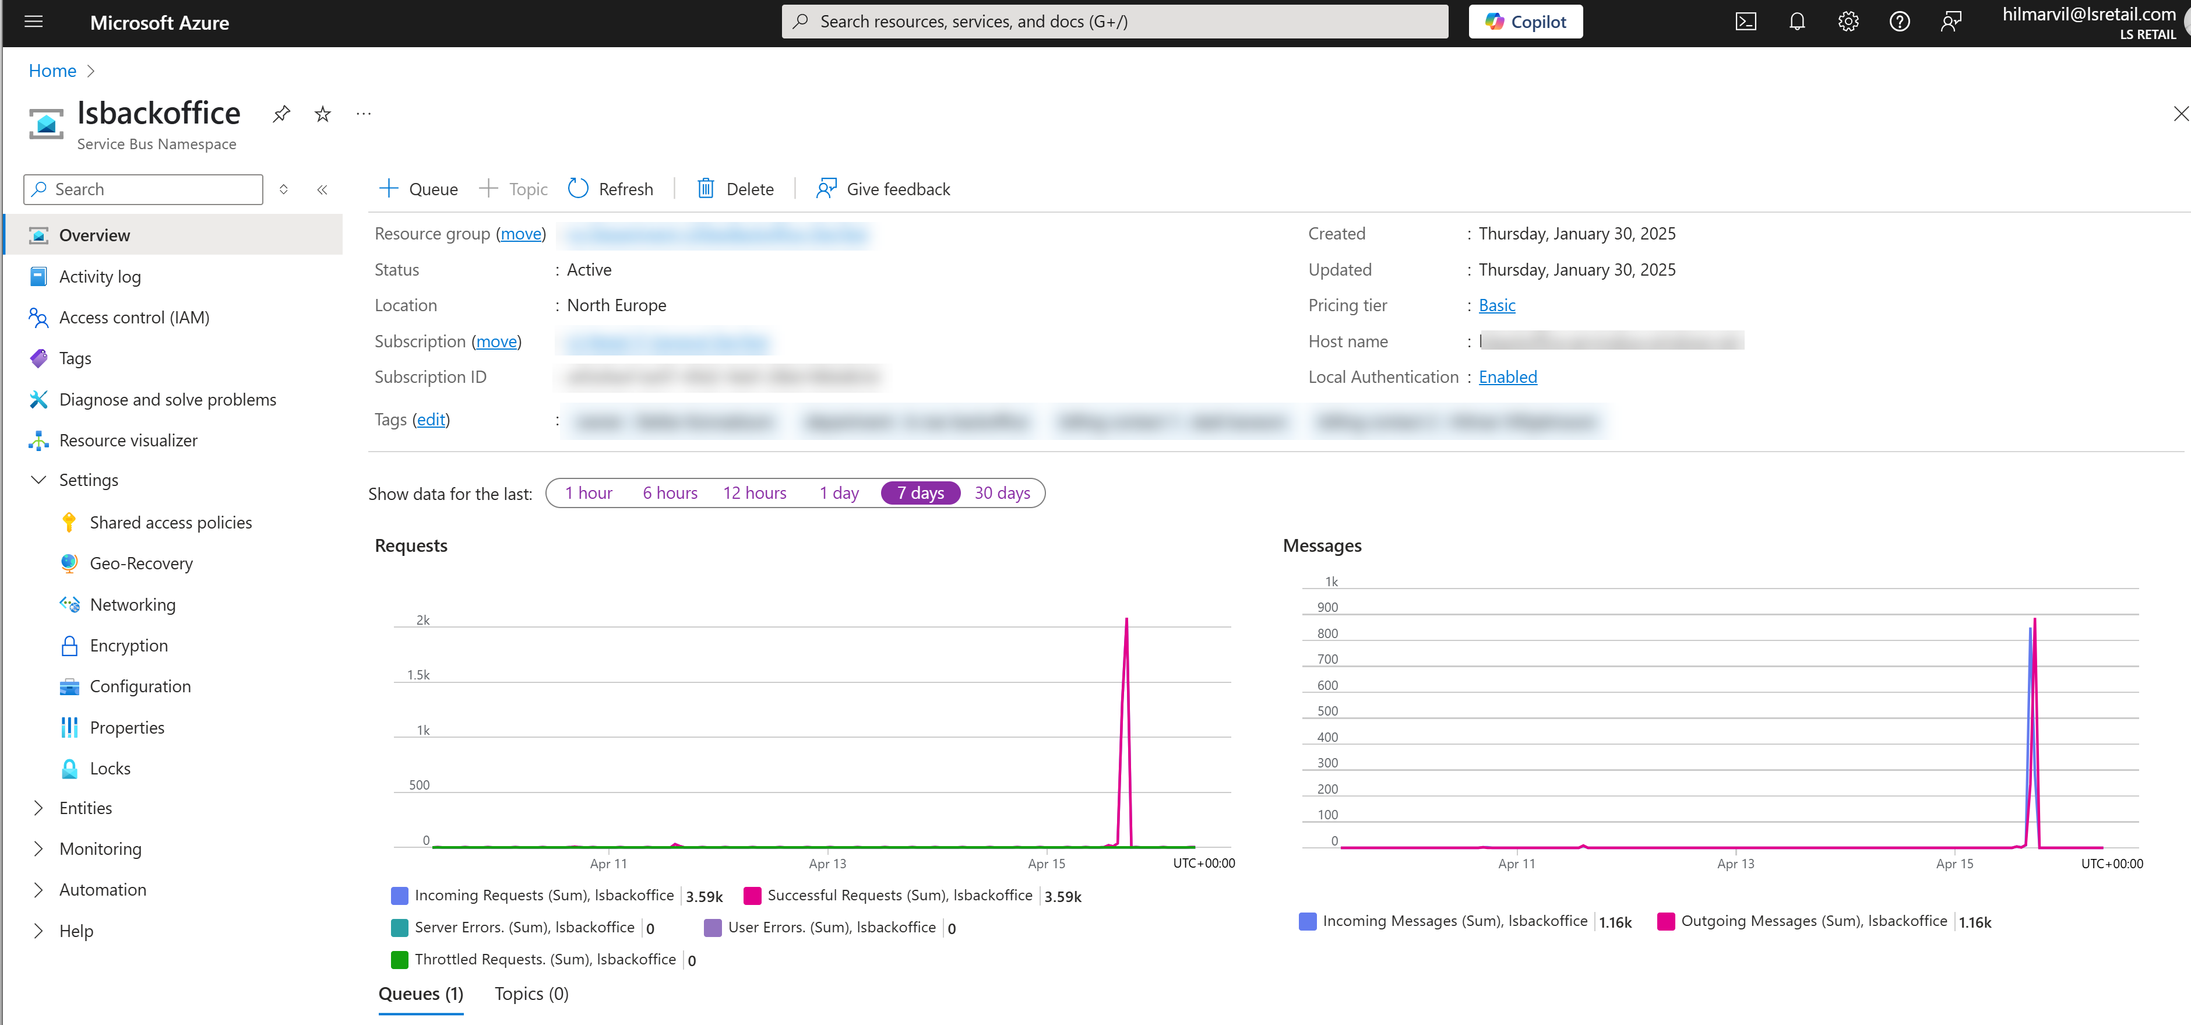
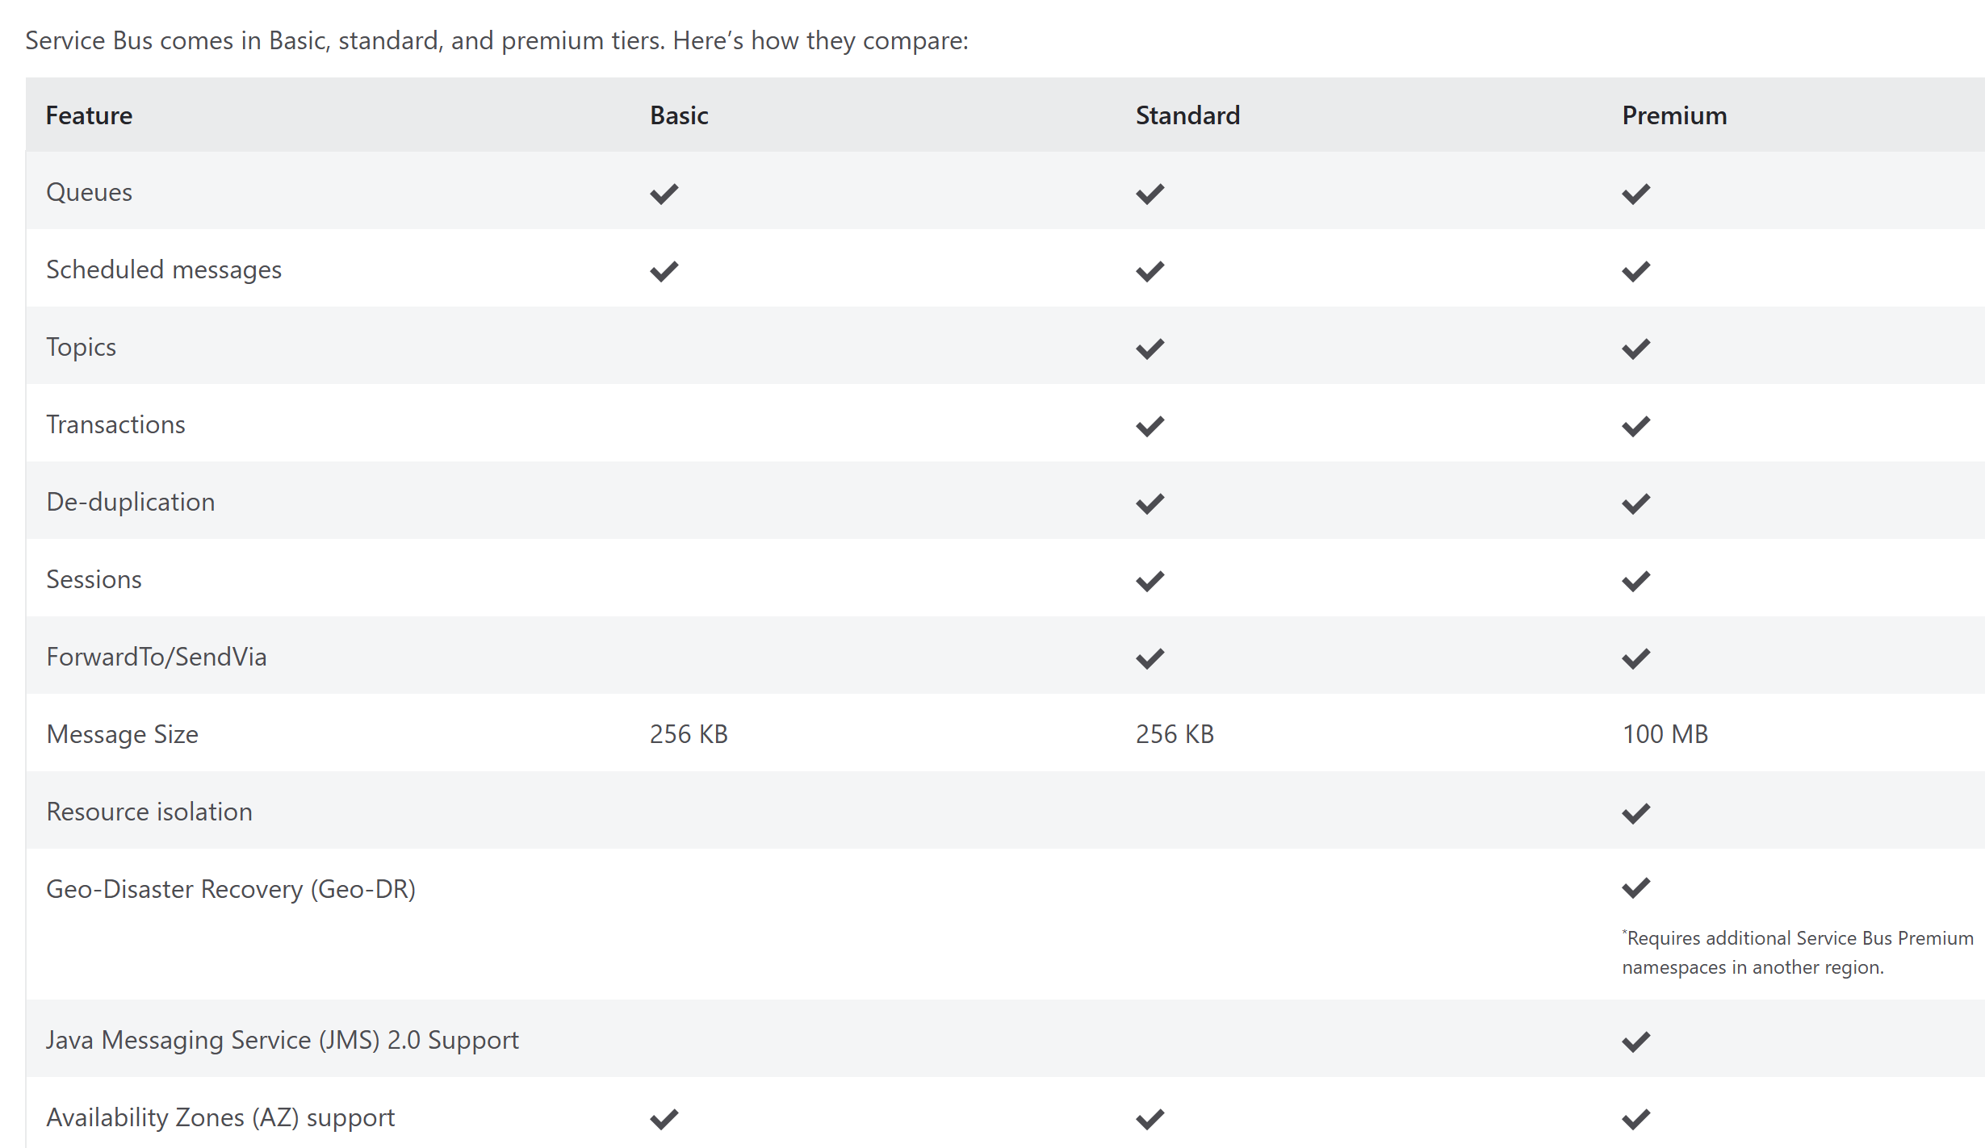
Sending Transaction – Azure setup
Create Service Bus subscription

Slide 16
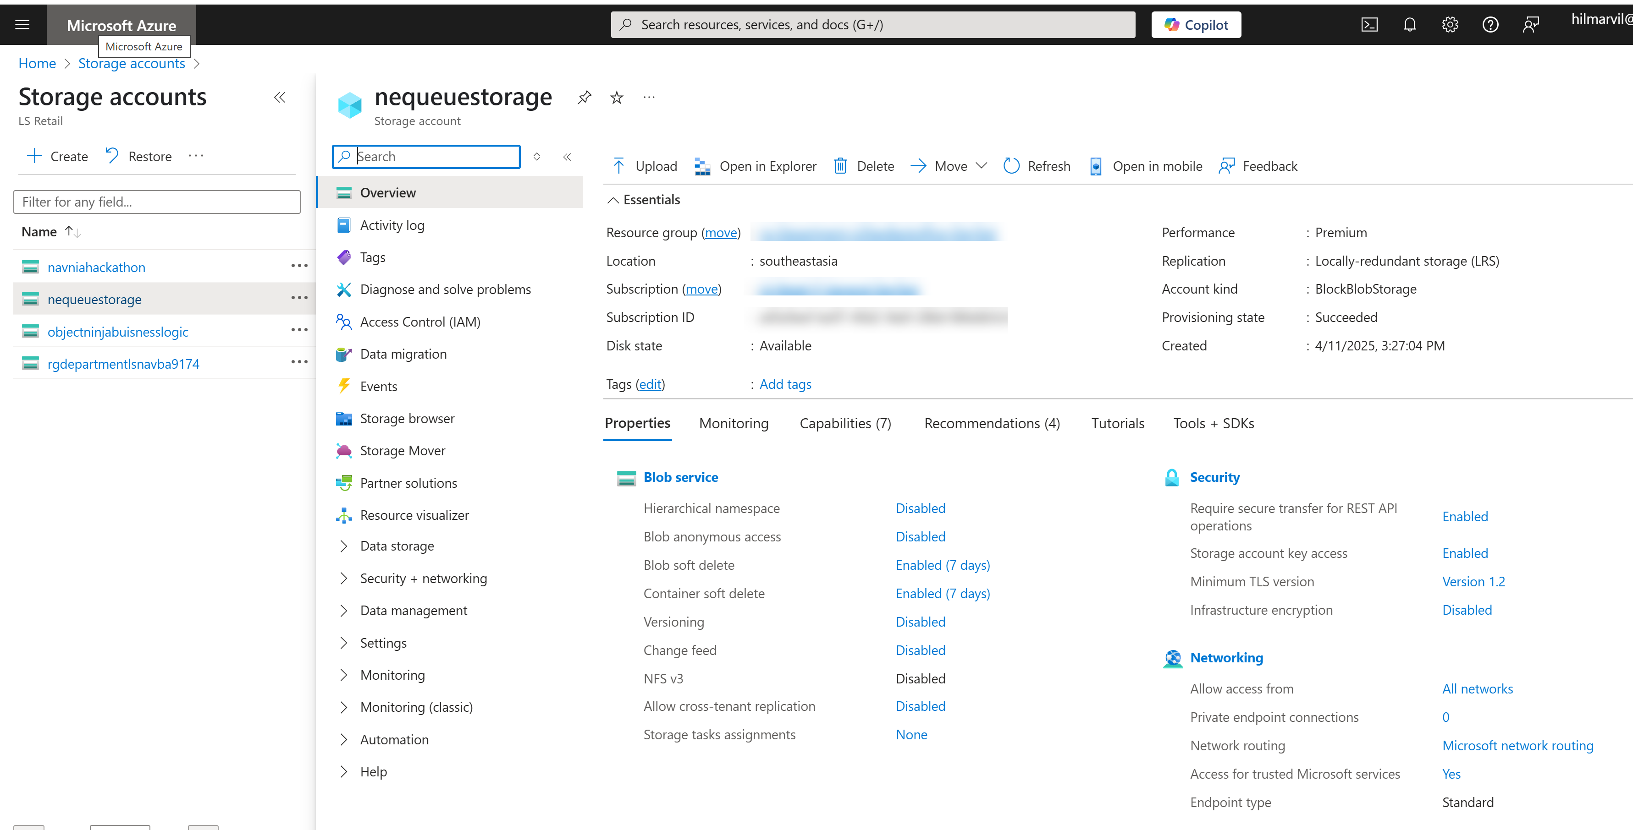
Sending Transaction – Azure setup
Create Storage Account subscription

Slide 17
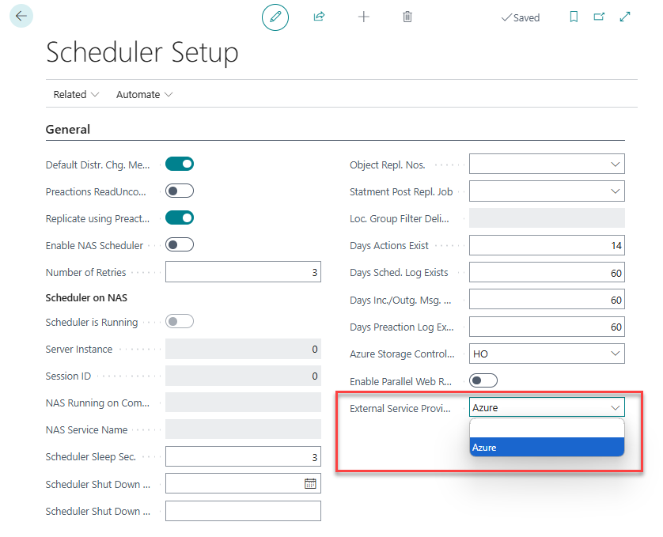
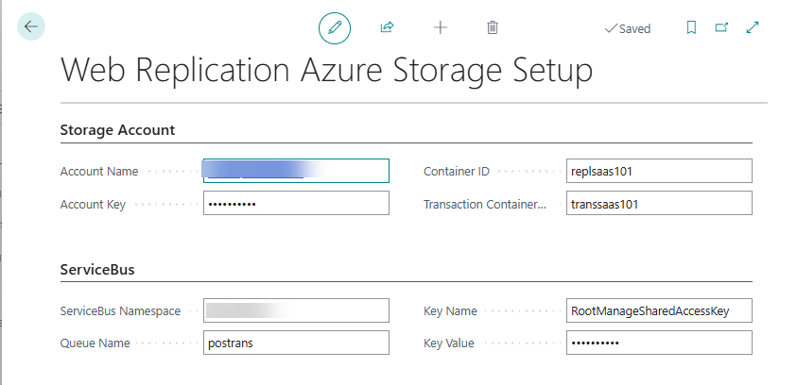
Sending Transaction – Head Office setup
Azure Accounts
Scheduler setup

Slide 18
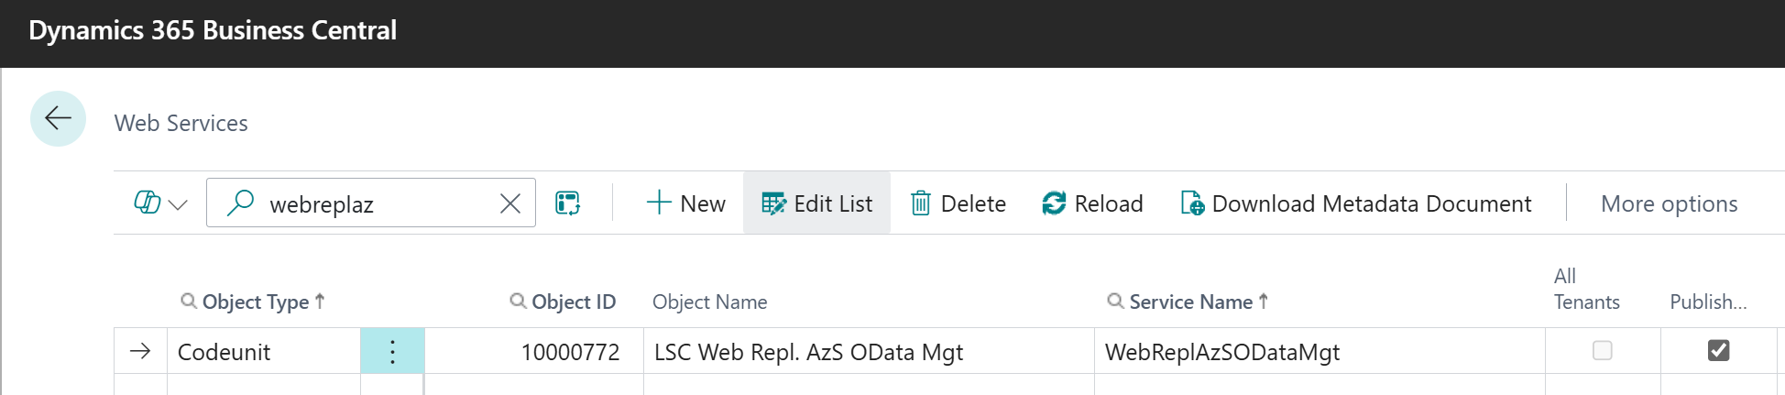
Sending Transaction – Head Office setup
Azure Accounts
Scheduler setup
Webservice

Slide 19
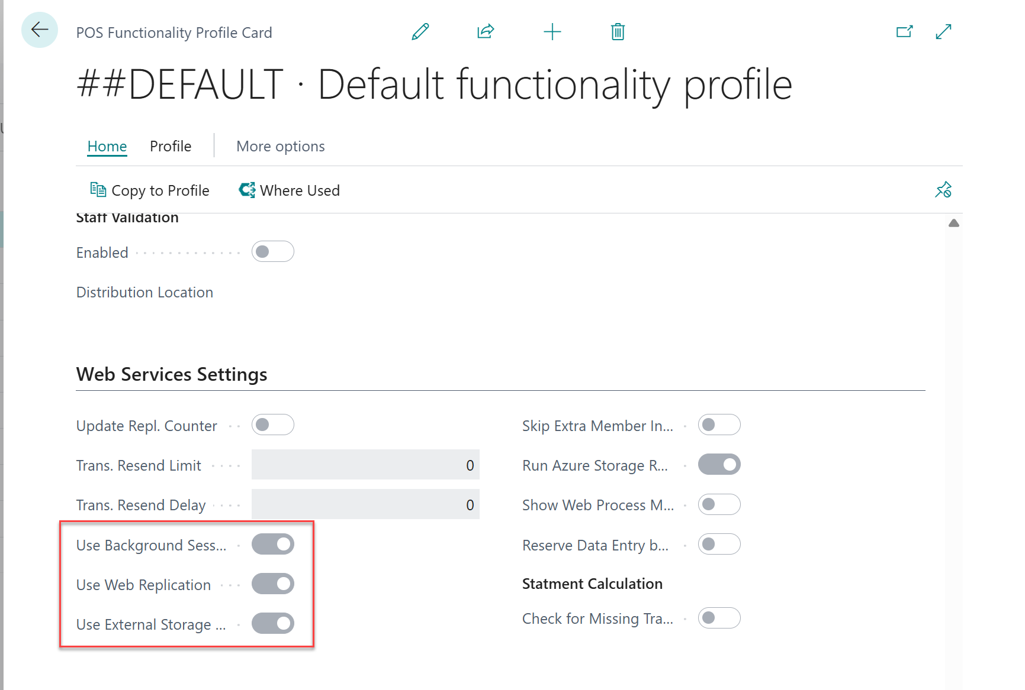
Sending Transaction – POS setup
Functionality Profile

Slide 20
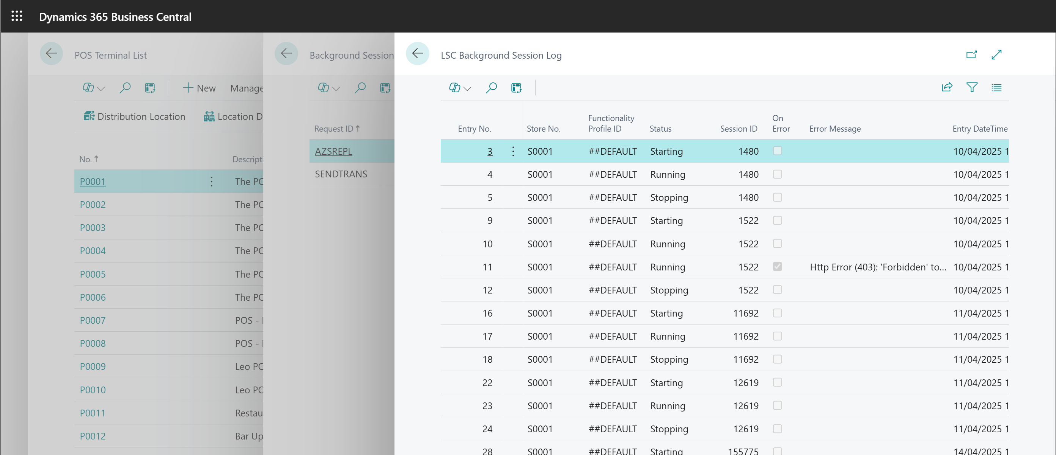
Sending Transaction – POS log
POS Terminal log

Slide 21
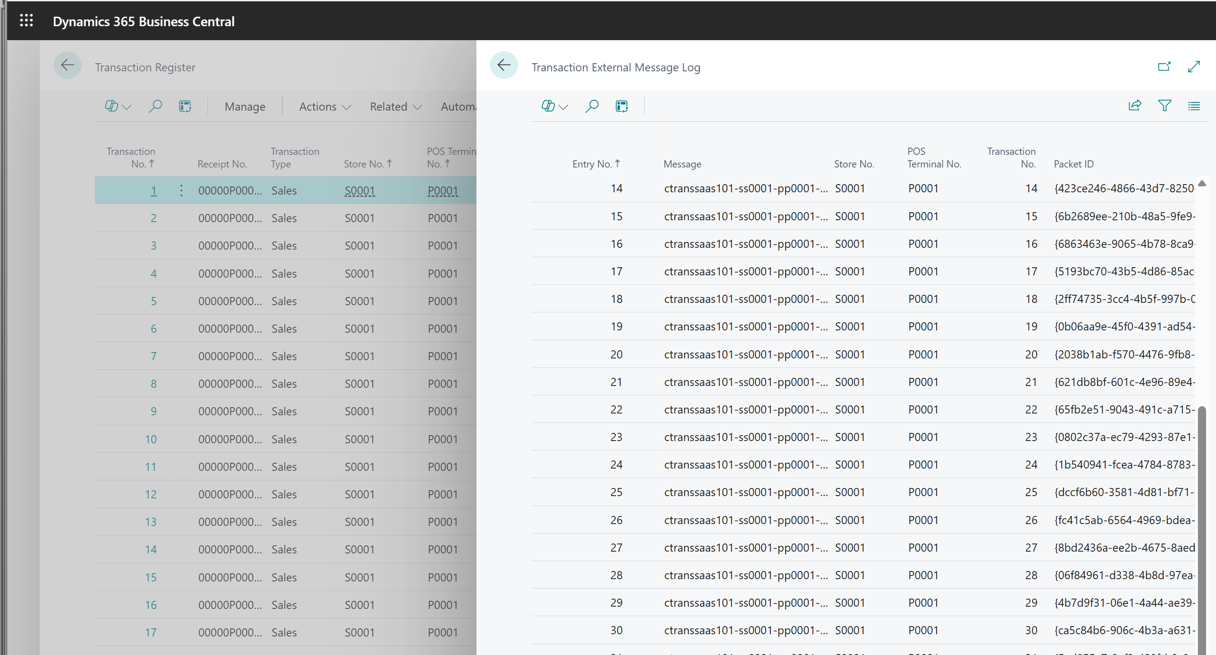
Sending Transaction – Head Office log
Processing transactions

Slide 22
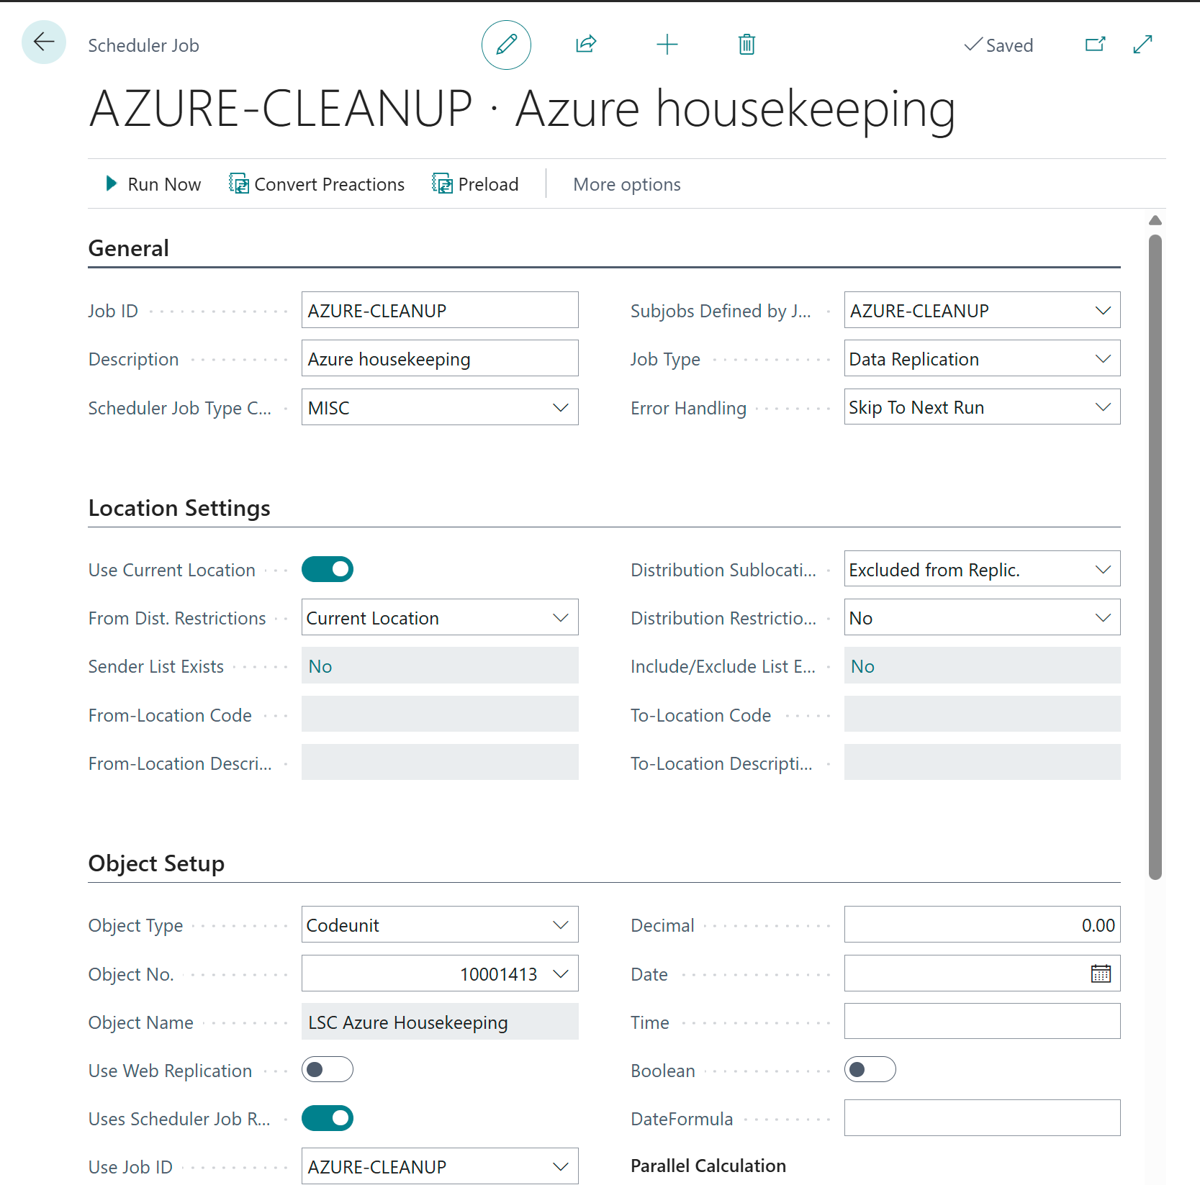
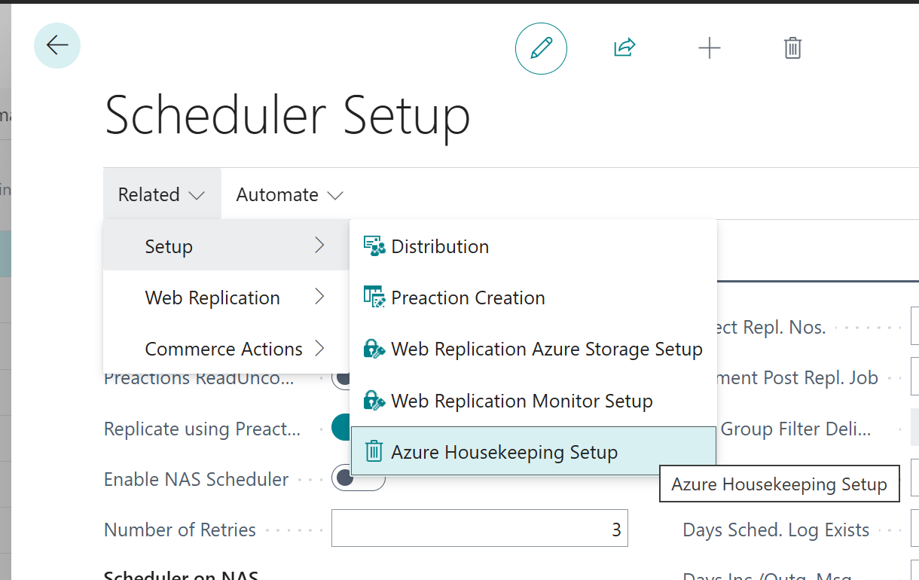
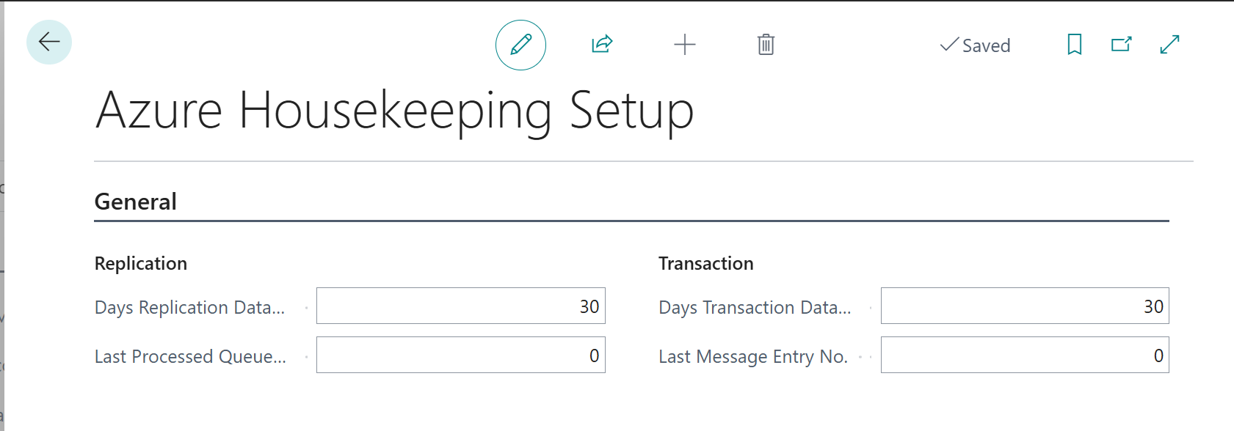
Azure housekeeping
Housekeeping setup

Slide 23
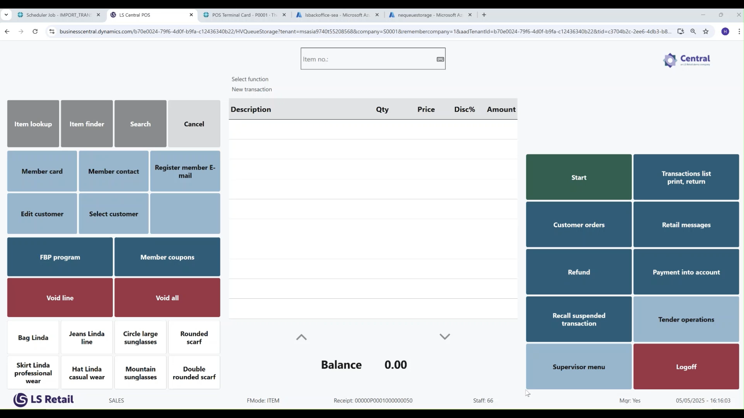

Slide 24



CentralConnect
Out-of-the-box integration
Connect LS Central to your existing ERP or head-office platform.
Full-retail solution
Manage items, prices, promotion in LS Central
POS-only mode
Keep master data in your ERP and use LS Central as POS solution
Azure environment
Data Management framework
Azure Function
End of day procedure
Daily retail operation
Sales order
Storage

