Slide 1
Customer stories
How LS Central supports self-service options for retail
Halldór Sigurjónsson
Lagerinn Iceland
Steinar J Kristjánsson Bonus
Asta Margret Karlsson
LS Retail

Slide 2
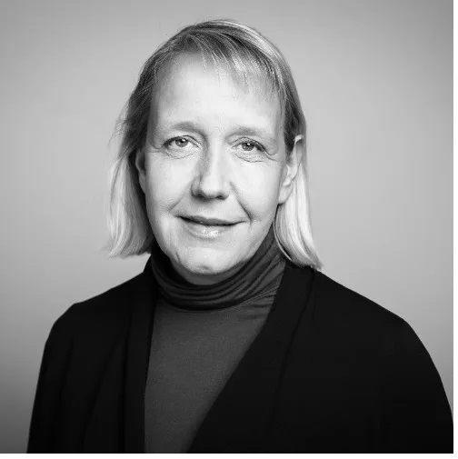
LS Retail
Asta Margret Karlsson
PMO Director

Slide 3
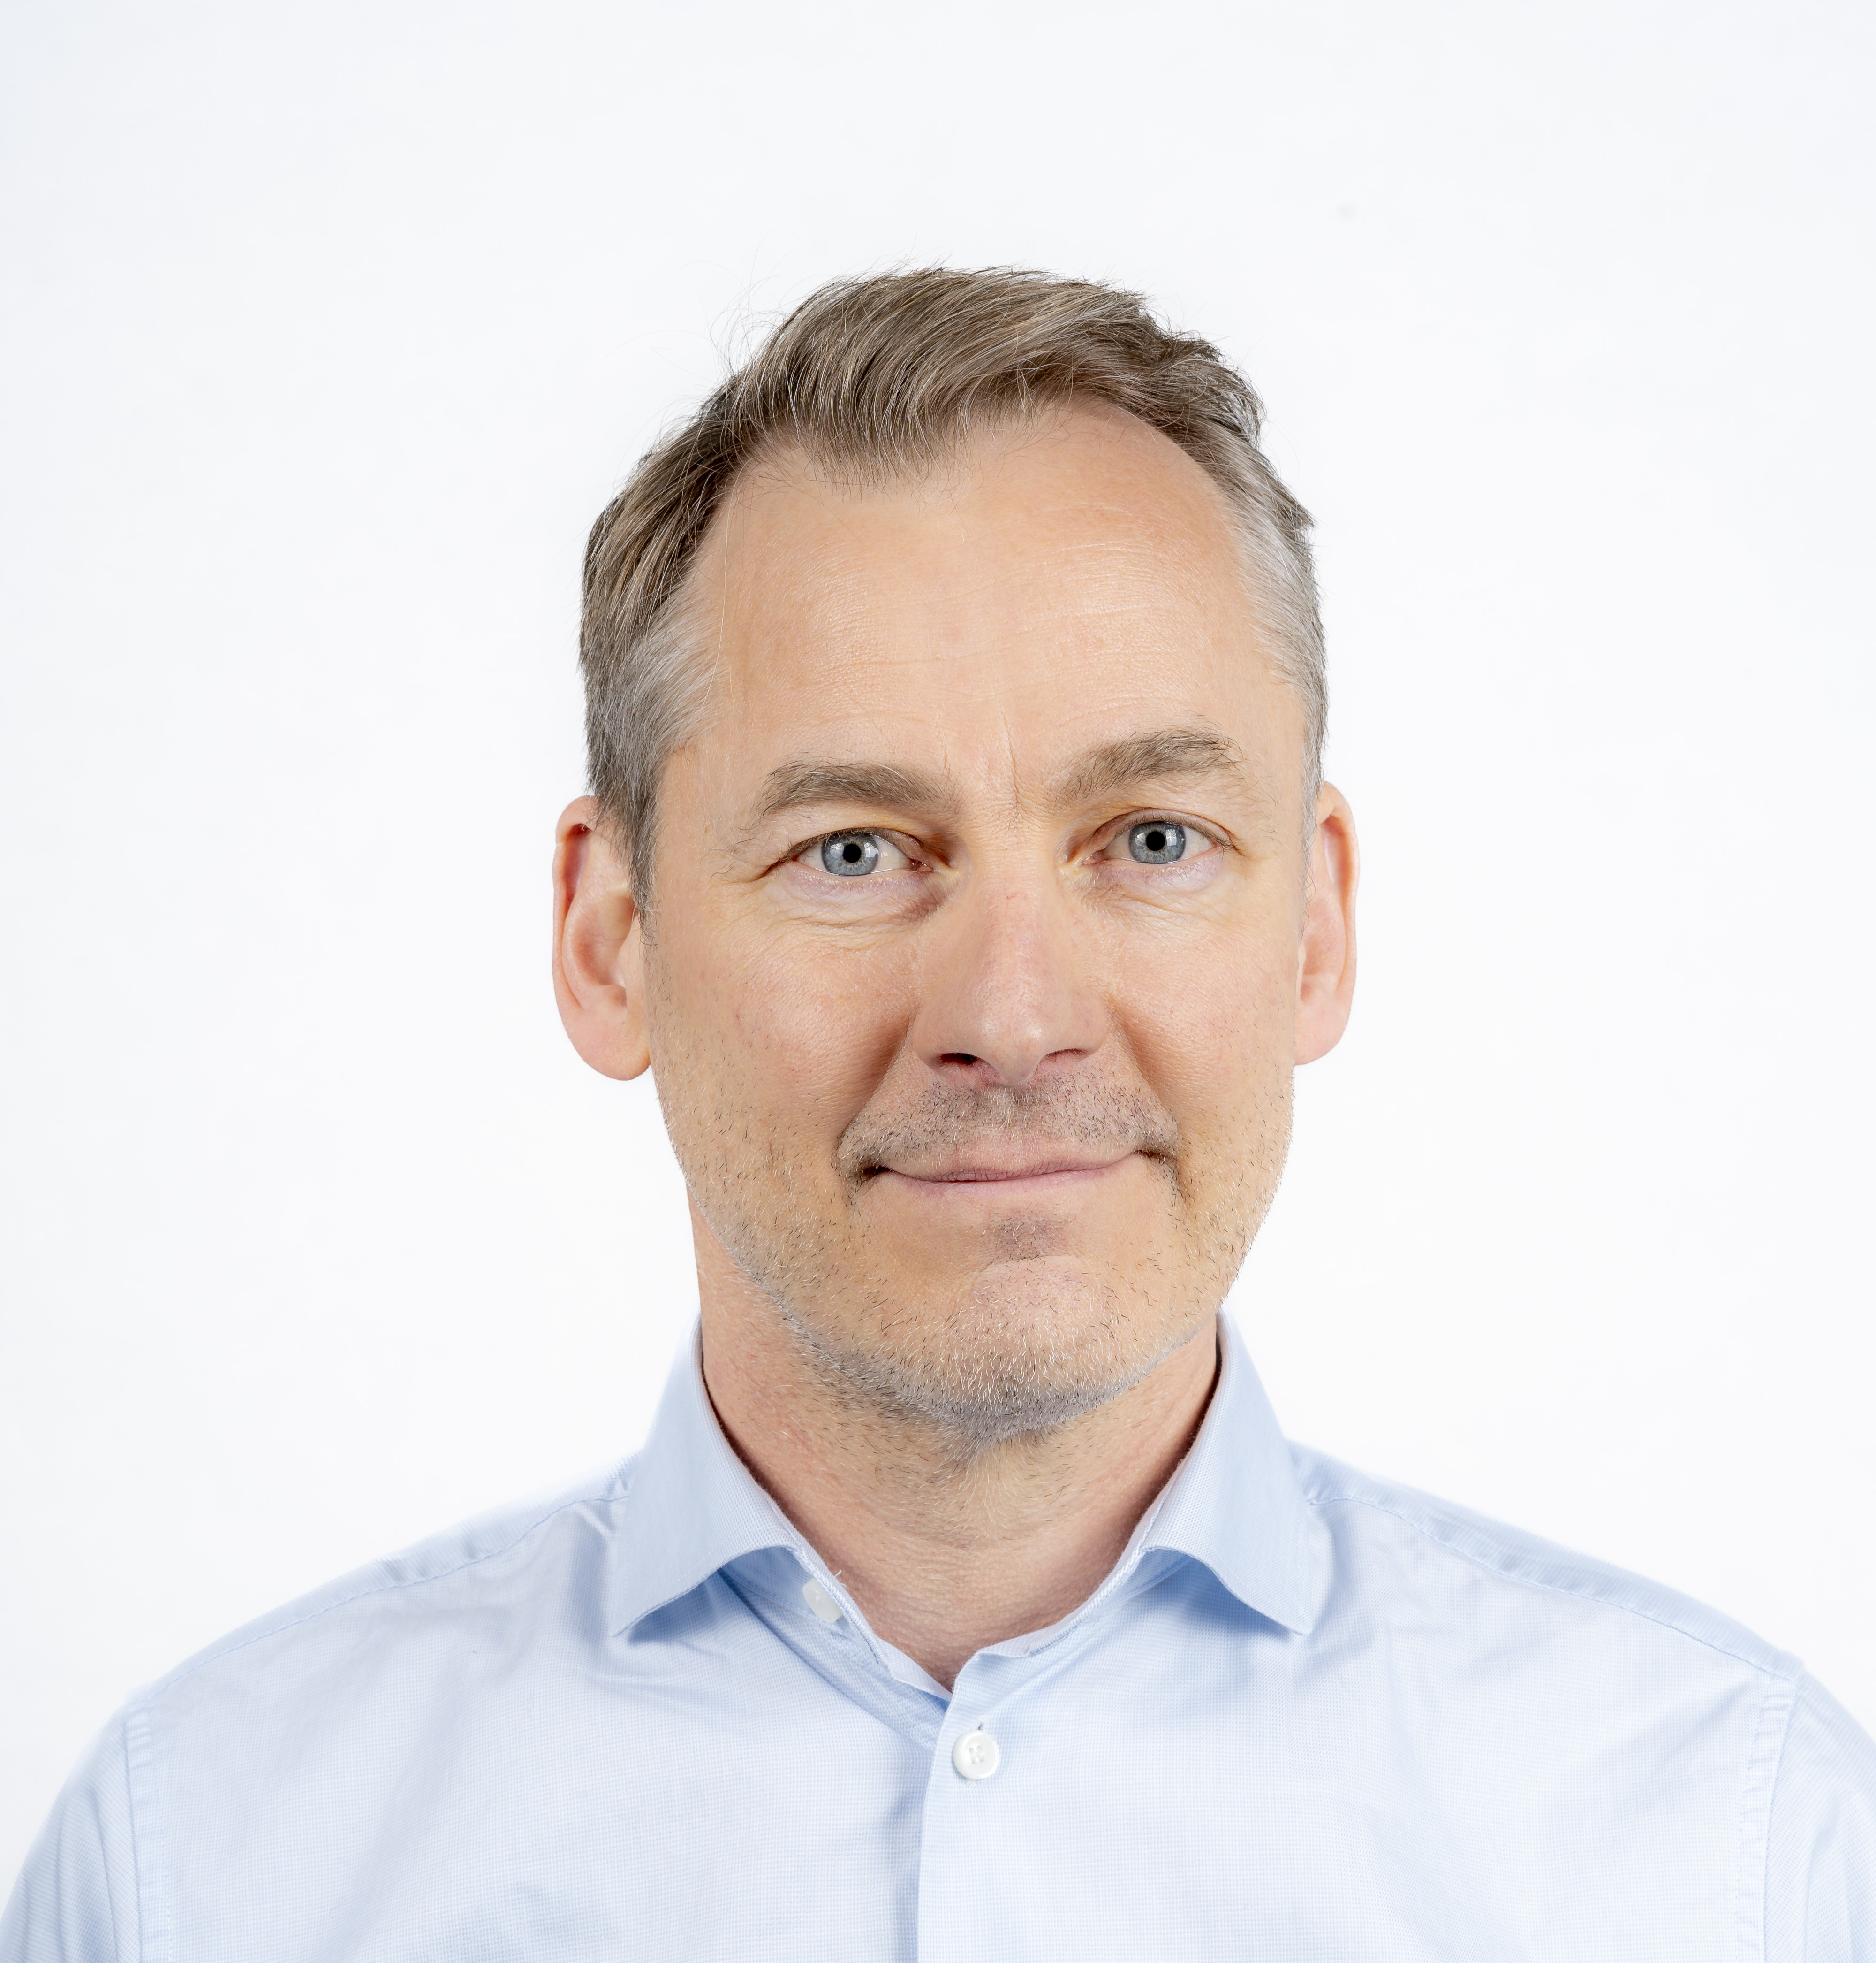
Lagerinn Iceland
Halldór Sigurjónsson
CFO

Slide 4


Personal - Background
CFO for Lagerinn Iceland since 2019
  Responsible for IT and Finance
Providing a fusion between IT and Finance
Lived in London UK between 2001-2012 working first in IT and later in Banking
Long involvement in start-ups
  Founder / CEO of a UK software company sold to a US buyer
  Board positions for several startups in different countries
  Active in KLAK Venture Mentoring Service
Started carrier as a programmer developing and selling software for retail

Slide 5
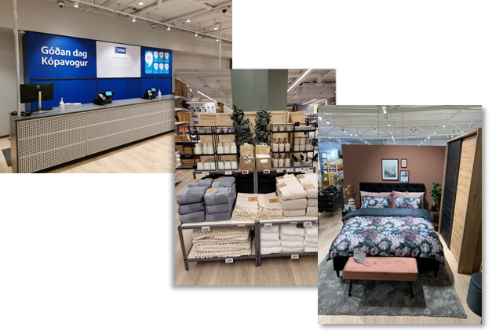
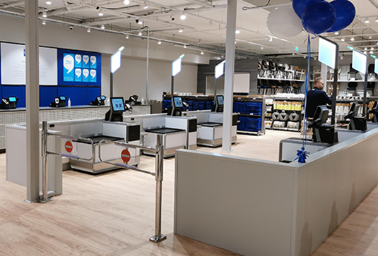
Franchise holder of JYSK and ILVA in Iceland
JYSK global is a 45-year-old Danish retail chain selling homeware with 3,300 stores in 48 countries with EUR 5.2 bn turnover
Franchise of JYSK has operated in Iceland for 38 years – rebranded from Rúmfatalagerinn to JYSK in October 2023
  ILVA franchise operated in Iceland since 2007
Lagerinn group is a JYSK franchise holder in Iceland, the Faroe Islands, Latvia, Estonia, Lithuania and Canada
  The Lagerinn group has a total turnover of around EUR 340m
Lagerinn Iceland has transformed all IT infrastructure and systems in recent years
Lagerinn Iceland manages 11 stores with around 130 POS devices
  Regular POS – online, furniture sales POS - online
  Self-service POS - offline
As part of rebranding in October 2023, Smáratorg, the worlds largest JYSK store by turnover, was rearranged to include self-checkout
  Based on the success, self-checkout is rolling out this month to three other stores
BC on-prem 20.4 since 1. March 2023 as a full ERP solution

Slide 6










JYSK and ILVA in Iceland – BC Partners and systems

Slide 7

Steinar J Kristjánsson
Upplýsingatæknistjóri - CIO

Slide 8
Steinar CIO of Bónus
Steinar J Kristjánsson
steinar@bonus.is
https://www.linkedin.com/in/steinarjk/
Steinar is the CIO of Bonus since 2003
Steinar has been in Retail IT since 1997
Steinar has led the self-service implementation for Bónus

Slide 9
Bónus
Bónus is a soft discount grocery store chain operating 33 stores round Iceland.
Bónus was founded in 1989 and celebrated it’s 35 anniversary in April this year.
  Bónus was the first store in Iceland to use barcode scanning
  Bónus aims to offer always the lowest price for
  grocery shopping.
  Bónus started using self checkout in June 2018
  Bónus started self scanning in May 2023 using Retail owned devices
  Bónus has been using LS-Retail and its predecessors from the beginning
  Bonus has about 350 Zebra PS20 Self Scanning devices in 5 stores
  Bonus has 363 checkouts in total

Slide 10
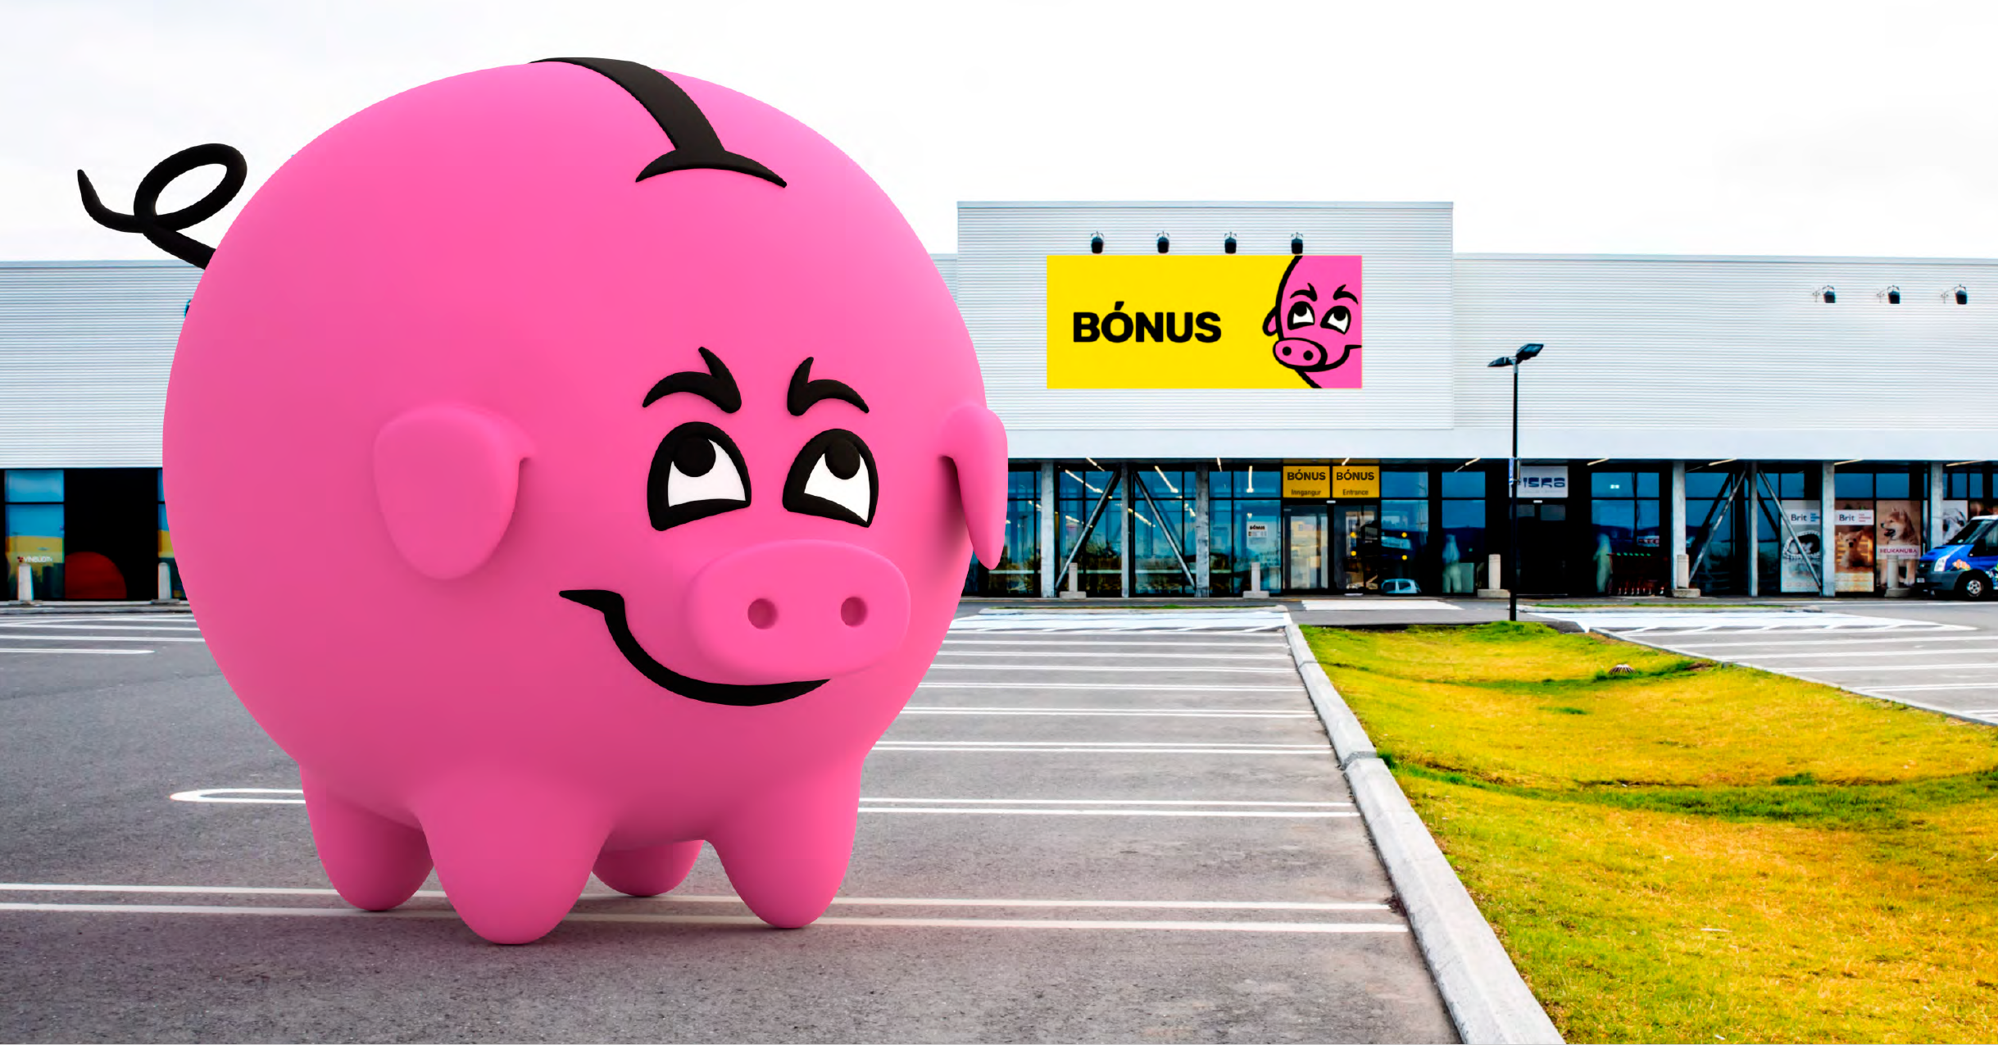

Sérstakar þakkir
Baldur Ólafsson
Otti Þór Kristmundsson
Steinar J Krisjánsson

