Slide 2
Run your fashion chain with LS Central
Johann Sveinsson Christina Cheng Martin Kleindl

Slide 3
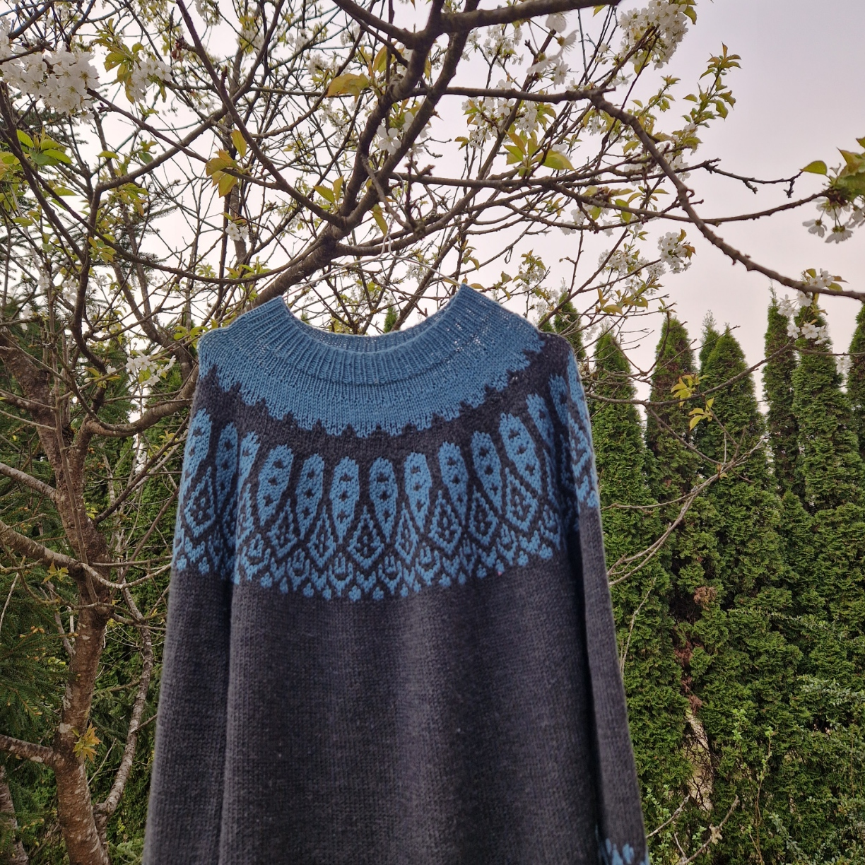

Slide 4
Lopapeysa (Icelandic: [ˈlɔːpaˌpʰeiːsa])

Slide 6
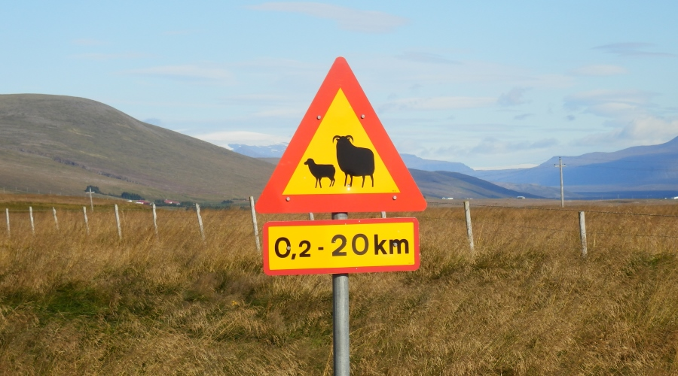

Slide 8
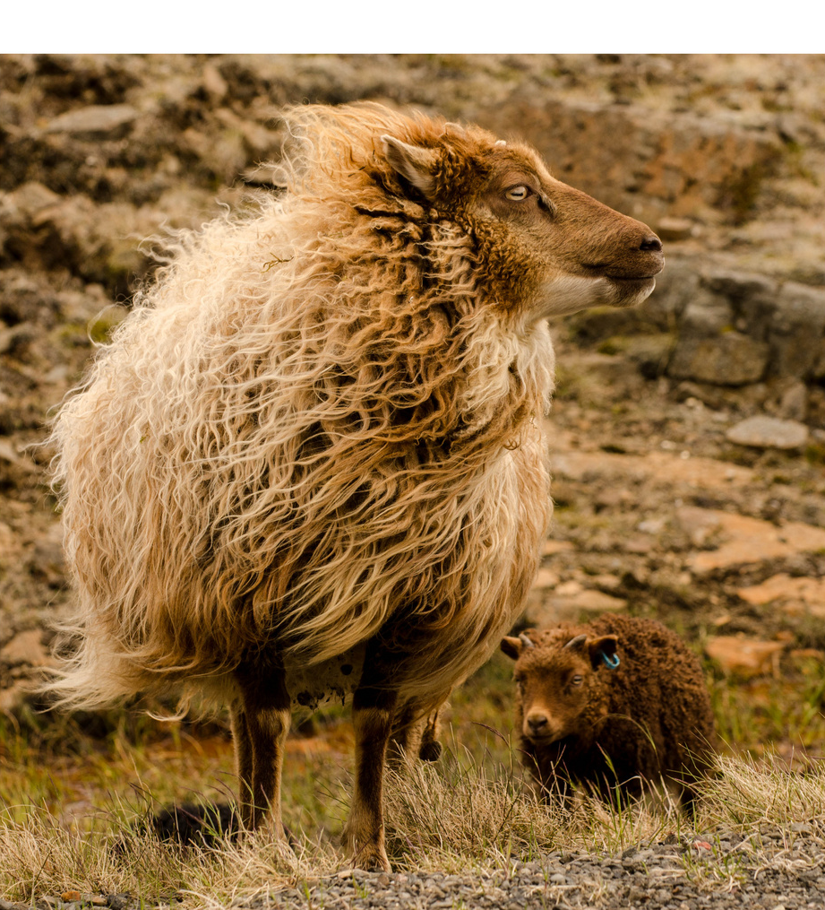

Slide 9
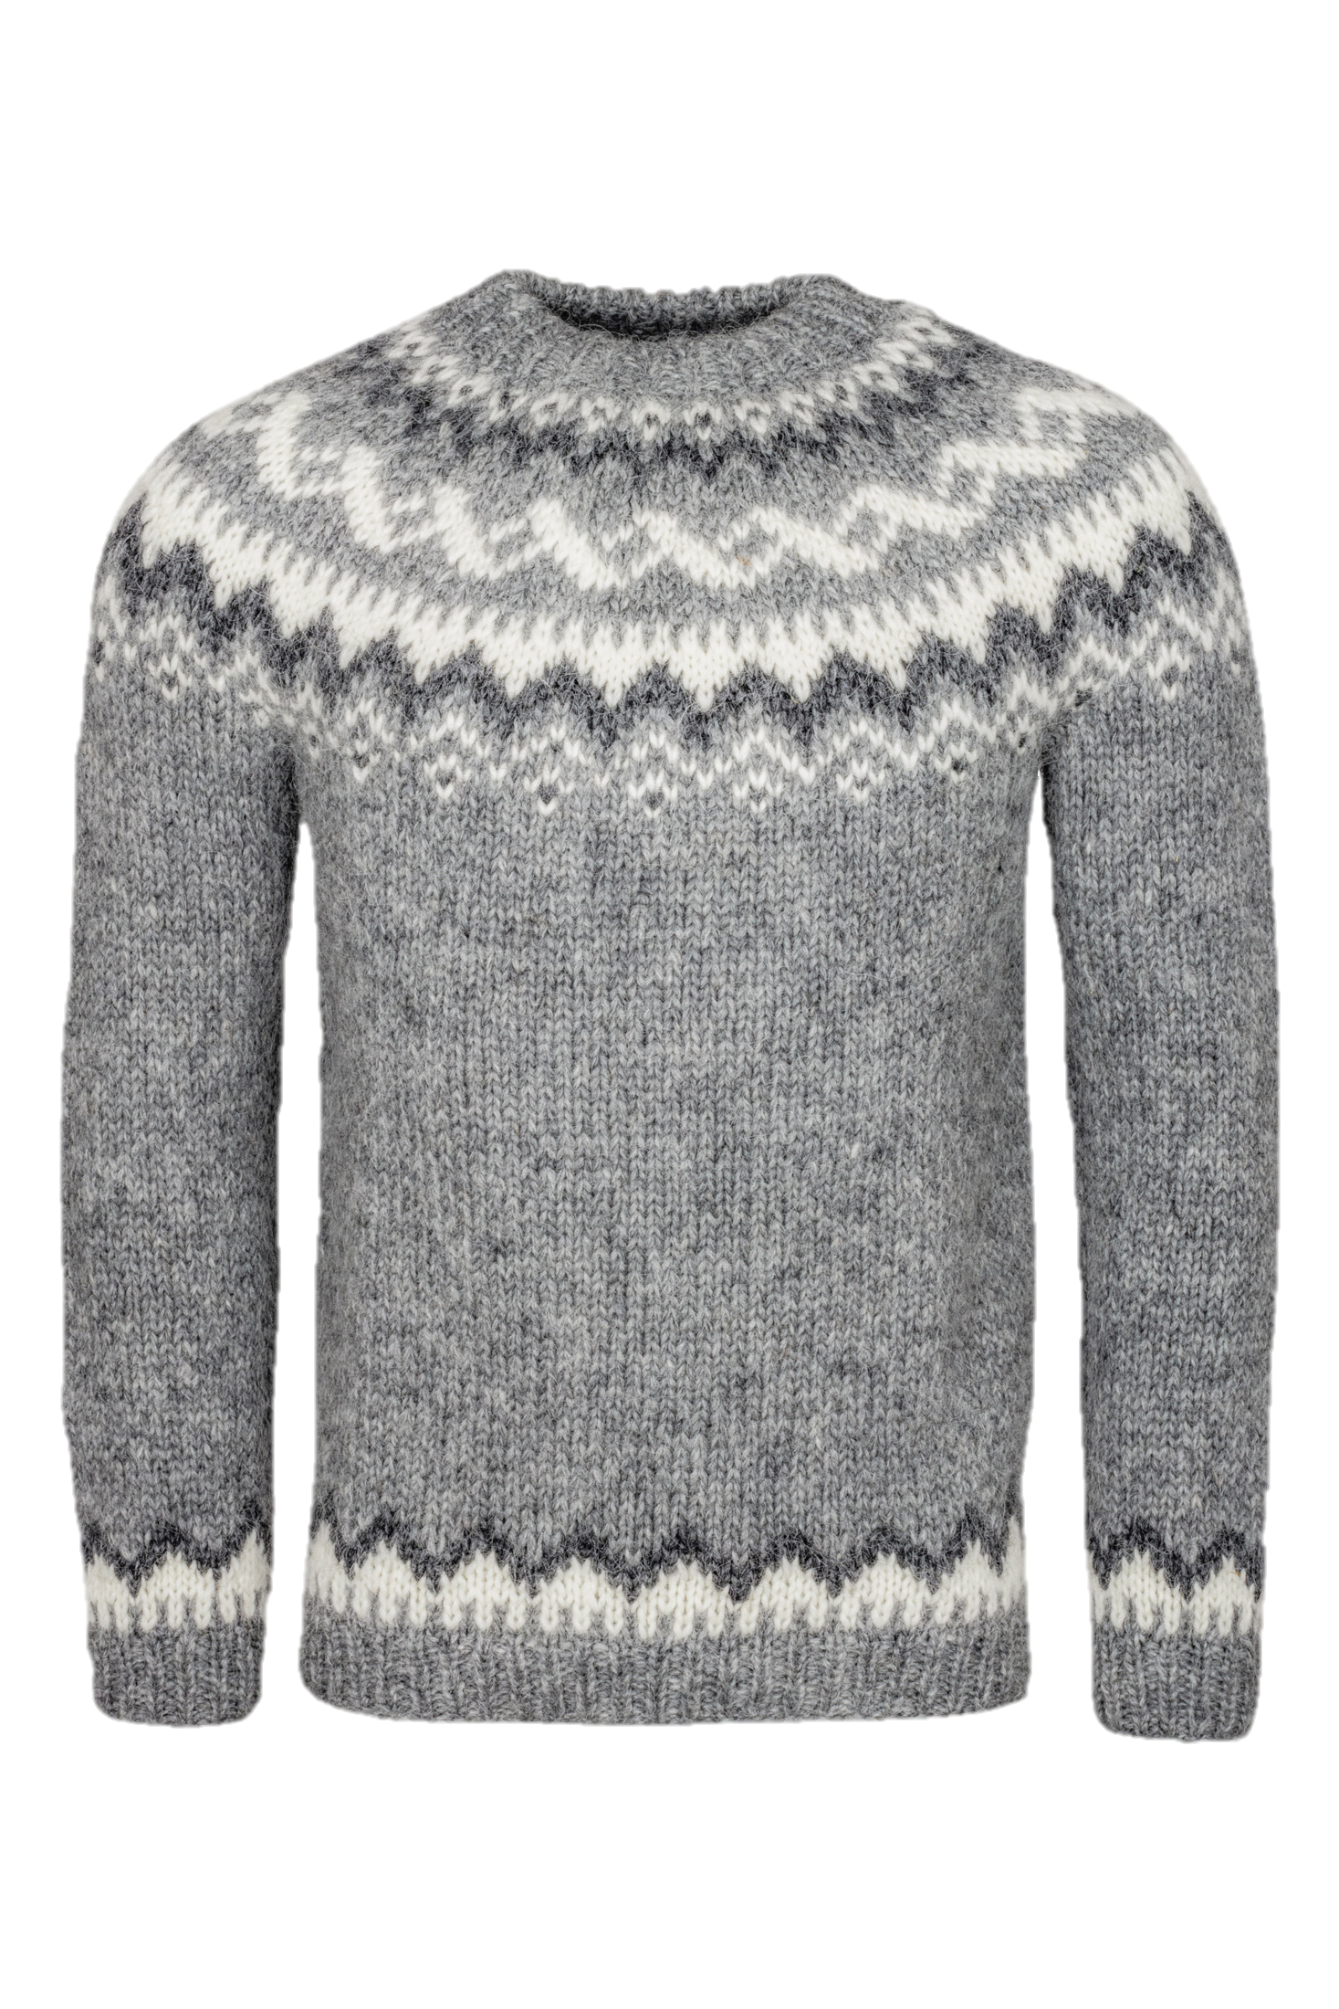
Items Colors, Sizes Prepacks Seasons
Planning, Budgets, Open-to-Buy
Assortmt. Mgmt.
Allocation Plans, Purchase Orders
Replenish ment
Store Stock Redistribu- tion
End-of-Season Sales
Stock Recalls
Sales

Slide 10
Items Colors, Sizes Prepacks Seasons
Planning, Budgets, Open-to-Buy
Assortmt. Mgmt.
Allocation Plans, Purchase Orders
Replenish ment
Store Stock Redistribu- tion
End-of-Season Sales
Stock Recalls
Sales

Slide 11
Season management
Goal Specify the season for seasonal items
Before LS Central v24
Just one single field on the Item Card
LS Central v24
Fields - Current Season Code - First Season Code (First Purchase)
Season Cockpit (easy to access all relevant information from one place)
Workflows - Assign items to seasons, carry over, - Special group copy functions
Analysis Views

Slide 12
Live Demo

Slide 13
Items Colors, Sizes Prepacks Seasons
Planning, Budgets, Open-to-Buy
Assortmt. Mgmt.
Allocation Plans, Purchase Orders
Replenish ment
Store Stock Redistribu- tion
End-of-Season Sales
Stock Recalls
Sales

Slide 14
Budgets
LS Central Sales Budgets and Purchase Budgets Integration to G/L Budgets
Company level and store level
Top-Down and Bottom-Up calculation
Calculation from sales history with factors
Excel integration (Import/Export)
Replenishment integration
Open to Buy reports
Analytics for LS Central New reports for Budgets
Budget Overview
Budget Overview (Items)
Budget Status

Slide 15
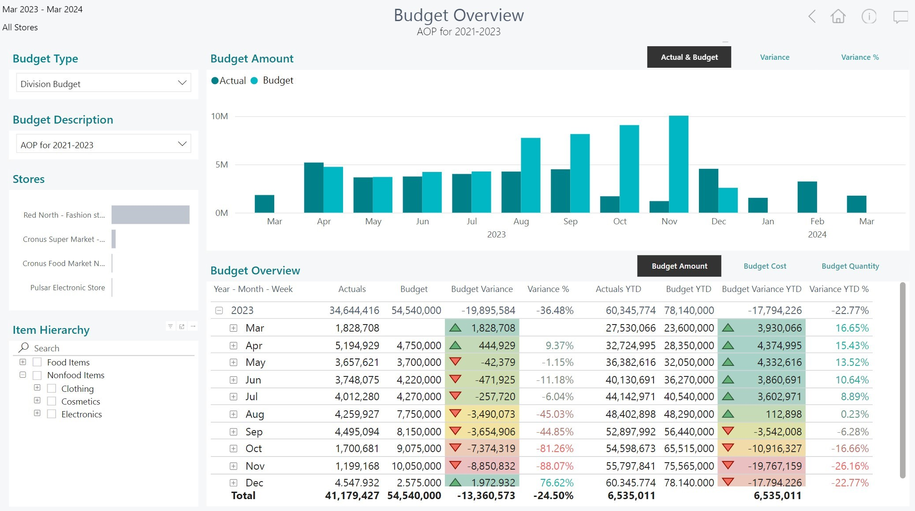
Budgets

Slide 16
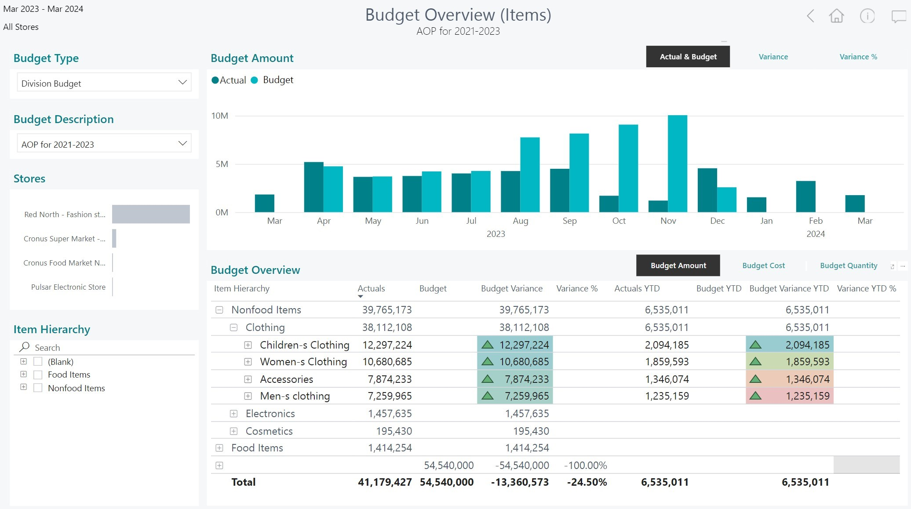
Budgets

Slide 17
Items Colors, Sizes Prepacks Seasons
Planning, Budgets, Open-to-Buy
Assortmt. Mgmt.
Allocation Plans, Purchase Orders
Replenish ment
Store Stock Redistribu- tion
End-of-Season Sales
Stock Recalls
Sales

Slide 18
Assortments
Approaches to define assortments
Grading
Hierarchies
Item Distribution
Mass data management
Replen. Control Data List
Improvements in LS Central v24
Item store record creation
Item distribution copy function

Slide 19
Live Demo

Slide 20
Items Colors, Sizes Prepacks Seasons
Planning, Budgets, Open-to-Buy
Assortmt. Mgmt.
Allocation Plans, Purchase Orders
Replenish ment
Store Stock Redistribu- tion
End-of-Season Sales
Stock Recalls
Sales

Slide 21
Out-of-stock management
Goal Calculate and visualize out-of-stock situations
Before LS Central v24 Just one single table and unstructured list page
LS Central v24 Out of stock overview page
Page with filter options to group by Date, Location, and Item Groups
Charts
Out-of-stock types - Started - Ongoing - Ended

Slide 22
Live Demo

Slide 23
Replenishment - Performance
Improvements for the out-of-stock process
Out of Stock Calculation
Replen. Item Quantity Calculation
Replen. Journal Calculation
Document Creation
Disabling items from calculation New field “Exclude from OOS Calc.”
Division, Item Category, Product Group, Item
New Replen. Setup field “OOS Calc. Scope”
Basic (all items)
Advanced (considers Item Distribution/Grading)

Slide 24
Items Colors, Sizes Prepacks Seasons
Planning, Budgets, Open-to-Buy
Assortmt. Mgmt.
Allocation Plans, Purchase Orders
Replenish ment
Store Stock Redistribu- tion
End-of-Season Sales
Stock Recalls
Sales

Slide 25
More improvements
Stock recalls Consideration of Item Distribution
Replen. Journals Advanced filtering for Item Attributes
Roadmap
Price management with Variant Matrix
Advanced Prepack handling

Slide 26
Run your fashion chain with LS Central Experiences from the field
Johann Sveinsson

Slide 27
Issues from fashion projects
Issues and challenges from the field:
Inventory processes in the store
Inventory lookup from another store (performance improvements)
Replication of item pictures
Personal tailored items
Rentals or borrowing clothes

Slide 28
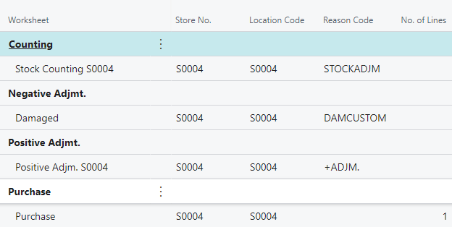
Inventory processes in the store
Challenge
Often there is only one POS terminal in the store
Need for inventory processes
Solution / Approach
Store inventory worksheets
POS Command to open worksheets
The POS needs to have a mouse and keyboard for this functionality

Slide 29
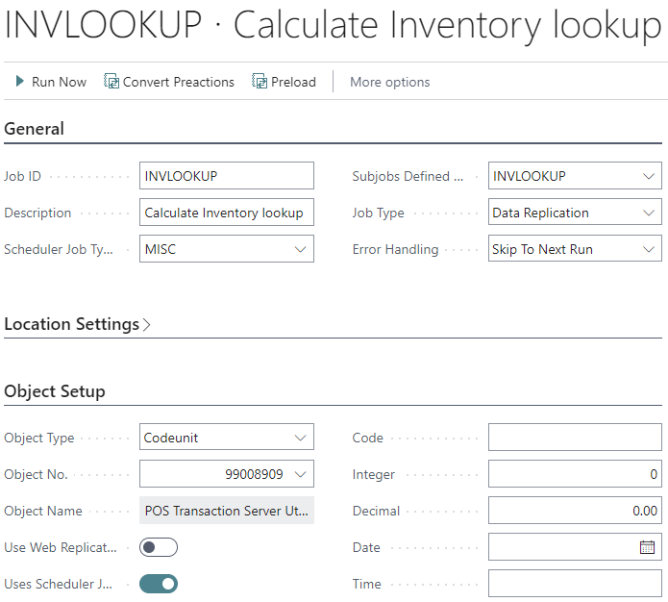
Inventory lookup from another store
Challenge
The calculation of inventory for all stores and all items and variants can take some time.
Scheduler Job INVLOOKUP is executing codeunit 99008909 “POS Transaction Server Utility” where inventory is calculated. This process can be optimized.
Solution
Calculate inventory only for items that have any movements (transactions and item ledgers).

Slide 30
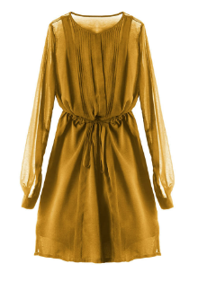
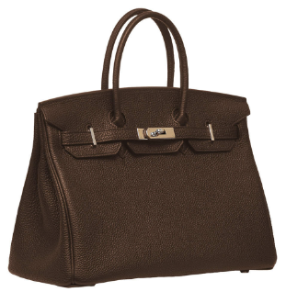
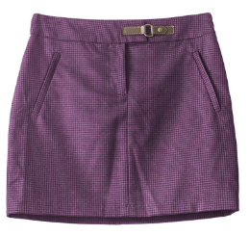
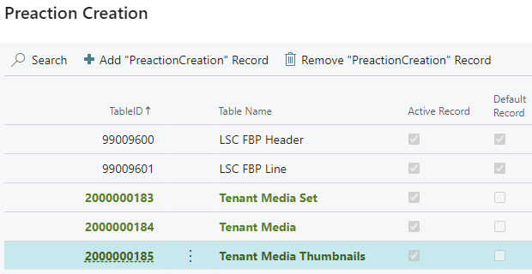
Replication of pictures from Head Office to POS
Challenge
Replication of pictures from Head Office to POS can take a long time. (especially if there are many pictures in use)
Older versions only supported “Normal” replication
Solution
Create actions on the Media tables and replicate by actions
Replicate by actions means that the packages are much smaller

Slide 31
Personal tailored items
Challenge
Handling personal tailored items
Solution
Use SUSPEND to create Sales Orders for backoffice
Add extra cost for the tailoring
Recall the Sales Order into the POS
Deliver to the customer and take the payment
Note
There is not a possibility in this approach to take a prepayment from the customer
Use Income/Expenses instead

Slide 32
Rentals or borrowing clothes
Challenge
Handling borrowing/rentals for items
Solution (with Customer Orders)
Register items and customer information
Take payment deposit
Assign rental item to customer order
Scenario A – Purchase
Complete transation
Take the rest of the payment
Scenario B – No Purchase
Refund the deposit

Slide 33
Items Colors, Sizes Prepacks Seasons
Planning, Budgets, Open-to-Buy
Assortmt. Mgmt.
Allocation Plans, Purchase Orders
Replenish ment
Store Stock Redistribu- tion
End-of-Season Sales
Stock Recalls
Sales

Slide 34
Your Questions please! (or feedback ☺)

Slide 36
Thank you

