Slide 2
Cloud queue and storage services
Damir Babikov
Hilmar Vilhjalmsson

Slide 3
Why queue and storage services
Agenda
LS Central queue and storage services

Slide 4

Why queue and storage services
To overcome
  Complexity
  Operational limit
  Lack of performance
  Security concerns
  Connectivity
Cloud services offer
  Scalability & georedundancy
  Security
  Performance
  Lower cost

Slide 5

Queue services
Asynchronous
Scalable
Durable
Increased reliability
Write once, read many, ordering
Security
Cost

Slide 6

Storage service
Scalable
Accessibility
Redundancy
Security
Cost

Slide 7

Telemetry
Metric
  Numeric, periodic, high level
Log
  Detailed, verbose, context, various levels
Trace
  Detailed, lifecycle, end-to-end, diagnostics

Slide 8
What services are out there
Queue services
Azure Service Bus, Event Grid, Event Hub
AWS MQ, SQS, SNS
GCP Pub / Sub
Others: Apache Kafka, Mulesoft, Confluent
Storage services
Azure storage
AWS S3
GCP cloud storage
Others: IBM, Oracle, DigitalOcean, Alibaba

Slide 9
Master Data to Azure storage
Head Office
  Writes data to storage

Slide 10
Master Data to Azure storage
Head Office
  Writes data to storage
POS
  Is there data to import?
  Import data from storage
  Notify Head Office

Slide 11
LS Central storage and queue integration module
Proven technology
Makes integrations easier

Slide 12
LS Central storage and queue integration module
Proven technology
Makes integrations easier
Extendable

Slide 13
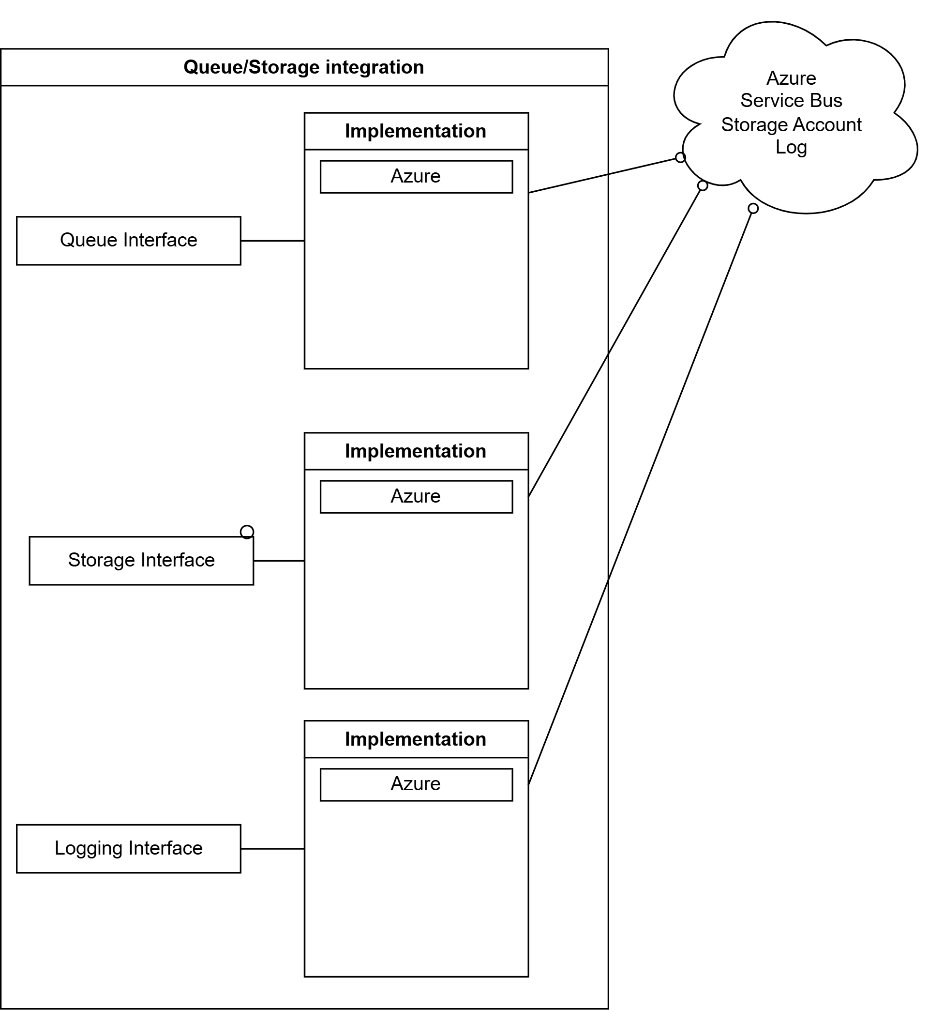
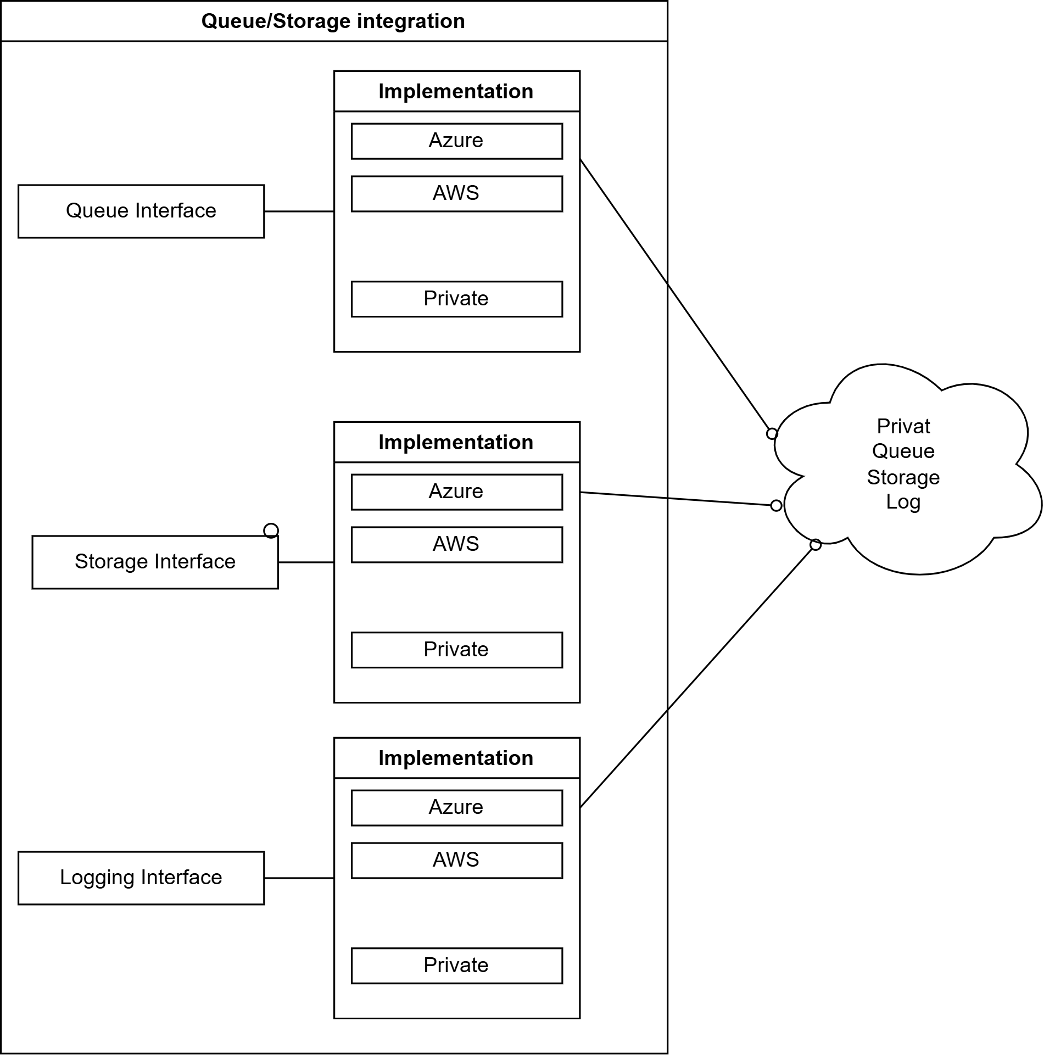
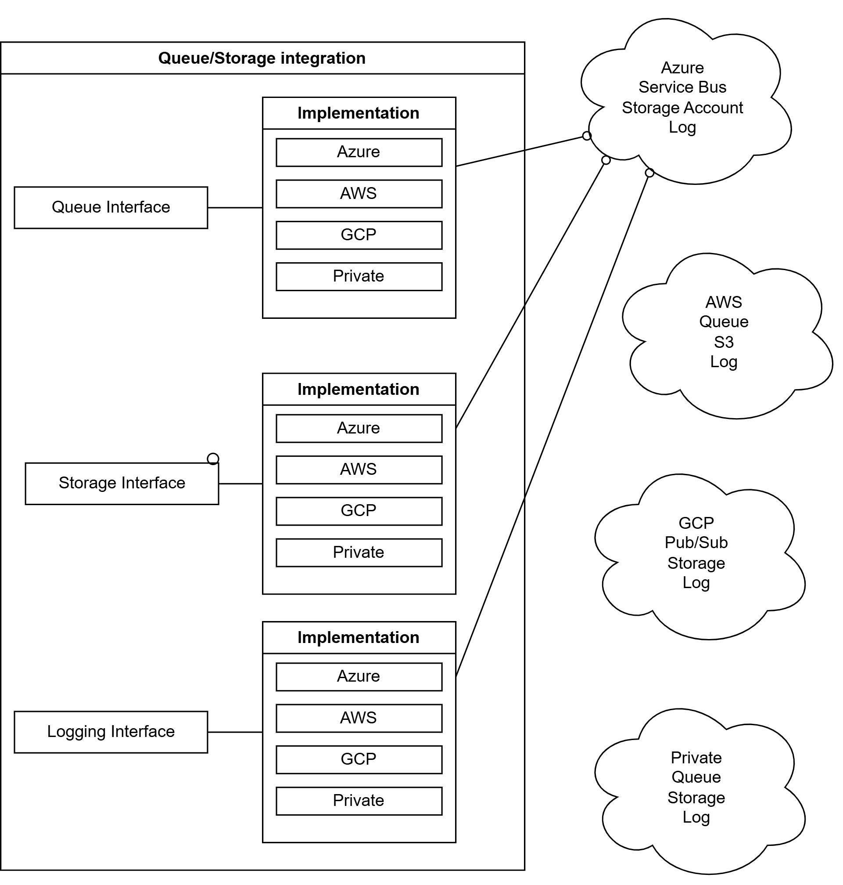
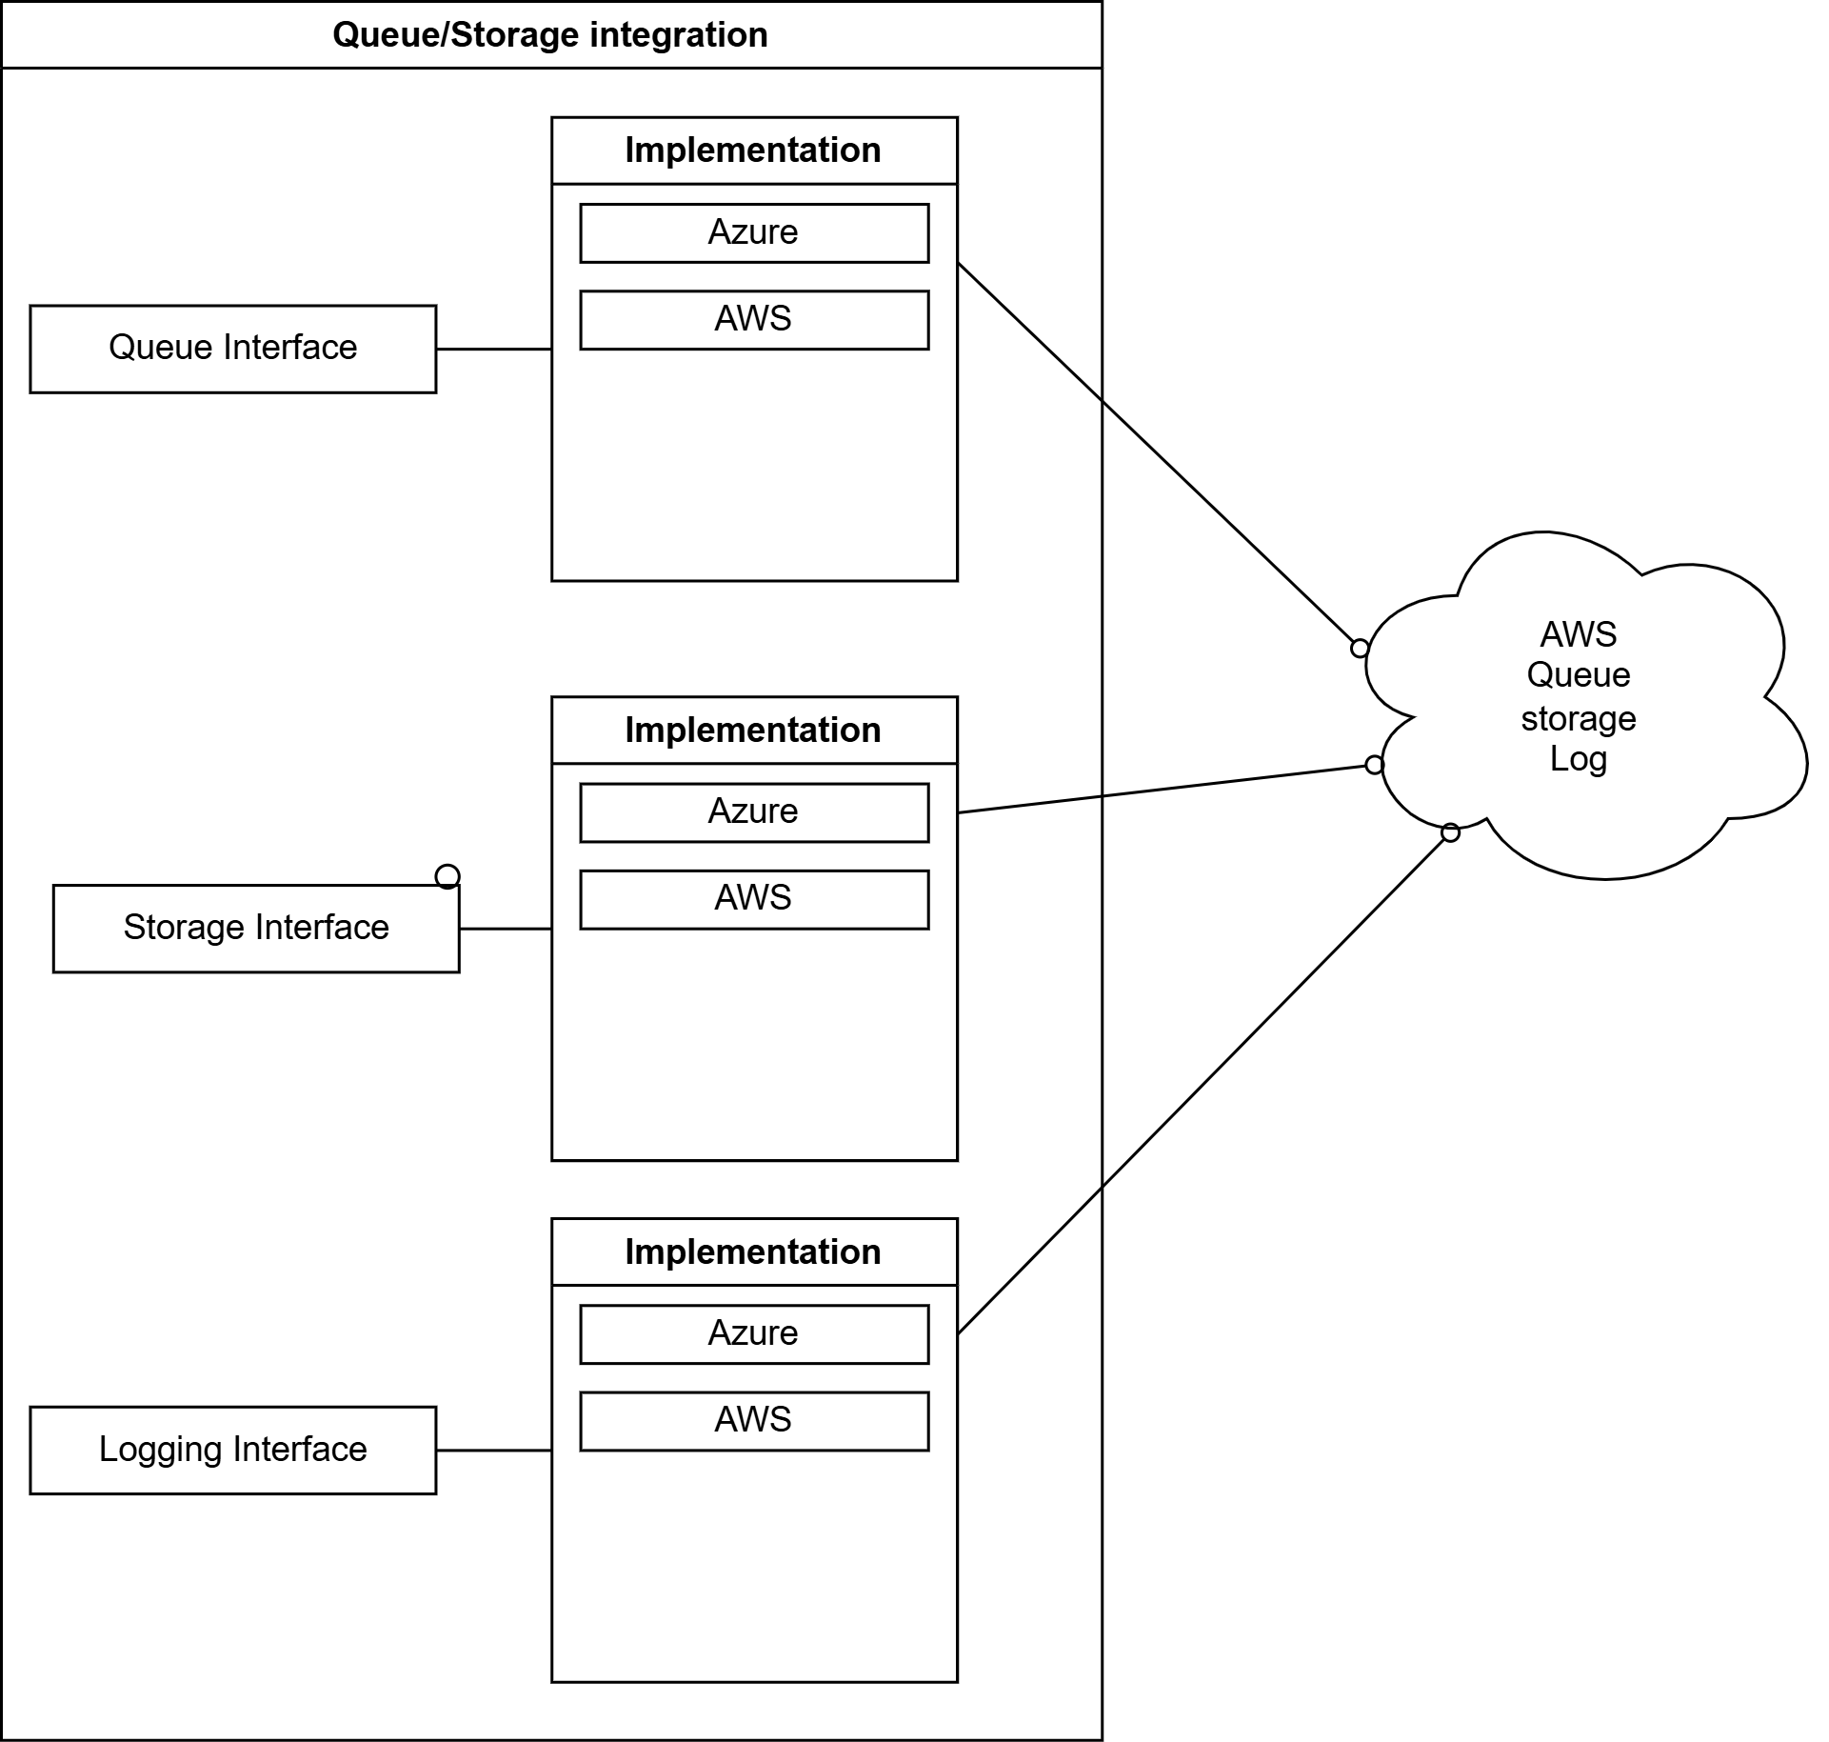
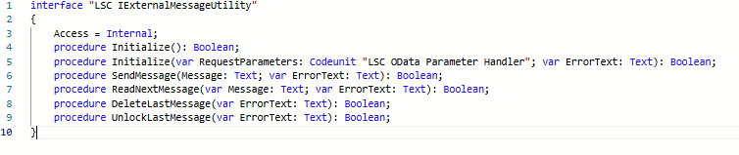

Slide 14
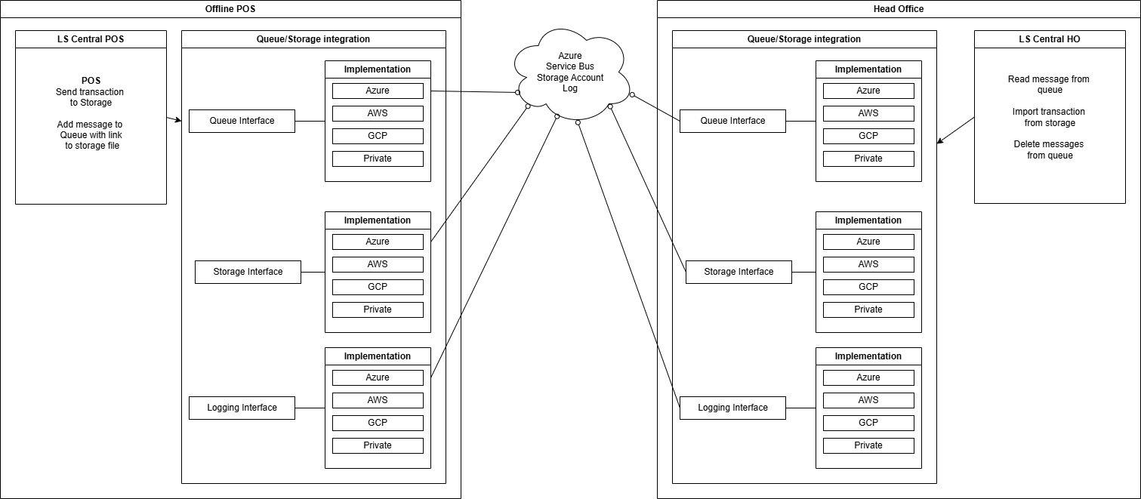

Slide 15
Sending transactions
POS
  Write transaction to storage
  Add message to queue
Head Office
  Read messages from queue
  Import transaction from storage
  Process message

Slide 16
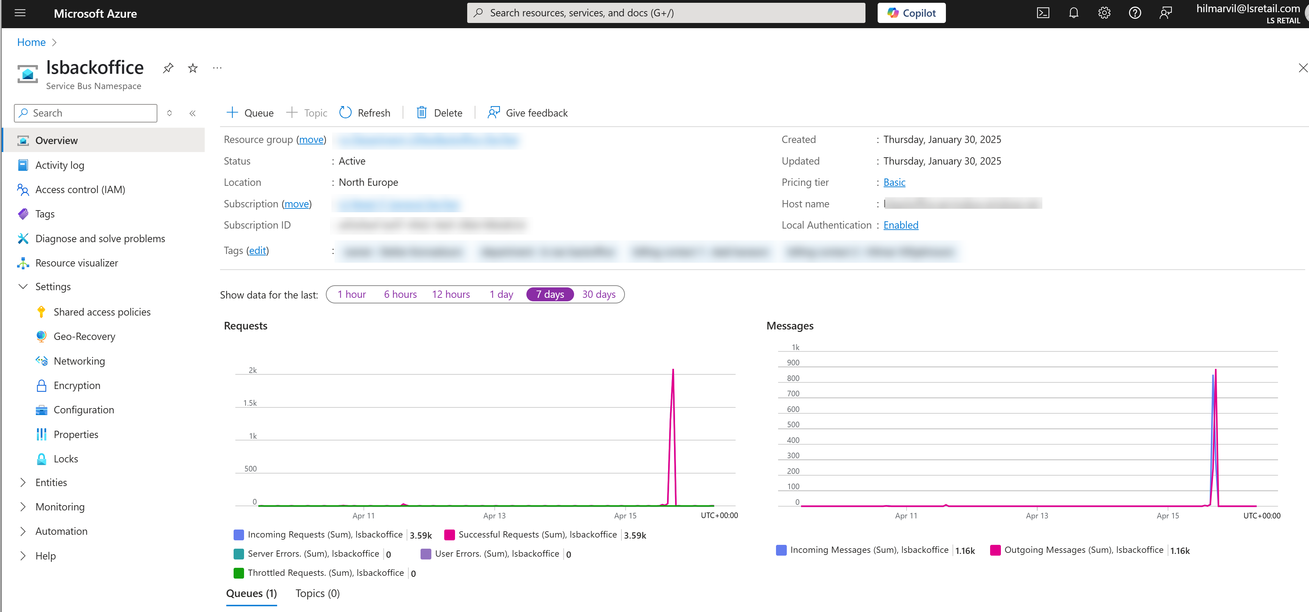
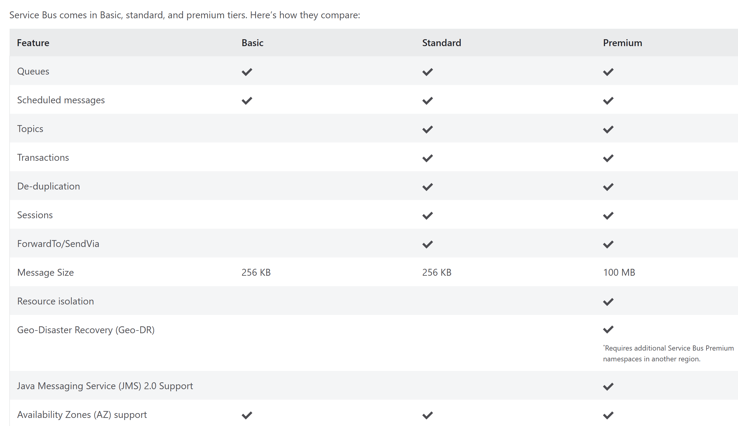
Sending Transaction – Azure setup
Create Service Bus subscription

Slide 17
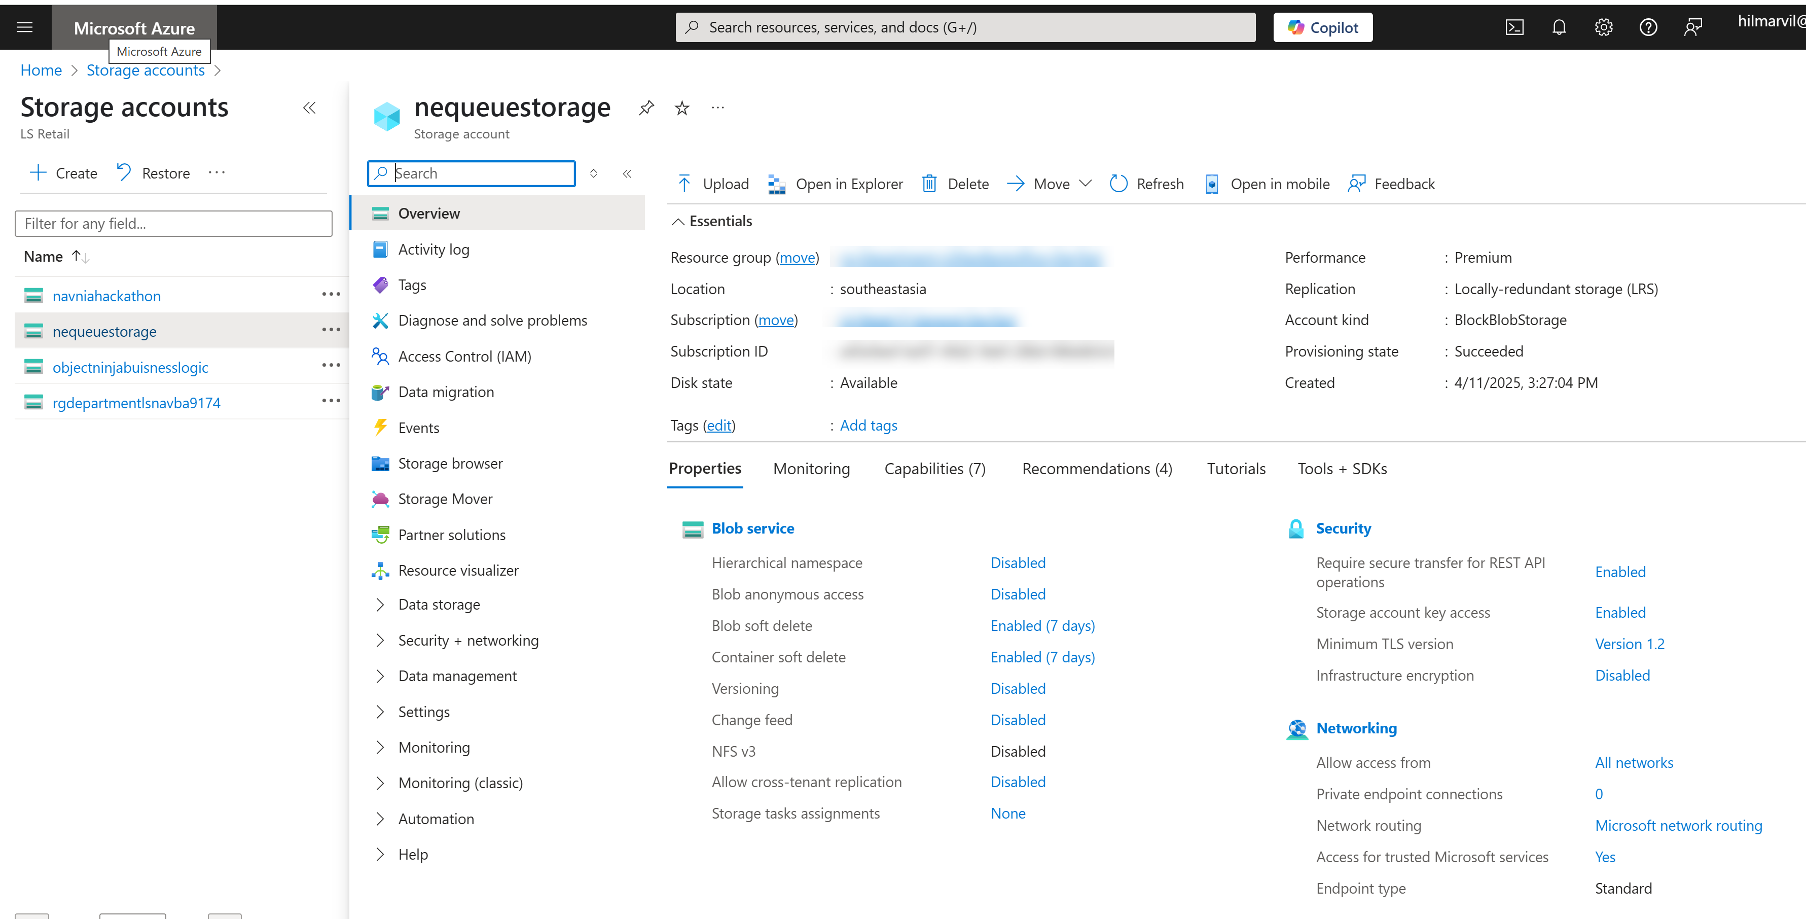
Sending Transaction – Azure setup
Create Storage Account subscription

Slide 18
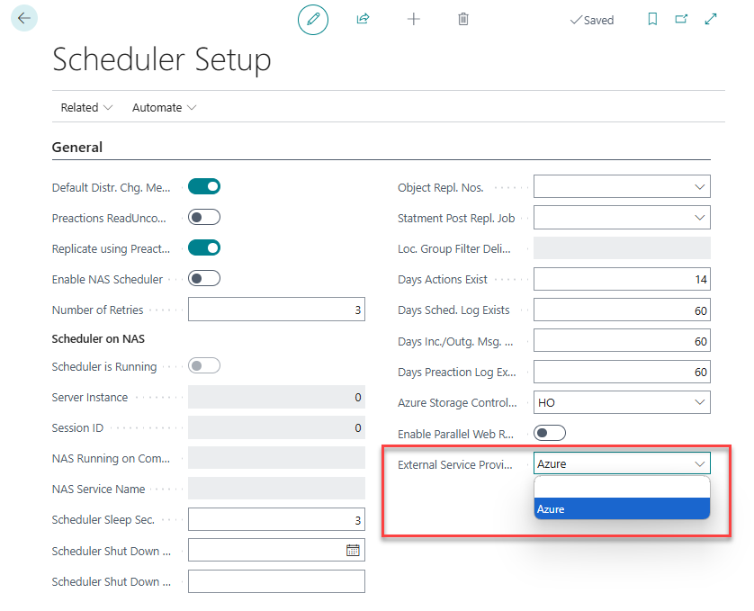
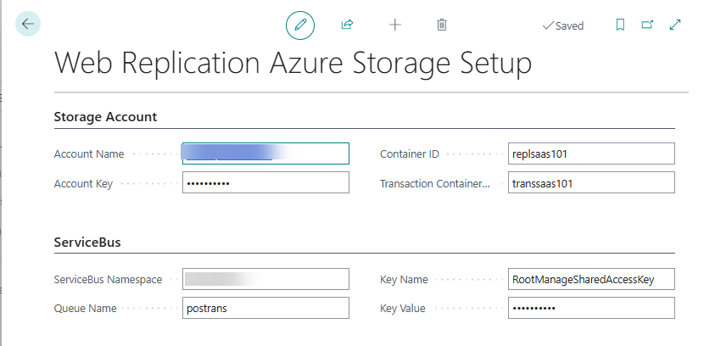
Sending Transaction – Head Office setup
Azure Accounts
Scheduler setup

Slide 19
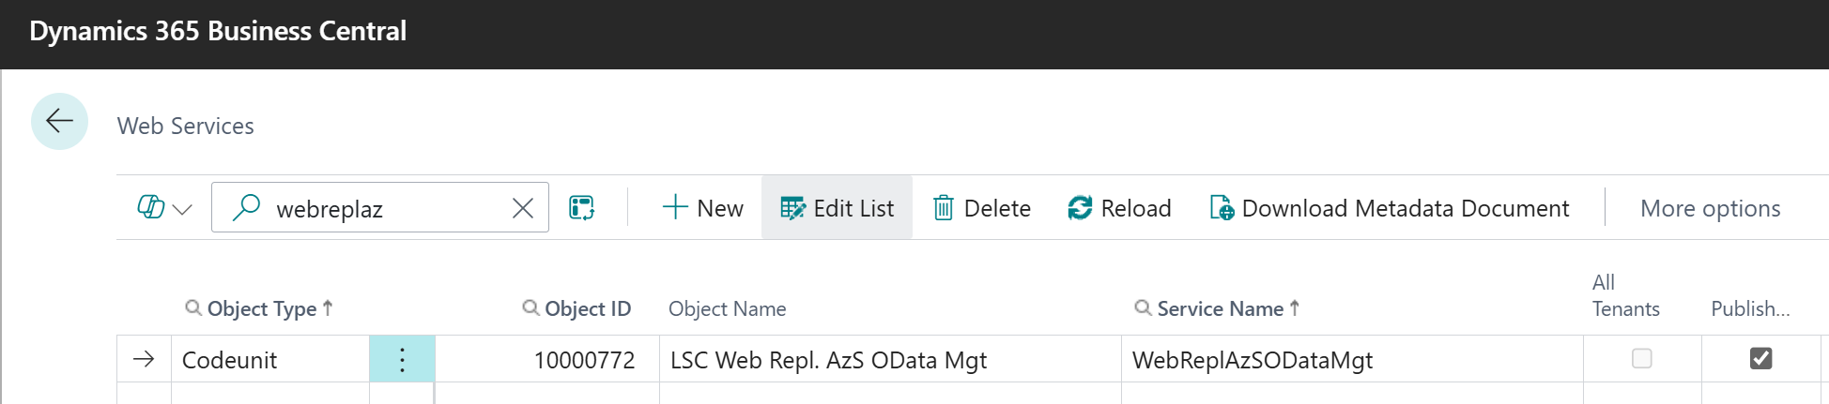
Sending Transaction – Head Office setup
Azure Accounts
Scheduler setup
Webservice

Slide 20
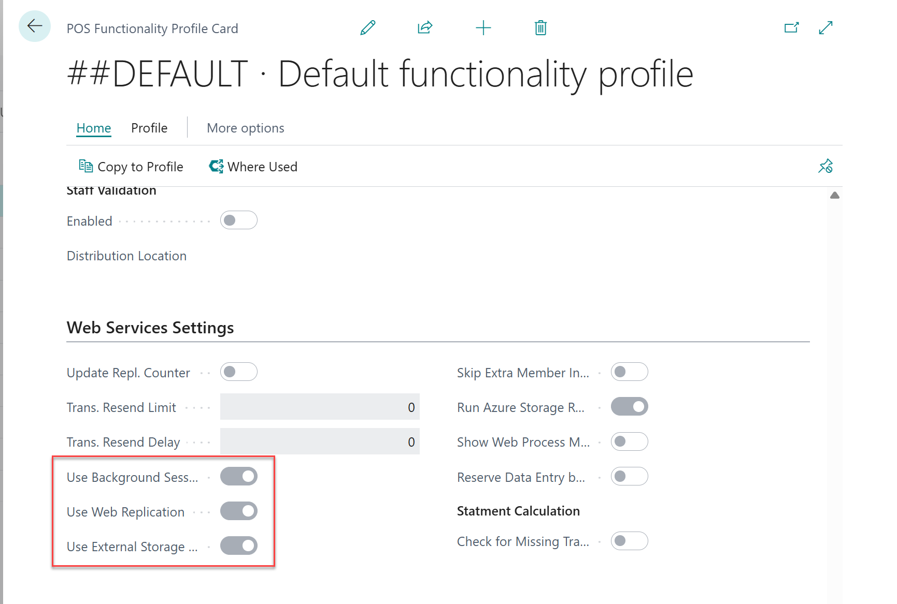
Sending Transaction – POS setup
Functionality Profile

Slide 21
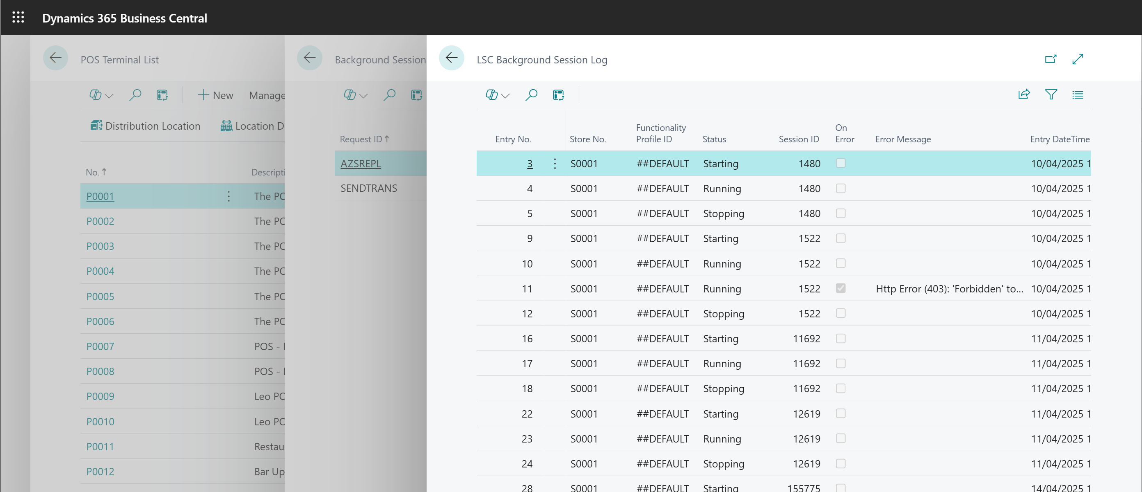
Sending Transaction – POS log
POS Terminal log

Slide 22
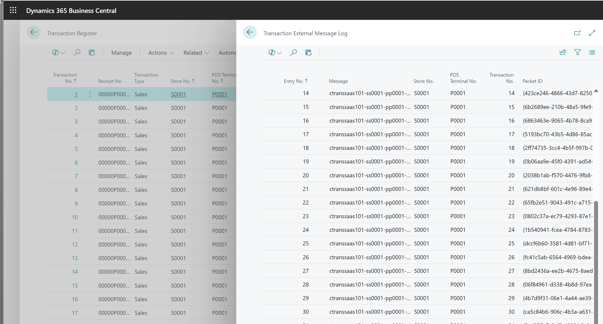
Sending Transaction – Head Office log
Processing transactions

Slide 23
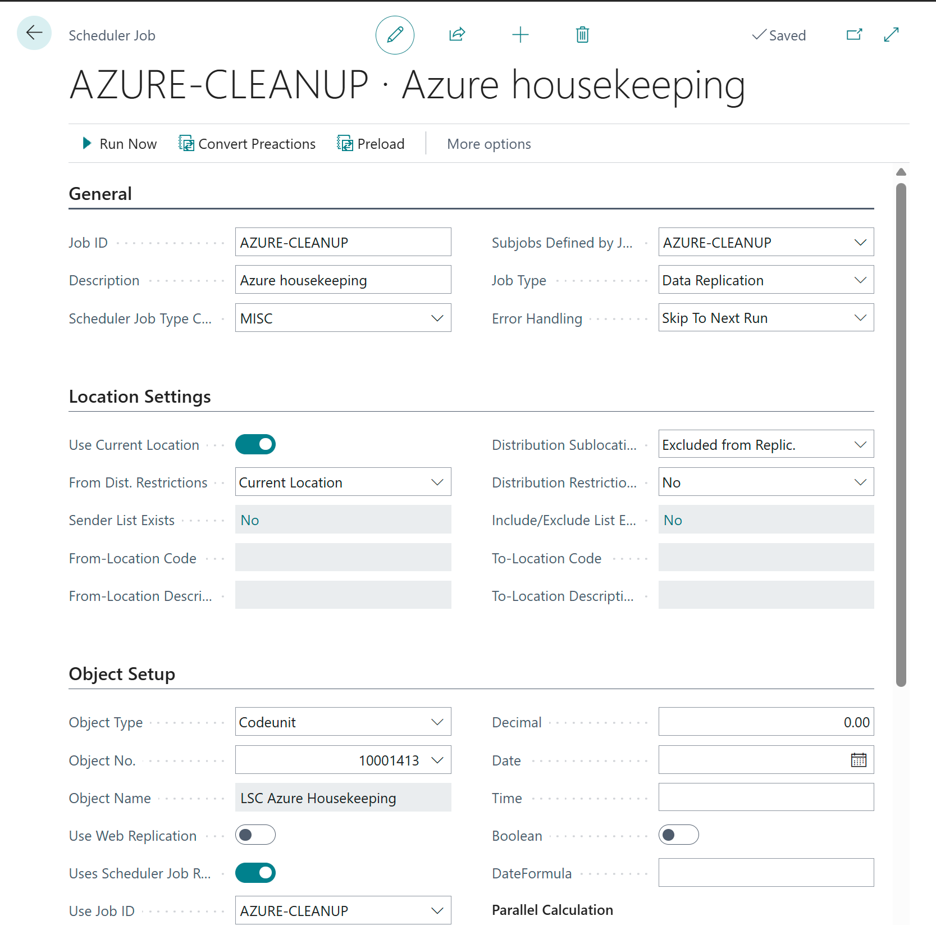
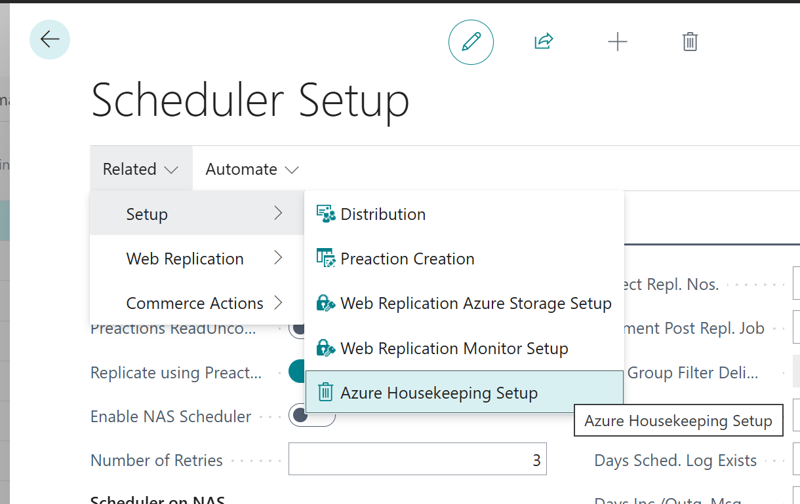
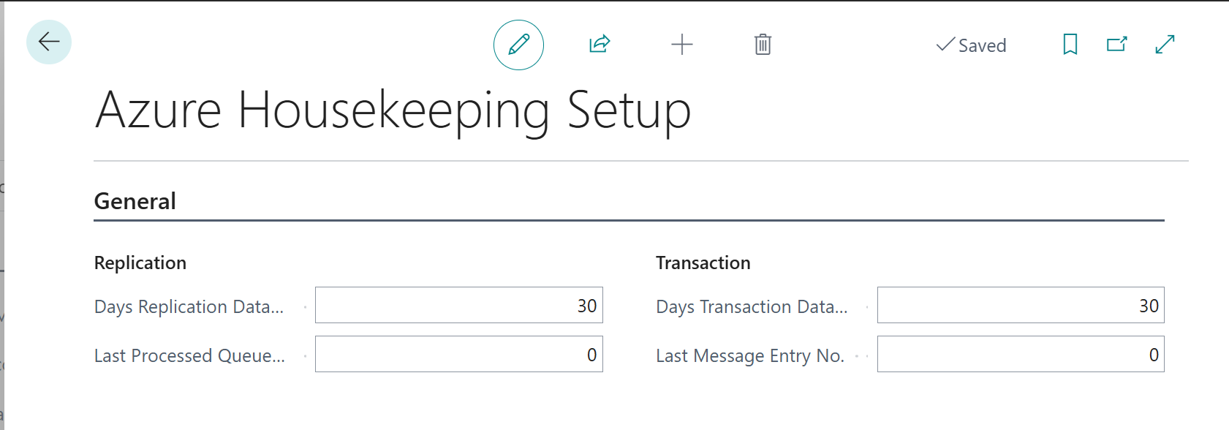
Azure housekeeping
Housekeeping setup

Slide 24
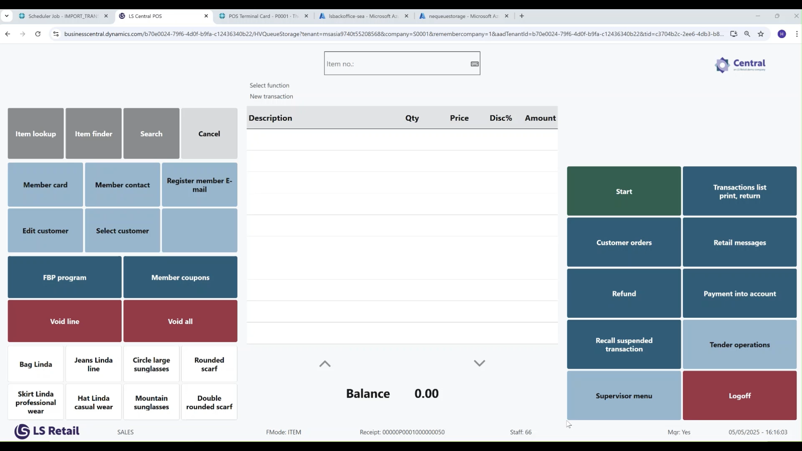

Slide 25



CentralConnect
Out-of-the-box integration
  Connect LS Central to your existing ERP or head-office platform.
Full-retail solution
  Manage items, prices, promotion in LS Central
POS-only mode
  Keep master data in your ERP and use LS Central as POS solution
Azure environment
Data Management framework
Azure Function
End of day procedure
Daily retail operation
Sales order
Storage

