Slide 1


Slide 2
Bookings for retailers
Enhance your retail business with value-added services using Bookings for LS Central
Gígja Eyjólfsdóttir
Daniel Ong

Slide 3
Why Appointment Shopping?
Introduction to Bookings for LS Central
Benefits of using the module
Our journey today…
Customer success stories
New Features and Road Map
OHBT initiative
Q&A

Slide 4
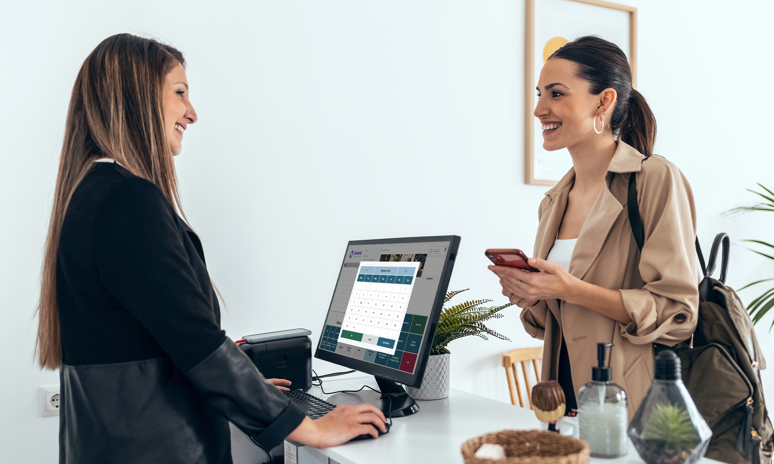

Generate graphic(s) for appointment shopping

Slide 5
Why appointment shopping?
Consumers determine when and how they desire to interact/engage with brands.
It offers an exclusive and unique shopping experience with high-touch services.
It creates a more comfortable shopping environments without unwanted disturbance.
IT CAN BE VERY IMPACTFUL.

Slide 6




According to studies/reports…
About 50% of consumers find the option to schedule/book a time for in-store shopping largely relevant (Shopify, 2022).
64.8% of millennial respondents made in-person appointments on average one to two times annually prior to the pandemic (Shopify, 2022).
68% of customers prefer businesses that offer online appointment booking (Verified Market Research, 2024).

Slide 7
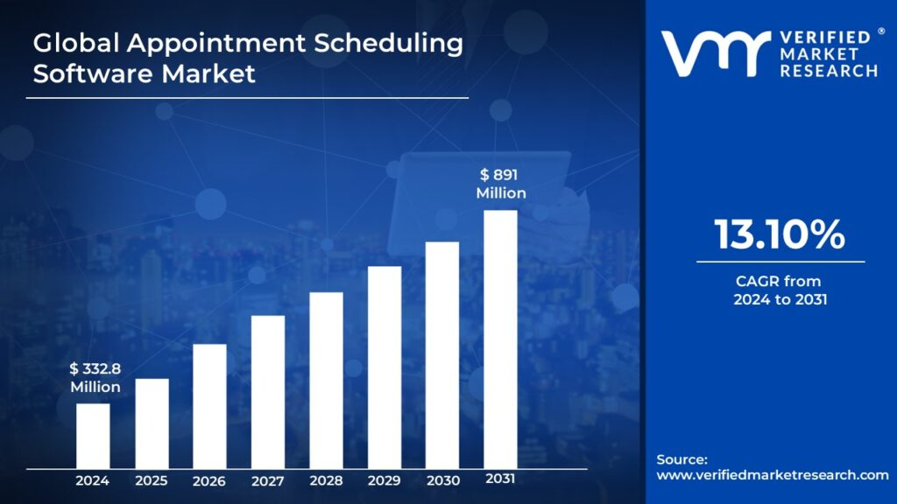

Slide 8










LS Central extends
Microsoft Dynamics 365 Business Central
Modular development framework
Ability to extend functionality without impacting base code
Built for upgradability
Microsoft AppSource marketplace
You can choose what you need and stay current with new features and compliance.
Bookings
Hotels
Analytics
LSC integrated tools
Modul enhance-ments
LS Central Localizations
AppSource add-ons
LS Central System App
Microsoft Dynamics
365 Business Central System App

Slide 9





Add more functionality when needed
KDS
Hotels
Bookings
Analytics
Expand the system with more functionality when needed – no complex integration required, as it’s designed to work together
LS Pay
Retail

Slide 10




Analytics
KDS
Bookings
A single system
LS Pay
PMS
LS Central

Slide 11
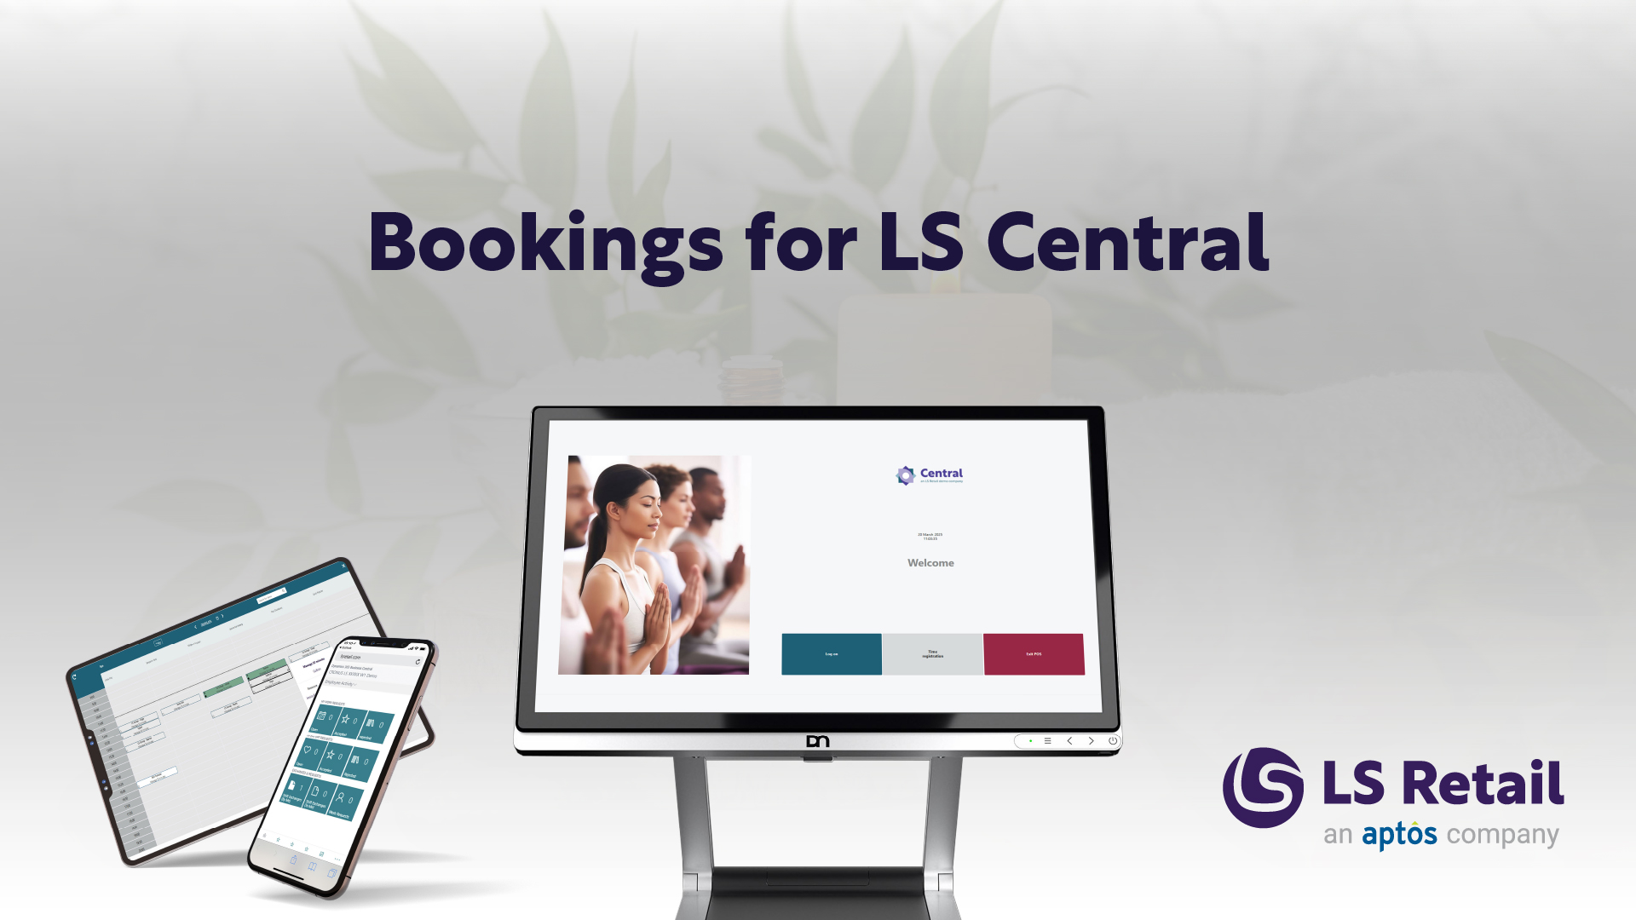
A leading end-to-end solution

Slide 12
Add-on to manage reservations, appointments, ticketing and other activities
Bookings for LS Central is a reservation management software that extends LS Central, letting you manage reservations, appointments, and additional services alongside all your other sales.
You don’t need to use multiple different systems that leave room for error or costly mistakes.
With Bookings for LS Central, you can offer a diverse range of services to your customers, create new bookings, make reservations, and manage your day-to-day with just one, easy to use software platform, keeping your business on track and your customers happy.

Slide 13
List of functionality
Reservations and Appointments
Treatments and activities
Ticketing and Access control
Access to baths, stadium or museums
Classes and Courses
Yoga classes or cooking course
Rentals
Rent a bike, boat or equipment
Memberships and Subscriptions
Gym or SPA memberships
Events
Meetings or conferences

Slide 14

Resource management
Human, Equipment, Locations and other
Product capabilities, priorities and preferences
Availability management based on:
Schedules
Opening hours
Staff management roster
Fixed quantity
Externally provided
Resource availability matrix

Slide 15
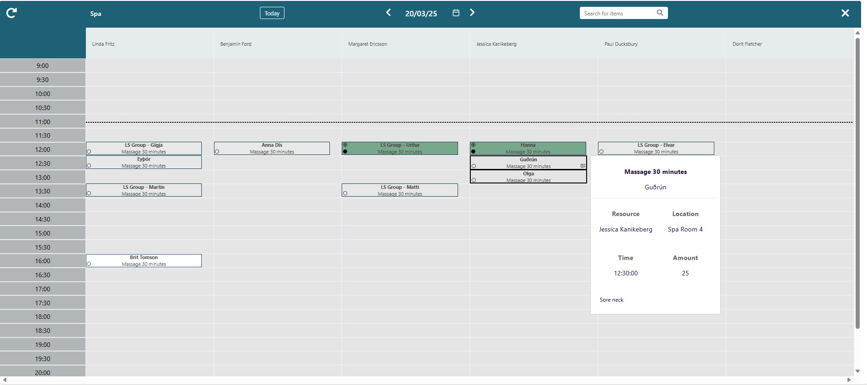
Bookings Matrix

Slide 16
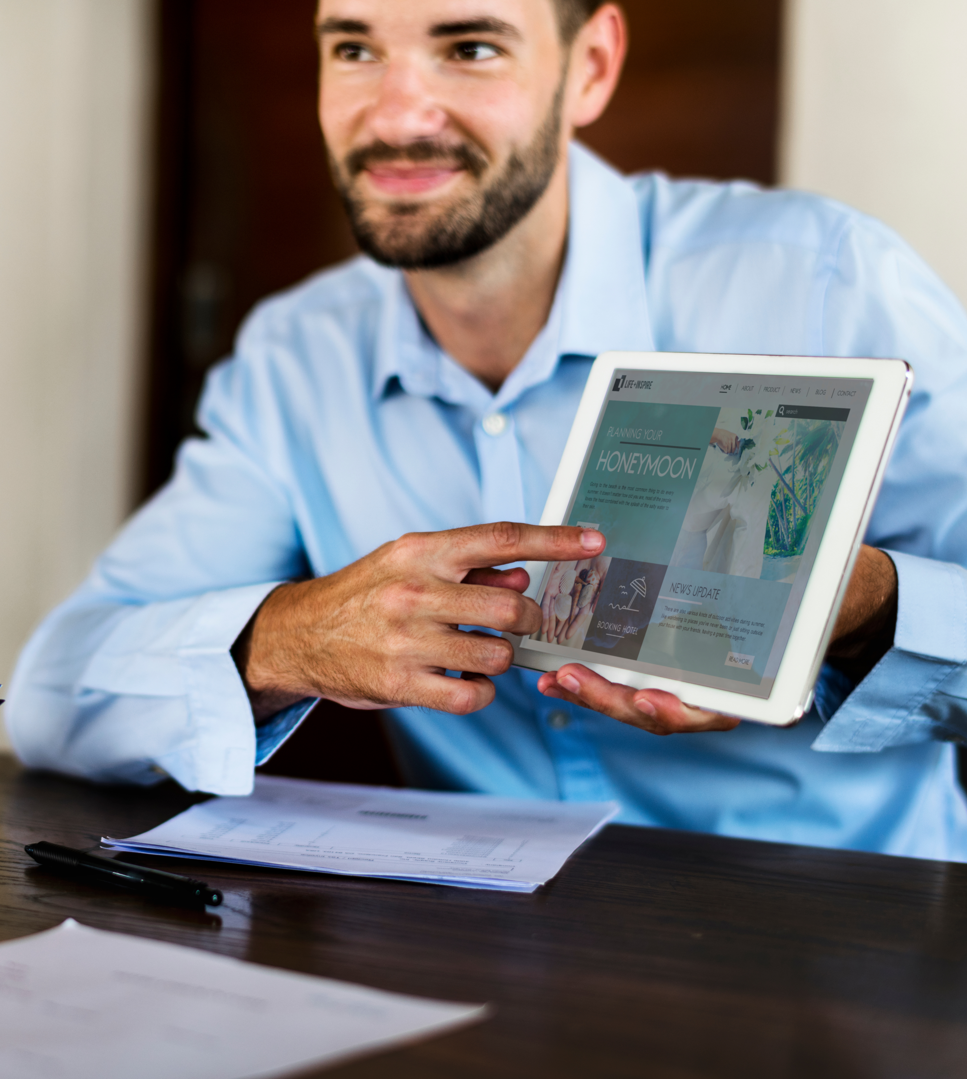
Package offers
Combine multiple products and activities into packages
Posting revenues for included products and services to different revenue centers
Package setup can include allowances
The allowance functionality supports:
Certain products are included in the package
Multiple choice allowance on guest reservation
Actual consumption and inventory tracking
Visibility for related allowances on POS for staff members

Slide 17
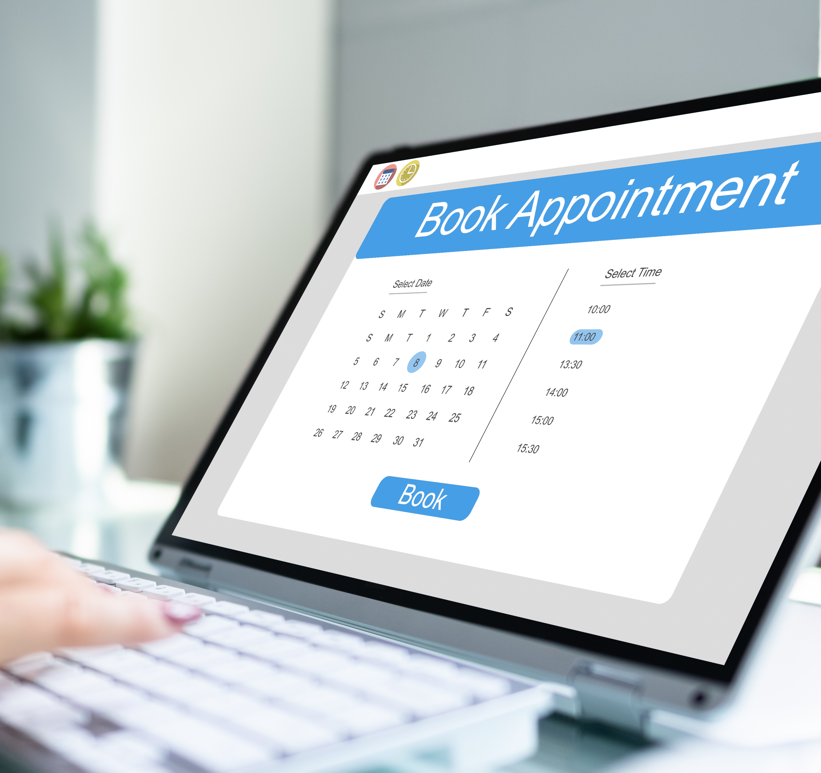
Open Web API for 3rd party integrations
SOAP/REST Web API
Upload products
Get availability
Book and cancel activity
Sell and cancel memberships
Update reservation details
Reservation tokens
Book and cancel groups

Slide 18

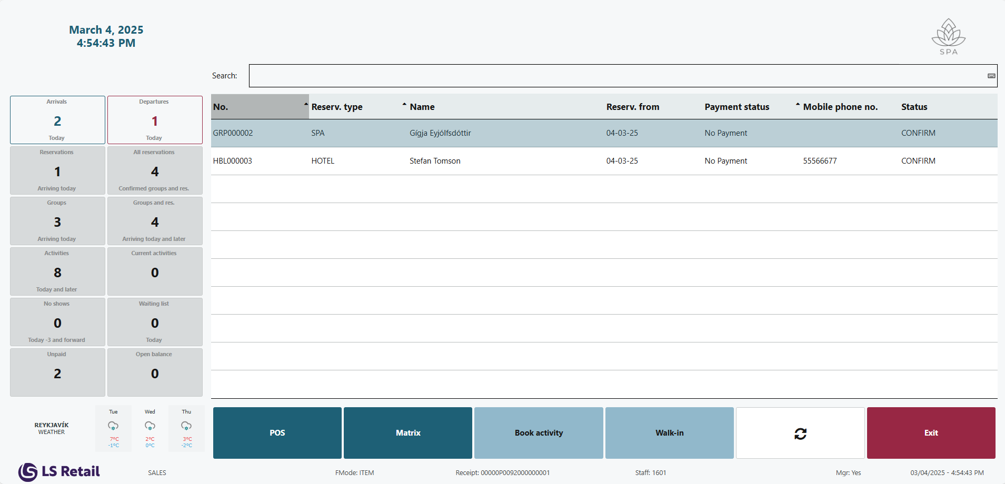
Point of Sale
Create and managing reservations
Sell/book additional activities
Rescheduling and cancelling activities
Assign and return rental units
Manage Memberships
Check and consume allowances
Take payment for reservations

Slide 19
Bookings Host

Slide 20
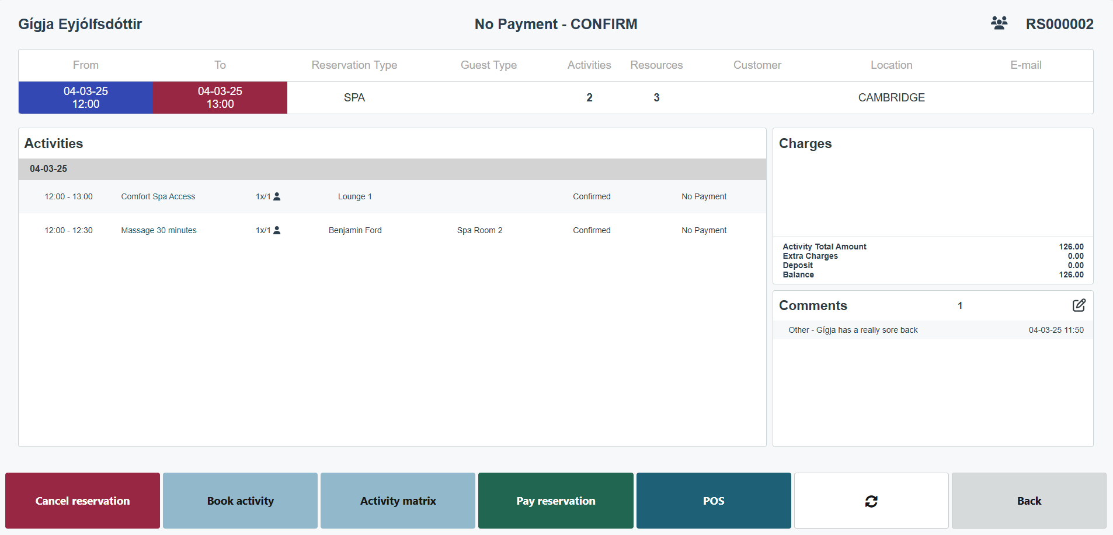
Reservation Panel

Slide 21
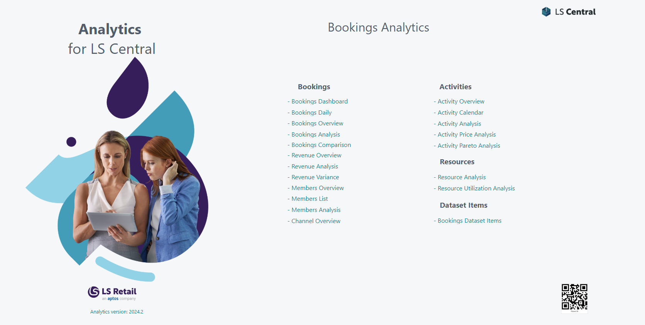

Bookings Reports - Microsoft Power BI
Link to PowerBI

Slide 22




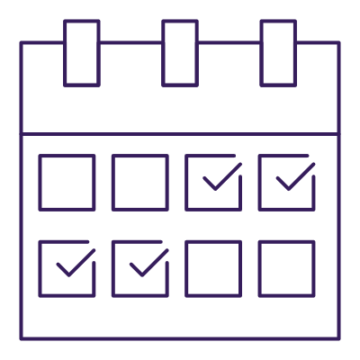
Who can benefit from using our solutions?
Hotels, resorts, spas, gyms and other hospitality businesses
Cafes, restaurants and other food service businesses
Amusement parks, museums, stadiums or other businesses that offer ticketing
Pharmacies that offer appointments, consultations and more
Retailers that offer rentals, appointments shopping and other services

Slide 23
Customer stories

Slide 24
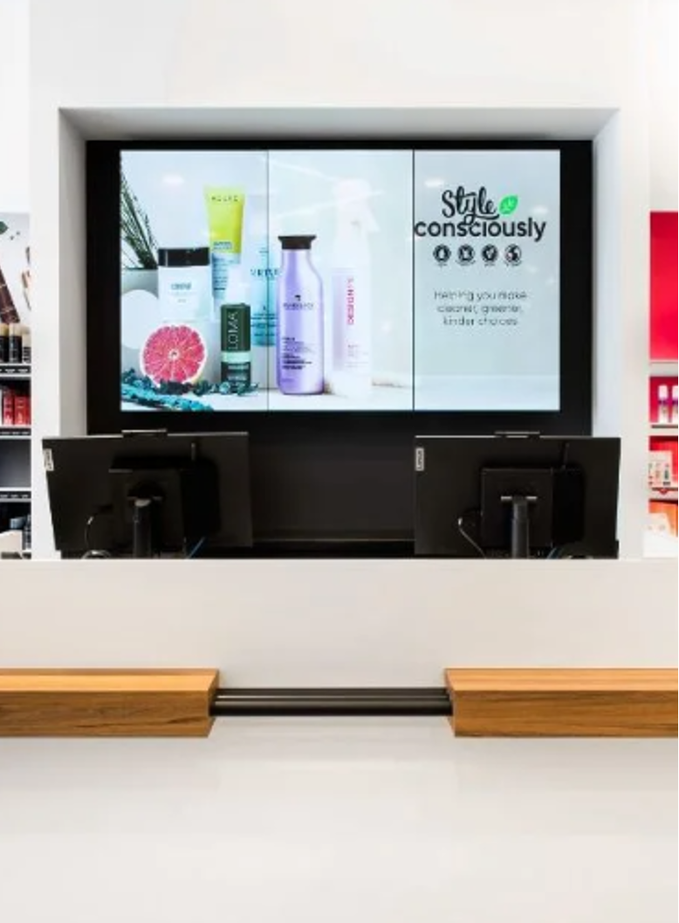

Canada's largest salon chain with over 115 locations across the country
Hair and beauty products from over 70 brands
Inclusive service menu, providing genderless haircuts and services
Online store
Online booking services
Membership management

Slide 25
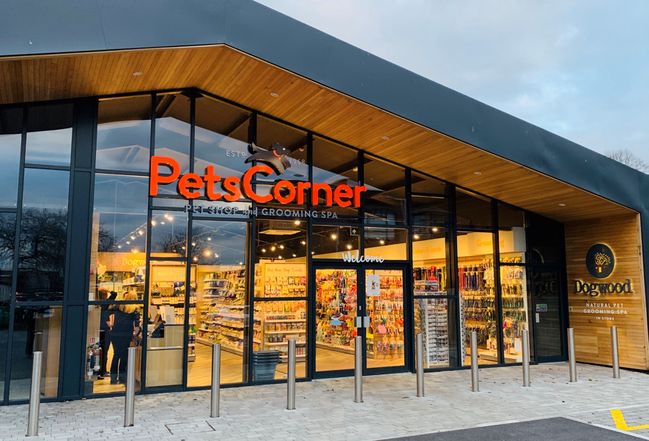
Pets Corner
Family-owned retail chain brand within the chain; Pet Family
Located in the UK
Focus on quality food and services for pets
Implemented Business Central and LS Central for retail
Roll-out was finalized in 6 weeks, without consultants going onsite
160+ stores (326 POSs)

Slide 26
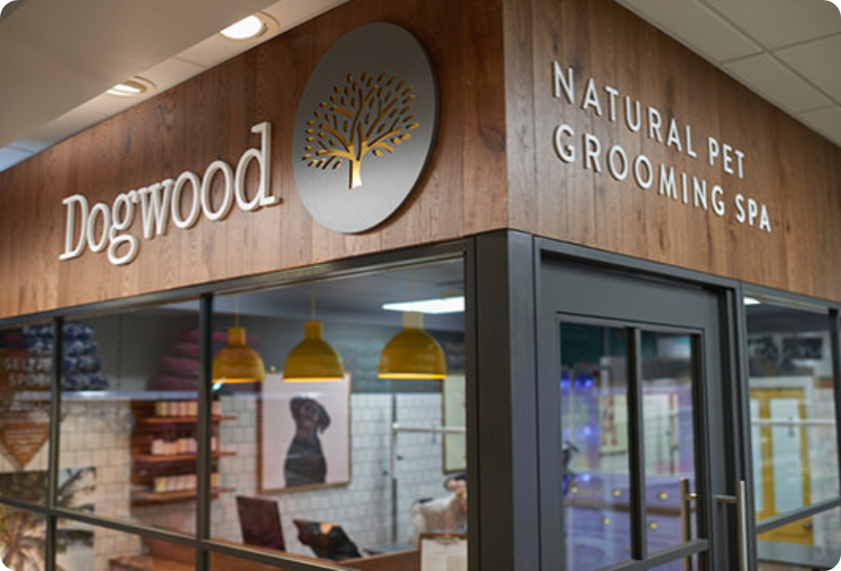
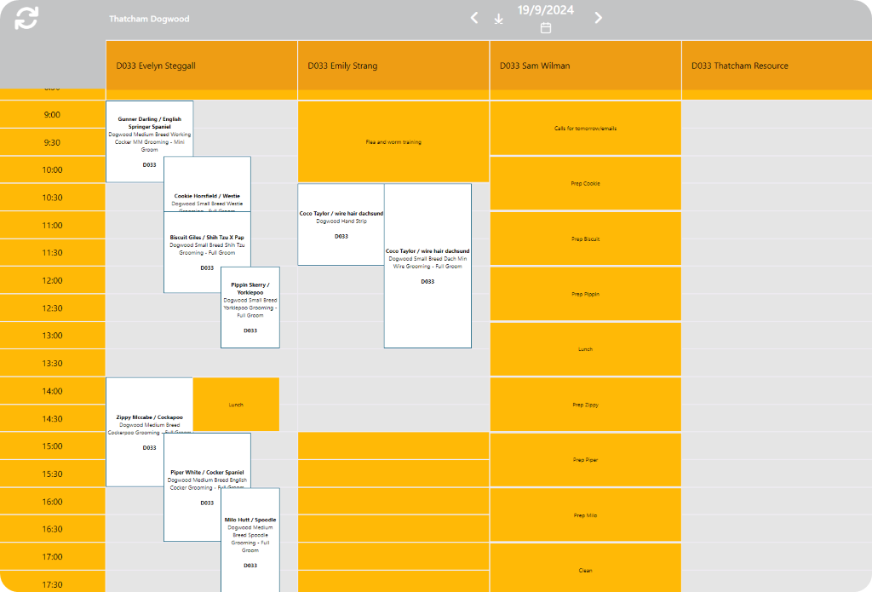
Dogwood – Pet Grooming SPA
About 50 Dogwood stores that offer pet treatments
They offer about 10.000 monthly appointments and needed a system to:
Make appointments
Reserve resources
Add comments and preferences for their customers
Implemented following modules:
Bookings for LS Central
Member Management
Staff Management

Slide 27
DEMO

Slide 28
New features & roadmap

Slide 29
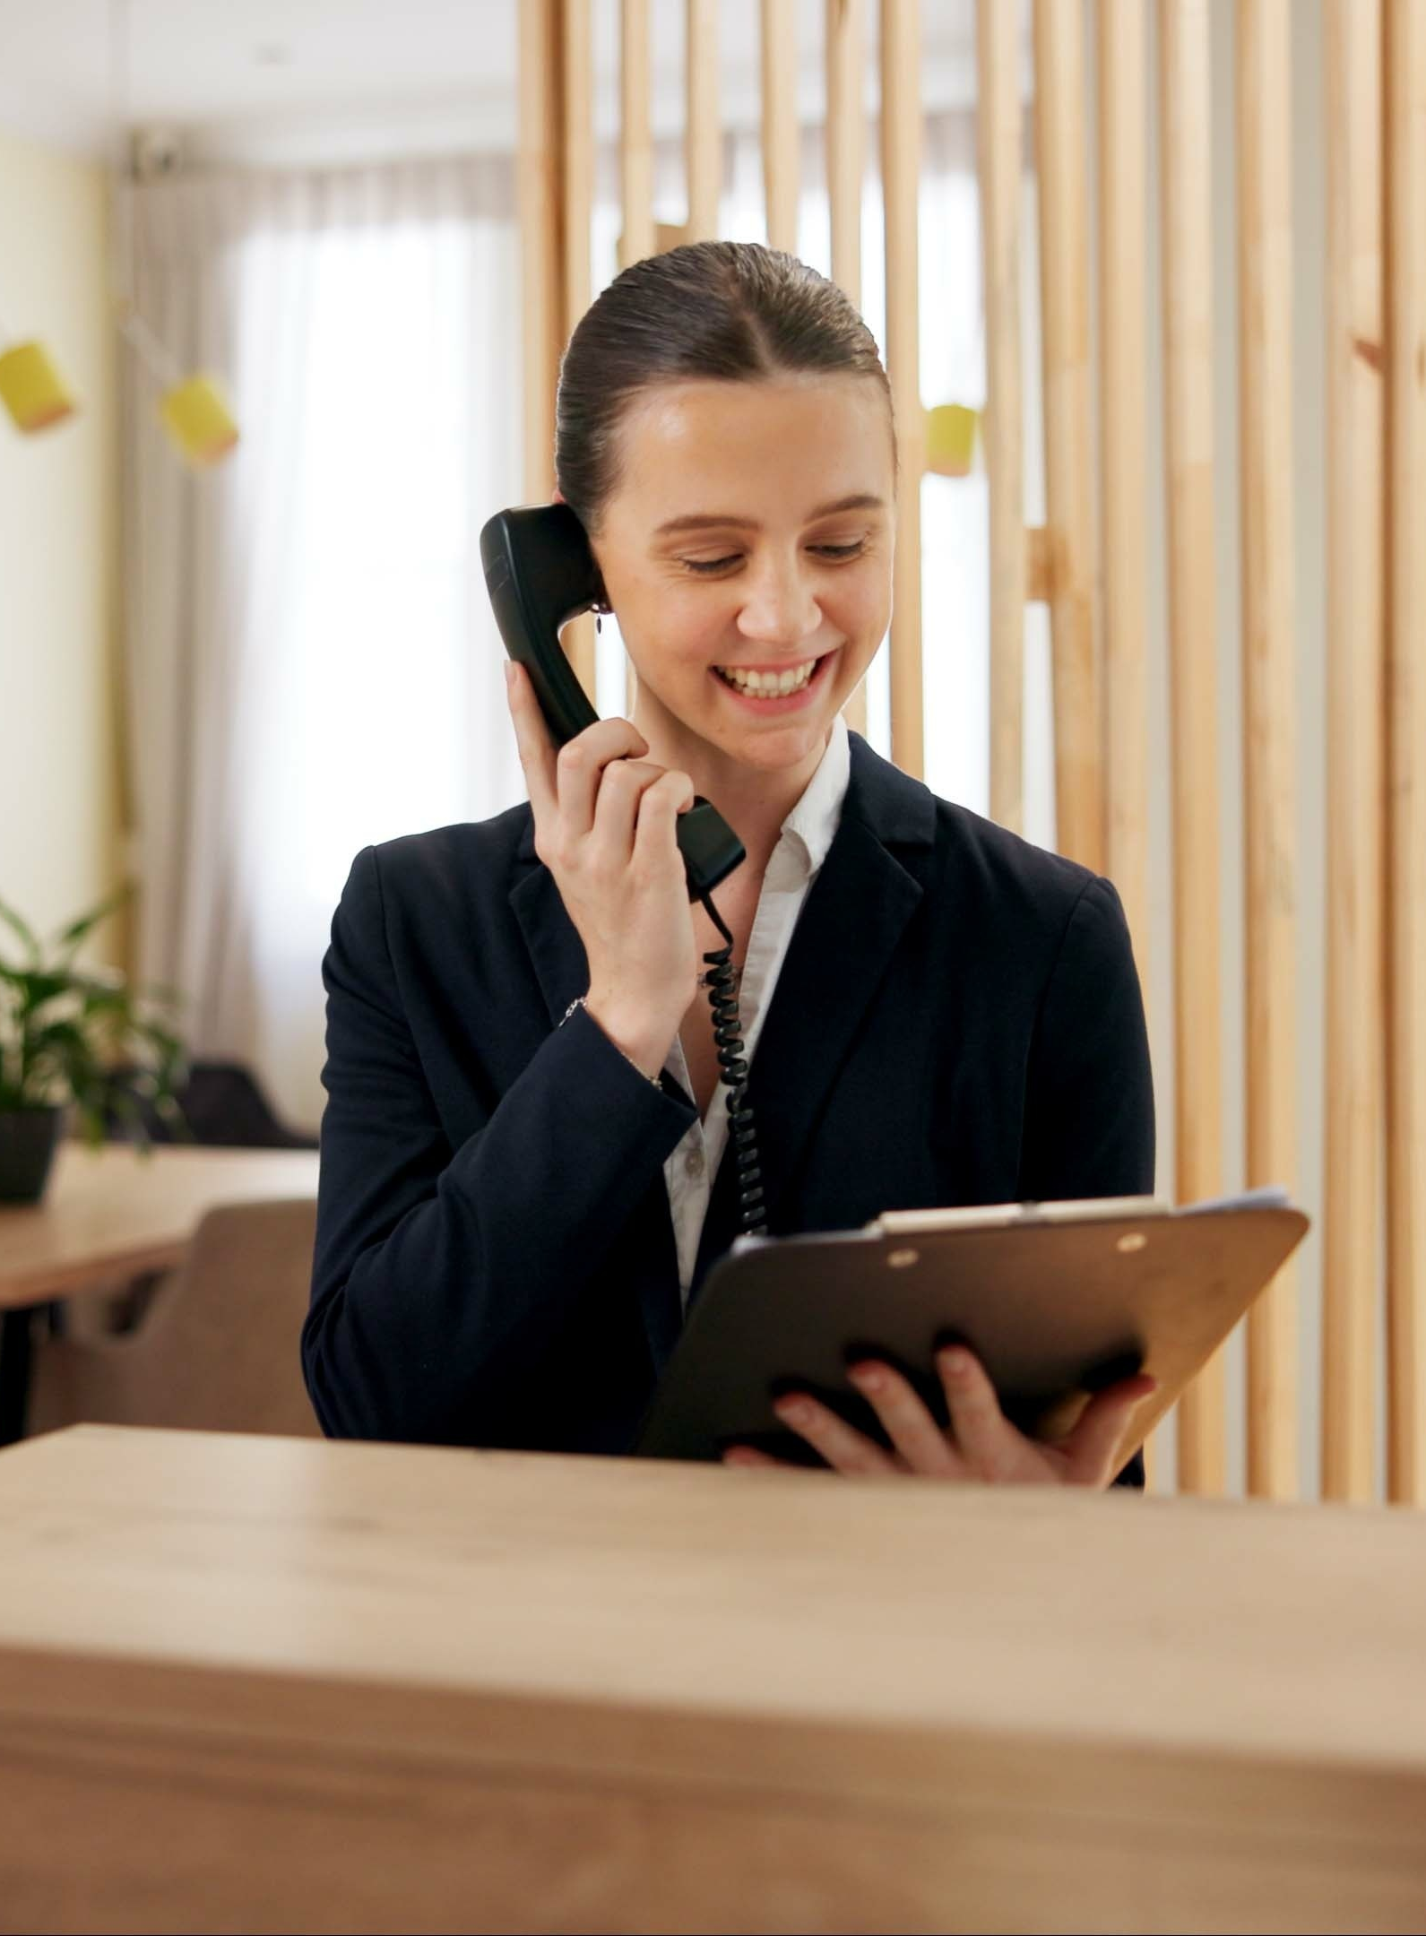
Bookings v26
Reservation management
BC customer prices
Course schedule enhancements
General enhancements
Bookings POS
New group reservation process
Better overview of group reservations and activities
Bookings matrix
Easily change duration of an appointment
Show and indicator on the cell next to an appointment that another appointment can be added or adding a participant to a course

Slide 30
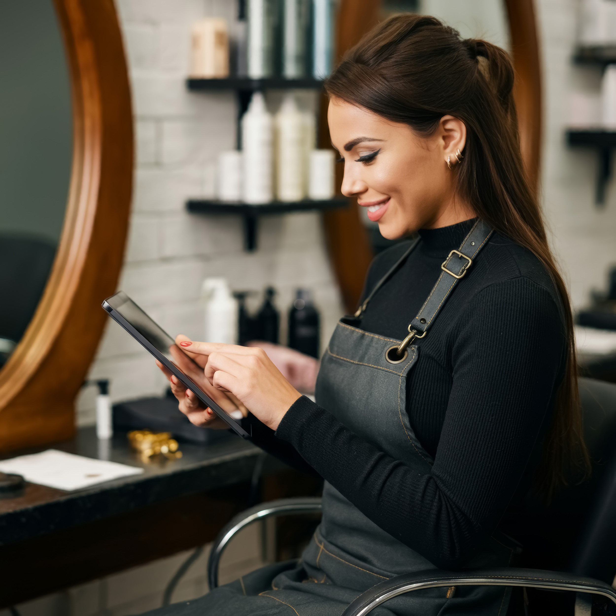
Bookings v27
Access device framework
Waiver management for members, products and reservations
Matrix enhancements
Matrix search
Show waiting list
Product view
Rentals
Multiple rental units support

Slide 31
One Hotel & Booking Team Initiative
“
Maximize LS Retail's opportunities and ensure delivery of top-notch solutions to our customers
How?
Form a virtual team with focus on the Hotels and Bookings modules
Identify our customer profile and set goals and KPIs
Focus on enhancements and features based on feedback from customers and partners.
Streamline internal processes
Enhance the service offerings and improve the products.

