Slide 1
The customers’ road to SaaS
How to migrate your customer to SaaS
LS Retail's recommended approach
Bjarni Asmundsson and Matthias Matthiasson

Slide 2

Agenda
Streamlining the migration process – Why?
How to get started
Upgrade vs (re-)implementation
Technical overview and comparison
Process workflow
Emphasis on the re-implementation process
Challenges related to data and code migration
LS Central migration tool

Slide 3

Streamline the process
Faster, more efficient migration
Reduce time spent on manual tasks and accelerate the transition
Lower risk of errors
Automation minimizes human errors during migration, ensuring a smoother process.
Enhanced consistency
Standardized procedures lead to more predictable outcomes across migrations
Cost savings
Streamlining reduces resource requirements, cutting both time and financial costs
Improved user adoption
Faster migrations allow teams to focus on training and adoption with minimal disruption
Better documentation
Automated processes create clear, consistent records for future reference and troubleshooting

Slide 4
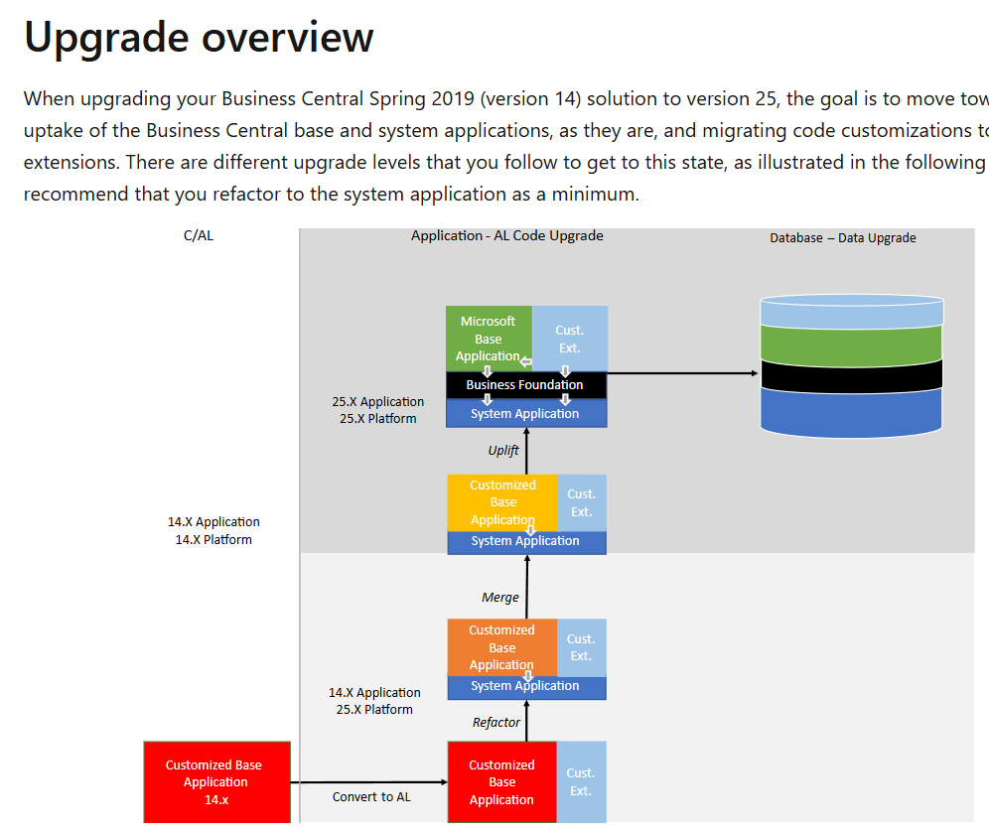
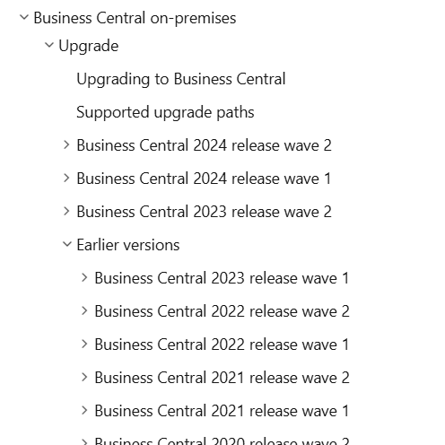
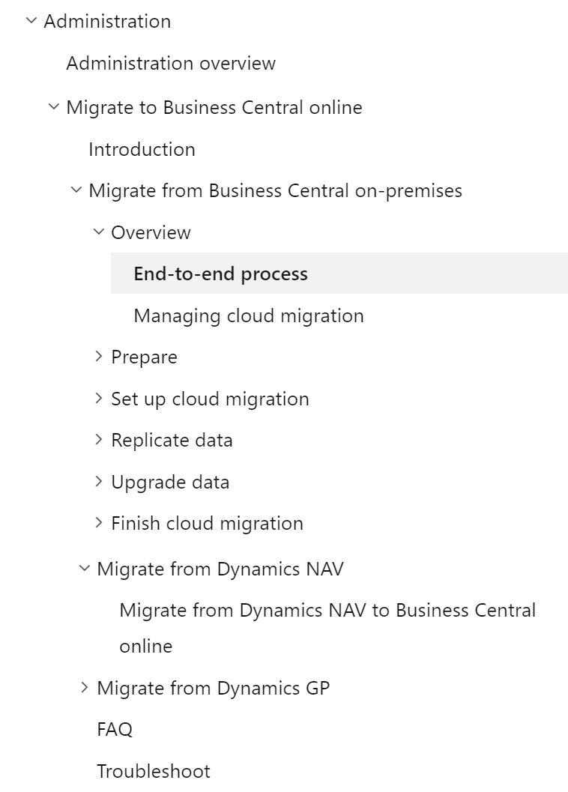
Get started
Microsoft Learn
https://learn.microsoft.com/en-us/dynamics365/business-central/dev-itpro/upgrade/upgrading-to-business-central
Business Central on-premise → Upgrade → Upgrading to Business Central
Administration → Migrate to Business Central online

Slide 5
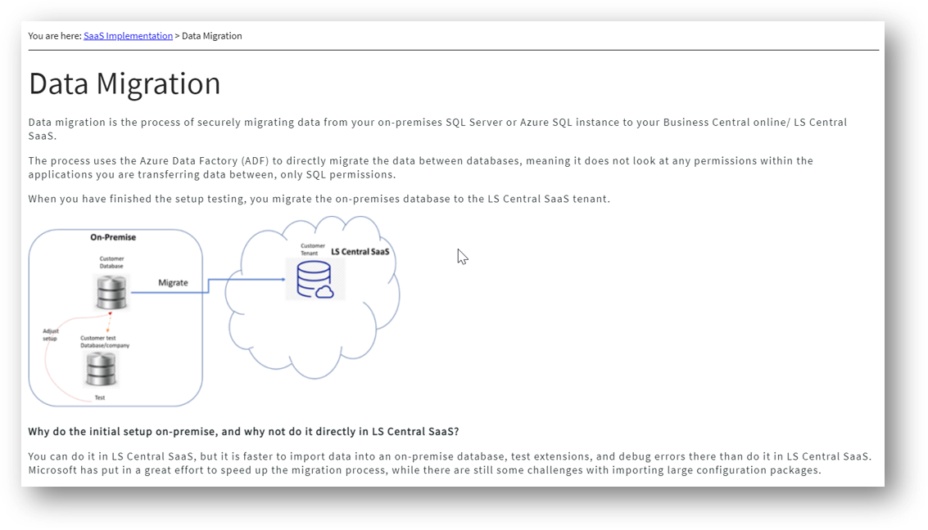
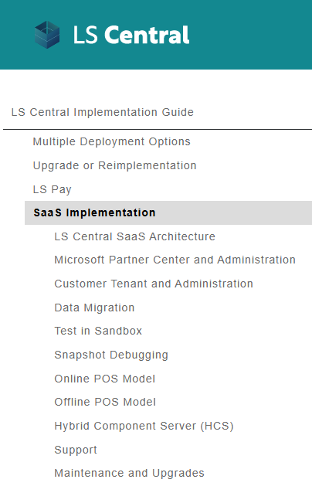
Get started
LS Central Online Help and Implementation Guide
https://help.lscentral.lsretail.com/Content/Implementation-Guide/LS-Central-SaaS.htm

Slide 6
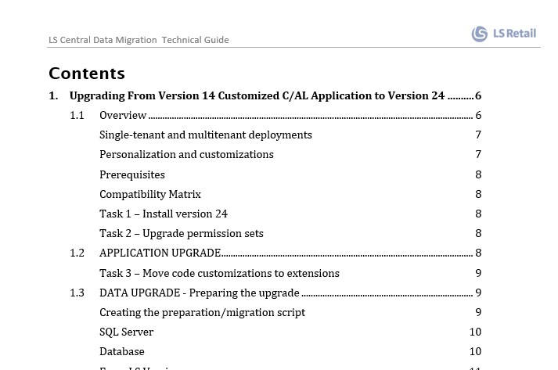

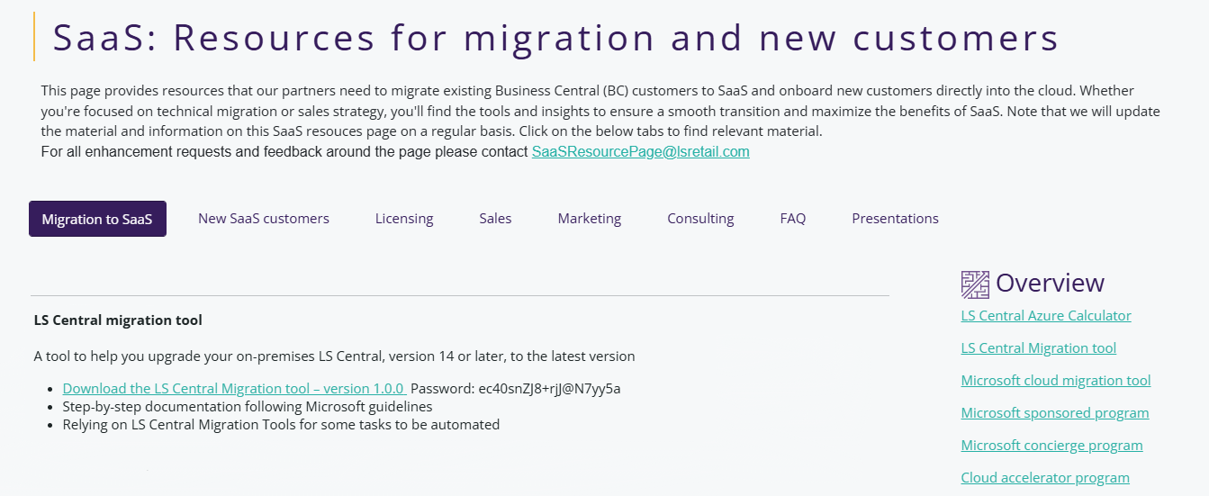
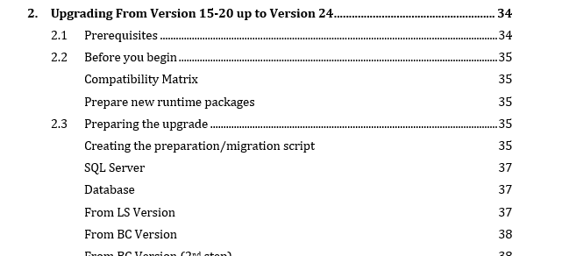
Get started
(NEW) SaaS: Resources for migration and new customers
https://portal.lsretail.com/products/ls-central/saas-resources/
LS Retail migration process
Step-by-step documentation following Microsoft guidelines
LS Central migration tool - PowerShell module to ease the migration process

Slide 7



The road to SaaS – Final step
Our recommendation is for you to prepare/have a
on-premises database with latest LS Central
with the
data to be migrated to SaaS
LS Central
26
on-premises
LS Central
SaaS
On-premises database
Latest LS Central version
Contains the data to be migrated to SaaS
Same Microsoft and LS Central extensions as in SaaS
Same custom extensions as in SaaS
Move on-premises database
to SaaS using
MS Cloud Migration Tool
Provides more control because partners have access to SQL at this point.
We recommend replicating data from original database using Data Director (via SQL).
Using Config. Packages to import data is faster on-premises.
Why?

Slide 8

Full upgrade
/
Re-implementation

Slide 9
Full upgrade / re-implementation
Full upgrade
Migrating (all) existing code and data into newer version
Not focused on trying to solve a set of business needs
Upgrading from a recent version of LS Central can be faster and cheaper
Works well if data is organized and customizations are not complex
Data does not need to re-enter
Re-implementation
Get rid of old and unnecessary data and customizations
Reduces the risk of errors from inaccurate / outdated data
A fresh system runs faster and is more flexible

Slide 10
Full upgrade / re-implementation – Comparison overview
 | Full upgrade | Re-implementation
What to migrate | All data All existing extensions/features | Opening balances and master data Selected historical data for replenishment purposes Focused on must-have customizations
Applies to | LS Central 18/19 or later On-premises database smaller than 160 GB Business processes haven’t evolved much. Data is reliable. | LS NAV 6 (NAV 2009) up to LS Central 14 (BC 14) | LS Central 15 onwards. On-premises database larger than 160 GB
Code migration | Uplift all extensions to latest version | Non-extension based framework Convert custom code from C/AL to AL Move custom code to extensions Legacy reports to RDLC/Word | Extension based framework Existing extensions should be reusable Obsoleted tables/fields in custom extensions needs to be reviewed Handle LS Central objects renaming in v17.5
Data migration |  | Migrate from LS NAV 6 (NAV 2009) or later to LS Central 26 following MS Upgrade guidelines supported by LS Central migration tool. Use Data Director (or Config. Packages/SQL scripts) to cherry-pick data from migrated database to empty LS Central 26 database on-premises

Slide 11
Technical migration overview
Full upgrade – Technical overview
Stage 1
Stage 2
Uplift all extensions to latest versions
Use MS Cloud Migration Tool to move the data to SaaS
Source
LS Central database
Uplifted database
LS Central 26
LS Central
SaaS

Slide 12

Technical migration overview
Re-implementation - Technical overview
Stage 1
Stage 2
Stage 3
Use MS Cloud Migration Tool to move the data to SaaS
LS Central
SaaS
Partial Data
Migration
Move data using Data Director
Source
LS NAV/LS Central database
Migration process
following MS Migration guidelines.
Supported by LS Central migration tool
Migrated database
LS Central 26 table schema
Cherry-pick tables to be moved to the destination on-premises database
Clean
LS Central 26
on-premises
Can be used to upgrade data from any version from NAV 2009 onwards
Data review
Data review is possible prior to or ahead of moving the data to the destination on-premises database

Slide 13
Stage 1
Migration process
following MS Migration guidelines
Supported by LS Central migration tool
Source
LS NAV/LS Central database
Can be used to upgrade data from any version from NAV 2009 onwards
Migrated database
LS Central 26 table schema
Re-implementation

Slide 14
Stage 1
Data migration
Includes some code migration
Custom fields added to standard tables
Custom tables
No code included in triggers
Source
LS NAV/LS Central database
Migrated database
LS Central 26 table schema
Code migration
Migrating customizations
Customized features
Integrations
Reports
Etc.
Not needed for stage 1
Data and code migration are separate tasks
Re-implementation

Slide 15

Data migration
Data upgrade flow
LS NAV
6 / 7
NAV 2009 R2
to
NAV 2013 R2
LS NAV
8 - 13
NAV 2015
to
BC 13
LS Central
14
BC 14
LS Central
15 - 24
BC 15-24
LS Central
25
BC 25
LS Central
26
BC 26
SaaS
Major challenges
Higher complexity
More upgrade steps required
Data upgrade codeunits might be needed to map custom fields
Big amount of data
Takes longer to run the steps
No major challenges
References to standard obsoleted tables / fields in your custom extensions
Truncate the biggest tables prior to start the migration process
Item Ledger Entries / Value Entries / Gen. Ledger Entries
LS Central transaction tables
Re-implementation

Slide 16
Code migration – Some challenges
Upgrading from Version: | Challenges | Suggestion
LS NAV 6 up to LSC 14 NAV 2009 up to BC 14 | Non-extension based framework Migrating custom code from C/AL to AL Moving custom code to extensions Identifying customizations in the base code Undocumented custom code Lack of documentation Usage of events subscription | Replace customizations with standard features Migrate only must-have customizations, after gap list analysis
 | Reports (Legacy to RDLC/Word report migration) | Rely on Export to Excel and built-in Analyse feature in list pages. Rely on objects usage log analysis tools from AIM partners to migrate only used reports. Use Analytics for LS Central / PowerBI for KPIs and for non-operational reporting. Use 3rd party solutions to help on the conversion.
LS Central 15 up to 17.4 | Table renaming in v17.5 | LS Central migration tool module will update your custom extensions source code and fix all references to LS Central objects.
 | Handle obsoleted objects | References to obsoleted objects must be manually fixed on custom extensions.
All versions | Legacy integrations based on local files or files stored in FTP servers. | Refactor integrations to use web services. Approaches to tackle related challenges: Rely on Azure Storage for files storage Rely on Azure Functions or Azure Logic Apps to read data from FTP servers
 | Dotnet libraries usage. | In SaaS, custom .net usage is not allowed. Alternatives: To implement the same logic in AL To implement the C# code in Azure Functions and make use of it. To implement an Azure Logic App.

Slide 17
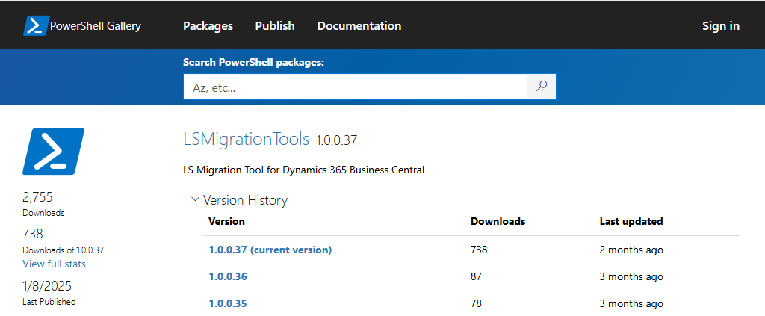
LS Central Migration Tools
Documentation
Step-by-step documentation based on Microsoft’s guidelines
Available on SaaS: Resources for migration and new customers page
Tooling set
PowerShell module to automate some migration steps
Available on the PowerShell Gallery

Slide 18
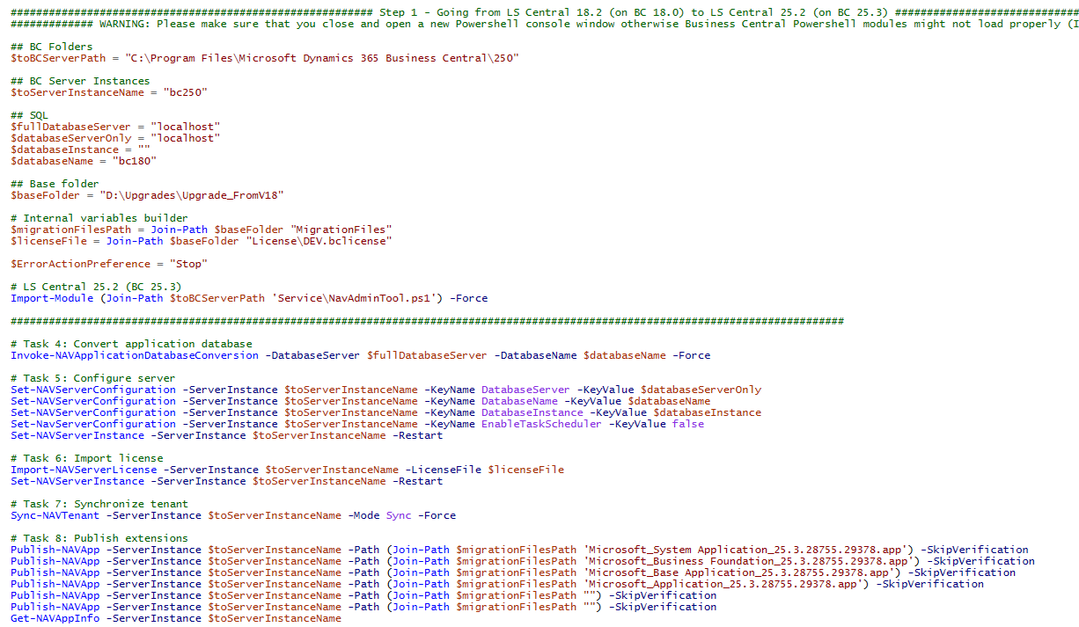
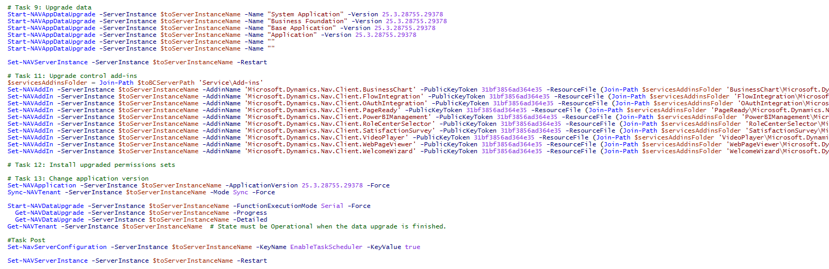
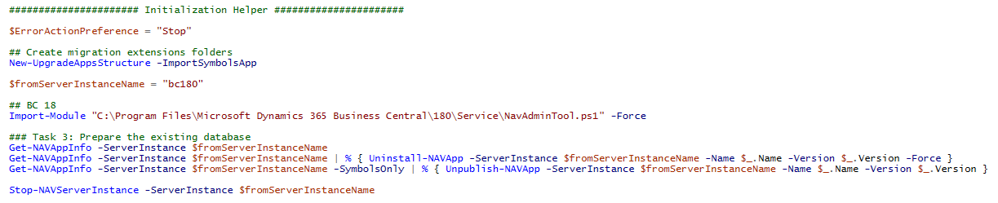
LS Central migration tool – Helping with the data migration
New-UpgradeInitializationScript
A wizard to automate the migration scripts creation
Creates two scripts that allows you to go through the migration process
Preparation-Script.ps1
Setup the folder structure and create the extensions needed for the migration (when applicable)
Migration-Script.ps1
The migration process itself

Slide 19
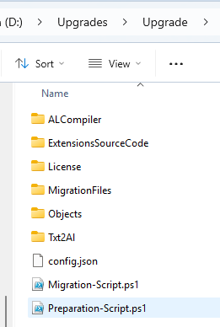
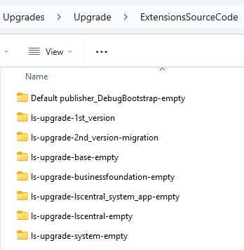
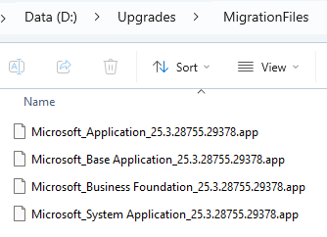
LS Central migration tool – Helping with the data migration
New-UpgradeAppsStructure
Creates the migration extensions needed for the migration process, as suggested in Microsoft guidelines.

Slide 20

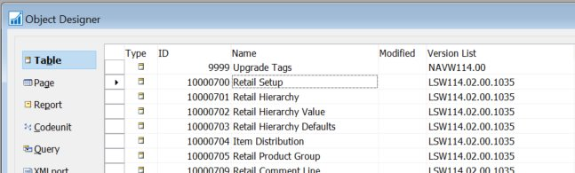
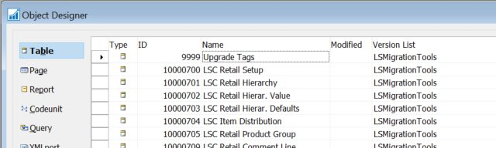
LS Central migration tool – Helping with the data migration
Most of the challenges related to data migration only happen when migrating from LS Central 14 (and earlier versions)
LS Central migration tool includes more features to ease the data migration, especially the data migration process from LS Central 14
Adding LSC prefix to tables
(migrating from LS Central 14)
Convert-BC14CALObjectsToTableSchemaOnly
Applies to Business Central 14​
Strips out all the code from tables, for an existing C/AL text file, while renaming the LS Central tables name​
Only properties and fields will be included​
Converted file will be imported back in BC 14​
Allows to easily rename all the LSC tables in BC 14 before moving forward​

Slide 21
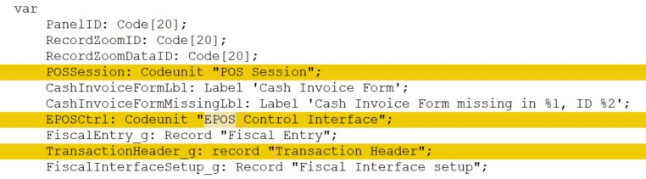
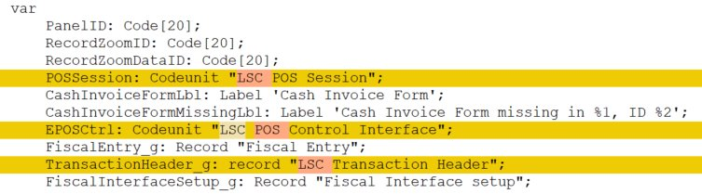
LS Central migration tool – Helping with the code migration
Before
Updating references to LS Central objects in your custom extensions
(migrating from LS Central 15 up to 17.4)
Repair-CustomExtensionFrom174orEarlier​
Will update references to LS Central objects in your custom extensions​
Variables​
Parameters
Tables, pages and other object extensions
Other properties
After

Slide 22
Stage 2
Partial Data
Migration
Move data using Data Director
Cherry-pick tables to be moved to the destination on-premises database
Clean
LS Central 26
on-premises
Migrated database
LS Central 26 table schema
Have all the data but the truncated tables, if any
Data review
Do data review prior to move it to the destination on-premises database

Slide 23
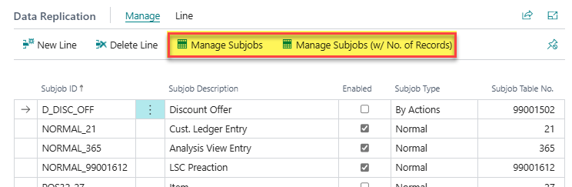
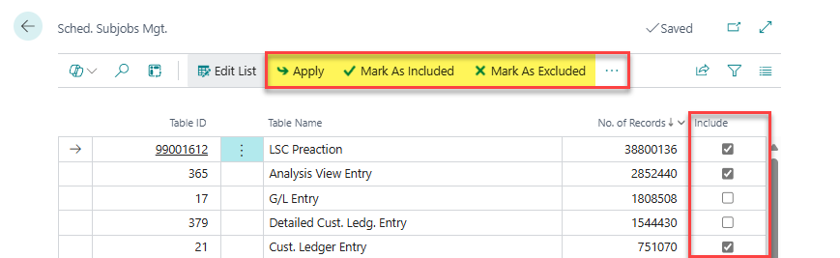
Scheduler Job improvement
Simplified Subjob Management (introduced in LS Central 26)
New feature to ease the process of managing the subjobs
Makes the process of including/excluding tables to be replicated much easier
Automatically create, enable or disable subjobs, based on the tables included

Slide 24
Stage 3
Use the MS Cloud Migration Tool to move the data to SaaS
LS Central
SaaS
LS Central 26
on-premises

Slide 25

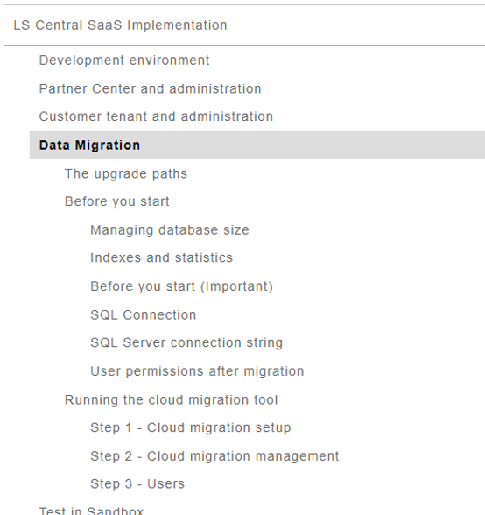
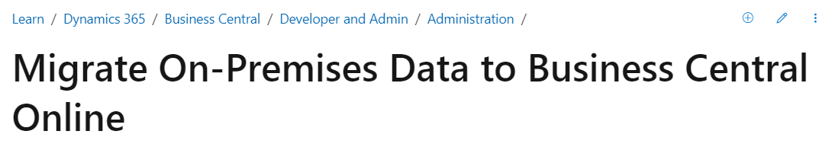
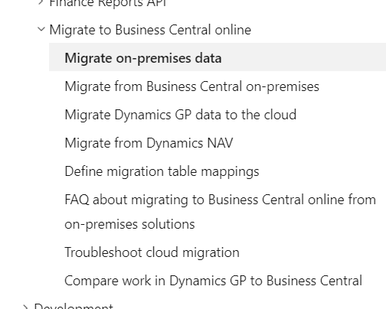
Running the Cloud Migration Tool
Running the cloud migration tool | LS Central SaaS Implementation Guide
Migrate on-premises data to the cloud - Business Central | Microsoft Learn

Slide 26

Takeaways
Streamlining makes the migration process more predictable and faster
Upgrade newer versions / Re-implement older versions
Most of the work happens on-premises
Data migration to latest version & moving customizations to extensions
Our partners knows how to do this
Rely on LS Central Migration Tools to automate some steps
Rely on our documentation and best practices
LS Retail is here to support you: CAP team, consulting services

Slide 27



Book a session: portal.lsretail.com/onboarding-ls-central-in-saas/
Book a session with the
CAP team

Slide 28
Documentation
Microsoft Learn - Upgrading to Dynamics 365 Business Central
https://learn.microsoft.com/en-us/dynamics365/business-central/dev-itpro/upgrade/upgrading-to-business-central
LS Central Help and Implementation Guide
https://help.lscentral.lsretail.com/Content/Implementation-Guide/LS-Central-SaaS.htm
(NEW) SaaS: Resources for migration and new customers
https://portal.lsretail.com/products/ls-central/saas-resources/
LS Central Migration Process
Step-by-step documentation following Microsoft guidelines
LS Central migration tool - PowerShell module to ease the migration process
Cloud Migration group in D365 BC Development Yammer​
https://www.yammer.com/dynamicsnavdev/#/threads/inGroup?type=in_group&feedId=48311992320

