Slide 1
Notes:
Welcome to this onboarding session for LS Central in SaaS

Slide 2
LS Central in SaaS - Onboarding
Adalbjorg Karlsdottir
Ricardo Moinhos
Onboarding Lead
Senior Onboarding Specialist
adalbjorg@lsretail.com
Ricardomo@lsretail.com
Notes:
My name is Adalbjorg and I’m the Onboarding lead, and with me in the Onboarding team is Ricardo our senior Onboarding Specialist

Slide 3
About the evergreen train
It’s Automatically renewed and repeatedly made valid.
It requires internal change to bee successful, not only within LS Retail but within our partners organizations too.
Continuous improvements
Continuous delivery
Rapid implementation
Automation
Notes:
The Evergreen train or cloud or SaaS is all about
Continuous improvements
Continuous delivery
Rapid implementation
Automation

Slide 4
Go
Notes:
We don’t want you to miss the train

Slide 5
But don‘t just jump on board!
Go
Notes:
But we don’t want you to just jump on board without any preparation, therefore we are offering this session to hand over the knowledge and best practices for LS Central in SaaS.

Slide 6
Educate yourself
Implementing LS Central SaaS is a process that should be approached with strategy
Educate yourself on the differences between LS Central SaaS and on-premise and determine the principal activities of your future LS Central SaaS operations
SaaS Onboarding guide LS Central Implementation Guide Onboarding Buddy and CAP
Educate yourself
LS Academy
CF-900 is now available On-demand
Notes:
Here are links to material we have for LS Central in SaaS, the SaaS Onboarding guide and the Implementation guide. Have you checked out these pages, if you have not, I recommended doing so, there are helpful information there. We offer the Onboarding LS Central SaaS program which you are already a part of and the Cloud Accelerator Program or CAP, which I will talk more about later.
Then we have the SaaS training or CF-900, that LS Acadamy offers, and is now available for you on-demand on the LS Training portal

Slide 7
Understand the support process
Understand the support process and your responsibility in supporting your customers.
Outage communication strategy
Partner Center
Delegated Administrator
Admin Center
Learn more about Support
Business Central reselling partner, means that you will get requests for support from your customers that you must triage, investigate, and either resolve or escalate to Microsoft or LS Retail, depending on the issue's nature.
As a Business Central reselling partner, you are an administrator of your customers' Business Central tenants, and you are the first line of support
Notes:
So where to start? The best place to start is to create a Have a support concept for your customers Outage strategy, on how outage is reported to MS
Use partner center
In Partner Center, you can:
Manage your Microsoft account and users
Access your customer's tenant
Manage Customer Subscriptions
You can use the delegate admin access to support them
Delegate Admin
Admin and development access to Customer LS Central SaaS tenants
LS Central SaaS access without consuming license of Customer
First line of support for your LS Central SaaS customers
Internal Administrators and Delegated Administrators can access the administration center
Partners can access admin center for each tenant from the partner center
Customers (and partners) can access after signing into business central -> Settings -> Admin Center
Or by placing admin after LS Central URI

Slide 8
Automation is your BEST friend
In a SaaS business, direct labor is your enemy. Automation is your friend.
When you neglect to automate core business processes and then cover it up with people, you ensure long-term unprofitability and engender a culture that undermines long term success.
Solve problems through automation, and then add people to push sales and service performance over the top, not to provide the basic function.
Make test environment as close to real environment as possible.
Don’t forget to test Hardware Station, printing, etc…
Notes:
Automate as much as possible. If you have developed customized extensions, it is your responsibility to make sure the extension does not break when Microsoft or LS Central release new updates. Therefore, we strongly advise you to create automated tests for every customization you develop. You must update environments each month, so automation is your best friend in SaaS

Slide 9
Cherry pick your first customers
Cherry pick your customers, focusing only on those that have the highest need and are the easiest to reach.
Don’t chase the big, bad elephants that need special features, requires a long sales cycle and has restrictive legal requirements.
Notes:
If possible, try to select the first SaaS customer as a simple customer with as few customization and integrations as possible A customer you already know all processes to guarantee that the move to SaaS is a straight forward one. This is not always possible, sometimes the customer has already chosen you

Slide 10
Production Environment
Every Production Environment comes with 3 sandboxes which all add up to the 80 GB of free space.
Approx 50% compression
Learn more
+ 3/2/1 GB per user
Notes:
Every Production environment in SaaS comes with 3 sandboxes, which add up to 80 GB storage across all environments There is on the average 50% compression, so the 80 GB are more than they look
In addition to the 80 GB you get 3/2/1 GB for each user depending if it is premium/essential or device user
Capacity tab in admin center shows information on available space
Exceeding Storage limit won't interrupt transaction
No automatic charges for the extra storage occupied by these environments.
Restriction will be placed on creating or copying environments
These operations will also be blocked for the customers who have more environments than they're entitled to, according to their subscription and purchased environment add-ons.

Slide 11
What is your support concept?
What is the customer ready to pay for?
Per hour
Monthly service fee
Hybrid - you need more time for support etc.
Online – Hardware Station updates
Notes:
Before you start the project, decide on a support concept with your customer. Who is going to do the update work, if you, what is the concept? The Hybrid setup will take more time with update, since the update will be on premise and in SaaS. Please note that there is no obligation in updating the offline POS each month, we are now guaranteeing 6 months backwards compatibility of the offline POS.

Slide 12
Template database
Template database contains standard components
Creating a customer database from a template:
Reduces the time for data setup
Ensures that databases are created consistently
Start with on-premise database and create a new company
Basic Setup needed for running HO, Store and POS
Run Retail Setup -> Insert default data
Use Import/Export Worksheet to get POS setup data
How to setup Template Database
GL/Account
Posting Groups
General Ledger Setup
Unit of Measure
Source Code
Reason Code
Payment Method
No Series
Retail Setup
Store
POS
Tender Type
Staff Permission
POS Setup
Keep the template database up to date on the newest LS Central SaaS version
Keep it clean!
Notes:
For new installations we recommend you to prepare a template database. This database should include all the basic BC/LS Central setup needed for running HO, store and a POS. You will use this template when you are onboarding customers. You must keep it clean and do testing in a copy of the template. Then you need to make sure it is always on the newest LS Central SaaS version.

Slide 13
Get ready

Slide 14
A stress-free go-live
Do a test implementation before starting the customer implementation
Develop a plan for onboarding
Notes:
We recommend doing a test implementation in SaaS before starting the customer implementation, for that you need a development or a demo environment. All LS Retail Partners that require a SaaS DEV license must contact Microsoft and purchase the Dynamics 365 Business Central Partner Sandbox license for their Microsoft Entra ID. Microsoft has made this available to support partners that need non-production environments to learn, test, and deliver end-to-end customer demos with their solutions. To install the LS Central App from App Source, please create a ticket with LS Retail Licenses Department at Licenses@lsretail.com and share the tenant Microsoft ID, Domain Name, and the environment localization and You will receive a link and instructions on how to install the LS Central App on your new Partner Sandbox license.

Slide 15
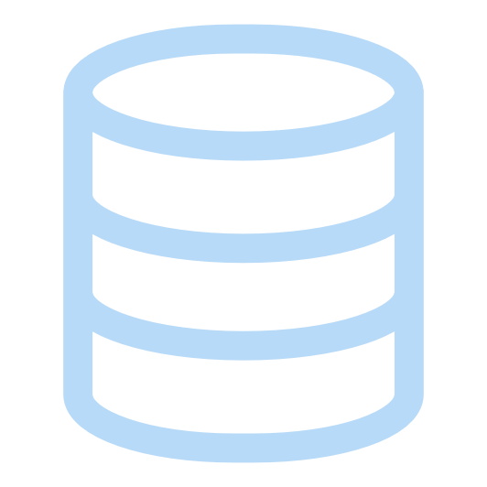
Onboarding with a new Customer
On-Premise
Copy of Template Database
- Master data
- Opening balance
- Quantities
Customer
Tenant
LS Central SaaS
Customer
Database
Migrate
How to Migrate
Adjust setup
Adjust setup
Customer test
Database/company
Test
Test
Notes:
Onboarding with a new customer, here we recommend using the template database mentioned earlier
Copy that database on premise and enter customer relevant data and setup and when it is ready to migrate to SaaS using the Cloud Migration tool. If you choose to use the configuration packages to import data into SaaS then it is good to realize the limitations for the performance of the configuration packages and that you might need to split bigger packages into parts before importing them into SaaS. For some time there was only the option of copying production environment to Sandbox, now you can copy a Sandbox to a production environment.
In certain circumstances this can be a good option to have.

Slide 16
Onboarding with On-Premise Customer
When it is time to decide whether to undertake upgrade or re-implementation, our advice is to re-implement if LS Central's version is older than v15 and has extensive customizations.
In the case of upgrades and migration, we strongly advise you to review the data before migration.
Which elements might be left behind?
The value of old data?
Learn more
We advice you to:
Upgrade to latest version before you migrate to LS Central SaaS
Notes:
Moving an on-premise customer to SaaS. If the customer is on LS Central older than version 15 and has extensive customization, we recommend a re-implementation. This is however a case-by-case decision. You can get an advice on how to migrate and update data and code from our migration specialist Ricardo
Before migrating the data, we recommend that you review the data before migration and clear up any data that does not need to be migrated, like logs and such.

Slide 17
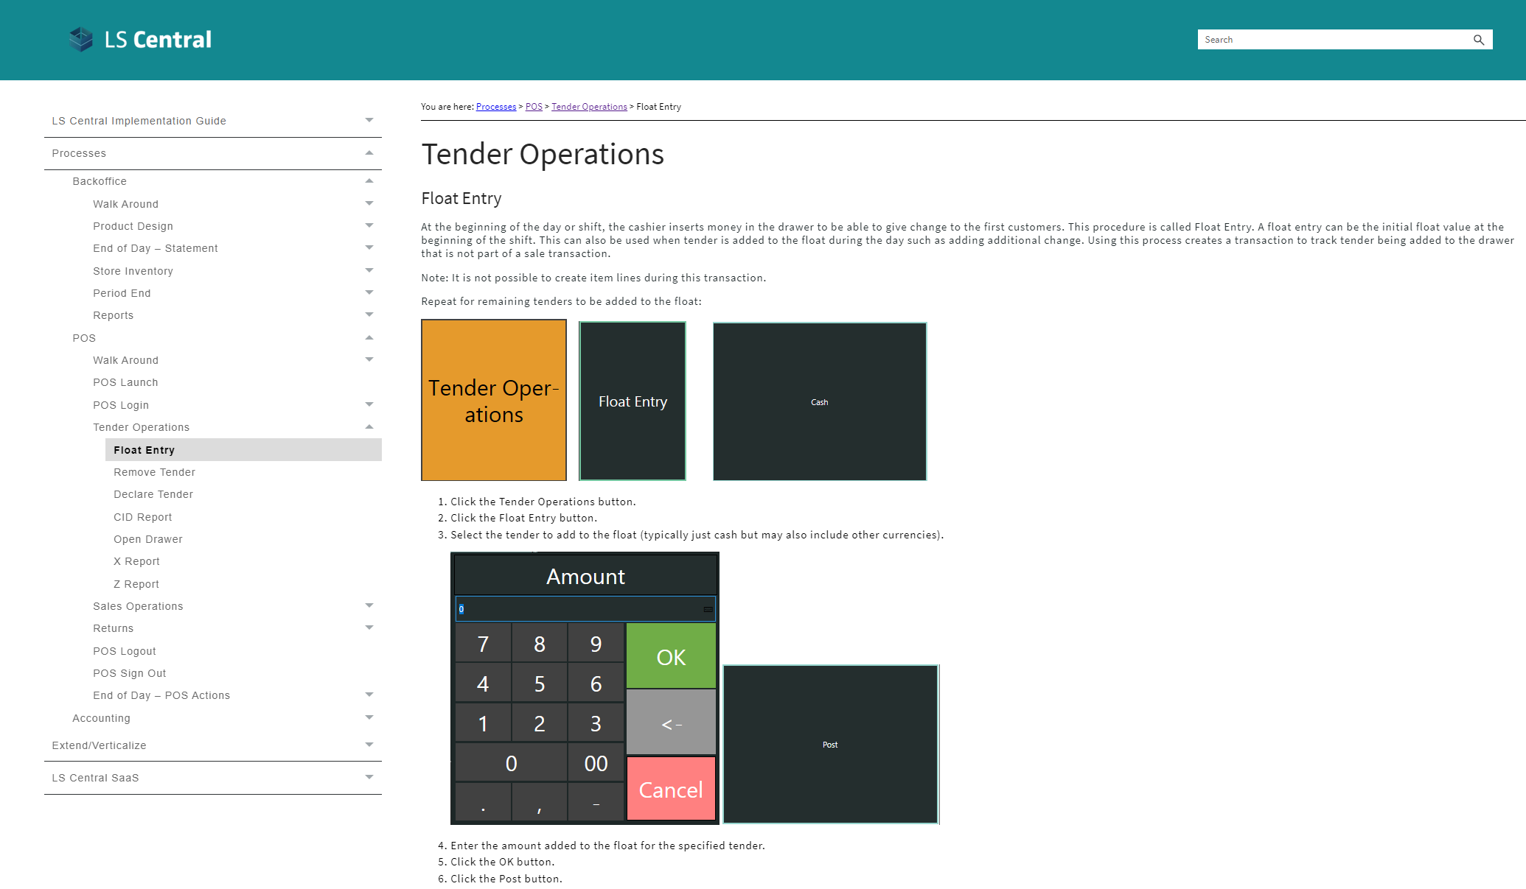
Educate your customer
Training material

Slide 18
Online or offline POS?
In LS Central SaaS, you can choose between two deployment options:
Online POS
Offline POS.
You can also combine the two.
To select the right deployment option for each customer, consider:
The pros and cons of each option alongside specific customer factors (volume of transactions, stability and quality of internet connection, etc.)
Notes:
In LS Central SaaS, you can choose between two deployment options:
Online POS
Offline POS.
You can also combine the two.
The first option should always be to go online with the POSs
But if we internet is unstable or the quality is not good, or if you have a customer with high volume of transactions (like a supermarket) we recommend going offline with the POSs.

Slide 19
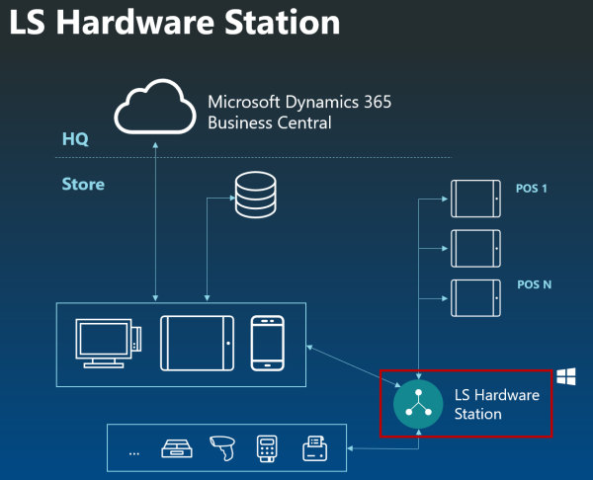
Online POS
POSs and back-office users run a modern web client and connect to the LS Central SaaS and are reliant on the internet works and they have access to the LS Central SaaS always
Software installation: Hardware station Install Hardware Station using Update Service Web Replication
Notes:
This is how the online POS works, you run the web client to connect to LS Central in SaaS. The only thing you need to setup on premise is the hardware station and the app shell. We recommend that you setup the hardware station and LS Central App shell using Update Services, this will make it easier to keep these components up to date in sync with the updates in SaaS. Data can be imported into BC in SaaS using Configuration packages or using the Cloud Migration tool For multi company or multi environment architecture, you can use Web Replication, to replicate data between companies. Here is a link to our online help with instructions on how to setup and run Web Replication in SaaS.

Slide 20
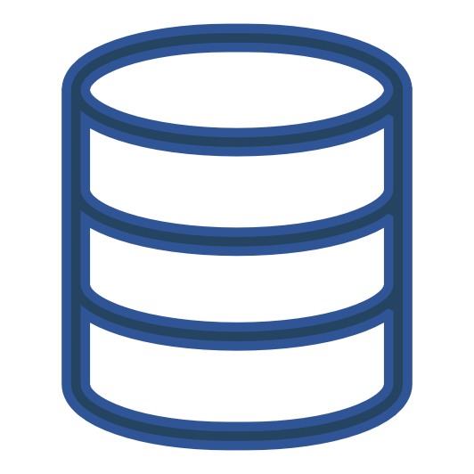
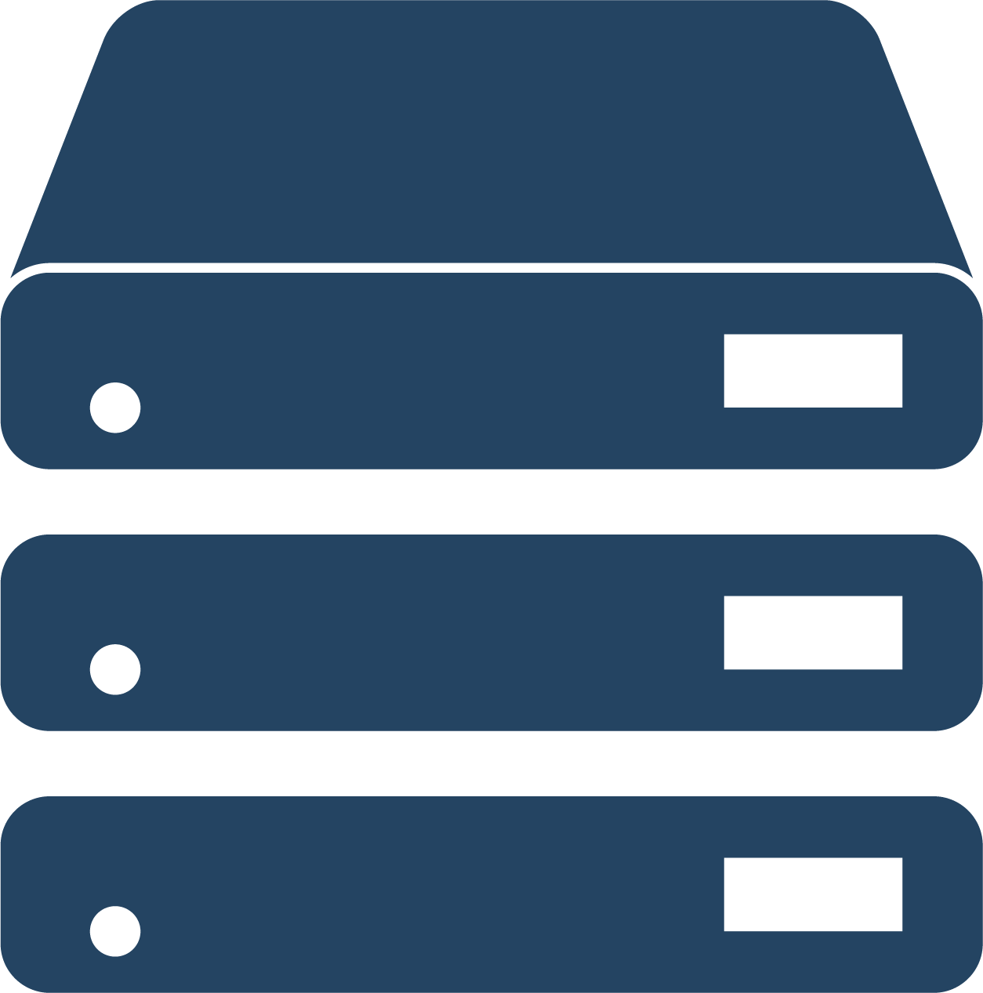
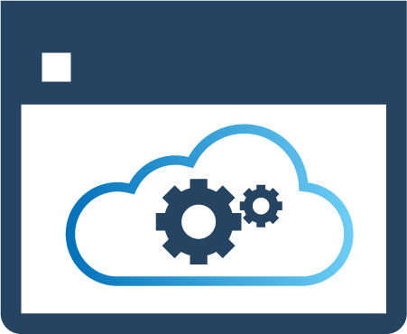
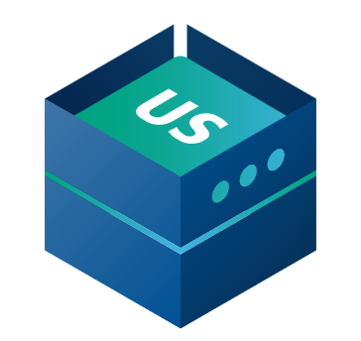
Offlin- History
Offline POS
SaaS
Hybrid Component Server
HEAD OFFICE IN BC SaaS
DD Webservice mode​
HYBRID
COMPONENT SERVER
POS MASTER
DATA DIRECTOR
UPDATE SERVICE
DD
DD
STORE 1
STORE 2
Offline POS
Offline POS
Offline POS
Offline POS
Notes:
A hybrid setup gives customers the ability to take advantage of the benefits of cloud hosting and the resilience of an offline POS.
LS Retail uses the Hybrid Component Server to achieve offline device architecture.
There are two deployment options for setting up the Hybrid model:
Offline POS Database
Offline POS Server Database
POS or Store are running fully offline
And then you have Online functionality with Web Service Requests
Send Transactions
Member Management
Customer Order
Customer validation and so forth …..
The Data Director communicates with the SaaS environment through webservice, updates are distributed to each offline POS using sql to sql replication The Update Service is used to create the middle layer, or the POSMaster that is where you run the scheduler jobs. This database is also used as the template database when creating installer for the offline POS, using Update Services. With the Update Service you can also easily and automatically roll out app updates to the offline Poses

Slide 21
Offline Offline POS POS History
Offline POS
The NEW replication
Azure Storage Replication
LS24.0
No more Hybrid Component Server
HEAD OFFICE IN BC SaaS
STORE 1
STORE 2
Offline POS
Offline POS
Offline POS
Offline POS
Notes:
Starting from LS24.0 we are offering Azure Storage replication, and this is a simplification from using Data Director. This is a pure SaaS solution and gives you the ability to run offline POS without Data Director and Hybrid Component Server.
POS or Store running fully offline, and the same as with the old Hybrid server there is
Online functionality with Web Service Requests
Send Transactions
Member Management
Customer Order
Customer validation …..
The Update Service still needs to be hosted by the customer.

Slide 22
Offline POS history
Azure Storage Account
Owned by customer
HEAD OFFICE IN BC SaaS
STORE 1
STORE 2
Offline POS
Offline POS
Offline POS
Offline POS
Notes:
Let’s go into how the Azure Storage replication works
As a first step, you need to create your own Azure Storage Account.

Slide 23
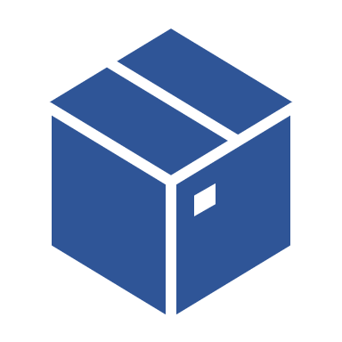
Offline POS history
Azure Storage Account
Owned by customer
Scheduler Replication Job
Creates a package
Registers destinations
HEAD OFFICE IN BC SaaS
POS | Created | Inform. | Import.
10 | X
15 | X
STORE 1
STORE 2
10
15
Offline POS
Offline POS
Offline POS
Offline POS
Notes:
You setup and run the Scheduler Jobs in HO in SaaS. When you run the job this creates the package in Azure Storage, and a record with information where the package should go.

Slide 24
Offline POS history
Azure Storage Account
Owned by customer
Scheduler Replication Job
Creates a package
Registers destinations
POS inquires about data for that POS
POS fetches package information from HO
HEAD OFFICE IN BC SaaS
POS | Created | Inform. | Import.
10 | X
15 | X | X
STORE 1
STORE 2
10
15
Offline POS
Offline POS
Offline POS
Offline POS
Notes:
In the example here POS 15 calls HO to see if there is any data for him, if there is data, HO in SaaS logs that POS has been informed about the package,

Slide 25
Offline POS history
Azure Storage Account
Owned by customer
Scheduler Replication Job
Creates a package
Registers destinations
POS inquires about data for that POS
POS fetches package information from HO
POS fetches the package from Azure Storage Account
HEAD OFFICE IN BC SaaS
POS | Created | Inform. | Import.
10 | X
15 | X | X
STORE 1
STORE 2
10
15
Offline POS
Offline POS
Offline POS
Offline POS
Notes:
the POS then goes to the Azure Storage fetches the package down to the POS it reads in the data, and once the data has been imported it updates that to HO in SaaS that it has successfully imported the data.

Slide 26
Offline POS history
Azure Storage Account
Owned by customer
Scheduler Replication Job
Creates a package
Registers destinations
POS inquires about data for that POS
POS fetches package information from HO
POS fetches the package from Azure Storage Account
Package imported to POS and marked as completed at HO
HEAD OFFICE IN BC SaaS
POS | Created | Inform. | Import.
10 | X
15 | X | X | X
STORE 1
STORE 2
10
15
Offline POS
Offline POS
Offline POS
Offline POS
Notes:
The logs in the central database or HO in SaaS are updated accordingly, there is good overview in central database of the status of the packages. In the example here, POS10 has not called for the package but POS15 has.
This new method of replication simplifies running of the offline POS, there is no middle server, or Hybrid server that you have to run on premise.

Slide 27
Before you start
It is important that you:
Have finished the LS Central General Base Course training
Know how Data Distribution and Replication is set up and works in LS Central
Basic PowerShell knowledge (Learn more)
Are familiar with Update Service (Learn more)
Notes:
Please note that we advise you not to proceed with the setup of the Hybrid Server or the new simplified offline POS unless you have completed the LS Central base training, you know how data distribution and replication is set up and works in LS Central and that you have basic PowerShell knowledge, which you need to operate the Update Service

Slide 28
Head Office in LS Central SaaS
GL/Account
It’s important to finish all setup in the Head Office Tenant before you start implementing.
Posting Groups
General Ledger Setup
Unit of Measure
Source Code
Reason Code
Payment Method
No Series
Retail Setup
Store
POS
Tender Type
Staff Permission
POS Setup
Notes:
The first step when setting up the offline POS, it does not matter if you choose the Hybrid Server or the new simplified offline POS using the Azure Storage Replication, is to setup all the date in head office in SaaS.

Slide 29
Steps to setup the Hybrid server
Steps to setup the Hybrid server manually Steps to setup the Hybrid Server using a script
Offline POS simplified Azure Storage Replication
Notes:
In our implementation guide, that is accessible from our online help, you can access a step by step guide on how to setup the Hybrid Server. The hybrid server is not a part of the SaaS service. The customer or partner needs to host it and manage it. The server can be in Azure or on an in- house server. To make the setup of the HCS as simple as possible we provide our partners with a script that automates the setup of the HCS. The script automates the process of creating an Azure virtual machine and installs the HCS components. As described in previous slides we are in the process of moving the replication and update service to SaaS. A first step in this process was taken when we released the Azure Storage replication in LS24.0, where you are running the Scheduler in SaaS and the Web Replication in SaaS pushes the package created from the source to Azure Storage Account, the Destination then pulls the package from Azure Storage. In this slide you find links to three ways to deploy the offline POS, first two using the Hybrid Component server, either setting it up manually or using a script to automate the creation of the server in Azure, and the third link is for the new Azure Storage replication.

Slide 30
What do I need to do when a new update is released?​
Update is available
Last date to schedule update
Outside upgrade window
LS Central release candidate
Upgrade window
Day 1
Day 60
Get familiar with the new release
Test your addons on the new release
Set Scheduled Update date and define update time window in the Business Central Admin Center
Notify customers
Notes:
LS Retail aligns the product development with the release timeline used by Microsoft for Business Central. This means that we will release new features for LS Central in two major release waves every year – scheduled for April and October, coinciding with the general availability of Business Central Release Wave 1 & 2. Our partners will be granted access to a feature-complete release candidate a 5-6 weeks ahead of time.
Release candidate – based on the latest LS Central version, gives you the opportunity to get familiar with the latest features and functionalities from LS Retail If you want to familiarize your self with upcoming release of Business Central please refer to the preview that they offer in SaaS
LS Central has weekly delivery of event packages that include hotfixes.
One minor versions between major versions with fixes.

Slide 31
Maintenance and upgrades
Managing updates customer tenant
Managing POS updates Online Model
Managing POS updates Hybrid Model LS Central Release Candidate page
Notes:
Links to our implementation guide on best practices when managing updates in SaaS

Slide 32
Important!
Update Window Schedule an update date
If you don't set a date in the Scheduled Update Date field, Microsoft will update the environment automatically on any day between the default date and the date that is shown as the last possible update date in your notification email. If you don't want your environment to be updated automatically, change the update date to one that fits you better.
Schedule an update date
Notes:
When creating a new Production environment in SaaS, make it one of your first tasks to set the update window for the environment. If you forget to do this you run the risk of Microsoft running updates within your customers business hours.

Slide 33
Hardware Station online in SaaS - Https
Can use http if localhost
Https recommended for increased security
SSL certificate
Self-signed for testing only
One certificate per customer setup using DNS management see link: How to use Https in LS Hardware Station

Slide 34
Application insight for telemetry
It is important to connect the tenant to Application Insights
You can monitor health, updates and also monitor if extensions are affecting performance etc.
Learn more
These videos on GitHub are helpful to guide you to connect your tenant to Application insights Here is the power BI performance report referred to in one of the videos. How telemetry can help you solve problems in a live SaaS environment
Notes:
We recommend that you connect the application insight key to your customer environment, Business Central emits telemetry data for various activities and operations on environments and apps/extensions. Monitoring telemetry gives you a look at the activities and general health of your environments/apps, so you can diagnose problems and analyze operations that affect performance.
Here are links to material from Microsoft on how to connect your environment to Application Insights and how to use the telemetry and help you optimize your SaaS environment and troubleshoot any issues that may arise.
The Business Central administration center provides some basic telemetry for the tenant environments to enable troubleshooting and support for the tenant.
The Telemetry tab provides telemetry of top-level AL events, and any errors resulting from calls through the telemetry stack.

Slide 35
Going to SaaS - how can we help you?
Pre-sales
Before go-live
After go-live
Notes:
We want you to know that we're here to support you throughout your entire SaaS project.
No matter where you're at in the process, we've got your back and want to help you out.

Slide 36
CAP
Cloud Acceleration Program
Notes:
We are thrilled to have been supporting our partners for almost three years now with our wonderful Cloud Accelerator Program (CAP)! Our CAP team is here to provide you with top-notch SaaS support in the form of engaging sessions that you can book anytime you need help with anything SaaS-related!

Slide 37
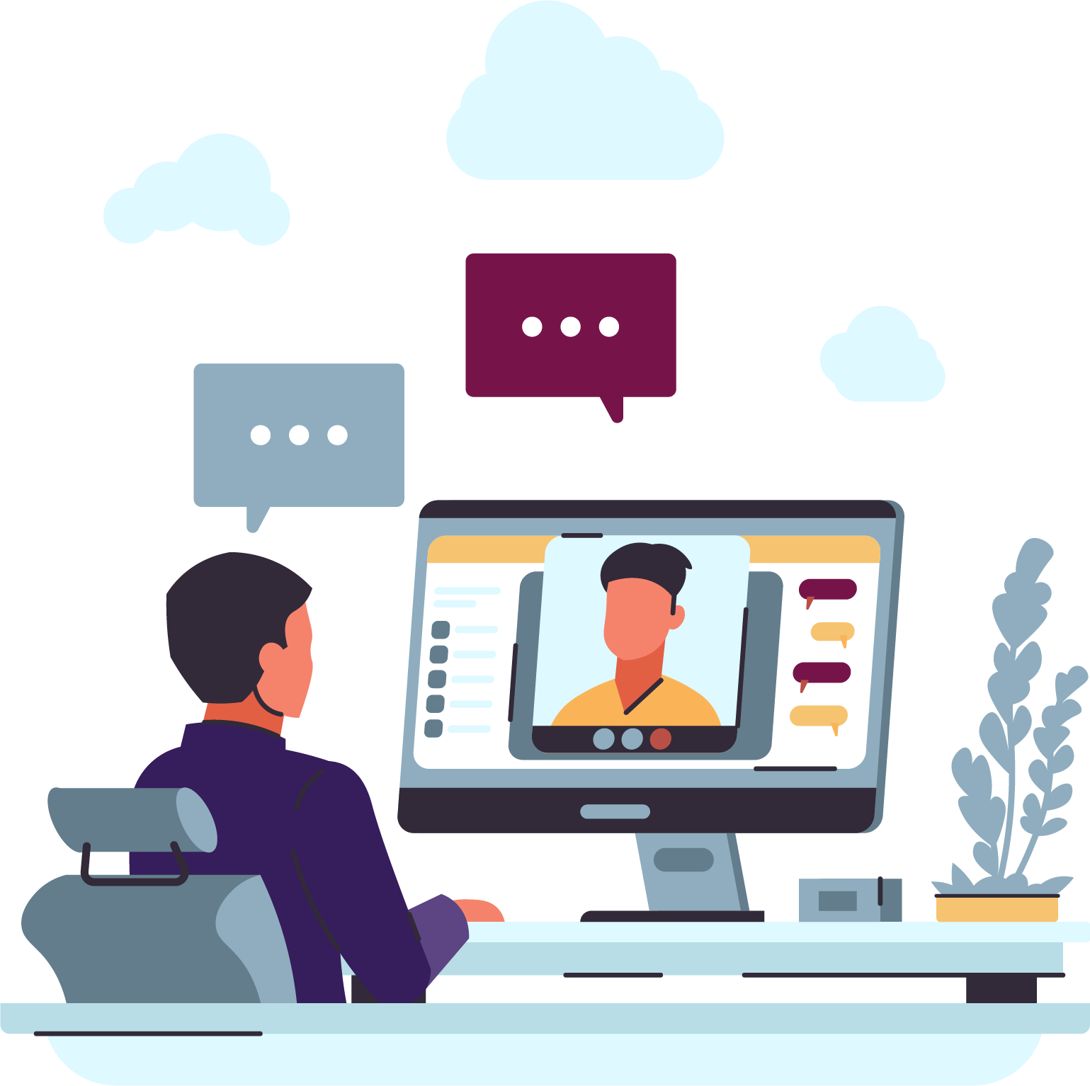
Book a session with the Onboarding and CAP Team
Book your overview session when it fits you
Use link
Link to book an Onboarding session
Do you need a 30-minute session to ask any SaaS-related questions
Use link
Link to book a session with the CAP team
More information on Onboarding SaaS and CAP
Notes:
When you sign the CSP with our partner operations team, we invite you to join an initial Onboarding session to go over the SaaS basics and answer any questions you might have about LS Central in SaaS. Here we are focusing more on the technical side of implementing LS Central in SaaS, so make sure that everyone that will be involved in implementing LS Central is joining the session. To make the best use of everyone's time, we provide you with a link with a recording to watch before hand, that is this recording, then you can leave all the questions that arise for the online Teams session.
Booking a session with our Onboarding SaaS and CAP team is easy! Simply use the link we provide here on the slide, and our team will be ready and waiting to assist you. We believe in your potential for growth and success, and we are here to help you every step of the way.
If support is needed after the onboarding session, we offer a 30-minute session with the CAP team to help you address any SaaS related topic. When booking this 30min session, please specify your topic, more details the better we can arrange the right support for you within the session to make it a success. You find all information about the Onboarding session, and the prerecorded video and the Cloud Accelerator Program under Onboarding LS Central in SaaS page on the partner portal.

Slide 38
Thank you

