Slide 2
Serving the future
What is new in LS Central for restaurants
Anna Kristín Jeppesen
Alejandro Vazquez
Wesley Silva
Principal Product Owner
Principal Consultant
Senior Developer

Slide 3
The future of restaurants is here
Technology
Solutions
Benefits

Slide 4
Successful restaurants
Delicious
food
Great location
Excellent
customer service
Unique concept

Slide 5
LS Central for restaurants
Functionality
Item, recipes and modifications
Deal for meals
Table management
Reservation and Allocation
Self Service
Kiosk
Ecommerce and QR ordering
Kitchen Display System
Types of restaurants
Fast-food
Ghost kitchen
Food trucks
Cafés
Breakfast and brunch
Bars and pubs
Fine dining
Pop-up restaurants

Slide 6
Ease of order taking
Modification of items and deals
Change quantity
Edit modifiers
Modifier unit of measure from parent
Modifier default selection
Modifier groups in one panel
Split line
Edit journal line menu specific to line type

Slide 7
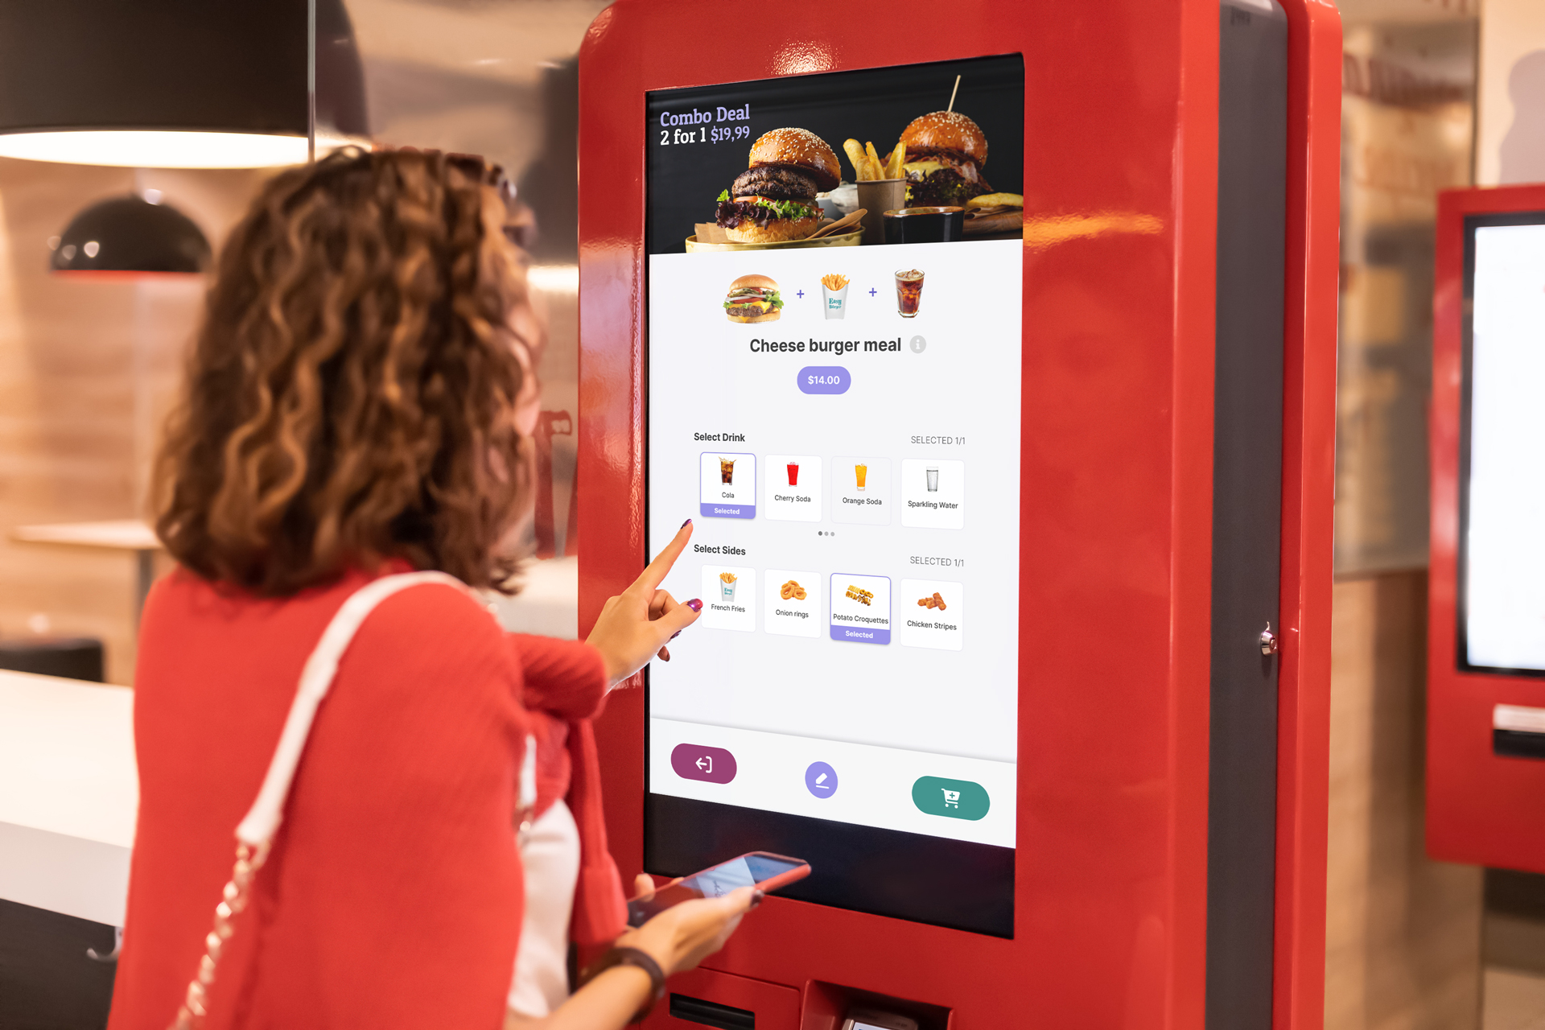
Customer Self Service

Slide 8
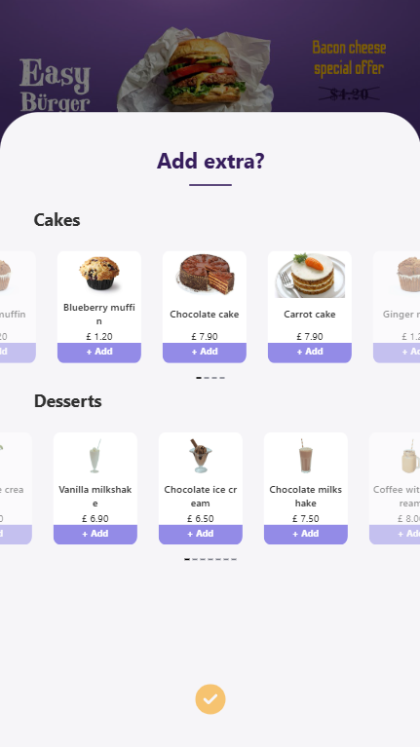
Upselling and Cross Selling
Upselling
Sell a burger suggest a deal
Cross sell
Offer additional items
When adding an item
At checkout

Slide 9
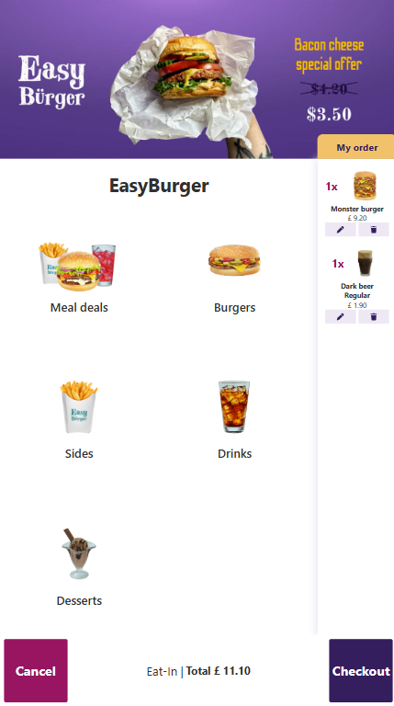
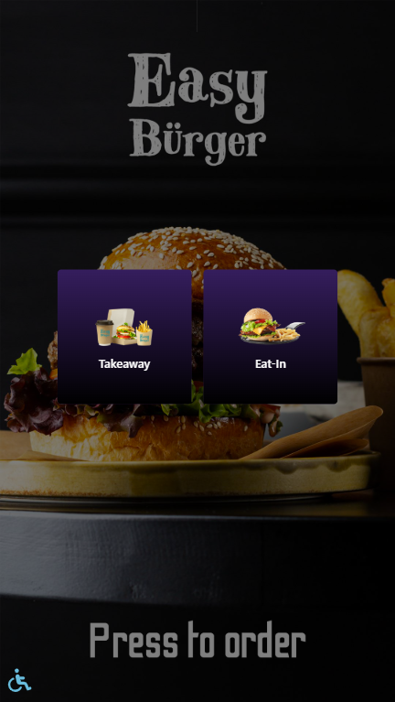
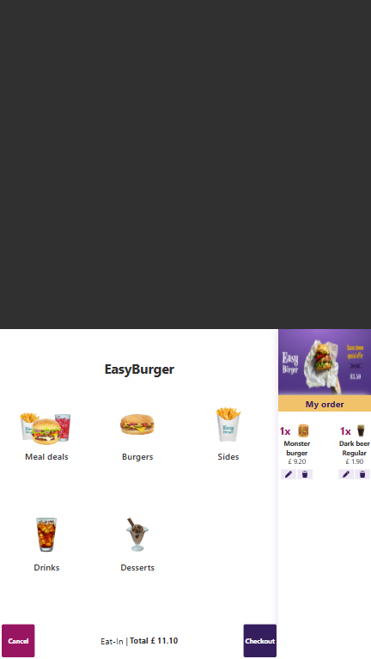
Accessibility

Slide 10
Accessibility

Slide 11
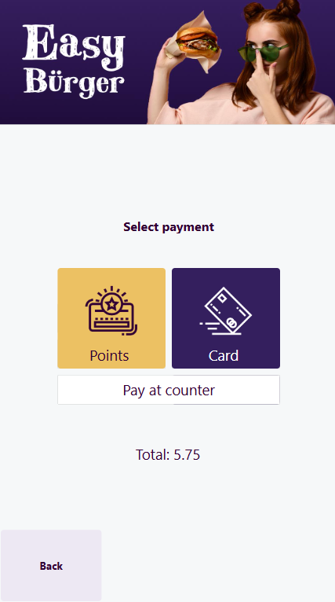
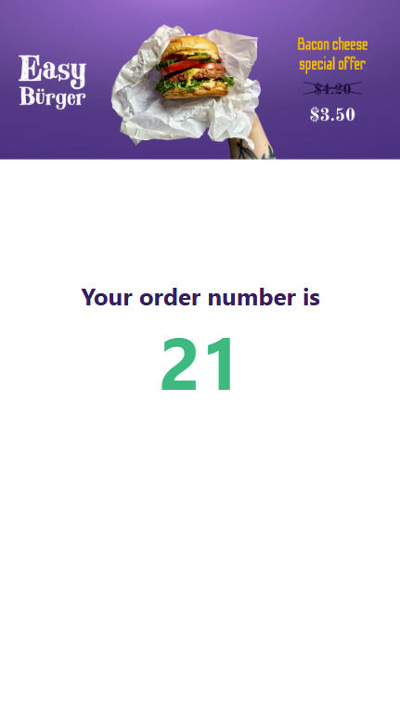
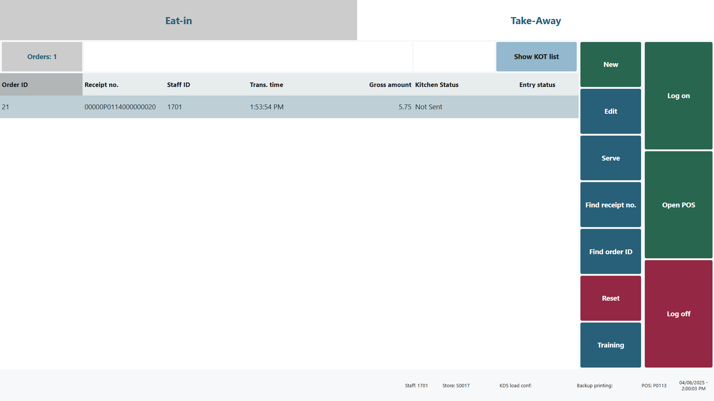
Pay at Counter

Slide 12
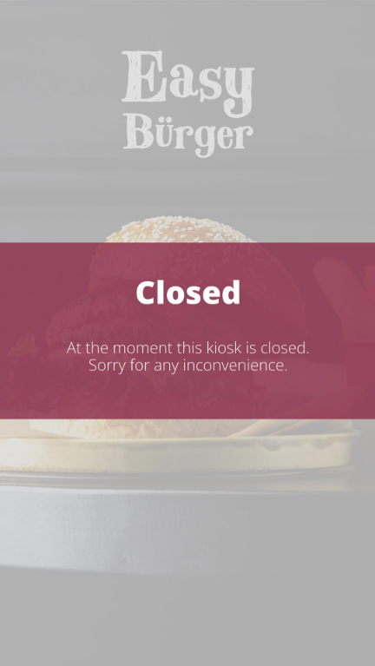
Kiosk Closed
Restaurant calendar
Self Service Kiosk Profile

Slide 13
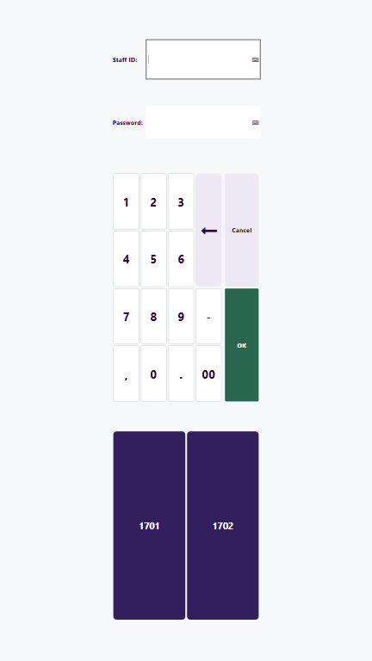
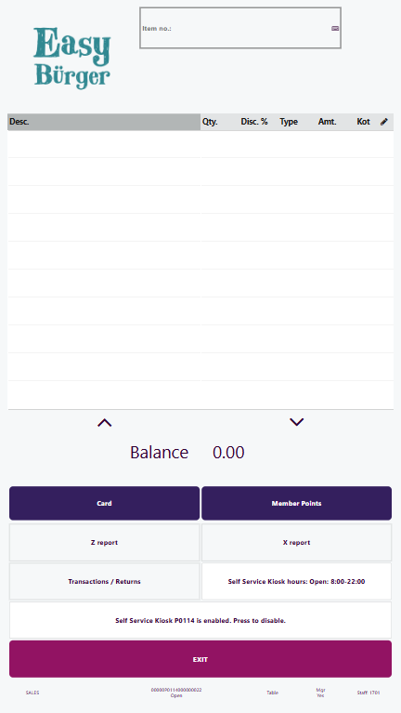
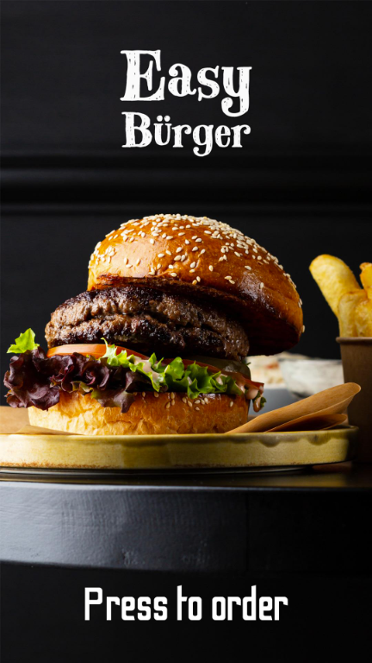
Manager Panel
POS panel
Printing Z reports
Enabling/disabling the Kiosk
Refunding transactions
Configured in Self Service Kiosk profile

Slide 14
Customers serve themselves
Order host to work with orders coming from ecommerce
QR orders – Group orders
Print a QR code specific for a seating

Slide 15
Data-driven decisions
Analytics for LS Central
Hospitality reports

Slide 16
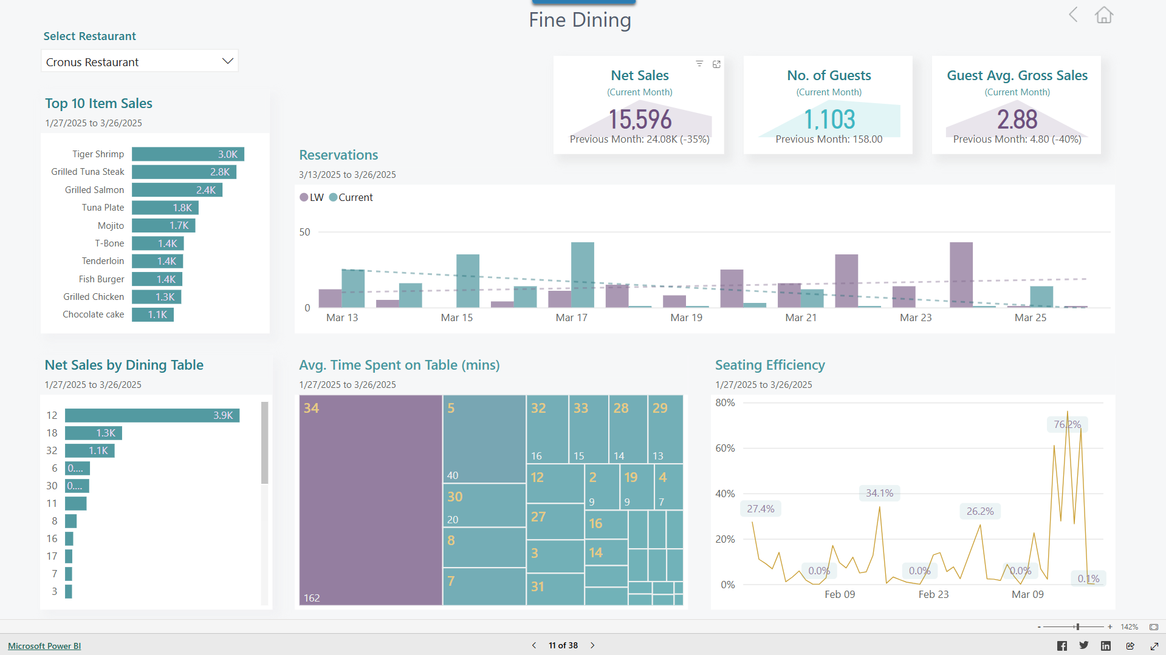

Slide 17
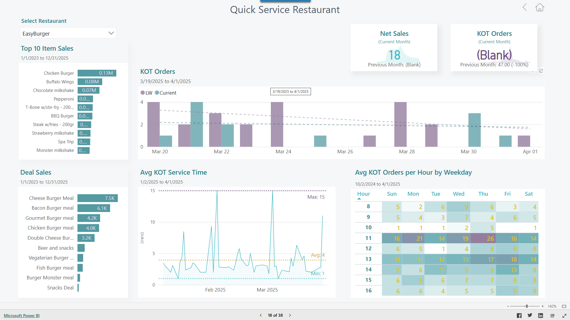

Slide 18
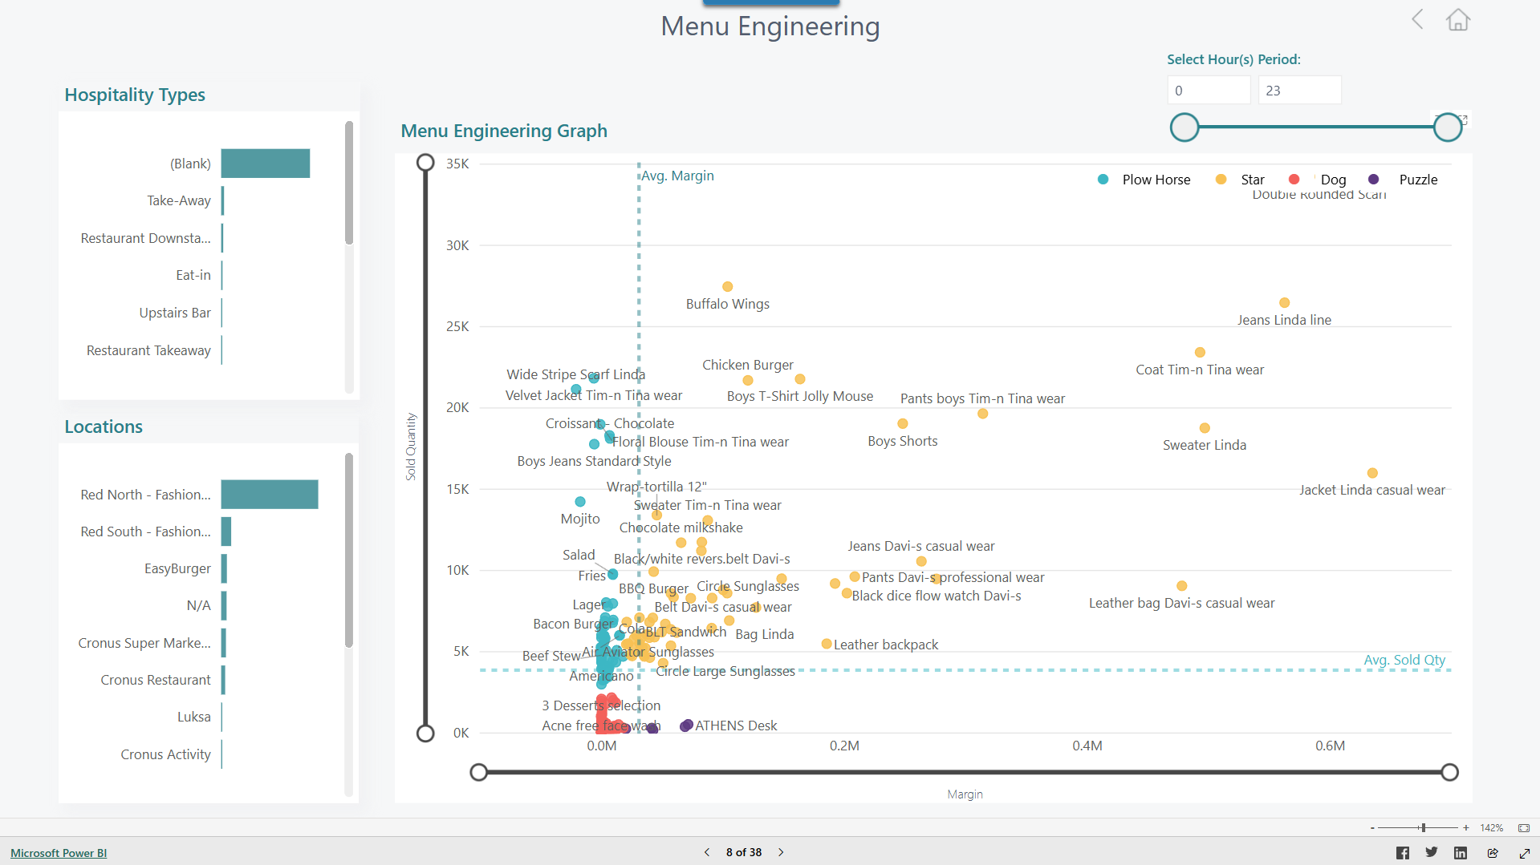

Slide 19
Kitchen efficiency
Web based kitchen display system
Hardware agnostic
Tablets
Load balance or manual assignment
Undo
Ghost stations
Flexible CFD
Print tickets or labels
Kitchen manager dashboard
Kitchen robotics?

Slide 20
System overview
POS
Printers
Hardware station
Kitchen screens
Multiple Business Central Service Tiers
Business Central Service Tier
Kitchen Service
Ecommerce

Slide 21
Burger group
Expeditor
Burger 1
Kitchen
Drinks
Bar

Slide 22
Burger group
Expeditor
Burger 1
Customer facing display
Kitchen
CFD
Drinks
Bar

Slide 23
Burger group
Assembly group
Expeditor
Burger 1
Assembly 1
Customer facing display
Kitchen
CFD
Drinks
Bar

Slide 24
Burger group
Assembly group
Expeditor
Burger 1
Assembly 1
Customer facing display
Burger 2
Assembly 2
Kitchen
Burger 3
Assembly 3
CFD
Drinks
Bar

Slide 25
Assign
Burger group
Assembly group
Expeditor
Burger 1
Assembly 1
Customer facing display
Assign
Burger 2
Assembly 2
Kitchen
Burger 3
Assembly 3
CFD
Drinks
Bar
Bar

Slide 26
Assign
Burger group
Assembly group
Expeditor
Burger 1
Assembly 1
Customer facing display
Assign
Burger 2
Assembly 2
Kitchen
Burger 3
Assembly 3
CFD
Ghost Burger
Drinks
Bar
Bar

Slide 27
Burger group
Assembly group
Expeditor
Burger 1
Assembly 1
Customer facing display
Burger 2
Assembly 2
Kitchen
Burger 3
Assembly 3
CFD
Ghost Burger
Drinks
Bar

Slide 28
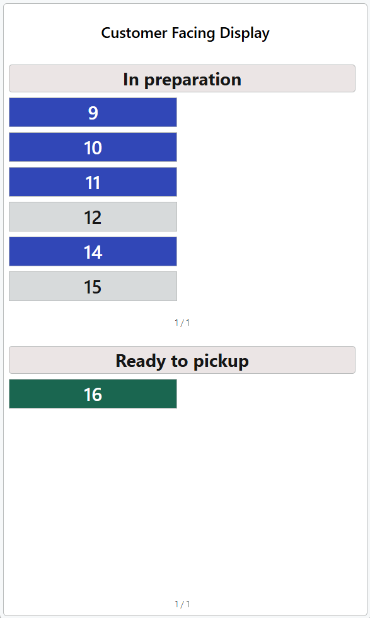
Customer facing display

Slide 29
Roadmap for version 27
General F&B
Kiosk
Web KDS
Tips handling enhancements
Enhancements to reservations and allocation
Order host enhancements
Item modifier enhancements
Color palette configurations
LS Central pushes the KOT to KDS
More flexibility in button setup
Turn display on/off
Line aggregation
Route item modifiers as items
Media component
Preparation instructions

Slide 30
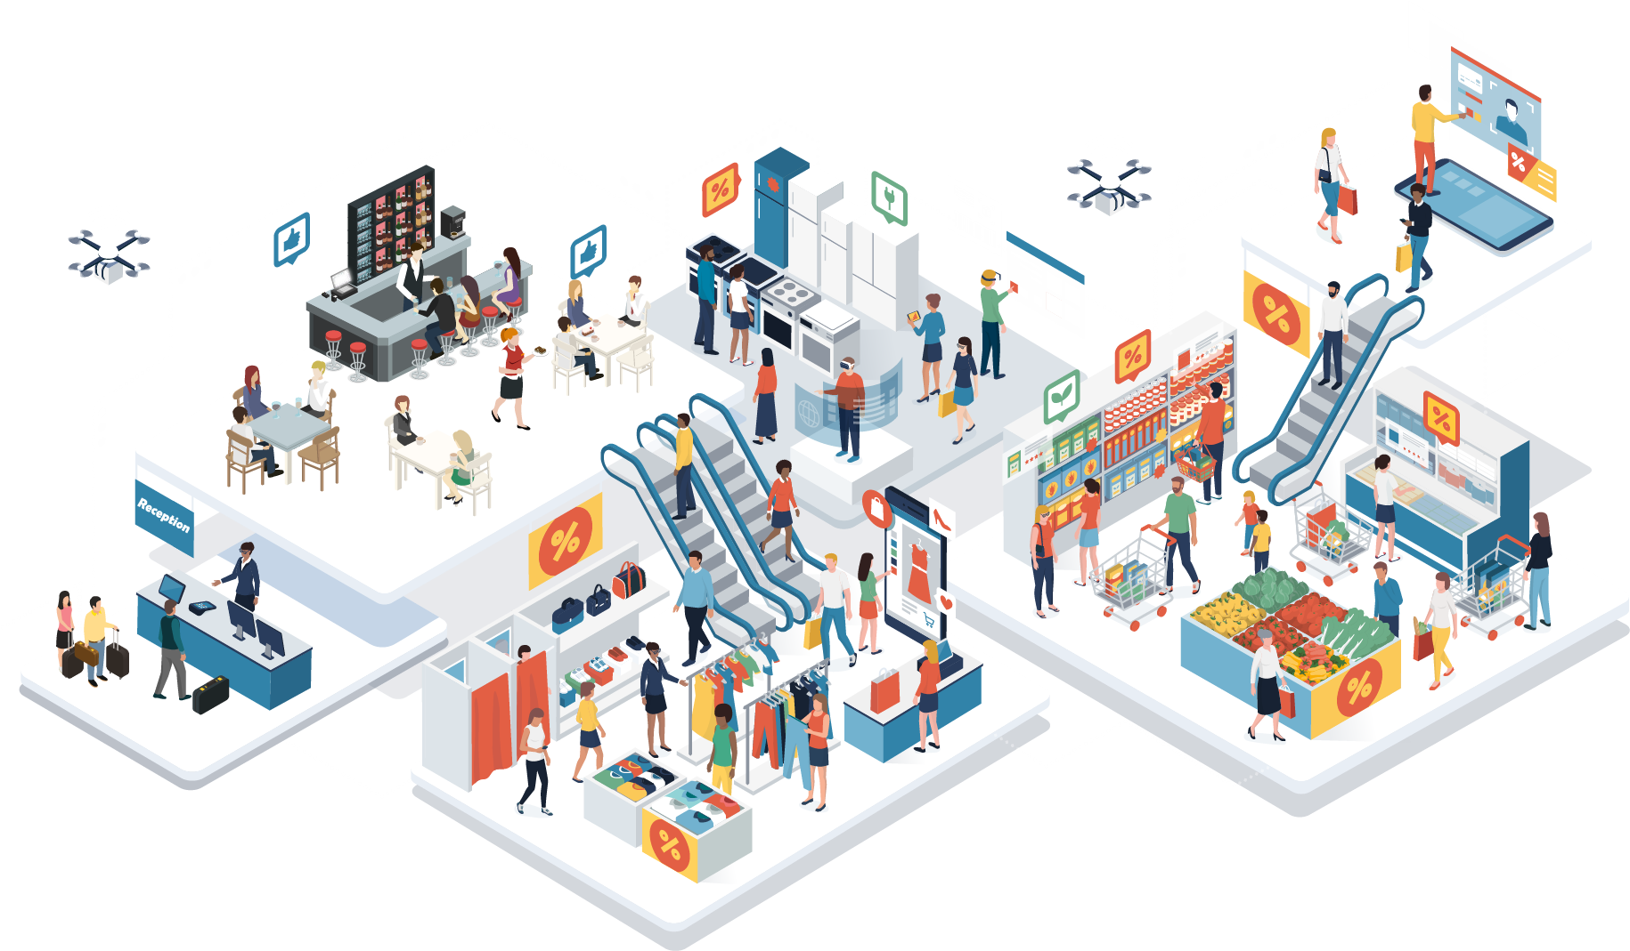
Consulting services
Workshops
Training sessions
Implement
eCommerce
Virtual Machines
Customization
LS Retail MaxAttention

