Slide 1
LS Central for hotels
Gunnar Örn Þorsteinsson
Product Director
Not just a PMS!
Anna Dís Þorvaldsdóttir
Consulting Manager

Slide 2
Introduction to LS Central for hotels
Introductions to other unified experience modules
DEMO
Our journey today…
Customer stories
New features and road map
Q&A

Slide 3
LS Central extends
Microsoft Dynamics 365 Business Central
Modular development framework
Ability to extend functionality without impacting base code
Built for upgradability
Microsoft AppSource marketplace
You can choose what you need and stay current with new features and compliance.
Bookings
PMS
Analytics
LSC integrated tools
Partner enhance-ments
LS Central Localizations
AppSource add-ons
LS Central System App
Microsoft Dynamics
365 Business Central System App

Slide 4
Add more functionality when needed
KDS
PMS
Bookings
Analytics
Expand the system with more functionality when needed – no complex integration required, as it’s designed to work together
LS Pay
Retail

Slide 5
Analytics
KDS
Bookings
A single system
LS Pay
PMS
LS Central

Slide 6
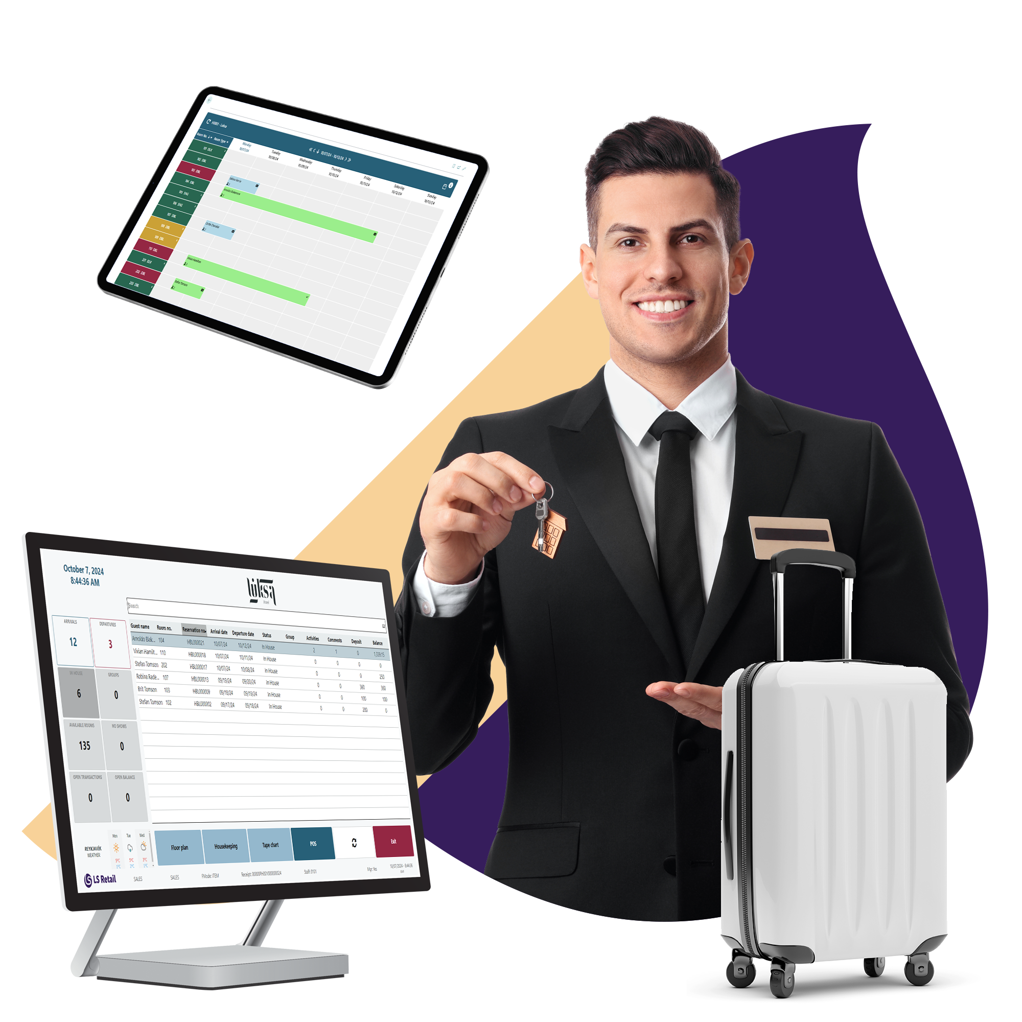
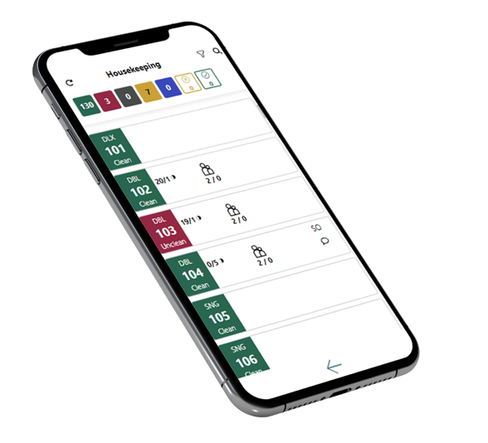
A leading end-to-end solution

Slide 7
Benefits of using LS Central modules
Flexibility
Offer and manage diverse range of services through single software platform
Powerful and visual POS
Equip staff with the right tools to:
Increase efficiency
Have complete guest overview
Make the experience personal and seamless
Single point of truth for data resulting in better and easier reporting

Slide 8
LS Central for Hotels
Property Management
Rate Management
Reservation Management
Invoice Management
Housekeeping
Hotel POS
Channel Management
Open Web APIs
Reports

Slide 9
Rate Management
Dynamic rates
Rate attributes
Posting patterns
Per reservation or per guest
Retail items / Activities
Derived Rate Codes
Periods or specific days
Discounts
Restrictions & overbooking limitations
Hotel policies for cancellations and deposits

Slide 10
Reservation overview
Overview of all reservation details in back office and at check in
Comments to view guest requests and information
Check availability book services to the reservation for other locations in the POS
Charge to room from the restaurant or retail shops
Flexibility to change dates, activities, etc.

Slide 11
Invoice Management
Folio management
Routing Rules to move charges to different folios
Deposits
Night Audit management

Slide 12
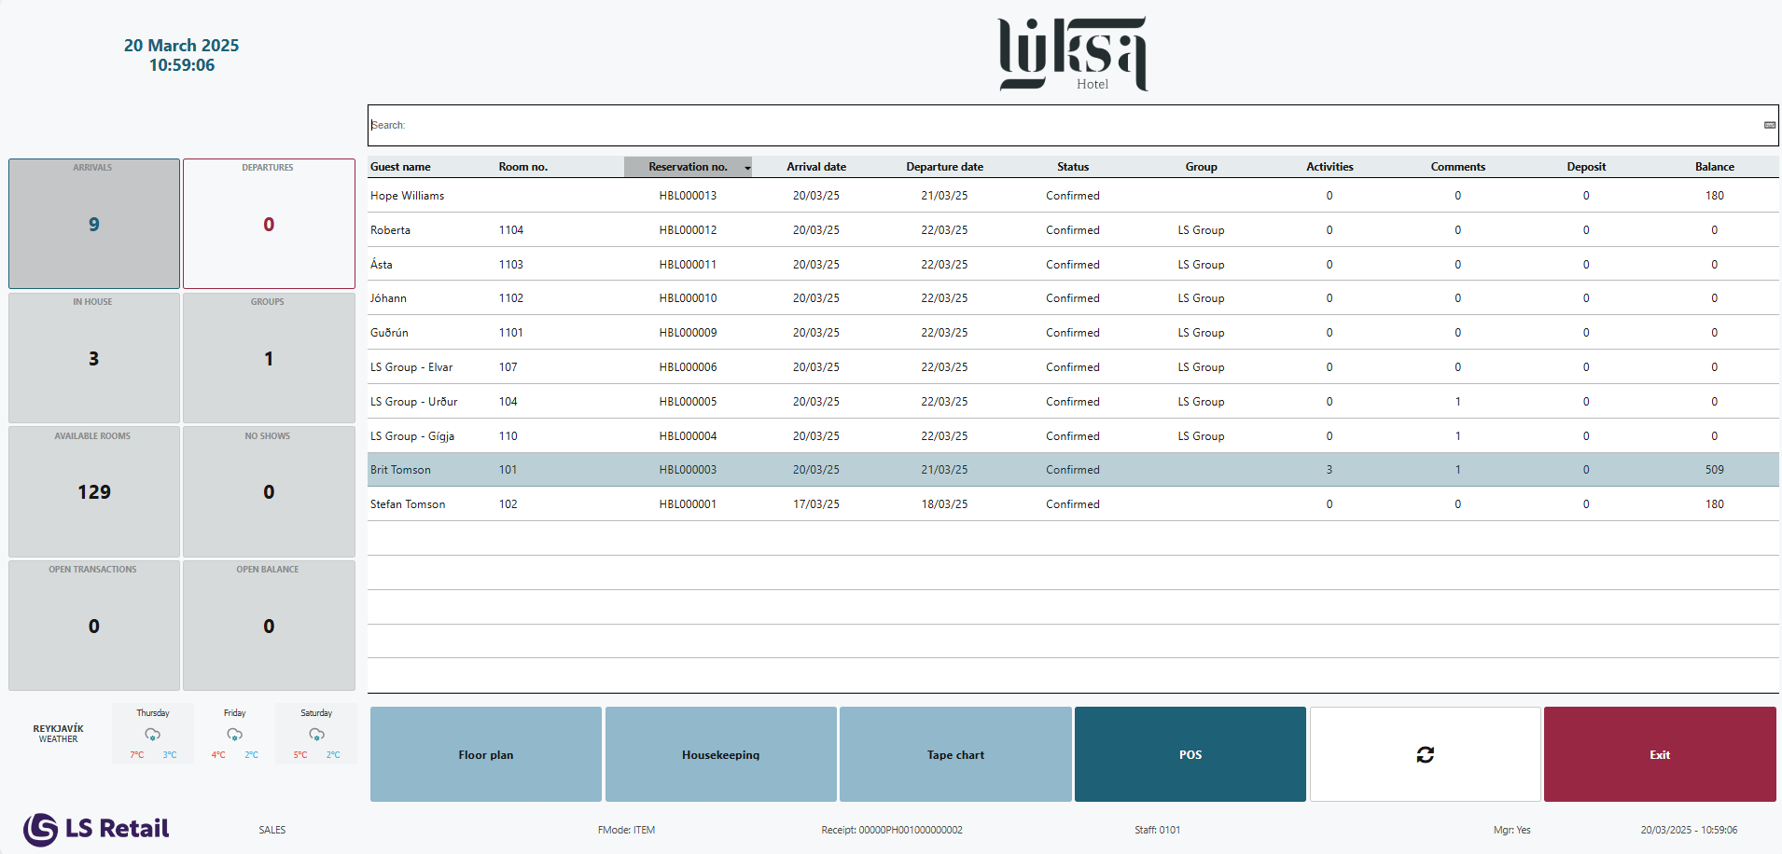
The Hotel POS

Slide 13
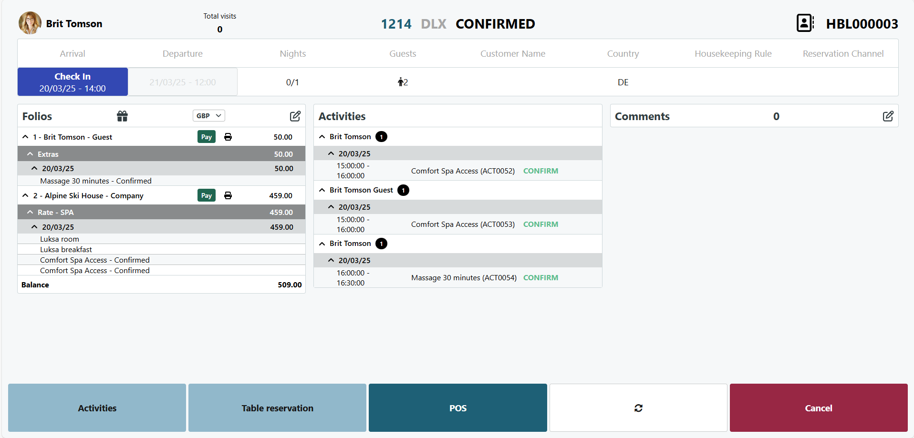
Reservation panel

Slide 14
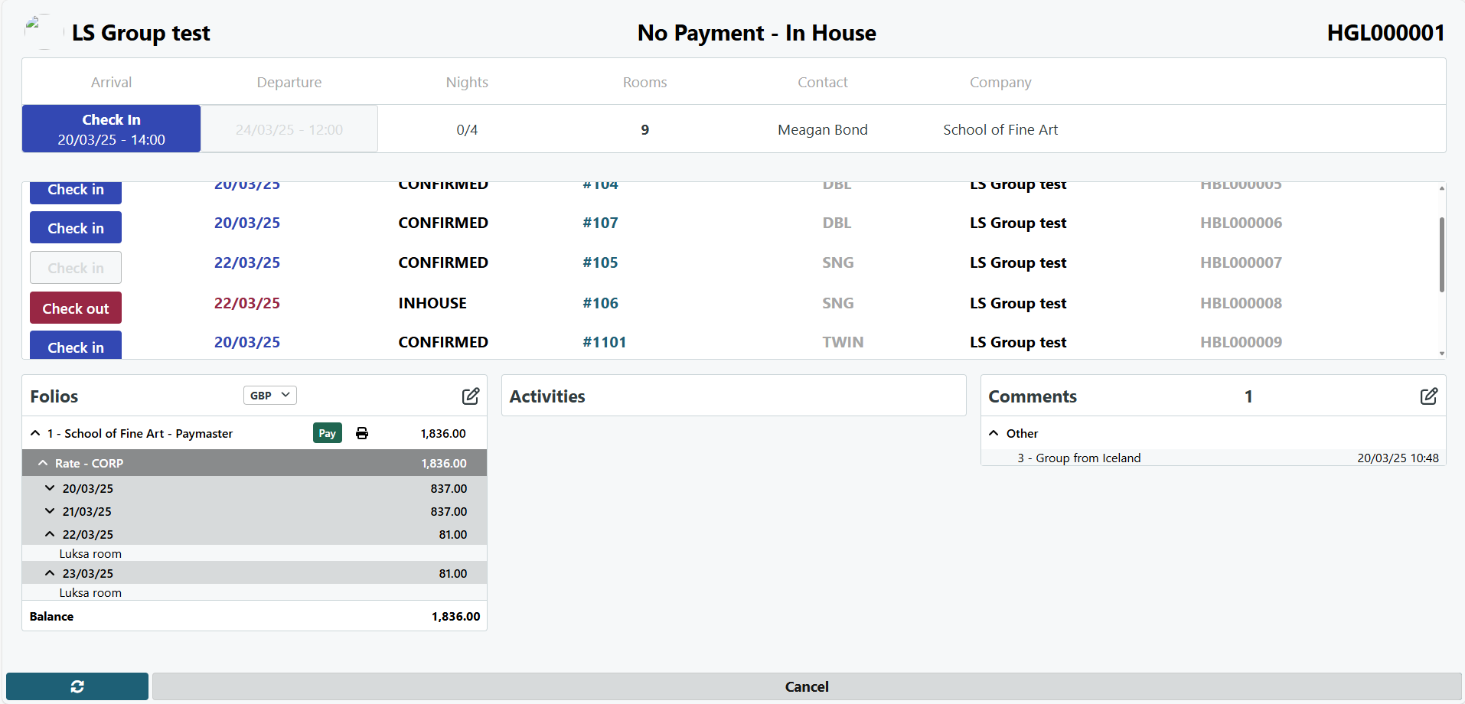
Group reservation panel

Slide 15
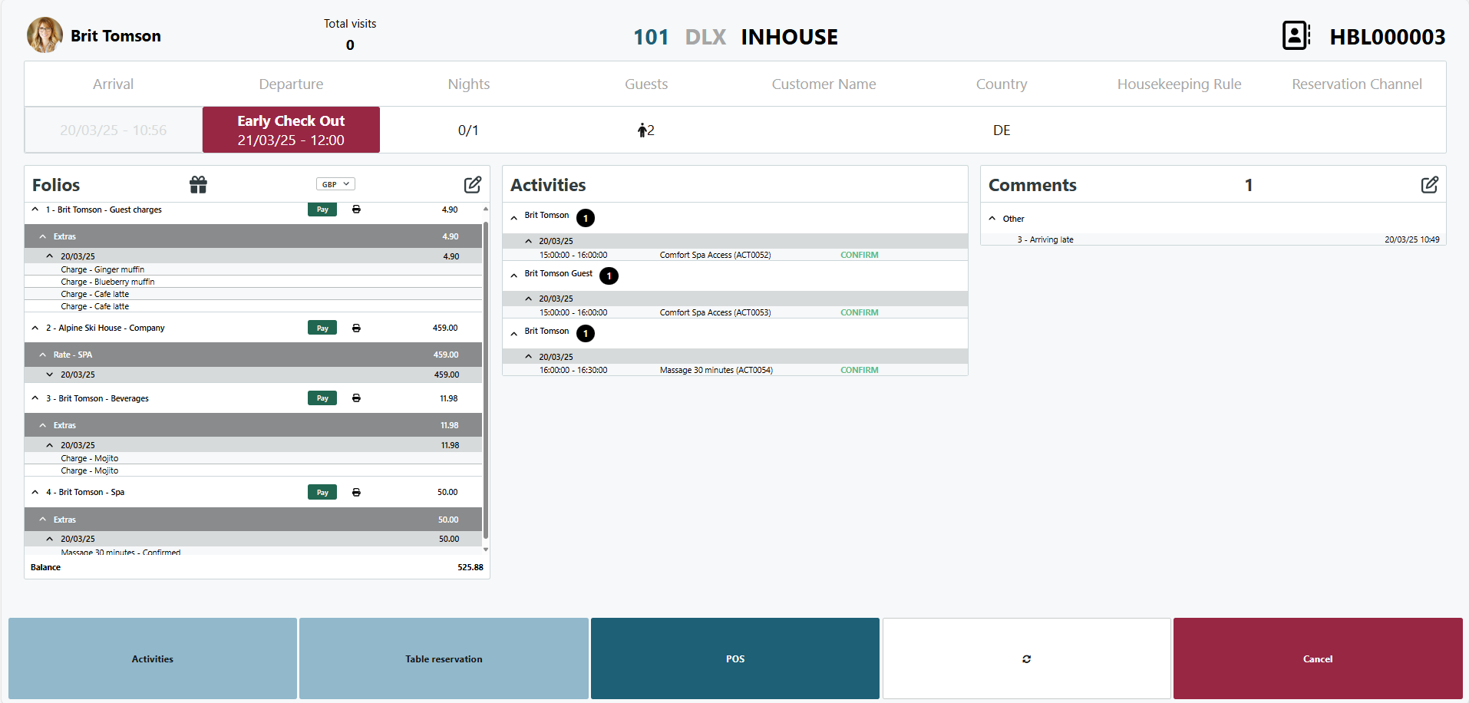
Folio management

Slide 16
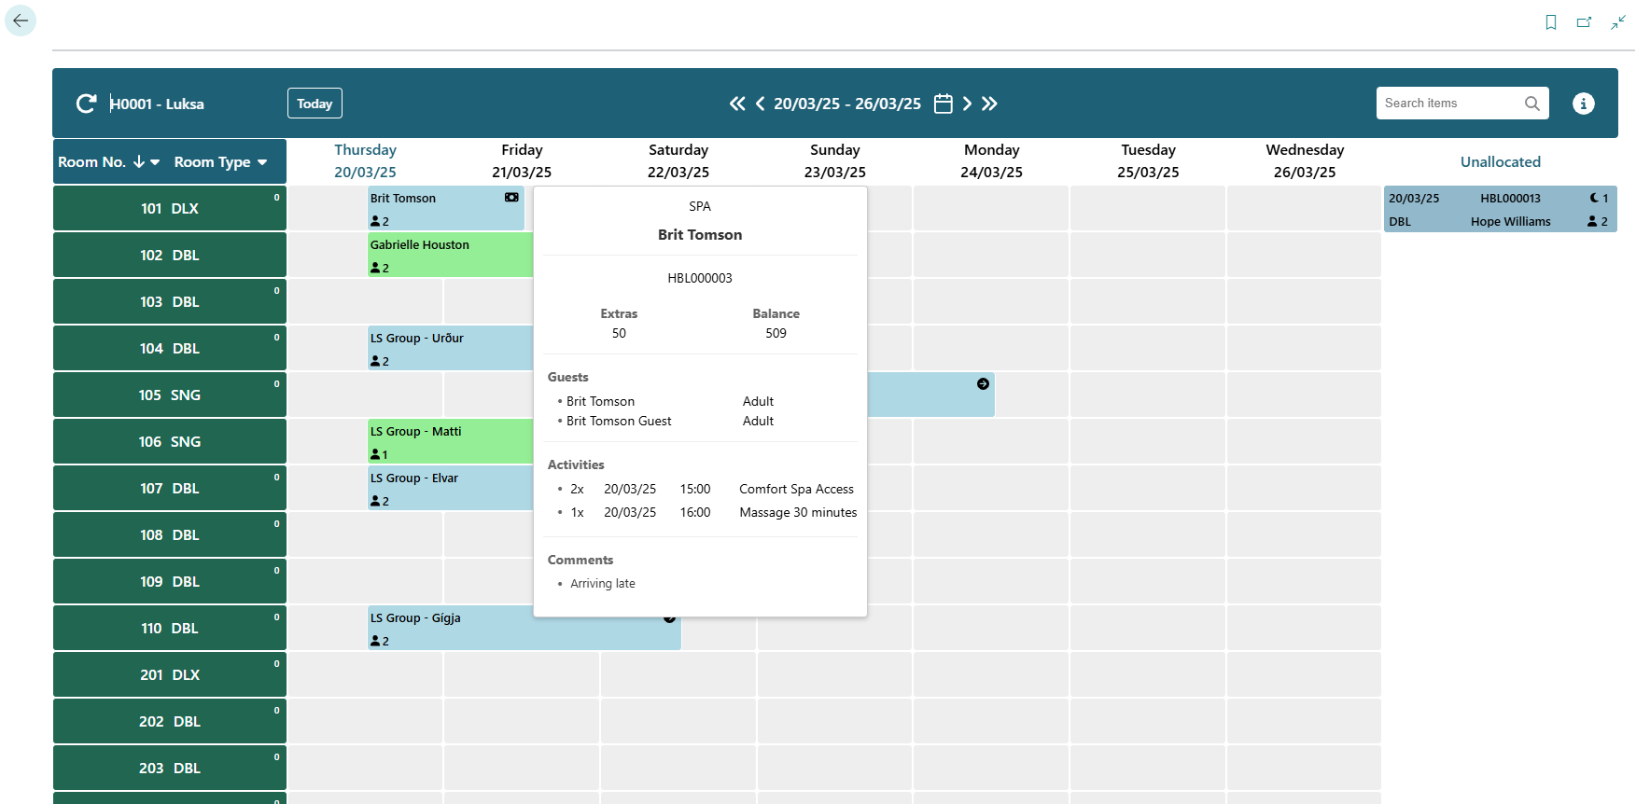
Tape Chart / Calendar View

Slide 17
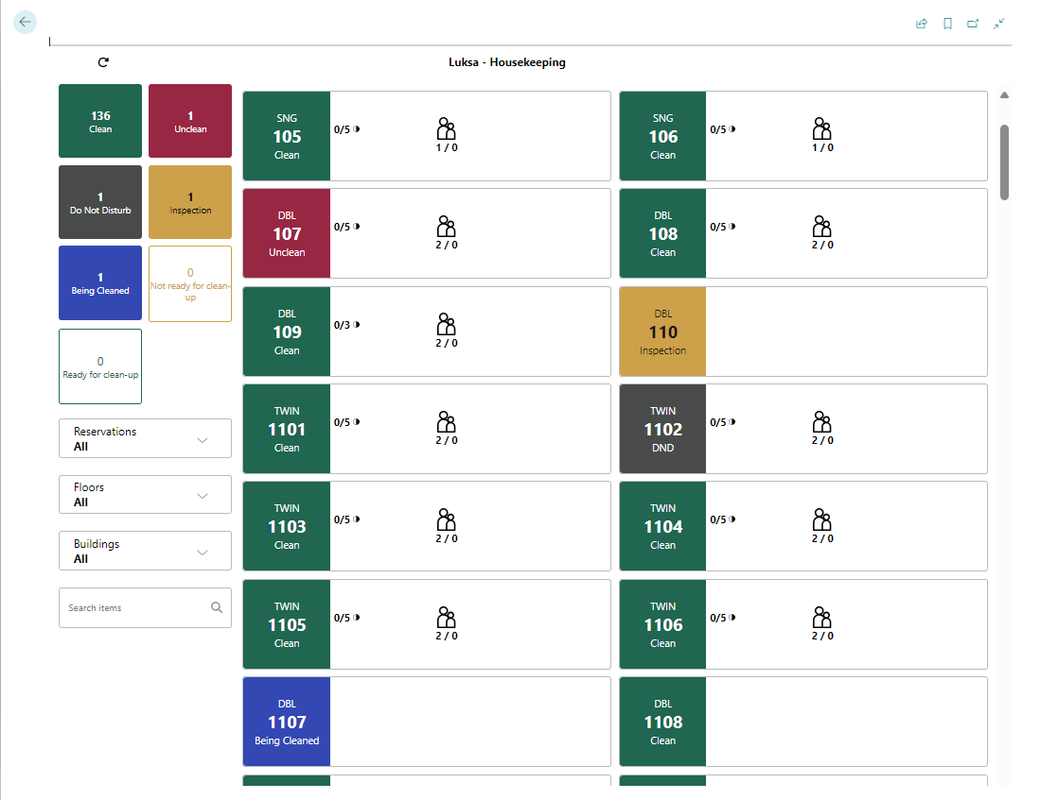
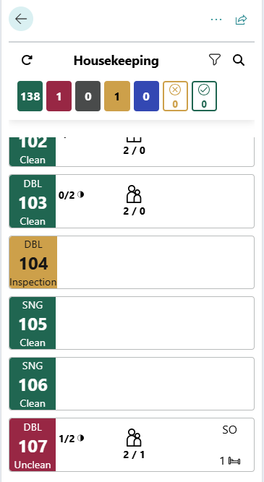
Housekeeping

Slide 18
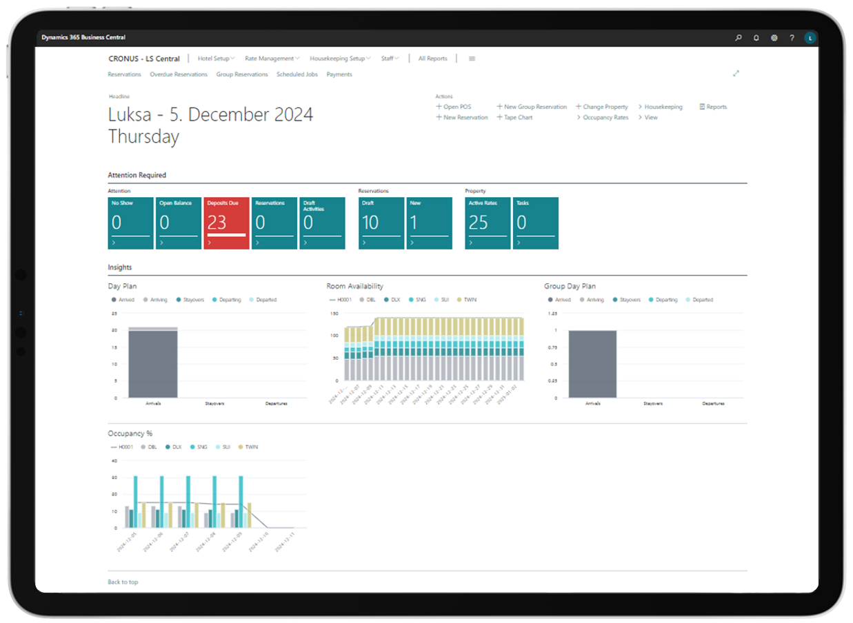
Different Role Centers
Hotel Back Office
Front Desk
Housekeeping

Slide 19
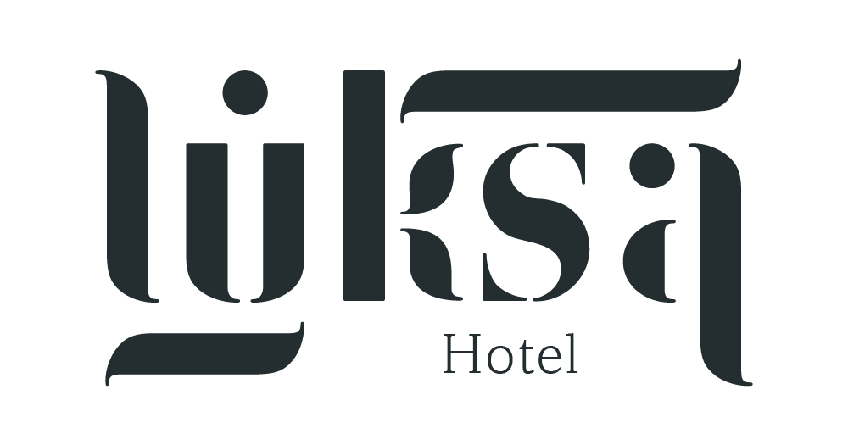
Booking Engine Connector
Channel Management Systems
Connects to Channel Management Systems or directly to booking engines (OTA)
Multi-property and multi-channel management
LS Central for hotels is certified by SynXis, SiteMinder and Channex
BEC is extensible so partners can write own BEC plugins (certification) instead of using connectors provided by LS Retail
Booking Engine Connector
LS Central for Hotels

Slide 20
Hotel Web APIs
Get list of Rate Codes
Manage reservations
Create
Update
Cancel
Get available discounts
Payments
Deposit
Refund

Slide 21
Hotel Reports - Microsoft Power BI
Link to PowerBI

Slide 23
Bookings for LS Central
Reservations / Appointments
Resource management
Package offers and allowances
Ticketing and access control
Classes and courses
Memberships & Subscriptions
Powerful visual POS
Events
Rental
Open Web APIs
Reports

Slide 24
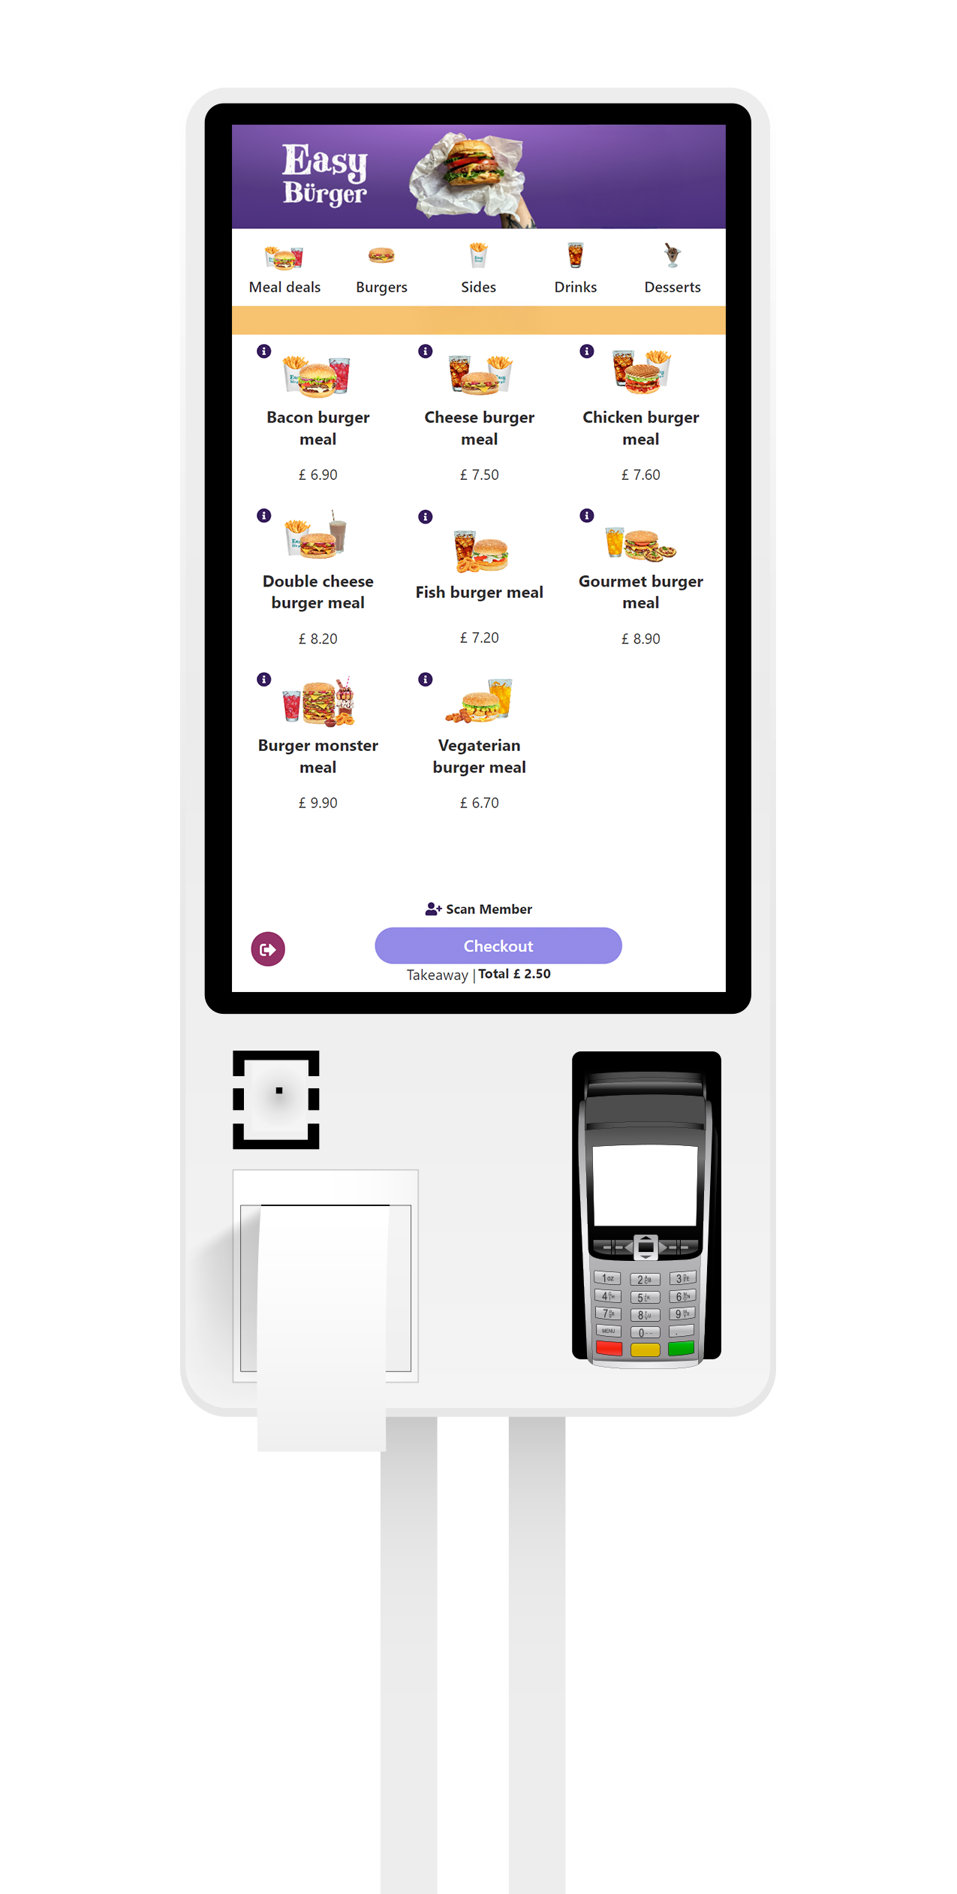
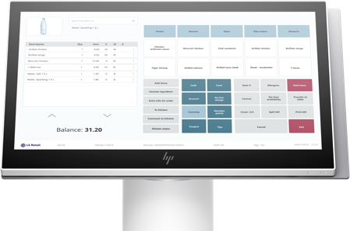
LS Central for restaurants

Slide 25
LS Central for restaurants
Seamless restaurant flow
Table management
Table reservations
Fast-order taking
Kitchen display system
Self-service kiosks
QR ordering

Slide 26
DEMO

Slide 27
Customer stories

Slide 28
Booking Engine Connector
Connects to Channel Management Systems or directly to booking engines (OTA)
Multi-property and multi-channel management
LS Central for hotels is certified by SynXis and SiteMinder
BEC is extensible so partners can write own BEC plugins (certification) instead of using connectors provided by LS
Channel Management Systems
Booking Engines
(not yet supported)
Booking Engine Connector
LS Central for Hotels

Slide 29
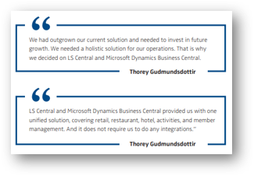
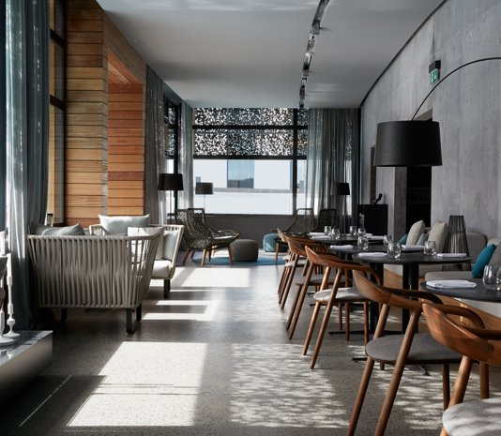
Blue Lagoon implementation
Challenges
Outgrown their solution
Multiple systems
Missing transparency
Their vision
Overview of guest journey with reservation details
Empower staff with tools to provide better service
Packages with services from multiple departments
System supporting new services and growth

Slide 30
Blue Lagoon Implementation
Project approach
Close cooperation between consulting, development and partner
LS Retail was leading the implementation in Bookings for LS Central, LS Central for hotels and restaurants.
Partner took the lead of environments setup and BC, finance
Environments have been updated to newest version throughout the project, currently on LS Central 24.1 but upgrading to 25.3 in May 2025

Slide 32
New features & roadmap

Slide 33
Hotels v26
Multiple accommodation tax support
Hotel POS
Refund folio transaction
Show folio values in different currencies
Usability enhancements
Reservation management
Create and check in reservation after midnight
Enhanced planning and working with room stay
Enhanced group reservation management

Slide 34
Hotels v26
Rate management
Easier to update derived codes
Edit day rates
Invoice management
Enhanced usability
Tape chart
Filter on available rooms for a date
Search on tape chart
Hover on un-allocated reservations

Slide 35
Hotels v27
Invoice management
POS charges – partial payments
Night audit processes
Post Sales Invoices directly from hotels
Prepayment Sales Invoices and Credit memos for hotels
Pay invoice in same currency as rate code
Hotel integrations
RMS – Atomize
Create hotel reservation from booking reservation

Slide 36
Hotels v27
Tape chart
Filter on room locations
Auto-allocate actions
Switch rooms
Rate management
Promo codes for reservation
Default location on activities in rate attributes
Reservation management
Usability enhancements

