Slide 1
eCommerce for LS Central
What’s new?
Fernando Romero Buck

Slide 2







3rd party
eCommerce
providers
eCommerce API
Commerce Service for
LS Central
Local Inventory

Slide 3


What’s new?
Retail
Restaurants
Stand-alone
integration options
Improved QR code
group ordering
Time based discounts
Queue counter support
Push notifications (PWA)
Code coverage
Code coverage

Slide 4

What’s new?
Retail
Smart order routing
Data translations
GraphQL Transitions (Ph 1)
Collection support
Partial shipments
Store send
Two-way member sync
Web hook configuration

Slide 5
Google
Local
Inventory
Ads

Slide 6
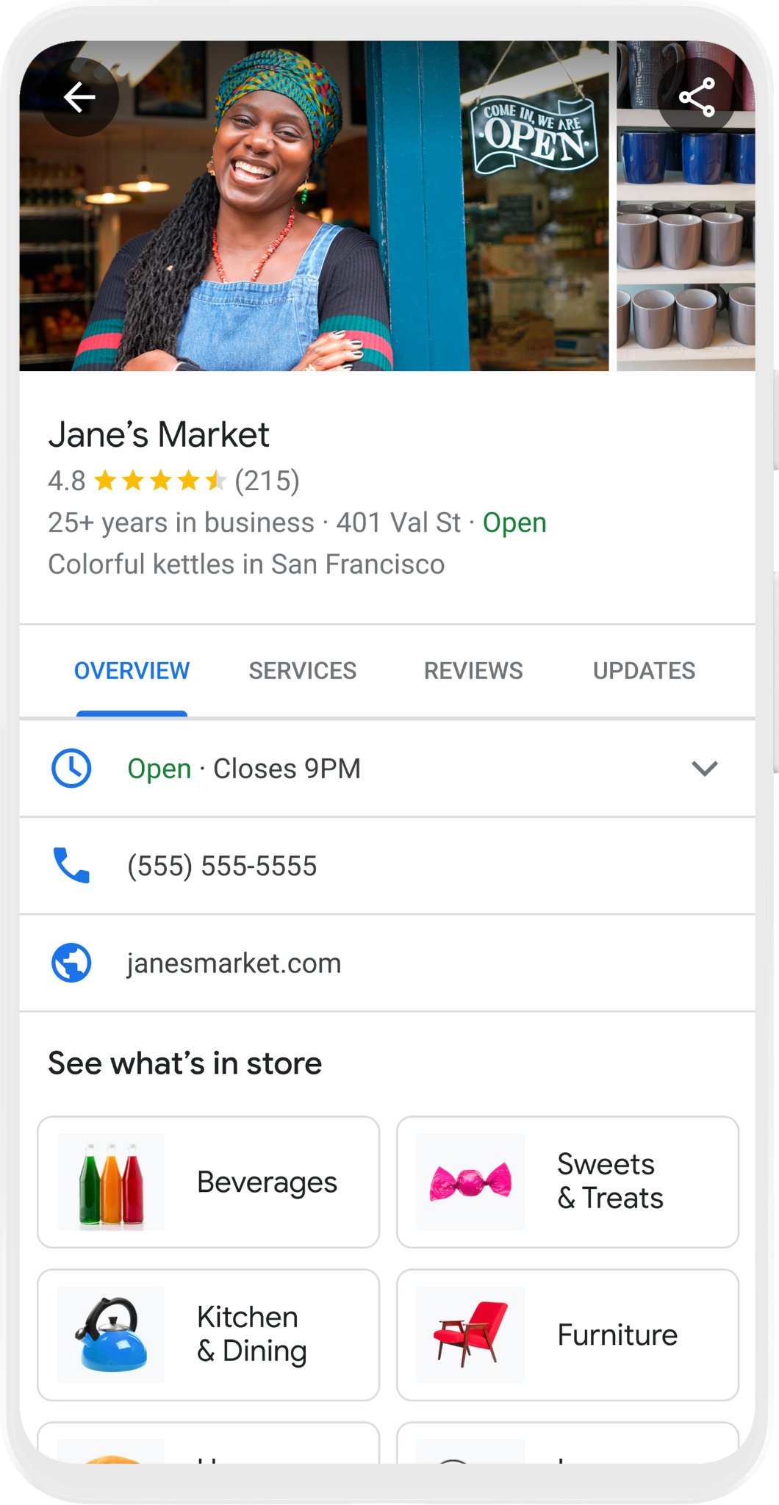
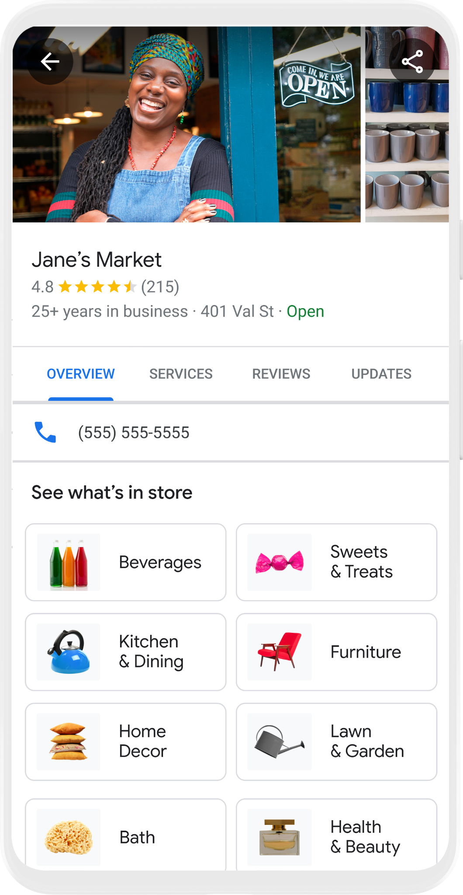


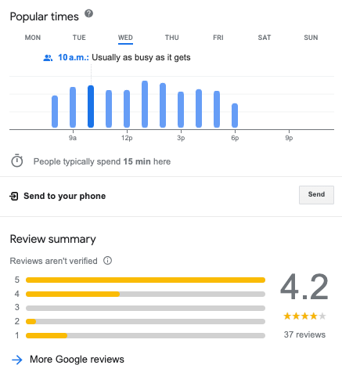
4.8
See What’s In Store

Slide 7
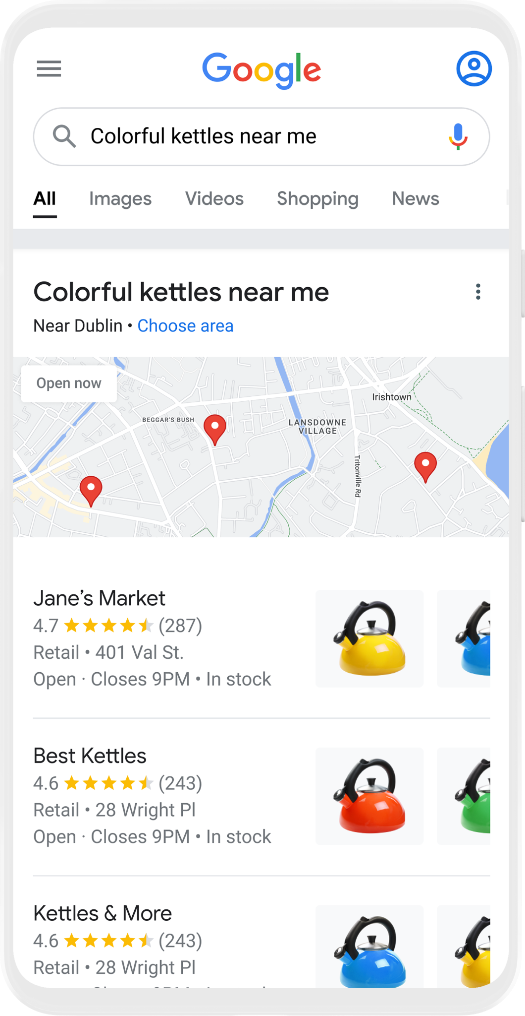
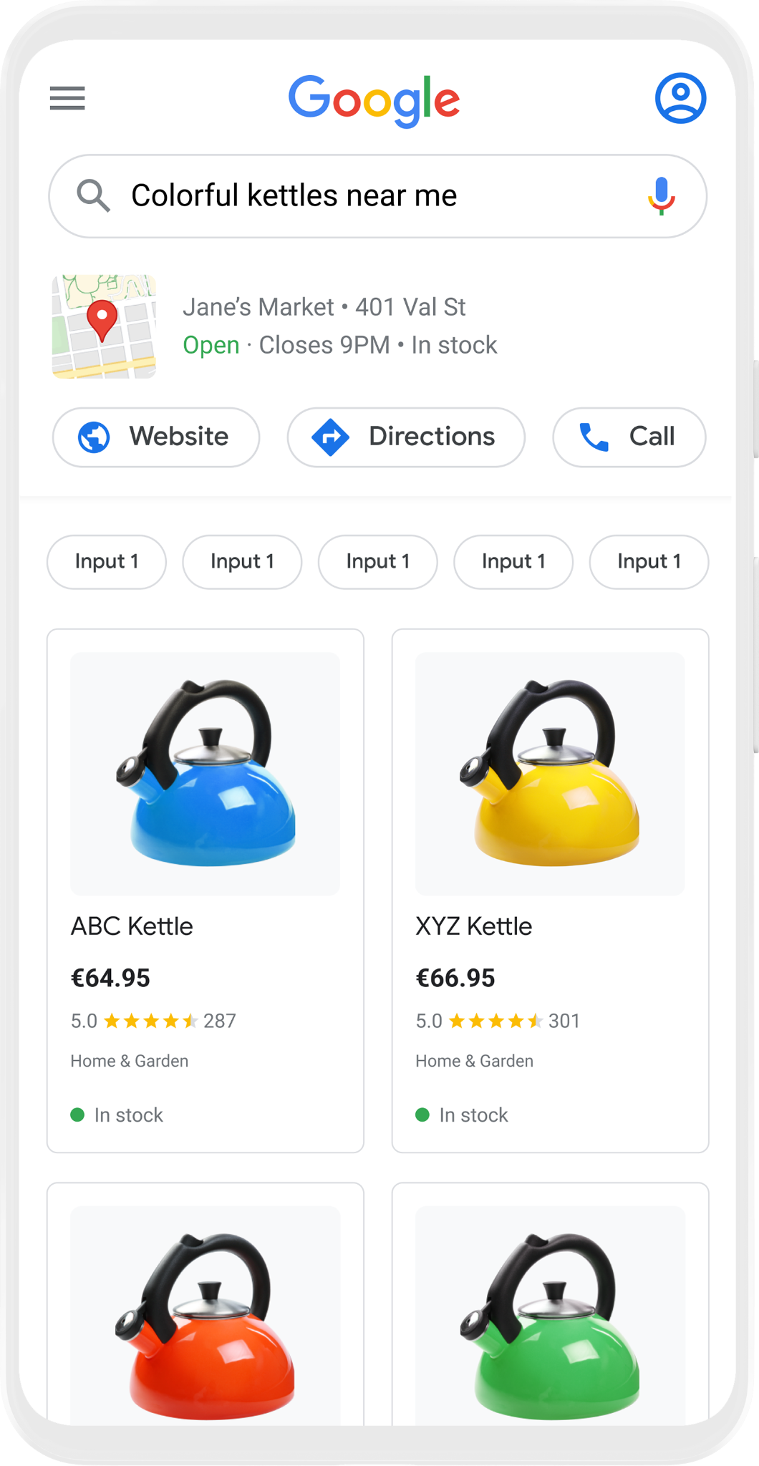

Free Local Product Listings
Showcase your store’s products for free on Google Search
Google Search
Shopping Tab
Google Business Profile
Red
Yellow
Large
Electric
Blue

Slide 8


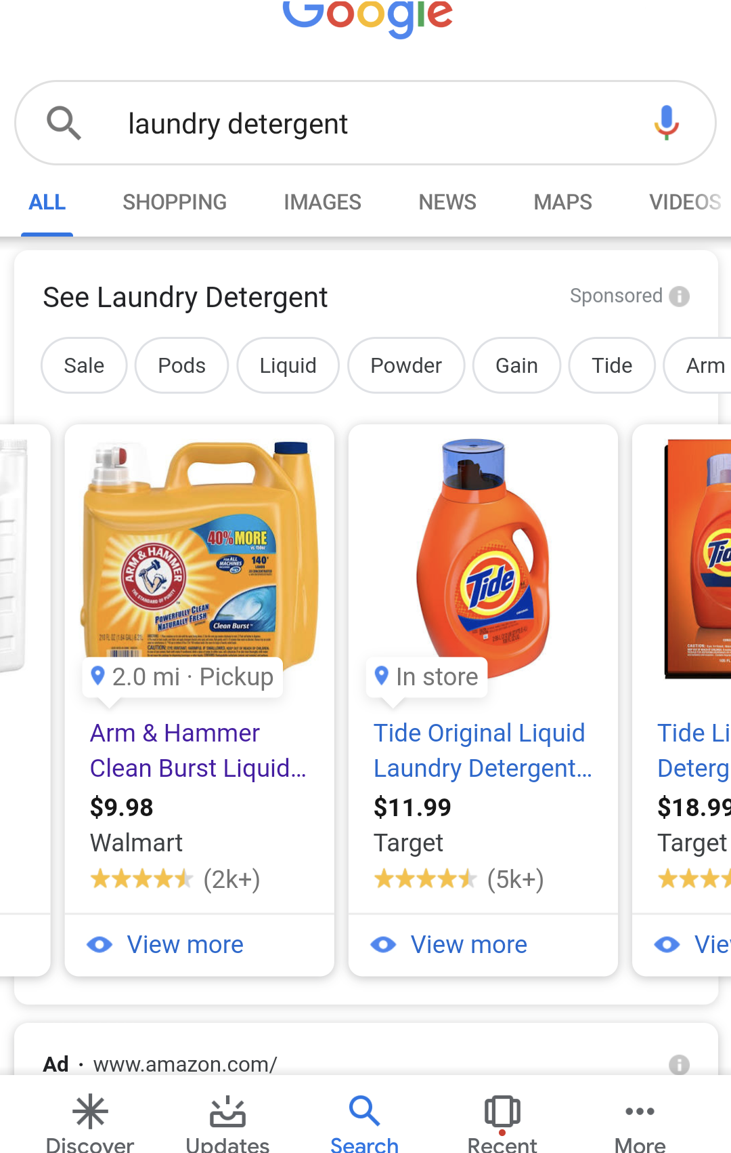
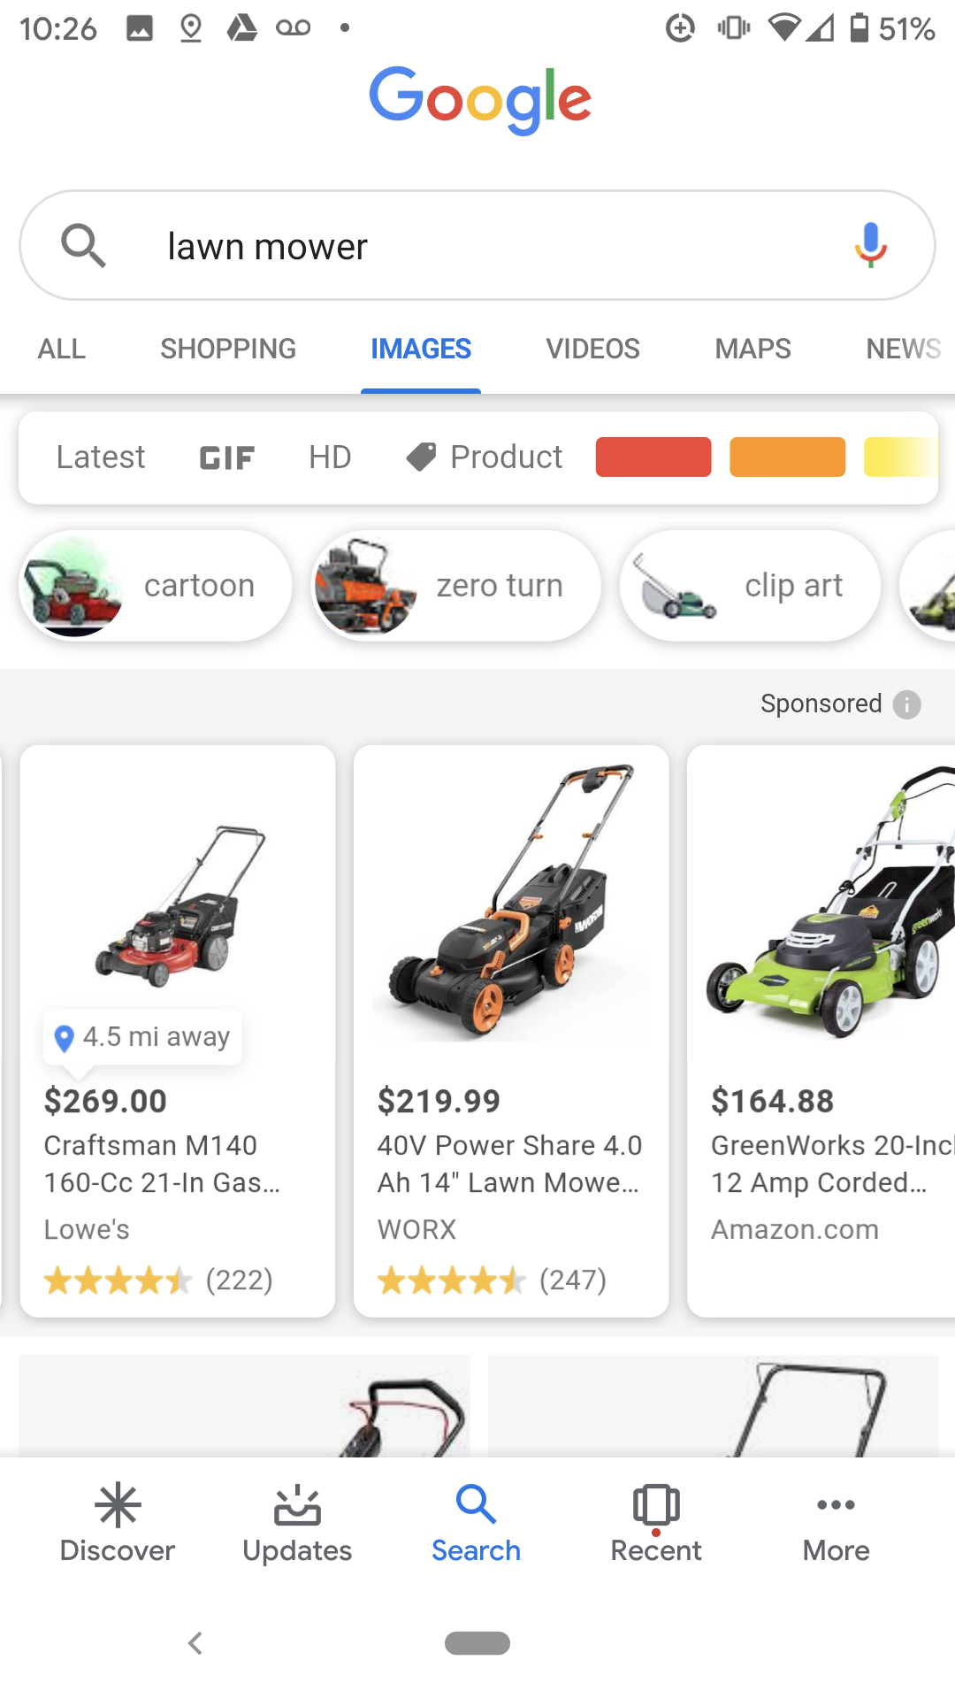
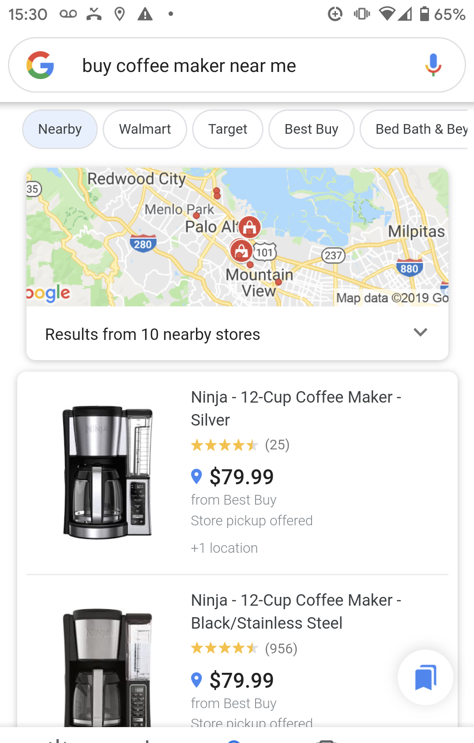
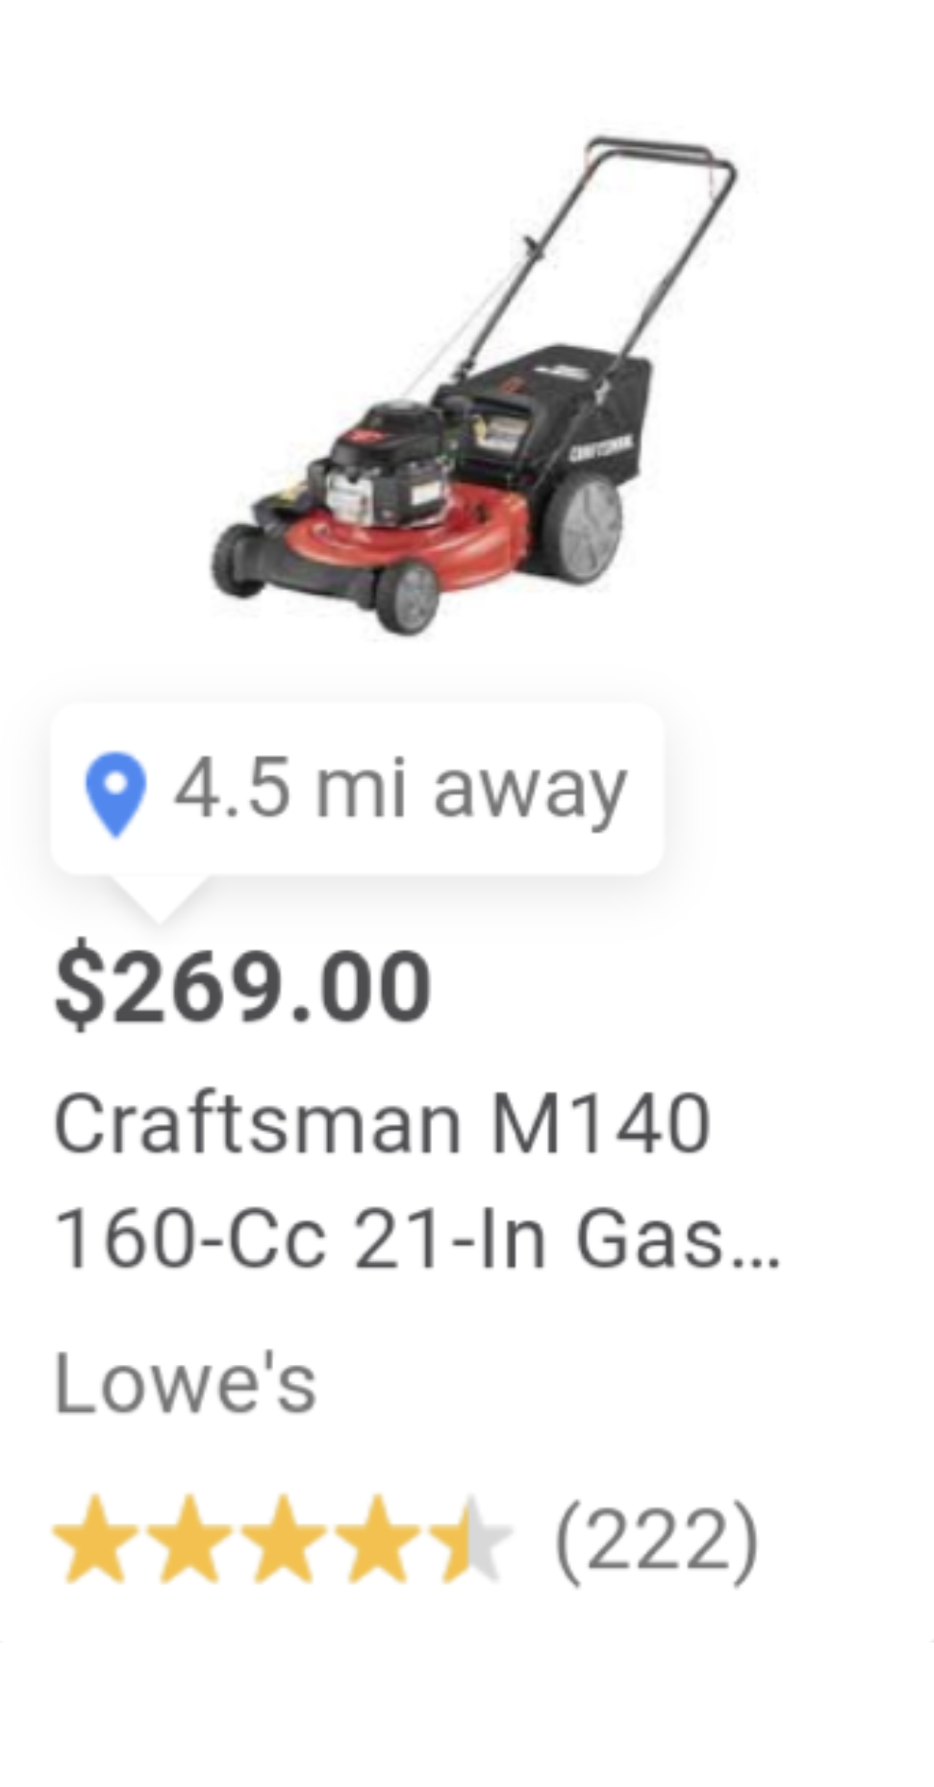
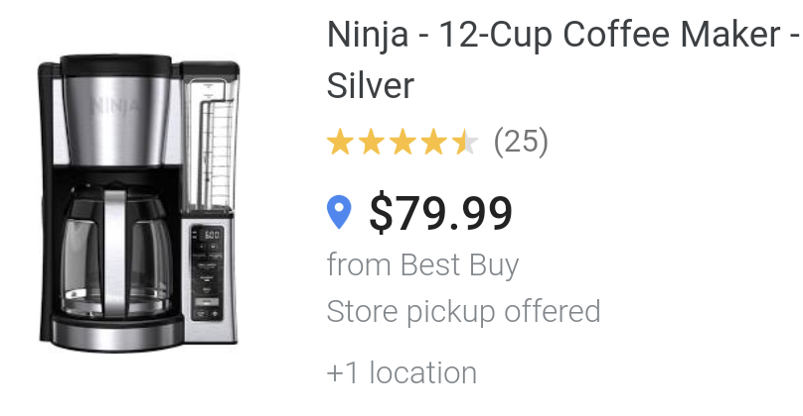
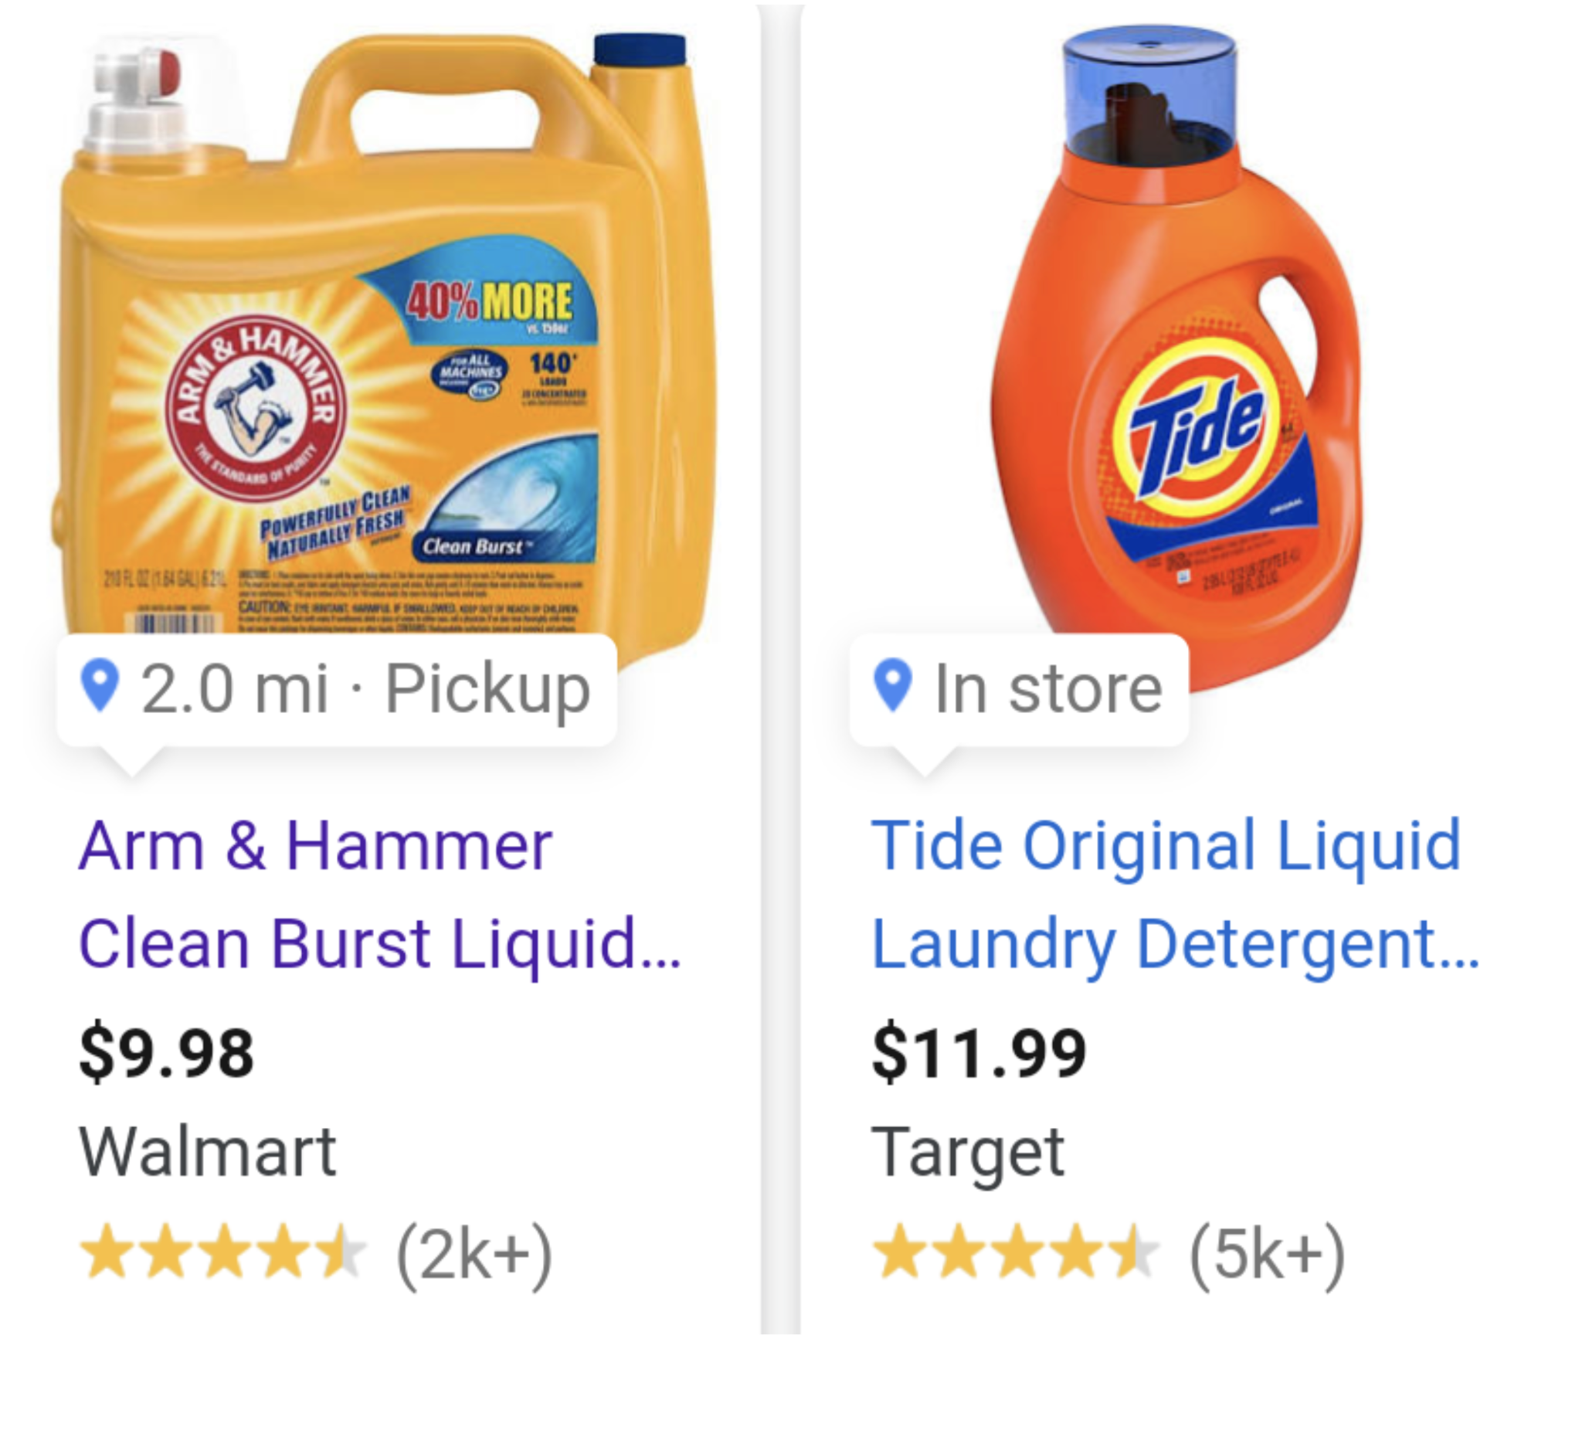


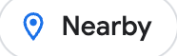


Local Inventory Ads
Drive more in store sales with highly targeted Ads campaigns
Top of Page Results
Image Search
Shopping Tab
2.0 mi · Pickup
Nearby
4.5mi away

Slide 9
3rd party
eCommerce
providers
eCommerce API
Commerce Service for
LS Central
Local Inventory

Slide 10
LS Retail Academy
CF-710 eCommerce for
LS Central
CF-720 eCommerce for
LS Central - Shopify
To be released:
CF-730 eCommerce - hospitality

Slide 11
3rd party online market-places
An extendable framework for custom marketplace integrations
Following our Shopify architecture
Default integrations provided by LS Retail
Starting with Shopee

Slide 12
3rd party
eCommerce
providers
3rd party
marketplaces
eCommerce API
Commerce Service for
LS Central
Local Inventory

Slide 13

Roadmap v27
3rd party online marketplaces – Shopee
Google local inventory – Phase II
Online returns
Magento
  Click and collect improvements
Shopify
  GraphQL transition – Phase II
  Partner feature requests
  Transitioning to the Microsoft connector?
Moving the eCommerce API to LS Central

Slide 14
3rd party
eCommerce
providers
Commerce Service
for LS Central
Local Inventory
Scan
Pay
Go
3rd
Party
Apps
3rd party
marketplaces

