Slide 3


New challenges in retail
Modern shoppers want to:
  Do shopping quicker and more efficiently
  Have contactless shopping
  Avoid queues at the checkout lane
  Have their own shopping lists that they can share
  Use their mobile device to take the shopping process into their own hands

Slide 4

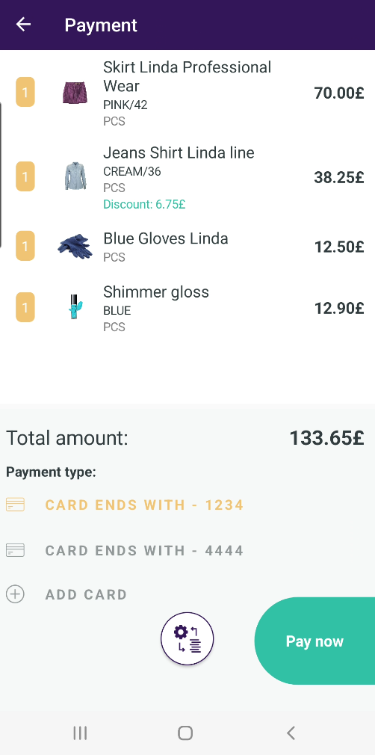
ScanPayGo is a mobile self-scanning app
  Install ScanPayGo on your phone
  Retailers can brand it with their logo and colors
  Designed for the modern shopper
  Shoppers scan products to their basket in their mobile device
  Shoppers can pay in the app or at the self-checkout
  Works out of the box with LS Central

Slide 5


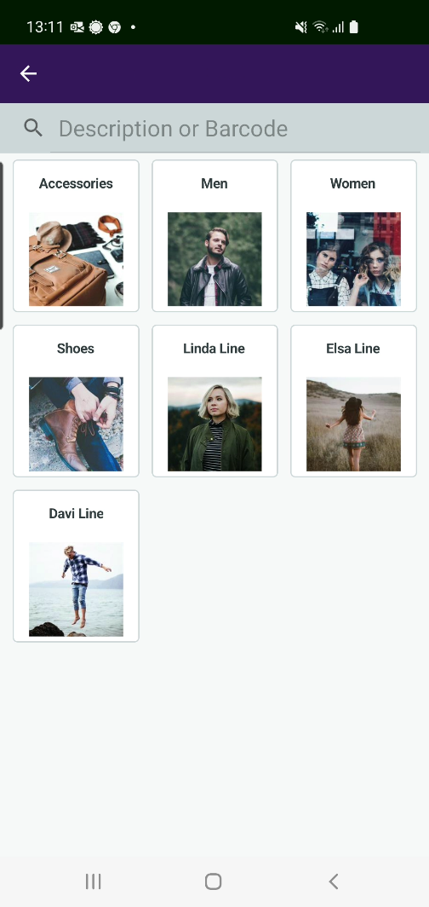
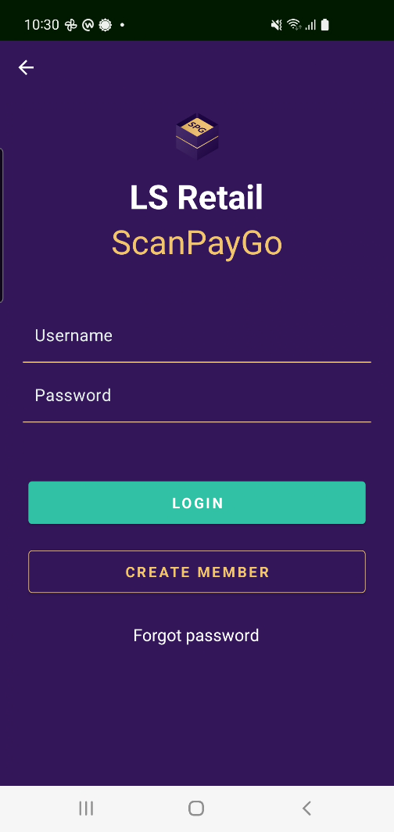
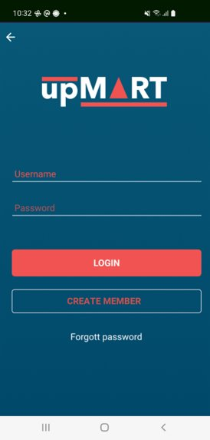
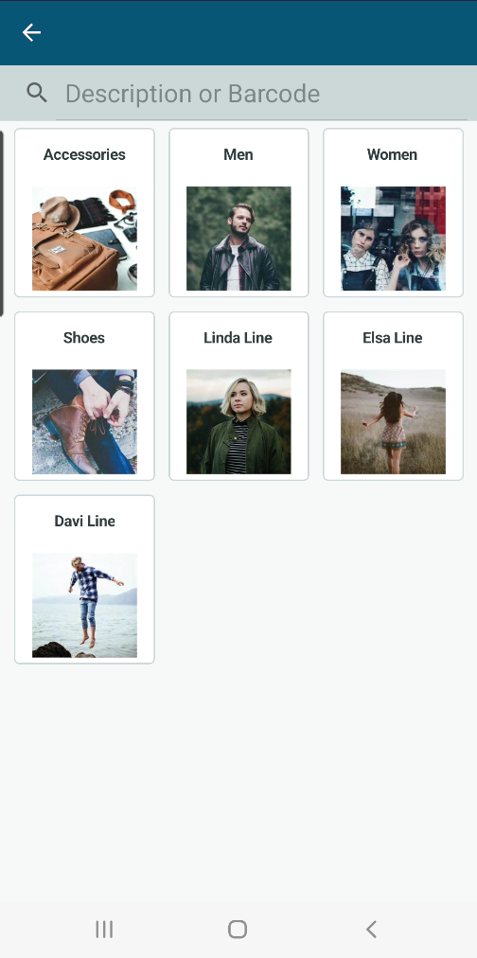
The ScanPayGo app
Easy to change logo and main colors – and possible to develop it further

Slide 6

With ScanPayGo the shopper can
  Create a “shopping basket” while shopping
  Pay for the shopping in the ScanPayGo app or at a POS / self-checkout station
  Create and share shopping lists
  Find stores on a map and look up their opening hours
  View offers and promotions
  View previous purchases

Slide 7

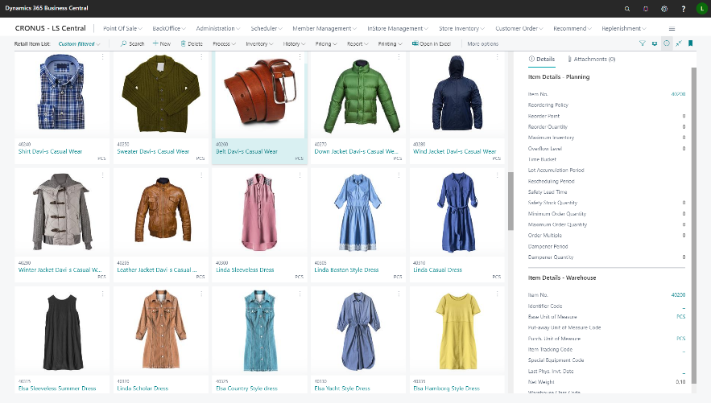
ScanPayGo and LS Central
All data for ScanPayGo comes from LS Central.
No data is stored on the device.
Data such as:
  Items and images
  Offer information
  Loyalty customers - members
  Store information
  Shopping history – previous purchases

Slide 8
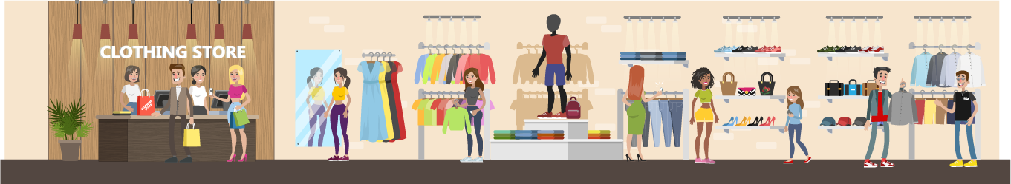
No additional hardware needed in store
Shoppers use their own phones while shopping
  Possible to pay for the shopping in the ScanPayGo app or with loyalty points
  Or scan the shopping’s QR code quickly to a POS / POS self-service station and pay for it there
Benefits:
  Shorter queues for customers – quicker throughput
  No additional hardware is required in the store
  Quick and easy shopping

Slide 9
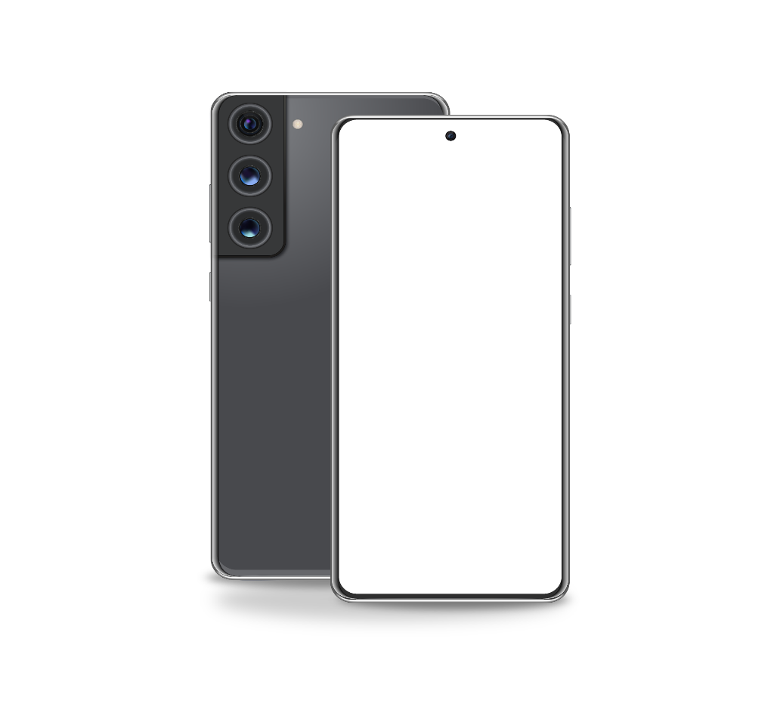
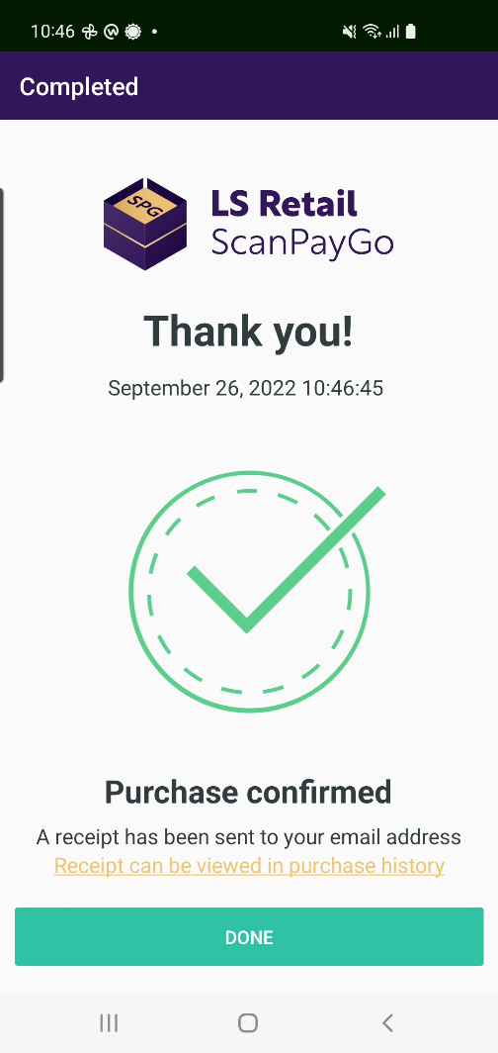
ScanPayGo
Quick and efficient
Enhances the shopping experience
Available for iOS and Android
Branded and easy to download
Easy and fast checkout
The retailer decides if the user finalizes their shopping in the app or at a fast lane checkout

Slide 10

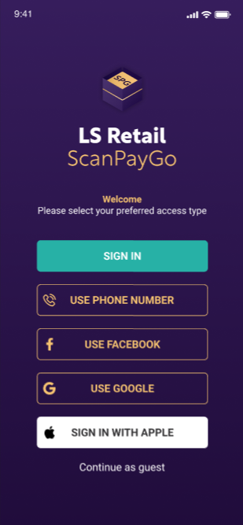
Easy to start using ScanPayGo
New users are created easily in the app or sign in using industry standard options.
  Can be integrated with country-specific digital signature programs
Users can also be created in:
  LS Central POS
  LS Central Back Office
  A website that has been set up for this purpose

Slide 11
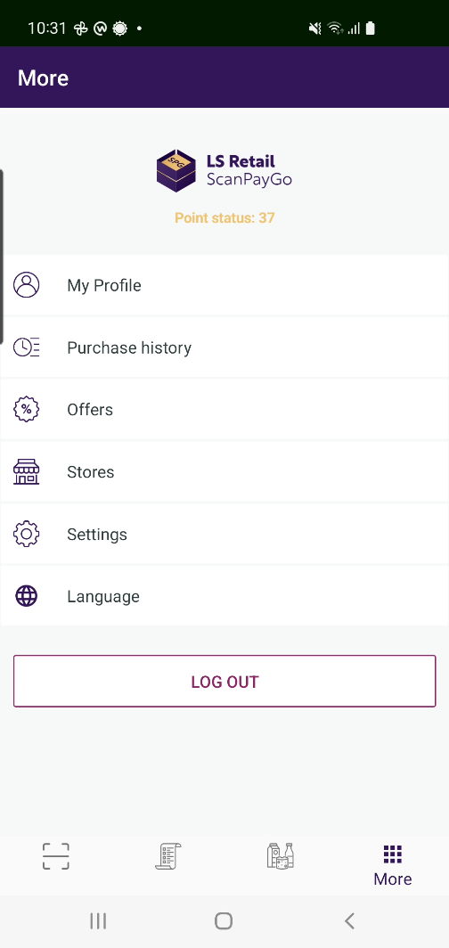
ScanPayGo
ScanPayGo users can view:
  Status of their loyalty points
  Previous purchases
  Store’s offers
  Store list and store’s information
  Items in a hierarchy view
  Detailed description of items
  Shopping lists

Slide 12

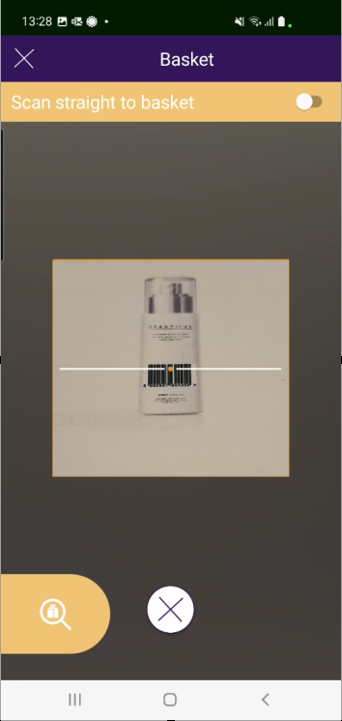
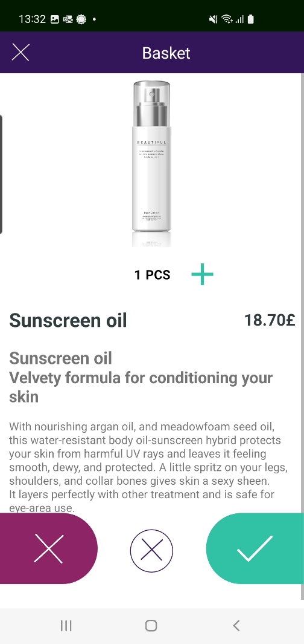
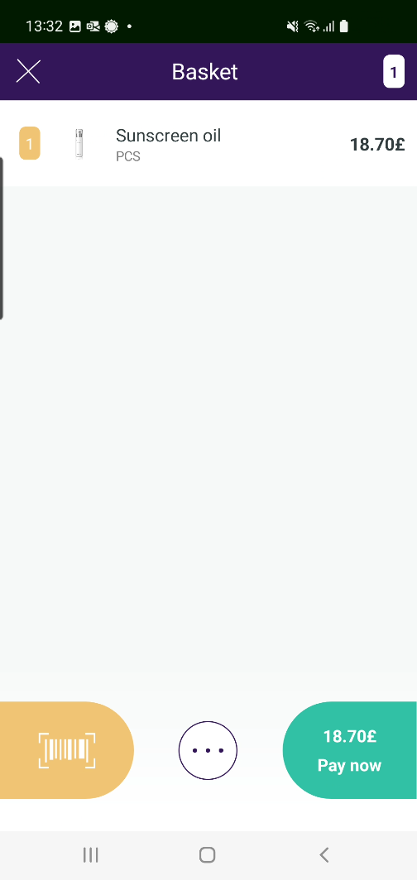
Easy shopping with ScanPayGo
The shopper enters the store
  The app detects in which store he or she is
  Possible to open the store’s gate with ScanPayGo
The shopper scans items into the basket
After scanning the shopper puts the items directly into his shopping bag
When finished the shopper pays for his shopping in the app or at the POS

Slide 13

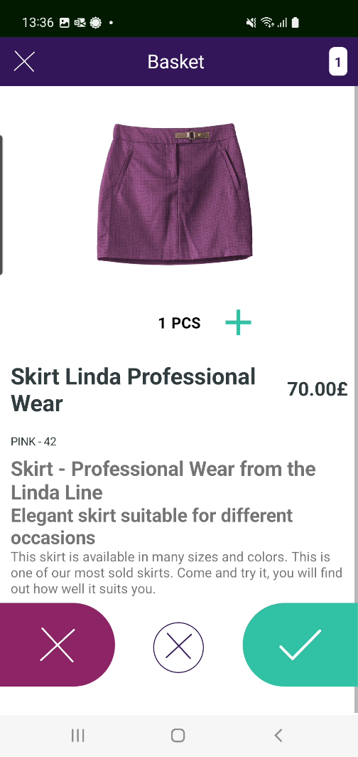
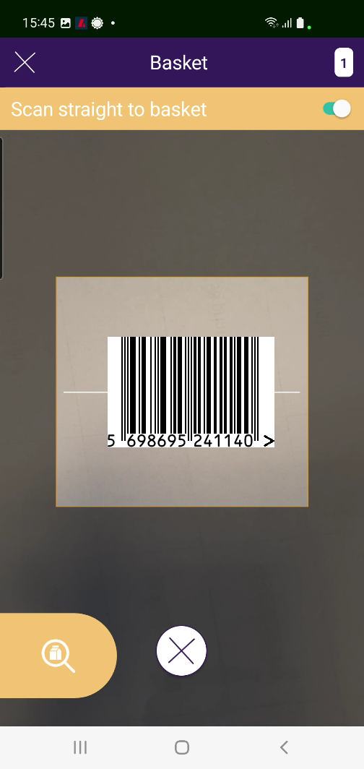
Scanning items into your basket
Two methods:
Scan and confirm
  Scan an item, a window opens where the user must confirm if he wants to buy this item
Scan straight to basket
  Scan an item and this way the item goes directly into the basket without confirmation

Slide 14
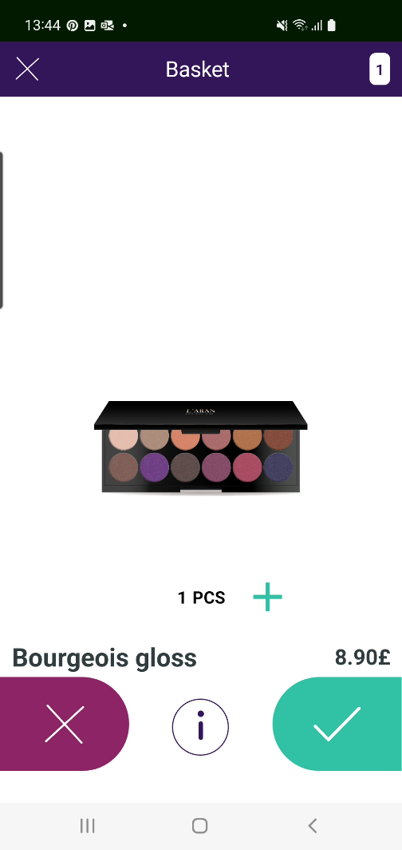
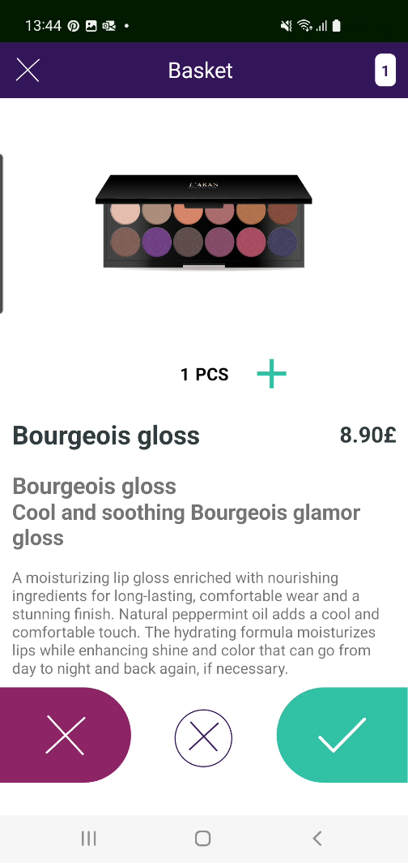



Item’s details
Easy to look at an item’s detailed information
When shopping press the option
  Only valid for items that have detailed information
For a line in basket select the line
Easy to change quantity for a line
Same method as for detailed information
Use the and options

Slide 15
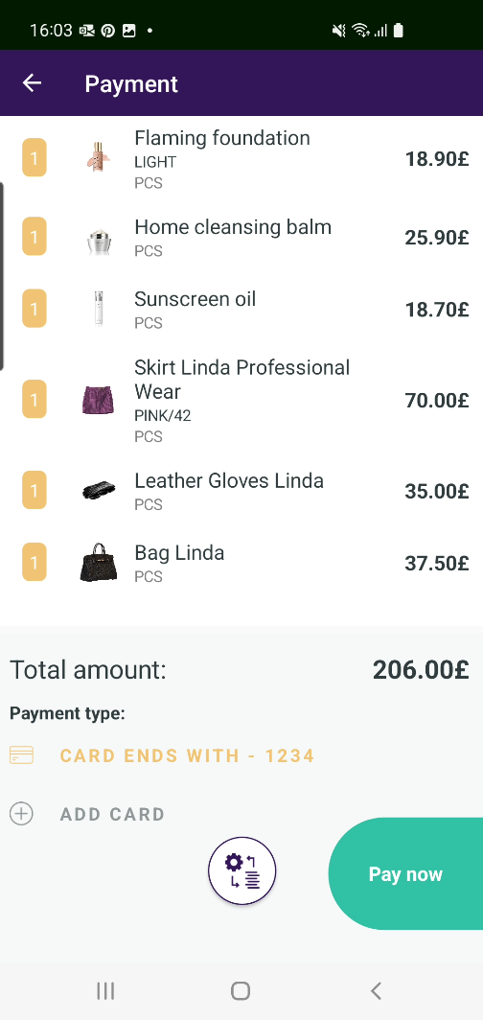
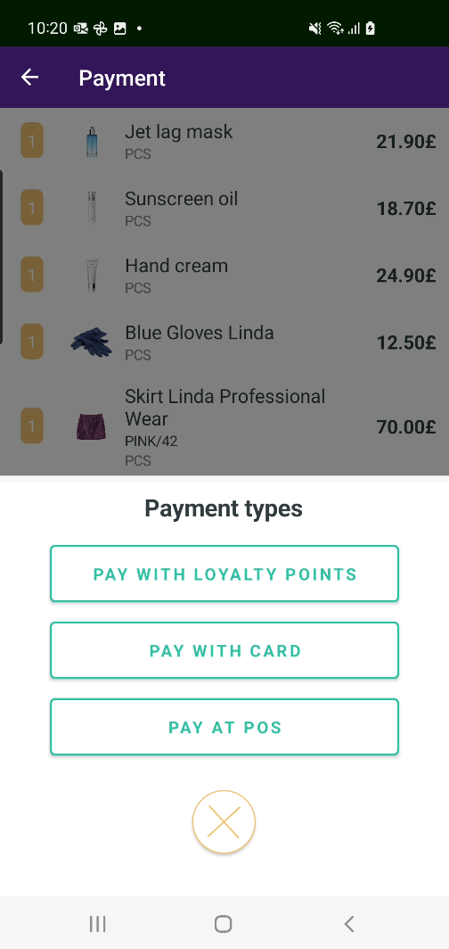
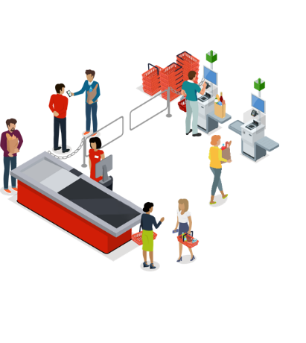
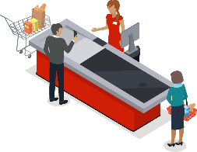
Fast checkout
The retailer decides the payment process:
  Pay in app and/or loyalty points
  Pay at the POS/self-service POS
  To have both options available
POS lane
POS station

Slide 16
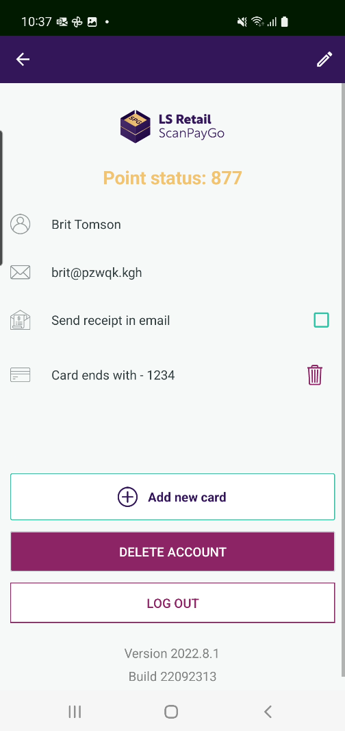
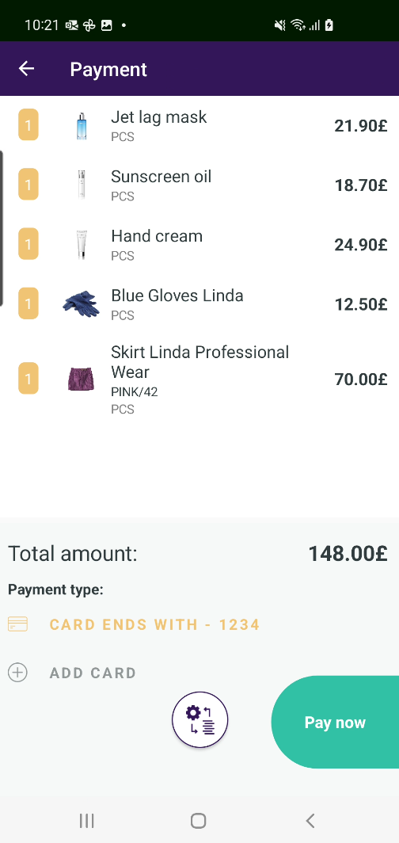
Pay in app
Payment inside app uses LS Retail’s module LS Pay (*)
Payment cards added to App are stored in Token vault in LS Central
Use Apple Pay / Google Pay where available
Select Pay now and finish the process
Off you go – transaction is paid for
(*) Depends on LS Pay availability in country/region

Slide 17


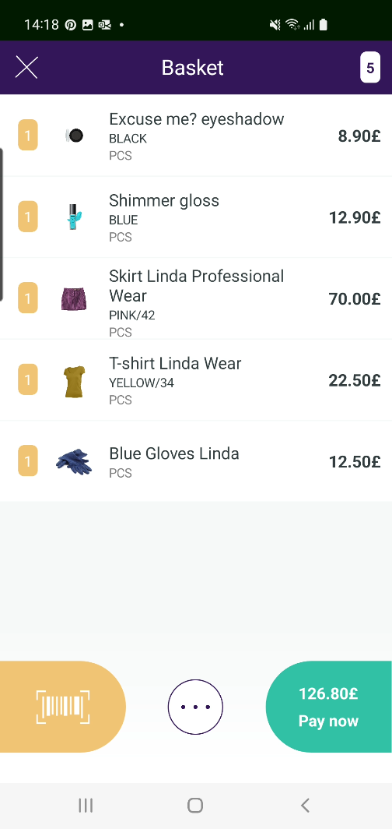
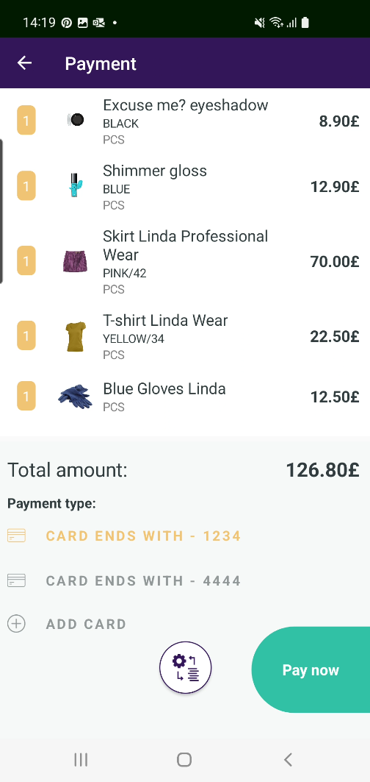
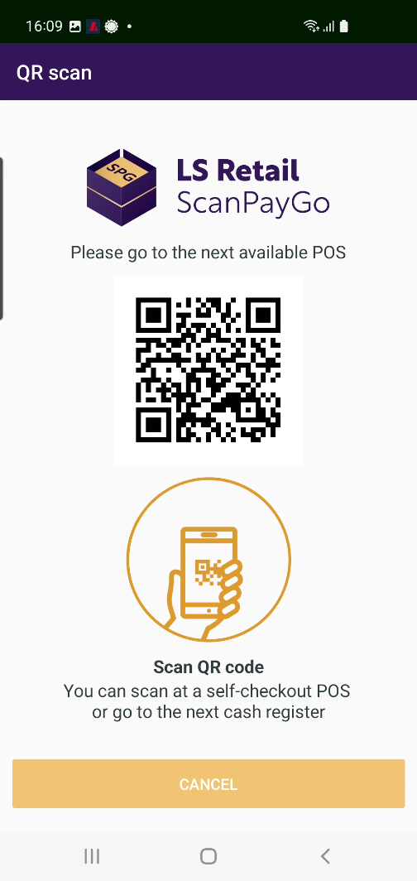
Pay at POS
A QR code is created for the basket
The shopper takes the phone to a POS
Displays the QR code
The QR code is scanned into the POS
By a cashier
By the user at a self-service station
Then sale is finished as any other POS sale
Quick and easy checkout

Slide 18


Pay with loyalty points
Customers can pay for their shopping with their loyalty points
The system checks the loyalty points’ availability
Retailers can select in LS Central Back Office whether this option is valid or not

Slide 19

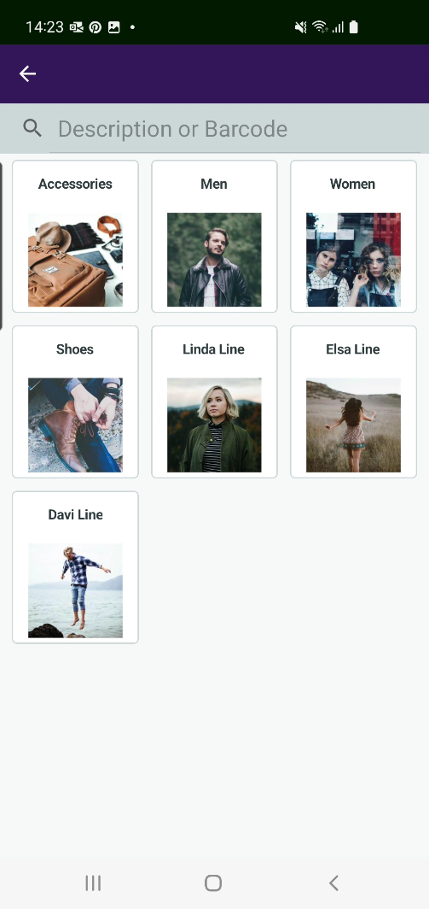
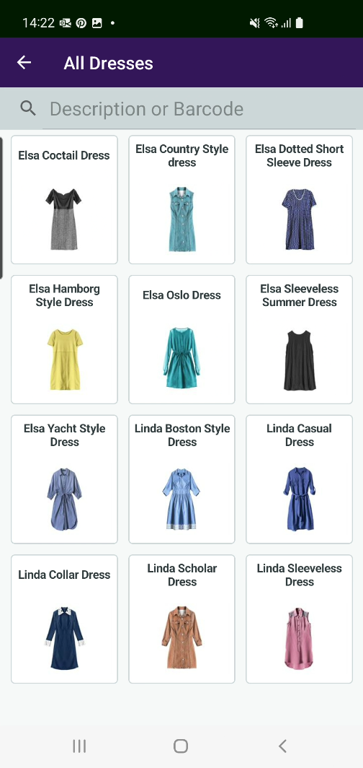
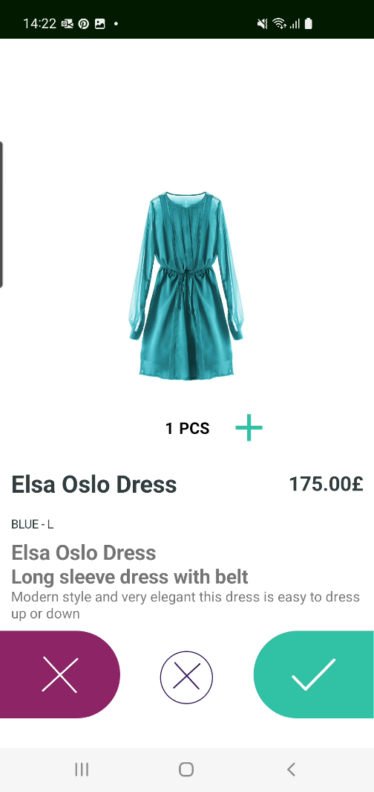
Easy to browse and find items
The retailer creates the grouping of items
Items in a group
Item details

Slide 20

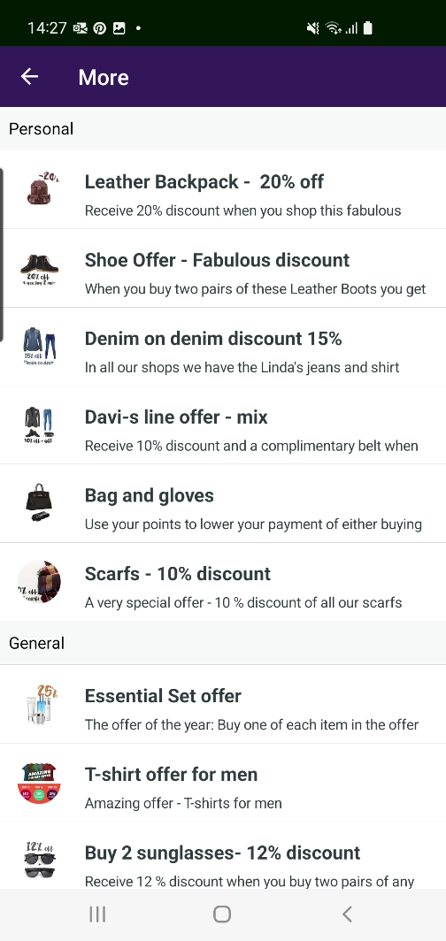

Offers in ScanPayGo
Easy to browse the retailer’s offers
  Personal offers
    Only valid for login users
  General offers
Select an offer and you see the offer’s details

Slide 21


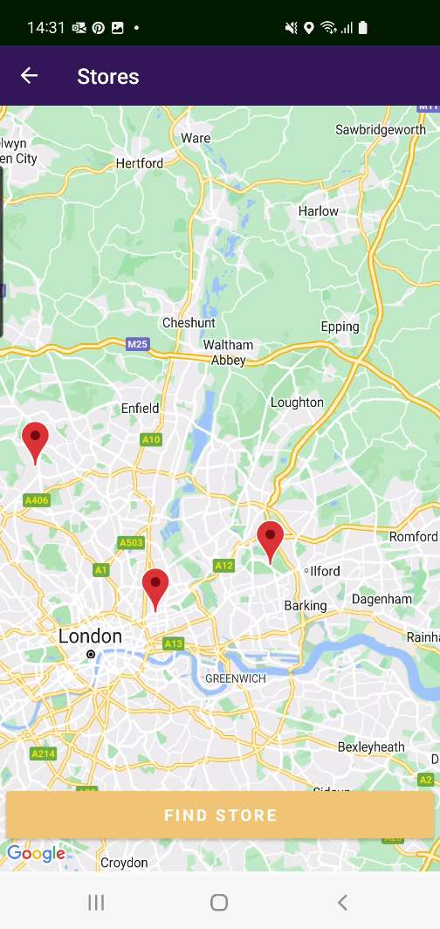
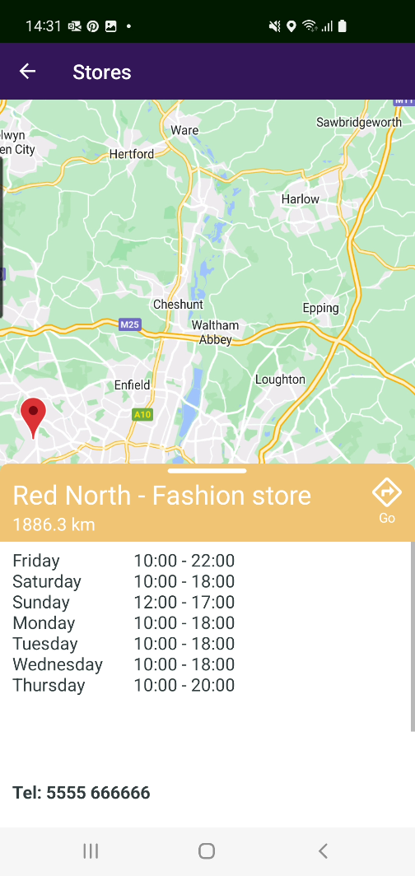
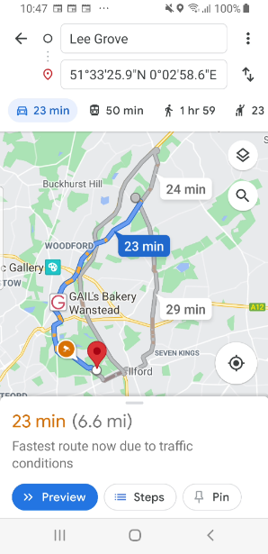
Stores and locations
Find your store and locate it on the map
Easy to look up opening hours for each store
Do you need driving instructions to go to the store? – The app provides them for you

Slide 22

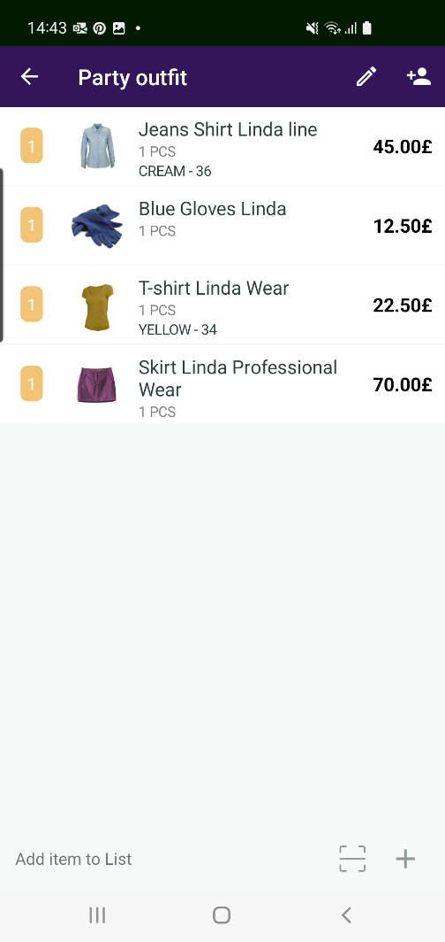
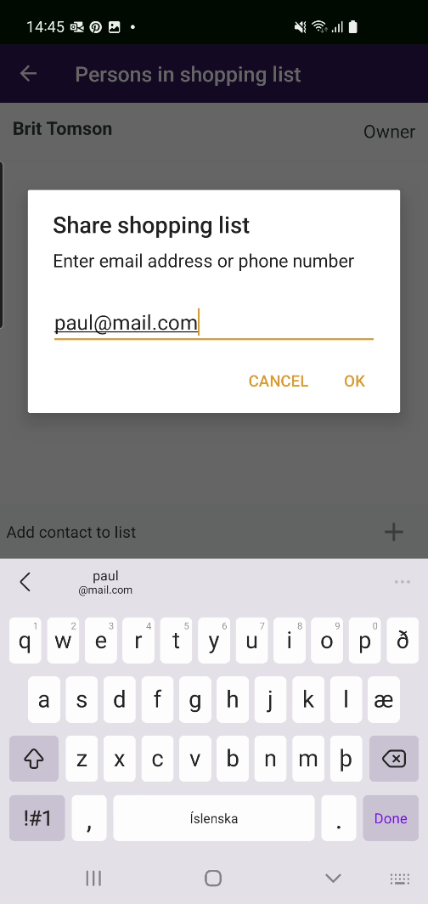
Shopping lists
It is easy to ensure that you remember to buy all your items
Create your shopping lists in the app
  As many as you want
Share your shopping lists with family and friends within the app
  All members can change, add and delete items in the lists
Easy to share text format version of the list with friends who do not have the app

Slide 23
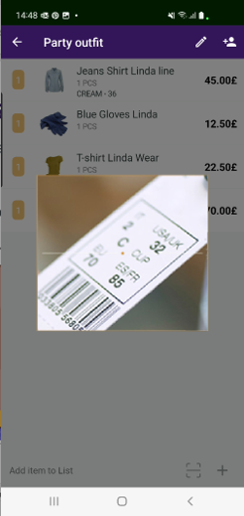
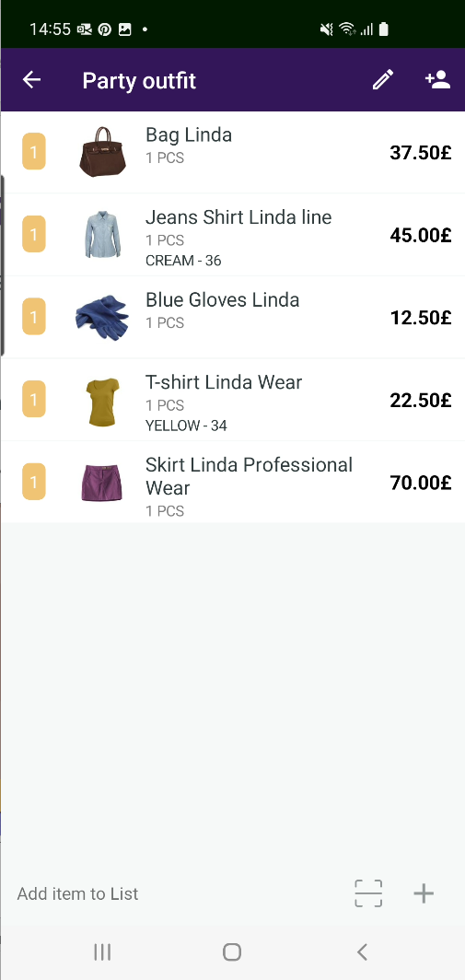

Shopping lists
Possible to scan items straight into the shopping list
  Are you at home and want a new dress?
  It is so easy to add an item straight into your shopping list
    By scanning
    By item hierarchy

Slide 24

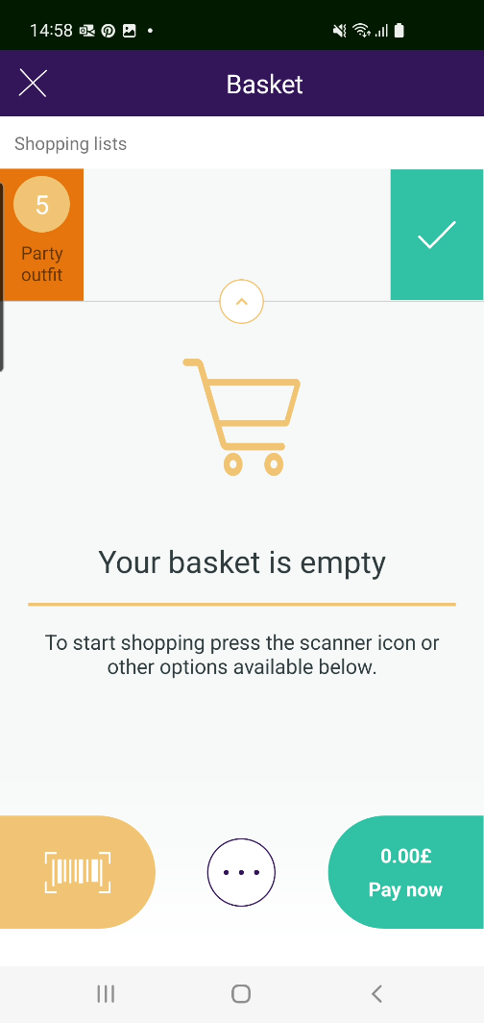
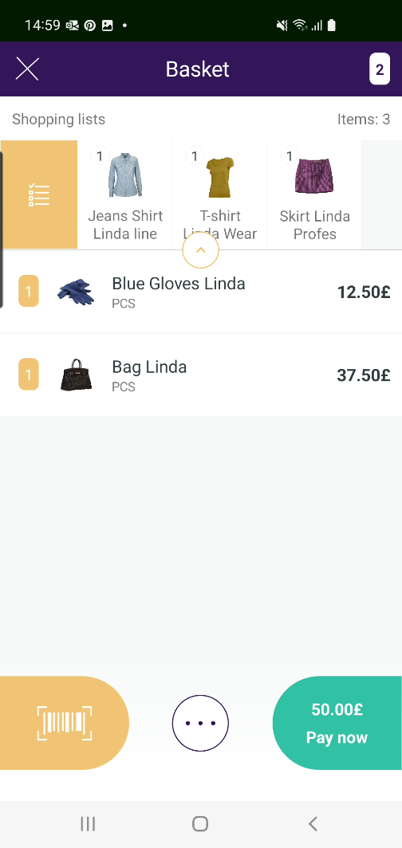
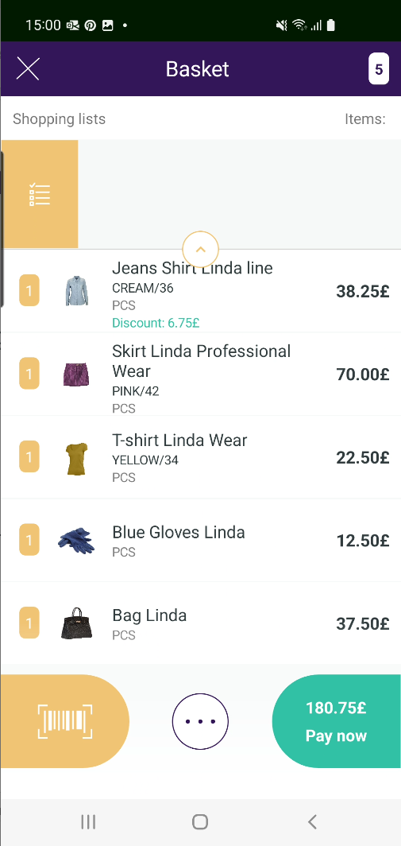
Shopping the smart way
Activate a shopping list/lists for the basket
When shopping
  You see how items go out of your shopping list when they get into the basket, which makes it very easy to monitor which items from your list/lists are not there yet
Activate shopping list, Friday grill, for the basket
When items from the list go into the basket they disappear from the list
No items are left in your shopping list

Slide 25
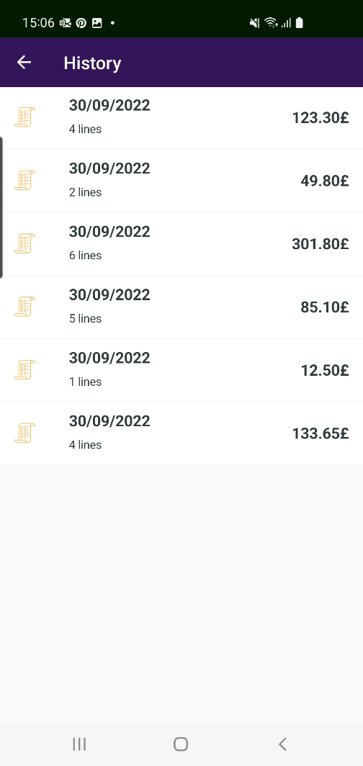
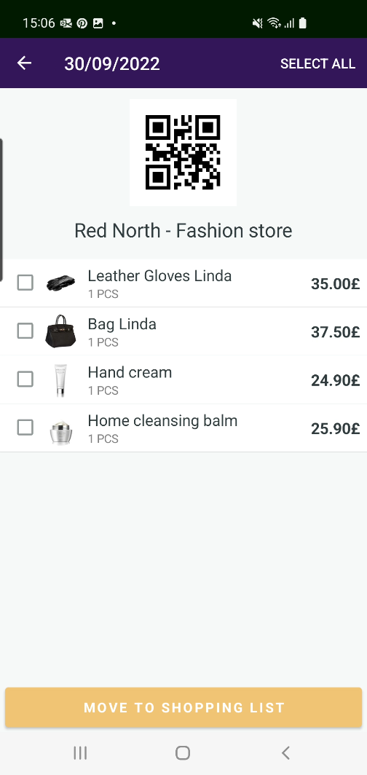
Purchase History
In ScanPayGo it is possible to view previous purchases
All purchase history is there
    Purchases done in ScanPayGo
    Purchases done in the POS
The latest one is at the top of the list
Possible to create a shopping list based on a previous purchase
    Select one, two or more items
    Select the all items in the list

Slide 26
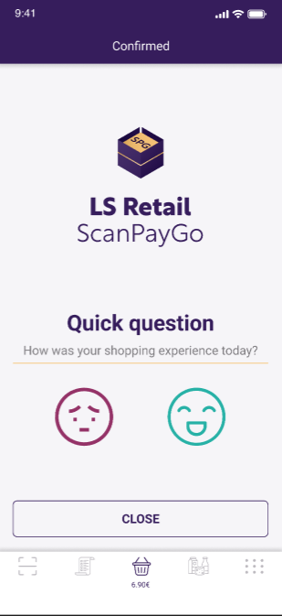
Unmanned stores
ScanPayGo can be used in unmanned stores
App features adjusted to unmanned stores
Provide QR code to open store and leave (*)
Option to add for shopping experience
(*) Integration in LS Central needed for the system in store

Slide 27
Change of colors and logo
Partners and customers can change the colors and logo of the ScanPayGo app
LS Retail has prepared a process for this change
What needs to be done
  Run a script to change:
    The main colors
    The logo
  Build the app and publish it

Slide 28
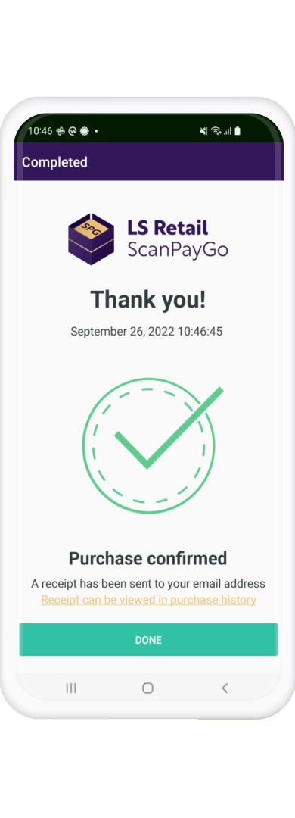
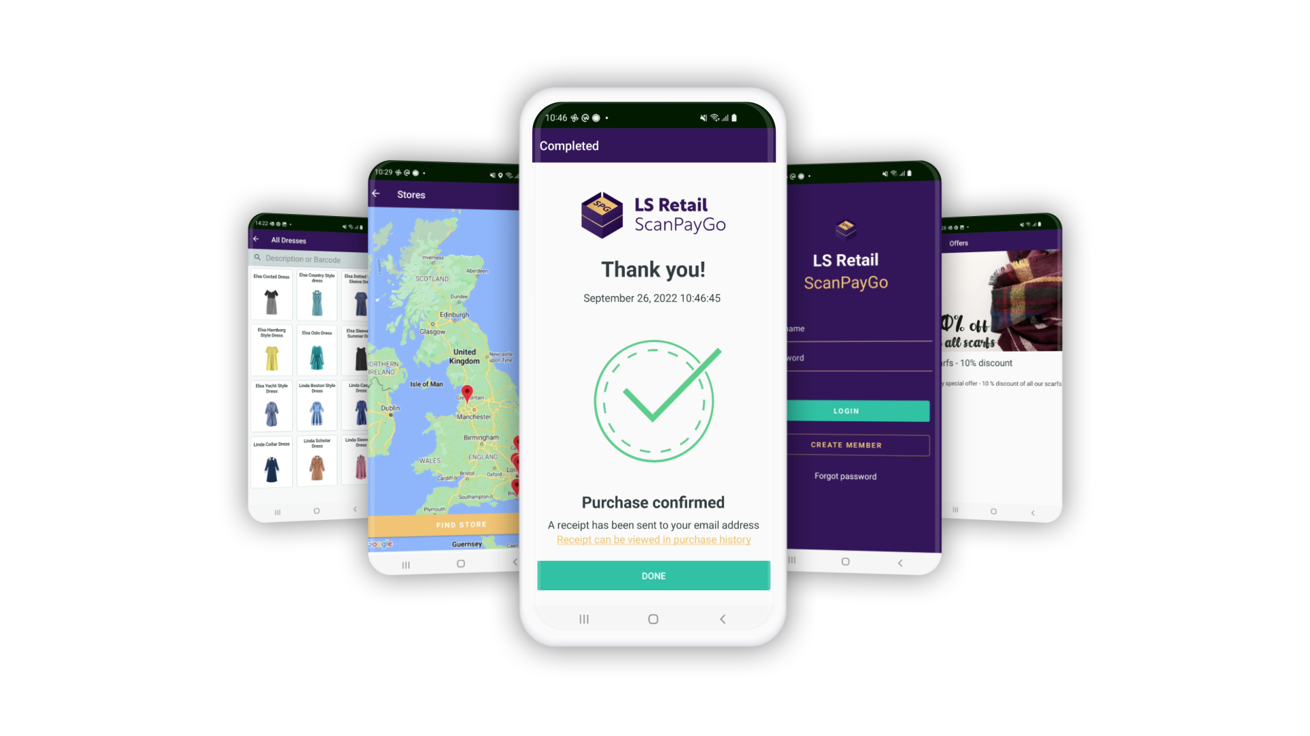







The Evergreen Train
Notes:
Customer expectation have never been as high as now. And with Covid, demands have increased. Now retailers are expected to offer contactless shopping, online orders, pick-up and delivery.
Having the latest technology has never been as crucial. Retailers need to meet these new demands promptly, but also cost-effectively.​
​
To help retailers face these new challenges today and tomorrow,
we at LS Retail have been working on a concept that we call “The Evergreen train”.
We are focusing on​
Simpler processes ​
Solutions that are easier, simpler, and faster for retailers to implement and maintain ​
Keeping customers always current by making the upgrade process automatic – no work, or extra costs, required for the retailer
​
Let’s look at “The Evergreen train”​

Slide 29
Thank you

