Slide 1
LS Central for hotels
Gunnar Örn Þorsteinsson
Product Director Hotels & Bookings
What’s new?
Gígja Eyjólfsdóttir
Senior Consultant

Slide 3
What makes LS Central for hotels a great product?
Complete view of the guest journey with unified modules and no integrations needed
Powerful and visual POS makes serving guests quick and easy
Packages can include room, services, items, and allowances
Transparency of financial details
All charges to one invoice from multiple locations
Certified integrations to common OTAs

Slide 4
Hótel Ísland - Iceland
First SaaS implementation
Implementation done in 6 weeks
High level analysis & design
Configurations done with packages
Testing
Training
Integration
Migration
Go live
Live 5th of June 2023

Slide 7
Reservation Management

Slide 8
Reservation Management – Draft reservation
New reservation pages for individual
Easier to work with reservations in draft-mode
Better overview of the reservation in draft-mode
Price builder lines for specific days
Plan room and room types for different days
Draft reservation – plan for DBL room on Days 1-2 and then on Day 3 set in DLX
Confirmed reservation – assign to different rooms on different days
Work with price lines
Manually change price
Assign another room type for a specific night
View what is included in rate
Edit the guest list
Add extra activities (activities from rate code are not created until on confirmation)
Add extras to the reservation
Work with comments

Slide 9
Reservation Management – Draft groups
New reservation pages for individual and groups
Easier to work with reservations in draft-mode
Create draft reservations for group reservations
Easier to create group reservations with different room assignments
Create draft reservations to work in more details
Build up room list with no. of adults in each room type
Work with comments

Slide 10
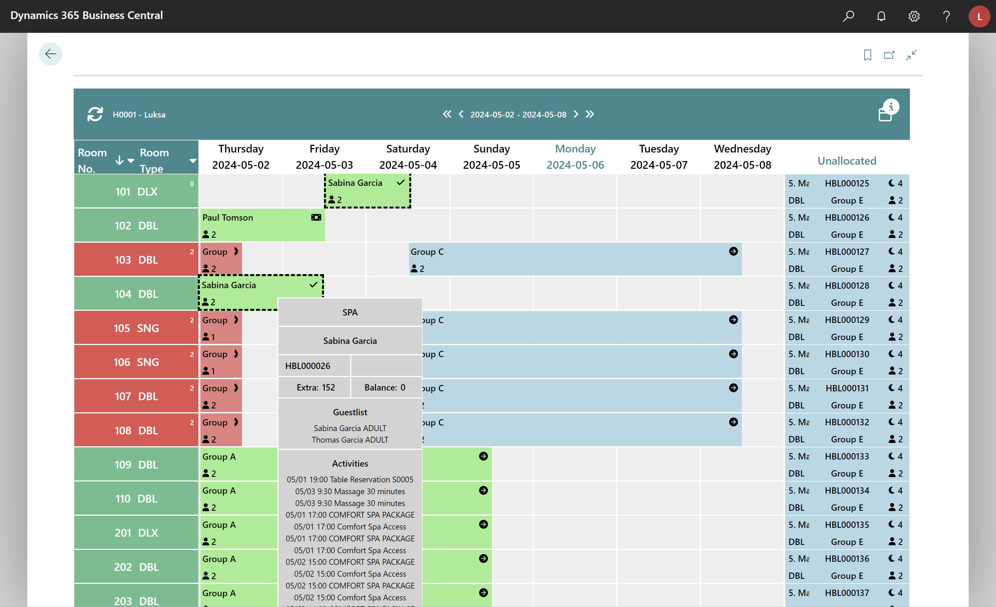
Reservation Management – Room assignment
Assign different rooms for different days
Different rooms or room types per day
If assigning to another room type, then the upgrade page opens
View disparate room assignments on Tape Chart
Assign different room for different days
Disparate room assignments shown on Tape Chart
Assign to different room type on different days

Slide 11
Reservation Management – Upgrade/Upsell
Upgrade/upsell process
Code refactoring
More detail on changes being made
View current information
Better view on what will be
Better view on what is changing

Slide 12
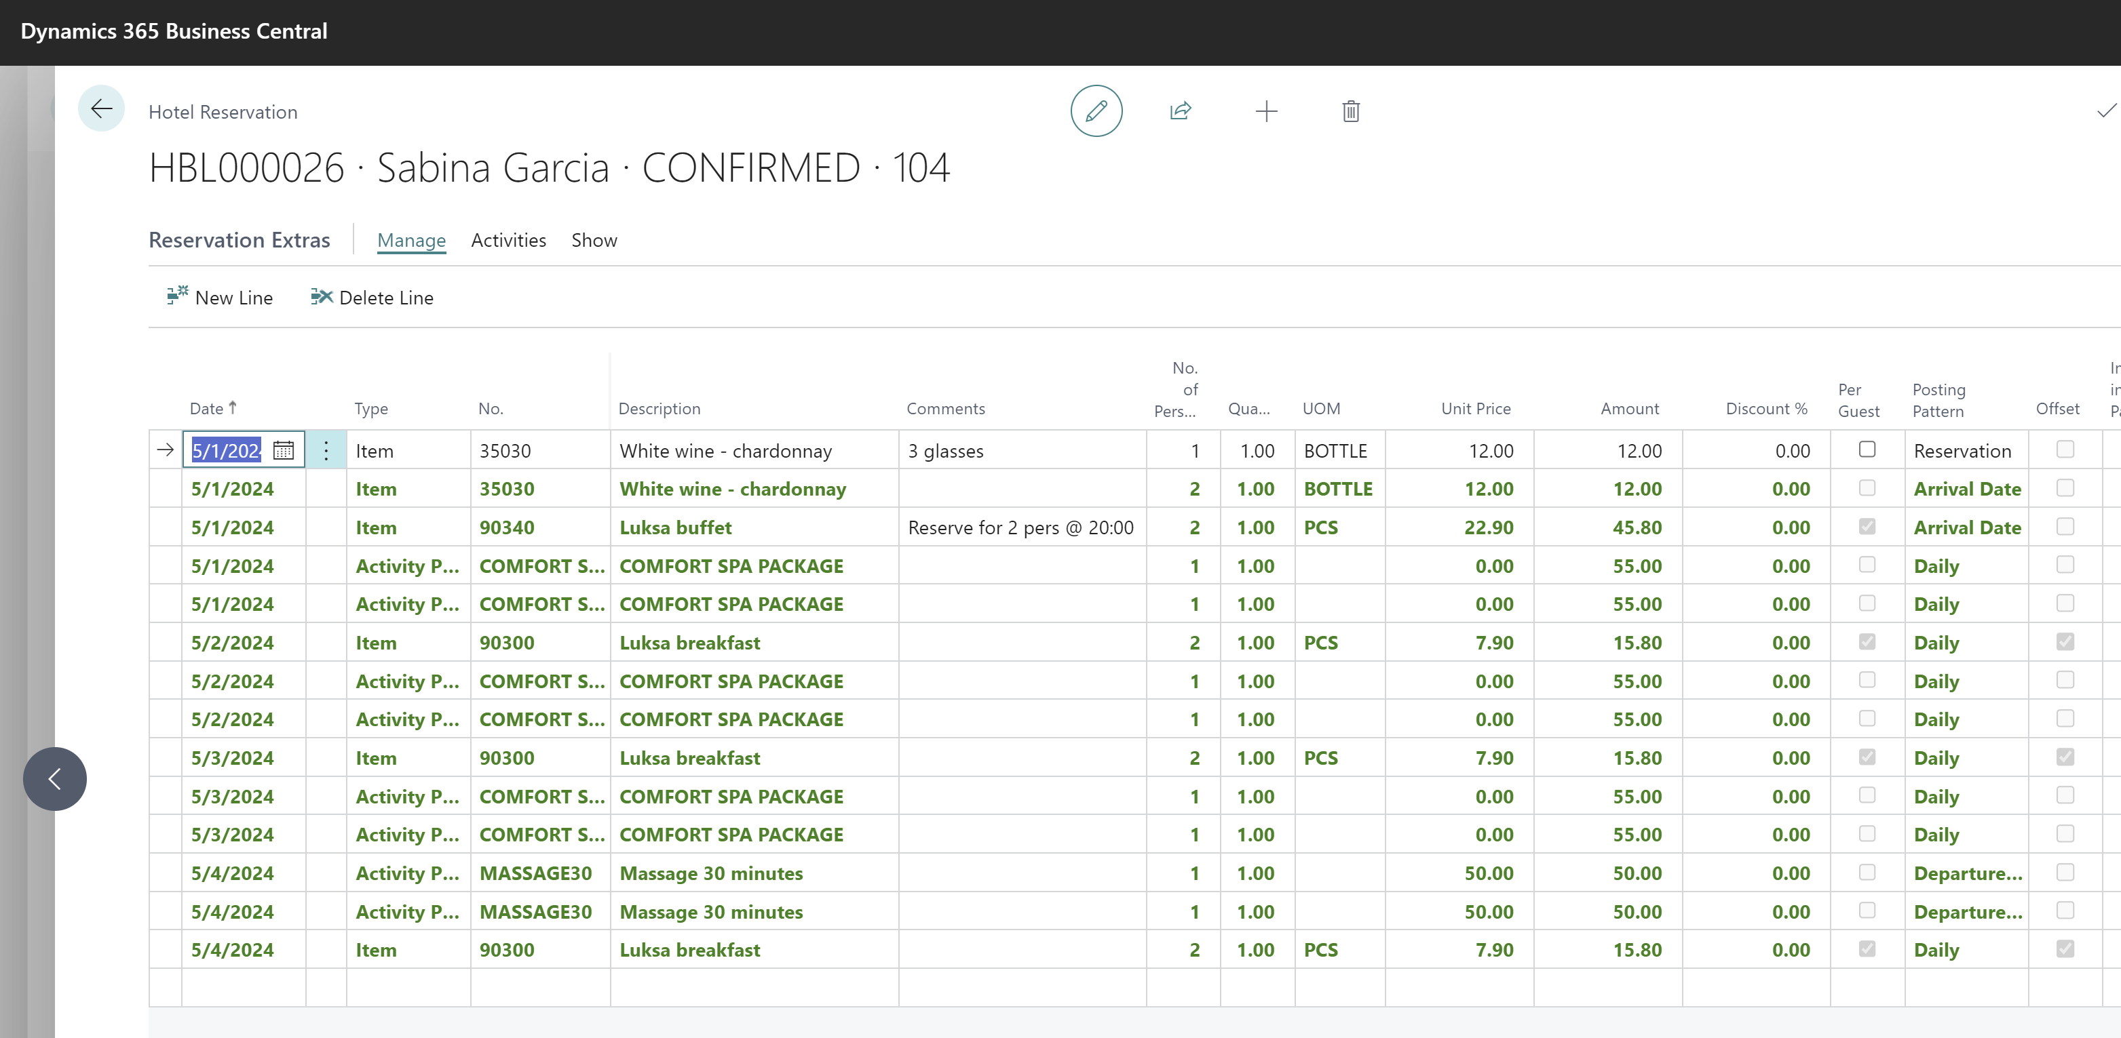
Reservation Management - Extras
Comments on reservation extras
Better communication and detail on reservations
Offset on reservation extras posting patterns
Ensures that reservation extras are posted and consumed on the correct day
Set offset to ensure correct posting date.
Example: Buffet on Departure date offset to consume on night before departure
Comments on reservation extras lines

Slide 13
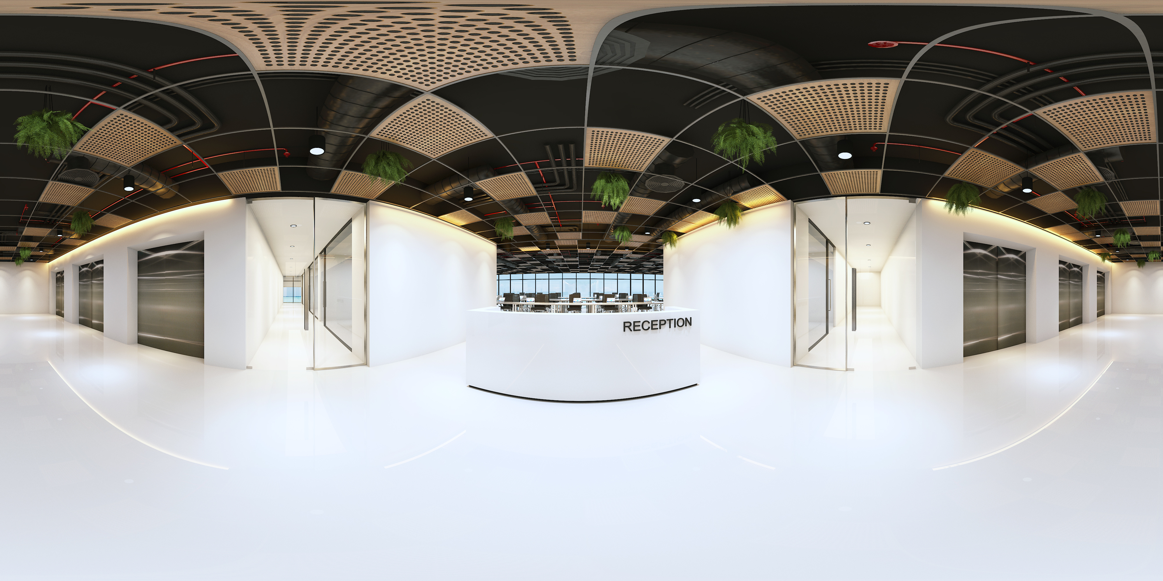

Slide 14
Rate Management

Slide 15
Rate management – Rate Info
Rate Info (Rate Matrix)
One stop shop to view rates per room type for different rate codes
View restrictions set on rate codes for a given period
Open from Active Rates tile on Role Center
Open from Rate Management -> Rate Info action
Create reservation by clicking on a date/cell
Filter on Rate Code and Room Type
Click a room type to change the filter -> this will show the rates for this room type
Click a rate code to change the filter -> this will show the rate for room types for this rate code
Click on a date/cell to create a reservation from there
If there are restrictions on the rate, then these can be extended and shown

Slide 16
Rate Management – Rate Codes
UOM on rate attributes
Unit of Measure for the rate attribute
View derived rate attribute lines
View and change prices on rate attribute lines
Change rate attribute price
Change Rate Attribute price on derived rate code
Offset on rate attributes
All items within a rate must be posted on the same date.
Set correct consumption date for rate attribute lines.
An example is a rate with breakfast and here the breakfast is set for Daily with an offset.
An example is a rate with breakfast and here the breakfast is set for Daily with an offset.
View rate attribute lines that are derived from the master rate code
Change price on derived rate attribute line
Set UOM on rate attribute – if not set then the base UOM is used
Set if rate attribute line is offset from the posting pattern

Slide 17
Rate Management – Rate Discounts
Rate discounts for members
Member Clubs
Member Scheme
Set discounts for member clubs and/or member schemes

Slide 19
Financial Management

Slide 20
Financial Management – Folios
Filter on Invoice Type
Easier to navigate and work with DRE lines
Folio overview in fact box
New list part
Filter on Invoice Type
Folio Overview

Slide 21
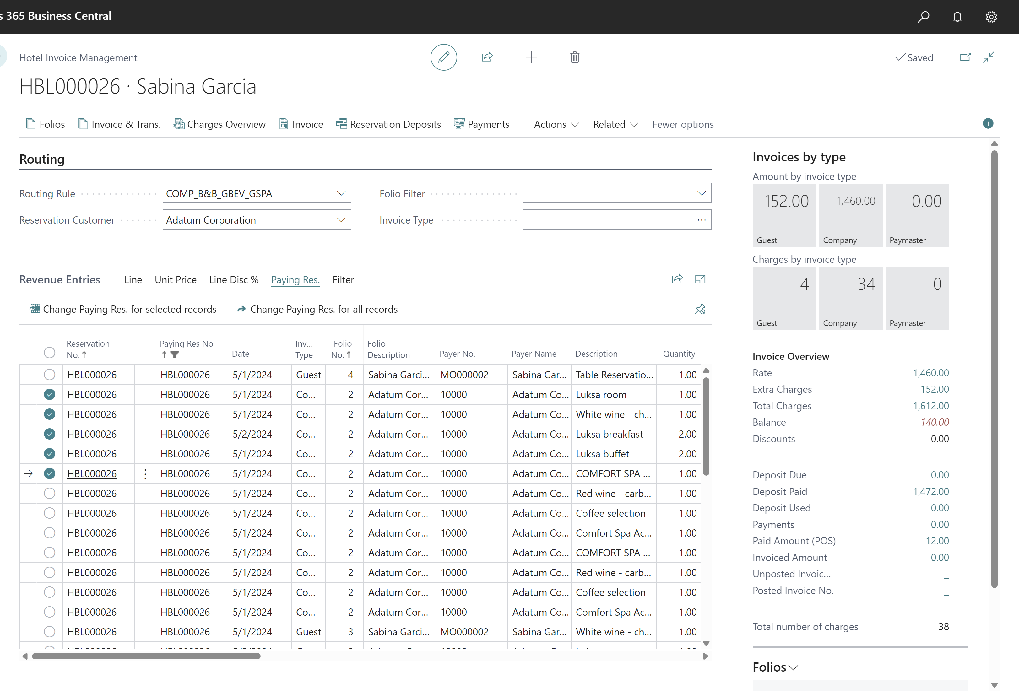
Financial Management – Paying Res
Paying Res
Change paying res for selected records
Change paying res for all records
Change paying res

Slide 22
Financial Management – Split lines
Split Lines
Split Invoice Management line in N parts
Undo split line
Filter on split lines
Split a line into N parts
Undo a split
Filter on split lines

Slide 23
Financial Management – Tokens
Token support* (Card on file)
Working with LS Pay
Depends on Payment Service Provider
View number of tokens
Reservation page in BO

Slide 24
Financial Management – Tokens
Token support* (Card on file)
Working with LS Pay
Depends on Payment Service Provider
View number of tokens
Reservation page in BO
Reservation page on POS
Capture token on POS and store for member
POS Command: ADDCARDTOFILE
TIP: Can use POS POST Command: POST
Use card on file as payment method
POS Command: CARDONFILE
If multiple cards, then user is prompted for which card to use

Slide 25
Financial Management – Changes when posted
Void and Copy on POS
Creates a credit line and new lines on folio in Detailed Revenue Entry in BO
Correct Sales Invoice
Creates a credit invoice line and new lines on folio

Slide 26
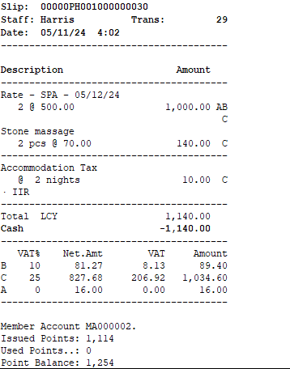
Financial Management – Sales invoices and receipts
Option on printing
Both for POS and Sales Invoice
Only header lines -> will only print a line for each night for the rate
Lines with details -> will print header line and show what is included in the rate or package
Collapsed or Detailed

Slide 27
Financial Management – G/L entries
Enhanced tracking for night audit
G/L entries are tagged with reservation and folio number
View detail trial balance for reservation

Slide 29
Deposit Management

Slide 30
Deposit Management
Deposit policy
Enhanced line validation
Deposit Due Calculation page – simulates how deposit due lines are calculated and added

Slide 31
Deposit Management
Deposit Overview Page
One page to show all deposit entries related to reservation
Deposit Schedule
Collect deposit for a deposit schedule line
Deposit schedule calculation details
Deposit Entries
View all deposit entries in one place
Collect or refund a deposit
Deposit Assignments
Assign a deposit amounts to different folios
Deposits Overview
View deposit amounts and balance

Slide 32
Deposit Management
Deposit on POS
Add more deposit to the reservation
POS command: HOTELPREPAYRES
Return all or part of already prepaid deposit on the reservation
POS command: HOTELRETDEPOSIT
Use all or part of already prepaid deposit as payment on reservation
POS command: HOTELCONSDEPOSIT

Slide 34
General usability

Slide 35
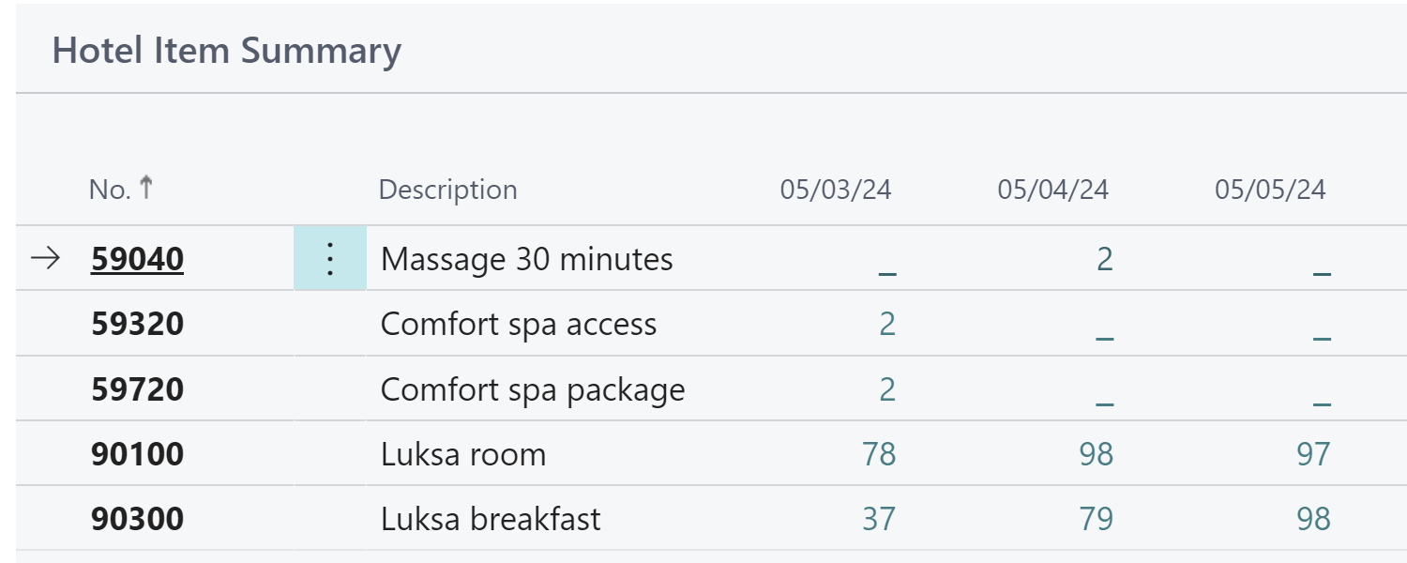
General usability - Item Summary
Item Summary Page
Shows expected consumption of items for next 9 days
Can filter on items, special groups, item categories or product groups
Convenient to track how many breakfasts are scheduled (or any other item)

Slide 36
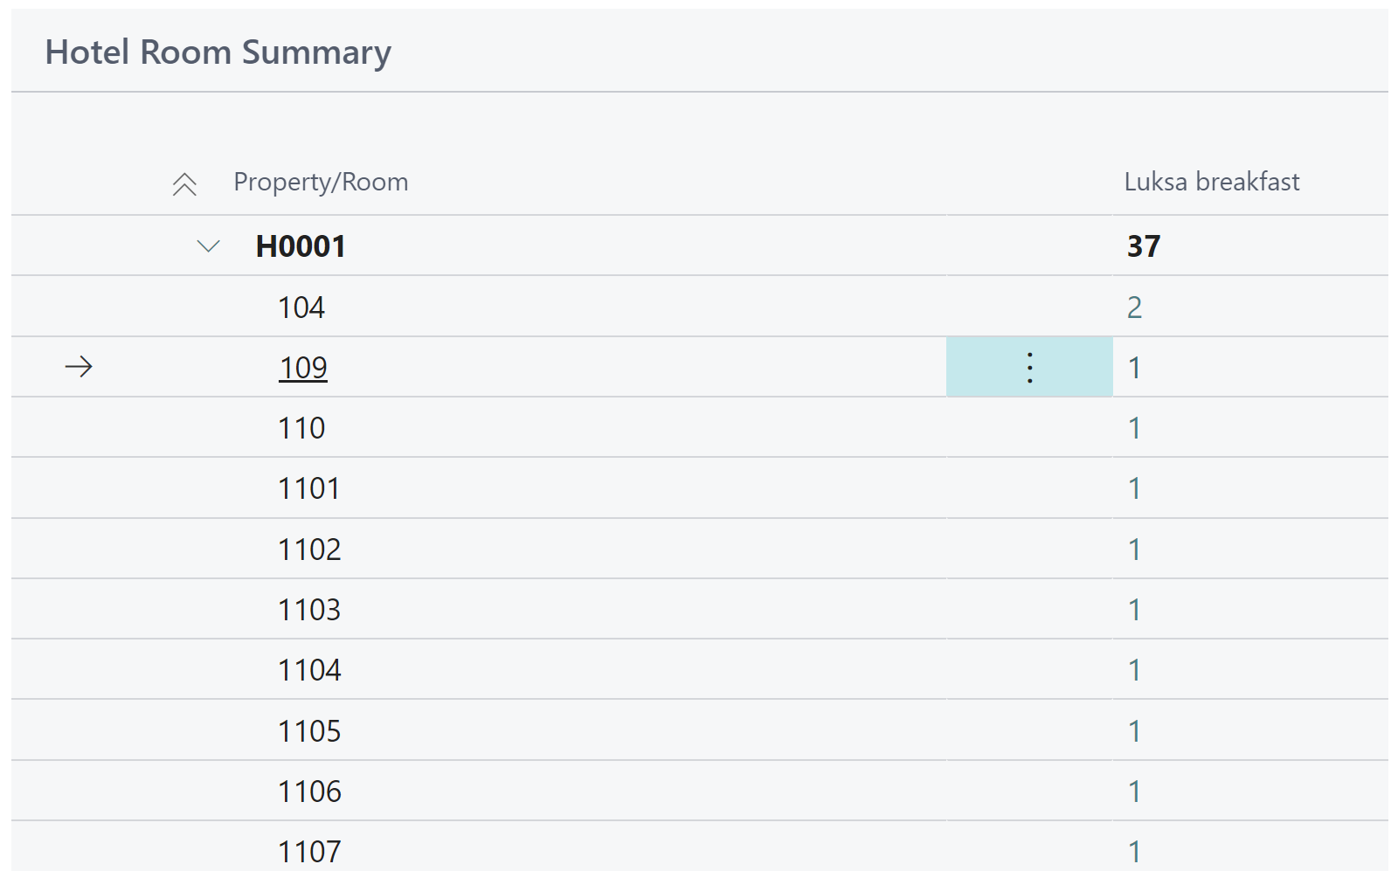
General usability - Room Summary
Room Summary Page
Shows expected consumption of items in rooms for a given day
Many filter possibilities
Convenient for example to see which rooms are scheduled for breakfast or which are using shuttle service

Slide 37
General usability
Role Center day plans
Charts showing arriving, arrived, stayover, departing and departed reservations for individuals and groups
Can drill down to reservations behind the numbers and filter on status
Chart showing room availability for the next 30 days
Can filter on room types and open Room Type Availablity information page
Chart showing hotel occupancy percentage for the next week
Can filter on room types and open Occupancy rate page

Slide 38
General usability
Improved navigation
Default member club for hotels
Room ranking for automatic allocation
Reservation history – more details tracked
Improved housekeeping POS
Improved online help

Slide 40
How to get started?
Setup for LS Central for hotels is not complex
“Plug and Play” for customers with BC and LS Central modules already
Configuration packages can be accessed on the LS Retail Partner Portal
Possibility to start small and add to existing setup

Slide 41
Fixed implementation packages
BASE
Implementation package
ADVANCED
Implementation package
ADD-ONS
Client has BC
Standard processes
Migration of reservations with standard tools offered by LS Central
No customizations
No integrations to 3rd party
Single OTA channel connection
Standard reporting
Fixed price rate codes
Manual payment process
No hardware setup
Client has BC
Standard processes
Migration of reservations with standard tools offered by LS Central
No customizations
No integrations to 3rd party
Multiple OTA channel connection
Standard reporting
Complex Rate codes
Manual payment process
No hardware setup
HSK Power App
Customization on specific processes
Complex migration
Enhancements for WEB API
Integration to third party solutions such as:
Marketing tools
Payment providers
Revenue management systems
HSK services
Door/Gate/Wristband Access systems
CRM systems
Etc.

Slide 42
Can't get enough of LS Central for hotels?

